Slide 1
Management of Carcinoma lung
Moderator : Dr Seema Gupta
Presenter : Dr Sandip Barik
Dept of Radiotherapy
CSMMU

Slide 2
EPIDEMIOLOGY
Lung cancer is the most common cancer worldwide contributing about 12.2% of all new case diagnosed
It is the most common cause of cancer in men worldwide(about 16.5% )
It is the most common cause of cancer related death world wide about(18.2% of all death)
In India incidence is about 12.1 men /100,000 population
Change in trend is seen with incidence increasing in women (0.4% per year)and decreasing in men from year 1990
Occurs most commonly between 40-70 yrs of age with peak incidence at 50s or 60s

Slide 3
RISK FACTORS
Smoking is the primary risk factor(87% of lung cancer occur in smokers
Average smokers have 10 fold greater risk,while heavy smokers(40 cigarettes/day) have 60 fold greater risk
Women have higher susceptibility to tobacco carcinogen than men do
Introduction of filter cigarettes entices smokers to take larger puffs and retain smoke longer
Second hand smoke or environmental tobacco smoke is estimated to cause about 3000 deaths/year

Slide 4
Risk factor cont…
Industrial agents like asbestos,coaltar fumes,nickle ,chromium,arsenic,radioactive materials,radon gas are carcinogenic
Genetic alterations with mutations in p53,RB1,p16(INK4a)
Dominant oncogenes frequently involved include c-MYC,KRAS,EGFR,c-MET and c-KIT
Precursors lesions like squamousdysplasia,atypical adenomatous hyperplasia,diffuse idiopathic pulmonary neuroendocrine cell hyperplasia
Vitamin A,C,E have protective effect

Slide 5
NATURAL HISTORY
Lung carcinoma arise most often in and about the hilus of lung
About 3/4th of the lesion originate from 1st,2nd,3rd order bronchi
Local spread to intrathoracic areas
The incidence of scalene (supraclavicular)node ranges from 2% to
35%
Metastasis to these nodes are from ipsilateral upper lobes
Metastasis also occur in cervical,axillary and inguinal lymphnodes

Slide 6
Natural hist cont…
Extrathoracic spread
Undifferentiated small cell cancer (oat cell variant) has a higher incidence of distant metastasis than nonsmall cell types
Among Non small cell group Adenocarcinoma have a greater propensity for distant metastases

Slide 7
LYMPHATIC DRAINAGE
During the past three decades two different lymphnode station have been used
1st was the Japanese Lung Cancer Society Classification
2nd was the Mountain Dressler Modification of the American Thoracic Society(MDATS)
Recently the International Association For The Study Of Lung Cancer(IASLC) proposed a lymphnode map
It provides more detailed nomenclature for the anatomic boundaries of lymphnode station
The IASLC is now the recommended means of describing regional lymphnode in lung cancer

Slide 8
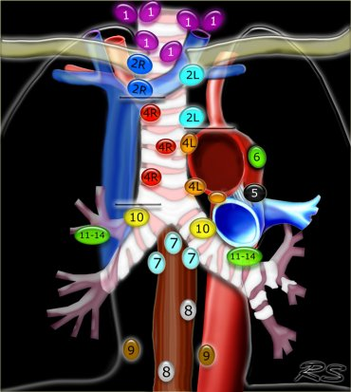
LYMPHNODE STATION
Supraclavicular | 1.Low cervical,supraclavicular,sternal notch
Superior Mediastinal | (2R,2L)Upper Paratracheal
 | (3a,3p)Pre vascular,Retrotracheal
 | (4R,4L)Lower paratracheal
Aortic | (5,6)Subaortic,Paraaortic
Inferior Mediastinal | 7 Subcarinal (8,9)Paraoesophageal,pulmonary ligament
N1 nodes | (10,11,12,13,14) Hilar,interlobar,lobar,segmental,subsegmental

Slide 9
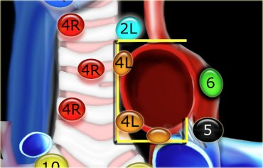
The lymph from right lung involves lower paratracheal nodes(iv) followed by subcarinal (vii)
The lymph from left upper lobe involve subaortic nodes(v)
The left lower lobe drains to subcarinal lymphnodes(vii)

Slide 10
WORLD HEALTH ORGANISATION CLASSIFICATION OF MALIGNANT LUNG CANCER
MALIGNANT
SQUAMOUS CELL CARCINOMA
a Spindle cell variant
SMALL CELL CARCINOMA
a Oat cell
b Intermediate cell
C Combined
ADENOCARCINOMA
A Acinar
B Papillary
C Bronchioalveolar
D Solid carcinoma with mucin
LARGE CELL CARCINOMA
A Giant cell
B Clear cell
ADENOSQUAMOUS
CARCINOID
BRONCHIAL GLAND CARCINOMA

Slide 11
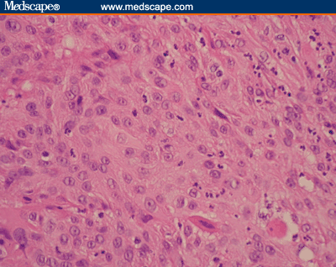
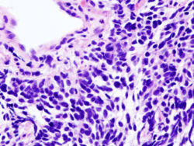
PATHOLOGICAL CLASSIFICATION
Squamous cell carcinoma is the most commonly found in men
It is closely related with smoking history
Adenocarcinoma has been common type of lung cancer in women and nonsmokers since 1950*
From 1990’s adenocarcinoma is the most common diagnosis in men*i
Currently Adenocarcinoma has surpassed Squamous cell type
Notes:
*Int journal radn onco 1992-24:11-16

Slide 12
Classification (cont…)
  Non Small Cell Lung Cancer (NSCLC)
Adenocarcinoma
Squamous Cell Carcinoma
Large Cell Carcinoma
  Small Cell Lung Cancer (SCLC)
Oat Cell
Intermediate
Combined

Slide 13
CLINICAL PRESENTATION
Although no set of signs and symptoms are pathognomic for carcinoma lung they can be broadly divided into three categories
Due to local tumour growth and intrathoracic spread
Due to distant metastasis
Nonspecific systemic symptoms or paraneoplastic syndromes

Slide 14
Due to local tumor and intrathoracic spread
Squamous and small cell cancers usually present as central mass
They produce cough,wheeze,hemoptysis
Symptoms and signs of airway obstruction &postobstructive pneumonitis(dyspnoea,fever,productive cough)
Adenocarcinoma and large cell tumour present as peripheral mass with pleural involvement
More likely to be asymtomatic but may cause pleuritic chest pain,cough
Squamous and large cell cavitate in 10-20% of cases

Slide 15
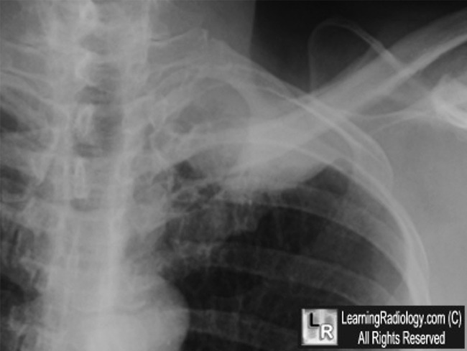
Intrathoracic spread
Usually causes nerve entrapment
Most commonly causes left recurrent laryngeal nerve palsy leads to hoarseness, dysphagia recurrent aspirations
Phrenic nerve entrapment leads to hiccups
Apical tumours causes Pancoast syndrome, lower brachialplexopathy(C8,T1), Horners syndrome, shoulder pain
Most superior sulcus tumour are squamous cell type

Slide 16
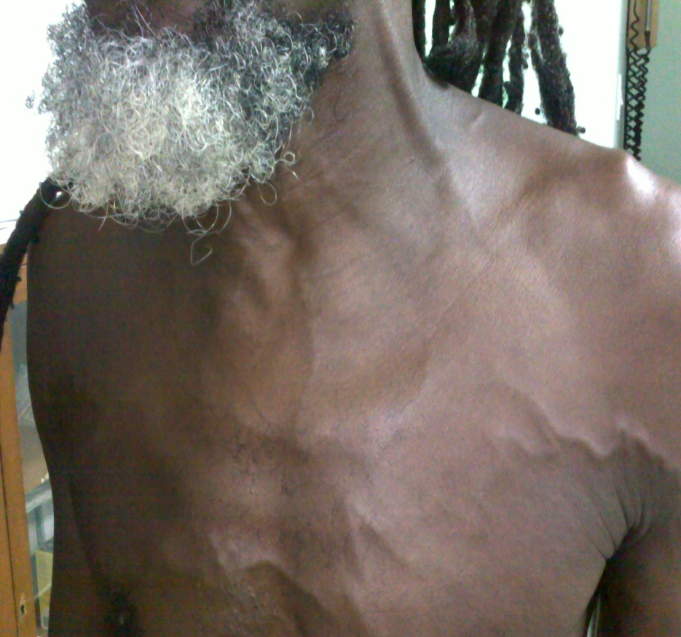
Intrathoracic spread
Compression of esophagus dysphagia recurrent aspirations tracheoesophageal fistula bronchoesophageal fistula
Principal vascular syndrome caused is Superior vena cava syndrome
Usually caused by tumour on right upper lobe or right main bronchus
Most commonly caused by small cell type followed by squamous cell

Slide 17
Intrathoracic spread
50% of patients with disseminated lung cancer develops pleural effusion
Lung cancer is the single most cause of pericardial metastases

Slide 18
SYMPTOMS DUE TO METASTASIS
Most common sites of haematogenous spread that are clinically apparent are brain,bones,liver,adrenals
Extrathoracic metastatic disease found at autopsy in 50% with squamous cell carcinoma 80% with adenocarcinoma and large cell 95%with small cell cancer
Symptoms are according to the organ involved
Adrenal metastases are common but rarely cause adrenal insufficiency

Slide 19
NONSPECIFIC AND PARANEOPLASTIC SYNDROMES
Paraneoplastic syndrome refer to the disorders that accompany tumours but not directly related to mass effect or invasion
Endocrine syndromes hypercalcaemia,hypophosphataemia due to parathyroid hormones by squamous cell. Hyponatraemia with SIADH by small cell hypokalemia due to ACTH by small cell
Clubbing in non small cell type
Hypertrophic pulmonary osteoarthropathy in adeno carcinoma
Neurologic myopathic syndromes like Eaton lambert
Trousseau’s syndrome
Dermatomyositis and Acanthosis nigricans

Slide 20
DIAGNOSTIC WORKUP
Detail History
Physical Examination
Chest xray
It is the single most important and initial investigation
It can present in different ways depending on the region of lung involved and histology
Hilus | Hilar prominence,hilar mass,perihilar mass
Pulmonary parenchyma | Mass,apical mass,multiple masses,bronchial obstruction,collapse,consolidation
Intrathoracic extrapulmonary structure | Mediastinal widening or mass,chest wall erosion,pleural effusion,elevation of diaphragm

Slide 21
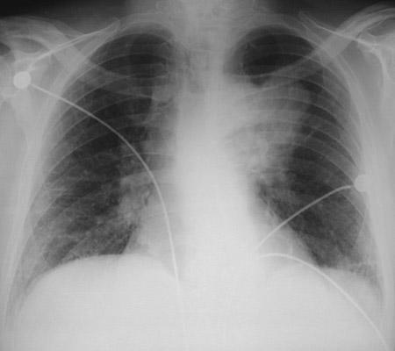
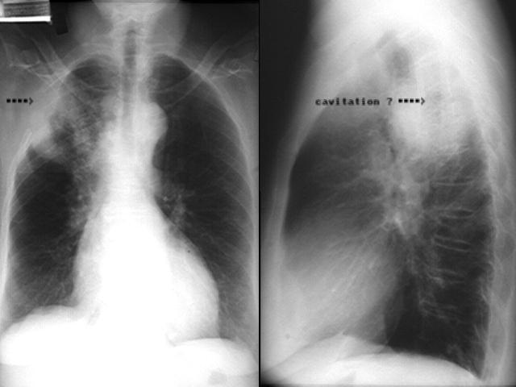
Chest x-ray cont..
Squamous cell carcinoma | Collapse,consolidation,cavitation,hilar abnormality
Adenocarcinoma | Peripheral mass,hilar abnormality,obstructive lesion,no cavitation
Large cell carcinoma | Peripheral mass,cavitation and hilar abnormalities rare
Small cell tumours | Hilar prominence

Slide 22
Confirmatory workup
Sputum cytology:it has a posive predictivity value of 100%,but sensitivity of 10-15%
Bronchoscopic biopsy
Transbronchial fine needle aspiration Used for central lesions Evaluation of mediastinal lymphadenopathy
Bronchoalveolar lavage peripheral regions not visible endoscopically
CT guided transthoracic percutaneous fnac/biopsy

Slide 23
Staging workup
CECT THORAX Sensitivity 75%,specificity 66% CT scan should extend inferiorly to include upper abdomen and adrenal glands
FDG PET SCAN Sensitivity 91%,specificity 86% Can detect lesions >5 to 8 mm on basis of FDG uptake Combinations of CT scan and PET scan has greater sensitivity and specificity than CTscan along
FIBREOPTIC BRONCHOSCOPY Most important procedure for determining the endobronchial extent of the disease,measuring tumour proximity to carina
MEDIASTINOSCOPY Best method to evaluate the upper,middle peritracheal and subcarinal lymphnodes
BONE SCAN/CT-MRI OF BRAIN
ULTRASONOGRAPHY WHOLE ABDOMEN

Slide 24
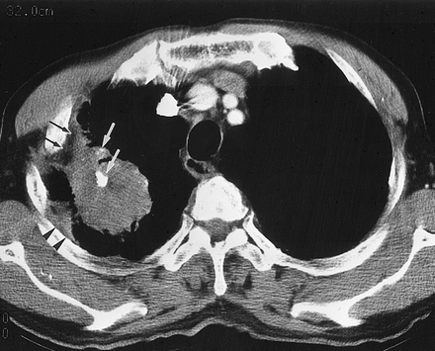
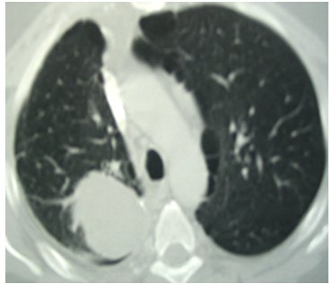
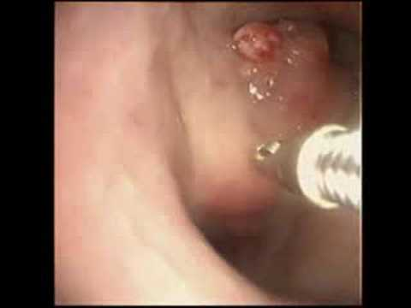
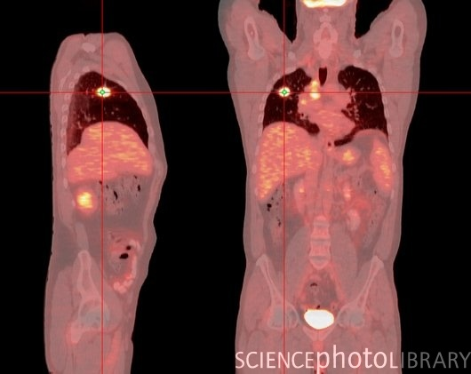

Slide 25
FOR ASSESSING GENERAL CONDITION
Blood
Haemogram
Kidney func test
Liver func test
Serum electrolytes
Hormones like parathyroid,ACTH
Urine
Routine & microscopic

Slide 26
AJCC STAGING(2010)
Tx | Primary cannot be accessed or positive cytology
To | No evidence of primary tumour
Tis | Carcinoma in situ
T1 T1a T1b | Tumour <3cm greatest dimention surrounded by lung or visceral pleura without bronchoscopic evidence of invasion more proximal than lobar bronchus(i.e not in main bronchus) Tumout 2 cm or less in greatest dimention Tumour >2cm but 3cm or less in greatest dimention
T2 T2a T2b | Tumour >3cm but 7cm or less or involves main bronchus,>2cm from the carina,invades visceral pleura associated with partial atelactasis Tumour more than 3cm but 5cm or less Tumour more than 5 cm but 7 cm or less
T3 | Tumour more than 7 cm or one directly invading the parietal pleura,chest wall,diaphragm,phrenic nerve,mediastinal pleura,parietal pericardium or tumour in the main bronchus<2cm from the carina but without involvement of carina,associated total atelectasis
T4 | Tumour of any size invading the mediastinum,heart,great vessels,trachea,recurrent laryngeal nerve,esophagus,vertebral body,carina,separate tumour nodule in tha same lobe,malignant effusion

Slide 27
Regional lymphnodes
Nx | Regional node cannot be accessed
No | No regional node metastasis
N1 | Metastasis in ipsilateral peribronchial and/or ipsilateral hilar node and intrapulmonary nodes including involvement by direct extention
N2 | Metastasis in ipsilateral mediastinal and/or subcarinal lymphnodes
N3 | Metastasis in contralateral mediastinal,contralateral hilar.ipsilateral or contralateral scalene or supraclavicular node
Distant Metastasis
Mo | No distant metastasis
M1 | Distant metastasis
M1a | Separate tumour nodule in a contralateral lobe tumour with pleural nodule or malignant pleural or pericardial effusion
M1b | Distant metastasis in extrathoracic organs

Slide 28
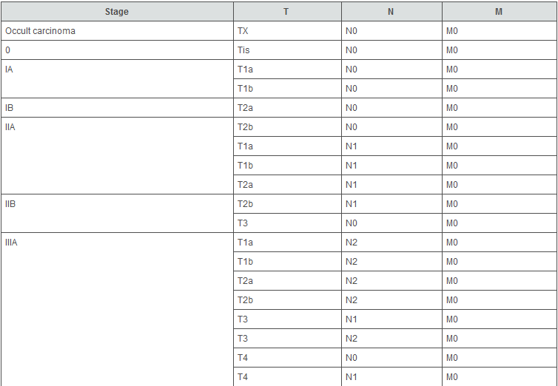

Slide 29
PROGNOSTIC FACTORS
Epidermoid carcinoma has the best prognosis followed by adenocarcinoma and undifferentiated large cell cancer
Undifferentiated small cell cancer has the poorest prognosis
In Lung cancer the most important prognostic factor is tumor stage
In SCLC pure cell carcinomas are more sensitive to chemotherapy and radiotherapy than variant cell.

Slide 30
Negative prognostic factors are
Mutations in Kras oncogene
Deletion of p53,NCAM molecule
Expression,elevated neuron specific enolase level
Over expression of erb1,erb2
Increased proliferative
Markers(ki67,cyclinD1,E,B1,p16 loss
Angiogenesis markers like VEGF
Decreased apoptotic markers like caspase 3

Slide 31
Management of NSCLC
    Stage I-II : Early stage(T1-2, N1)
    Stage IIIA : Locally advanced (surgery feasible)(T3,N2)
    Stage IIIB : Locally advanced (surgery not feasible)(T4,N3)
    Stage IV : Metastatic disease

Slide 32
For Non Small Cell Cancer usually a multimodality approach is used
Surgery
Chemotherapy
Radiotherapy

Slide 33
Surgery
Indications
Stage I , II
Stage IIIA(T1-3 N2,T3N1)
Medically fit
Good performance scale

Slide 34
Surgery(cont…)
Surgery is the standard treatment of choice for patients with stage I,II and IIIA tumours.
Lobectomy with nodal dissection is the method of chioce
Pneumonectomy is done only when
Involves proximal bronchus or proximal pulmonary artery Crosses major fissure
Wedge resection is only restricted to persons who are not able to tolerate lobectomy

Slide 35
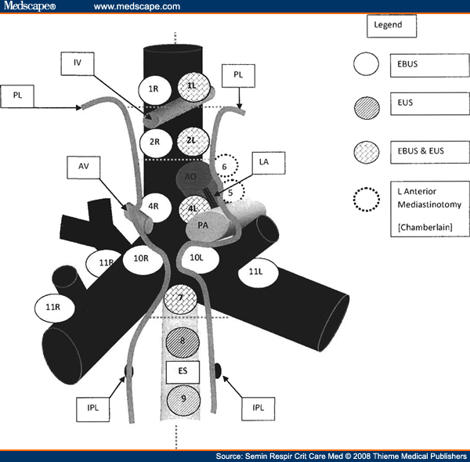
Lymphnode dissection
The current minimum standard is a systemic sampling of each lymph node station of tumor
Rt sided tumors – 2,3,4,7,8, 9,tracheobronchial angle and interlobar area (10,11)
Lt sided tumors – sub aortic, ant med nodes (5,6), 7,8,9

Slide 36
Results
5 yrs survival for patients with Stage I is 65%,Stage II is 60% ,Stage IIIA( N1 disease is 34%,N2 is 24%)
Various studies also concluded that lymphnode dissection is necessary for accurate staging.
Lesser resections like wedge resection result in higher recurrence rate and reduced survival.
Survival is longer in clinical (pre op)N0 or N1 disease but pathological(post resection N2) than clinical N2 disease

Slide 37
RADIOTHERAPY
  Radiation is used in following forms in NSCLC
  A. AS ADJUVANT * Post Operative
  * Pre Operative
  PRIMARY RADIATION * Radical
        * Palliative
  C. CHEMO-RADIATION
  NSCLC is a radio responsive tumor but not radiosensitive

Slide 38
Role of pre op irradiation
Indications
In stage I,II,III tumours
Dose :20 Gy in 5#
Results
Multi institutional trail compared preop RT vs surg alone
No added benefits was found in stage I,II Tumours
But a significant 3 yr survival rate (49.4% vs 28.1%) was observed in stage III

Slide 39
Role of Post op RT
Indications
Incomplete resection
Close or positive margins
Positive mediastinal metastases
Resected N2 disease
Chest wall involvement
Superior sulcus tumour
Contraindications
Currently contraindicated in patients with stage I completely resected

Slide 40
Post op RT(cont…)
Dose for potential microscopic disease 50 GY | Dose for margins positive 60 to 66 Gy
RESULTS
TRIALS | PORT Meta Analysis SEER Database British Medical Research
CONCLUSIONS | Role of PORT in positive N1 disease is controversial More data supporting role in N2 The studies used conventional technique Modern tech like IMRT,3D CRT hopefully will increase the result in favour of PORT

Slide 41
Definitive radiotherapy in NSCLC (early stage)
INDICATIONS :
1. Medically inoperable T1-T3 lesions.
2. Patient refuses surgery.
3. Critically located lesion.
4. Non-resectable Stage-II & Stage-IIIA
5. Patient with incomplete resection.
6. Localized recurrent lung cancer.

Slide 42
RADIOTHERAPY TECHNIQUES
Conventional External beam radiotherapy
VOLUME
2 cm around the tumour margin
ENERGY
6-10 Mev linac
PORTALS
2 to 3 fields depending on tumour and lymphnodes
DOSE
60-66 GY @1.8-2 GY/#

Slide 43
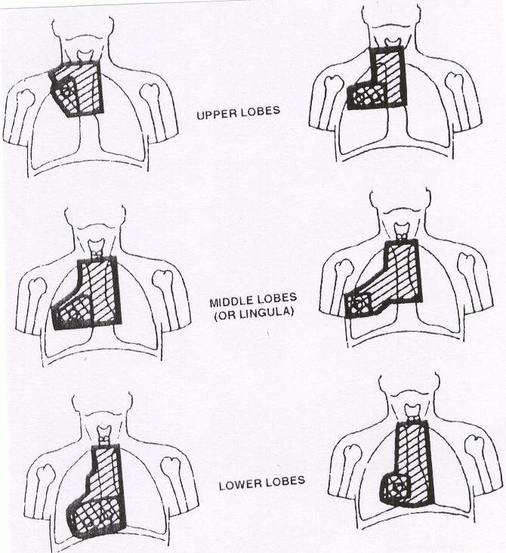

Slide 44
Results of Radiotherapy in early stage
Local control is poor and results are not very encouraging for NSCLC
5yr local control and overall survival rates ranges from 30 to 50% and 10-30%
Results of conventional RT is certainly inferior when compared with other modality

Slide 45
STEREOTACTIC BODY RADIATION THERAPY
SBRT is a combination of multiple beam angles to achieve sharp dose gradients,high precision localisation and a high dose per fraction in extracranial locations.
Delivers a high biologic effective dose BED to target
Minimise normal tissue toxicity
Reduced treatment volume
Reducing treatment time

Slide 46
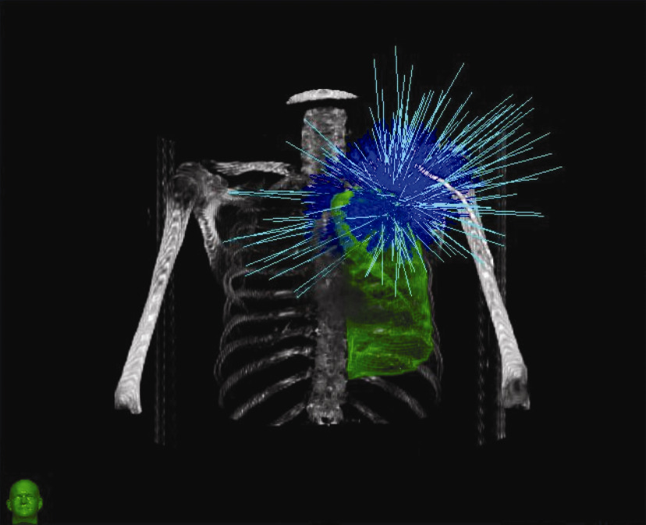
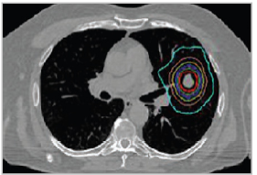
SBRT

Slide 47
Results of SBRT
Image guided SBRT with delivery of BED>100 GY is feasible and produces better results than <100 gy
3 to 5 yr survival rate and local control is much more better than those for conventional RT
For stage I A disease results are comparable with surgery
Emerging as the standard treatment for inoperable stage I NSCLC.

Slide 48
Definitive RT In Advanced NSCLC(stage III)
Larger unresectable tumours T4N0-1 or T1-4 N2-3.
Dose given is 60 GY @2GY/#
A higher dose upto 80 to 100 gy is required to improve local control and potential survival but toxicity is main limiting factor here.
However advanced such as 3D crt and imrt have provided a way for dose escalation with out toxicity.

Slide 49
non small cell lung cancer newer radiation techniques
3-Dimentional Conformal Therapy.
Intensity Modulated Radiation Therapy.
IGRT and Gated Radiotherapy.
Interstitial Brachytherapy.
Endobronchial Brachytherapy.
Intra Operative Radiotherapy.

Slide 50
3-D CRT & IMRT IN LUNG CANCER
Goal:
To increase dose delivery to tumour
To minimize dose to normal tissues.
Advantages
Better conformity of radiation dose to the tumour.
Sparing of all the vital structures around tumour.
Escalation of dose is possible.
Better control of disease.
Reduced morbidity.

Slide 51
3-D CRT & IMRT IN LUNG CANCER
TREATMENT PLANNING

Slide 52
Radiotherapy planning
GTV (Gross Tumor volume)
CTV (Clinical Target volume)
PTV (Planning Target volume)
GTV
Visible tumor by any imaging modality including the lesion and lymphnode > 1 cm.

Slide 53
RT-Planning – Defining the CTV
CTV is the volume that contains gross and microscopic disease
A Radiographic histopathologic study demonstrated that CTV varies with histologic type

Slide 54
PTV
One of the important reason of uncertainty in ca lung is motion of the tumor during respirations
PTV is defined as CTV with a margin to account for daily set up error and target motion

Slide 55
NON SMALL CELL LUNG CANCER
RADICAL RADIATION
Image Guided RadiationTherapy-IGRT:
It is defined as the use of modern imaging modalities specially those incorporating functional and biological information.
1. To augment target delineation
2. Use of imaging to adjust to target motion and
positional uncertainty- respiratory gated therapy
3. Potential to adopt treatment to tumor
response.

Slide 56
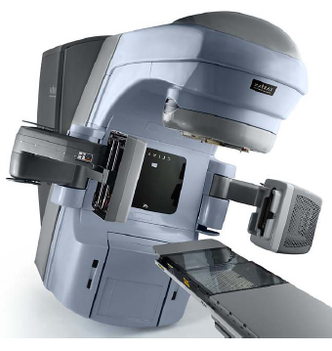
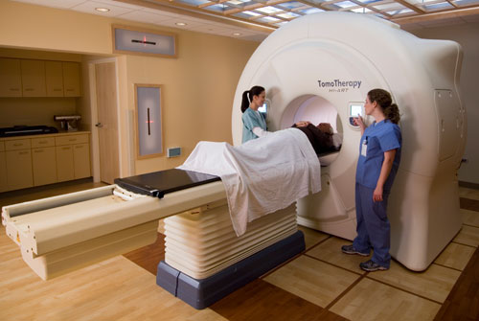
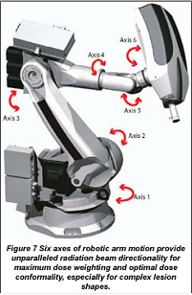
IMAGE GUIDED RADIATION THERAPY
EQUIPMENT REQUIRED
CT-SCAN MRI PET-CT
Linac with on Tomotherapy Cyber knife
Board imaging

Slide 61
Chemotherapy
(NCCN Guidelines 2010)
Indicated in all stages above stage Ib, significant improvement in survival.
First line
Premetrexate + cisplatin is superior to Gemcitabine + cisplatin in non sq cell tumors.
Paclitaxal + carboplatin for sq cell tumors.
Bevacizumab and Erlotinib combined with chemotherapy.
No use of using a third drug in the regime.
Older patients single agent chemotherapy is adviced

Slide 62
Second line (in combination with platinum)
Docetaxal
Premetrexate
Irinotecan
Erlotonib
Third line
Erlotinib
Vinorelabine

Slide 63
SMALL CELL LUNG CANCER

Slide 64
Staging of SCLC
Veterans Administration Lung Study Group (VALG) staging system
Limited-Stage Disease (LD SCLC )
- Confined to the hemithorax of origin, the mediastinum, or the supraclavicular nodes, which can be encompassed within a tolerable radiation therapy port.
Extensive-Stage Disease (ED SCLC)
- Any disease not meeting limited stage criteria
- Distant metastasis.

Slide 65
Staging of SCLC
The International Association for the Study of Lung Cancer (IASLC) revised the VALG classification in accordance with the TNM system.
- LD definition is consistent with TNM stages I to IIIB.
- ED is limited to patients with distant metastases.

Slide 66
Management of SCLC
SURGERY
Stage I(T1-2,N0)
Lobectomy with mediastinal nodal dissection is the surgery of choice
Early stage SCLC is diagnosed in fewer than 5% of SCLC patients,limits the scope of surgery
The trial by Medical Research Council led to abandonment of surgery as a primary modality of treatment

Slide 67
Combined Chemotherapy and Radiation therapy
Indications
To decrease the local recurrence
To improve survival
Positive lymphnode involvement after surgery

Slide 68
Role of Radiotherapy
Meta-analysis by Warde and Payne
- 11 prospective trials of chemotherapy with or without RT were analysed
- Results : Absolute increase of OS by 5.4 % at 2 years
Local control of 25 % with limited stage disease
Pignon et al
- 16 randomized studies with 2,140 patients
- improvement in abolute survival of 5.4 % at 3 years
Definite role for RT in local control of disease which leads to increase in overall survival

Slide 69
Role of chemo radiotherapy
McCracken et al (154 patients)
Results
Time Survival
2 yr 42 %
4 yr 30 %
5 yr 26 %
Cisplatin , Etoposide & vincristine 2 cycles with RT 1.8 Gy per day upto 45 Gy
Concurrent chemo radiotherapy provides good survival advantage with tolerable toxicity to the patient

Slide 70
Concurrent Chemoradiation
Advantages
Overall shorter treatment time
High dose intensity
Sensitisation of tumours
Disadvantages
Enhanced normal tissue toxicity
Treatment breaks
Inability to access response to either mode

Slide 71
Sequential vs Concurrent chemoradiotherapy
Japanese Clinical Oncology Group
Arm 1
Paclitaxel 80 mg/m2 on d1 and etoposide 100 mg/m2 d1-3 (2 cycles)
RT 45 GY
Results showed significant improvement of survival in CRT arm
Conclusion:CRT is better than sequential chemo and radiotherapy
Arm 2
Paclitaxel 80 mg/m2 on d1 and etoposide 100 mg/m2 d1-3
+
RT was started along with chemo from day1

Slide 72
Timing of Chemo Radiotherapy
NCI Canada trial
40 Gy in 15 fractions over 3 weeks to the primary site concurrent with the first cycle of EP (week 3)
All 308 eligible patients received cyclophosphamide, doxorubicin, and vincristine (CAV) alternating with etoposide and cisplatin (EP) every 3 weeks for three cycles of each chemotherapy regimen.
late TI patients received the same radiation concurrent with the last cycle of EP (week 15)
Overall survival better in Early RT arm

Slide 73
Altered fractionation
Turrisi et al
Once-daily therapy received
1.8 Gy daily in 25 treatments
over a period of five weeks.
417 patients with limited
small-cell lung cancer.
All the patients received four
21-day cycles of
cisplatin 60 mg/m2 and Etoposide 120 mg/m2
RT started with CT in first week
Patients with a complete response
Received prophylactic cranial irradiation 25 Gy 1n 10 #
Accelerated twice-daily thoracic
radiotherapy involved the
administration of 1.5 Gy in 30 #
over a period of three weeks
Conclusion : 10% absolute increase in overall survival @ 5yrs with15% increase in high grade esophagitis in Acc RT arm

Slide 74
Prophylactic cranial irradiation
Metaanalysis conducted in 1999 studied 7 prospectively randomised trail
They found a disease free and overall survival advantage in those patients who under went prophylactic cranial irradiation
Dose is still a matter of debate however there is a trend in reduction of brain relapses at 36 GY @ 2 GY /#
Prophylactic cranial irradiation should be consideredfor complete clinical responders

Slide 75
CONCLUSION
NSCLC
1.STAGE I&II
Surgery if feasible followed by adjuvant chemotherapy when indicated
SBRT if not medically fit
2.STAGE IIIA
Surgery with adj chemotherapy + PORT
EBRT with chemotherapy if not fit
3.STAGE IIIB
EBRT with chemotherapy
4.STAGE IV
Chemotherapy with EBRT for palliation

Slide 76
CONCLUSION
  SCLC;Limited disease
  CONCURRENT CHEMORADIATION IS CONSIDERED
Dose of Radiotherapy should be delivered at 45 GY with1.5 GY/#,twice daily with concurrent Cisplatin and Etoposide.
Prophylactic cranial irradiation should be considered for complete clinical responders.
Patients should be encouraged to participate in newer protocol
Extensive disease
Chemotherapy
Prophylactic cranial irradiation for responders
Palliation

Slide 77
THANKYOU

