Slide 1
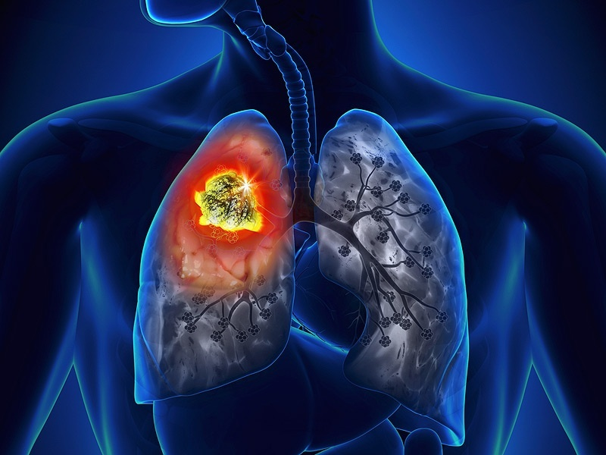
Newer Advances in Lung Cancer Treatment
Dr.Tinku Joseph
Dept. of Pulmonary Medicine
AIMS, Kochi

Slide 2
Contents
Chemotherapy
Radiotherapy
Interventional Procedures (Palliative)

Slide 3
Management: ACCP guidelines
.
Advances in treatment for different stages
CT Screening
Only to smokers age 55-74, with > 30 pack-years of smoking
Annual low-dose CT scanning in NLST-compliant setting
Not to pts. with severe comorbidities
Stages I & II
VATS with systematic lymph node sampling preferred
Better outcomes with specialty-trained surgeons & at high-volume centers
Stage III
Stage IV
Chemo + radiation therapy for most N2,3 pts
Trimodal approach for toxicity mgmt.
Tailor treatment depending on mediastinal involvement
EGFR+-pts: targeted therapy is 1st line of treatment
Appropriate maintenance chemotherapy
VEGF inhibitors safe & useful
Doublet chemotherapy in selected cases
ACCP, American College of Chest Physicians; chemo, chemotherapy; mgmt., management; NLST, National Lung Cancer Screening Trial; pts., patients; VATS, video-assisted thoracic surgery; VEGF, Vascular endothelial growth factor
5. Detterbeck FC, Lewis SZ, Diekemper R, Addrizzo-Harris D, Alberts WM. Executive Summary: Diagnosis and management of lung cancer, 3rd ed: American College of Chest Physicians evidence-based clinical practice guidelines. Chest. 2013;143(5 Suppl):7s-37s.

Slide 4
Advances in Chemotherapy for Lung cancer

Slide 5
Targeted Therapies
“Newer type of cancer treatment that uses drugs or other substances to more precisely identify and attack cancer cells, while doing little damage to normal cells”—American Cancer Society
FDA approved specific targeted therapies
Erlotinib: EGFR positive mutation
Crizotinib: EML4-ALK positive mutation
Bevacizumab*: if neither positive
*In combination with chemotherapy: carboplatin + paclitaxel

Slide 6
NSCLC
Slow growing than small cell→ better prognosis
Adenocarcinoma: most common type in non-smokers
Squamous cell carcinoma: common in smokers
Mutations in KRAS, EGFR & EML4-ALK → more targeted therapies
EGFR: Epidermal Growth Factor Receptor
EML4-ALK: Echinoderm Microtubule-associated protein-Like 4-Anaplastic Lymphoma kinase

Slide 7
Incidence of Mutations in Lung Cancer
Mutation found in 54% (280/516) of
tumors completely tested.
Kris MG, J Clin Oncol 2011; 29: Abstr CRA 7506

Slide 8
KRAS
Most common mutation: 25% of all adenocarcinoma
Exclusive to smoker
Mutation has lack of therapeutic efficacy→ shorter survival
No targeted therapy established so far
Non-Small Cell Lung Cancer, NCCN Guidelines Version 7. 2015
https://sangakukan.jp/journal/journal_contents/2013/01/articles/1301-02-1/1301-02-1_earticle.html

Slide 9
EGFR
Mutation cause receptor deregulation or over expression
Overall frequencies in NSCLC = 10-15%
Most common forms:
Deletions in exon 19 and exon 21 [sensitizing EGFR mutation]
Sensitive to small molecule tyrosine kinase inhibitor (TKI) (Erlotinib, Gefitinib)
Erlotinib
Non-Small Cell Lung Cancer, NCCN Guidelines Version 7. 2015
Brambilla E. et al. Eur Respir J. 2009; 33(6): 1485–1497

Slide 10
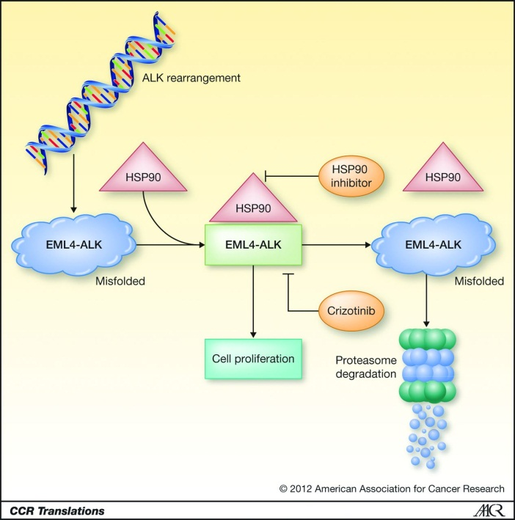
EML4-ALK
Estimates 2-7% of patients with NSCLC and common in young men (median: 52 years)
Due to inversion in chromosome 2 that links EML4 to ALK→ cancer cell proliferation
Does not occur concurrently with EGFR or KRAS
Sensitive to TKI, Crizotinib
Non-Small Cell Lung Cancer, NCCN Guidelines Version 7. 2015
https://sangakukan.jp/journal/journal_contents/2013/01/articles/1301-02-1/1301-02-1_earticle.html

Slide 11
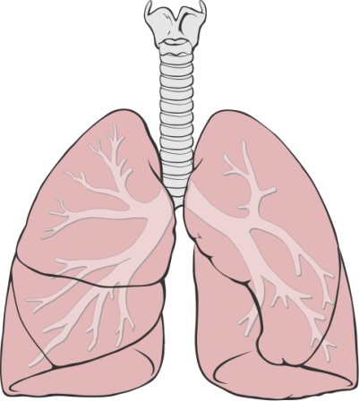
Initial trials showing utility of genotype-directed treatments
EGFR* as 1st line TKI
(Trial acronyms: IPASS, WJTOG3405, OPTIMAL)
EGFR as 2nd- line TKI
and 1st vs. 2nd generation TKIs (selected patients)
Slightly better outcomes with chemotherapy in mutation-negative patients
OPTIMAL (erlotinib vs. chemotherapy; 83 vs. 82 randomized pts.): one of the Phase III trials showing value of TKI plus chemotherapy
LUX-lung 3 (afatinib vs. cisplatin/pemetrexed; 345/1,269 pts randomized to intervention): PFS prolongation & acceptable safety profile
LUX-lung7 (1st vs. 2nd generation TKIs; 264 pts. to be recruited); awaiting data
EGFR vs. chemo in 2nd-line therapy (Trial acronyms: INTEREST, V-15-32, ISTANA, TITAN, HORG, TAILOR, unselected patients)
EORTC 08114-GEM intergroup translational research-observational study will focus on the genetics of EGFR+ - NSCLC; EGFR, epidermal growth factor receptor; PFS, progression-free survival; pts., patients; TKI, tyrosine kinase inhibitors
7.Verma S, Tsao M, Sivjee K. Webinar Archive: Integration of Targeted Therapies in the Management of NSCLC: oncologyeducation.com; 2014. Available from: http://www.oncologyeducation.com/information/lung/lung-cancer-videos/webinar-archive-nsclc/

Slide 12
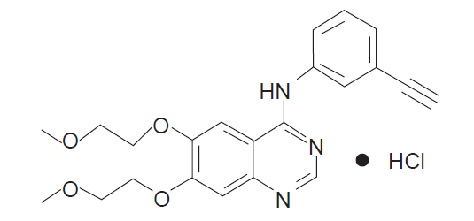
Erlotinib
Small molecule TKI used as:
First-line: patient with EGFR mutation
Second line: locally advanced/metastatic NSCLC after progression on at least one prior chemotherapy
Dose: 150 mg by mouth daily until disease progression or unacceptable toxicity
Drug-drug interaction: strong CYP3A4 (inducers/inhibitors); proton pump inhibitors
Side effects:
Dermatologic: skin rash
Gastrointestinal: diarrhea
Respiratory: Cough,dyspnea
Kristen NG. et al. Biologics: Targets & Therapy 2007:1(4) 335–346
Erlotinib. Lexi-Drugs Multinational [Internet]. Accessed: June 06 2015

Slide 13
Dose Adjustments: Toxicity
Discontinuation of therapy:
Bullous, blister or exfoliative
GI perforation
Corneal perforation or severe ulceration
Withhold and reinitiate with 50 mg dose reduction:
Severe rash
Dehydration due to diarrhea
Acute or worsening ocular toxicities or keratitis
Erlotinib. Lexi-Drugs Multinational [Internet]. Accessed: June 06 2015

Slide 14
Landmark Trials
Trial | Study Design | Patient Population | Results
OPTIMAL n = 83 | Multicenter, open-label, randomized, phase III. Oral erlotinib (150 mg/d) vs. chemotherapy (GEM+CIS) | Adults >18 years with confirmed Stage IIIB or IV NSCLC + EGFR positive mutation | Median progression-free survival (PFS): 13.1 months vs. 4.6 months; p<0.0001. Grade 3 and 4 side effects were less in erlotinib group
EURTAC n = 174 | Multicenter, multinational, open-label, randomized, phase III. Oral erlotinib (150 mg/d) vs. chemo (DTX+CIS) | Adults >18 years with confirmed Stage IIIB or IV NSCLC + EGFR positive mutation | Median PFS: 9.7 months vs. 5.2 months; p<0.0001. Grade 3 & 4 hematologic toxicity was higher in chemo group (22% vs. none), whereas, erlotinib has higher rash (13%), and ↑ of LFTs (2%)

Slide 15
Geftinib
EGFR inhibitor, like erlotinib
Interrupts signaling through the epidermal growth factor receptor (EGFR) in target cells.
Dose-: 250mg once a day
IPASS (IRESSA Pan-Asia Study) was a randomized, large-scale, double-blinded study which compared Gefitinib vs. carboplatin/ paclitaxel as a first line treatment in advanced NSCLC

Slide 16
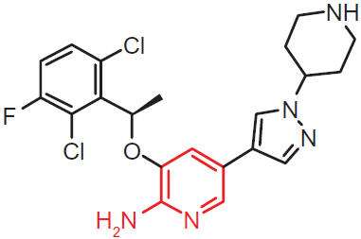
Crizotinib
Small molecule tyrosine kinase inhibitor of c-MET, ALK, or ROS 1 and indicated for:
ALK-positive metastatic NSCLC
Dose: 250 mg orally twice daily, continue treatment until disease progression or unacceptable toxicity
Drug-drug interaction: strong CYP3A4 inhibitors/inducers
Side effects:
Cardiovascular: edema (28% to 39%), bradycardia (5% to 11%)
Metabolic: hypophosphatemia (28%), hypokalemia (18%)
Gastrointestinal: Diarrhea (43% to 60%), nausea (51% to 55%), vomiting (40% to 47%)
Hematologic: lymphocytopenia (51%; grades 3/4: 9% to 11%), neutropenia (49%; grades 3/4: 5% to 12%)
Hepatic: Increased serum ALT (13% to 76%; grades 3/4: 5% to 17%), AST (9% to 61%; grades 3/4: 2% to 9%)
Ophthalmic: Visual disturbance (55% to 62%; onset: <2 weeks)
Ingnateus SH. et al. Drug Design, Development and Therapy 2011:5 471–485
Crizotinib. Lexi-Drugs Multinational [Internet]. Accessed: June 06 2015

Slide 17
Dose Adjustments: Toxicity
Discontinuation of therapy:
Pulmonary toxicity: Interstitial lung disease (any grade)
Grade 4 hematologic toxicity despite lowest dose (250 mg once daily)
QT_{c} >500 msec or ≥60 msec change from baseline with life-threatening symptoms
Dose reduction necessary, if patient develops grade 3 or 4 cardiac, hematologic, and hepatotoxicity
Dose reduction scheme:
Step1: reduce dose to 200 mg orally twice daily; if not tolerable
Step2: reduce to 250 mg once daily. If not tolerable
Step3: reduce to 250 mg once daily
Erlotinib. Lexi-Drugs Multinational [Internet]. Accessed: June 06 2015

Slide 18
Landmark Trials
FDA approval as a second line from phase I and II studies (PROFILE 1001 phase I, PROFILE 1005 phase II)
Tumor response 60%
PFS 7-10 months
PROFILE 1007 [2012]: Phase 3, open-label, randomized, two-arm study (n=318) between crizotinib vs. standard chemotherapy
Results (favoring crizotinib):
Response rate: 65% vs. 20%; p<0.0001
PFS: 7.7 months vs. 3 months; p<0.0001
Fewer side effects mainly
Diarrhea (53%), nausea (52%), vomiting (44%), elevation of LFTs (36%)
7.7
3
PFS-: Progression free survival
Kwak EL et al. N Engl J Med 2010;363:1693-1703
Shaw AT. et al. Vienna, Austria: European Society for Medical Oncology, September 2012. Abstract LBA1

Slide 19
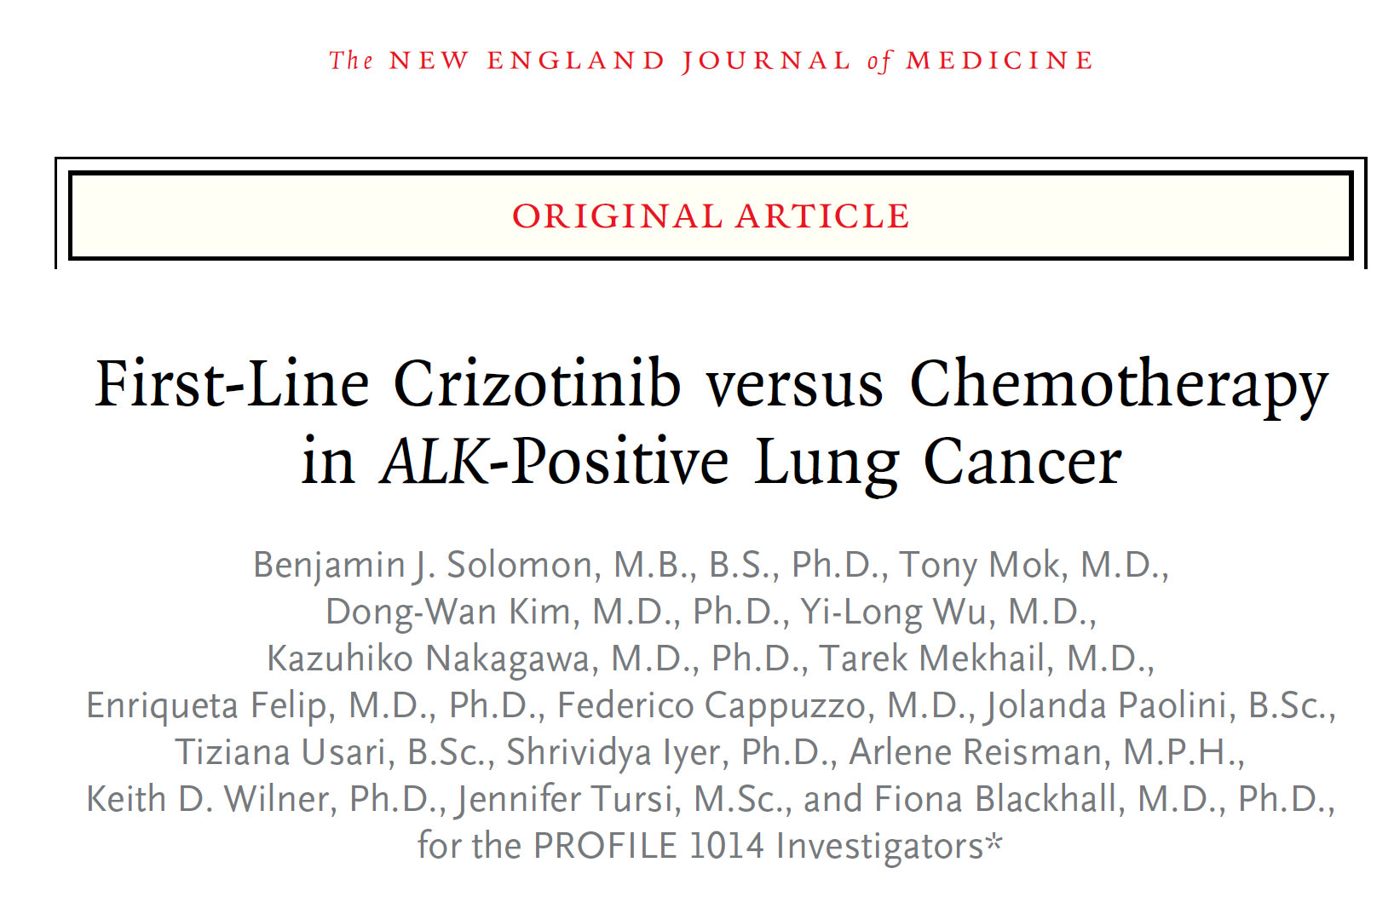
Landmark Trials
PROFILE 1014 [2014]:
Randomized, open-label, phase III trial between crizotinib 250 mg twice daily, or intravenous chemotherapy (pemetrexed, at a dose of 500 mg/m² of body-surface area or carboplatin, target area under the curve of 5 to 6 mg per milliliter per minute) every 3 weeks for 6 cycles

Slide 20
Bevacizumab
Anti VEGF, FDA approved indication (2006):
Unresectable, locally advanced, recurrent, or metastatic, non-squamous NSCLC who are not positive for EGFR or ALK
First targeted agent that improved outcomes compared to chemotherapy, however, not commonly used in most of the counties
Dose:
15 mg/kg IV every 3 weeks + chemotherapy X 6 cycles
Maintenance: 15 mg/kg every 3 weeks as monotherapy until disease progression or unacceptable toxicity
Side effects:
Cardiovascular: hypertension (12% to 34%; grades 3/4: 5% to 18%)
Renal: increased serum creatinine (16%) & proteinuria (≥2 g proteinuria/24 hours)
Hematologic: hemorrhage (40%; grades 3/4: ≤7%), leukopenia (grades 3/4: 37%), pulmonary hemorrhage (4% to 31%)
Respiratory: upper respiratory tract infection (40% to 47%), epistaxis (17% to 35%), dyspnea (25% to 26%), rhinitis (3% to >10%)
VEGF: Vascular Endothelial Growth Factor
DiPiro J. Lung Cancer. In: Pharmacotherapy: A Pathophysiological Approach, 2014
Erlotinib. Lexi-Drugs Multinational [Internet]. Accessed: June 06 2015

Slide 21
Landmark Trials
Results:
Compared to control arm, adding bevacizumab (15 mg/kg) resulted in
Higher response rate (31.5% v 18.8%)
longer median time to progression (7.4 v 4.2 months)
modest increase in survival (17.7 v 14.9 months)
Bleeding was the most prominent adverse event (minor mucocutaneous hemorrhage and major hemoptysis)

Slide 22
Landmark Trials

Slide 23
Cytotoxic Chemotherapy

Slide 24
Cytotoxic Chemotherapy

Slide 25
Cytotoxic Chemotherapy

Slide 26
Advances in Radiotherapy for Lung Tumours

Slide 27
CyberKnife system
Robotic Radiosurgery System
Non-invasive alternative to surgery for the treatment of both cancerous and non-cancerous tumors anywhere in the body.
Delivers beams of high dose radiation to tumors with extreme accuracy.
Offers new hope to patients worldwide.

Slide 28
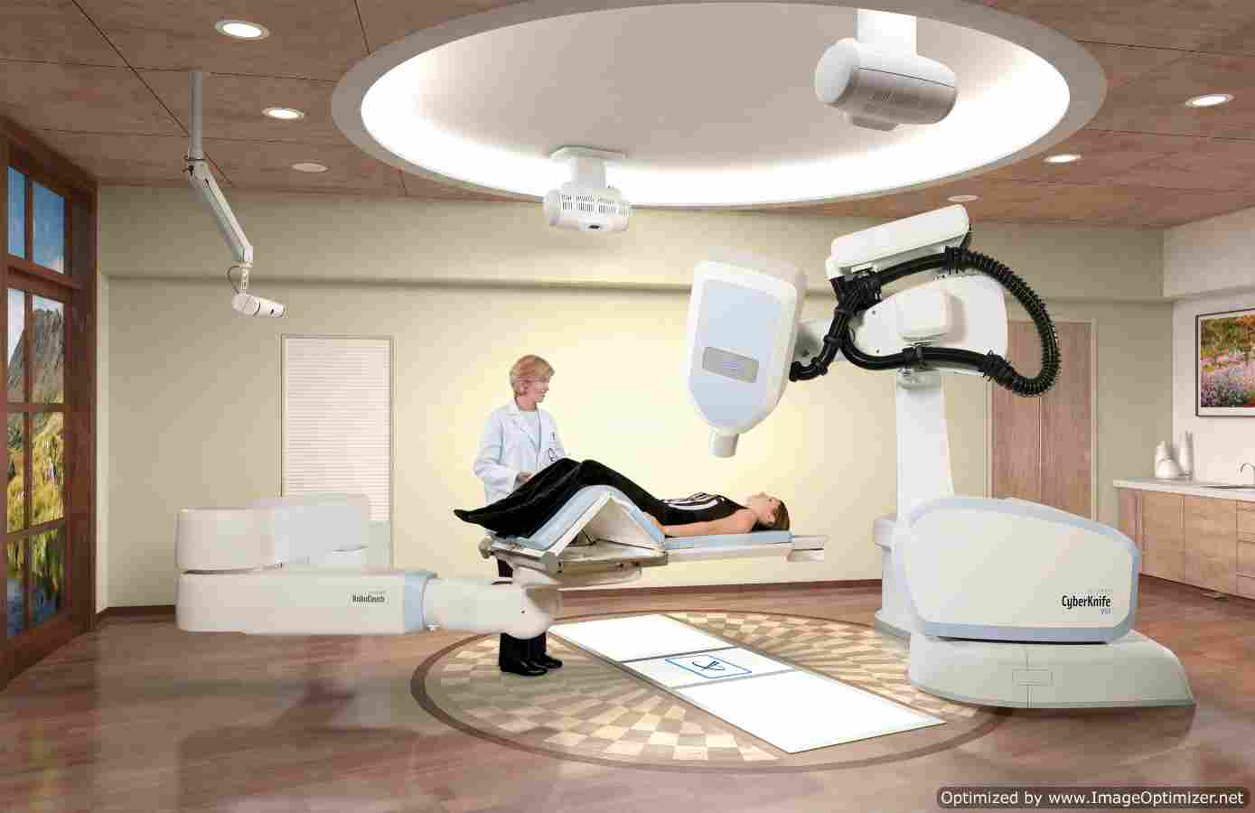

Slide 30
CyberKnife system
world’s first and only robotic radiosurgery system designed to treat tumors throughout the body non-invasively
Provides a pain-free, non-surgical option for patients who have inoperable or surgically complex tumors, or who may be looking for an alternative to surgery.

Slide 31
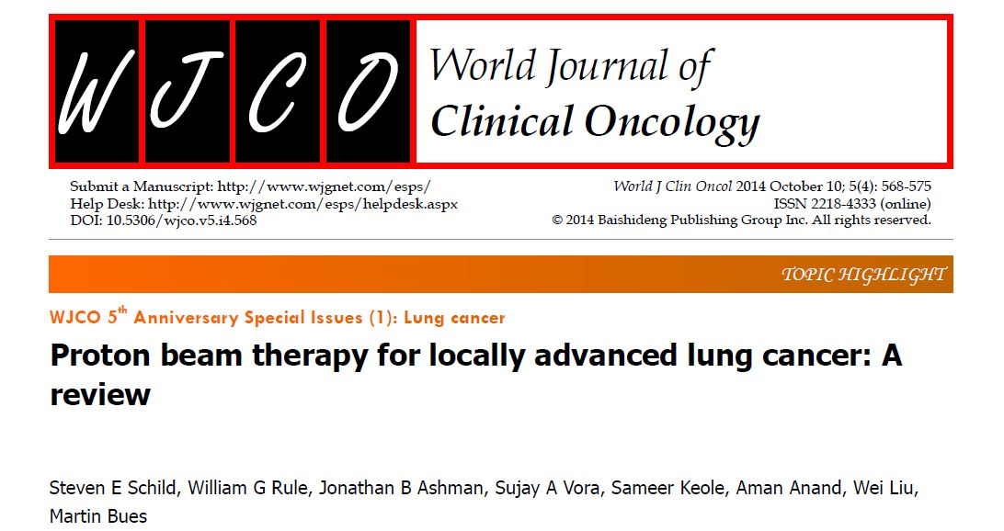

Slide 32
Immunotherapy and vaccines for Lung Tumours

Slide 33
NSCLC and therapeutic vaccines
Full protein vaccine (MAGE-A3 vs. placebo); Ph. II (N=182, stage II*)
Full protein vaccine (chemo. + TG4010 vaccine vs. chemo); Ph II (N=148; stage IIIB/IV)
Peptide (L-BLP25 vaccine vs placebo; Ph III; N=1514, stage III)
Ganglioside vaccine (Racotumomab + BSC vs BSC; Ph III,; N=1082; stage IIIB/IV*)
Whole tumor cell vaccine (Belagen-pumatucel+BSC vs BSC; Ph III; N=532)
Trials did not meet primary endpoints, but significant benefits seen in sub-groups.
12. Cuppens K, Vansteenkiste J. Vaccination therapy for non-small-cell lung cancer. Current opinion in oncology. 2014;26(2):165-70.

Slide 34
Immune regulators & suppressive mechanisms
Potential biomarkers/drug targets
P-serine externalization
KIR 2DL1 promotion
B7-3 overexpression
TAA deletion/
nitrosylation
MHC-1 loss
N-glycolil-GM3 expression
GITR
PD1- overexpression
IDO-upregulation
LAG-3
TIM-3
OX40
IDO, indoleamine 2,3 dioxygenase; GITR, Glucocorticoid-induced tumor necrosis factor receptor; KIR, killer immunoglobulin receptor ; OX40 (CD134), Tumor necrosis factor receptor superfamily, member 4, P-serine, phosphatidylserine; TAA, tumor-associated antigen
13. Creelan BC. Update on immune checkpoint inhibitors in lung cancer. Cancer control 2014;21(1):80-9.

Slide 37
Interventional Bronchoscopic procedures in lung cancer

Slide 38
Interventional Bronchoscopic procedures in lung cancer (Palliative)
Mechanical removal of obstruction
Endobronchial laser therapy
Electrocautery
Argon plasma coagulation (APC)
Cryotherapy
Photodynamic therapy
Endobronchial irradiation (brachytherapy)
Endobronchial stenting

Slide 39
Endobronchial laser therapy
‘Gold standard’ for palliative treatment of endoluminal airway obstruction
Most widely used and most versatile laser for endobronchial treatment is the Nd:YAG (neodymium-yttrium aluminum garnet) laser, using an infrared wavelength of 1064 nm.
The thermal energy of the laser light is used.
Laser therapy most often is performed through a rigid bronchoscope.

Slide 40
Endobronchial laser therapy
Uses:
coagulate and devascularize endoluminal tumors, immediately prior to mechanical resection
Complications:
hemorrhage (1–10%)
airway wall perforation and pneumothorax (3%)
transient desaturation and burns

Slide 41
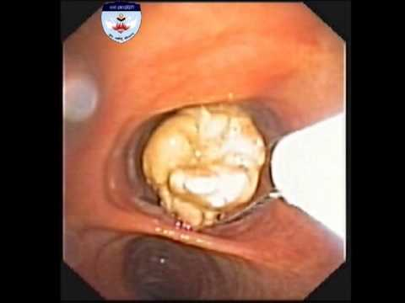
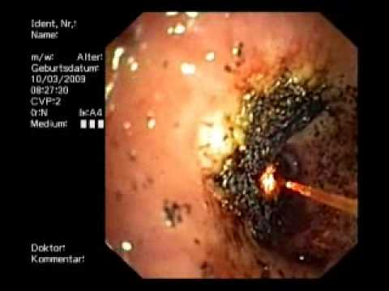

Slide 42
Electrocautery
Similar to Nd:YAG-laser therapy
Principle: local application of heat, using electrical current via a dedicated probe, to coagulate or vaporize tissue.
Electric current is generated with a standard high-frequency electric generator, which is available in any operating theatre.

Slide 43
Electrocautery
unipolar probes (including blunt probes, wire snares,forceps, ...) can be used via flexible and rigid bronchoscopes.
Indications: Same
Advantages v/s Laser
very low cost.
equal levels of efficiency,
superior levels of safety

Slide 44
Argon plasma coagulation (APC)
Non-contact mode of electrocoagulation: argon gas is ejected around a high-frequency electrode.
Principle:
The ionized gas serves as a conductor between the electrode and the nearest tissue.
A spark through the plasma jet desiccates and coagulates the tissue.

Slide 45
Argon plasma coagulation (APC)
Nearest area of contact is not necessarily geometrically straight forward from the direction of the electrode, because the high frequency current follows the lowest electrical impedance.

Slide 46
Argon plasma coagulation (APC)
Advantages:
superficial action makes APC a safe technique
superficially bleeding lesions are therefore the ideal indication for APC.
Disadvantage:
Less efficient than Nd:YAGlaser or electrocautery in the treatment of bulky lesions.

Slide 47
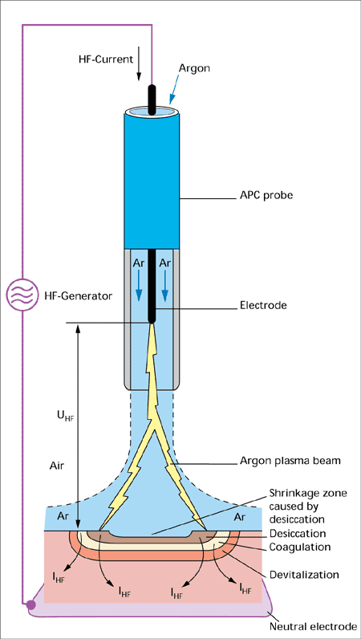
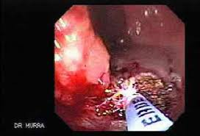

Slide 48
Cryotherapy
Cryotherapy is the application of extreme cold for local destruction of living tissue.
Principle:
Two mechanisms of injury are associated with cryotherapy.
1) Rapid freezing produces intracellular ice crystals which are lethal to the cell.

Slide 49
Cryotherapy
As tissue thaws, a second mechanism of injury becomes operative: the circulation of the previously frozen area is restored, but progressive failure of the microcirculation due to endothelial cell damage and thrombosis occurs.
Failure of circulation, a larger volume of tissue death will occur.

Slide 50
Cryotherapy
No immediate removal of obstructions can be carried out: only hours to days after application can debris be removed.
Should not be used to treat severe, life-threatening airway obstruction.
Cryosenstive/Cryoresistant

Slide 51
Cryotherapy
Indications:
Non-critical malignant airway obstruction
Hemoptysis
Treatment of superficial early lung cancer
Removal of (water-containing) foreign bodies.
Advatages:
Complication rate and costs are low.
Comparable results

Slide 52
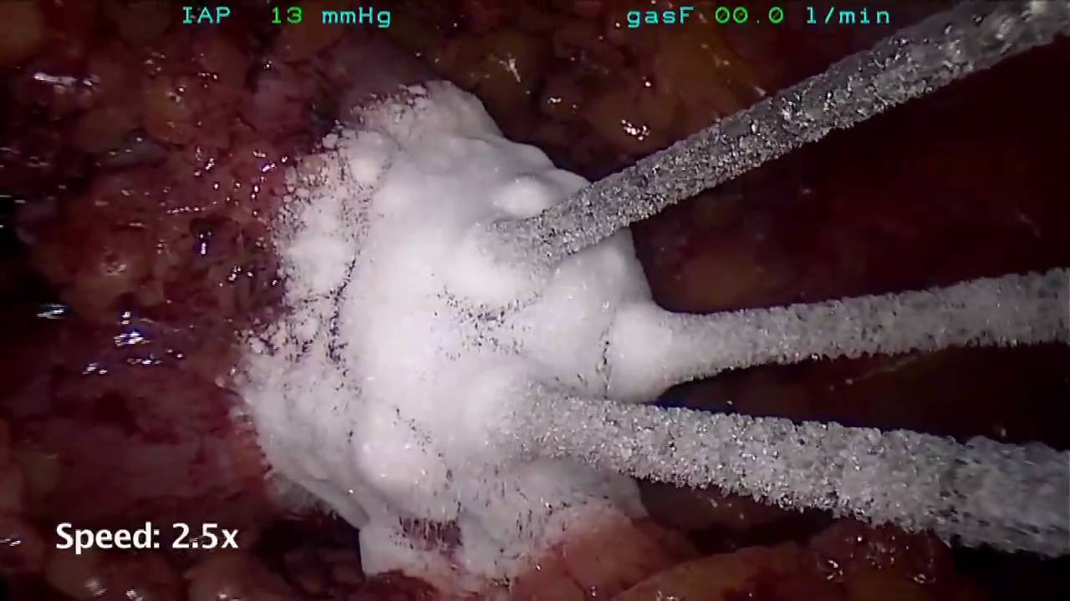
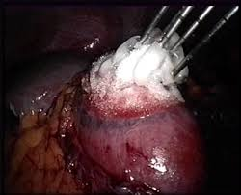

Slide 53
Photodynamic therapy
Principle:
Intravenous injection of a tumor-specific photosensitizing agent (e.g. porfimer sodium, photofrin)
Followed by activation of the agent by exposure to laser light of a specific wavelength (630 mm) administered by means of flexible bronchoscopy.

Slide 54
Photodynamic therapy
After photosensitizer activation, a photochemical reaction with production of reactive oxygen singlets destroys tumor cells.
Approx 48 h later, a ‘clean-up’ bronchoscopy is required to remove debris.
Use: Superficially located lung tumour.

Slide 55
Endobronchial irradiation (Brachytherapy)
Achieved by placing a highly radioactive source (iridium 192 probe, hence ‘high dose rate’ or ‘HDR’) through a hollow catheter (hence, ‘afterloading’).
Positioned by means of a flexible bronchoscope at the desired location.
HDR treatment is usually delivered with one to six fractions at an interval of 1–3 weeks
A dose of 2–30 Gy per fraction at1 cm from the source axis.

Slide 56
Endobronchial irradiation (Brachytherapy)
Uses:
curative treatment of early superficial lung cancer.
Treatment of primary non-resectable bronchial carcinoma with curative intent.
Palliative treatment involving the removal of obstruction for primary or recurrent endoluminal lung cancer.

Slide 57
Endobronchial irradiation (Brachytherapy)
Advantages:
OP basis procedure combined with other treatment modalities
well tolerated.
Disadvantages:
High procedural and infrastructural costs.
Severe radiation fibrosis or (fatal) hemorrhage.

Slide 58
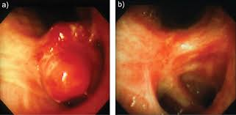
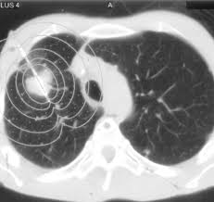
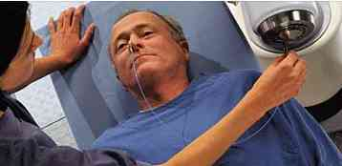

Slide 59
Endobronchial stenting
Uses:
Palliative
maintaining patency of airways
sealing of fistulas
control of hemoptysis.

Slide 60
Endobronchial stenting
Numerous types of stents are available
classified according to:
Material (polymer stents, metallic stents, hybrid stents and covered metallic stents).
Insertion technique (rigid bronchoscopy, flexible bronchoscopy, fluoroscopical).
Type (self-expandable, fixed diameter)
Anatomical position (bifurcation, stump, trachea, bronchus).

Slide 61
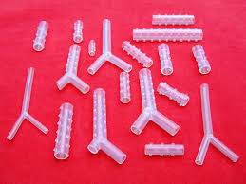
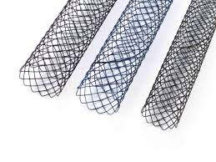

Slide 62
Endobronchial stenting
Complications
Bacterial colonization
Migration
Granuloma formation
Tumor overgrowth,
stent rupture
(rarely) wall perforation.

