Slide 1
HIV and TB in Pregnancy
Helen V. Madamba, MD MPH-TM FPOGS FPIDSOG
September 4, 2015
Cagayan De Oro City, Philippines

Slide 2
UN Millenium Development Goals

Slide 3
UN Millenium Development Goals

Slide 4
Unprotected penetrative sex and IV drug use are main modes of HIV transmission
MSM
M-F Sex
IVDU
March 2015 DOH NEC AIDS registry

Slide 5
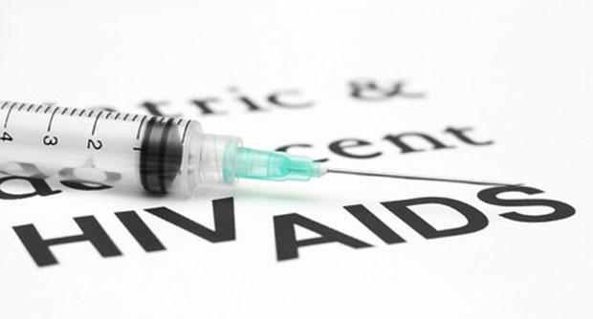
July 2014 Philippine HIV and AIDS Registry
585 new HIV cases posted in July
36 of the new HIV cases progressed into full-blown AIDS
Seventeen deaths due to AIDS were accounted, and all were male.
http://newsinfo.inquirer.net/633519/585-new-hiv-cases-posted-in-july-17-deaths-recorded-doh

Slide 6
Region 10 is #8 in terms of regional distribution of reported HIV cases

Slide 7
Philippine HIV testing centers on googlemaps
https://www.google.com.ph/maps/search/hiv+testing+center+philippines/@11.6978351,122.6217542,6z/data=!3m1!4b1

Slide 8
There are many other notable advocates working to stop the HIV epidemic to achieve the goal of GETTING TO ZERO:
zero new infections,
zero AIDS-related deaths
zero discrimination.

Slide 10
Notes:
Hi my name is Andrew Pulsipher. I am HIV+ and have been since birth.
Here are the facts about me:
1. I am married to an amazing woman and we will be celebrating our 10 year anniversary this October.
2. I have 3 beautiful children. They are ages 5, 3, and 1 year old.
3. I have been HIV positive for almost 34 years. I can’t say with complete confidence that I am the oldest person living with the disease, but I am pretty sure I am at least one of the oldest living people prenatally infected or born with HIV.
4. Kids who are born with HIV and not treated usually die around age 3 -7. I started taking medication when I was eight.
5. I am currently “undetectable”. No it doesn’t mean I am a ninja. This phrase relates to the amount of virus detectable in my blood, although it still can be hidden in other parts of my body. It also means that the medicine I take every day is working!!!
6. Both of my parents died from AIDS. My dad died when I was 4, my mom when I was 8.
7. None of my brothers and sisters are HIV positive, just my parents and I. The virus will end with me.
8. I grew up with my aunt, uncle and their four children, my “cousins.” I call them my mom, dad, brothers, and sisters because that’s what they are to me.
9. I grew up very rarely telling people I was HIV positive. Only few family members outside of our immediate family and a couple close friends knew. This was to allow as normal of a childhood as possible for me.
10. I am sharing this with you because for the first time I can be completely honest with myself and others. This has taken me a very long time to be comfortable with (almost 34 years!). I know HIV has a negative stigma, but that it doesn’t have to and I want to help change that. It is a treatable disease and you can live a normal life with it. I am proof of that. I want to educate people so that we can get past the “HOW you got the disease” to “HOW you are living your life with it”? There are many miracles in the world and I believe my life is one of them. I am not the only one and we all have stories to tell. If you feel drawn to share my story, please do. I would love to be part of the change in how we talk about HIV. — with Victoria Pulsipher.

Slide 11
Philippine Obstetrical and Gynecological Society (Foundation) Inc Clinical Practice Recommendation on Prevention of Mother to Child Transmission of HIV Infection
HIV Screening
Antiretroviral Drugs
Management of Delivery
Infant Feeding
Contraception
POGS Clinical Practice Recommendations on PMTCT

Slide 12
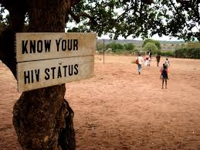
HIV Screening
Antenatal infections package
HIV screening
Hepatitis B virus
Syphilis
Rubella
Urinary tract infection
Papsmear for HPV
POGS Clinical Practice Recommendations on PMTCT

Slide 13
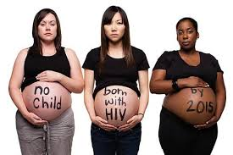
HIV Screening Preliminary Counselling Dialogue
Part of thorough assessment of her status in relation to her pregnancy
Routine interview + standard counselling about HIV
Strictly confidential
Opt out - and still receive
the same standard care
POGS Clinical Practice Recommendations on PMTCT

Slide 14
HIV Screening Post-test counselling
If the test is negative
Recommend repeat test 6 months later to account for window period
Counsel patient and her partner to maintain healthy lifestyle, including low risk sexual relationship
POGS Clinical Practice Recommendations on PMTCT

Slide 15
HIV Screening Post-test counselling
If the test is positive:
HIV viral load, CD4 cell count etc
Antiretroviral drug therapy
Planned cesarean section scheduled around 38-39 weeks to avoid labor and vaginal delivery
POGS Clinical Practice Recommendations on PMTCT

Slide 16
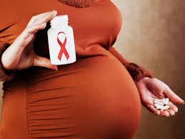
HIV Screening Post-test counselling
If the test is positive:
Infant formula feeding instead of breast milk feeding
Antiretroviral drug therapy for and serial HIV testing of infant
Contraception, healthy lifestyle, safe sex counselling.
POGS Clinical Practice Recommendations on PMTCT

Slide 17
HIV Screening Post-test counselling
If the test is positive:
Importance of long-term follow up care
Need to refer to other specialists (e.g. adult and/or pediatric infectious disease)
POGS Clinical Practice Recommendations on PMTCT

Slide 18
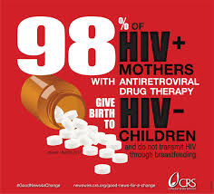
Anti-retroviral (ARV) Drugs
Anti-retroviral (ARV) treatment and prophylaxis to prevent maternal-to-child transmission (MTCT) of HIV
Determine stage of HIV using WHO CLINICAL STAGING OF HIV IN WOMEN.
Determine CD4 cell count
POGS Clinical Practice Recommendations on PMTCT

Slide 19
Anti-retroviral (ARV) Drugs
Determine whether patient requires ARV treatment or just prophylaxis using the eligibility criteria based on WHO clinical stage and CD4 cell count.
POGS Clinical Practice Recommendations on PMTCT

Slide 20
Eligibility Criteria for initiating ART or ARV prophylaxis in HIV-infected pregnant women based n CD4 count and WHO clinical stage
WHO CLINICAL STAGE | CD4 CELL COUNT NOT AVAILABLE | CD4 COUNT AVAILABLE
 |  | CD4 ≤ 350 | CD4 > 350
1 | ARV Prophylaxis | ART | ARV prophylaxis
2 | ARV Prophylaxis | ART | ARV prophylaxis
3 | ART | ART | ART
4 | ART | ART | ART
POGS Clinical Practice Recommendations on PMTCT

Slide 21
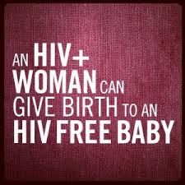
Anti-retroviral (ARV) Drugs
Assure initiation and/or maintenance of antiretroviral therapy (ART) or ARV
The choice of ARV to be given to a pregnant patient and her newborn depends on different clinical scenarios.
POGS Clinical Practice Recommendations on PMTCT

Slide 22
Anti-retroviral (ARV) Drugs Different Clinical Scenarios
Woman already receiving ARV treatment for her own health – continue.
ARV-naïve HIV-infected pregnant woman
With indication for own health, start ARV regardless of AOG
ARV prophylaxis started at 14 weeks AOG
POGS Clinical Practice Recommendations on PMTCT

Slide 23
Anti-retroviral (ARV) Drugs Eligibility for ARV Prophylaxis
Option A: maternal AZT + infant ARV prophylaxis
Option B: maternal triple ARV prophylaxis until delivery or if breastfeeding, until 1 week after all exposure to breast milk ended
Option B+: start triple ARVs as soon as diagnosed and continued for life
POGS Clinical Practice Recommendations on PMTCT

Slide 24
Anti-retroviral (ARV) Drugs Advantages of Option B+
Simplify PMTCT program requirements – no need for CD4 testing to determine ARV eligibility
Extended protection from mother-to-child transmission
Strong and continuing prevention benefit against sexual transmission in sero-discordant couples and partners
POGS Clinical Practice Recommendations on PMTCT

Slide 25
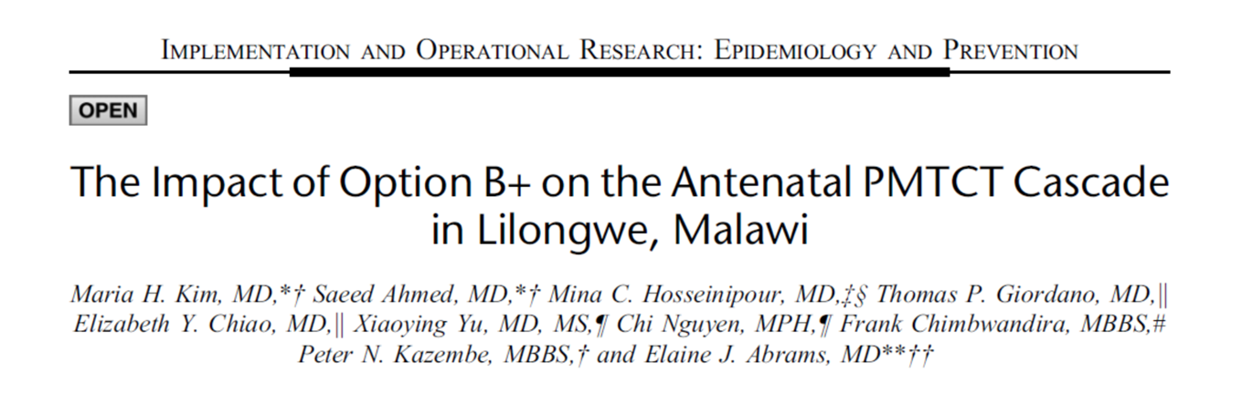
Option B+’s simplified approach = improvements in antenatal PMTCT cascade:
greater proportion ofHIV-infected pregnant women enrolled into PMTCT services
increased use of ART during pregnancy
more rapid initiation of ART
Kim, M. H., Ahmed, S., Hosseinipour, M. C., Giordano, T. P., Chiao, E. Y., Yu, X., … Abrams, E. J. (2015). The Impact of Option B + on the Antenatal PMTCT Cascade in Lilongwe , Malawi, 68(5), 77–83.

Slide 26
Anti-retroviral (ARV) Drugs Advantages of Option B+
Earlier treatment for woman’s health and avoiding risks of stopping and starting triple ARVs especially in settings of high fertility
Simple message to communities “once ARV started, it is taken for life.”
POGS Clinical Practice Recommendations on PMTCT

Slide 27
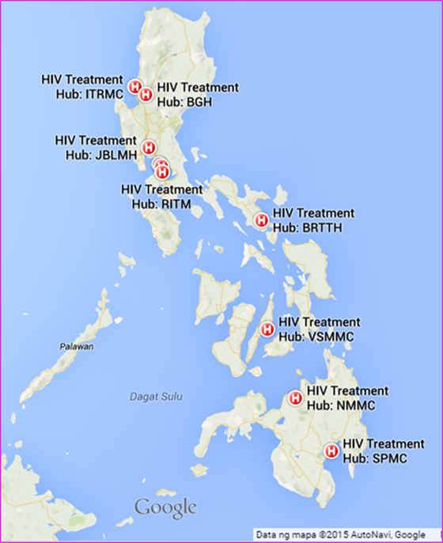
Anti-retroviral (ARV) Drugs
Explain to the mother that ARVs can be procured from the following treatment hubs all over the archipelago
POGS Clinical Practice Recommendations on PMTCT

Slide 28
Anti-retroviral (ARV) Drugs HIV Treatment Hubs in Philippines
NMMC HIV Treatment Hub
SPMC HIV Treatment Hub

Slide 29
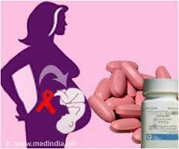
Management of Delivery
risks of transmission during delivery
cesarean section vs vaginal delivery
antiretroviral drugs through labor and delivery
immediate postpartum
care
POGS Clinical Practice Recommendations on PMTCT

Slide 30
Management of Delivery Essential Intrapartum Newborn Care (EINC)
Thoroughly dry newborn infant
vigorous suctioning
Skin to skin bonding should be encouraged
Delayed clamping of umbilical cord is NOT recommended.
Latching on is done ONLY IF breastfeeding has been chosen.
POGS Clinical Practice Recommendations on PMTCT

Slide 31
Infant Feeding
avoid breastfeeding, danger of mixed feeding
continuing ARV medications
replacement feeding: acceptable, feasible, affordable, sustainable and safe (AFASS)
risks, follow up and other options for replacement feeding
relieve breast engorgement
POGS Clinical Practice Recommendations on PMTCT

Slide 32
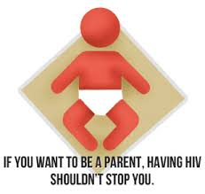
Contraception
SAFER SEX is any sexual practice that reduces the chance of transmitting HIV and any other sexually transmitted (STIs) from one person to another
STI PREVENTION
A – abstinence
B – be faithful
C – correct consistent condom use
D – diagnose and drugs
E – educate
POGS Clinical Practice Recommendations on PMTCT

Slide 33
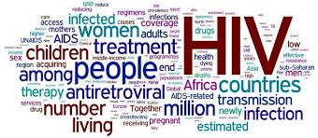
Contraception
Best protection obtained by:
Correct and consistent use of condoms during every sexual act
Choosing sexual activities that do not allow semen, fluid from the vagina, or blood to enter the mouth, vagina or anus of the partner
Reducing the number of partners
POGS Clinical Practice Recommendations on PMTCT

Slide 34
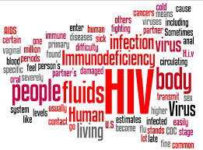
Contraception
Condoms
Lactational Amenorrhea
Spermicides
Intrauterine device
Fertility awareness methods
Hormonal contraception
Female sterilization
POGS Clinical Practice Recommendations on PMTCT

Slide 35
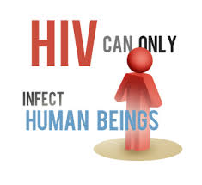
Prevention of HIV Infection of Health Care Workers
Standard precautions
Post-exposure prophylaxis
Hospital infection control
POGS Clinical Practice Recommendations on PMTCT

Slide 36
Prevention of Mother to Child Transmission of HIV
“Offer HIV counselling and testing for all pregnant patients because pregnancy is an evidence of unprotected penetrative sex, which is the most common mode of transmission for HIV.”
POGS Clinical Practice Recommendations on PMTCT

Slide 37
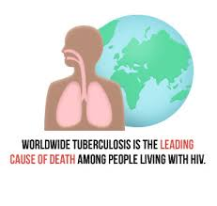
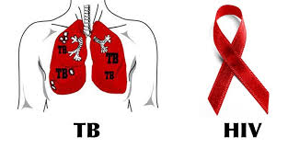
HIV and TB: DOUBLE TROUBLE

Slide 38
Management of TB/HIV Co-infection
Possible options include the following:
Defer ART until completion of TB treatment.
Defer ART until the completion of the intensive phase of TB treatment and then use Ethambutol and Isoniazid in the continuation phase.
Treat TB with a Rifampicin-containing regimen and use efavirenz + two Nucleoside Reverse Transcriptase Inhibitors (NsRTIs).
2013 Manual of Procedures for the National TB Control Program. (2013)

Slide 39
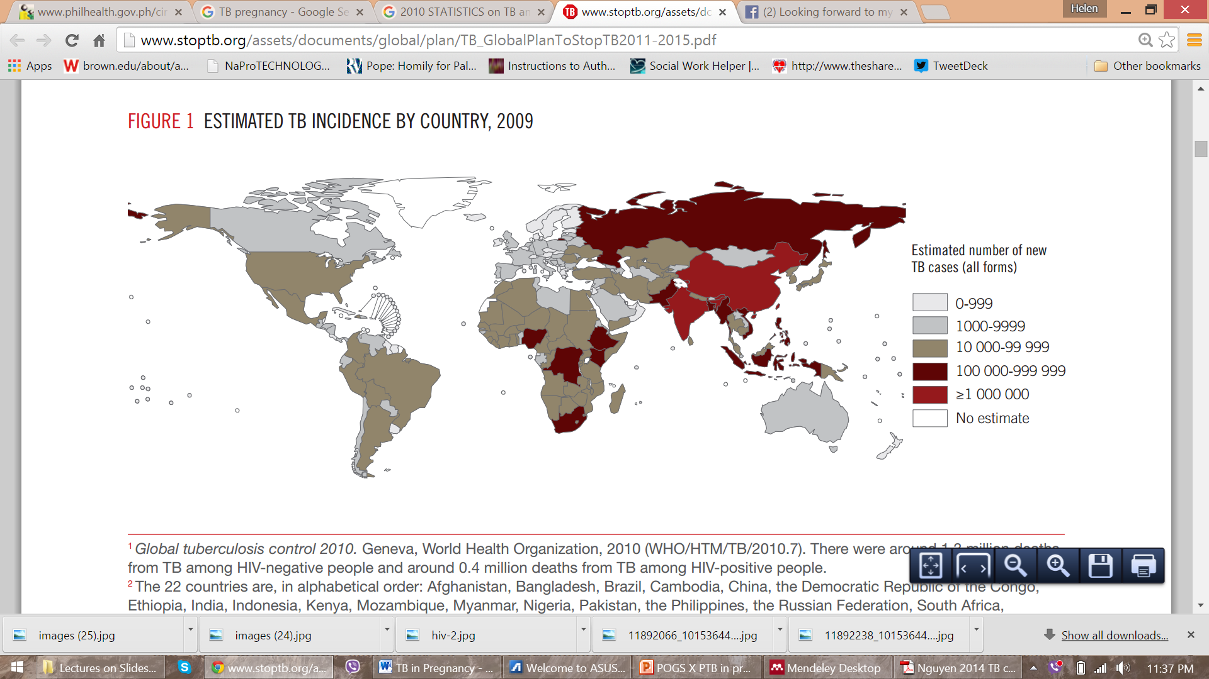
Global TB Control 2010. Geneva, WHO.
1.3 million deaths from TB among HIV-negative people
0.4 million deaths from TB among HIV-positive people
http://www.stoptb.org/assets/documents/global/plan/TB_GlobalPlanToStopTB2011-2015.pdf

Slide 40
Global Burden of Disease
216 500 (95% uncertainty range 192 100–247 000) active tuberculosis cases existed in pregnant women globally in 2011.
The greatest burdens in pregnant women were in the
WHO African region - 89 400 cases
WHO SEAsian region - 67 500 cases
Sugarman, J., Colvin, C., Moran, A. C., & Oxlade, O. (2014). Tuberculosis in pregnancy: an estimate of the global burden of disease. The Lancet Global Health, 2(12), e710–e716. doi:10.1016/S2214-109X(14)70330-4

Slide 41
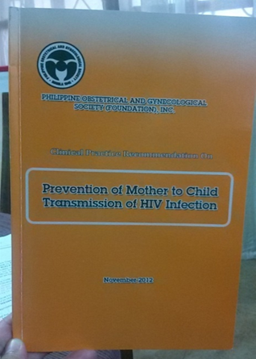
???
POGS
Prevention of Mother to Child Transmission of TB

Slide 42
Prevalence of TB in pregnancy
Effects on Immunity
TB as a cause of maternal deaths
Effects of maternal TB infection and treatment on the neonate
M. Bates et al. Perspectives on tuberculosis in pregnancy. International Journal of Infectious Diseases 32 (2015) 124–127.
Notes:
PREV

Slide 43
1922 – Observations of Dr David Stewart, a medical superintendent of a women’s TB sanatorium:
both pregnancy and TB can have adverse effects on each other and linked with poor outcomes
outcomes are variable, extremely difficult to predict early in pregnancy, and management decisions case-by-case basis
special provision made for pregnant women with TB
M. Bates et al. Perspectives on tuberculosis in pregnancy. International Journal of Infectious Diseases 32 (2015) 124–127.

Slide 44
Challenges for TB in pregnancy
the well established epidemiological links between TB and HIV
less clarity and unified mass action with respect to TB diagnosis and treatment during pregnancy
treating TB in HIV-infected pregnant women poses huge challenges because of overlapping toxicities, side effects, pill burden, changes in tolerability, and the pharmacokinetics of drugs
M. Bates et al. Perspectives on tuberculosis in pregnancy. International Journal of Infectious Diseases 32 (2015) 124–127.

Slide 45
Prevalence of TB in pregnancy
WHO Tuberculosis Report 2014:
in 2013 there were an estimated 3.3 million cases among women;
510 000 deaths;
a third of these women were co-infected with HIV
*no mention of “pregnancy”
M. Bates et al. Perspectives on tuberculosis in pregnancy. International Journal of Infectious Diseases 32 (2015) 124–127.
Notes:
PREV

Slide 46
Prevalence of TB in pregnancy
In high-burden countries:
rates of between 0.07% and 0.5% were found among HIV-negative women,
between 0.7% and 11% among HIV-positive women
M. Bates et al. Perspectives on tuberculosis in pregnancy. International Journal of Infectious Diseases 32 (2015) 124–127.
Notes:
PREV

Slide 47
Effects on Immunity
women are at increased risk of TB during pregnancy
immunological changes associated with pregnancy present an opportunity for mycobacterial infection or re-activation
pregnant women who are HIV-positive and have LTBI are more likely to progress to active TB disease
M. Bates et al. Perspectives on tuberculosis in pregnancy. International Journal of Infectious Diseases 32 (2015) 124–127.
Notes:
PREV

Slide 48
TB as a cause of maternal deaths
Over 50% of pregnant women who die of TB during pregnancy and postpartum are HIV-positive.
Notes:
PREV

Slide 49
WHO recommendations for microbiological screening of TB in pregnancy for high HIV and TB-burden antenatal clinics:
National TB Programmes (NTPs) should make a concerted effort to capture pregnancy-associated TB and to follow-up on perinatal outcomes.
M. Bates et al. Perspectives on tuberculosis in pregnancy. International Journal of Infectious Diseases 32 (2015) 124–127.

Slide 50
TUBERCULOSIS ON PREGNANCY
Obstetric complications:
higher rate of spontaneous abortion
suboptimal weight gain in pregnancy
preterm labor
low birth weight
increased neonatal mortality
Loto, O. M., & Awowole, I. (2012). Tuberculosis in pregnancy: A review. Journal of Pregnancy, 2012.

Slide 51
To Treat or Not to Treat?
“Untreated tuberculosis represents a far greater hazard to a pregnant woman and her fetus than does treatment of the disease”
Centre for Disease Control, “Treatment of tuberculosis,” MMWR, vol. 52, no. RR-11, pp. 1–77, 2003

Slide 52
PREGNANCY ON TUBERCULOSIS
Natural History of TB
Amita, A., Ketan, M., & John, G. (2010). Review Diagnosis and management of tuberculosis in pregnancy Learning objectives : Ethical issues :, 163–171.

Slide 53
Pregnancy on Tuberculosis
111 pregnant women diagnosed with TB
Pregnancy had no effect on the course of TB as regards
sputum conversion
stabilization of the disease
relapse rate
Tripathy SN, Tripathy SN. Tuberculosis and pregnancy. Int J Gynaecol Obstet 2003;80:247–53.

Slide 54
CASE FINDING
Case finding is the identification and diagnosis of TB cases among individuals with signs and symptoms presumptive of tuberculosis.

Slide 55
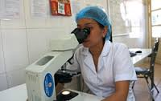
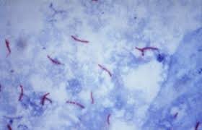
DIRECT SPUTUM SMEAR MICROSCOPY (DSSM)
It provides a definitive diagnosis of active TB
the procedure is simple
it is economical; and,
a microscopy center could be put up even in remote areas.

Slide 56
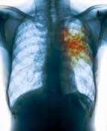
CHEST XRAY
Chest X-ray is used to complement bacteriologic testing in making a diagnosis. However, it has low specificity and does not differentiate drug-susceptible from drug-resistant disease
2013 Manual of Procedures for the National TB Control Program. (2013)

Slide 57
The aims of treatment:
achieve cure without relapse
prevent progression of the disease or occurrence of complications
stop transmission to other individuals, healthcare professionals or newborns
prevent emergence of drug resistance
Amita, A., Ketan, M., & John, G. (2010). Review Diagnosis and management of tuberculosis in pregnancy Learning objectives : Ethical issues :, 163–171.

Slide 58
DOTS
All treatment regimens should be administered under directly observed therapy (DOT) for the total duration of the treatment, within the context of a DOTS program

Slide 59
TB/HIV Co-Infection
HIV-infected pregnant women who are suspected of having TB disease should be treated without delay.
TB treatment regimens for HIV-infected pregnant women should include a rifamycin.

Slide 60
TB DOTS REGIMEN
2 months intensive phase – HRZE
Isoniazid (INH)
Rifampicin (RIF)
Pyrazinamide (PZA)
Ethambutol (EMB)
4 months maintenance phase – RH
Isoniazid (INH)
Rifampicin (RIF)

Slide 61
PZA in TB treatment among pregnant women
The benefits of a TB treatment regimen that includes PZA for HIV-infected pregnant women may outweigh the undetermined potential risks to the fetus.

Slide 62
Recommended Dosages for Daily Administration (mg/kg body weight)
Drugs | Daily (range) | Thrice weekly (range)
Isoniazid | 10
Rifampicin | 10 (8-12) | 10 (8-12)
Pyrazinamide | 25 (20-30) | 35 (30-40)
Ethambutol | 15 (15-20) | 30 (25-35)
2013 Manual of Procedures for the National TB Control Program. (2013)

Slide 63
2HRZE/4HR Fixed Dose Combinations
2013 Manual of Procedures for the National TB Control Program. (2013)

Slide 64
Contraindications
The following anti-tuberculosis drugs are contraindicated in pregnant women:
Streptomycin
Kanamycin
Amikacin
Capreomycin
Fluoroquinolones
http://www.cdc.gov/tb/publications/factsheets/specpop/pregnancy.pdf

Slide 65
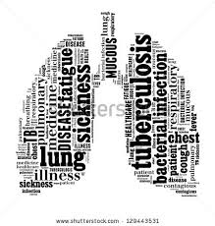
Considerations
Women who are being treated for drug-resistant TB should receive counseling concerning the risk to the fetus because of the known and unknown risks of second-line antituberculosis drugs.
http://www.cdc.gov/tb/publications/factsheets/specpop/pregnancy.pdf

Slide 66
Ascertain whether or not a woman is pregnant before she starts TB treatment.
http://thepafp.org/wp-content/downloads/cpg/ntp2013.pdf

Slide 67
PREGNANCY
Most anti-tuberculosis drugs are safe for pregnant women, except streptomycin, which is ototoxic to the fetus.
Pregnant women taking isoniazid should be given pyridoxine (Vitamin B6) at 25mg/day.
2013 Manual of Procedures for the National TB Control Program. (2013)

Slide 68
BREASTFEEDING
A breastfeeding woman afflicted with TB should receive a full course of TB treatment.
Timely and properly applied chemotherapy is the best way to prevent transmission of tubercle bacilli to the baby.
2013 Manual of Procedures for the National TB Control Program. (2013)

Slide 69
BREASTFEEDING
In lactating mothers on treatment, most anti-tuberculosis drugs will be found in the breast milk in concentrations equal to only a small fraction of the therapeutic dose used in infants.
2013 Manual of Procedures for the National TB Control Program. (2013)

Slide 70
BREASTFEEDING
It is recommended that lactating mothers feed their infants before taking medications.
Supplemental pyridoxine (i.e., vitamin B6) should be given to the infant who is taking INH or whose breastfeeding mother is taking INH.
2013 Manual of Procedures for the National TB Control Program. (2013)

Slide 71
Congenital TB
Few neonates born to mothers who have active TB disease will contract TB congenitally
Congenital TB may be subclinical or associated with a range of birth defects.
Bates, M., Ahmed, Y., Kapata, N., Maeurer, M., Mwaba, P., & Zumla, A. (2015). Perspectives on tuberculosis in pregnancy. International Journal of Infectious Diseases, 32, 124–127.

Slide 72
Perinatal TB
Adjusted perinatal mortality rate attributable to TB of 65.2/1000 among HIV-infected women
Maternal TB associated with increased morbidity, lower birth weight, and an increased risk of death
Bates, M., Ahmed, Y., Kapata, N., Maeurer, M., Mwaba, P., & Zumla, A. (2015). Perspectives on tuberculosis in pregnancy. International Journal of Infectious Diseases, 32, 124–127.

Slide 73
@helenvmadamba www.helenvmadamba.blogspot.com #HealthXPH tweetchat every Saturday 9PM

Slide 74
HIV and TB in Pregnancy
THANK YOU!
Helen V. Madamba, MD MPH-TM FPOGS FPIDSOG
September 4, 2015
Cagayan De Oro City, Philippines

