Slide 1
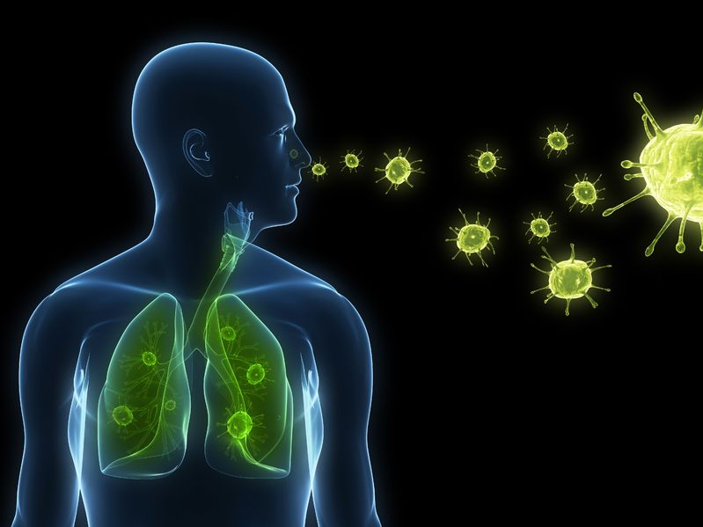
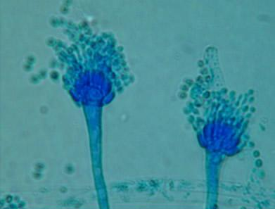
Allergic Broncho Pulmonary Aspergillosis (ABPA)
Dr.Tinku Joseph
Resident
Dept. Of Pulmonary Medicine
AIMS, Kochi.

Slide 2
Pulmonary Aspergillosis

Slide 3
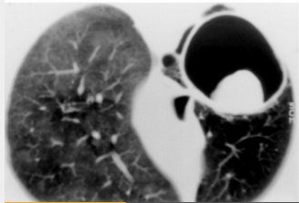
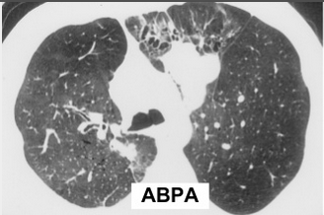
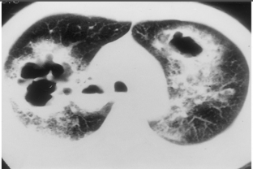
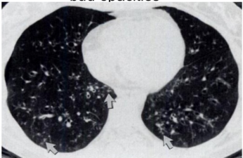
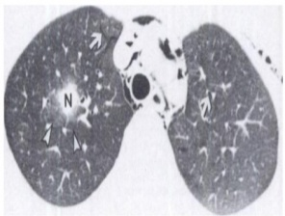
Pulmonary Aspergillosis

Slide 4
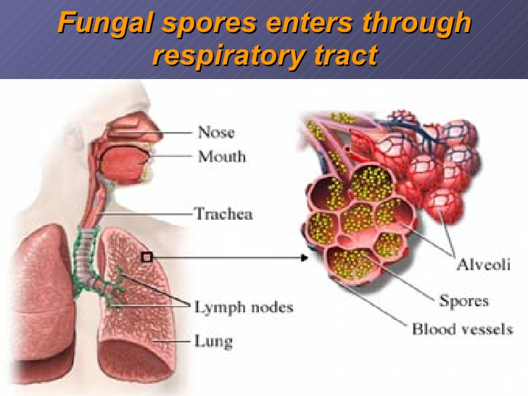
Allergic Broncho Pulmonary Aspergillosis (ABPA)

Slide 5
Contents
Definition
Historical perspective
Epidemiology
Pathogenesis
Clinical Features
Diagnosis
Treatment

Slide 6
What is ABPA?
An idiopathic inflammatory lung disease
Complex hypersensitivity reaction in response to colonization of the airways with Aspergillus (fumigatus) or other fungi in the lung.

Slide 7
Historical perspective
Asthma and “aspergillosis” were first associated by Renon in 1897
1st report of ABPA was published in 1952 by Hinson and colleagues described 3 pts with
-Recurrent episodes of “wheezy bronchitis”
-Serum eosinophilia
-Sputum production
-Fever
-Infiltrates on chest x-ray films.
JO A. DOUGLASS et al .Middleton’s allergy ; 8th edition 2013:1000-13

Slide 8
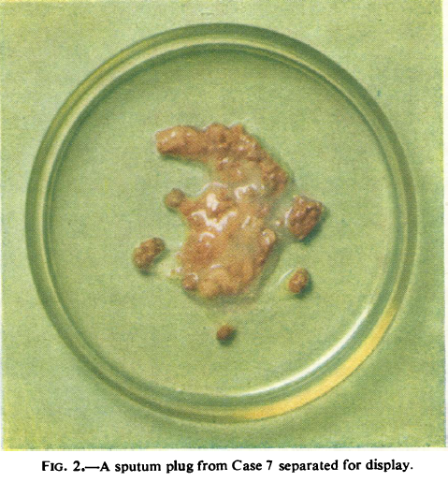
Historical perspective
Hinson KFW, Moon A Broncho­pulmonary aspergillosis. Thorax 1952;7:317-33

Slide 9
Epidemiology of ABPA
First described by Hinson et al in 1952 in the UK (1)
Prevalence (2) :
-1 to 2% in patients with asthma and
-2 to 9% in patients with Cystic Fibrosis.
Last 2 decades , increased in the number of cases of ABPA due to :
-Heightened physician awareness and
-widespread availability of serologic assays.
(1)-Hinson KFW, Moon AJ, Plummer NS. Broncho-pulmonary aspergillosis; a review and a report of eight new cases.
Thorax 1952; 7:317-333
(2)-Greenberger PA. Clinical aspects of allergic bronchopulmonary aspergillosis. Front Biosci 2003; 8S119-S127.

Slide 10
Epidemiology of ABPA
Most cases occur between 3rd to 5th decade.
May also present during childhood.
In some patients , starts early in life and continued , unrecognized , until adulthood.
Familial cases have been reported.

Slide 11
Epidemiology of ABPA
In a specialist unit ABPA was found after detailed investigation in 8.3% of a population of outpatients with severe asthma.
50% of patients given a diagnosis of pulmonary eosinophilia have ABPA.(3)
(3)-Champman BJ, Capewell S, Gibson R, Greening AP, Crampton GK. Pulmonary esinophilia
with and without allergic bronchopulmonary aspergillosis. Thorax 1989; 44:919.

Slide 12
Pathogenesis of ABPA
Exposure to large concentrations of spores of A. Fumigatus may cause ABPA (4)
Spores colonize the airway , proliferate , and result in chronic antigenic stimulation of the airway , and tissue injury.
(4)-Hinson KFW, Moon AJ, Plummer NS. Broncho-pulmonary aspergillosis; a review and
a report of eight new cases. Thorax 1952; 7:317-333

Slide 13
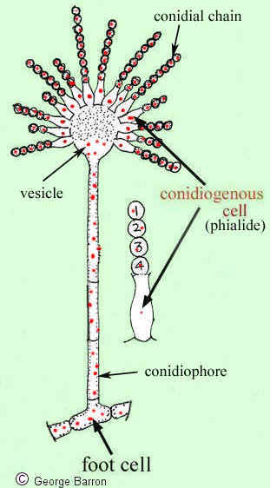
Pathogenesis
Fungal spors(conidia) 2.5-3.5mm
are inhaled into the lower airway & alveoli
Aspergillus grows through the product of hyphae from sprout
conidiophores
Aspergillus secrete proteolytic enz.
Adherence of conidia to resp. epith. cells
JO A. DOUGLASS et al .Middleton’s allergy ; 8th edition 2013:1000-13

Slide 14
Pathogenesis And Etiology
Adherence of conidia to respiratory epithelial cells
Cellular dysfunction
Initially cilial disruption
The fungal colony grows,
Hyphae are produced invade between & through epithelial cells
Leading to substantial tissue disruption
JO A. DOUGLASS et al .Middleton’s allergy ; 8th edition 2013:1000-13

Slide 15
Pathogenesis And Etiology
Inhalation of fungal spores is ubiquitous
Aspergillus colonization and infection only occur in some patients
Predisposing factors must enable Aspergillus proliferation up to a high antigen burden.
Pre-existing lung diseases : bronchiectasis, ciliary dysfunction
JO A. DOUGLASS et al .Middleton’s allergy ; 8th edition 2013:1000-13

Slide 16
Genetic associations with ABPA
Miller and coworkers
Demonstrated a higher prevalence of cystic fibrosis transmembrane conductance regulator (CFTR) mutations in ABPA patients than healthy controls.
In transgenic mice models the HLA-DR2 genotype, particularly DRB1 1503, appears to convey enhanced susceptibility to the pulmonary eosinophilic inflammation associated with ABPA
JO A. DOUGLASS et al .Middleton’s allergy ; 8th edition 2013:1000-13

Slide 17
Genetic associations with ABPA
Other specific associations with ABPA have been found in
-IL-4 receptor polymorphisms
-IL-13 polymorphisms
-tumor necrosis factor-α polymorphisms
-IL-10 polymorphisms
JO A. DOUGLASS et al .Middleton’s allergy ; 8th edition 2013:1000-13

Slide 18
Pathogenesis
The pathogenesis of ABPA remains incompletely understood.
In healthy individuals-: Normally low level of IgG against fungal antigens in the circulation and the low antifungal secretory IgA in bronchoalveolar fluid. (Less chance for ABPA). Effectively eliminate fungal spores
Th2 CD4+ cell responses to Aspergillus antigens.
Aspergillus-responsive T cells generate cytokines interleukin (IL)-4, IL-5, and IL-13 -: accounts for the increases in blood and airway eosinophils and IgE in ABPA.

Slide 19
Pathogenesis of ABPA
The condition has immunologic features of:
Immediate hypersensitivity [type I] ( the elevated serum levels of total and Aspergillus-specific IgE ).
Antigen-Antibody complex [type III] ( presence of Aspergillus precipitin and circulating immune complexes during disease exacerbations) .
Cell mediated immunity [type IV] dual ( immediate and delayed) cutaneous reactions.

Slide 20
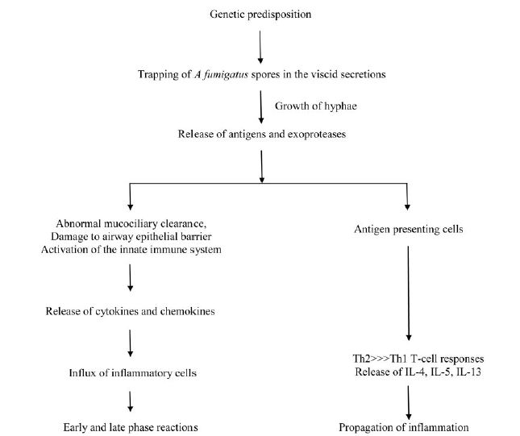
CHEST ABPA 2009

Slide 21
Pathology of ABPA
Pathology varies from: patient to patient and in different areas of the lung in the same patient.
Mucoid impaction of the bronchi, eosinophilic pneumonia, and bronchocentric granulomatosis in addition to the histologic features of asthma.

Slide 22
Pathology of ABPA
Histological examination:
Reveals the presence of :
Mucus fibrin, Curschmann spirals, Charcot-Leyden crystals, and inflammatory cells.
Scanty hyphae can often be demonstrated in the bronchiectatic cavities.
The bronchial wall in ABPA is usually infiltrated by inflammatory cells, primarily the eosinophils.

Slide 23
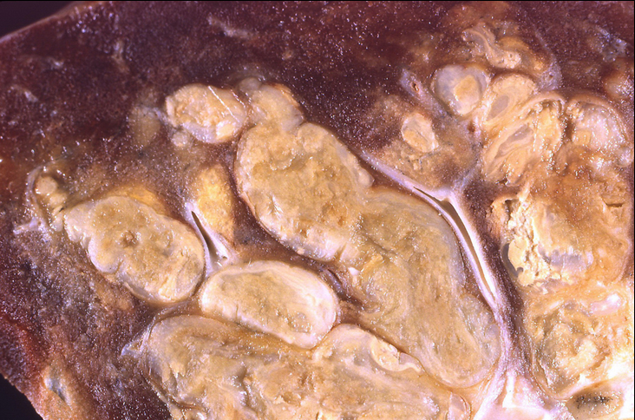
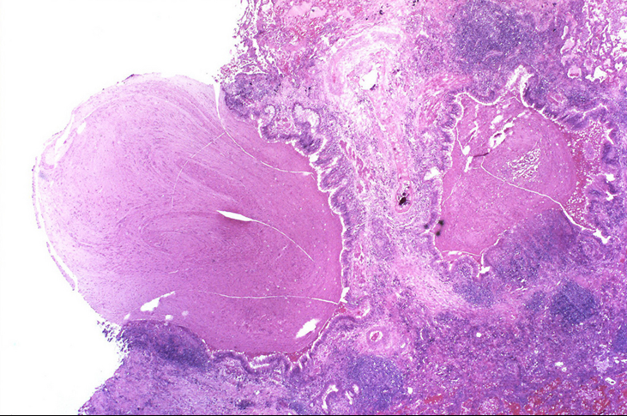
The bronchi of this resected lobe are markedly distended with mucous. This is a manifestation of allergic bronchopulmonary aspergillosis

Slide 24
Clinical Features
No gender predilection
Family history of ABPA
ABPA occurs predominantly in patients with pre-existing asthma/cystic fibrosis.
Features:
-low-grade fever
-wheezing
-breathlessness,
-hemoptysis , or productive cough of bronchial casts.
-expectoration of brownish black mucus plugs- 31-69% of
patients(5)
(5) Chakrabarri A, Sethi S, Raman DS, et al. Eight-years study of allergic bronchopulmonary
aspergillosis in ana Indian teaching hospital. Mycoses 2002; 45:295-299

Slide 25
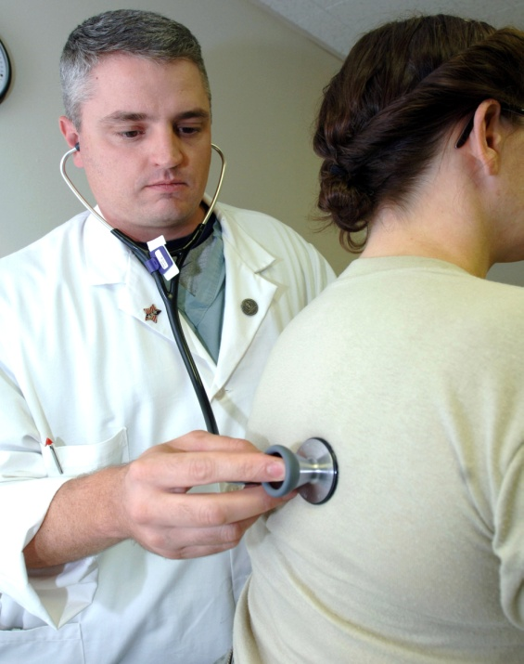
Clinical Features
History of pulmonary opacities in an asthmatic patient suggest ABPA.
Usually diagnosed on routine screening of asthmatic patient.
Physical examination:
Clubbing is rare, 16% of patients.
Normal or may reveal polyphonic rhonchi
Coarse crackles can be heard in 15% of patients.

Slide 26
Laboratory investigations
Microscopic examination of sputum for fungal hyphae of A. fumigatus
Sputum culture for A fumigatus
Peripheral eosinophilia
Prick skin test to an extract of A fumigatus
Serum Ig E levels
Serum Ig E & Ig G antibodies specific to A fumigatus.
Serum precipitins against A fumigatus
Radiological investigations
Pulmonary function tests

Slide 27
Microscopic examination of sputum for fungal hyphae of A fumigatus
Mycological examination of sputum :
Visualization of aspergillus hyphae in sputum
It is recommended that the 24-hour volume produced on 3 consecutive days should be examined by experienced mycologist to detect A fumigatus .

Slide 28
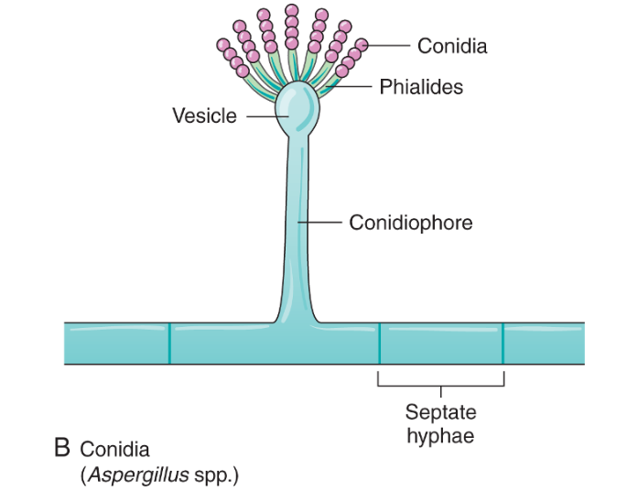
Oppotunistic mycosis
Aspergillus fumigatus
Aspergillus flavus
Aspergillus niger
Aspergillus terreus
Dr. Patrick R. Murray et al Medical Microbiology;7 th edition 2012

Slide 29
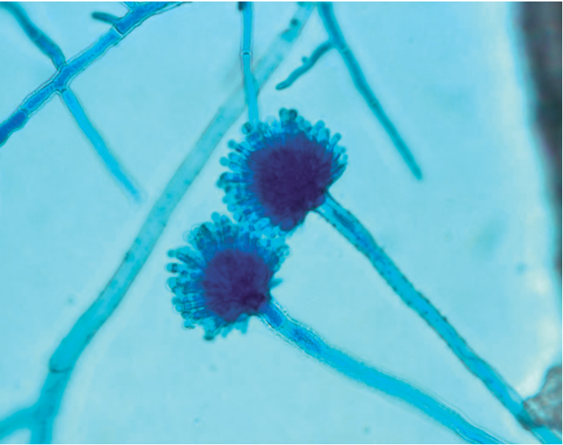
Aspergillus fumigatus. Lactophenol cotton blue preparation show conidial head
Dr. Patrick R. Murray et al Medical Microbiology;7 th edition 2012

Slide 30
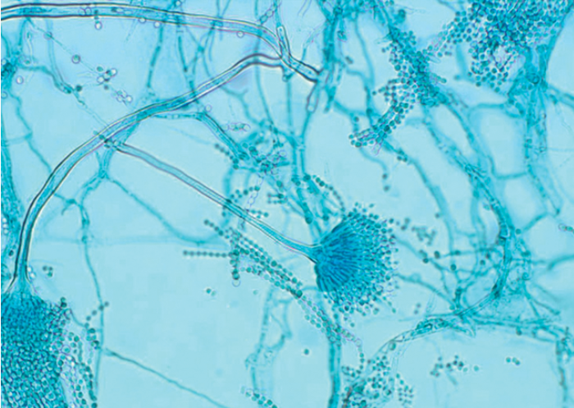
Aspergillus terreus. Lactophenol cotton blue preparation show conidial head
Dr. Patrick R. Murray et al Medical Microbiology;7 th edition 2012

Slide 31
Sputum culture for A fumigatus
Culture of A fumigatus in the sputum is supportive but not diagnostic.
The fungus can also be grown in patients with other pulmonary diseases due to the ubiquitous nature of the fungi.
Sputum culture for diagnosis is usually rarely done.

Slide 32
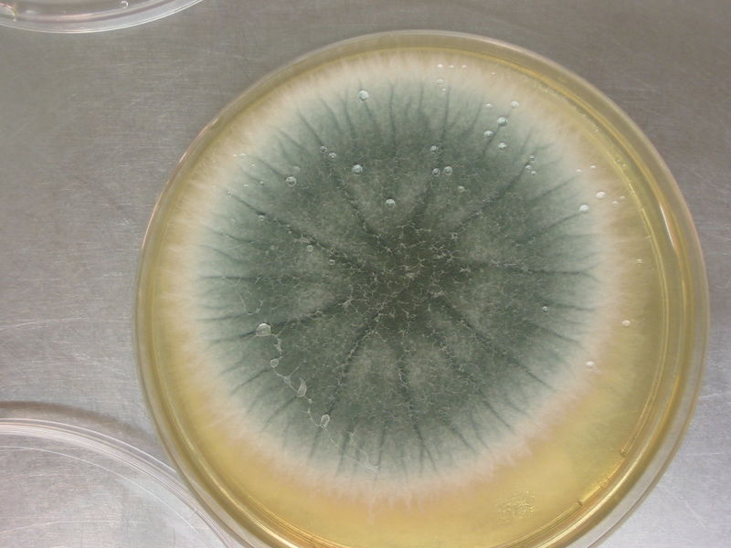
The colonies of Aspergillus may be black, brown, green, yellow, white, or other colors, depending upon the species

Slide 33
Peripheral eosinophilia
A blood AEC 1,000 cells/mm3 is also a major criteria.
Peripheral eosinophilia are often very high >2,000 cells/mm3 at time when transient radiological abnormalities are present on the CXR.
In one study 53% of patients had an absolute eosinophil count< 1.000 cell/mm3, and thus a low eosinophil count does not exclude the diagnosis of ABPA.
(Thorax 2002)

Slide 34
Aspergillus prick skin test
Performed using an A fumigatus antigen. Either commercial (e.g. Aspergillin; Hollister-Stier laboratories ; Spokane, WA ) or locally prepared.
The test read every 15 min for 1 hour and then after 6 to 8 hrs.
The reaction are classified :
1-Type I: If a weal and erythema developed within
1 min, reached a maximum after 10 to 20 min and
resolves within 1 to 2 hrs.
2-Type III : Is read after 6 hrs and any amount of
subcutaneous edema is considered a positive result.

Slide 35
Aspergillus prick skin test
An immediate cutaneous hypersensitivity to A fumigatus antigen is a characterisitic finding of ABPA.
This represents the presence of A fumigatus specific IgE antibodies, whereas a type III skin reaction probably represents the immune complex hypersensitivity reaction.
A positive immediate weal and flare reaction to aspergillus skin test is pre-request for establishing a diagnosis of ABPA
Skin tests to other common allergens (pollens, house dust mites, animal danders ,etc ) are frequently negative.
(8)-McCarthy DS, Pepys J . Allergic bronchopulmonary aspergillosis. Clin Immun ; (2). Skin ,
nasal and bronchial tests. Clin Allergy 1971; 1:415.

Slide 36
Serum Ig E levels
Total serum IgE levels:
Most useful test for diagnosis and follow-up of ABPA.
Normal serum IgE level excludes ABPA as the cause(except patient on glucocorticoid therapy).
After treatment with glucocorticoid, the serum levels decline, and a 35 to 50% decrease is taken as a criteria for remission.
The serum IgE determination is also used for follow-up and a doubling of the patient’s baseline IgE levels indicates relapse of ABPA.

Slide 37
Serum Ig E & Ig G antibodies specific to A fumigatus
Elevated level of A fumigatus antibodies (measured by fluorescent enzyme immunoassay) is considered the hallmark of ABPA.
ELISA technique for measuring IgE & IgG antibodies against A fumigatus has been shown to be effective in distinguishing patient with ABPA from asthmatic patients with positive A fumigatus skin test only (9).
A cutoff value of IgG/IgE more than twice the pooled serum samples from patients with asthma can greatly helpful in the differentiation of ABPA from other conditions.
(9)-Faux JA , Shale DJ , Lane DJ , Precipitins and specific IgE antibody to aspergillus fumigatus
in a chest unit population. Thorax 1992; 47:48.

Slide 38
Serum precipitins against A fumigatus
The precipitating IgG antibodies are elicited from crude extracts of A fumigatus.
Can be demonstrated using the double gel diffusion technique.
Precipitating Ab of IgG types is present in 70% of patients and is less sensitive investigation than A fumigatus skin test.
Precipitins have been found in 3% of healthy office workers, 12% of patients with allergic asthma , and 27% of patients with farmer’s lung.
Because they are present in other pulmonary disorders and thus represent supportive not diagnostic evidence for ABPA.

Slide 39
Radiological investigations: Chest X Ray
Shows wide range of radiographic appearances.
Transient changes:
Common – Patchy areas of consolidation.
Radiologic infiltrates: toothpaste and gloved finger shadows due to mucoid impaction in dilated bronchi.
Collapse: lobar or segmental.

Slide 40
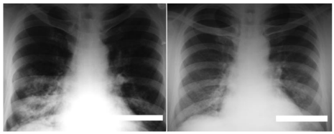
Chest X Ray
(A)
(B)
Chest radiograph showing transient pulmonary opacities in the right lower lobe (A) in a patient with ABPA that have spontaneously disappeared (B)

Slide 41
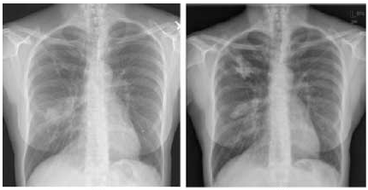
Chest X Ray of a patient with ABPA
A
B
A-bilateral bronchiectasis with internal mucus filling
in the right lung .
B-Mucous plugging and fleeting nature of infiltrates
are shown.

Slide 42
Chest X Ray
Uncommon:
Bronchial wall thickening.
Air-fluid levels from dilated central bronchi filled with fluid.
Perihilar infiltrates simulating adenopathy.
Massive consolidation: unilateral or bilateral.
Small nodules.
Pleural effusion.

Slide 43
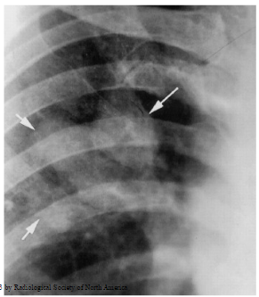
Close-up CXR of RUL obtained in a patient with asthma and ABPA
High-attenuation mucoid impaction (mucus visually denser than the paraspinal muscle) is a pathognomonic finding encountered in patients with ABPA.

Slide 44
Chest X Ray
Permanent changes:
Common:
Parallel-line shadows representing bronchial thickening.
Ring-shadow 1-2 cm in diameter representing dilated bronchi en face.
Pulmonary fibrosis: fibrotic scarred upper lobes with cavitation.
Uncommon:
Pleural thickening.
Mycetoma formation.
Linear scars.

Slide 45
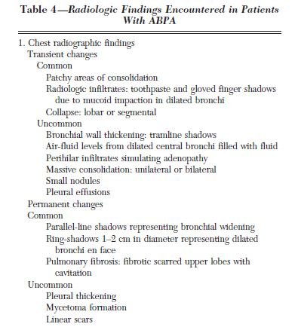
CHEST 2009

Slide 46
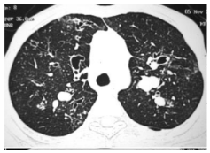
HRCT
Common:
Central bronchiectasis.
Mucoid plugging with bronchoceles.
Consolidation.
Centrilobular nodules with tree-in-bud opacities.
Bronchial wall thickening.
Areas of atelactasis.
Mosaic perfusion with air trapping on expiration.
Bilateral central bronchiectasis with centrilobular nodules and tree-in-bud opacities in the left lung

Slide 47
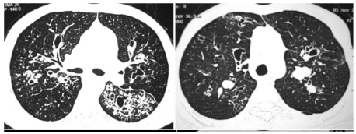
HRCT
Top right:
Bilateral central opacities with centrilobular nodules and tree-in-bud opacities in left lung.
Top left:
Bilateral central bronchiectasis with many mucus-filled bronchi.

Slide 48
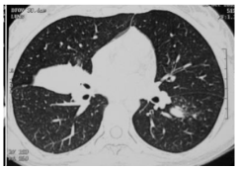
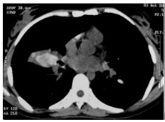
HRCT
Uncommon:
High-attenuation mucus (filling most helpful in differential diagnosis).
Pleural involvement.
Randomly scattered nodular opacities.
CT chest shows high-attenuation mucoid impaction, the mucoid impaction in the right lung is visually denser than the paraspinal skeletal muscle.

Slide 49
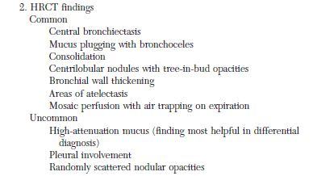
HRCT
CHEST 2009

Slide 50
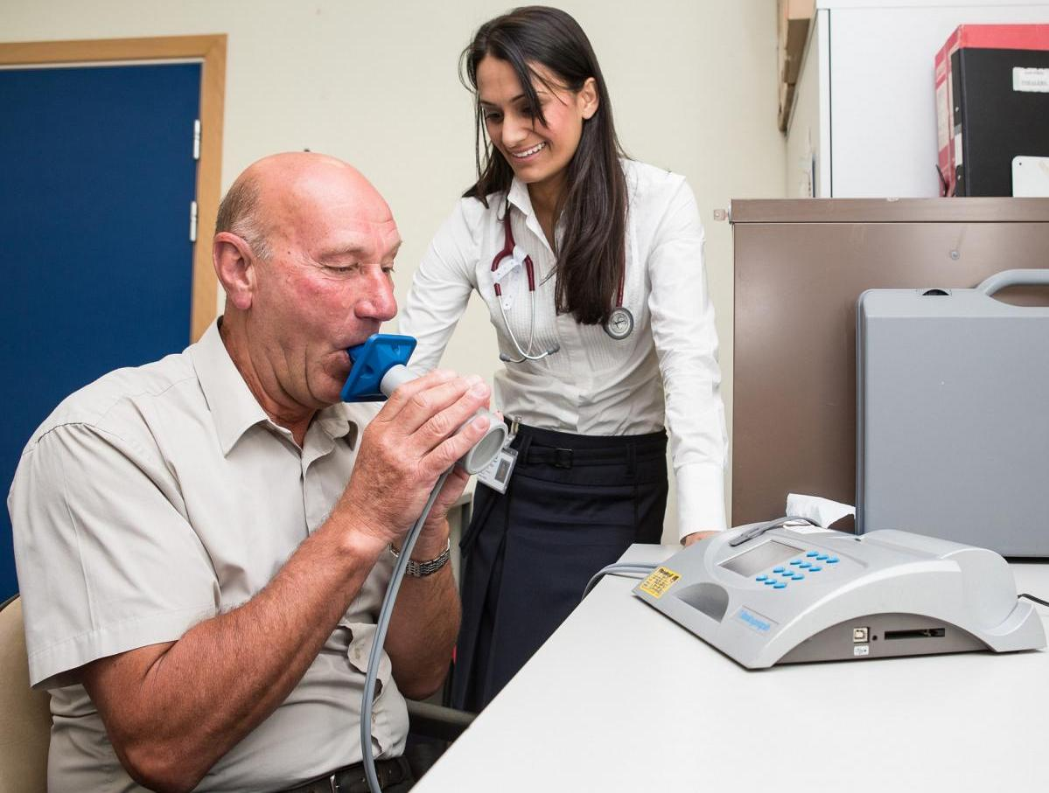
Pulmonary function tests
These tests help categorize the severity of the lung disease but have no diagnostic value in ABPA.
Need not constitute the basis for screening of ABPA.
The usual finding is an obstructive defect of varying severity.

Slide 51
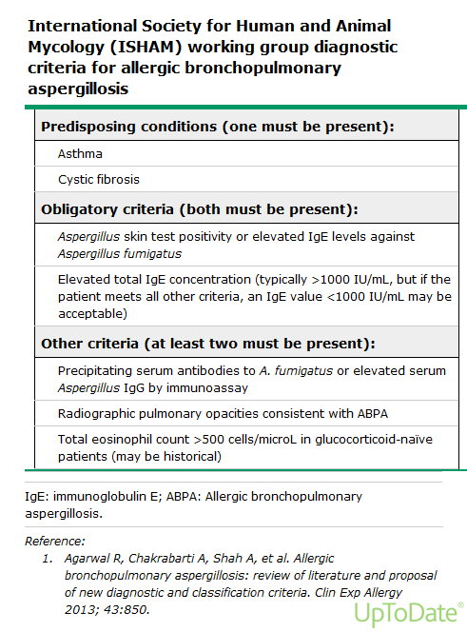
Uptodate

Slide 52
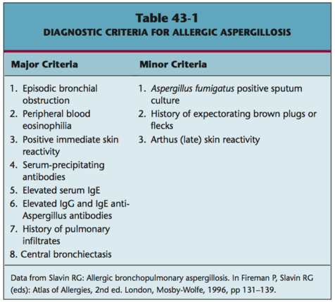

Slide 53
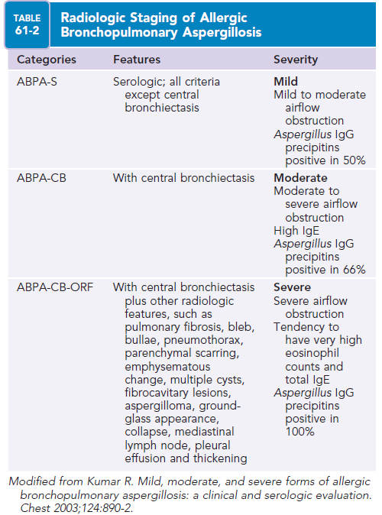

Slide 54
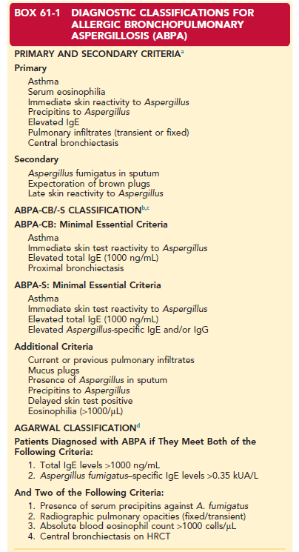
a.Rosenberg M, Patterson R, Mintzer R, et al
1977
b.Schwartz HJ, Greenberger PA
1991
c.Greenberger PA.
1994
d.Agarwal R, Khan A, Gupta D, et al
2010

Slide 55
ABPA has been classified into 5 stages (6,7)
These stages used in an attempt to aid in diagnosis and management of ABPA
Stage I (acute) ABPA
Stage II (remission ) ABPA
Stage III (exacerbation ) ABPA
Stage IV (corticosteroid-dependent asthma) ABPA
Stage V (fibrotic end stage) ABPA.
(6)-Patterson R, Greenberger PA, Radin RC, Roberts M. Allergic bronchopulmonary aspergillosis ;
staging as an aid to management. Ann Intern Med 1982 ; 96: 286.
(7)-Greenberger Pa , Patterson R, Allergic bronchopulmonary aspergillosis and evaluation of the
patient with asthma. J Allergy Clin immunol 1988; 81:646.

Slide 56
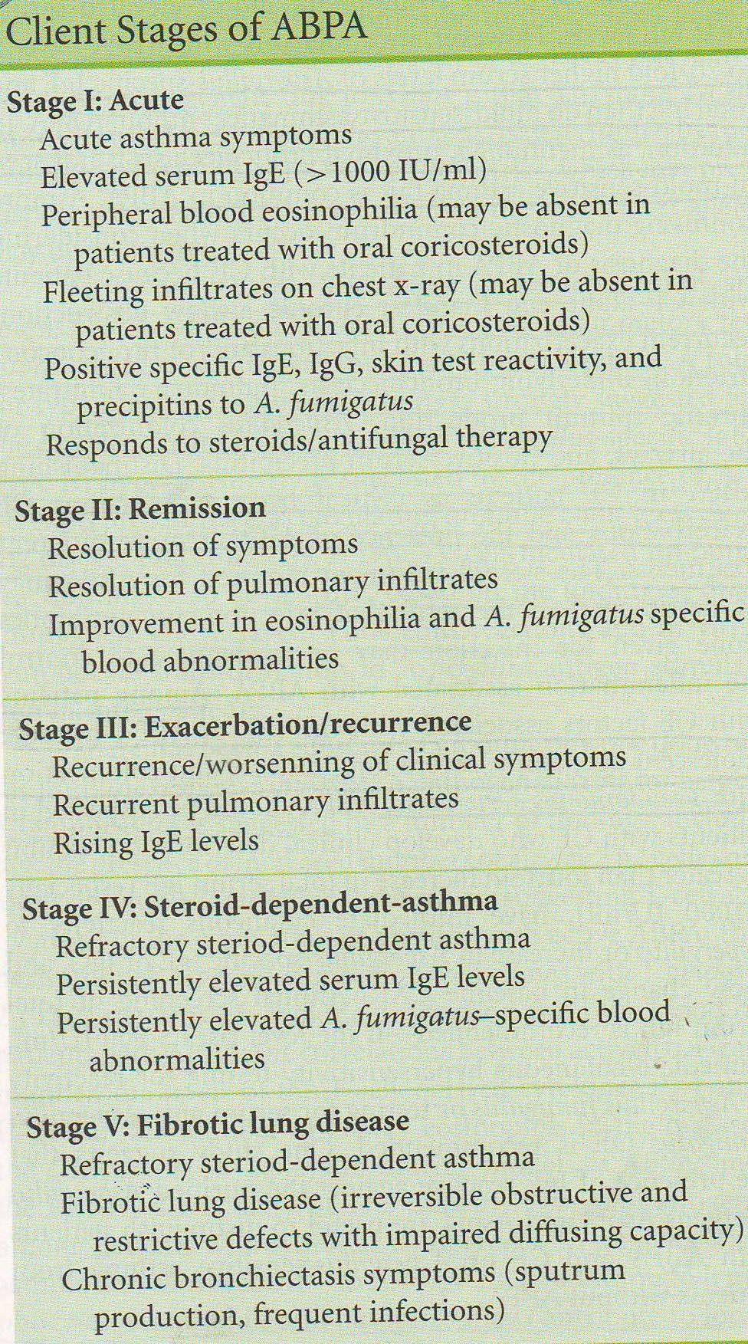

Slide 57
Treatment
Includes 3 important aspects:
1 Institution of steroids to control the
immunologic activity
2 Close monitoring for detection of relapses
3 Use of antifungal to attenuate the fungal burden secondary to the fungal colonization in the airways.

Slide 58
Treatment
Oral Antifungals
Inhaled corticosteroids
Other therapies
Management of ABPA
Systemic glucocorticoid therapy

Slide 59
Systemic glucocorticoid therapy
Oral corticosteroid are the treatment of choice for ABPA.
suppress the immune hyper-function/ anti-inflammatory.
No data to guide the dose and duration of glucocorticoids.
Different regimens of glucocorticoids have been used, selection is a matter of personal preference.
Higher dosage of glucocorticoids for a longer duration and observed higher remission rates (15) .
(15)-Agrwal R , Gupta D, Aggarwal AN , et al . ABPA : lessons from 126 patients attending a chest
clinic in North India. Chest 2006; 130:442-448.

Slide 60
Systemic glucocorticoid therapy
Effectiveness of steroid therapy is reflected by marked decreases in the patient’s total serum IgE levels along with symptom and radiologic improvements.
The goal of therapy is not to attempt normalization of IgE levels but to decrease the IgE levels by 35 to 50%, which leads to clinical and radiological improvement.
One should also establish a stable serum level of total IgE to serve as guide to future detection of relapse.

Slide 61
Systemic glucocorticoid therapy
Oral glucocorticoids:
Regime 1:
Prednisolone 0.5 mg/kg/day for 1-2 weeks , then on alternate days for 6-8 weeks.
Then taper by 5-10 mg every 2 week and discontinue.
Repeat the total serum IgE concentration and CXR in 6 to 8 weeks.

Slide 62
Systemic glucocorticoid therapy
Oral glucocorticoids:
Regime 2:
Prednisolone 0.75 mg/kg/day for 6 weeks , 0.5 mg/kg/day for 6 weeks, then tapered by 5 mg every 6 weeks to continue for a total of at least 6 to 12 months.
The total IgE levels are repeated every 6 to 8 weeks for 1 year to determine the baseline IgE concentration.
The patients are followed up with a medical history and physical examination, CXR , and measurement of total IgE levels every 6 weeks to demonstrate decline in IgE levels and clearing of the chest radiograph.

Slide 63
Systemic glucocorticoid therapy
A 35% decline in IgE level signifies satisfactory response to therapy.
Doubling of the baseline IgE value can signify a silent ABPA exacerbation.
If the patient can not be tapered off prednisolone, the disease has evolved into stage IV.
Management should be attempted with alternate-day prednisolone with the least possible dose.
Monitor for adverse effects (e.g. hypertension , secondary DM)
Prophylaxis for osteporosis: oral calcium and bisphosponates.

Slide 64
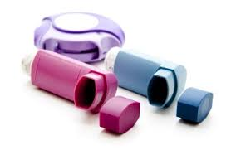
Inhaled corticosteroids
Inhaled corticosteroid only for the control of asthma once the oral prednisolone doses= is reduced to 10 mg/day.

Slide 65
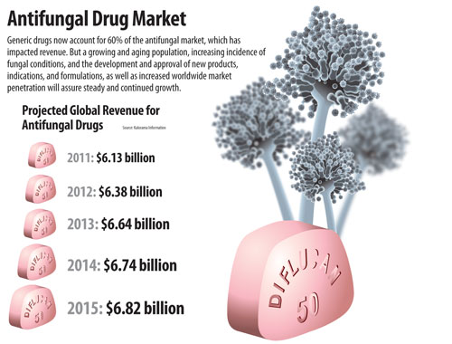
Antifungal Therapy
Reserve it for-: who are unable to taper oral glucocorticoids or have an exacerbation of ABPA (Uptodate 2016).
Initial therapy for acute ABPA (IDSA).
Common agents-: Itraconazole, Voriconazole, Posaconazole.

Slide 66
Itraconazole
Dose: 200 mg three times a day for three days, then
200 mg twice a day for 16 weeks then once a day for 16 weeks.
Indications: -First relapse of ABPA or -Glucocorticoid-dependent ABPA.
Follow-up and monitoring
Monitor for adverse effects (e.g. nusea, vomiting ,diarrhea, and elevated liver enzymes).
Monitor clinical response based on clinical course , radiography and total IgE levels.

Slide 67
Itraconazole
Reduces antigenic stimulus for bronchial inflammation.
Inhibits the metabolism of methylprednisolone (but not prednisolone) with resultant increased frequency of steroid side effects including adrenal insufficiency.
Itraconazole could significantly decrease the total IgE levels by 25%.

Slide 68
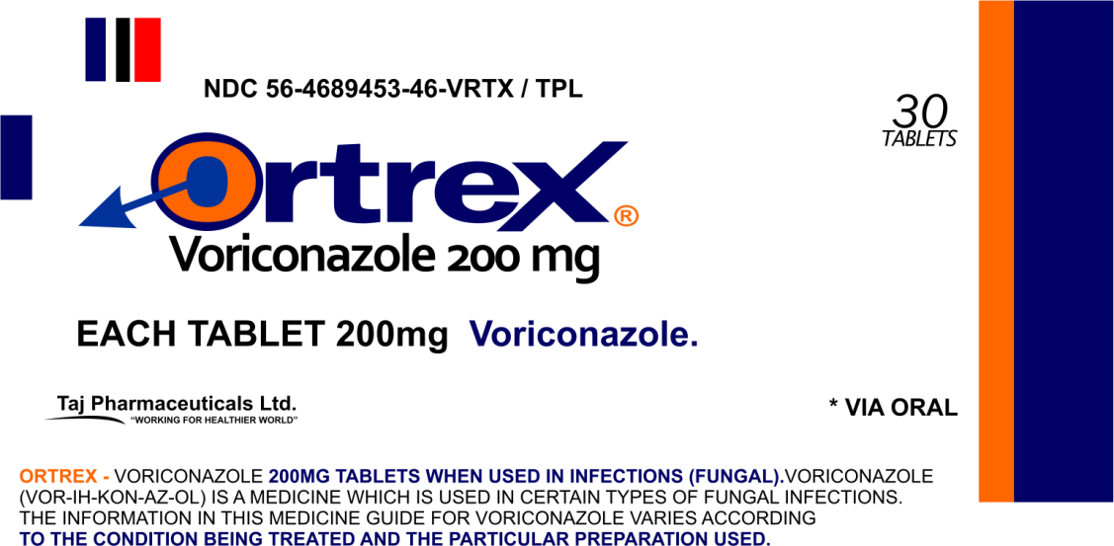
Voriconazole
Loading doses of 400 mg orally every 12 hours for two doses.
Maintenance dose of 200 mg twice daily.

Slide 69
Other therapies
There are three case reports of ABPA treated with inhaled amphotericin B and budesonide. (CF-ABPA)
Pulse doses of iv methylprednisolone for the treatment of severe ABPA.
use of Omalizumab for the management of ABPA. (Excellent results)
Immunotherapy with fungal allergens.
Reducing exposure to environmental sources of Aspergillus.

Slide 70
Differential Diagnosis
Aspergillus hypersensitivity bronchial asthma.
Infections-: TB, CAP
Pulmonary Eosinophilia and raised IgE.
Chronic Pulmonary Aspergillosis
Mucoid Impaction and Bronchocentric granulomatosis.

Slide 71
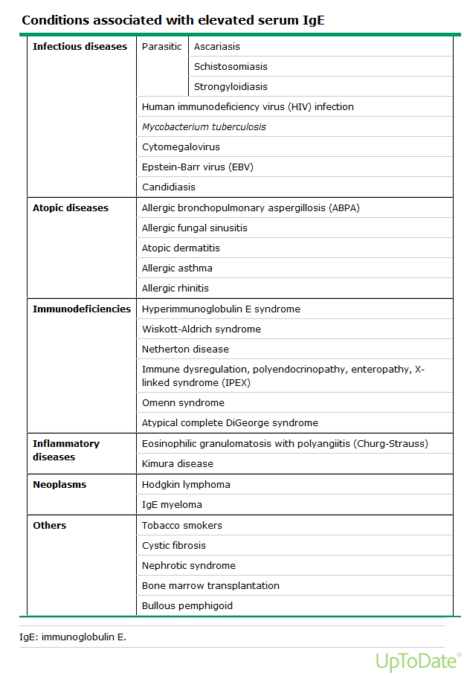
Differentials

Slide 72
Differentials

Slide 74
Complications of ABPA
Recurrent asthma exacerbations.
If ABPA untreated the development of:
Bronchiectasis,
Pulmonary fibrosis (stage 5) -: PAH and Respiratory failure.
Acute invasive pulmonary aspergillosis.
Aspergilloma
Chronic pulmonary aspergillosis
Problems related to bronchiectasis

Slide 75
Consensus Conference Proposed Diagnostic Criteria for ABPA in CF
Classic diagnostic criteria
Acute or subacute clinical deterioration not explained by another etiology
Total IgE > 1,000 IU/mL
Immediate cutaneous reactivity to Aspergillus or presence of serum IgE to A fumigatus
Precipitating Ab to A fumigatus or serum IgG to A fumigatus
New or recent abnormalities on chest radiograph or chest CT scan that not cleared with ATB and standard physiotherapy
Minimal diagnostic criteria
Acute or subacute clinical deterioration not explained by another etiology
Total IgE > 500 IU/mL. If total IgE 200–500 IU/mL, repeat testing in 1–3 mo is recommended
Immediate cutaneous reactivity to Aspergillus or presence of serum IgE to A fumigatus
One of following:
(1) precipitins to A fumigatus or demonstration of IgG to A fumigatus; or
(2) new or recent abnormalities on chest radiography or chest CT scan that not cleared with ATB and standard physiotherapy
CHEST 2009; 135:805–826

Slide 76
ABPA without Bronchial Asthma
ABPA may occasionally develop in an individual without preexisting bronchial asthma.
In total they include 36 cases reported across the globe.
Most of the cases demonstrated hypersensitivity to A fumigatus , but 3 cases showed hypersisitivity to Helminthosporium and 2 cases to Aspergillus niger.
Because of the absence of bronchial asthma , these cases are often mistaken initially for other pulmonary disorders like bronchogenic carcinoma or pulmonary TB.

Slide 77
ABPA complicating other conditions
Coexistence of ABPA and aspergilloma:
The serology findings of ABPA have also been reported in patients with aspergilloma and chronic necrotizing pulmonary asperillosis.
This ABPA-like syndrome probably represents a true hypersensitivity reaction consequent to the colonization of Aspergillus in long-standing pulmonary cavities and the continuous release of Aspergillus Ags that leads to immunologic activation.
Most patients show a brisk response to steroids.

Slide 78
ABPA and allergic Asperigllus sinusitis
It is a clinical entity in which mucoid impaction due ABPA occurs in the paranasal sinuses.
The pathogenesis is also similar to ABPA and represents an allergic hypersensitivity response to the presence of fungi within the sinus cavity.
The patient is often asymptomatic or can manifest with symptoms of nasal obstruction, rhinorrhea, headache, and epistaxis.

Slide 79
Conclusion
ABPA is common manifestation in chronic allergic asthma and cystic fibrosis
Th2 cytokine mediated
Diagnostic criteria
Asthma
pulmonary opacities
Skin test positive for Aspergillus
Eosinophilia
Precipitating Abs (IgG) in serum
IgE > 1,000 IU/mL
Central bronchiectasis
Serums A fumigatus-specific IgG and IgE

Slide 80
Conclusion
Treatment
Corticosteroid : drug of choice
Itraconazole/Voriconazole : adjunctive therapy

