Slide 1
B I O T E R R O R I S M
Dr. Amit Apte

Slide 2
Bioterrorism :
primary goal – destroy the morale of society through fear and uncertainity
Actual biologic impact of single attack is small & degree of disruption is enormous

Slide 3
Key Features of Biologic Agents Used as Bioweapons
High morbidity and mortality
Potential for person-to-person spread
Low infective dose and highly infectious by aerosol
Lack of rapid diagnostic capability
Lack of universally available effective vaccine
Potential to cause anxiety
Availability of pathogen and feasibility of production
Environmental stability
Database of prior research and development
Potential to be "weaponized"

Slide 4
Microbial bioterrorism
includes processing of microbes or toxins in a manner which ensures devastating effect on release-weaponisation
Threats produced by microbial methods
Accidental release of anthrax spores from soviet union bioweapons facility in sverdlosk,Russia
Exposure of American public to anthrax spores in 2001 through postal system
The infamous unit731 of Japanese army dropped plague infested fleas over parts of China.
Outbreak of tularaemia among German and soviet soldiers on eastern front during WW2
Contamination of salad s with salmonella typhimurium in Oregon in 1984

Slide 5
The U.S. centres for CDC classifies biologic threats under 3 categories
Category A : agents with highest-priority pathogens. They pose the greatest risk to national security because they
(1) can be easily disseminated or transmitted from person to person,
(2) result in high mortality rates and have the potential for major public health impact
(3) might cause public panic and social disruption, and
(4) require special action for public health preparedness.
Category B : agents are the second highest priority pathogens and include those that are moderately easy to disseminate, result in moderate morbidity rates and low mortality rates, and require specifically enhanced diagnostic capacity.

Slide 6
Category C : agents are the third highest priority.
These include certain emerging pathogens, to which the general population lacks immunity, & could be engineered for mass dissemination in the future because of availability, ease of production, ease of dissemination, potential for high morbidity and mortality, and to produce major public health impact

Slide 7
CDC Category A, B, and C Agents
Category A
Anthrax (Bacillus anthracis)
Botulism (Clostridium botulinum toxin)
Plague (Yersinia pestis)
Smallpox (Variola major)
Tularemia (Francisella tularensis)
Viral hemorrhagic fevers
Arenaviruses: Lassa, New World (Machupo )
Filoviridae: Ebola, Marburg
Category B
Brucellosis (Brucella spp.)
Epsilon toxin of Clostridium perfringens
Food safety threats (e.g., Salmonella spp., Escherichia coli 0157:H7, Shigella)
Melioidosis (B. pseudomallei)
Q fever (Coxiella burnetii)
Category C : emerging infectious threats such as hanta , corona, nipah virus

Slide 8
BACILLUS ANTHRACIS :
Studied as a potential biologic weapon in WW2 to cause Anthrax
Gm+ve , nonmotile , spore-forming rod found in soil
Predominantly causes disease in cattle , goats and sheep
Spores remain dormant in alveoli for atleast 4-6 wks without immune response
LD₅₀ for 10,000 spores accepted no.
clinical features
Gastrointestinal anthrax : unlikely to be a result of bioterrorism event.
Results from ingestion of contaminated meat
Cutaneous anthrax :
Following introduction of spores through the opening in the skin
Begins as a papule and evolve into a painless vesicle and devlops into
Notes:
LD₅₀-suggest that 10,000 spores are required to produce lethal disease in 50% of animals exposed to this dose

Slide 9
coal-black eschar
Incubation period – 10-12 days
Inhalational anthrax :
Commonest form of anthrax responsible for death in bioterrorist attack
Due to deposition of spores in alveolar spaces
Spores phagocytosed by macrophages , transported to mediastenal and peribronhial lymhnodes and germinate to produce lethal toxin
clinical features
Fever ,malaise ,abdominal/chest pain ,fatigue
Also present with cough , shotness of breath
May progress to hypotension , cyanosis and death
Overall mortality ~55%

Slide 10
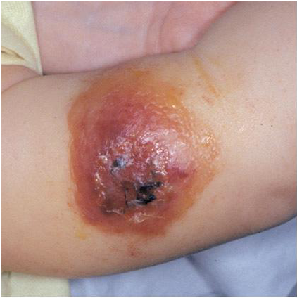
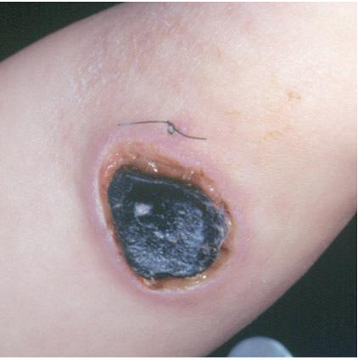
Cutaneous anthrax showing vesicular eruption
Necrotic stage showing black escar

Slide 11
investigations :
Haemat :
raised TLC , and transaminase levels
X-ray findings :
bilateral pulmonary infiltrates, mediastenal widening and haemorrhagic plueral effusions may be seen

Slide 12
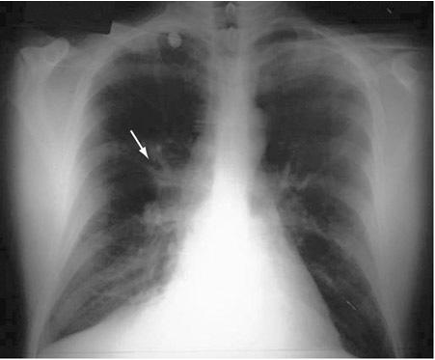
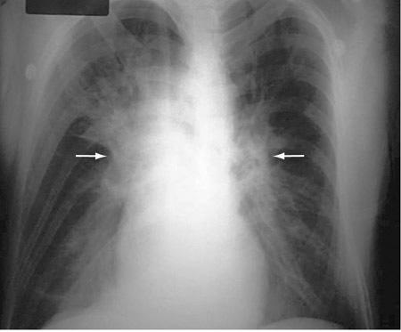
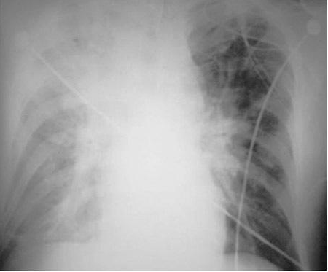

Slide 13
TREATMENT :
POSTEXPOSURE :
ciprofloxacin 500mg ,PO bid – 60 days or
doxycycline 100mg, PO bid– 60 days also,
amoxicillin 500mg, POq8h if strain is Penicillin sensitive
ACTIVE DISEASE :
Ciprofloxacin 400mg, IV q12h or
Doxycycline 100mg, IV q 12h plus
Clindamycin 900mg, IV q8h and/or
Rifampin 300mg, IV q12h,switched to PO when pt is stable– 60 days
Prophylaxis :
Anthrax vaccine adsorbed ( AVA ) :prudent to use within 60 days
Notes:
AVA:- cell free culture supernatent of an attentuated , nonencapsulated strain of B.anthracis ( stern strain )

Slide 14
YERSINIA PESTIS :
Causative agent of plague
to ideal agent of bioterrorism as it is highly contagious and has high mortality
nonmotile, gram-negative bacillus that exhibit"safety pin," staining with Wright, Giemsa, or Wayson stains.
clinical features
manifested as Bubonic or pnuemonic type
Bubonic plague :
Most common type due to flea bite
With inoculation of bacteria into the skin the organisms travel to regional lymphnodes and result into painful lymphadenopathy with necrosis, fever,
septicemia, and death
Few patients may devlop ecchymoses and gangrene of digits and nose
These patients transmit the agents to others via respiratory route
Notes:
Incubation period : 1-6 days

Slide 15
diagnosis: -
-peripheral smear : show bipolar staining of Y.pestis
- culture of lymph node aspirate
-blood culture : with culture medias like Brain-heart infusion, MacConkey agar.
one smear should with Wayson or giemsa stain and gram stain and submitted for direct flouroscent antibody and PCR test.
Pnuemonic plague :
most likely result of a bioterrorist attack due to spread of aerosolised bacteria
in a wide densely populated region

Slide 16
clinical features
May present with fever, cough with hemoptysis, dyspnea, and gastrointestinal
symptoms
X-ray chest—show bilateral pulmonary infiltrates and consolidated patches

Slide 17
Treatment :
- Gentamycin : 2 mg/kg I.V. bolus and 1.7mg/kg q8h I.V. Or
-streptomycin 1 g q12h I.M/I.V.
-alternatives :- doxycycline 100mg bid PO or IV or
-cholramphenicol 500 mg qid PO or IV
Prophylaxis :
-Doxycycline 100mg PO bid
-formalin fixed vaccine used for prevention of plague (not available)

Slide 18
Variola virus :
Causative agent of small pox
Considered as a good agent of bioterrorism
Has 10-30% mortality in unimmunised individuals and has devastating effect on deliberate spread
Microbiology :
Caused by 2 variants V.major and V.minor
Double stranded DNA virus of orthopox virus genus of pox viriade family
V.major is the only considered viable bio weapon
Clinical features :
Infection with V.major occurs following contact with infected person after the devlopment of maculopapular rash on skin or oropharynx
Notes:
Incub.period: 7-17 days

Slide 19
Which transmits infection through inhalation of saliva droplets.
Primary viraemia on several days of exposure due to dissemination of virus to lymphoid tissue
Secondary viremia ~ 4 days later which leads to localization of infection to dermis
Patients presents with high grade fever, vomitting, headache, backache
Maculopapular rash on face and extremities and spread to trunk which evolves into vesicles, pustules and then scabs.
Two atypical forms haemorrhagic and malignant are seen in 5-10% of cases
Haemorrhagic : abrupt onset seen with high grade fever severe headache and abdominal pain .

Slide 20
Cutaneous erythema devlops with petechie and hemorrhages into skin and mucus membrane
Death within 5-6 days
Malignant : frequently fatal with onset similar to hemorrhagic form but skin lesions never progress to pustular stage
Diagnosis :
Culture, electron microscopy , PCR
Treatment :
Supportive measures
Cidofovir
Prophylaxis : with vaccinia

Slide 21
Francisella tularensis :
Causative agent of tularemia
An extremely infectious organism with infections occuring by merely examining and uncovered petri dish with colonies
As few as 10 organisms can lead to establishment of infections
Might be used as bioweapon either through aerosol , contamination of food or drinking water
F.trularensis – small, non motile, gram negative cocco-bacillus
Human infections often results from insect bites from ticks, flies or mosquitoes
Most likely mode of disemmination of tularemia as bilogical weapon is by aerosol
Notes:
I.c: 1-14 days

Slide 22
Clinical features :
Drinking of contaminated water can lead to oropharyngeal form with pharyngitis with cervial and retropharyngeal lymphadenopathy
Aerosol spread and cause inflammation of airways with pharyngitis, pleuritis and bronchopneumonia
Patient present with fever, fatigue, chills , headache
Some patients have conjnuctivitis with ulceration or cutaneous exanthens
X-ray : 50% show pulmonary infiltrates with hilar adenopathy
LAB :
Direct microscopic examination of tissue reveals f.tularensis both intra and extra cellular
Indirect flouroscent antibody test

Slide 23
agglutination testing : microagglutination and tube agglutination commonly used to detect antibody to f.tularensis
ELISA : also useful in detecting antibodies and antigens
Urine analysis :
PCR : used to detect f.tularensis DNA
Treatment :
Streptomycin 1 g IM bid or
gentamycin 5mg/kg per day IV for 14 days or
doxycycline 100mg IV bid or
ciprofloxacin 400 mg IV bid
Prophylaxis :
doxycycline 100 mg PO bid - 14 days / ciprofloxacin 500 mg PO bid -14 days

Slide 24
Hemorrhagic fever viruses :
Have been reported to be weaponized by soviet union and united states.
Excellent candidate of bio terorrism with mortality rate 90%
Highly infectious through aerosol preparations
E.g. Ebola virus , Marburg virus, rift velly virus , lassa virus, new world virus
Envelope single stranded RNA viruses depends upon rodents or insect host reserviors for long survival.
Transmission depends upon direct contact with virus containing body fluids
Clinical features :
Fever, myalgia , prostration, DIC with thrombocytopenia and capillary hemorrhages.
Notes:
I.c: 2-21 days

Slide 25
Leukopenia, temp-pulse dissociation, renal failure and seizures seen in few patients
Diagnosis :
Suspected in cases with temprature > 38.3 c for less than 3 weeks with atleast two of following features : hemorrhagic or purpuric rash, epistaxix, hematemesis, hemoptyisis or hematochezia in absence of any other identifiable cause
Confirmed by labs of CDC and US army
Treatment :
Supportive measures
Ribavirin 30mg/kg – upto 2 g – 1 day then 16 mg/kg IV – 4 days then 8 mg/kg IV -6 days

Slide 26
Botulinum toxin :
Dispersed as an aerosol or as contamination of food supply
1 g of toxin sufficient to kill 1 million individuals
Produced by clostridium botulinum – gram positive spore forming anerobe
7 antigenic distinct forms from A to G.
A,B and E involved in naturally occuring infections
Zinc containing protease which prevents the intracellular fusion of ACh vesicles with motor neuron membrane and prevents release of Ach which leads to flaccid paralysis.
Botulism can result from infection in wound or the intestine, ingestion of contaminated food or inhalation of aerosolized toxin.
Food contamination and aerosolization are most likely source for bio terrorism.
Notes:
i.c: 12-72hrs

Slide 27
Clinical features :
Initially multiple cranial nerve palsies, diplopia, dysphagia, dysarthria, dry mouth, bulrring of vision, ptosis which progress to flaccid paralysis
Few present with complete muscular collapse, loss of gag reflex, and respiratory failure
Diagnosis :
Suspected on clinical grounds and confirmed by mouse bio-assay or toxin immunoassay
Treatment :
Mainly supportive
May recquire intubation and mechanical ventilation
If diagnosed early equine anti-toxin may reduce extent of nerve injury.

Slide 28
Vaccination and prevention : botulinum toxoid for high risk individual

Slide 29
Chemical bioterrorism
Threats produced from chemical means
Sulfur mustard and nerve agents were used by Iraq against Iranian military
Use of sulfur mustard in WW1 against U.S troops
Tokyo subway sarin incident in 1995
Notes:
Tokyo-where 12 deaths were reported

Slide 30
Vesicants :
Sulfur mustard :
Has been a military threat since WW1
Remains potential terrorist agent because of simplicity of manufacturing and extreme effectivness
Constitutes both vapour and liquid threat to epithelial surfaces
Organs most commonly affected are skin, eyes and airways
Mustard disolves slowly in aqueous media ( sweat) and forms reactive cyclic ethylin sulfonium ions which reacts with cell proteins , cell membrane and DNA which causes radio mimetic changes
DNA alkylation and cross linking in rapidly dividing cells such as corneal epithilum, basal keratinocytes, bone marrow precursor cells lead to ellular death and inflammatory reactions

Slide 31
Clinical features :
Skin : erythema associated with pruritus, burning or stinging pain which devlop to form vesicles and coalesce to form bullae
Airway : necrosis of mucosa usually begins in upper airways and progress downwards due to exposure to vapour form
1) irritation, epistaxis , sinus pain and pharyngeal pain, with low dose exposure
2) dyspnoea, severe cough with increased exposure
3) necrosis of airway mucosa which leads to pseudo membrane formation and obstruction of brochi

Slide 32
Eyes : most sensitive to mustard vapour injury ,
irritation conujctivitis, photophobia, blephrospams, corneal damage with low dose exposure
Extensive exposure to vapour leads to corneal perforation and blindness
Few have latent chronic keratitis with corneal ulceration
GI tract :
nausea , vomitting
Cause of death in mustard poisioning cases is due to sepsis and respiratory failure. Sepsis secondary to bacterial invasion of denuded necrotic mucosa and bone marrow supression.

Slide 33
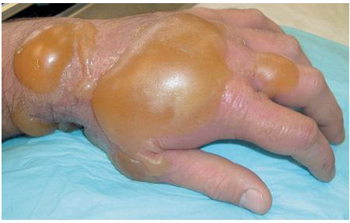
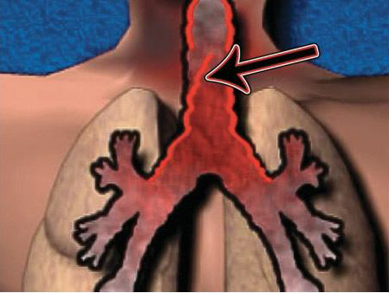
Large bulla formation mustrad burn in a pt
Schematic diagram of pseudomembrane formation

Slide 34
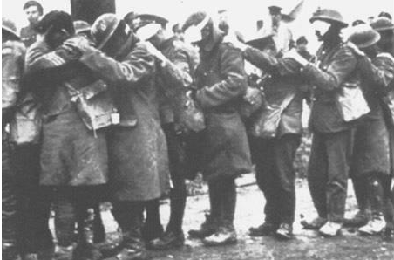
World war 1 photograph of troops exposed to sulfur mustard vapor

Slide 35
Treatment :
Supportive : liberal use of systemic analgesics , correction of fluid and electrolyte imbalance
In Exposed person topical cortisone creams or lotions are beneficial which prevent denudation of parts of skin
Irrigation 3-4 times daily with saline, soapy water, and then covered with topical antibiotics
Large areas of vesication requires IV therapy and whirlpool bath irrigation
Conjunctival irrigation with instillation of topical antibiotics in vapour exposed individuals.
Vaseline applied regularly to edges of lids

Slide 36
Intubation in cases of laryngeal spasm and edema
Fibre optic bronchoscopy and suctioning of necrotic debris in cases of pseudomembrane formation
Sterilization of gut with non-absorbable antibiotics considered in cases of sepsis from enteric organisms

Slide 37
Nerve agents :
They are organophosphorus agents which causes acute cholinergic crisis
Include tabun, sarin, soman, cyclosarin ( G agents ) and VX and VR which are liquids at standard temprature
G agents evaporate at about the rate of water
Clinical features :
Miosis : due to penetration of nerve agent vapour in cornea
Rinorrhea, excess salivation, bronchorrhea causing bronchospasm due exposure of exocrine glands
Abdominal cramping, nausea, vomitting and diarrhea due to blood born exposure of GI tract
Fasiculations, frank twitchings and flaccid paralysis

Slide 38
Rapid loss of consciousness, seizures, and central apnea leading to death
Liquid exposure of skin causes localized sweating, fasiculations which later causes respiratory distress, loss of consciousness, seizures due to penetration of nerve agents in circulation
Treatment :
1) Decontamination : carried out in patients in which agent is trapped in clothing or wounds.
Decontamination of liquids is done with M291 skin decontamination kit which contains ambergard resin which absorbs liquid from the skin
Extraction of foreign material and contaminated clothing
2) Respiratory support : adequate ventilation is achieved by intubation with prior treatment of atropine

Slide 39
Antidotal therapy :
Atropine :
loading dose of 2,4 or 6 mg and re-treatment every 5-10mins until breating and secretions improve
Rapid reverses cholinergic overload at muscarnic synapses
Oxime therapy :
are nucleophiles that reactivates the cholinestrase which have been inhibited
PAM 2.5-25 mg/kg IV found to reactivate 50% of inhibited cholinestrase
Dosage : 1800mg slow IM or 15mg/kg IV slowly

Slide 40
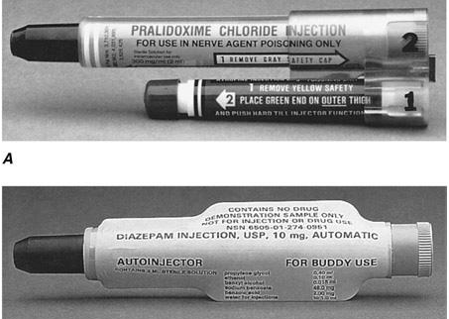
Anti-convulsants :
Diazepam : only benzodiazepines aproved for seizures
MARK 1 autoinjectors containing 600mg PAM and 2 mg atropine

Slide 41
Other chemical agents used for terrorism :
Asphyxiants :
Arsine, cyanogen chloride, hydrogen cyanide
Lead to confusion, cyanosis, frostbite
Choking/pulmonary damaging agents :
Chlorine, HCL, nitrogen oxides and phogene
Lead to airway, eye irritation, dyspnoea, cough and chest tightness
Behavior altering agents :
Agent 15/BZ
Lead to tachycardia, hyperthermia, ataxia , hallucinations or delusions

Slide 42
Radiation bioterrorism
Nuclear or radiation related terror attacks are unequivocal threats which leads to medical and psychological effects.
Possible means of generating terror attacks are from malfunctioning nuclear weapons that are detonated and/or installation of radio-nuclides in food or water
Types of radio-isotopic radiation :
Alpha – radiation : heavy positively charged particles with two protons and two neutrons
emitted from isotopes such as uranium or plutonium
human skin and clothes cause an obstacle for penetration

Slide 43
If internalised can cause significant cellular damage.
Beta radiation : small, light , negatively charged particles which consist of electrons
Source of exposure – radio active iodine released in nuclear plant accidents
Plastic layers and clothing cause obstacle during penetration
Gamma rays : uncharged electromagnetic radiation discharged from nucleus as a wave or photons of energy
Travel easily through any matter and cause total body exposure
X-rays :- product of abrupt mechanical deceleration of electrons striking a heavy metal such as tungsten
causes total body radiation
Nuetrons : heavy , uncharged particles emitted during nuclear detonation

Slide 44
Types of exposure :
Whole body exposure : deposition of radiation energy over entire body.
Result from gamma, X-ray or neutron exposure and can result in damage of multiple tissue and organs and produce dose dependant damage.
External contamination :
Result from fallout of radioactive particles on body surface, clothing and hair.
Common contaminants are alpha and beta radiation
Alpha have minimal systemic effects
Beta cause cutaneous burns and scarring
Gamma can cause whole body exposure.

Slide 45
Treatment :
Decontamination of wounds, burns and prevent internalisation of contamination
Removal of clothes –reduce contamination significantly and is first step
Secondary contamination depends directly duration of exposure and inversely proportional to square of the distance from source
Internal contamination :
Occurs due to ingestion or pentrance in body through open wounds or burns
Respiratory system is main portal of entrance for internal contamination
Aerosolised particles (<5um) get deposit in alveoli and larger get deposit in proximal airways

Slide 46
Smaller particles gain entry into lymphatics or blood vessels and irradiate continuously
Treatment : bronchial lavage helpful
Localised exposure :
Results from close contact between highly radioactive source and part of body which causes damage to skin and deeper tissues
Cutaneous manifestation : epilation, erythema, moist desquamation, ulceration, blistering and necrosis are seen
Alopecia : transient or permanent with dose > 3 Gy
Long term changes such as keratosis, fibrosis and talengiectasia can appear year after exposure

Slide 47
Treatment :
Analgesia
Antibiotics for prophylaxis of infection
Skin grafting or amputation may be required in patients of extensive cutaneous lesions.

Slide 48
Radiologic dispersal agents :
Two types
Small ( localised sources )
Amount and spread of radio active material is limited
Prevention : protective clothing minimizes the contamination of energy responders
Wide dispersal over large areas :
Source : use of explosives, nuclear reactors, spent nuclear fuel and transport vehicles
Silent exposure :
Results from hidden radiologic source in a crowded place
Can lead to acute radiation sickness.

Slide 49
Nuclear weapons :
Common event : detonation of single low yeild device
The effects are combination of series of events
Ground shock, air blast, thermal radiation, initial nuclear radiation, residual nuclear radiation, crater formation and radioactive fallout.
releases ionizing radiation mainly gamma rays and neutrons
Radiation produced in 1st min – initial radiation
Ongoing radiation due to fall out termed as residual radiation
The LD 50/30 (i.e. dose causing 50% mortality in 30 days) is 4 Gy
Inhalation of large amounts of radiological dust leads to radiation pneumonitis which progress to pulmonary fibrosis

Slide 50
Acute radiation sickness :
Interaction with atoms can result in ionization and formation of free radicles damages tissue by distruption of chemical bonds in cells and lead to cell death
Bone marrow and mucosal surfaces significantly sensitive to radiation
Clinical feature :
Four major stage prodrome, latent , illness and either recovery or death
Prodrome : appears within minutes to 4 days post exposure. Patient present with diarrhea, nausea, vomitting
Latent : upto 2-5 weeks ( can last upto 6 weeks ) minimal or no symptoms
Progress to illness with either recovery or death

Slide 51
ARS is generally mild with exposure to doses < 1 Gy
With exposure to 6-8 Gy GI symptoms accompany haemopoetic manifestations, absorption of fluid, electrolytes and nutrients is hampered
Treatment :
To maintain homeostasis
Antibiotics and transfusion of blood products to treat bone marrow depression
Partial and total parentral nutrition is given to bypass altered GI system
Psychological support

Slide 52
Notes:
To sort out patients into groups accordng to severity ,so that severely injured individuals can get better rx..regist-with disaster response team

Slide 53
Medical management of radiation bioterrorism
Emergency treatment is administered according to presence of conventional injuries such as wounds ,trauma and thermal or chemical burns
Victims clothes should be removed and must be wrapped inblankets or nylon sheets
Decontamination should be done in the field itself before arriving medical facilities
Contaminated clothes should be carefully wrapped in plastic bags
In order to prevent internalisation open wounds should be covered prior to decontamination
Radiation detector should be used to check for any residual contaminating agent
Showering and washing of entire skin and hair
Notes:
Removal of clothes reduces decontam by 80-90%

Slide 54
Excision of wounds done if surgically necessary
Prevention of contamination of medical personnel achieved by using a pair of gloves, a gown , shoe covers, a head cover and face mask

Slide 55
Treatment of radionuclide contamination :
To leave the smallest amount of radionuclides in the body and reduce absorption and enhance elimination and excretion
Emetics such as apomorphine 5-10mg or ipecac 1-2g with GI lavage to clear the tract
Prussian blue 1 g tid – 3 weeks acts as an ion exchanger and used to treat cesium 137 contamination
Aluminium antacids reduce strontium uptake
Reversal of radionuclide interaction with tissues can be achieved with use of blocking agents, diluting, mobilizing and chelating agents
Blocking agents : prevent entrance of radioactive materials
e.g. KI blocks the uptake of radioactive iodine by thyroid

Slide 56
most effective if taken within 1st hour of exposure
dosage : 130 mg/day – 7-14 days, if amount of exposure >10cGy
prophythiouracil 100mg tid – 8 days
Diluting agents : decrease absorption of radionuclides
e.g : water at a diluting agent in tritium contamination
Mobilizing agents : induce release of radionuclides from tissues and most effective if given immediately e.g. antithyroid drugs, parathyroid extract, glucocorticoids and diuretics
Chelating agents : bind radioactive materials to form complexes excreted from the body e.g Ca-DTPA or Zn-DTPA used to treat contamination with plutonium, americium and curium.

Slide 57
dosage : 1g Ca or Zn DTPA, IV over 1 hr
nebulized Zn-DTPA used for inhalational contamination
BAL : to reduce radiation induce pneumonitis

Slide 59
Medical assay of radiation exposed patient
Baseline lab tests should include CBC,DLC ,platelet count , electrolytes and renal function tests. Pts exposed to 0.7-4 Gy devlop pancytopenia
Absolute lymphocyte count done for every 5-6 hrs for 5 days
considered as most sensitive marker of radiation damage. A 50% drop of ALS in 24 hrs indicates significant injury
Urine & stool samples teken to detect internal contamination
Nasal swabs to detect inhaled radionuclides
HLA typing to confirm bonemarrow damage
Lymphocyte chromosomal analysis can detect radiation exposure as low as 0.03-0.06 Gy

Slide 60
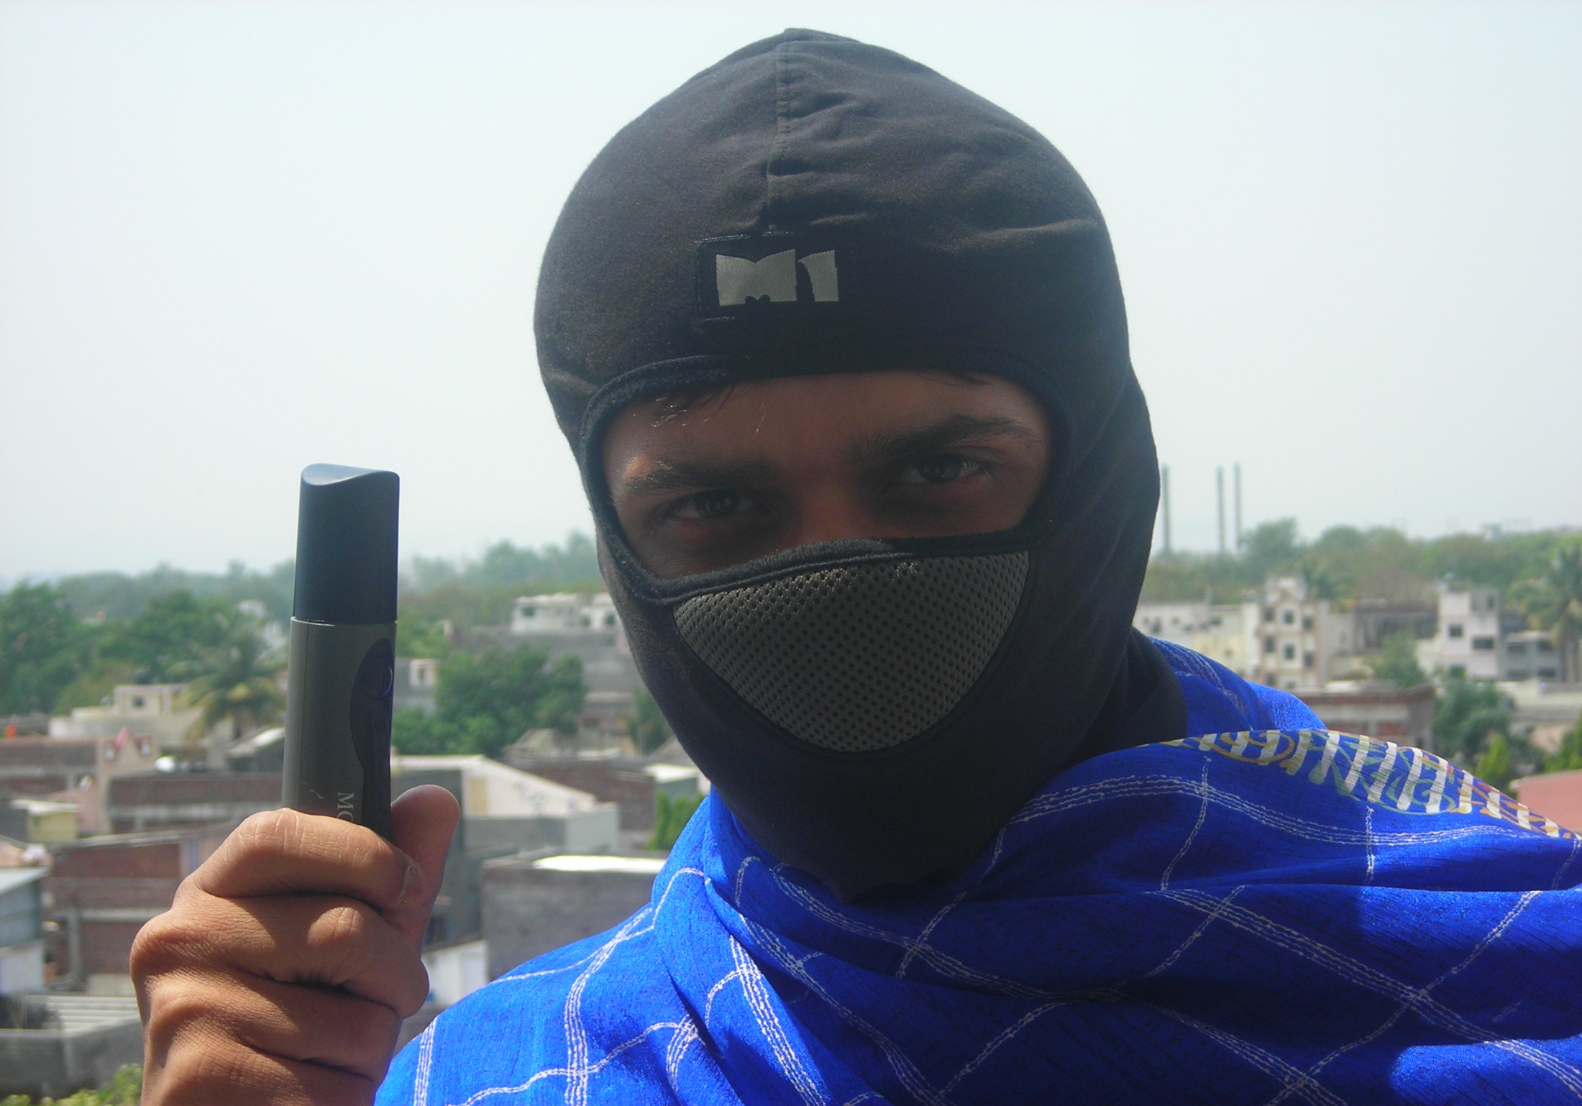
Thank you

