Slide 1
COR PULMONALE

Slide 2
OBJECTIVES
review the anatomy and physiology of the respiratory system
review the anatomy and physiology of the cardiovascular system
interpret the term cor pulmonale
describe the etiology of cor pulmonale

Slide 3
OBJECTIVES CONTINUED…...
discuss the pathogenesis involved in the disease process
examine the clinical manifestations closely
differentiate the various diagnostic measures
explain the medical management

Slide 4
OBJECTIVES CONTINUED…...
identify the surgical management of cor pulmonale
distinguish the nursing management for cor pulmonale including the nursing diagnosis
obtain knowledge on the prognosis of cor pulmonale

Slide 5
REVIEW OF ANATOMY & PHYSIOLOGY
RESPIRATORY SYSTEM

Slide 6
UPPER RESPIRATORY TRACT

Slide 7
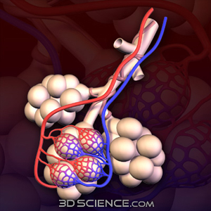
LOWER RESPIRATORY TRACT

Slide 8
LOWER RESPIRATORY TRACT

Slide 9
RESPIRATORY PROCESS

Slide 10
CARDIOVASCULAR SYSTEM

Slide 11
HEART WALLS AND LAYERS

Slide 12
CHAMBERS OF THE HEART

Slide 13
VALVES OF THE HEART

Slide 14
CORONARY ARTERIES

Slide 15
HEART RATES
NORMAL HEART RATE
SINUS TACHYCARDIA

Slide 16
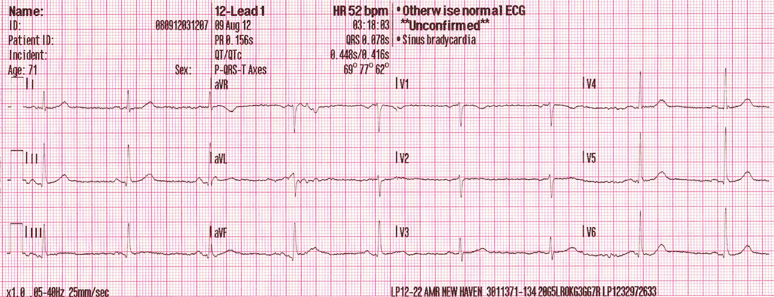
HEART RATES
SINUS BRADYCARDIA

Slide 17
COR PULMONALE

Slide 18
DEFINITION
It is the hypertrophy of the right ventricle resulting from diseases affecting the function and/or structure of the lung, except when these pulmonary alterations are the result of diseases that primarily affect the left side of the heart or congenital heart disease(WHO, 1963)

Slide 19
DEFINITION
It is the enlargement of the right ventricle secondary to diseases of the lung , thorax, or pulmonary circulation. Pulmonary hypertension is usually a pre-existing condition in the individual with cor pulmonale. The most common cause is COPD. (lewis)

Slide 20
DEFINITION
It is a condition in which the right ventricle of the heart enlarges (with or without right sided heart failure) as a result of diseases that affect the structure or function of the lung or its vasculature

Slide 21
ETIOLOGY
Conditions that restrict or compromise ventilatory function, leading to hypoxemia or acidosis e.g. deformities of the thoracic cage, massive obesity
Conditions that reduce the pulmonary vascular bed e.g. primary idiopathic pulmonary arterial hypertension, pulmonary embolus

Slide 22
ETIOLOGY
Disorders involving nervous system, respiratory muscles, chest wall , and pulmonary arterial tree may also be responsible for cor pulmonale

Slide 23
PATHOGENESIS
GENETIC CAUSES
UNKNOWN CAUSES

Slide 24
PATHOGENESIS CONTINUED……
PULMONARY ENDOTHELIAL INJURY

Slide 25
PATHOGENESIS CONTINUED……
VASOCONSTRICTION
REMODELLING

Slide 26
PATHOGENESIS CONTINUED……
SUSTAINED PULMONARY HYPERTENSION
RIGHT VENTRICULAR HYPERTROPHY

Slide 27
PATHOGENESIS CONTINUED……
COR PULMONALE

Slide 28
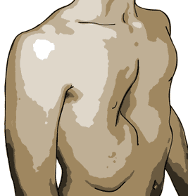
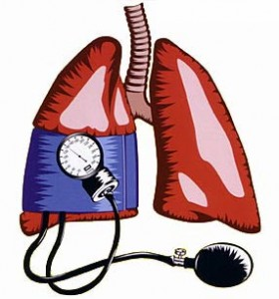
PATHOPHYSIOLOGIC CLASSIFICATION
High altitude dwellers
Hyperventilation syndromes
Chest deformities
Idiopathic pulmonary hypertension
PERSISTENT VASOCONSTRICTION

Slide 29
PATHOPHYSIOLOGIC CLASSIFICATION
Thromboembolic disease
Emphysema
Lung resection
Fibrotic lung disease
Cystic fibrosis
LOSS OF CROSS SECTIONAL AREA OF THE VASCULAR BED

Slide 30
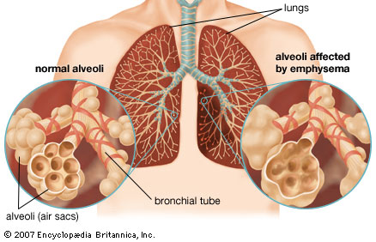

Slide 31
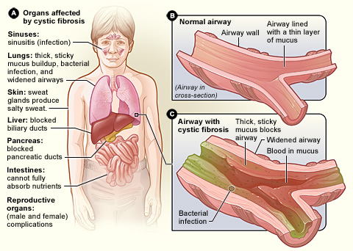

Slide 32
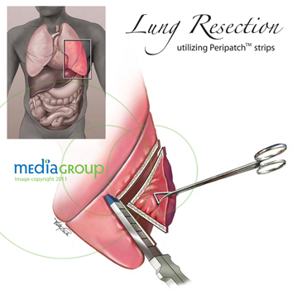

Slide 33
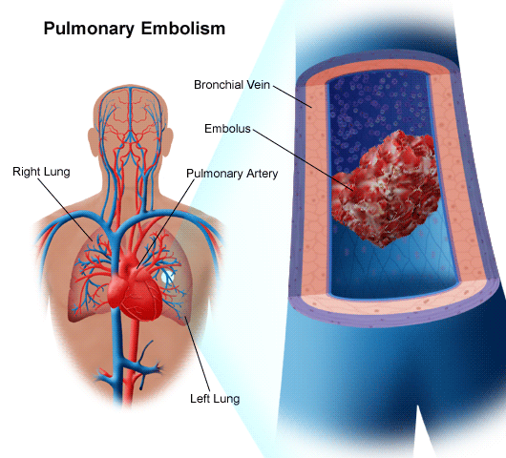

Slide 34
PATHOPHYSIOLOGIC CLASSIFICATION
Extrinsic compression of the pulmonary veins
Fibrosing mediastinitis
Adenopathy or tumors
Pulmonary
veno-occlusive disease
OBSTRUCTION OF LUNG VESSELS

Slide 35
PATHOPHYSIOLOGIC CLASSIFICATION
EISENMENGER SYNDROME
CHRONICALLY INCREASED BLOOD FLOW

Slide 36
PATHOPHYSIOLOGIC CLASSIFICATION
Primary pulmonary hypertension
Secondry pulmonary hypertension
Collagen vascular diseases
Cystic fibrosis
VASCULAR
REMODELLING

Slide 37
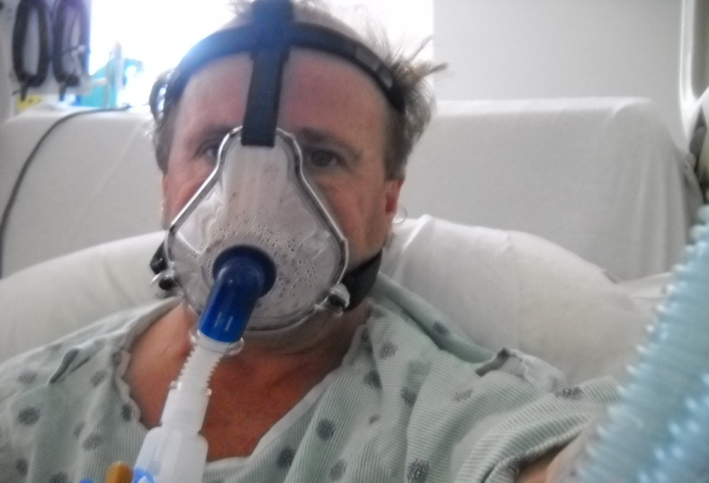
CLINICAL MANIFESTATIONS
Dyspnea
Chronic productive cough
Wheezing respirations
Retrosternal or substernal pain
Fatigue
Polycythemia

Slide 38
CLINICAL MANIFESTATIONS
If heart failure accompanies cor pulmonale additional manifestations such as
Peripheral edema
Weight gain
Distended neck veins
Full bounding pulse
Enlarged liver

Slide 39
CLINICAL MANIFESTATIONS
Palpitation
Atypical chest pain
Swelling of the lower extremities
Dizziness and even syncope

Slide 40
DIAGNOSIS
HISTORY COLLECTION

Slide 41
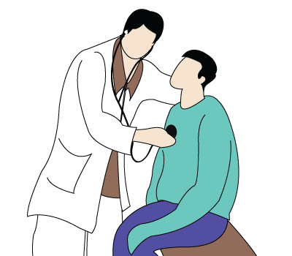
DIAGNOSIS
PHYSICAL EXAMINATION

Slide 42
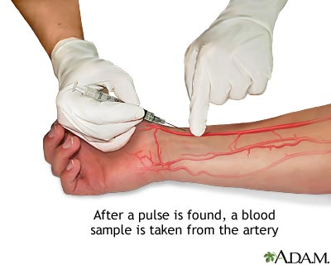
DIAGNOSIS
LABORATORY TESTS
ABG
ANALYSIS
BRAIN
NATRIURETIC
PEPTIDE

Slide 43
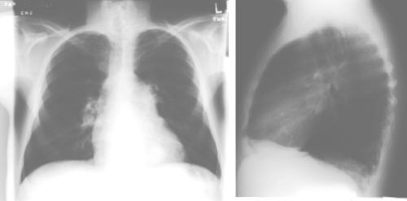
DIAGNOSIS
PULMONARY FUNCTION TEST
CHEST RADIOGRAPHY

Slide 44
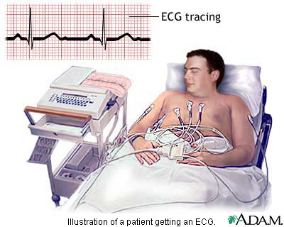
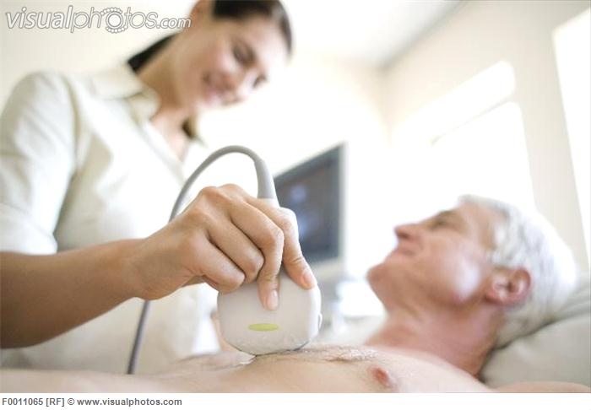
DIAGNOSIS
ELECTROCARDIOGRAPHY
ECHOCARDIOGRAPHY

Slide 45
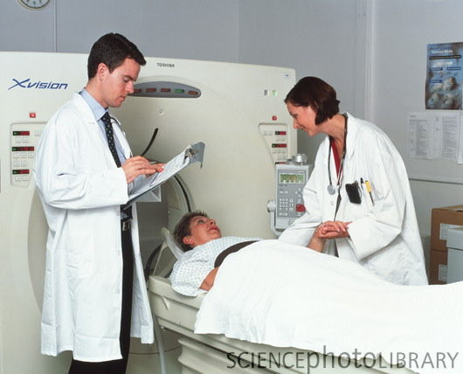
DIAGNOSIS
PULMONARY THROMBOEMBOLISM IMAGING STUDIES
ULTRAFAST, ECG-GATED CT SCANNING

Slide 46
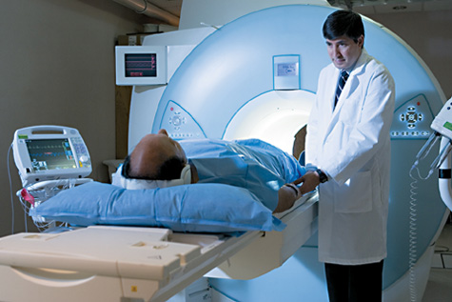
DIAGNOSIS
MAGNETIC RESONANCE IMAGING
NUCLEAR IMAGING

Slide 47
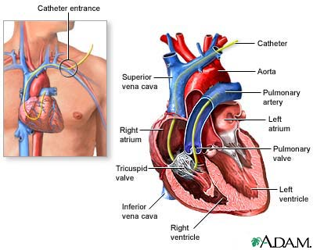
DIAGNOSIS
CARDIAC CATHETERIZATION

Slide 48
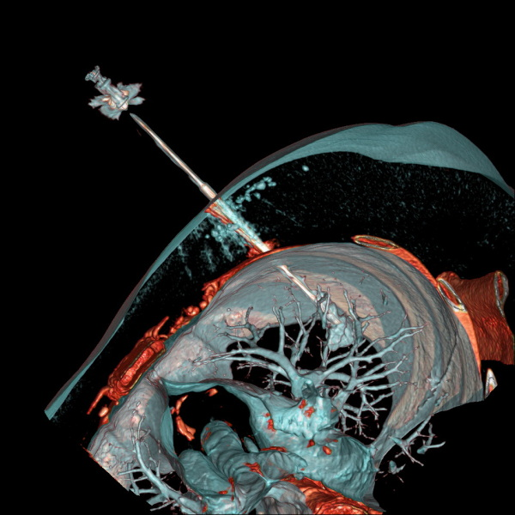
DIAGNOSIS
LUNG BIOPSY

Slide 49
MEDICAL MANAGEMENT
OXYGEN THERAPY

Slide 50
MEDICAL MANAGEMENT
PHARMACOTHERAPY
DIURETIC AGENTS
VASODIALATORS
BETA SELECTIVE AGONISTS
CARDIAC GLYCOSIDES
THEOPHYLLINE
WARFARIN

Slide 51
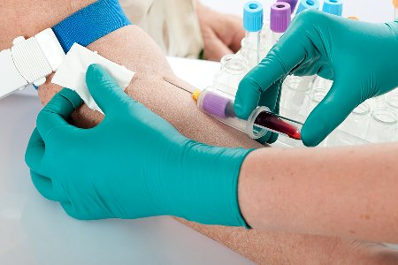
SURGICAL MANAGEMENT
PHLEBOTOMY

Slide 52
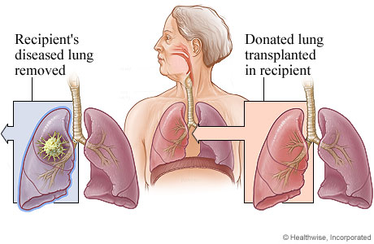
SURGICAL MANAGEMENT
LUNG TRANSPLANTATION

Slide 53
NURSING MANAGEMENT

Slide 54
NURSING DIAGNOSIS
Decreased cardiac output related to restricted cardiac muscle contractility as evidenced by echocardiographic finding
Impaired gas exchange related to expiratory airflow obstruction as evidenced by decreased oxygen saturation levels

Slide 55
NURSING DIAGNOSIS
Impaired tissue perfusion related to decreased cardiac contractility and expiratory airflow obstruction as evidenced by increased capillary refilling time >3 seconds
Activity intolerance related to decreased cardiac activity and laboured respirations as evidenced by difficulty in performing activities of daily living

Slide 56
NURSING DIAGNOSIS
Fatigue related to decreased cardiac activity and laboured respirations as evidenced by difficulty in performing activities of daily living
Anxiety related to breathlessness as evidenced by patient`s verbalization and facial expressions

Slide 57
NURSING DIAGNOSIS
Imbalanced nutrition :less than body requirement related to breathlessness as evidenced by weight loss
Disturbed sleep pattern related to shortness of breath as evidenced by presence of dark circles around the eyes

Slide 58
JOURNAL PRESENTATIONS
A Case Report of Cor Pulmonale in a Woman Without Exposure to Tobacco Smoke: An Example of the Risks of Indoor Wood Burning
Alexander R. Opotowsky, MD, MPH, Rajesh Vedanthan, MD, MPH, and Joseph J. Mamlin, MD

Slide 59
JOURNAL PRESENTATIONS
Chronic Cor Pulmonale in Delhi : A Study of 127 Cases
S. PADMAVATI and S. N. PATHAK

Slide 60
ASSIGNMENT
1.The accessory muscles of respiration includes
a)scalene muscles
b) sternocleidoid muscle
c) trapezius and pectoralis muscle
d) a, b and c

Slide 61
ASSIGNMENT
The most significant change in ECG readings for a patient with cor pulmonale is in
a) Pwave
b) QRS complex
c) ST segment
d) T wave

Slide 62
ASSIGNMENT
An example of cardiac glycoside
a)Digitalis
b) nifidipine
c) theophylline
d) Lasix

Slide 63
ASSIGNMENT
The area of heart mainly affected in cor pulmonale is
a)Left side of heart
b) apex of the heart
c) right side of the heart
d) septum of the heart

Slide 64
REFERENCES
Mason R.J, Braaddus V.C.Murray and Nadel`s :Textbook of Respiratory Medicine. 5th edn. Philadelphia:Saunders;2010.
George R.B,Light R.W. Chestmedicine:Essentials of Pulmonary and Critical Care Medicine. 4th edn . Philadelphia:Lippincott;2000.

Slide 65
REFERENCES
Fauci AS, Braunwald E, Kasper DL, Hauser SL, Longo DL, Jameson JL, et al., editors. Harrison’s principles of internal medicine. 17th ed. New York: McGraw Hill; 2008
Crawform M.H.Current Diagnosis and Treatment in cardiology. 2nd edn . New York: McGraw Hill;2003.

Slide 66
REFERENCES
Michael H.C,Paulus W.J.Cardiology. 3rd edn.Philadelphia:Elsevier;2010.
Johnson J.Y.Brunner anD Suddharth`s:Textbook of Medical Surgical Nursing. 11th edn. Philadelphia:Lippincott;2008.

Slide 67
REFERENCES
Padmavati S, Pathak S.N. Chronic Cor Pulmonale in Delhi. American Heart Association[Internet].aug 28.2012.available from http://circ.ahajournals.org/
Kings E.S, Mandel J.Cor pulmonale[internet].july 9,2012.Available at www.uptodate.com

Slide 68
REFERENCES
Opotowsky a.r, Vedanthan .R, Mamlin J.J. A Case Report of Cor Pulmonale in a Woman Without Exposure to Tobacco Smoke: An Example of the Risks of Indoor Wood Burning.The Medscape journal of Medicine[internet].January 29,2008.available from www.pubmed.com

