Slide 1
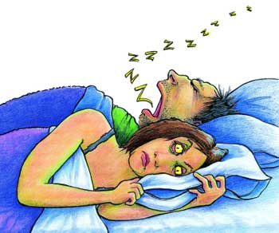
Obstructive Sleep Apnea (OSA)
Dr Muhammed Aslam
Junior Resident
Pulmonary Medicine
Pariyaram medical college

Slide 2
Introduction
OSA is a sleep disorder that involves cessation or significant decrease in airflow in the presence of breathing effort.
It is the most common type of sleep-disordered breathing (SDB) and is characterized by recurrent episodes of upper airway (UA) collapse during sleep

Slide 3
Definitions of respiratory events
Apnea is defined by the American Academy of Sleep Medicine (AASM) as the cessation of airflow for at least 10 seconds.
Hypopnea is defined as a recognizable transient reduction (but not complete cessation) of breathing for 10 seconds or longer, a decrease of greater than 50% in the amplitude of a validated measure of breathing, or a reduction in amplitude of less than 50% associated with oxygen desaturation of 4% or more.

Slide 4
Respiratory effort–related arousal (RERA)
is an event characterized by increasing respiratory effort for 10 seconds or longer leading to an arousal from sleep but one that does not fulfill the criteria for a hypopnea or apnea.

Slide 5
Obstructive events are characterized by continued thoracoabdominal effort in the setting of partial or complete airflow cessation,
Central events by lack of thoracoabdominal effort in this setting.
Mixed events have both obstructive and central features. They generally begin without thoracoabdominal effort and end with several thoracoabdominal efforts in breathing

Slide 6
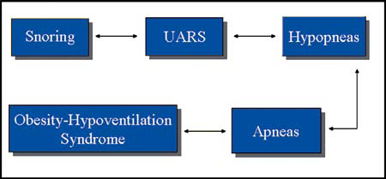
Sleep-related breathing disorder continuum
obstructive sleep apnea should be considered as a continuum of disease, i.e., a spectrum of abnormalities from snoring to obesity-hypoventilation syndrome

Slide 7
Pathophysiology
OSA is caused by soft tissue collapse in the pharynx
Transmural pressure is the difference between intraluminal pressure and the surrounding tissue pressure. If transmural pressure decreases, the cross-sectional area of the pharynx decreases. If this pressure passes a critical point, pharyngeal closing pressure is reached. Exceeding pharyngeal critical pressure (Pcrit) causes tissues collapsing inward. The airway is obstructed.

Slide 8
Anatomic factors
Enlarged tonsils (children)
volume of the tongue
soft tissue
lateral pharyngeal walls
length of the soft palate
abnormal positioning of the maxilla and mandible

Slide 9
Neuromuscular factors
Decreased Neuromuscular activity in the UA, including reflex activity
Reduced ventilatory motor output to upper airway muscles

Slide 10
Etiology-Structural factors
Innate anatomic variations (facial elongation, posterior facial compression)
Retrognathia and micrognathia
Mandibular hypoplasia
Brachycephalic head form
Inferior displacement of the hyoid
Adenotonsillar hypertrophy, particularly in children and young adults
Pierre Robin syndrome
Down syndrome
Marfan syndrome
Prader-Willi syndrome
High, arched palate (particularly in women)

Slide 11
Nasal obstruction -polyps, septal deviation, tumors, trauma, and stenosis.
Retropalatal obstruction -elongated, posteriorly placed palate and uvula ,tonsil and adenoid hypertrophy
Retroglossal obstruction -macroglossia and tumor.

Slide 12
Non structural risk factors
Obesity
Central fat distribution
Male sex (male/female 2:1)
Age
Postmenopausal state
Alcohol use
Sedative use
Smoking
Habitual snoring with daytime somnolence
Supine sleep position
Rapid eye movement (REM) sleep

Slide 13
Other conditions associated
Hypothyroidism (macroglossia ,increased soft tissue mass ,myopathy)
Neurologic syndromes ( postpolio syndrome, muscular dystrophies, and autonomic failure syndromes such as Shy-Drager syndrome)
Stroke
Acromegaly (macroglossia and increased soft tissue mass)
Environmental exposures (smoke, environmental irritants or allergens, and alcohol and hypnotic-sedative medications)

Slide 14
Epidemiology
Prevalence in US has been 2-4% for women and 4-9% for men.
SDB remains undiagnosed in approximately 93% of affected women and 82% of affected men.

Slide 15
History
Nocturnal symptoms
Snoring, usually loud, habitual, and bothersome to others
Witnessed apneas, which often interrupt the snoring and end with a snort
Gasping and choking sensations that arouse the patient from sleep
Nocturia
Insomnia
Restless sleep, with patients often experiencing frequent arousals and tossing or turning during the night

Slide 16
Daytime symptoms
Nonrestorative sleep (ie, “waking up as tired as when they went to bed”)
Morning headache, dry or sore throat
Excessive daytime sleepiness (EDS) that usually begins during quiet activities (eg, reading, watching television); as the severity worsens, patients begin to feel sleepy during activities that generally require alertness (eg, school, work, driving).
Daytime fatigue/tiredness
Cognitive deficits; memory and intellectual impairment (short-term memory, concentration)

Slide 17
Daytime symptoms
Decreased vigilance
Morning confusion
Personality and mood changes, including depression and anxiety
Sexual dysfunction, including impotence and decreased libido
Gastroesophageal reflux
Hypertension
Depression

Slide 18
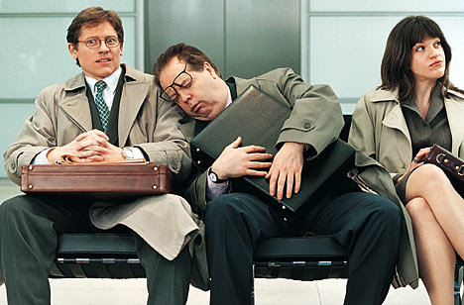
Excessive daytime sleepiness (EDS)

Slide 19
Excessive daytime sleepiness (EDS)
One of the most common and difficult symptoms
Reduces quality of life, impairs daytime performance, and causes neurocognitive deficits (eg, memory deficits).
Assessed using the Epworth Sleepiness Scale (ESS). This questionnaire is used to help determine how frequently the patient is likely to doze off in 8 frequently encountered situations

Slide 20
Epworth Sleepiness Scale (ESS) questionnaire
In contrast to just feeling tired, how likely are you to doze off or fall asleep in the following situations? :
0 =Would never doze
1 = Slight chance of dozing
2=Moderate chanceofdozing
3 = High chance of dozing

Slide 21
Sitting and reading
Watching TV
Sitting inactive a public place (i.e. a theater or a meeting)
As a passenger in a car for an hour without break
Lying down to rest in the afternoon when circumstances permit
Sitting and talking to someone
Sitting quietly after lunch without alcohol
In a car, while stopping for a few minutes in traffic

Slide 22
ESS score of 12 is associated with a greater propensity to fall asleep on the Multiple Sleep Latency Test (MSLT)
ESS is useful for evaluating responses to treatment; the ESS score should decrease with effective treatment.

Slide 23
Physical Examination
Obesity – Body mass index (BMI) greater than 30 kg/m²
Large neck circumference – Greater than 17 inches in men and 15 inches in women
Abnormal (increased) Mallampati score
Narrowing of the lateral airway walls
Enlarged tonsils
Retrognathia or micrognathia
High-arched hard palate

Slide 24
Systemic arterial hypertension, present in approximately 50% of patients with OSA
Congestive heart failure (CHF)
Pulmonary hypertension
Stroke
Metabolic syndrome
Type 2 diabetes mellitus

Slide 25
Cardiovascular Disease in Obstructive Sleep Apnea
Vagal stimulation causes bradycardia
Bradycardia and hypoxia provoke serious cardiac rhythm disturbances i.e. premature beats asystole, ventricular tachycardia , cardiac arrest.

Slide 26
Indices for sleep-disordered breathing
Apnea-hypopnea index (AHI)
The AHI is defined as the average number of episodes of apnea and hypopnea per hour.
Respiratory disturbance index (RDI)
Defined as the average number of respiratory disturbances (obstructive apneas, hypopneas, and respiratory event–related arousals [RERAs]) per hour.

Slide 27
Diagnostic criteria for OSA
Individualsmust fulfill criterion A or B, plus criterion C to be diagnosed with OSAS:
A. Excessive daytime sleepiness that is not explained by other factors
B. Two or more of the following that are not explained
by other factors:
-Choking or gasping during sleep
-Recurrent awakenings from sleep
-Unrefreshing sleep
-Daytime fatigue
- Impaired concentration

Slide 28
C. Overnight monitoring demonstrates 5 to 10 or more obstructed breathing events per hour during sleep
or
greater than 30 events per 6 hours of sleep.
These events may include any combination of obstructive apnea, hypopnea, or respiratory effort–related arousals.

Slide 29
Workup
An overnight sleep study,or polysomnography:
In-laboratory measurement of sleep architecture and electroencephalographic (EEG) arousals, eye movements, chin movements, airflow, respiratory effort, oximetry, electrocardiographic (ECG) tracings, body position, snoring, and leg movements

Slide 30
Routine laboratory tests usually are not helpful in obstructive sleep apnea (OSA) unless a specific indication is present.
Routine radiographic imaging of the UA is not performed.

Slide 31
AASM guidelines for performance of PSG
Sleep stages are recorded via an EEG, electrooculogram, and chin electromyogram (EMG).
Heart rhythm is monitored with a single-lead ECG.
Leg movements are recorded via an anterior tibialis EMG.
Breathing is monitored, including airflow at the nose and mouth (using both a thermal sensors and a nasal pressure transducer), effort (using inductance plethysmography), and oxygen saturation.
The breathing pattern is analyzed for the presence of apneas and hypopneas

Slide 32
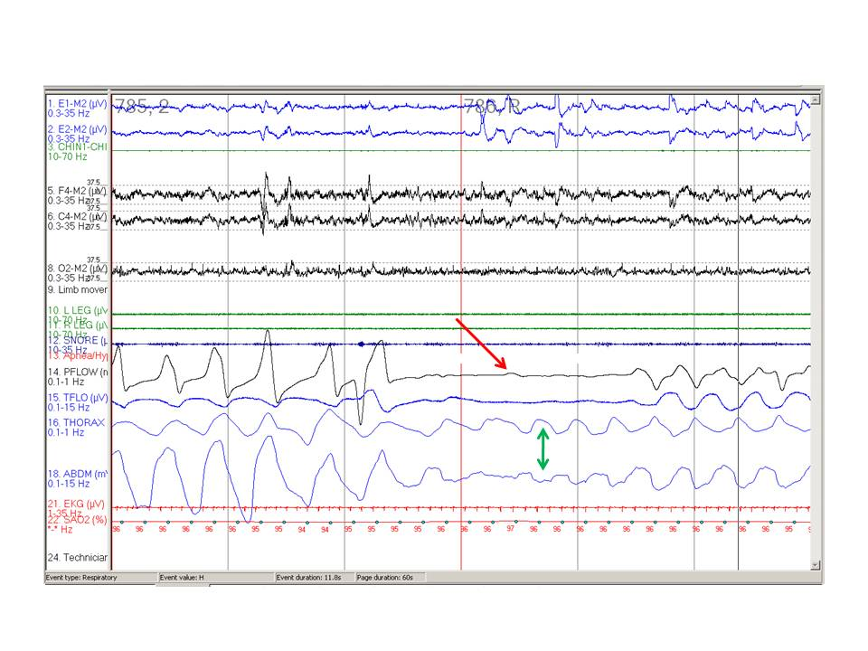
Obstructive apnea is the cessation of airflow for at least 10 seconds with persistent respiratory effort

Slide 33
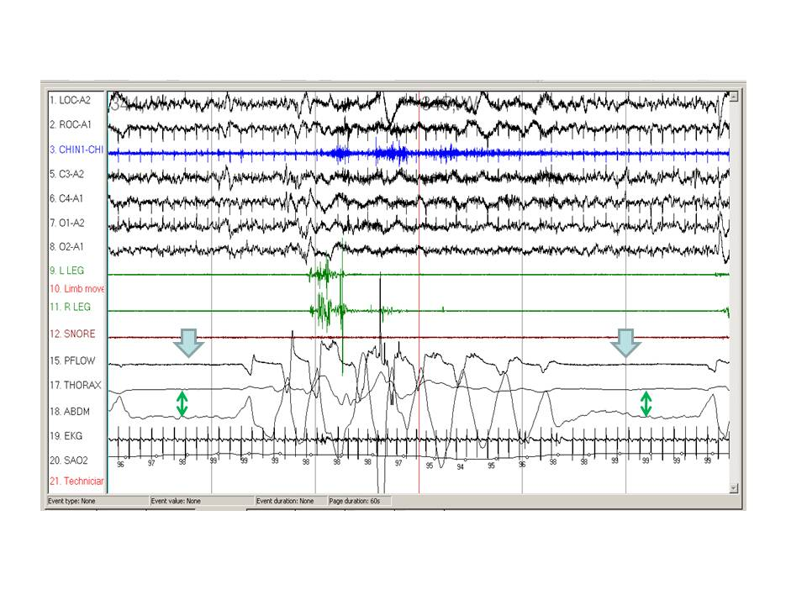
Central apnea is the cessation of airflow for at least 10 seconds with no respiratory effort

Slide 34
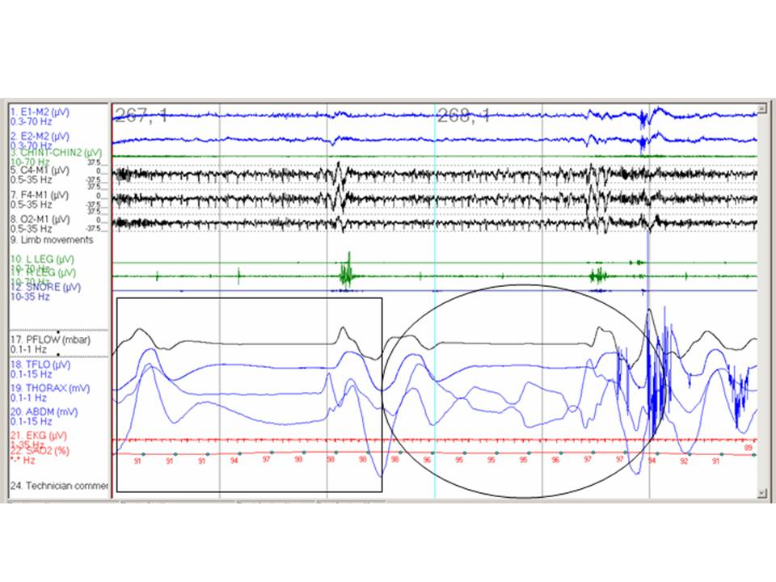
Mixed apnea is an apnea that begins as a central apnea and ends as an obstructive apnea
Comparison of a central apnea (box) and obstructive apnea (circle).

Slide 35
The Apnea-hypopnea index (AHI)
derived from the total number of apneas and hypopneas divided by the total sleep time
Most sleep centers use a cutoff of 5-10 episodes per hour as normal
5-15 episodes per hour for mild
15-30 episodes per hour for moderate,
more than 30 episodes per hour for severe.

Slide 36
Split-night PSG
Patients with a respiratory disturbance index (RDI) higher than 40 during the first 2 hours of diagnostic PSG should undergo a split-night PSG study.
The final portion of the study is used for titrating the continuous positive airway pressure (CPAP) device.

Slide 37
Home testing
3 levels of portable monitors are
(a) level 2, a portable monitor with the same parameters as a full attended PSG (includes EEG)
(b) level 3, with at least 4 channels, including flow, effort, oximetry and heart rate
(c) level 4, with fewer than 4 channels, often oximetry with flow or oximetry alone.
level 3 monitors are best used to confirm the diagnosis of OSA

Slide 38
Multiple sleep latency test [MSLT ]
Objective measurement of excessive daytime sleepiness (EDS)
consists of 4-5 naps of 20-minute duration every 2 hours during the day.
The latency to sleep onset for each nap is averaged to determine the daytime sleep latency.
Normal daytime sleep latency is greater than 10-15 minutes.
OSAHS is generally associated with latencies of less than 10 minutes.

Slide 39
MSLT is generally used to confirm the diagnosis of narcolepsy in patients in whom narcolepsy is a consideration.
Narcoleptic patients have rapid eye movement sleep on at least 2 of the 4-5 naps during the day

Slide 40
Treatment
Mild apnea have a wider variety of options,
Moderate-to-severe apnea should be treated with nasal continuous positive airway pressure (CPAP).

Slide 41
conservative nonsurgical treatment
Weight loss- 10% reduction in weight leads to a 26% reduction in the respiratory disturbance index (RDI)
Avoidance of alcohol for 4-6 hours prior to bedtime
Sleeping on one’s side rather than on the stomach or back

Slide 42
Nasal CPAP Therapy
The most effective treatment for OSA
Increases the caliber of the airway in the retropalatal and retroglossal regions
It increases the lateral dimensions of the UA and thins the lateral pharyngeal walls
Maintain UA patency during sleep, preventing the soft tissues from collapsing

Slide 43
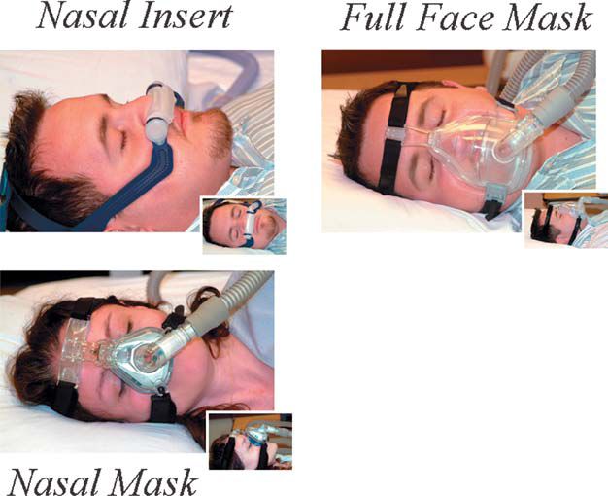

Slide 44
Guidelines for use of cpap
All patients with an apnea-hypopnea index (AHI) greater than 15 regardless of symptomatology.
For patients with an AHI of 5-14.9, CPAP is indicated if the patient has one of the following: excessive daytime sleepiness (EDS), hypertension, or cardiovascular disease.

Slide 45
Complications and adverse effects
Sensation of suffocation or claustrophobia
Difficulty exhaling
Inability to sleep
Musculoskeletal chest discomfort
Aerophagia
Sinus discomfort.
Pneumothorax and/or pneumomediastinum (extremely rare)
Pneumoencephalos (isolated case report)
Tympanic membrane rupture (rare).
Mask-related problems include skin abrasions, rash, and conjunctivitis
Nasal problems can include rhinorrhea, nasal congestion, epistaxis, and nasal and/or oral dryness.

Slide 46
Other modalities
BiPAP Therapy
Oral Appliance Therapy
Surgical Correction of the Upper Airway

Slide 47
Surgery for Obstructive Sleep Apnea
Nasal surgery (septoplasty, sinus surgery, and others)
Tonsillectomy ± adenoidectomy
Uvulopalatopharyngoplasty (UPPP)
Laser assisted uvulopalatoplasty (LAUP)
Radiofrequency volumetric tissue reduction
Linguaplasty
Genioglossus and hyoid advancement (GAHM)
Sliding genioplasty
Maxillo-mandibular advancement osteotomy
Tracheostomy

Slide 48
Pharmacologic therapy
Modafinil is approved by the US Food and Drug Administration (FDA) for use in patients who have residual daytime sleepiness despite optimal use of CPAP.
Selective serotonin reuptake inhibitor agents such as paroxetine (Paxil) and fluoxetine (Prozac) have been shownto increase genioglossal muscle activity and decrease REM sleep (apneas are more common in REM), although this has not translated to a reduction in AHI in apnea patients

Slide 49
Obstructive Sleep Apnea in Special Populations
Children
Prevalence-2% , equal in boys and girls
Adenotonsillar hypertrophy is the major etiology
EDS is not a common symptom but problems with school work
Tonsillectomy is the major treatment.
Pregnancy
IUGR is associated with pregnant women with untreated OSAHS.

Slide 50
Upper Airway Resistance Syndrome
Abnormal respiratory effort,nasal airflow limitation, minimal or no oxygen desaturation (greater than 90 percent oxygen saturation), and frequent sleep arousals in the absence of obstructive apneas
Untreated diagnosed UARS patients over a 4-year period were found to have increased symptoms of daytime fatigue, insomnia, depression, increased sleep disturbance
First-line treatment is CPAP

Slide 51
Obesity hypoventilation syndrome or the Pickwickian syndrome
Defined by morbid obesity (body mass index greater than 40 kg/m2) and chronic hypoventilation with hypercapnia (PaCO2 greater than 45 mmHg) during wakefulness.
Characteristic findings observed include awake resting hypoxemia, hypersomnolence, signs of cor pulmonale (right-sided heart failure and lower extremity edema), and nocturnal hypoventilation.
The diagnosis of OHS requires a demonstration of at least a 10 mmHg increment in PaCO2 during sleep.

Slide 52
The treatment strategy for OHS begins with weightloss, which improves pulmonary function, central ventilatory drive, and concomitant OSA.
However, it should notbe used as the only strategy, as it is difficult to achieve and maintain.
Nocturnal non-invasive ventilation, the treatment of choice, has been demonstrated to correct daytime and nighttime hypoxemia and hypercapnia, ameliorate sleep fragmentation,allow for respiratory muscle rest, reduce pulmonary artery pressures, and improve right ventricular function.

Slide 53
OSA related syndromes
Syndrome Z :
syndrome X(metabolic syndrome) + OSA.
Overlap syndrome :
chronic obstructive pulmonary disease +OSA

