Slide 1
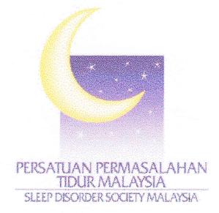
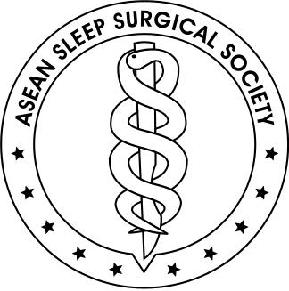

Snoring & Obstructive Sleep Apnea
-Clinical Staging & Treatment
Dr Raymond Tan AIIMS, FRCS(Glasgow)
Consultant ENT Surgeon
iHeal Medical Center
Taman Desa Medical Centre
Treasurer
Sleep Disorder Society of Malaysia(SDSM)
MPCN Talk-19th Oct 2013

Slide 2
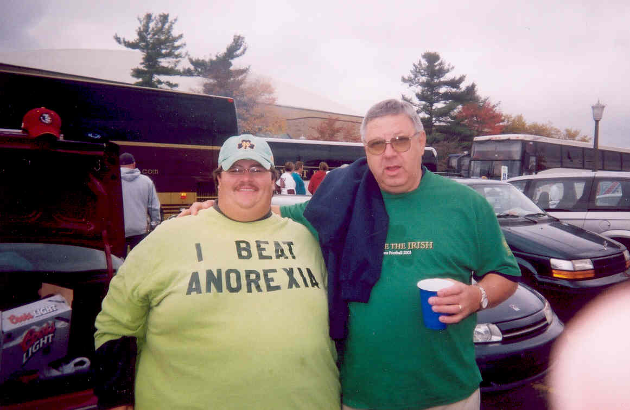
Container
(Skeletal
Framework) vs
Contents
(Soft Tissue)

Slide 3
Typical case scenarios…
Dr, I fall asleep at the wheel and have had 3 car accidents, please help me…
Dr, I really, really LOVE my husband…but when he sleeps, I really, really HATE him…please help him
Dr, I am a walking zombie and I’ve seen 20 doctors…please help me….

Slide 4
SNORING
“ A coarse sound made by VIBRATIONS of the soft palate, and other tissue in the mouth, nose, & throat (upper airway). It is caused by the TURBULENCE inside the airway during INSPIRATION”
- British Snoring & Sleep Apnoea Association

Slide 5
OBSTRUCTIVE SLEEP APNOEA
(OSA)
“ A clinical condition/ spectrum* in which the upper airway collapses intermittently & repeatedly during sleep”
Apnoea (complete obstruction)
ten second breathing pause
and/or
Hypopnoea (partial/ reduction in cross sectional area)
ten second event where there is continued breathing but ventilation is reduced by at least 50% from the previous baseline during sleep
British Snoring & Sleep Apnoea Association

Slide 6
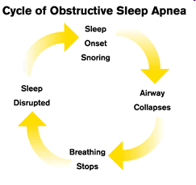

Slide 7
Epidemiology of OSA
25 to 58% of men (N Engl J Med 2003)
10 to 37% women (Sleep heart Health Study 2002)
20 -41% men and women > 65 years less obese populations (Sleep 1991)
Only 4% men and 2% women have symptomatic OSA (Sleep heart Health Study 2002)
Notes:
7

Slide 8
WHO IS AT RISK?
OBESITY
SEX
AGE
HYPERTENSIVES
HEART FAILURE
PATIENTS
CORONARY ARTERY
SYNDROMES
DIABETICS

Slide 9
WHO IS AT RISK?
Obesity: most powerful risk factor for OSA
OBESITY
70% OSA PTS ARE OBESE (Lancet, 2002)
40% OBESE SUBJECTS HAVE OSA (Arch Intern Med 2002)
MORBIDLY OBESE(BMI>40),98% OSA (Obes Res 2000)
Notes:
9

Slide 10

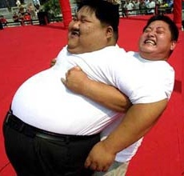
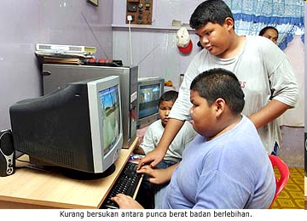
3rd Malaysian National Health Morbidity Survey 2006
14% Malaysians are obese
29% Malaysians are overweight
1 in 5 Malaysian children is obese
20% of Malaysians above 50 years old are diabetics
Urban=rural
Indians>Malays>Chinese

Slide 11
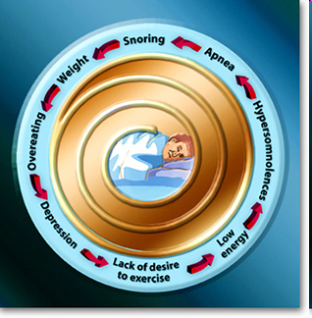
OSA-Obesity Vicious Cycle
OSA individuals get tired.. Eating for Stimulation….put on more weight….OSA worsens
Notes:
11

Slide 12
SNORING
Simple snoring Snoring
With Apnea
Disturbances to others, fatigue, morning tiredness, headache, sore throat & dry mouth
Symptom of sleep apnoea which is frequently associated with hypertension, stroke, and other cardiopulmonary problems

Slide 13
Measurement of severity in OSAHS
Apnoea/ Hypopnoea Index (AHI)
or
Respiratory Disturbance Index (RDI)
Mild: 5-14/hr
Moderate: 15-30/hr
Severe: >30/hr

Slide 14
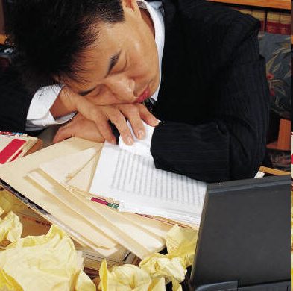
CLINICAL FEATURES
Common
• Loud snoring*
• Excessive daytime sleepiness*
• Feelings of choking or shortness of breath at night
• Restless sleep
• Unrefreshing sleep
• Changes in personality (impaired concentration*
anxiety, irritability, depression, forgetfulness)
• Nocturia

Slide 15
CLINICAL FEATURES
Less common
• Morning headaches
• Enuresis
• Reduced libido
• Spouse worried by apnoeic pauses
• Nocturnal sweating
Rare
• Recurrent arousals/ insomnia
• Nocturnal cough
• Symptomatic oesophageal reflux

Slide 16

Rhinitis & Sleep
Longer Sleep latency time
Unrefreshing sleep leading to daytme sleepiness
Nasal blockage can cause Obstructive Sleep Apnea (OSA)

Slide 17
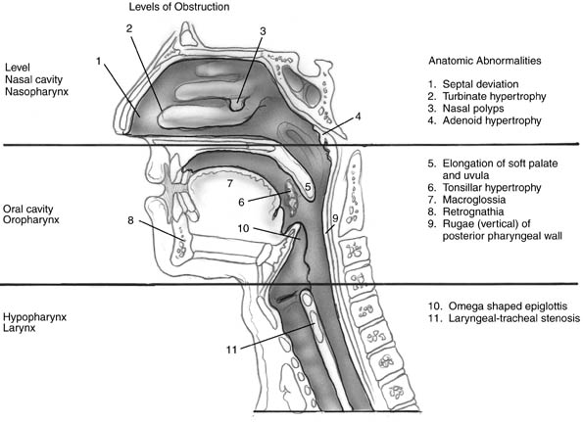
Air flows from atmosphere, through the nose to the lung, via upper airway
Nose Surgery is Pivotal, Not Primary

Slide 18
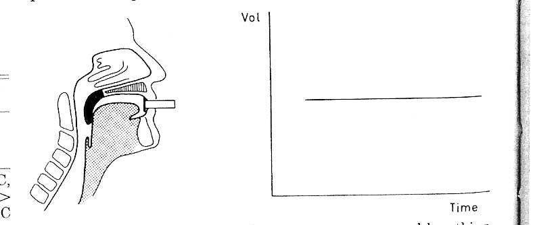
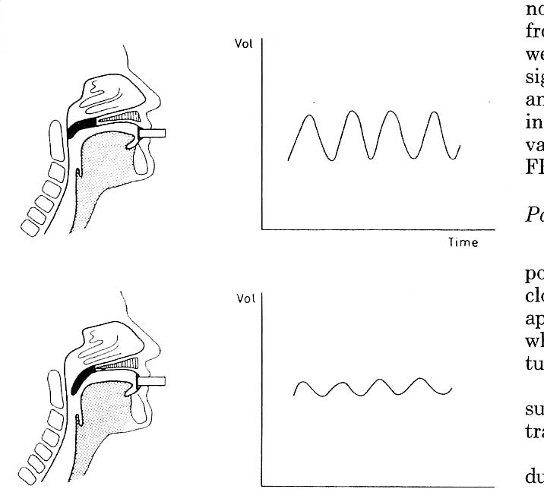
Oro-nasal Breathing
Nasal
Primary route breathing
Oro-nasal
Shift at onset of turbulence
Oral
Shift with full turbulence
Mediated via nasal and pharyngeal
pressure receptors

Slide 19
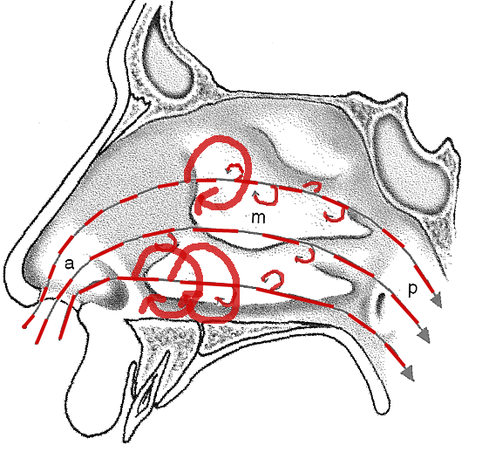
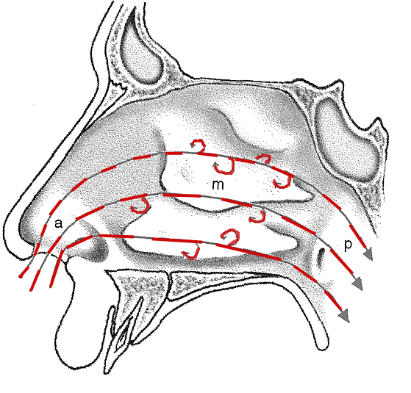

Slide 20
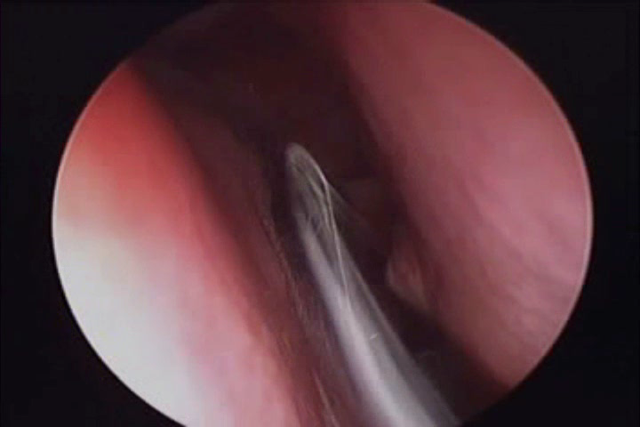
Nasal Laminar Air Flow

Slide 21
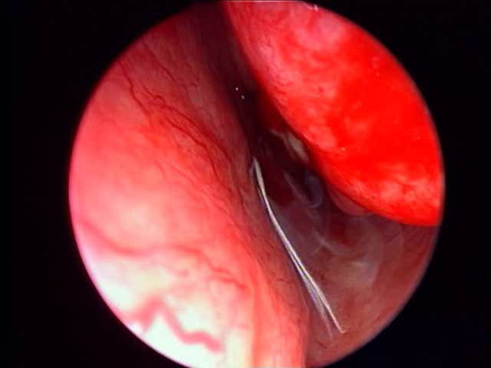
Air Flow Stasis/Turbulence

Slide 22
Nasal Resistance
2/3 of total upper airway resistance
Nasal cycle
  2-4 hour awake upright (70% subjects)
  Supine position worsens bilaterally
  Lateral recumbancy worsens ipsilaterally
Symptoms
  Poor correlations of objective Rn to symptoms

Slide 23
Success Criteria
Objective
50% reduction from pre-op AHI
&
Post-op AHI < 20 or AHI < 15
Subjective
QOL, Epworth, Snoring

Slide 24
CONSEQUENCES OF UNTREATED SLEEP APNOEA
August 2009 Issue of PLoS Medicine
Sleep-Disordered Breathing and Mortality:
A Prospective Cohort Study-Johns Hopkins
School Of Medicine
Naresh M. Punjabi1*, Brian S. Caffo1, James L. Goodwin2, Daniel J. Gottlieb3, Anne B. Newman4, George T. O'Connor5, David M. Rapoport6, Susan Redline7, Helaine E. Resnick8, John A. Robbins9, Eyal Shahar2, Mark L. Unruh4, Jonathan M. Samet
Notes:
24

Slide 25
August 2009 Issue of PLoS Medicine
Sleep-Disordered Breathing and Mortality: A Prospective Cohort Study - Johns Hopkins
Method
6,441 men and women above 40 years old studied over a period of 8 years
Home sleep study done at start of study
Notes:
25

Slide 26
August 2009 Issue of PLoS Medicine
Sleep-Disordered Breathing and Mortality: A Prospective Cohort Study - Johns Hopkins
Results
Average follow up: 8.2 years
1,047 deaths among 6,441 study population
Notes:
26

Slide 27
August 2009 Issue of PLoS Medicine
Sleep-Disordered Breathing and Mortality: A Prospective Cohort Study - Johns Hopkins
Results
1 in 4 Men, 1 in 10 Women had OSA
Men 40-70 years old with severe OSA: DOUBLING of chance of dying
Especially from coronary artery disease and sudden cardiac deaths
Heart attacks occurred between 10 p.m. to 6 a.m
Notes:
27

Slide 28
August 2009 Issue of PLoS Medicine
Sleep-Disordered Breathing and Mortality: A Prospective Cohort Study - Johns Hopkins
Discussion
Hypoxemia causes dangerous arrhythmias resulting in sudden cardiac deaths
Notes:
28

Slide 29
CONSEQUENCES OF UNTREATED SLEEP APNOEA
Increased risk of hypertension-Independent risk factor [N Engl J Med 2000;342:1378-84]
Myocardial Infarct: 23X increased risk [Hung et al., Association of sleep apnoea with myocardial infarction in men, Lancet 336 (1990) (8710)]
Premature deaths: 2X increased risk , 1 in 4 males, 1 in 10 females [John Hopkins Study[PLoS Med 2009 6(8)]
Increased risk of strokes: 3x (American Journal of Respiratory and Critical Care Medicine 2010)

Slide 30
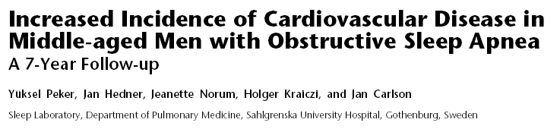

Slide 31
CONSEQUENCES OF UNTREATED SLEEP APNOEA
Daytime sleepiness- work and study suffers
Impaired cognitive function, memory problems
Depression, anxiety, panic attacks

Slide 32
CONSEQUENCES OF UNTREATED SLEEP APNOEA
Worsened relationship between spouse/ partner...Grounds for divorce in US!...British study…wives sleep only 3-5hrs a night
Look older, look tired, decrease sexual libido, impotency
Reduced in alertness: Road traffic accident..7X UK DVLA licence suspended, sleepy drivers cause 300x more accidents than drunk drivers

Slide 33
Childhood Sleep Apnea
Hong Kong Childhood
OSA Prevalence Study:
5 % children have OSA
Boys > Girls

Slide 34
Childhood Sleep Apnea
Diagnose early, prevent consequences
AHI>1
Large tonsils, allergy, obesity,
Craniofacial &
neuromuscular abnormalities

Slide 35
Childhood Sleep Apnea
Neurocognitive deficits, attention-deficit hyperactivity disorders
Increased BP
Left ventricular dysfunction

Slide 36
DIAGNOSIS
HISTORY
PHYSICAL EXAMINATION + AIRWAY ASSESSMENT
QUESTIONNAIRE’S: STOP, ESS
DIAGNOSTIC TOOLS
  SLEEP STUDIES
  MULLER’S MANOEUVRE

Slide 37
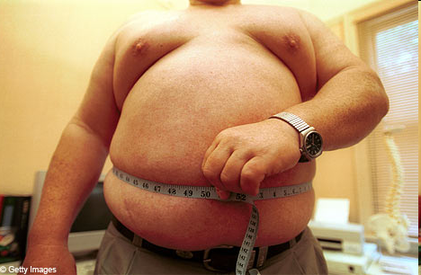
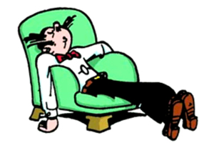
PHYSICAL EXAMINATION/ AIRWAY ASSESSMENT
Weight & Height: BMI
Neck circumference (>16”)
Abdominal Circumference
Abnormal size of mandible
Nasal patency
Tongue (macroglossia), dentition, teeth

Slide 38
PHYSICAL EXAMINATION/ ENT ASSESSMENT
Pharyngeal appearances (tonsils, uvula, lumen)
Blood pressure
Routine respiratory, cardiovascular & neurological examination (i.e. cor pulmonale, chest wall deformity, myopathies)
FEV1, FVC
Endocrine abnormalities (hypothyroidism, acromegaly)

Slide 39
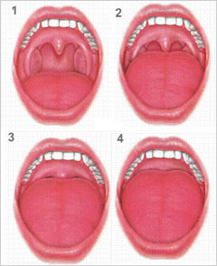
Friedman’s Palatal Position Grading

Slide 40
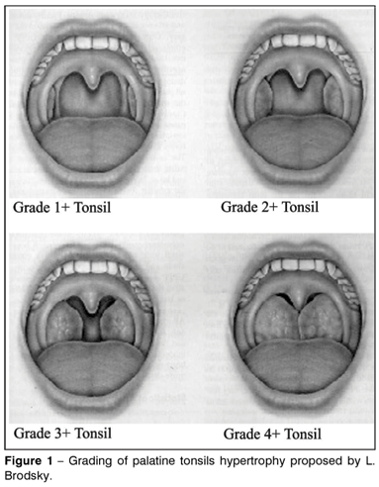
Tonsil Size Grading

Slide 41
ESS (Epworth Sleepiness Score)
0 - Would never doze off
1 - Slight chance of dozing off
2 - Moderate chance of dozing off
3 - High chance of dozing off
Score situation
_____ Sitting and reading
_____ Watching TV
_____ Sitting inactive in a public place (e.g., theatre, meeting)
_____ As a passenger in a car for an hour without break
_____ Lying down to rest in the afternoon when circumstances permit
_____ Sitting and talking to someone
_____ Sitting quietly after a lunch without alcohol
_____ In a car, while stopped for a few minutes in the traffic
_____ Total
Normal range: <11 Mild: 11-14 Severe:>18

Slide 42
STOP
Questionnaire for OSA
The STOP test consists of four questions:
S: Do you snore loudly?
T: Do you often feel tired, fatigued or sleepy during daytime?
O: Has anyone observed you stop breathing during sleep?
P: Do you have or are you being treated for high blood pressure?
2 or more yes: High risk for obstructive sleep apnea
Anaesthesiology. 2008 May;108(5): Chung F, University of Toronto, Toronto
Western Hospital, University Health Network, Toronto, Ontario, Canada.

Slide 43
SLEEP STUDIES
OBJECTIVE EVALUATIONS

Slide 44
Sleep studies
Lab-based
Home-based
Polysomnography (gold standard)
Ambulatory home monitoring devices
- Continuous monitoring
- More parameters recorded
- Less expensive
-Familiar sleep environment
-Convenient
High cost
Long waiting period
Unfamiliar sleep environment
- Unattended equipment
- Data may be lost
- Other tests required

Slide 45

Polysomnography
Parameters measured:
2 - 6 channels of EEG
2 channels of EOG
Chin EMG
Airflow from the nose and mouth
Respiratory effort
Body position
1 channel of ECG
Oxymetry
2 channels of leg EMG

Slide 46
Home monitoring device
Polysomnograph

Slide 47
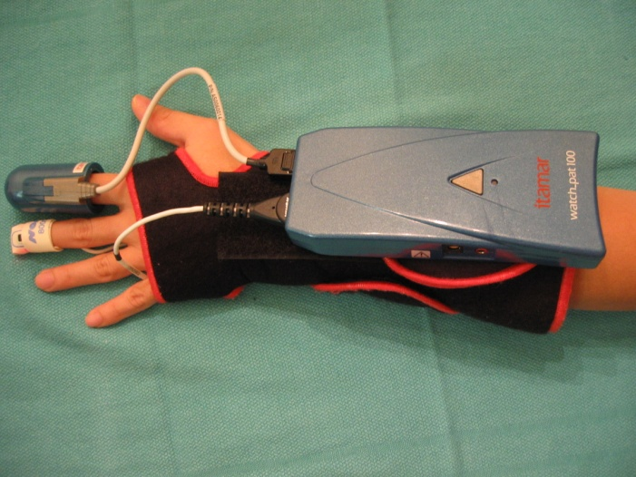
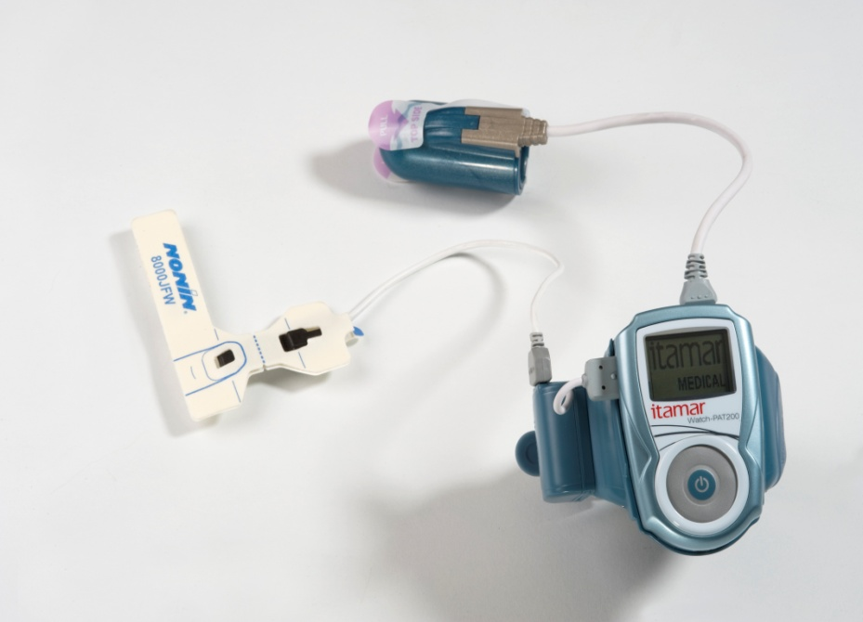
Watch PAT
Diagnostic Device for Sleep Apnea
Records 3 main parameters
(1) Actigraphy
(2) Pulse Oximetry
(3) Peripheral Arterial Tonometry
Self-administered
Portable
Non- invasive
Reliable

Slide 48
Watch PAT
Watch PAT Mechanics:
2 finger probes
3 parameters : Actigarphy, Pulse Oximetry, Peripheral Arterial Tonometry
Actigraph – determines sleep/wake stages
Pulse oximetry – oxygen saturation
PAT – records sympathetic tone

Slide 49

Watch PAT
Great as a diagnostic device for OSA.
Small, lightweight
Non-invasive
Reliable, accurate
Convenient
Easy-to-use
Safe
No risk

Slide 50
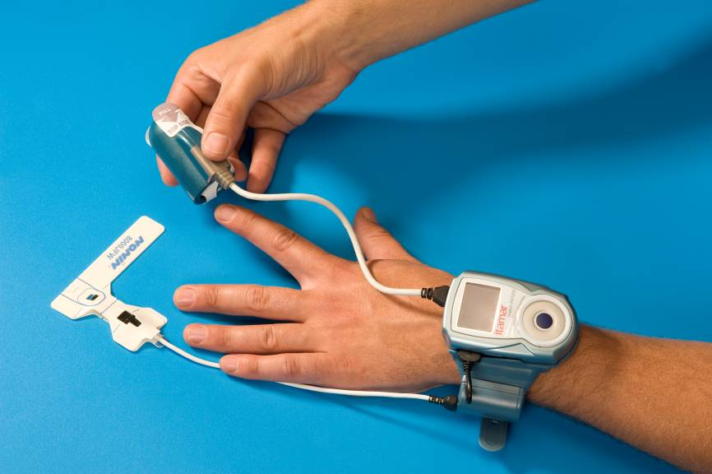
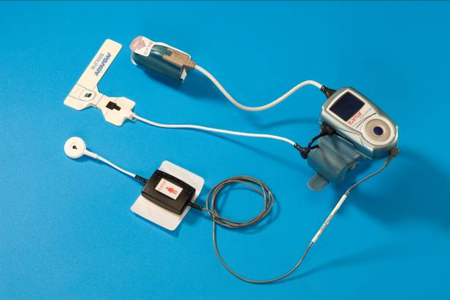
Watch-PAT200
50
Notes:
50

Slide 51
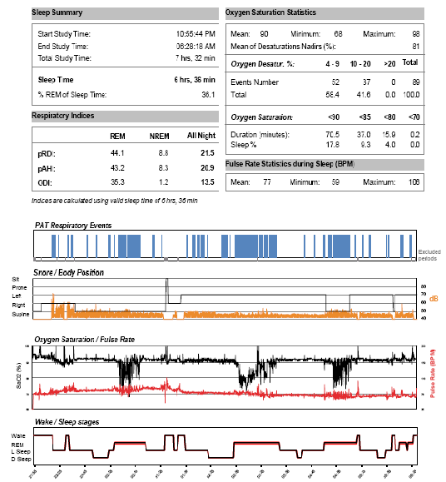
Watch-PAT Report
51

Slide 52
Primary Snoring
Resting
Muller's Maneuver
Jaw Thrust
Jaw Open
Mild Obstructive Sleep Apnea
Resting
Muller's Maneuver
Jaw Thrust
Jaw Open

Slide 53
Moderately Severe Obstructive Sleep Apnea
Resting
Muller's Maneuver
Jaw Thrust
Jaw Open
Severe Obstructive Sleep Apnea
Resting
Muller's Maneuver
Jaw Thrust
Jaw Open

Slide 54
MANAGEMENT
WHO TO TREAT?
Recommendation: Symptomatic AHI >5
BEHAVIOURAL INTERVENTION
  Loss weight, cessation of smoking, avoid alcohol & sedatives drugs
  Sleeping habits: sleep by the side (sew tennis ball into pyjamas back), establish regular sleeping pattern, sleep without pillow

Slide 55
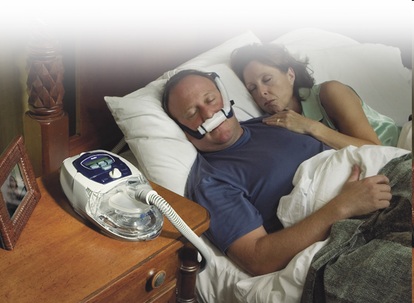
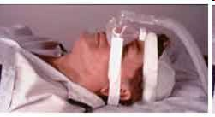
Treatment -CPAP
Continuous positive airway pressure (CPAP).
Face mask connected to pump – high-pressured air forced into the nasal passages

Slide 56
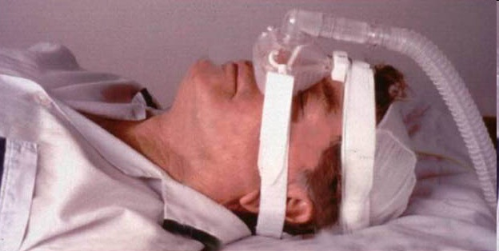
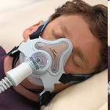
Treatment - CPAP
Nasal CPAP - airway pressure delivered through nose continuously during inspiration and expiration.
Full face CPAP - covers both nose and mouth

Slide 57
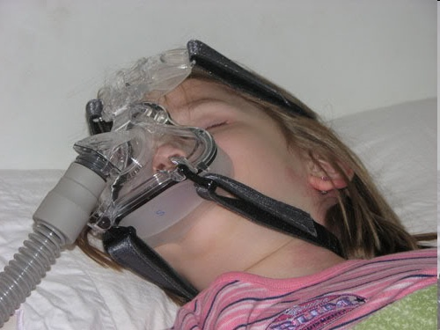
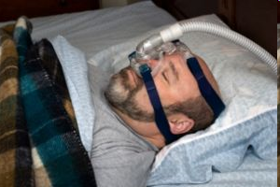
Treatment -CPAP
Advantages
  No surgical intervention
  Quality of life and sleep improves
  Daytime sleepiness lessened
  Heart function and hypertension improves

Slide 58
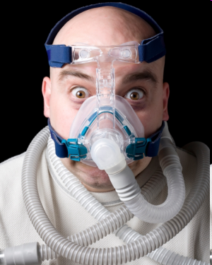
Treatment – CPAP (Cont’d)
Disadvantages
Life long treatment-not a cure
  Non-compliance, Claustrophobia
  Side effects of CPAP:
    Nose block and bleeds
    Sore eyes , dry throat
    Abdominal bloating and chest muscle discomfort
    Rash, skin abrasions, and conjunctivitis
    Sound of the machine

Slide 59
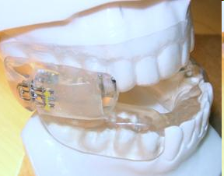

Treatment - MAD
Mandibular Advancement Devices

Slide 60
Surgery
Inpatients who have failed or not keen on CPAP
Where CPAP pressures are too high due to anatomical obstruction

Slide 61
Adenotonsillectomy
For patients with large tonsils and adenoids
In children, this procedure is the mainstay of treatment for OSA. 25% or more cure rate. Rest still need nasal steroids, CPAP.
(J Pediatr 2006;149:803-8)

Slide 62


Slide 63
Nasal Surgery
Patients with nasal obstruction eg nasal polyps, enlarged turbinates, deviated septums

Slide 64
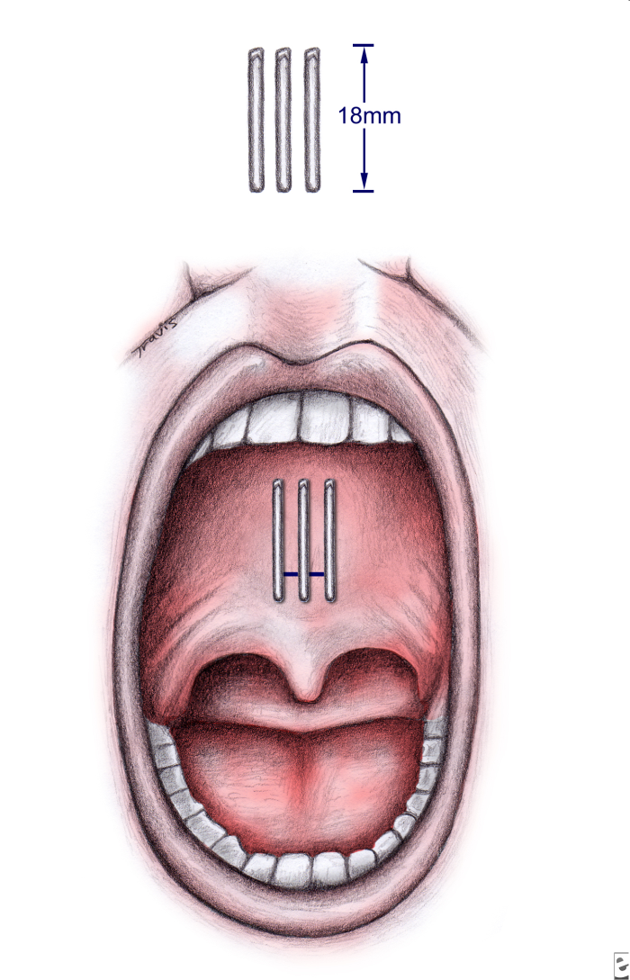
Pillar Implants
The overall efficacy is limited in these groups of patients with mild OSA.
Efficacy of Pillar® palatal implants
in patients with OSA
SwissMedWkly 2009;139(43-44):624-629

Slide 65

RFA Somnoplasty
Radio Frequency Ablation
Quick outpatient clinic procedure under local or general anaesthesia
RFA probe stiffens soft palate
RF volume reduction base of tongue, nasal turbinates
80% patients reported reduced snoring
High patient acceptability

Slide 66
UPPP
A procedure used to remove excess tissue at the back of the throat (tonsils, uvula, and 1/3rd of the soft palate)
Requires general anaesthesia and an overnight hospital stay
Very painful
Long-term nasal regurgitation of food

Slide 67
Anterior Palatoplasty
(The Palatal Lift)
for the Treatment of OSA
– 3 year results
Otolaryngology - Head and Neck Surgery 2009, Volume 141, Issue 2, Pages 253-256
Kenny P. Pang FRCSEd, FRCSI(OTO)
Raymond Tan FRCS(Glas)
P. Puraviappan MS(ORL)
David J. Terris M.D. F.A.C.S.

Slide 68
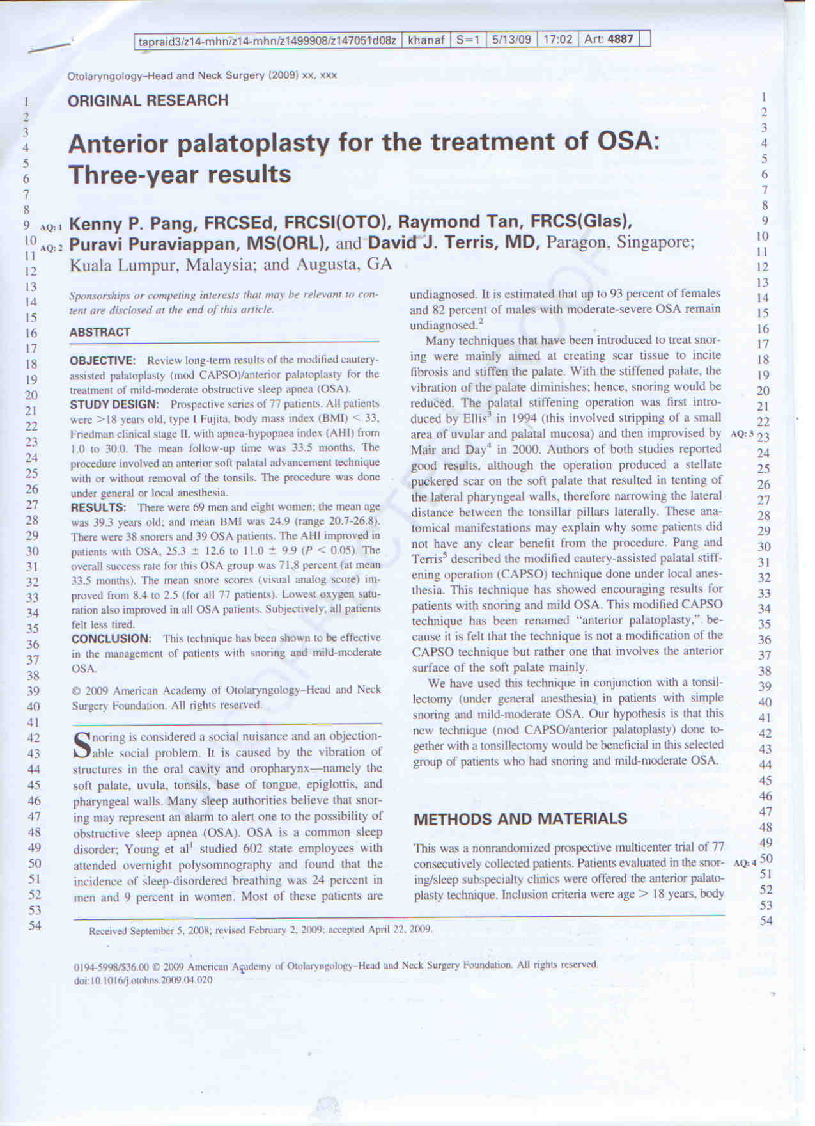

Slide 69
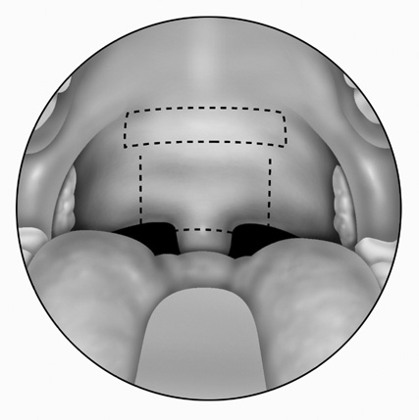
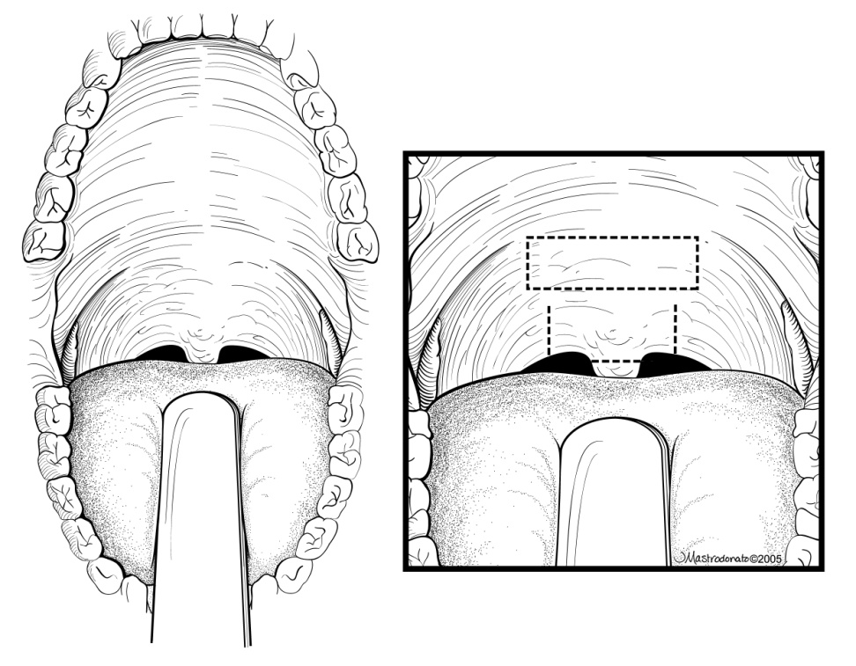
Anterior Palatoplasty

Slide 70
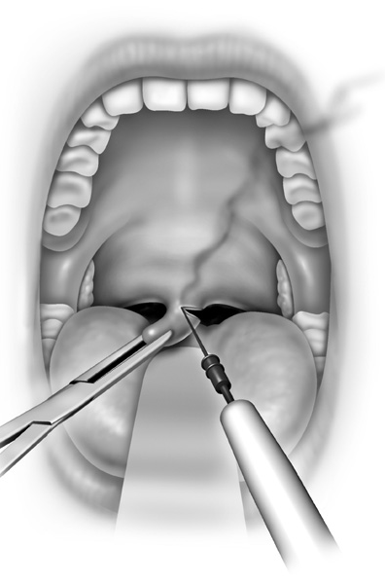
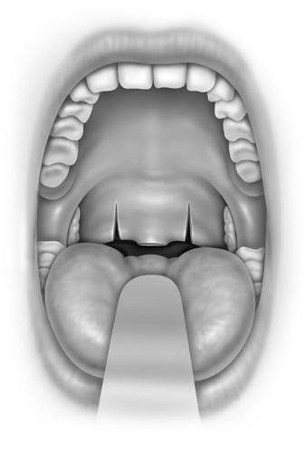
Anterior Palatoplasty

Slide 71
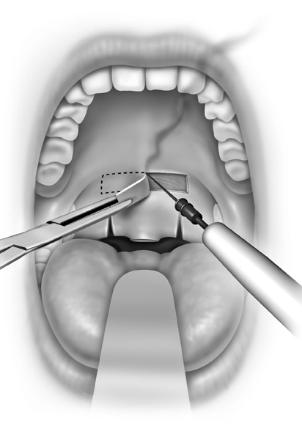
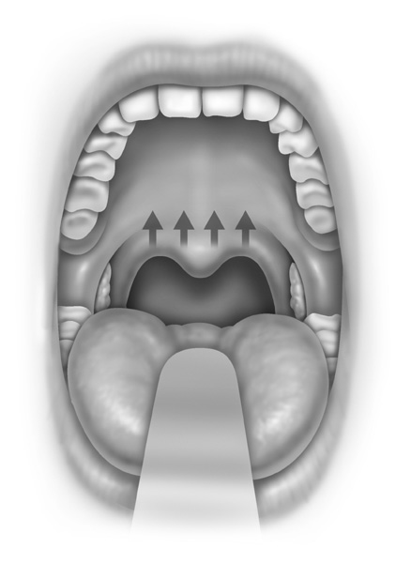
Anterior Palatoplasty

Slide 72
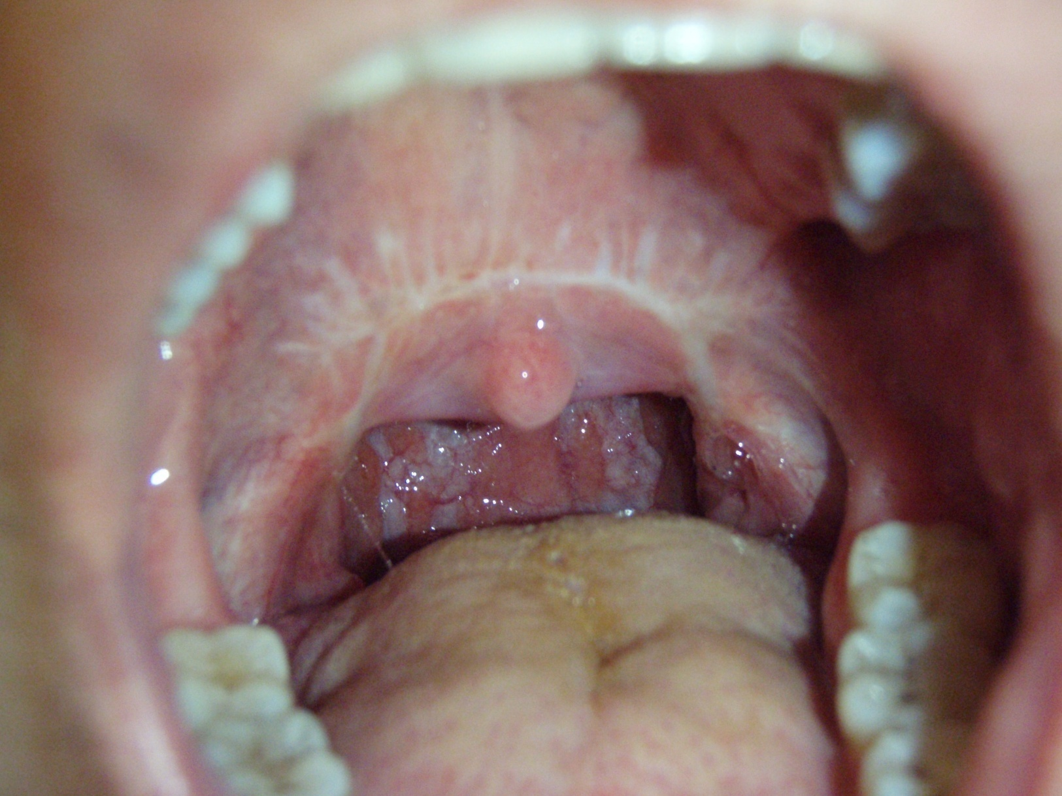
Anterior Palatoplasty

Slide 73
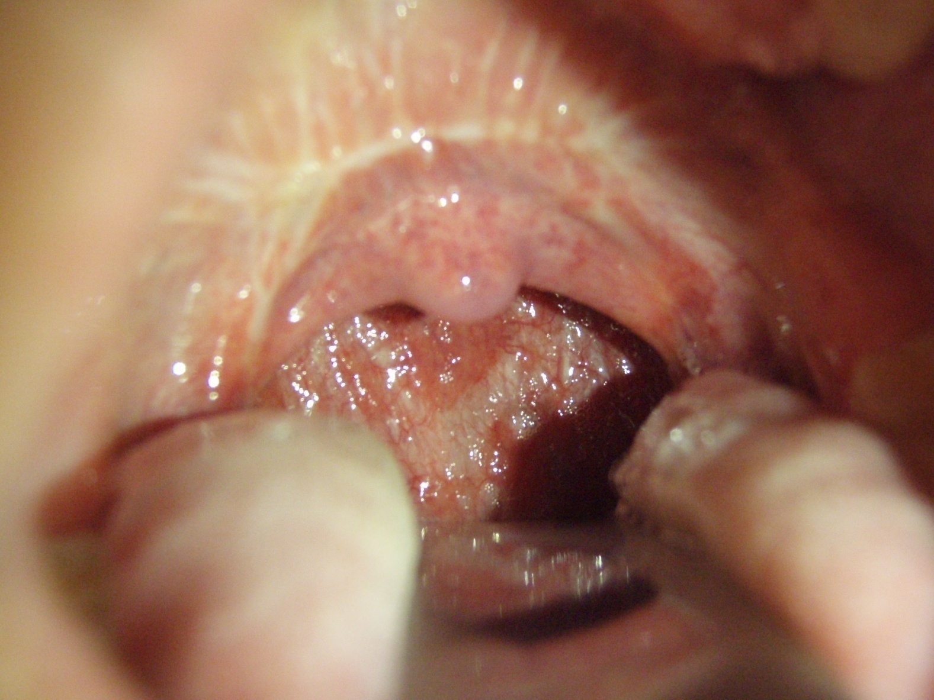
Anterior Palatoplasty

Slide 74
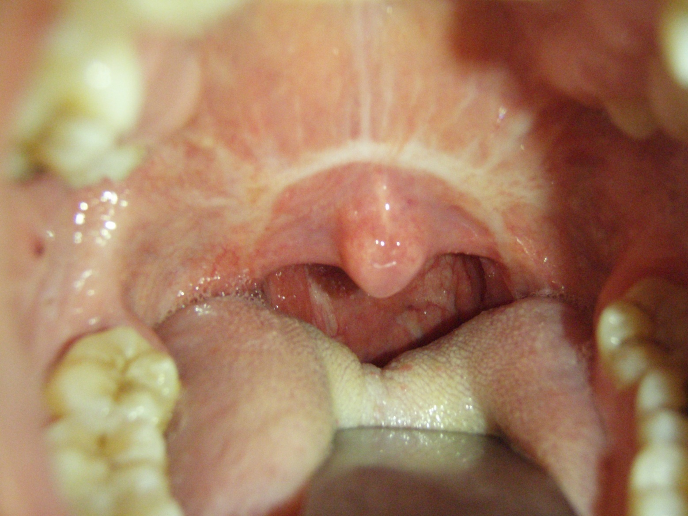
Anterior Palatoplasty

Slide 75
Anterior Palatoplasty-
The Palatal Lift Operation
Less extensive than UPPP
Can be done under local
Reshapes the soft palate-lifts it up via a mucosal cut and absorbable sutures
AHI index reduced by more than half
Snoring intensity reduced by > 70%
Not a single case of long-term nasal reflux

Slide 76
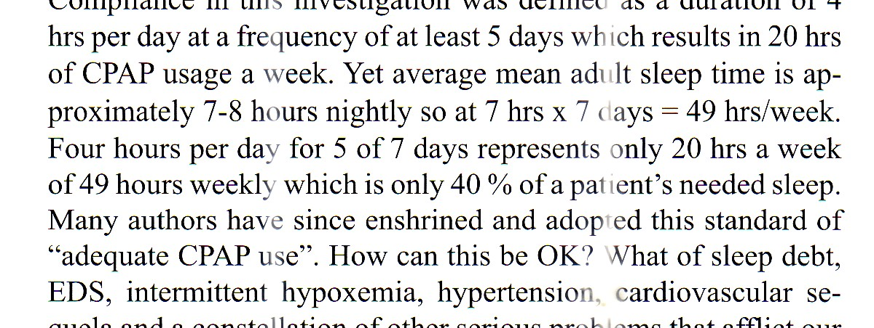
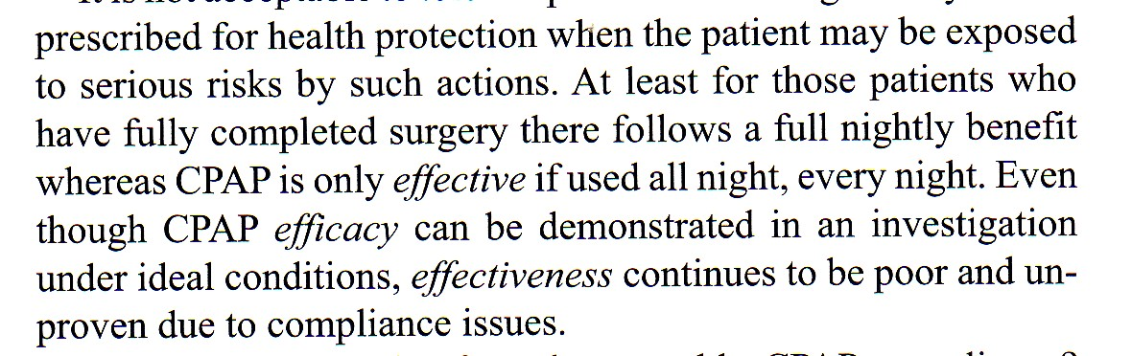
Upper Airway Surgery

Slide 77
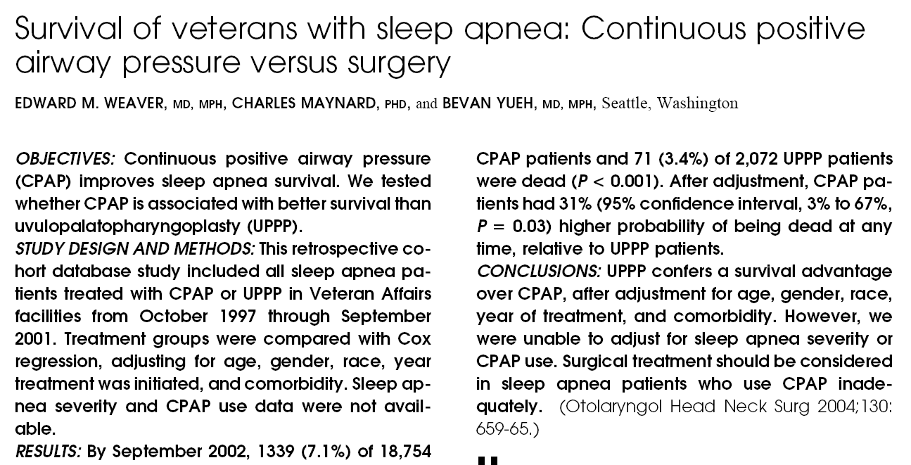
UPPP Survival
Level II

Slide 78
Benefits of treatment…patient reports
Walking zombie to mountain-biking mum
Fresher sleep… even 5 hours enough
Heightened levels of…spousal intimacy- …….Rabbit Kisses
End to…. noon time naps
Winning at …golf again!...
Look ten years younger…what magic-drug are you on?
Better BP control

Slide 79
thesnoringsurgeon@gmail.com
www.sleepsocietymalaysia.org

Slide 80
ASEAN Sleep Surgical Society www.AseanSleepSurgicalSociety.com
Membership
FREE

Slide 81
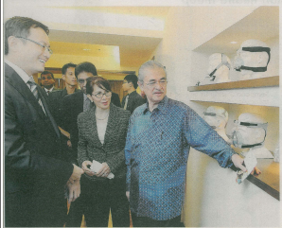
Thank You
www.sleepsocietymalaysia.org

