Slide 1
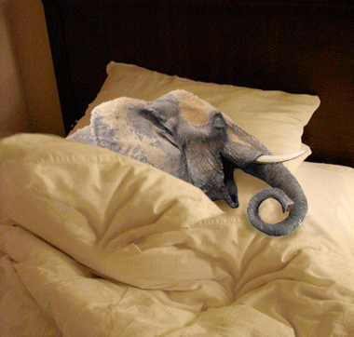
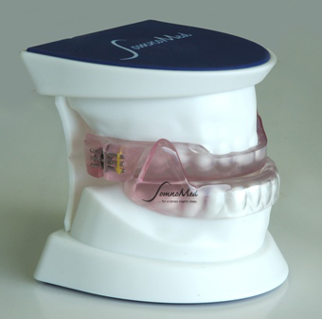
SAY GOOD
BYE TO SNORING
PRESENTED BY,
VINEETHA.K
INTERN
RVS DENTAL COLLEGE
AND HOSPITAL

Slide 2
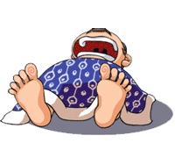
ZZZZZZZZZZZZZZZZZZZZZ
Snoring is the vibration of respiratory structures and the resulting sound, due to obstructed air movement during breathing while sleeping. Snoring during sleep may be a sign, or first alarm, of obstructive sleep apnea (OSA).

Slide 3
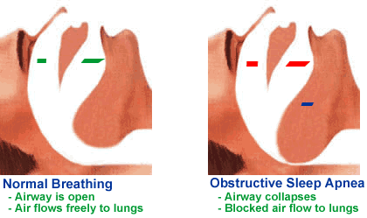
WHAT IS OSA?
Sleep disorder characterized by recurrent episodes of narrowing or collapse of pharyngeal airway during sleep despite ongoing breathing efforts.
NORMAL BREATHING
Airway is open
Air flows freely to lungs
OBSTRUCTIVE SLEEP APNEA
Airway collapses
Blocked air flow to lungs

Slide 5
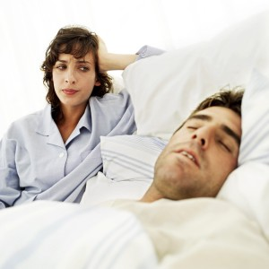
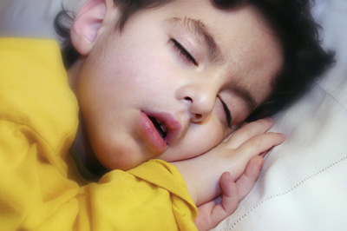
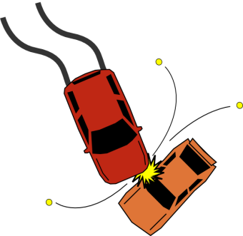
SOME FACTS ABOUT SNORING
%
OVER 50 YEARS SNORE
730 DAYS …PEOPLE WHOSE PARTNERS SNORE SPENT 2 YEARS LYING AWAKE.
MALES TWICE AS LIKELY AS FEMALES
ADMIT TO SNORING
1,00,000 CAR CRASHES PER YEAR ARE ATTRIBUTED DROWSINESS DUE TO LACK OF SLEEP
5.6 % OF CHILDREN ARE HABITUAL SNORERS.

Slide 6
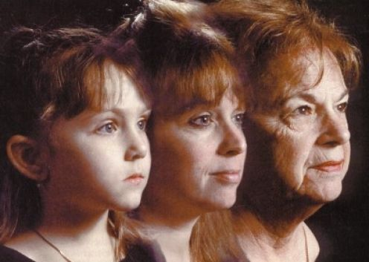
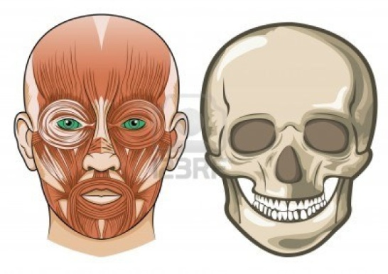
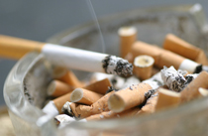
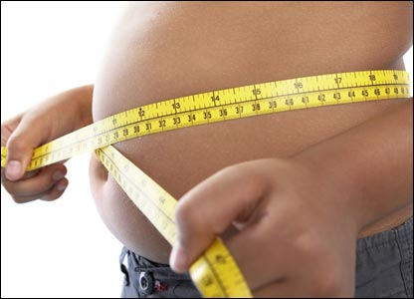
RISK FACTORS
CRANIOFACIAL ANATOMY
CIGARETTE SMOKING
AGE
ALCOHOL
OBESITY

Slide 7
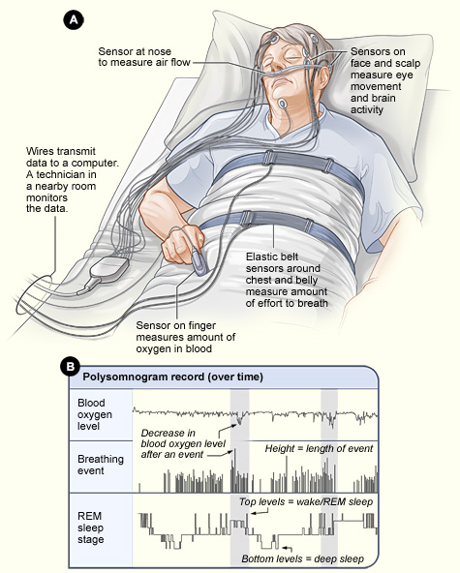
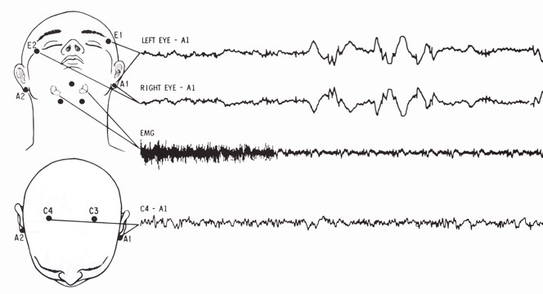
DIAGNOSIS
Based on clinical features and
Objective sleep study data.
The gold standard:overnight polysomnogram
The Polysomnogram (PSG):
- Provides detailed information on sleep state and
respiratory and gas exchange abnormalities.

Slide 8
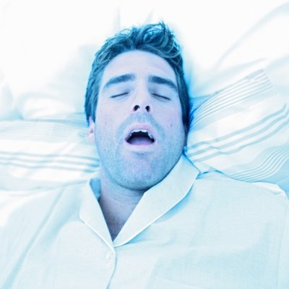
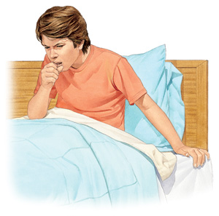
DIAGNOSIS: CLINICAL FEATURES
Nocturnal symptoms
1. SNORING
2.WITNESSED APNEAS
3. INSOMNIA

Slide 9
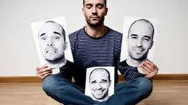
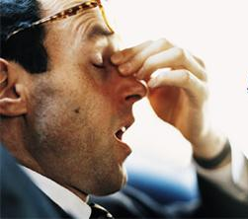
DAY TIME SYMPTOMS
1 . MORNING
HEADACHES
2. MEMORY IMPAIRMENT
5.DEPRESSION
3. DAYTIME SLEEPINESS
4.PERSONALITY CHANGES

Slide 10
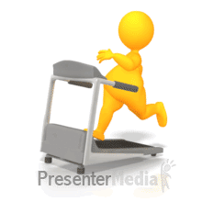
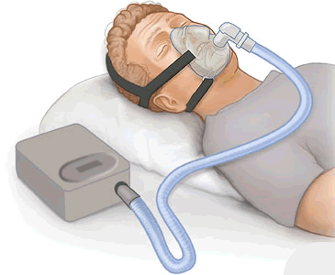
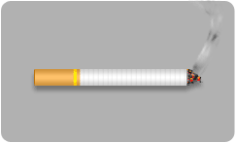
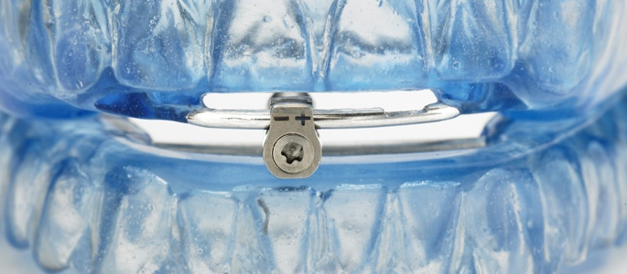
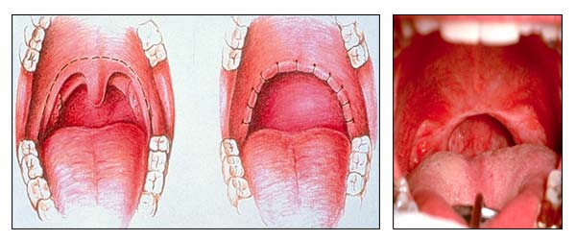
Treatment
CPAP
WEIGHT LOSS
AVOIDANCE OF DRUG AND ALCOHOL USE
SURGERY
DENTAL APPLIANCES

Slide 11
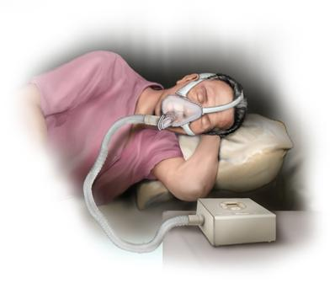
CONTINUOUS POSITIVE AIRWAY PRESSURE APPLIANCE (CPAP).
CPAP treats patient by pumping room air under pressure through a sealed face mask or a nose mask through the upper airway to lung.
DISADVANTAGES
poor patient compliance due to lack of portability
pump noise
dryness of the airway passage,
mask discomfort
Claustrophobia

Slide 12
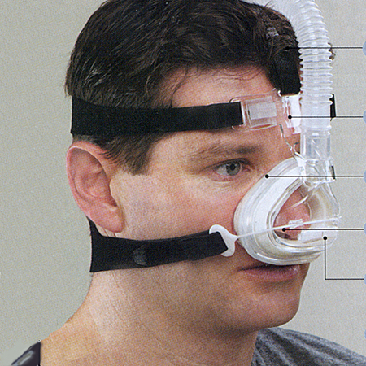
CAN YOU SLEEP LIKE THIS??

Slide 13
SURGERY
Surgery to correct the airway obstruction
Septoplasty/turbinoplasty
Tonsillectomy
Uvulopalatopharyngoplasty
Tongue base surgery
Genioglossus advancement
Tracheotomy
Maxillary-mandibular advancement
Not all surgeries are for everyone. Some only work on certain types of obstruction
More invasive surgeries have been more effective

Slide 14
ORAL DEVICE HOW AND WHAT

Slide 15
How Does An Oral Device Work?
MOST ORAL DEVICES ADVANCE THE MANDIBLE
THIS PULLS THE GENIOGLOSSUS FORWARD
THIS PULLS THE TONGUE FORWARD
UPPER AIRWAY SPACE IS REGAINED
SNORING/OSA DIMINISHED OR ELIMINATED

Slide 16
Oral Devices Indications
-Recommended for snoring
-Mild to moderate sleep apnea
if CPAPunsuccessful.
An American Sleep Disorders Association Report. Sleep.
1995;18(6):511-13

Slide 17
Device Treatment Options
Tongue Retaining Device (TRD)
Mandibular Advancement Device (MAD)

Slide 18
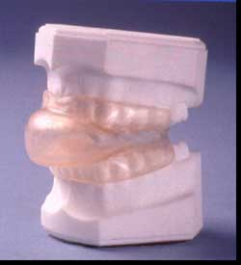
Tongue Retaining Device (TRD)

Slide 19
INDICATION
Edentulous patients
Patients with potential temporomandibular joint problems

Slide 20
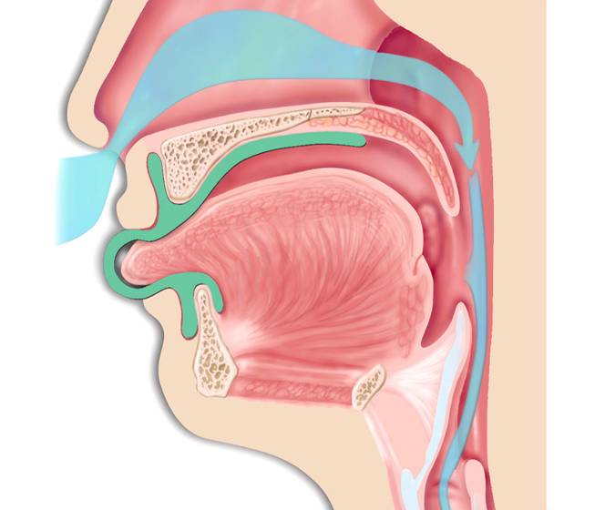
Tongue Retaining Device

Slide 21
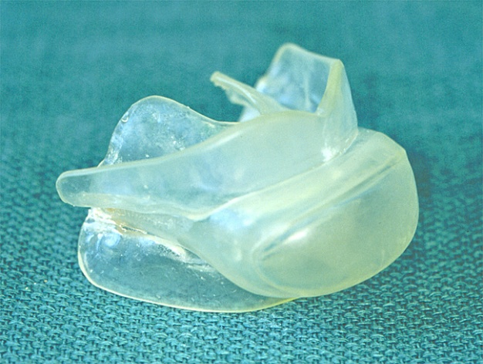
It is a one piece device made of non rigid vinyl material without thermoplastic material to adapt to teeth. It consists of Kelgauge template of various sizes. Patient is asked to protrude the tongue into the hollow bulb template of the appropriate size and interocclusal records are made. Appliance is fabricated with the help of these records.

Slide 22
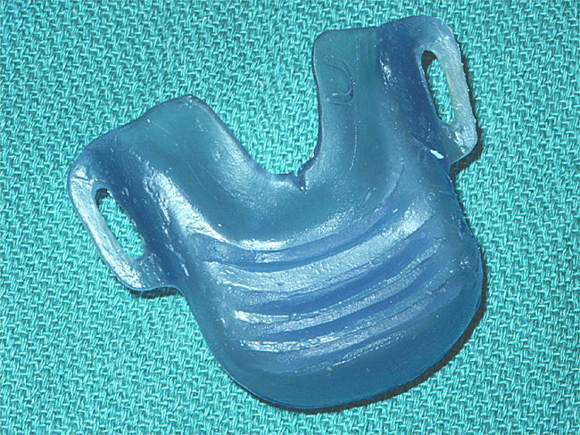
Kelgauge

Slide 23
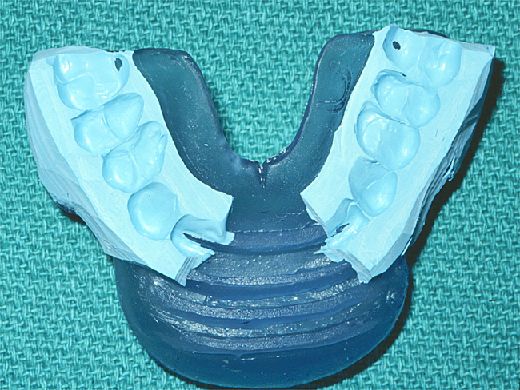

Slide 24
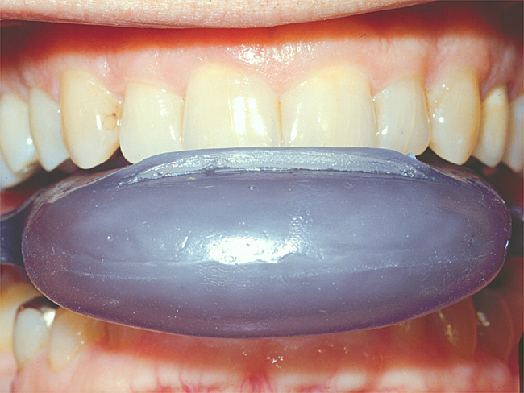

Slide 25
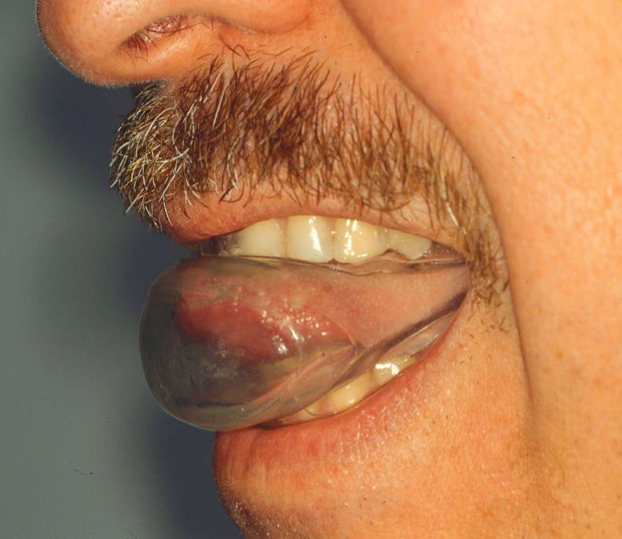

Slide 26
TRD Findings
Oxygen desaturation index dropped to fewer than 10 events/ h in 75% of patients
Significantly improved the blood oxygen saturation level in infants
Helped patients with mild to moderate OSA; however, patients with more severe OSA may also be treated effectively

Slide 27
ADVANTAGES OF TRD
THEY DO NOT REQUIRE RETENTION FROM DENTITION.
MINIMAL ADJUSTMENTS ARE REQUIRED.
CAUSE MINIMAL SENSITIVITY TO TEETH AND TEMPEROMANDIBULAR JOINT.

Slide 28
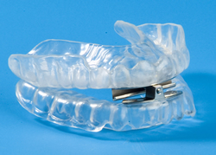
MANDIBULAR ADVANCEMENT DEVICES
IT PROTRUDES THE MANDIBLE FORWARD, THUS PREVENTING OR MINIMIZING UPPER AIRWAY COLLAPSE DURING SLEEP.

Slide 29
Fabrication of an “Adjustable”
Laboratory Fabricated Device
THE MANDIBULAR ADVANCEMENT DEVICES REQUIRE’S
GOOD RETENTION
SUFFICIENT PROTRUSION TO MAINTAIN AIRWAY
MINIMAL VERTICAL OPENING
FULL OCCLUSAL COVERAGE

Slide 30
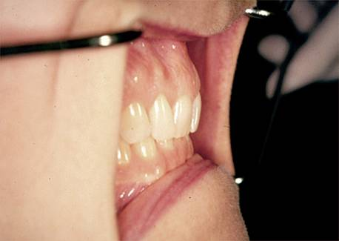
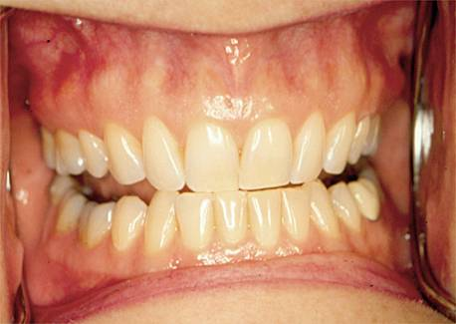
THE INTEROCCLUSAL RECORDS ARE MADE WITH PATIENT PROTRUDED TO
70 TO 75% OF THE MAXIMUM PROTRUSIVE MOVEMENT

Slide 31
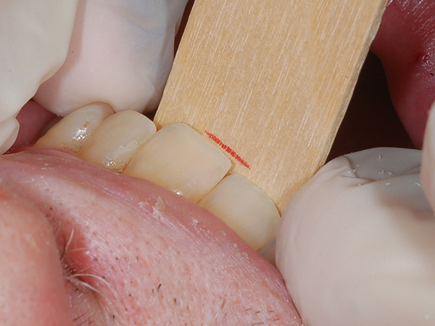

Slide 32
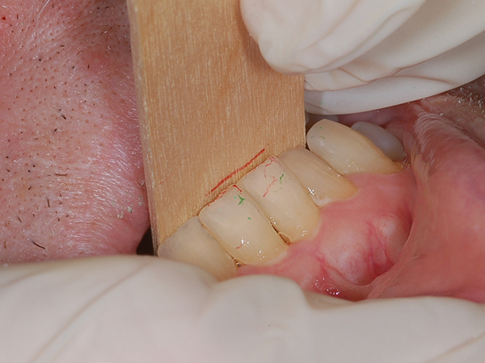

Slide 33
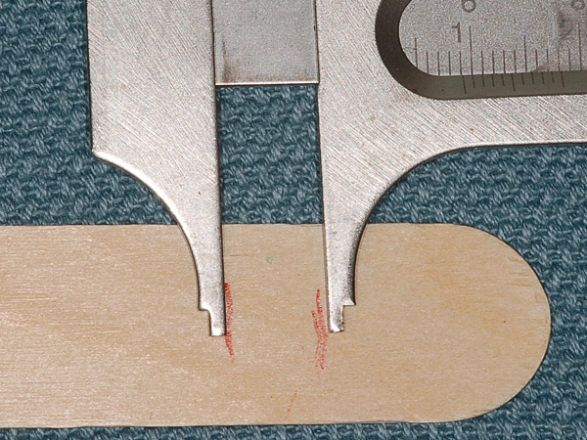

Slide 34
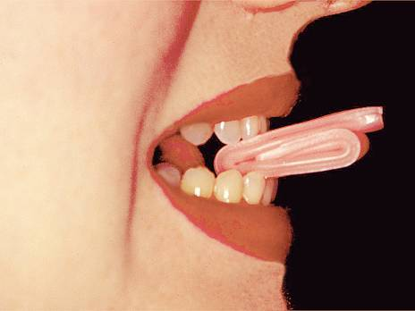
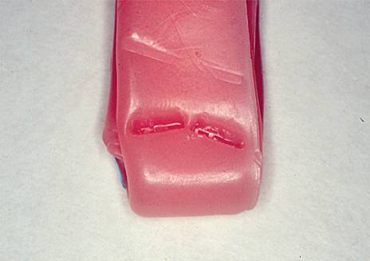
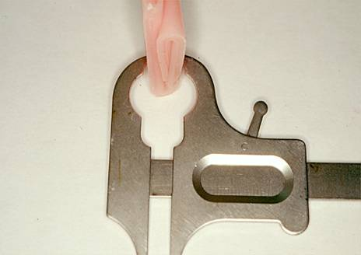
PATIENT CLOSING IN THE
PRE-SELECTED PROTRUDED POSITION

Slide 35
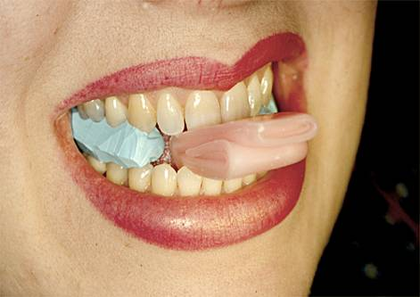
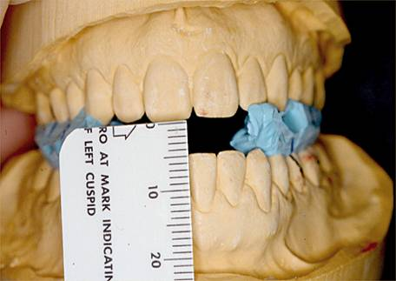
AN INTEROCCLUSAL
RECORDING IS MADE
USING THE WAX
MATRIX

Slide 36
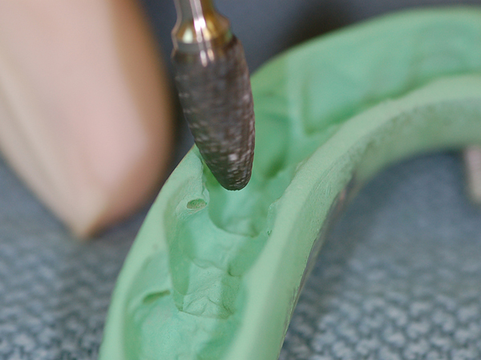

Slide 37
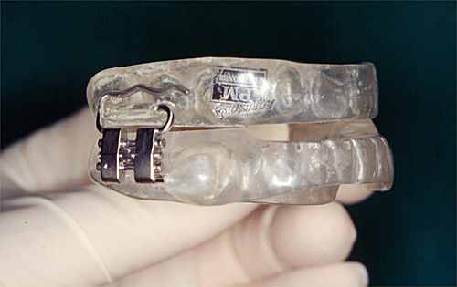

Slide 38
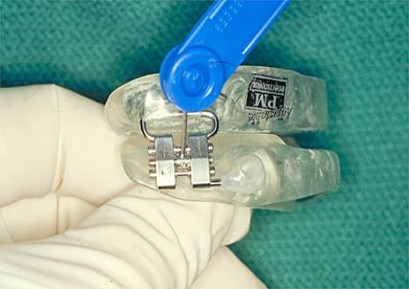
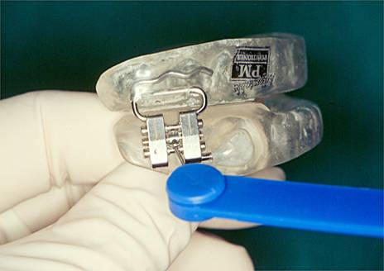
It is a method of slowly moving the mandible anteriorly or posteriorly using adjustable mechanisms until symptoms are relieved with minimal possible protrusive position. Recall is necessary at 2 weeks, 1 month and every 6 months interval.

Slide 39
PATIENT SHOULD EXPECT
LIPS WILL BE VERY DRY - LIP BALM
DIFFICULTY GOING TO SLEEP FOR A FEW NIGHTS.
LOTS OF SALIVA - ON PILLOW
SORE TEETH AND SENSITIVE TEMPOROMANDIBULAR JOINTS - should disappear within a couple of hours

Slide 40
WHY ORAL APPLIANCES?
LESS COST
MORE PATIENT COMPLIANCE
NO NEED TO UNDERGO GENERAL ANESTHESIA
PORTABILITY
In 1995 the American Sleep Disorders Association published its parameters of Care document that recommends treatment modalities for Upper airway sleep disorders (UASD) where oral appliances are a treatment of choice for snoring and mild to moderate OSA in certain patients and ahead of surgical procedures for all but the most severe patients.

Slide 41
REFERENCES
2006 American Academy of Sleep Medicine
Eckert, D, et al. “Pathophysiology of Adult Obstructive Sleep Apnea” American Thoracic Society. Vol 5. pp 144-153, 2008
Golbin, J, et al. “Obstructive Sleep Apnea, Cardiovascular Disease, and Pulmonary Hypertension.” American Thoracic Society. Vol 5. pp 20o– 206, 2008
McNicholas, W, et al. “Diagnosis of Obstructive Sleep Apnea in Adults” American Thoracic Society. Vol 5. pp 154-160, 2008
Punjabi, N. M. “The Epidemiology of Adult Obstructive Sleep Apnea” American Thoracic Society. Vol 5.pp 136-143, 2008
Schwartz, A, et al. “Obesity and Obstructive Sleep Apnea” American Thoracic Society. Vol 5. pp 185 – 192, 2008

Slide 42
MY SINCERE THANKS TO…….
Dr.Rajthilak HOD MDS
Dr.Rajashekhar MDS
Dr.Deepa MDS
Dr.Sathyasree MDS
Dr.Muthukumar MDS
Dr.Suresh MDS
Dr.Jagdish BDS

Slide 43
T
H
A
K
Y
O
U
N

