Slide 1
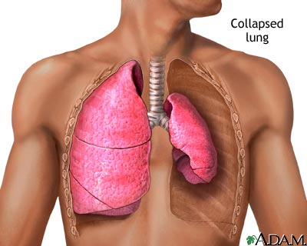
Pneumothorax (Collapsed Lung)
Casey MacWilliams

Slide 2
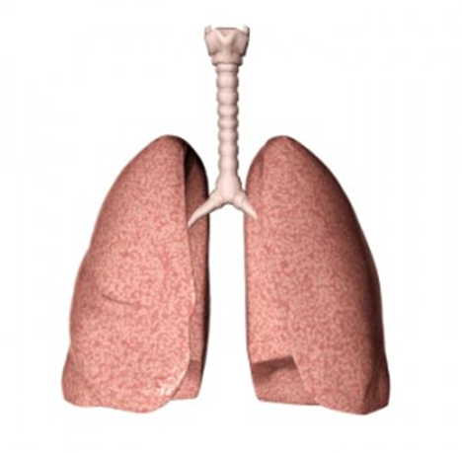
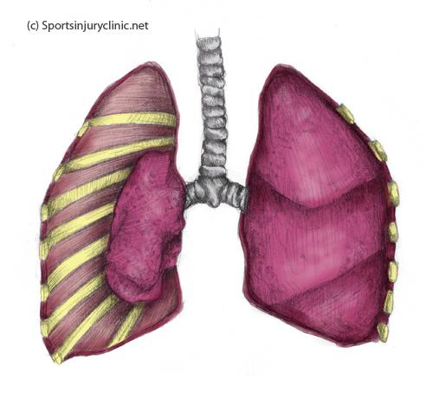
What is pneumothorax?
Pneumothorax, which is known as a collapsed lung, is a collection of free air in the chest outside the lung that causes the lung to collapse.

Slide 3
Types of pneumothorax
Simple- usually only a partial collapse of the lung. The pressure built up isn’t enough to cause cardiovascular dysfunction
Tension- when air builds up under pressure and usually totally collapses one or both of the lungs. This causes severe dysfunction of the cardiovascular system

Slide 4
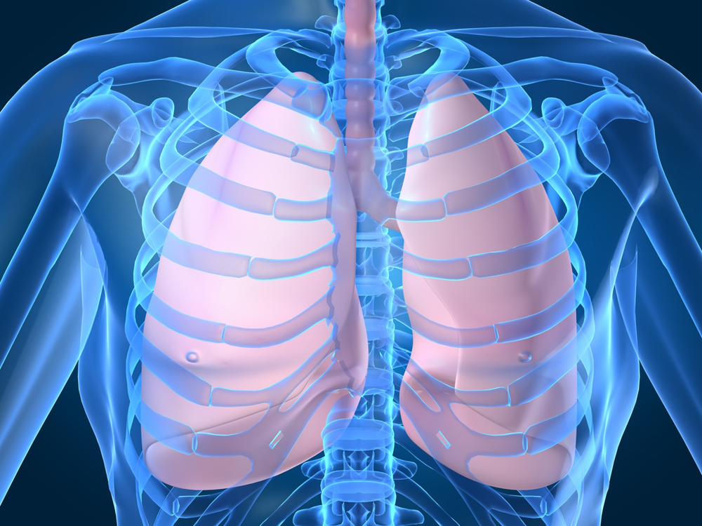
What is affected by pneumothorax?
The lungs!

Slide 5
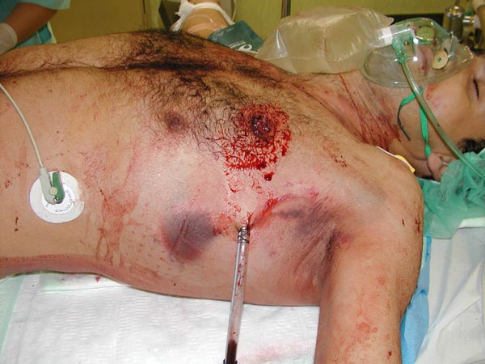
Cause of Collapsed Lung
Air leaks when the alveoli expand and burst
Injuries to the lung wall (fractured rib, gun shot/stabbing)
Underlying lung diseases such as cystic fibrosis, COPD, lung cancer, asthma, etc.

Slide 6
Treatment
There’s no real home care treatment, but if you want to ease the pain you can hold a soft pillow to the chest wall
Simple pneumothorax- usually heals on its own
Tension pneumothorax- the doctor will make an incision and use a syringe to take out the extra air and might even have to sew the lung to the chest wall

Slide 7
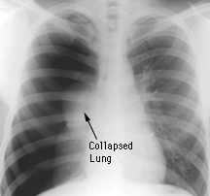
Expected outcome
Simple pneumothorax heals on its own and most likely won’t come back
Tension pneumothorax can spontaneously reappear
About 40% of people who have it will have reoccurrences of it, most cases reoccur within 1.5 to 2 years

