Slide 1
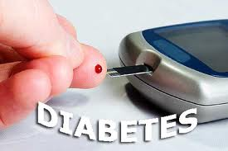
DIABETES MELLITUS
Dr.Saranya vinoth

Slide 2
INTRODUCTION
Diabetes is a group of metabolic disorders characterized by abnormal metabolism, which results most notably in hyperglycemia , due to defects in insulin secretion, insulin action, or both.
Diabetes is a serious chronic disease without a cure, and it is associated with significant morbidity and mortality.
Diabetes is a serious disease associated with acute (due to hyperglycemia) and chronic (due to vascular damage) complications.

Slide 3
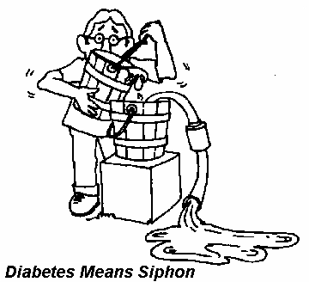

Diabetes mellitus
"Diabetes" comes from the Greek word for "siphon", and implies that a lot of urine is made.
The second term,"mellitus" comes from the Latin word, "mel" which means "honey", and was used because the urine was sweet.

Slide 4
Diabetes in india
According to the Indian Council of Medical Research-Indian Diabetes study (ICMR-INDIAB), a national diabetes study, India currently has 63 million people with diabetes.
India represents the world’s second largest diabetes population after China.
This is set to increase to over 100 million by 2030.
The majority of people with diabetes (>90%) have Type 2 diabetes (T2DM).

Slide 5
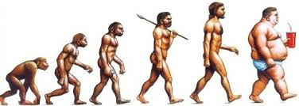

Slide 6
Learning Objectives
At the end of this talk you should understand:
  What diabetes mellitus means
  The difference between types-1 and -2 diabetes
  How the different types are treated
  The reasons for the current epidemic of diabetes and how it can be prevented
  What the complications of diabetes are and how they can be prevented

Slide 7
TYPES OF DIABETES
TYPE -- 1 Diabetes Mellitus
TYPE --2 Diabetes Mellitus
Gestational Diabetes Mellitus
Other uncommon types like
Genetic defects of beta cell function
Genetic defects in insulin action
Exocrine pancreatic defects
Infections
Drugs
Genetic syndromes like Down syndrome

Slide 8
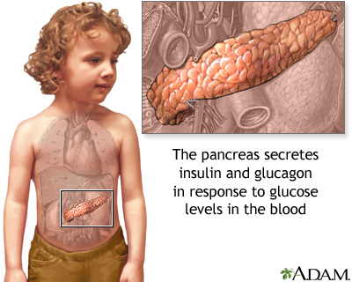
PATHOPHYSIOLOGY

Slide 9
ETIOLOGY OF DIABETES
Both type 1 and type 2 diabetes share one central feature: elevated blood sugar (glucose) levels due to absolute or relative insufficiencies of insulin, a hormone produced by the pancreas.
Type 1-Beta cell destruction completely leading to absolute insulin deficiency
Type 2 –combination of insulin resistance and Beta cell dysfunction

Slide 10
BASIC UNDERSTANDING OF GLUCOSE METABOLISM AND INSULIN ACTION

Slide 11
Action of insulin
It works in the following way:
During and immediately after a meal, digestion breaks carbohydrates down into sugar molecules (of which glucose is one) and proteins into amino acids.
Right after the meal, glucose and amino acids are absorbed directly into the bloodstream, and blood glucose levels rise sharply. (Glucose levels after a meal are called postprandial levels.)

Slide 12
The rise in blood glucose levels signals important cells in the pancreas, called beta cells, to secrete insulin, which pours into the bloodstream. Within 20 minutes after a meal insulin rises to its peak level.
Insulin enables glucose to enter cells in the body, particularly muscle and liver cells. Here, insulin and other hormones direct whether glucose will be burned for energy or stored for future use.
When insulin levels are high, the liver stops producing glucose and stores it in other forms until the body needs it again.

Slide 13
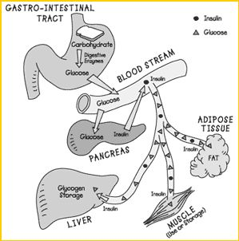

Slide 14
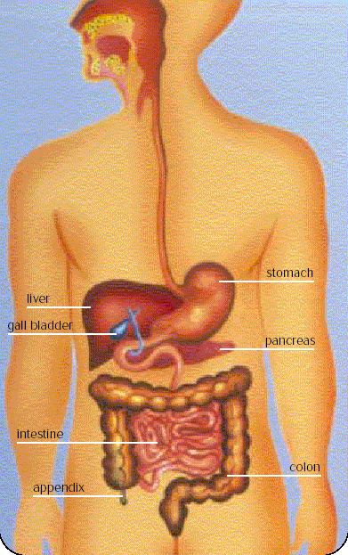
Blood sugar and health
Sugar (glucose) is
an important source
of energy
Insulin is produced
by the pancreas when
blood sugar is high
What is eaten is
absorbed into
the blood
Insulin keeps blood
sugar level within
the normal range
for health

Slide 15
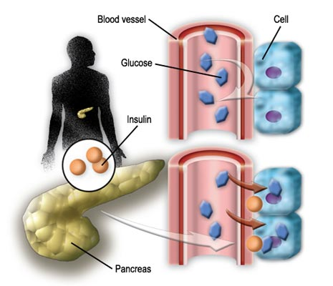

Slide 16
PATHOPHYSIOLOGY OF TYPE 1

Slide 17
Pathophysiology of Type1
Type 1 diabetes is characterized by destruction of the pancreatic beta cells. Most likely cause of these conditions is combined genetic, immunologic and possibly environmental (e.g. viral) factors contribute to cell destruction.
This is abnormal response of the body in which the antibodies are direct against the normal tissues as if they were foreign and eventually can damage Islet of Langerhans , specific area of the pancreas that produce insulin, reducing the production of insulin or totally no production of insulin.

Slide 18

PATHOPHYSIOLOGY OF TYPE 2

Slide 19
PATHOPHYSIOLOGY OF TYPE 2
Type 2 Diabetes Mellitus is a adult onset, and non-insulin dependent. There are 2 main problems related to insulin in type 2 diabetes, first one is “insulin resistance “ (insulin do not bind with the special receptor on cell surface) and impaired insulin secretion (insulin secreting glands release irregular amount of insulin).

Slide 20
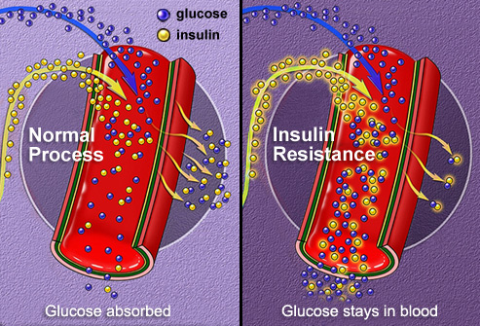

Slide 21
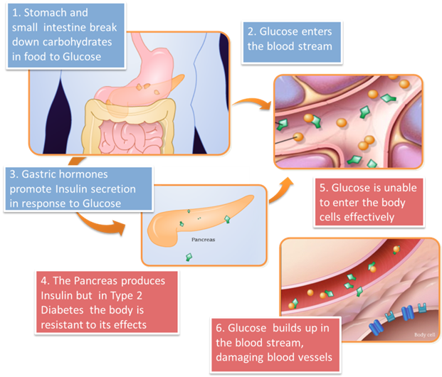

Slide 22
Gestational Diabetes
Diabetes diagnosed during pregnancy
Gestational diabetes is caused when the insulin receptors do not function properly.
This is likely due to pregnancy related factors such as the presence of human placental lactogen that interferes with susceptible insulin receptors.
Increased health risk to mother and baby
Big baby,jaundice,still birth can occur for untreated cases
Goes away after birth, but increased risk of developing Type 2 DM for mother and child

Slide 23
Differences between type-1 and type-2 Diabetes Mellitus
Type 1
Young age
Normal BMI, not obese
No immediate family history
Short duration of symptoms (weeks)
Can present with diabetic coma (diabetic ketoacidosis)
Insulin required
Type 2
Middle aged, elderly
Usually overweight/obese
Family history usual
Symptoms may be present for months/years
Do not present with diabetic coma
Insulin not necessarily required
Previous diabetes in pregnancy
These differences are not absolute

Slide 24

DOUBTS????

Slide 26
Case 1
32 year old male
Referred to Emergency Dept by GP
Complaining of thirst, excessive urination, more than 3 kg weight loss in the last 6 weeks
No relevant past history
First cousin has diabetes on insulin
On no regular medications
Thin man
Blood sugar level = 240 mg
DIAGNOSIS ???

Slide 27
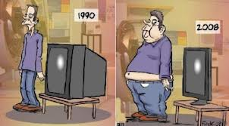

Slide 28
RISK FACTORS &SYMPTOMS

Slide 29
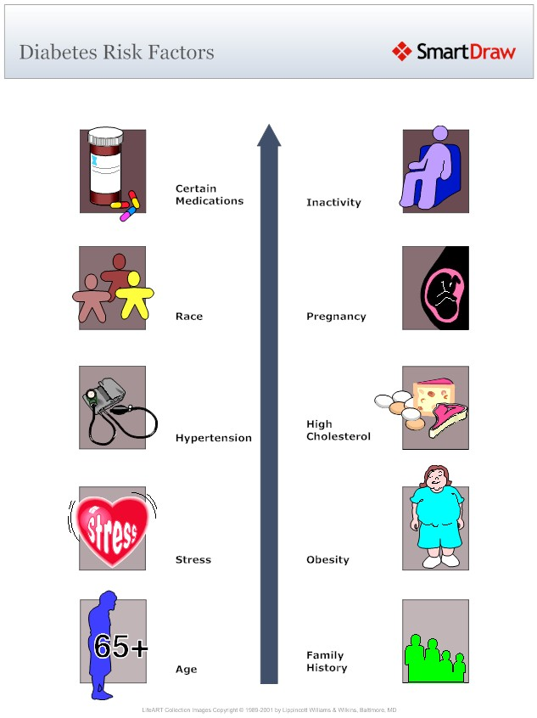
RISK FACTORS

Slide 30
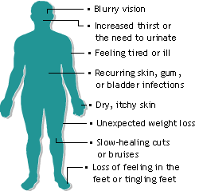
Symptoms of Diabetes

Slide 31
Symptoms of new onset
Polyurea
Polydipsia
Polyphagia
Weight loss
Fatigue

Slide 32
Symptoms
Hypoglycemia
Hyperglycemia
Tremor
Headache
Pallor
Dizziness
Paresthesia
Loss of coordination
Anxiety
Mood confusion
seizure
Polyurea
Polydipsia
Dry mouth
Ketoacidosis (shortness of breath)
Hyperosmolar hyperglycemic non ketotic syndrome(fever,confusion,
weakness)

Slide 33
INVESTIGATIONS

Slide 34
INVESTIGATION
  Fasting blood sugar
  Post prandial blood sugar
  HbA1C
  Lipid Profile – To diagnose dyslipidaemia
RBS can be done only if the patient follows up for the diagnostic tests after a meal

Slide 35
FASTING BLOOD SUGAR
Person to be tested should be on a normal diet for at least 3 days prior to testing.
The test should be done after an overnight fast of 8 – 10 hours (no beverages including tea or coffee should be consumed),
Draw a sample of blood after confirming fasting state of the patient.
Fasting Serum Glucose (mg/dl) | Diagnosis
Below 110 | Normal
Between 110 and 126 | Pre-diabetes
Above 126 | Diabetes (Must be confirmed with a second fasting test)

Slide 36
Post prandial blood sugar
Following the collection of the fasting blood sample for analysis of fasting serum glucose (FSG). Patient is advised to have a normal meal and return to the clinic after 2 hours following the meal.
Draw a sample of blood after confirming the time of meal.
Post prandial blood sugar | Diagnosis
< 140mg/dl | Normal
140-200mg/dl | Pre -diabetic
>200mg/dl | Diabetic

Slide 37
HbA1C
Person to be tested should be on a normal diet for at least 3 days prior to testing.
The test should be done after an overnight fast of 8 – 10 hours
Draw a sample of blood after confirming fasting state of the patient.
HbA1C Levels | Diagnosis
4 - 6 | Normal for those without diabetes
6.1-7 | Target range for diabetics
>7 | Poor control

Slide 38
Lipid profile
Results of lipid profile | Classification
LDL
< 100 | optimal
100-129 | Near optimal
130-159 | Borderline high
160-190 | High
>190 | Very high
Serum triglycerides
< 150 | Optimal
150-199 | Borderline high
200-499 | High
>500 | Very high
HDL cholesterol
< 40 | Low
> 60 | High

Slide 39
TREATMENT GUIDELINES
Major Risk Factors (Exclusive of LDL Cholesterol)
Cigarette smoking
Hypertension (BP >140/90 mmHg or on antihypertensive medication)
Low HDL cholesterol (<40 mg/dL)
Family history of premature CHD
Age (men >45 years; women >55 years)

Slide 40
TREATMENT GUIDELINES
LDL VALUES | Risk factor | Treatment goal
>_130 | CHD | Pharmacological theraphy
>160 | +2 risk factors | Pharmacological theraphy
>160-190 | + 1 risk factor | Life style modification
>190 | +1 risk factor | Pharmocological theraphy

Slide 41
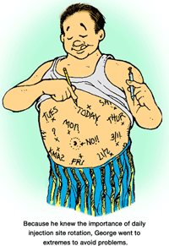

Slide 42
PHYSICAL EXAMINATION

Slide 43
Complete physical examination
Examination
Weight/waist: – Body Mass Index (BMI)
– Waist circumference
Cardiovascular system:
– Blood pressure, ideally lying and standing
– Peripheral, neck and abdominal vessels
Eyes: – Visual acuity (with correction)
– Cataracts
– Retinopathy (examine with pupil dilation)

Slide 44
Feet: – Sensation and circulation
– Skin condition
– Pressure areas
– Interdigital problems
– Abnormal bone architecture
Peripheral nerves: – Tendon reflexes
– Sensation: touch
-vibration
Urinalysis: – Albumin
– Ketones
– Nitrites and/or leucocytes

Slide 45
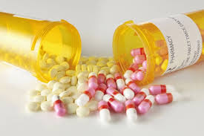
TREATMENT

Slide 46
Management of DM
The major components of the treatment of diabetes are:
A
Diet and Exercise
B
Oral hypoglycaemic therapy
C
Insulin Therapy

Slide 47
A. Diet
Diet is a basic part of management in every case. Treatment cannot be effective unless adequate attention is given to ensuring appropriate nutrition.
Dietary treatment should aim at:
  ensuring weight control
  providing nutritional requirements
  allowing good glycaemic control with blood glucose levels as close to normal as possible
  correcting any associated blood lipid abnormalities

Slide 48
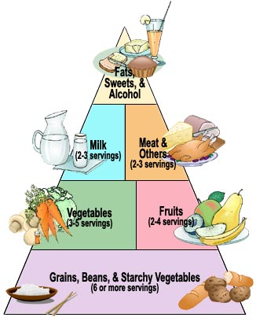

Slide 49
Exercise
Physical activity promotes weight reduction and improves insulin sensitivity, thus lowering blood glucose levels.
Together with dietary treatment, a programme of regular physical activity and exercise should be considered for each person. Such a programme must be tailored to the individual’s health status and fitness.
People should, however, be educated about the potential risk of hypoglycaemia and how to avoid it.

Slide 50
Nutritional Management for Type I Diabetes
Consistency and timing of meals
Timing of insulin
Monitor blood glucose regularly
Notes:
Consistency and timing of meals
Timing of meals and administration of insulin
Insulin plans should be designed to match the person’s eating pattern
Monitor blood glucose regularly

Slide 51
Nutritional Management for Type II Diabetes
Weight loss
Smaller meals and snacks
Physical activity
Monitor blood glucose and medications
Notes:
Weight loss: 10-20# is sufficient
Smaller meals and snacks
Physical activity
Monitor blood glucose and medications

Slide 52
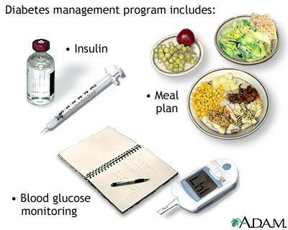
MANAGEMENT OF TYPE 1 DIABETES

Slide 53
MANAGEMENT OF TYPE 2 DIABETES

Slide 54
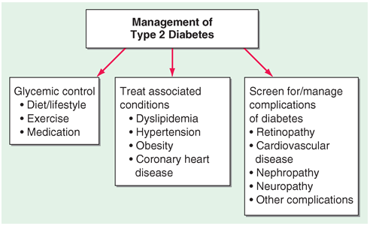

Slide 55
Stepwise Management of
Type 2 Diabetes
Insulin ± oral agents
Oral combination
Oral monotherapy
Diet & exercise
Notes:
Type 2 diabetes is traditionally treated in a stepwise manner. Initial therapy is usually diet and increased exercise. However, lifestyle measures generally fail to control glycaemia and, therefore, pharmacological treatment is instigated. Initial therapy is with a single oral drug although monotherapy often fails over a period of time and a combination of two or more oral therapies is used. Subsequently, failure of all oral combination therapy may occur when β-cell failure has progressed to such a degree that additional, exogenous insulin is required.

Slide 56
DIABETES – ORAL MEDICATIONS
5 Classes :
Sulfonylureas
Biguanides
Thiazolidinediones
Alpha-glycosidase inhibitors
Meglitinides

Slide 57
Classes of Oral Hypoglycaemic Agents
Target insulin secretion
  Sulphonylureas (glibenclamide)
  Meglitinides (repaglinide)
Target insulin resistance
  Biguanides (metformin)
  Thiazolidinediones (rosiglitazone)
Target glucose absorption from intestine
  Alpha glucosidase inhibitors (ascarbase)
Notes:
Glitazones

Slide 58
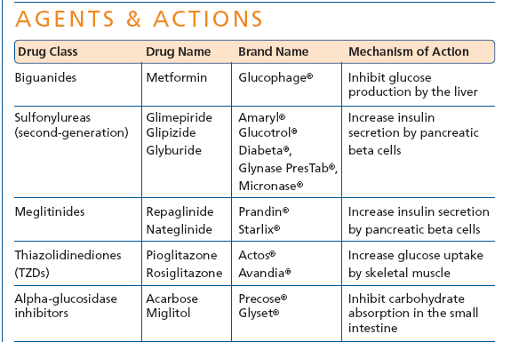
Oral Hypoglycaemic Medications

Slide 59
Biguanides: Metformin
Decreases hepatic glucose output
Increases peripheral uptake of glucose into cells
Monotherapy or adjunct
Does not produce weight gain, useful in obese clients
Dose:
  500mg daily increasing gradually to 500mg three times a day
  Max dose 2-2.5 gms daily
Notes:
Drug of choice in obese patients only?
Decreases gluconeogenesis

Slide 60

Metformin
Reduces HbA1C by 1-2%
Contraindications:
  Contraindicated with Renal impairment
  Liver & heart failure
  Severe dehydration
Side effects
  Nausea, vomiting, diarrhoea, abdominal discomfort, impaired B₁₂ absorption
Notes:
Check renal & liver function periodically
Avoid in pregnancy, alcohol dependence and breast-feeding
Safe
Reduces Basal & post prandial glucose levels
Weight neutral
No hypoglycaemia
Increased insulin sensitivity
Beneficial effect on plasma lipid profile

Slide 61
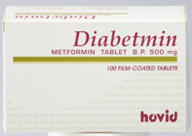
Sulphonylureas
Stimulate beta cells to release insulin from functioning pancreatic cells
Other drugs in the category are Glipizide,Glibinclamide etc.
Glimepiride is a third generation sulphonyl ureas.
DOSE
Glimepiride 1mg (OD) 10-15 minutes before breakfast for two weeks; can be titrated by 1mg doses till 8mg/day with two week intervals.
Notes:
Use identified 1940’s
(assumes there is residual beta cell activity)
??Tolbutamide (Rastinon)
Shortest acting

Slide 62
Sulphonylureas
Reduces HbA1C by 1-1.5%
1st choice in lean patients
Drugs broken down in liver so avoid in people with liver and renal impairment
Adverse Effects:
  GI disturbances, headache; bone marrow depression
  Mild skin reactions, photosensitivity, mild alcohol intolerance.
  Hypoglycaemia
  Weight gain
5-10% secondary failure rate / year

Slide 63
Sulphonylurea
Long Term Side Effects
  Beta cell exhaustion
    Secondary failure of treatment
  Therefore, use
    Short-acting versions
    Lowest effective doses
  After many years of treatment
    Secondary failure inevitable

Slide 64
Optimal Glycaemic Control
One of the primary goals in treating diabetes is to ‘treat to target’ in terms of HbA₁C
With long term treatment, 75% of patients do not maintain optimal glycaemic control (<7% HbA_{1c}) with monotherapy alone¹
Optimal combinations of oral therapy to treat diabetes need to be found to achieve this target
Combination therapy used when monotherapy fails
Notes:
1. UKPDS 49. JAMA 1999; 281: 2005–12.

Slide 65
Case 2
Ms A, a 45 year old woman is concerned she may have diabetes
She had diabetes during her last pregnancy managed with diet
Lately she has been feeling tired but otherwise has no complaints
Her mother had diabetes
She has been overweight since her last pregnancy and has taken a tablet for blood pressure for the last 2 years
She is obese, body mass index 34.5
Blood pressure is 140/90 but otherwise her examination is normal
She undergoes a testing and her fasting glucose is 180mg
DIAGNOSIS??

Slide 66
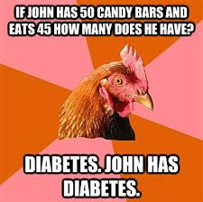

Slide 67
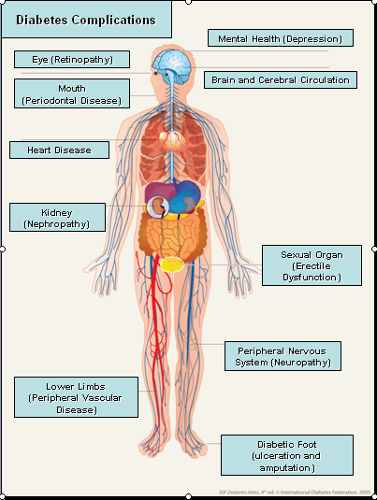
COMPLICATIONS

Slide 68
Chronic Complications
Systems Effected | Disease | Health Concern
Eyes | Retinopathy Glaucoma Cataracts | Blindness
Blood Vessels | Coronary artery disease Cerebral vascular disease Peripheral vascular disease Hypertension | Heart attack Stroke Poor circulation in feet and legs Heart attack, stroke, kidney damage
Kidneys | Renal insufficiency Kidney failure | Insufficient blood filtering Loss of ability to filter blood
Nerves | Neuropathies Autonomic neuropathy | Chronic pain Poor nerve signaling to organ systems
Skin, Muscle, Bone | Advanced infections Cellulitis Gangrene | Amputation

Slide 69
GENERAL TIPS
Steps to lower risk of diabetes complications:
  A1C < 7, which is an estimated average glucose of 154mg/dl
  Blood pressure < 130/80
  Cholesterol (LDL) < 100
  Cholesterol (HDL) > 40 (men) and > 50 (women)
  Triglycerides < 150
  Quitting smoking.
  Active life style.
  Healthy food choices.

Slide 70
Do’s and Don'ts of foot care
Patient should
  check feet daily
  Wash feet daily
  Keep toenails short
  Protect feet
  Always wear shoes
  Look inside shoes before putting them on
  Always wear socks
  Break in new shoes gradually

Slide 71
FOLLOW UP
Fortnightly follow up for newly diagnosed cases
Monthly follow up for known diabetics
Quarterly review
Annual review
Health education
Self examination

Slide 72
Quarterly review
Weight/waist
Height (children and adolescents)
Blood pressure
Feet examination without shoes, if new symptoms or at risk

Slide 73
Annual review
Weight/waist
Height (children and adolescents)
Blood pressure
Feet examination: without shoes, pulses, monofilament check
Blood glucose at examination
Urinalysis
Visual acuity

Slide 74
Cornerstones of Diabetes Management
Healthy eating
Exercise
Monitoring
Medication/Insulin
Health Care Team
Notes:
No evidence to support eating too much sugar leads to diabetes
Obesity is key risk factor
W:H ratio most useful predictor (women < 0.80 ,men < 0.95)
Saturated fat is an independent risk factor
Low fruit and vegetable intakes have been linked to higher HbA1c in general population (EPIC Norfolk study)
Inactivity is an independent risk factor

Slide 75

THANK YOU

