Slide 1
EOSINOPHILIC LUNG DISEASES
ANKIT MITTAL
MD 1ST YEAR
(PULMONARY MEDICINE)

Slide 2
DEFINITION
Heterogenous group of pulmonary disorders
characterized by pulmonary parenchymal or peripheral
blood eosinophilia.
May involve
Parenchyma – eosinophilic pneumonia
Airways - ABPA
Fishman’s pulmonary diseases & disorders. 4th edition. Kristina crothers, carolyn rochester. The Eosinophilic Pneumonias; Vol1: 72: pg 1213

Slide 3
EOSINOPHIL
Two-lobed, polymorphonuclear leukocyte, 12 to 15 um.
Stains red with Eosin, a red dye. (granules)
Granules consists of
Histamines,
Proteins such as eosinophil peroxidase, RNAse, DNAse, lipase, plasminogen & major basic protein.
Pathological basis of diseases, Robbins & Cotran: 7th edition

Slide 4
EOSINOPHIL- FUNCTIONS
Competing theories:
Host defense
Modulator of inflammation
Tissue destroyer
Kills Parasites, tumor cells, respiratory epithelial cells.
Chemotaxis :
Complement, histamine, ECF-A, PAF, LT’s,
lymphokines, tumor factors, IL-5
Pathological basis of diseases, Robbins & Cotran: 7th edition

Slide 5
EOSINOPHILIC ACTIVATION
Th1/Th2 imbalance
IL-4,IL-5, IL-13
Pathological basis of diseases, Robbins & Cotran: 7th edition

Slide 6
WHAT’S NORMAL
*The normal AEC : <500/mm³ .
Mild eosinophilia : 500-1500/mm³
Moderate eosinophilia : 1500-5000/mm³
Severe eosinophilia : > 5000/mm³
**Bronchoscopy (BAL) EOS % & not absolute number
Normal volunteers < 2%
Increased >5%
Primary pulmonary eosinophilic syndromes >20%
*Practical approach to the patient with hypereosinophilia: Florence Roufosse, Peter F. Weller :J ALLERGY CLIN IMMUNOL ; JULY 2010
**Fishman’s pulmonary diseases & disorders. 4th edition. Kristina crothers, carolyn rochester. The Eosinophilic Pneumonias; Vol1: 72: pg 1214

Slide 7
CLASSIFICATION
In 1932, Loeffler: -
Association between pulmonary infiltrates and eosinophilia
In 1952 Reeder and Goodrich:-
Pulmonary Infiltrates & Eosinophilia (coined ‘PIE syndrome’)
Fishman’s pulmonary diseases & disorders. 4th edition. Kristina crothers, carolyn rochester. The Eosinophilic Pneumonias; Vol1: 72: pg 1213

Slide 8
CLASSIFICATION
Croften et al, 1952 (clinical criteria) *
Simple pulmonary eosinophilia (Loeffler’s)
Prolonged pulmonary eosinophilia
Tropical eosinophilia
Pulmonary eosinophilia with asthma
Polyarteritis nodosa (PAN)
*Crofton JW, Livingstone JL, Oswald NC, et al: Pulmonary eosinophilia. Thorax 1952; 7:1-35 .

Slide 9
DISEASES ASSOCIATED WITH
PULMONARY INFILTERATES
AND
EOSINOPHILIA

Slide 10
Diseases Associated with Pulmonary Infiltrates & Eosinophilia
Pulmonary Eosinophilic Syndromes of Known Cause
Pulmonary Eosinophilic Syndromes of Unknown Cause
Other Lung Diseases Variably Associated with Eosinophilia
Murray & Nadel’s textbook of respiratory medicine , 5 th edition

Slide 11
Pulmonary Eosinophilic Syndromes of Known Cause:
Parasitic-induced eosinophilic pneumonias (including Loeffler’s syndrome)
Drug-or toxin-induced eosinophilic pneumonias
Tropical pulmonary eosinophilia
Allergic bronchopulmonary mycosis
Murray & Nadel’s textbook of respiratory medicine , 5 th edition

Slide 12
Pulmonary Eosinophilic Syndromes of Unknown Cause
Idiopathic acute eosinophilic pneumonia
Chronic eosinophilic pneumonia
Churg-Strauss syndrome (allergic granulomatosis and angiitis)
Idiopathic hypereosinophilic syndrome
Murray & Nadel’s textbook of respiratory medicine , 5 th edition

Slide 13
Other Lung Diseases Variably Associated with Eosinophilia
Asthma/allergy
Bronchocentric granulomatosis
Bronchiolitis obliterans-organizing pneumonia
Infections –
– Fungal (Coccidioidomycosis, Aspergillus,P. jirovecii)
– Tuberculosis
Murray & Nadel’s textbook of respiratory medicine , 5 th edition

Slide 14
Other Lung Diseases Variably Associated with Eosinophilia
Interstitial lung disease:
- Idiopathic pulmonary fibrosis
- Collagen-vascular disease associated Sarcoidosis
- Eosinophilic granuloma (pulmonary histiocytosis X)
Malignancy:
- Non-small-cell cancer of lung
- Non-Hodgkin’s lymphoma
- Myeloblastic leukemia
Miscellaneous (lung transplantation, ulcerative colitis)
Murray & Nadel’s textbook of respiratory medicine , 5 th edition

Slide 15
EOSINOPHILIC PNEUMONIAS WITH ACUTE PRESENTATIONS
Loeffler’s Syndrome (Simple Pulmonary Eosinophilia)
Parasitic Infections
Drug and Toxin-Induced Pulmonary Eosinophilic
Syndromes
Idiopathic Acute Eosinophilic Pneumonia
Fishman’s pulmonary diseases & disorders. 4th edition. Kristina crothers, carolyn rochester. The Eosinophilic Pneumonias; Vol1: 72: pg 1214

Slide 16
Loeffler’s Syndrome:
Simple
Pulmonary Eosinophilia

Slide 17
Loeffler’s Syndrome (Simple Pulmonary Eosinophilia)
In 1932, Loeffler first described a clinical syndrome characterized by:
- mild respiratory symptoms
- peripheral blood eosinophilia and
- transient, migratory pulmonary infiltrates.
Affects all ages
Immune hypersensitivity to Ascaris lumbricoides - likely cause.
Fishman’s pulmonary diseases & disorders. 4th edition. Kristina crothers, carolyn rochester. The Eosinophilic Pneumonias; Vol1: 72: pg 1214

Slide 18
Loeffler’s Syndrome (Simple Pulmonary Eosinophilia)
CLINICAL FEATURES
Low-grade fever
Nonproductive cough
Dyspnea (mild to severe) and
Hemoptysis(occ.)
Respiratory manifestations- self-limited
Typically resolving in 1 to 2 weeks.
Fishman’s pulmonary diseases & disorders. 4th edition. Kristina crothers, carolyn rochester. The Eosinophilic Pneumonias; Vol1: 72: pg 1214

Slide 19
Loeffler’s Syndrome (Simple Pulmonary Eosinophilia)
INVESTIGATIONS:
Peripheral blood - moderate to extreme eosinophilia
Sputum - contains eosinophils.
C X ray- Transient, migratory, nonsegmental interstitial & alveolar infiltrates (often peripheral or pleural based).
PFT: typically Reveals mild to moderate restrictive ventilatory defect with a reduced DLCO
Fishman’s pulmonary diseases & disorders. 4th edition. Kristina crothers, carolyn rochester. The Eosinophilic Pneumonias; Vol1: 72: pg 1214

Slide 20
Radiology
Jeong Y J et al. Radiographics 2007;27:617-637

Slide 21
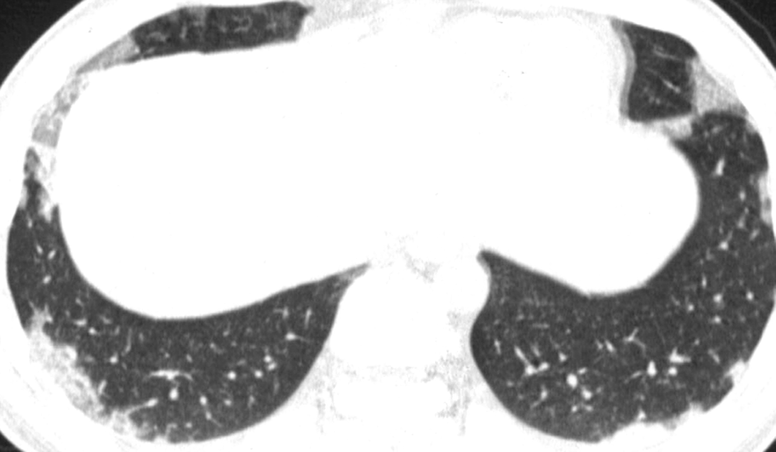
MICROSCOPY
SPE in a 25-year-old man with 13.5% peripheral eosinophilia.
Jeong Y J et al. Radiographics 2007;27:617-637
Notes:
Figure 2. SPE in a 25-year-old man with 13.5% peripheral eosinophilia. Transverse thin-section (1-mm collimation) CT scan (lung windowing) shows consolidation and ground-glass opacity involving mainly the peripheral regions of both lower lobes. At follow-up radiography performed 10 days later, the parenchymal opacities had cleared spontaneously.

Slide 22
Drug and Toxin-Induced
Pulmonary
Eosinophilic Syndromes

Slide 23
Drug and Toxin-Induced Pulmonary Eosinophilic Syndromes
Onset : Acute or subacute.
Respiratory symptoms: vary widely in severity
- mild Loeffler’s-like illness with dyspnea, cough, and
fever
- severe fulminant respiratory failure.
P.F.T.: obstructive physiology is not common.
Fishman’s pulmonary diseases & disorders. 4th edition. Kristina crothers, carolyn rochester. The Eosinophilic Pneumonias; Vol1: 72: pg 1216

Slide 24
Drug and Toxin-Induced Pulmonary Eosinophilic Syndromes
RADIOGRAPHIC FINDINGS:
Not specific
Interstitial or alveolar infiltrates are typical.
CT FINDINGS:
Bilateral consolidation and ground-glass opacities, both
of which are frequently peripherally located.
A concomitant skin rash and pleural effusion can
support the diagnosis of drug-induced eosinophilic
pneumonia.
Fishman’s pulmonary diseases & disorders. 4th edition. Kristina crothers, carolyn rochester. The Eosinophilic Pneumonias; Vol1: 72: pg 1216

Slide 25
Drug and Toxin-Induced Pulmonary Eosinophilic Syndromes
PROGNOSIS:
Favorable in most cases.
Elimination of exposure to the drug/toxin leads to resolution of
- symptoms
- eosinophilia
- pulmonary infiltrates,
- normalization of lung function within a month.
Corticosteroids is not universally required, but may hasten recovery in ill patients.
Fishman’s pulmonary diseases & disorders. 4th edition. Kristina crothers, carolyn rochester. The Eosinophilic Pneumonias; Vol1: 72: pg 1216

Slide 26
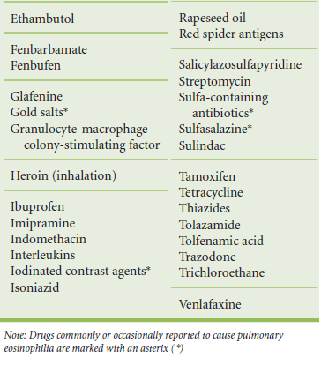
Fishman’s pulmonary diseases & disorders. 4th edition. Kristina crothers, carolyn rochester. The Eosinophilic Pneumonias; Vol1: 72: pg 1214

Slide 27
Idiopathic
Acute Eosinophilic
Pneumonia

Slide 28
Idiopathic Acute Eosinophilic Pneumonia
More common in younger men, with a mean age of approximately 30 years
Occurs commonly in previously healthy persons.
Also seen in persons with h/o CML, HIV infection, recent
commencement of smoking, involvement in unusual
activities (like cave exploration, plant repotting, indoor
renovations etc.)
*N Engl J Med 321:569–574, 1989.
*Allergy 60:841–857, 2005.

Slide 29
Idiopathic Acute Eosinophilic Pneumonia
** DIAGNOSTIC CRITERIA:
1. Acute onset of febrile respiratory manifestations (≤1
month duration before consultation)
Bilateral diffuse infiltrates on chest radiography
Hypoxemia, with PaO2 on room air < 60 mm Hg,
and/or PaO2 /FiO2 <= 300 mm Hg, and/or oxygen
saturation on room air < 90%
** Tazelaar HD, Linz LJ, Colby TV, et al: Acute eosinophilic pneumonia: Histopathologic findings in nine patients. Am J Respir Crit Care Med 1997; 155:296-302.
Pope-Harman AL, Davis WB, Allen ED, et al: Acute eosinophilic pneumonia: A summary of 15 cases and a review of the literature. Medicine (Baltimore) 1996; 75:334-342
Philit F, Etienne- Mastroianni B, Parrot A, et al: Idiopathic acute eosinophilic pneumonia: A study of 22 patients. Am J Respir Crit Care Med 2002; 166:1235-1239

Slide 30
Idiopathic Acute Eosinophilic Pneumonia
** DIAGNOSTIC CRITERIA:
(CONTINUED)
4. Lung eosinophilia , with > 25% eosinophils in BAL(or
eosinophilic pneumonia at lung biopsy)
5. Absence of infection, or of other known causes of
eosinophilic lung disease (especially exposure to drug
known to induce pulmonary eosinophilia.
** Tazelaar HD, Linz LJ, Colby TV, et al: Acute eosinophilic pneumonia: Histopathologic findings in nine patients. Am J Respir Crit Care Med 1997; 155:296-302.
Pope-Harman AL, Davis WB, Allen ED, et al: Acute eosinophilic pneumonia: A summary of 15 cases and a review of the literature. Medicine (Baltimore) 1996; 75:334-342
Philit F, Etienne- Mastroianni B, Parrot A, et al: Idiopathic acute eosinophilic pneumonia: A study of 22 patients. Am J Respir Crit Care Med 2002; 166:1235-1239

Slide 31
Idiopathic Acute Eosinophilic Pneumonia
CLINICAL FEATURES:
Presents as an acute illness with fever, myalgias, cough,
dyspnea, pleuritic chest pain, & hypoxemia (PaO2 < 60)
Patients often have diffuse crackles on auscultation & develop overt respiratory failure requiring mechanical ventilation.
Presents as ARDS but shock & extrapulmonary organ failure characteristically absent
Chest 2008; 133:1174-1180

Slide 32
Idiopathic Acute Eosinophilic Pneumonia
INVESTIGATIONS:
A moderate leukocytosis is typical, but in contrast to
other forms of AEP, blood eosinophilia is usually absent.
Serum IgE levels may be moderately elevated.
Striking eosinophilia (25 to 50 percent) is present in BAL
fluid.
Pulmonary function tests reveal a restrictive ventilatory
defect with a reduced DLco
Fishman’s pulmonary diseases & disorders. 4th edition. Kristina crothers, carolyn rochester. The Eosinophilic Pneumonias; Vol1: 72: pg 1217

Slide 33
Idiopathic Acute Eosinophilic Pneumonia
RADIOLOGY:
Early in the course of illness, the chest radiograph
reveals subtle, patchy infiltrates with Kerley B lines.
Diffuse symmetric alveolar and interstitial infiltrates
resembling ARDS with a ground-glass or micronodular
appearance develop within 48 hours.
Bilateral infiltrates is a defining feature of the disease.
Small to moderate bilateral pleural effusions is common.
Fishman’s pulmonary diseases & disorders. 4th edition. Kristina crothers, carolyn rochester. The Eosinophilic Pneumonias; Vol1: 72: pg 1217

Slide 34
Idiopathic Acute Eosinophilic Pneumonia
RADIOLOGY:
CT scanning confirms the presence of:
diffuse parenchymal ground-glass attenuation and consolidation.
prominence along bronchovascular bundles and septae.
pleural effusion.
Fluid analysis typically reveals a high pH and marked eosinophilia.
Fishman’s pulmonary diseases & disorders. 4th edition. Kristina crothers, carolyn rochester. The Eosinophilic Pneumonias; Vol1: 72: pg 1217

Slide 35
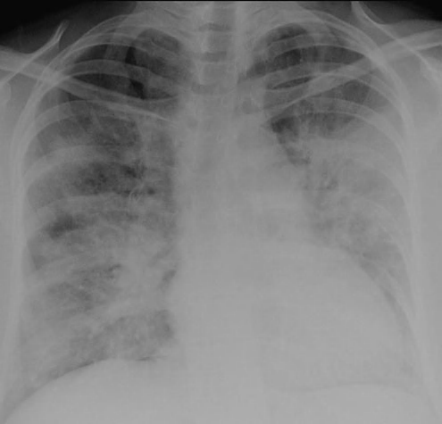
Radiology
B/L Opacities with mixed
alveolar & interstitial opacities
B/L Pleural effusion & Kerley B
lines
Air space consolidation
Ground glass haze
Interlobular septal thickening
B/L pleural effusion
Jeong Y J et al. Radiographics 2007;27:617-637

Slide 36
Idiopathic Acute Eosinophilic Pneumonia
LIGHT MICROSCOPY:
Prominent eosinophil infiltration in alveolar
spaces, bronchial walls, and, to a lesser
degree, the interstitium.
The pathological pattern of diffuse alveolar damage with
eosinophilic infiltrates should suggest the possibility of
Acute Eosinophilic Pneumonia.
Fishman’s pulmonary diseases & disorders. 4th edition. Kristina crothers, carolyn rochester. The Eosinophilic Pneumonias; Vol1: 72: pg 1218

Slide 37
Microscopy
Eosinophils infiltrating the alveolar spaces & wall with Diffuse alveolar damage
Jeong Y J et al. Radiographics 2007;27:617-637

Slide 38
Idiopathic Acute Eosinophilic Pneumonia
Elevated levels of the fungal cell wall component
β-d-glucan have been described in the BAL fluid of
patients with AEP suggesting a possible association
between exposure to fungus and development of disease.
Idiopathic AEP is a diagnosis of exclusion and should be
considered in a patient who presents with apparent
acute lung injury (ALI) or ARDS without a typical
antecedent illness.
Fishman’s pulmonary diseases & disorders. 4th edition. Kristina crothers, carolyn rochester. The Eosinophilic Pneumonias; Vol1: 72: pg 1218

Slide 39
Idiopathic Acute Eosinophilic Pneumonia
TREATMENT:
Initial doses of methyl-prednisolone typically
used range from 60 to 125 mg administered
every 6 hours.
After resolution of respiratory failure, oral
prednisone (in doses of 40 to 60 mg per day) may
be continued for 2 to 4weeks with a subsequent
slow taper over the next several weeks
Fishman’s pulmonary diseases & disorders. 4th edition. Kristina crothers, carolyn rochester. The Eosinophilic Pneumonias; Vol1: 72: pg 1218

Slide 40
Idiopathic Acute Eosinophilic Pneumonia
PROGNOSIS:
Idiopathic AEP carries an excellent prognosis.
Rapid dramatic responses to corticosteroid therapy with
abatement of fever and respiratory symptoms within
hours and complete resolution of infiltrates usually
within 1 month.
Fishman’s pulmonary diseases & disorders. 4th edition. Kristina crothers, carolyn rochester. The Eosinophilic Pneumonias; Vol1: 72: pg 1218

Slide 41
Idiopathic Acute Eosinophilic Pneumonia
Absence of clinical relapse is characteristic.
Follow-up pulmonary function testing is
generally normal, although a small number of
patients may demonstrate mild reductions in
DLco or lung volumes.
Fishman’s pulmonary diseases & disorders. 4th edition. Kristina crothers, carolyn rochester. The Eosinophilic Pneumonias; Vol1: 72: pg 1218

Slide 42
CHRONIC EOSINOPHILIC
PNEUMONIA

Slide 43
CHRONIC EOSINOPHILIC PNEUMONIA
First described by Carrington et al in 1969.
Peak incidence : 30 to 40 yrs. F>M
Most cases occur in Caucasians
1/3 to ½ h/o: atopy, allergic rhinitis, or nasal polyps.
2/3 rd adult-onset asthma: preceding or concurrent with
the occurrence of CEP
Fishman’s pulmonary diseases & disorders. 4th edition. Kristina crothers, carolyn rochester. The Eosinophilic Pneumonias; Vol1: 72: pg 1220

Slide 44
CHRONIC EOSINOPHILIC PNEUMONIA
CLINICAL FEATURES:
Typically subacute presentation.
Symptoms present for several months before diagnosis.
Common presenting complaints include:
- Low-grade fevers,
- Drenching night sweats
- Moderate (10-to 50-pound) weight loss.
- Cough
Fishman’s pulmonary diseases & disorders. 4th edition. Kristina crothers, carolyn rochester. The Eosinophilic Pneumonias; Vol1: 72: pg 1220

Slide 45
CHRONIC EOSINOPHILIC PNEUMONIA
Patients ultimately develop progressive dyspnea, which
may be associated with wheezing in those with adult-
onset asthma.
Less commonly ARDS with severe hypoxemia.
No major extrapulmonary manifestations.
Rarely, arthralgia, skin rash, pericarditis, unexplained
heart failure have been described.
Fishman’s pulmonary diseases & disorders. 4th edition. Kristina crothers, carolyn rochester. The Eosinophilic Pneumonias; Vol1: 72: pg 1220

Slide 46
CHRONIC EOSINOPHILIC PNEUMONIA
Moderate leukocytosis.
The majority (66 to 95 percent) have peripheral blood
eosinophilia(> 6≈90%)
Moderate normochromic,normocytic anemia and
thrombocytosis may be present.
The ESR is typically elevated (>20mm).
Fishman’s pulmonary diseases & disorders. 4th edition. Kristina crothers, carolyn rochester. The Eosinophilic Pneumonias; Vol1: 72: pg 1220

Slide 47
CHRONIC EOSINOPHILIC PNEUMONIA
IgE levels are elevated in up to 50% of cases.
BRONCHOALVEOLAR LAVAGE:
Increased eosinophils, typically accounting for 40% or
more of the WBC’S.
Blood and sputum cultures routinely fail to identify an
infectious etiology in these patients.
Fishman’s pulmonary diseases & disorders. 4th edition. Kristina crothers, carolyn rochester. The Eosinophilic Pneumonias; Vol1: 72: pg 1220

Slide 48
CHRONIC EOSINOPHILIC PNEUMONIA
PULMONARY FUNCTION TEST:
Depends on the stage and severity of the disease.
In the initial stage prior to treatment with corticosteroids, testing may reveal:
- restrictive, due to acute eosinophilic infiltration of lung
parenchyma.
- obstructive, common in patients with a history of asthma.
- normal physiology.
Fishman’s pulmonary diseases & disorders. 4th edition. Kristina crothers, carolyn rochester. The Eosinophilic Pneumonias; Vol1: 72: pg 1220

Slide 49
CHRONIC EOSINOPHILIC PNEUMONIA
RADIOGRAPHIC FEATURES:
Peripherally based, progressive dense infiltrates with ill
defined margins.
Infiltrates are most commonly bilateral, located in the mid
to upper lung zones.
They are frequently nonsegmental, subsegmental, or
lobar in distribution and apposed to the pleura & may
mimic loculated pleural fluid.
Fishman’s pulmonary diseases & disorders. 4th edition. Kristina crothers, carolyn rochester. The Eosinophilic Pneumonias; Vol1: 72: pg 1220

Slide 50
CHRONIC EOSINOPHILIC PNEUMONIA
The characteristic “photographic negative of pulmonary
edema” appearance (<50% cases) results if extensive
infiltrates surround major portions of or the entire lung.
Pulmonary infiltrates a/w CEP are typically non-migratory
& affect the outer two-thirds of lung fields
Rapid resolution of infiltrates occurs following
corticosteroid treatment, with recurrences in identical
locations.
Fishman’s pulmonary diseases & disorders. 4th edition. Kristina crothers, carolyn rochester. The Eosinophilic Pneumonias; Vol1: 72: pg 1220

Slide 51
CHRONIC EOSINOPHILIC PNEUMONIA
CT SCAN FINDINGS:
Ground-glass opacities without clear consolidation.
Mediastinal adenopathy
Less typical features include:
nodular infiltrates
Linear oblique/vertical densities
Areas of fibrosis unassociated with anatomic divisions.
Fishman’s pulmonary diseases & disorders. 4th edition. Kristina crothers, carolyn rochester. The Eosinophilic Pneumonias; Vol1: 72: pg 1220

Slide 52
CHRONIC EOSINOPHILIC PNEUMONIA
CT SCAN FINDINGS: (contd)
Findings may vary depending on the timing of CT
relative to onset of symptoms.
Typical areas of dense, peripherally located airspace
consolidation are found in most cases within the first
several weeks of disease onset.
Streaky band-like opacities may appear when symptoms
have been present for more than 2 months.
Fishman’s pulmonary diseases & disorders. 4th edition. Kristina crothers, carolyn rochester. The Eosinophilic Pneumonias; Vol1: 72: pg 1220

Slide 53
Radiology
B/L Peripheral opacities
Ground glass haze
Septal line thickening
B/L Opacities in Upper & Mid Zone
Photographic negative of
pulmonary edema
Jeong Y J et al. Radiographics 2007;27:617-637

Slide 54
CHRONIC EOSINOPHILIC PNEUMONIA
HISTOPATHOLOGY:
Varying degree of leukocytic infilterates in alveolar
airspaces & interstitium.
Predominantly eosinophilic with macrophages,
lymphocytes & occassional plasma cells.
Focal edema of capillary endothelium, focal type II
epithelial cell hyperplasia, proteinaceous alveolar
exudates & multinucleated histiocytes within alveolar
spaces.
Fishman’s pulmonary diseases & disorders. 4th edition. Kristina crothers, carolyn rochester. The Eosinophilic Pneumonias; Vol1: 72: pg 1221

Slide 55
CHRONIC EOSINOPHILIC PNEUMONIA
HISTOPATHOLOGY:
Proliferative bronchiolitis obliterans (1/3rd cases)
Mild, non necrotising microangitis affecting small venules
may be seen.
Less than 20% may have:
Frank intra-alveolar necrosis
eosinophilic microabcess
Non caseating granuloma.
Fishman’s pulmonary diseases & disorders. 4th edition. Kristina crothers, carolyn rochester. The Eosinophilic Pneumonias; Vol1: 72: pg 1221

Slide 56
Microscopy
Eosinophilic infiltration of alveolar walls with variable fibrosis
Jeong Y J et al. Radiographics 2007;27:617-637

Slide 57
CHRONIC EOSINOPHILIC PNEUMONIA
DIAGNOSIS:
The diagnosis of CEP is based on clinical, radiographic,
& BAL findings, and on the inability to document
pulmonary or systemic infection.
Transbronchial biopsy, usually performed to rule out
other diagnostic entities.
In most reported series, open lung biopsy has been
required only rarely to establish the diagnosis.
Fishman’s pulmonary diseases & disorders. 4th edition. Kristina crothers, carolyn rochester. The Eosinophilic Pneumonias; Vol1: 72: pg 1221

Slide 58
CHRONIC EOSINOPHILIC PNEUMONIA
DIAGNOSIS: (contd)
Because of the rapid and dramatic responsiveness of
CEP to steroid treatment, a therapeutic trial of steroids
is often useful in establishing the diagnosis.
Failure to document rapid clinicial improvement should
alert the clinician to consider other diagnosis.
Fishman’s pulmonary diseases & disorders. 4th edition. Kristina crothers, carolyn rochester. The Eosinophilic Pneumonias; Vol1: 72: pg 1222

Slide 59
CHRONIC EOSINOPHILIC PNEUMONIA
DIFFERENTIAL DIAGNOSIS:
Infection (especially TB and fungal diseases like cryptococcosis).
Sarcoidosis.
Loeffler’s syndrome.
Desquamative interstitial Pneumonitis.
Bronchiolitis Obliterans-Organizing Pneumonia.
Chronic Hypersensitivity Pneumonitis.
Eosinophilic Granuloma.
Fishman’s pulmonary diseases & disorders. 4th edition. Kristina crothers, carolyn rochester. The Eosinophilic Pneumonias; Vol1: 72: pg 1222

Slide 61
CHRONIC EOSINOPHILIC PNEUMONIA
TREATMENT:
Corticosteroids are the mainstay of therapy for CEP.
Dramatic clinical, radiographic, and physiological
improvements have been documented following steroid
treatment in all series Reported.
Even patients presenting with severe respiratory failure
may respond welll to steroids.
Fishman’s pulmonary diseases & disorders. 4th edition. Kristina crothers, carolyn rochester. The Eosinophilic Pneumonias; Vol1: 72: pg 1222

Slide 62
CHRONIC EOSINOPHILIC PNEUMONIA
Treatment with steroids leads to:
Defervescence within 6 hours
Reduced dyspnea, cough, and blood eosinophilia
within 24 to 48 hours
Resolution of hypoxia in 2 to 3 days
Radiographic improvement within 1 to 2 weeks
Complete resolution of symptoms within 2-3 weeks
Normalization of the chest radiograph within 2 months.
Fishman’s pulmonary diseases & disorders. 4th edition. Kristina crothers, carolyn rochester. The Eosinophilic Pneumonias; Vol1: 72: pg 1222

Slide 63
CHRONIC EOSINOPHILIC PNEUMONIA
STEROID REGIMEN:
No comparative study for appropriate dose or duration.
Recommended regimen: prednisone(40-60 mg/day) until
2 wks after resolution of symptoms & Xray abnormalities.
The dose of prednisone can then be tapered slowly.
Treatment is usually maintained for at least 3 months &
optimally for 6 to 9 months
Fishman’s pulmonary diseases & disorders. 4th edition. Kristina crothers, carolyn rochester. The Eosinophilic Pneumonias; Vol1: 72: pg 1222

Slide 64
CHRONIC EOSINOPHILIC PNEUMONIA
PROGNOSIS:
Generally favourable
Patients may require 1 to 3 years of initial steroid
treatment for disease control & up to 25% may require
long-term maintenance treatment (2.5-10mg/day)
Some patients may respond to inhaled corticosteroids allowing discontinuation of oral steroids.
Fishman’s pulmonary diseases & disorders. 4th edition. Kristina crothers, carolyn rochester. The Eosinophilic Pneumonias; Vol1: 72: pg 1222

Slide 65
CHRONIC EOSINOPHILIC PNEUMONIA
PROGNOSIS: (contd)
Relapse occurs in approximately one-third to one-half of
patients when steroids are tapered or discontinued.
No obvious factors exist to identify persons who are likely to relapse or require long-term steroids.
Relapses are more common in persons treated initially with a short course (less than 6 months) of steroids
Fishman’s pulmonary diseases & disorders. 4th edition. Kristina crothers, carolyn rochester. The Eosinophilic Pneumonias; Vol1: 72: pg 1222

Slide 66
CHURG-STRAUSS SYNDROME
(ALLERGIC GRANULOMATOSIS
AND ANGIITIS)

Slide 67
CHURG-STRAUSS SYNDROME
In 1939, Rackemann & Greene: reported a subgroup of
patients with P.A.N. & concomitant allergic disease.
In 1951, Churg and Strauss: first described the histopathology and clinical features.
They Reported a form of necrotizing vasculitis in several
organs, associated with eosinophilic tissue inflammation
& extravascular granulomas, occurring in asthmatics,
with associated fever and peripheral hypereosinophilia.
Ann Intern Med 143:632–638, 2005
Arthritis Rheum 52:2926–2935, 2005

Slide 68
CHURG-STRAUSS SYNDROME
CSS is an uncommon systemic disease & typically
affects multiple-organ systems.
10% of all patients with vasculitis prove to have CSS.
Increased incidence is seen in asthmatics.
Precise incidence is unknown due to uncertainities
regarding the diagnosis & variable clinical presentation.
Fishman’s pulmonary diseases & disorders. 4th edition. Kristina crothers, carolyn rochester. The Eosinophilic Pneumonias; Vol1: 72: pg 1223

Slide 69
CHURG-STRAUSS SYNDROME
Occur in patients of any age most commonly between 38
to 50yrs.
No clear gender predominance.
Among women, disease onset has been reported during
pregnancy.
Fishman’s pulmonary diseases & disorders. 4th edition. Kristina crothers, carolyn rochester. The Eosinophilic Pneumonias; Vol1: 72: pg 1223

Slide 70
Criteria for diagnosis of CSS

Slide 71
CHURG-STRAUSS SYNDROME
Subacute course (with symptoms ranging over months to
years)
Three distinct clinical phases of the disease have been
recognized:
1) The prodromal phase,
2) The eosinophilic phase,
3) Vasculitic phase .
Fishman’s pulmonary diseases & disorders. 4th edition. Kristina crothers, carolyn rochester. The Eosinophilic Pneumonias; Vol1: 72: pg 1224

Slide 72
CHURG-STRAUSS SYNDROME
1. PRODROMAL PHASE:
Late-onset (in the second or third decade) allergic rhinitis
and atopy in persons often lacking a family history of
atopy.
Severe allergic rhinitis, sinusitis, drug sensitivity, and
asthma are usually present for 8 to 10 years, and up to
30 years before CSS disease recognition.
Fishman’s pulmonary diseases & disorders. 4th edition. Kristina crothers, carolyn rochester. The Eosinophilic Pneumonias; Vol1: 72: pg 1224

Slide 73
CHURG-STRAUSS SYNDROME
2. VASCULITIC PHASE:
vasculitis of the small and medium vessels with vascular
and extravascular granulomas.
The onset of the vasculitic phase is often heralded by
development of constitutional symptoms, including fever,
malaise, weight loss, and increased allergic or asthmatic
symptoms .
Fishman’s pulmonary diseases & disorders. 4th edition. Kristina crothers, carolyn rochester. The Eosinophilic Pneumonias; Vol1: 72: pg 1224

Slide 74
CHURG-STRAUSS SYNDROME
Vasculitis tends to occur several years after the onset of
allergic manifestations
In some cases it develops within months of, or
concomitant with, the onset of asthma.
Typically affects multiple-organ systems.
Manifestations in the lungs, heart, skin, and nervous
system are most common
Fishman’s pulmonary diseases & disorders. 4th edition. Kristina crothers, carolyn rochester. The Eosinophilic Pneumonias; Vol1: 72: pg 1224

Slide 75
CHURG-STRAUSS SYNDROME
3. THE EOSINOPHILIC PHASE:
Marked peripheral blood eosinophilia and eosinophilic
tissue infiltration, most commonly of lung, GIT, & skin.
RESPIRATORY MANIFESTATIONS:
Occur in the prodromal and eosinophilic phases of the
disease.
Nearly all patients have asthma at some point in the illness.
Fishman’s pulmonary diseases & disorders. 4th edition. Kristina crothers, carolyn rochester. The Eosinophilic Pneumonias; Vol1: 72: pg 1224

Slide 76
CHURG-STRAUSS SYNDROME
RESPIRATORY MANIFESTATIONS: (contd)
Upper airway allergic disease, sinusitis, rhinitis, and
polyposis, is seen in 75 to 85 percent of patients.
The asthma and upper-airway disease usually are
long-standing and often require steroid therapy
(systemic or inhaled) to maintain control of symptoms.
In rare instances, recurrent respiratory infections leads to bronchiectasis.
Fishman’s pulmonary diseases & disorders. 4th edition. Kristina crothers, carolyn rochester. The Eosinophilic Pneumonias; Vol1: 72: pg 1224

Slide 77
CHURG-STRAUSS SYNDROME
RESPIRATORY MANIFESTATIONS: (contd)
A Loeffler’s-like syndrome with eosinophilic infiltration of
the lung parenchyma is seen in 38 to 40% of patients.
These patients may develop dyspnea, cough, and
wheezing.
PFT: obstructive ventilatory defect
Fishman’s pulmonary diseases & disorders. 4th edition. Kristina crothers, carolyn rochester. The Eosinophilic Pneumonias; Vol1: 72: pg 1225

Slide 78
CHURG-STRAUSS SYNDROME
SYSTEMIC MANIFESTATIONS:
Cardiac > CNS > renal > GIT
CARDIAC MANIFESTATIONS:
NOT present on initial presentation & occur during the
vasculitic phase.
Major source of morbidity & mortality(in up to 50% of cases).
Fishman’s pulmonary diseases & disorders. 4th edition. Kristina crothers, carolyn rochester. The Eosinophilic Pneumonias; Vol1: 72: pg 1225

Slide 79
CHURG-STRAUSS SYNDROME
Progressive CHF occurs in 47% because of myocardial
infiltration by eosinophils or ischemic cardiomyopathy
due to necrotizing vasculitis of the coronary arteries.
Coronary vasculitis is fatal up to 60% of time.
Acute pericarditis(1/3rd cases), cardiac tamponade have
been reported.
Constrictive pericarditis may develop over time.
Fishman’s pulmonary diseases & disorders. 4th edition. Kristina crothers, carolyn rochester. The Eosinophilic Pneumonias; Vol1: 72: pg 1225

Slide 80
CHURG-STRAUSS SYNDROME
NEUROLOGICAL MANIFESTATIONS:
Mono- or polyneuropathy (present in 69 to 75% of cases)
CNS manifestations occur in approximately 2/3rd of patients & include:-
cranial nerve impairment (especially optic neuritis),
seizure,
subarachnoid hemorrhage common causes of
cerebral infarction. patient death
Fishman’s pulmonary diseases & disorders. 4th edition. Kristina crothers, carolyn rochester. The Eosinophilic Pneumonias; Vol1: 72: pg 1225

Slide 81
CHURG-STRAUSS SYNDROME
DERMATOLOGICAL MANIFESTATIONS:
Seen in 2/3 rd cases
They can manifest as:
Nonthrombocytopenic purpura,
Tender cutaneous or subcut. nodules (may ulcerate)
Urticaria,
Maculopapular rash,
Petechiae, ecchymoses, or
livedo reticularis
Fishman’s pulmonary diseases & disorders. 4th edition. Kristina crothers, carolyn rochester. The Eosinophilic Pneumonias; Vol1: 72: pg 1225

Slide 82
CHURG-STRAUSS SYNDROME
GI MANIFESTATIONS:
Present in 60% of cases & is the 4th leading cause of
death in CSS.
They include
Eosinophilic gastroenteritis/vasculitis leading to diarrhea,
abdominal pain,
- Cholecystitis, Pancreatitis, Liver function abnormalities,
Intestinal obstruction, GI bleed & Bowel perforation may occur.
Fishman’s pulmonary diseases & disorders. 4th edition. Kristina crothers, carolyn rochester. The Eosinophilic Pneumonias; Vol1: 72: pg 1225

Slide 83
CHURG-STRAUSS SYNDROME
RENAL MANIEFESTATIONS:
Renal insufficiency occurs in up to 50% of cases.
Interstitial nephritis, FSGN(often with necrotizing features), hematuria & albuminuria are common.
Severe hypertension may occur in 25-75 % of cases
& may be due to recurrent renal infarction.
In contrast to WG, overt renal failure is not common.
Fishman’s pulmonary diseases & disorders. 4th edition. Kristina crothers, carolyn rochester. The Eosinophilic Pneumonias; Vol1: 72: pg 1225

Slide 84
CHURG-STRAUSS SYNDROME
OTHER MANIFESTATIONS:
Mild lymphadenopathy(in 30 to 40 percent),
Rheumatological manifestations (migratory
polyarthralgias, myalgias, temporal arteritis),
Urological disease (ureteral, urethral, prostatic),
Ocular manifestations have also been described
Fishman’s pulmonary diseases & disorders. 4th edition. Kristina crothers, carolyn rochester. The Eosinophilic Pneumonias; Vol1: 72: pg 1225

Slide 85
Frequency of organ manifestation & clinical features of CSS
Rheum Dis Clin N Am 36 (2010) 527–543

Slide 86
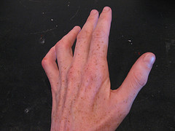
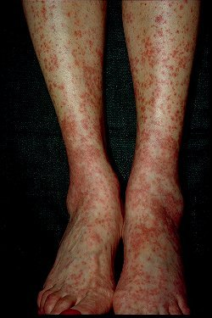
Variants of CSS
 | Vasculitic phenotype | Tissue disease phenotype
Frequency | 40 % | 60 %
ANCA | Present (p ANCA) | Absent
Predominant clinical feature | Glomerular renal ds Peripheral neuropathy Purpura | Cardiac involvement(eosinophilic myocarditis) Fever
Predominant histopathological feature | Biopsy proven vasculitis | Eosinophilic pneumonia
Rheum Dis Clin N Am 36 (2010) 527–543

Slide 87
CHURG-STRAUSS SYNDROME
INVESTIGATIONS
Fluctuating degree of peripheral blood eosinophilia
(20 to 90 percent of the WBC differential)
S. Total IgE levels are elevated (range, 500-1000 U/ml)
& may parallel disease activity.
normochromic, normocytic anemia.
ESR- moderately elevated.
Fishman’s pulmonary diseases & disorders. 4th edition. Kristina crothers, carolyn rochester. The Eosinophilic Pneumonias; Vol1: 72: pg 1225

Slide 88
CHURG-STRAUSS SYNDROME
INVESTIGATIONS: (contd)
70-75% of patients have +ve pANCA.
Pleural fluid, if present, reveals an acidotic
eosinophilic exudate with low glucose levels.
Pleural biopsy shows chronic pleuritis with
eosinophilic infiltration.
BAL reveals an increased percentage of eosinophil
Fishman’s pulmonary diseases & disorders. 4th edition. Kristina crothers, carolyn rochester. The Eosinophilic Pneumonias; Vol1: 72: pg 1225

Slide 89
CHURG-STRAUSS SYNDROME
RADIOLOGY:
Transient, migratory nonlobar, nonsegmental, often
peripheral pulmonary infiltrates, with no regional
predilection.
Nodular lesions, interstitial lung disease, and hilar
adenopathy are less common findings.
The chest radiograph may occasionally be normal.
Fishman’s pulmonary diseases & disorders. 4th edition. Kristina crothers, carolyn rochester. The Eosinophilic Pneumonias; Vol1: 72: pg 1225

Slide 90
CHURG-STRAUSS SYNDROME
HRCT FINDINGS:
patchy peribronchial thickening,
pulmonary artery enlargement,
Irregular stellate configuration of some vessels,
Areas of septal thickening,
Scattered patchy parenchymal opacities with ground-
glass or consolidated appearance.
Fishman’s pulmonary diseases & disorders. 4th edition. Kristina crothers, carolyn rochester. The Eosinophilic Pneumonias; Vol1: 72: pg 1225

Slide 91
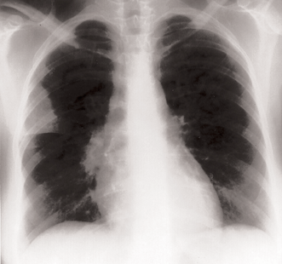
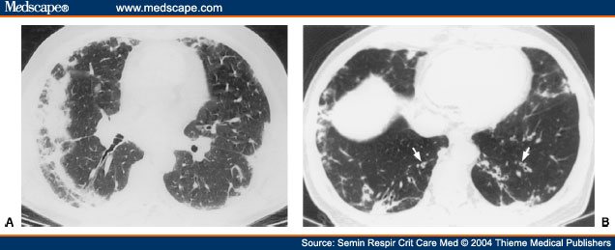
Radiology
Scattered patchy opacities with
Ground glass haze
Patchy peribronchial thickening
B/L pleural effusion
Pericardial effusion
Transient migratory non lobar,
Non segmental peripheral opacities
Jeong Y J et al. Radiographics 2007;27:617-637

Slide 92
CHURG-STRAUSS SYNDROME
¹⁸FDG/¹³N ammonia PET imaging may be useful to
identify cardiac involvement.
The histopathological hallmarks depends on stage of
illness: -
Early lesions demonstrate eosinophilic infiltration of the
vessels and perivascular region.
Later lesions are characterized by necrotizing arteritis or
vessel obliteration and scarring.
Fishman’s pulmonary diseases & disorders. 4th edition. Kristina crothers, carolyn rochester. The Eosinophilic Pneumonias; Vol1: 72: pg 1225

Slide 93
CHURG-STRAUSS SYNDROME
Open lung biopsy is the gold-standard site for tissue
biopsy.
Transbronchial biopsy may reveal the diagnosis if there
is alveolar involvement, but is often non diagnostic..
Fishman’s pulmonary diseases & disorders. 4th edition. Kristina crothers, carolyn rochester. The Eosinophilic Pneumonias; Vol1: 72: pg 1225

Slide 94
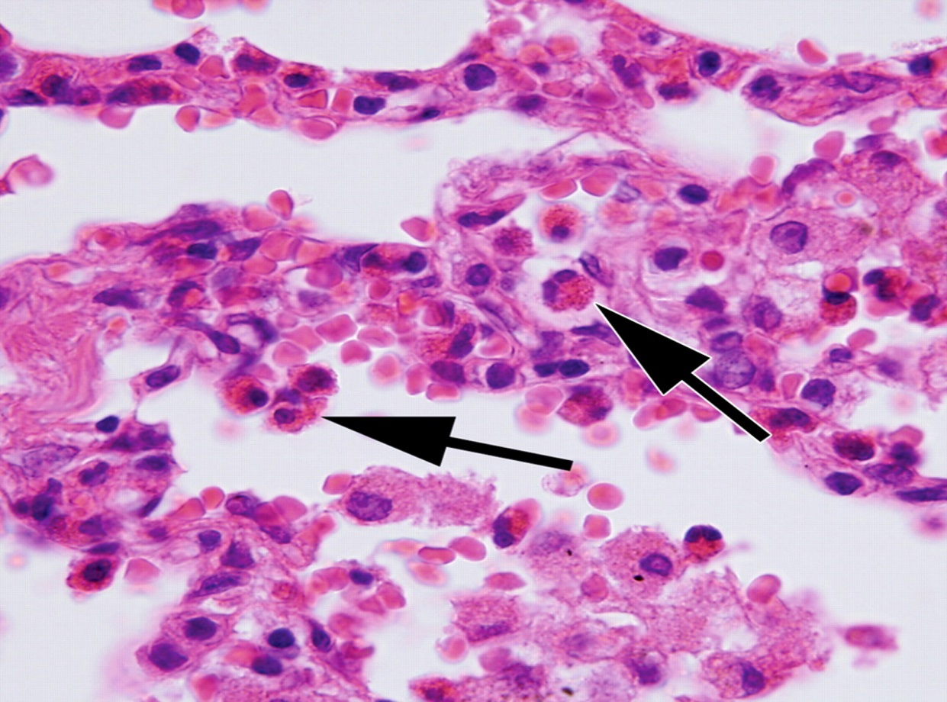
Microscopy
High-power photomicrograph showing numerous eosinophils (arrows), each of which has a lobulated nucleus and cytoplasm that includes specific granules.
Jeong Y J et al. Radiographics 2007;27:617-637
Notes:
Figure 1. High-power photomicrograph (original magnification, ×1000; hematoxylin-eosin [H-E] stain) shows numerous eosinophils (arrows), each of which has a lobulated nucleus and cytoplasm that includes specific granules.

Slide 95
CHURG-STRAUSS SYNDROME
DIFFERENTIALS:
Polyarteritis nodosa,
Microscopic angiitis,
Wegner’s Granulomatosis,
CEP
ABPA
Idiopathic hypereosinophilic syndrome,
Loeffler’s syndrome
Asthma
Fungal or parasitic infection,
Drug-induced vasculitis,
Sarcoidosis and
Hodgkin’s lymphoma
Fishman’s pulmonary diseases & disorders. 4th edition. Kristina crothers, carolyn rochester. The Eosinophilic Pneumonias; Vol1: 72: pg 1226

Slide 96
CHURG-STRAUSS SYNDROME
PROGNOSIS:
Patients in whom CSS goes untreated have a poor
prognosis
Upto 50% die within 3 months of the onset of vasculitis.
Early recognition and treatment are important.
Corticosteroid treatment generally leads to dramatic
clinical improvement, with disease stabilization or cure.
Fishman’s pulmonary diseases & disorders. 4th edition. Kristina crothers, carolyn rochester. The Eosinophilic Pneumonias; Vol1: 72: pg 1226

Slide 97
CHURG-STRAUSS SYNDROME
TREATMENT:
Prednisone,0.5 to 1.5 mg/kg/day (or 60 mg/day in adults)
for 6 to 12 weeks, to eliminate constitutional symptoms.
Once the vasculitic phase is controlled, steroids may be
tapered with doses titrated to maintain disease control.
Low-dose prednisone is often given every day or every
other day for up to 1 year.
Fishman’s pulmonary diseases & disorders. 4th edition. Kristina crothers, carolyn rochester. The Eosinophilic Pneumonias; Vol1: 72: pg 1226

Slide 98
CHURG-STRAUSS SYNDROME
TREATMENT : (contd)
Treatment with cytotoxic immunosuppressive agents
such as: azathioprine, cyclophosphamide, high-dose
methylprednisolone, or chlorambucil may prove effective.
Should be considered in patients whose condition fails to
improve with steroid treatment or poor prognostic
features, including cardiac or GI involvement, renal
insufficiency or proteinuria greater than 1 g/day.
Fishman’s pulmonary diseases & disorders. 4th edition. Kristina crothers, carolyn rochester. The Eosinophilic Pneumonias; Vol1: 72: pg 1226

Slide 99
CHURG-STRAUSS SYNDROME
TREATMENT: (contd)
Cyclophosphamide (2 mg/kg/day orally or 0.6 g/m² iv per
month) may be given concurrently with corticosteroids.
IFN-α has led to improved pulmonary function tests,
Plasma exchange may be a successful adjunct T/t.
β-blockers should be avoided in CSS related HTn owing to the risk of bronchospasm & CHF.
Fishman’s pulmonary diseases & disorders. 4th edition. Kristina crothers, carolyn rochester. The Eosinophilic Pneumonias; Vol1: 72: pg 1226

Slide 100
CHURG-STRAUSS SYNDROME
OUTCOME:
Long term overall remission can be achieved in 81 to 92
percent of patients.
Relapses if occurs are usually within 1st year.
Patients with severe disease when treated with
cyclophosphamide & corticosteroids have better survival
than those treated with corticosteroids alone.
Fishman’s pulmonary diseases & disorders. 4th edition. Kristina crothers, carolyn rochester. The Eosinophilic Pneumonias; Vol1: 72: pg 1226

Slide 101
Association between leukotriene receptor antagonists and Churg-Strauss syndrome
The authors show that in two thirds of cases, LTRA therapy may
be implicated in the pathogenesis of CSS.
The association is much stronger than for long-acting beta-
adrenergic agents or inhaled corticosteroids, which might be
added as asthma worsens during the prodromal phase of CSS.
The authors fail to identify a biologically plausible reason for the
association, however, and many cases of CSS occur in the
absence of LTRA therapy.
Bibby S, Healy B, Steele R, et al: Association between leukotriene receptor antagonist therapy and Churg-Strauss syndrome: An analysis of the FDA AERS database. Thorax 2010; 65(2):132-138.

Slide 102
IDIOPATHIC
HYPEREOSINOPHILIC
SYNDROME

Slide 103
IDIOPATHIC HYPEREOSINOPHILIC SYNDROME
Several names-including:
Eosinophilic leukemia,
Loeffler’s fibroplastic endocarditis,
Disseminated eosinophilic cardiovascular disease.
In 1975, Chusid and colleagues revised the definition of
IHS to include only cases in which no other underlying
cause of hypereosinophilia could be found.
Fishman’s pulmonary diseases & disorders. 4th edition. Kristina crothers, carolyn rochester. The Eosinophilic Pneumonias; Vol1: 72: pg 1227

Slide 104
IDIOPATHIC HYPEREOSINOPHILIC SYNDROME
CLINICAL FEATURES:
Clinically heterogeneous syndrome with a wide range of
disease severity.
Predominantly affects males between 20 to 50 yrs of age
Clinical features varies from mild limited form of disease
with minimal involvement of non critical organ to life
threatening multi organ dysfunction.
Fishman’s pulmonary diseases & disorders. 4th edition. Kristina crothers, carolyn rochester. The Eosinophilic Pneumonias; Vol1: 72: pg 1227

Slide 105
IDIOPATHIC HYPEREOSINOPHILIC SYNDROME
CLINICAL FEATURES: (contd)
Often nonspecific & include:
weakness, fatigue, low-grade fevers, myalgias, cough,
angioedema, rash, retinal lesions, and dyspnea.
virtually every organ system can be involved.
Cough is predominantly nocturnal ,either nonproductive or productive of small quantities of non-purulent sputum.
Fishman’s pulmonary diseases & disorders. 4th edition. Kristina crothers, carolyn rochester. The Eosinophilic Pneumonias; Vol1: 72: pg 1227

Slide 106
IDIOPATHIC HYPEREOSINOPHILIC SYNDROME
CLINICAL FEATURES:
Wheezing and dyspnea are also common, without
evidence of airflow obstruction on spirometry
Pulmonary hypertension, ARDS, and pleural effusions
(which may be due to CHF) have been reported.
Chest x ray:
Transient focal or diffuse pulmonary infiltrates (with no
predilection for any particular distribution )
Fishman’s pulmonary diseases & disorders. 4th edition. Kristina crothers, carolyn rochester. The Eosinophilic Pneumonias; Vol1: 72: pg 1227

Slide 107
IDIOPATHIC HYPEREOSINOPHILIC SYNDROME
CLINICAL FEATURES: (contd)
*The three principal clinical features defining IHS are:
persistent blood eosinophilia greater than 1500/μl
for more than 6 months;
(2) symptoms and signs of end-organ dysfunction; and
(3) no other identifiable underlying cause of
eosinophilia.
Histopathological examination reveals intense interstitial
infilteration with eosinophils.
*Chusid MJ, Dale DC, West BC, Wolff SM. The hypereosinophilic syndrome: analysis of fourteen cases with review of the literature. Medicine (Baltimore). Jan 1975;54(1):1-27.

Slide 108
IDIOPATHIC HYPEREOSINOPHILIC SYNDROME
CARDIAC MANIFESTATIONS:
Occurs in most patients with IHS & is the major cause of
morbidity and mortality.
Includes:
Progressive CHF due to eosinophilic myocarditis & endocarditis
intracardiac thrombi
endocardial fibrosis.
Fishman’s pulmonary diseases & disorders. 4th edition. Kristina crothers, carolyn rochester. The Eosinophilic Pneumonias; Vol1: 72: pg 1227

Slide 109
IDIOPATHIC HYPEREOSINOPHILIC SYNDROME
NEUROLOGICAL MANIFESTATIONS:
Encephalopathy with neuropsychiatric dysfunction,
Memory loss,
Gait disturbances with or without signs of upper motor neuron injury,
Visual changes,
Sequelae of thromboembolic events, like hemiparesis.
Peripheral neuropathy with sensory and/or motor axonal
loss (no vasculitic or eosinophilic infiltration) is
extremely common in IHS.
Fishman’s pulmonary diseases & disorders. 4th edition. Kristina crothers, carolyn rochester. The Eosinophilic Pneumonias; Vol1: 72: pg 1228

Slide 110
IDIOPATHIC HYPEREOSINOPHILIC SYNDROME
OTHER MANIFESTATIONS:
- Venous and arterial thromboembolism,
Anemia,
Thrombocytopenia,
Elevated vitamin B12 levels,
Hepatosplenomegaly,
Lymphadenopathy
The bone marrow is universally affected with a striking
eosinophilia (up to 25 to 75 percent of the differential).
Fishman’s pulmonary diseases & disorders. 4th edition. Kristina crothers, carolyn rochester. The Eosinophilic Pneumonias; Vol1: 72: pg 1228

Slide 111
Clinical features of HES

Slide 112
IDIOPATHIC HYPEREOSINOPHILIC SYNDROME
Organ damage in IHS is believed to be due both to
eosinophilic infiltration of tissues and to tissue injury
caused by thromboembolic events.
Eosinophils probably contribute to tissue damage via
antibody mediated cytotoxicity.
BAL eosinophilia is absent in patients lacking pulmonary
manifestations of the disease.
Fishman’s pulmonary diseases & disorders. 4th edition. Kristina crothers, carolyn rochester. The Eosinophilic Pneumonias; Vol1: 72: pg 1228

Slide 113
IDIOPATHIC HYPEREOSINOPHILIC SYNDROME
LABORATORY FINDINGS:
Elevated serum total IgE (25 to 38 percent)
Hypergammaglobulinemia
Circulating immune complexes (32 to 50 percent)
ESR above 15 mm/h (68 percent)
Elevated serum B12 and leukocyte alkaline phosphatase levels are also noted
Fungal and parasitic serologies, as well as aspirates of body fluids for ova and parasites, are negative.
Fishman’s pulmonary diseases & disorders. 4th edition. Kristina crothers, carolyn rochester. The Eosinophilic Pneumonias; Vol1: 72: pg 1228

Slide 114
IDIOPATHIC HYPEREOSINOPHILIC SYNDROME
Major pathogenetic and clinical variants:
Patients with clonal abnormalities in eosinophils
Patients with features of myeloproliferative disorder
and chromosomal aberrations leading to abnormal
constitutive production of tyrosine kinases
Patients with dysregulation of T lymphocytes with
overproduction of IL-5, a cytokine important for
eosinophil growth, differentiation, and chemotaxis.
Fishman’s pulmonary diseases & disorders. 4th edition. Kristina crothers, carolyn rochester. The Eosinophilic Pneumonias; Vol1: 72: pg 1228

Slide 115
IDIOPATHIC HYPEREOSINOPHILIC SYNDROME
*DIAGNOSTIC CRITERIA:
A sustained absolute eosinophil count (AEC) greater
than >1500/µl is present, which persists for >6 months.
No identifiable etiology for eosinophilia is present.
Patients must have signs and symptoms of multi-organ
involvement.
Peripheral leukocyte count is typically elevated to above
10,000 (typical range, 10,000 to 30,000), with a
preponderance of eosinophils (up to 70 percent).
*Chusid MJ, Dale DC, West BC, Wolff SM. The hypereosinophilic syndrome: analysis of fourteen cases with review of the literature. Medicine (Baltimore). Jan 1975;54(1):1-27.

Slide 116
Redefining HES
J ALLERGY CLIN IMMUNOL JULY 2010

Slide 117
IDIOPATHIC HYPEREOSINOPHILIC SYNDROME
DIFFERENTIAL DIAGNOSIS:
Parasitic infection
Acute Eosinophilic Leukemia
CSS
Episodic angioedema with eosinophilia
Tuberculous or fungal infection
Allergic or autoimmune disease
Acute or CEPs, TPE, and other lymphoproliferative disorders.
Fishman’s pulmonary diseases & disorders. 4th edition. Kristina crothers, carolyn rochester. The Eosinophilic Pneumonias; Vol1: 72: pg 1228

Slide 118
IDIOPATHIC HYPEREOSINOPHILIC SYNDROME
TREATMENT:
Currently, there are no recommendations for treating
asymptomatic patients with hypereosinophilic syndrome,
Such patients are closely monitored with serum troponin
level every 3-6 months, and ECHO and pulmonary
function tests every 6-12 months.
Glucocorticoids are the first line therapy in all patients
without FIP1L1/PDGFRAmutation
Klion AD, Bochner BS, Gleich GJ, et al, and The Hypereosinophilic Syndromes Working Group. Approaches to the treatment of hypereosinophilic syndromes: a workshop summary report. J Allergy Clin Immunol. Jun 2006;117(6):1292-302.

Slide 119
IDIOPATHIC HYPEREOSINOPHILIC SYNDROME
TREATMENT: (contd)
Hydroxyurea (0.5 to 1.5 g per day) may be added if there
is evidence of further disease progression, with the aim
of reducing the TLC to the range of 5000 to 10,000.
A high dose (400 mg) of imatinib is the t/t of choice, if first & second line drug fails.
For those with FIP1L1/PDGFRA mutation, imatinib is the drug of choice with a very good response rate that approaches 100% in various studies.
Parrillo JE, Fauci AS, Wolff SM. Therapy of the hypereosinophilic syndrome. Ann Intern Med. Aug 1978;89(2):167-72.

Slide 120
IDIOPATHIC HYPEREOSINOPHILIC SYNDROME
TREATMENT: (contd)
Vincristine may be used as a chemotherapeutic inducing agent in patients with extremely high TLC.
Etoposide & chlorambucil are effective alternative for cases refractory to standard treatment with steroids.
Cyclosporine may also be of benefit in controlling the disease, especially in combination with corticosteroids.
Klion AD, Bochner BS, Gleich GJ, et al, and The Hypereosinophilic Syndromes Working Group. Approaches to the treatment of hypereosinophilic syndromes: a workshop summary report. J Allergy Clin Immunol. Jun 2006;117(6):1292-302

Slide 121
IDIOPATHIC HYPEREOSINOPHILIC SYNDROME
IFN- α should be tried as a second-line agent among patients with IHS who fail to respond to corticosteroid treatment.
A humanized anti–IL-5 monoclonal antibody (eg, mepolizumab) and an anti-CD52 antibody (alemtuzumab) have been shown to control symptoms as well as eosinophilia.
Schwartz LB, Sheikh J, Singh A. Current strategies in the management of hypereosinophilic syndrome, including mepolizumab. Curr Med Res Opin. Aug 2010;26(8):1933-46.

Slide 122
EOSINOPHILIA
> 5% or AEC > 500/mm³
RPT COUNTS
STRONGYLOIDES,ASCARIS,SCHISTOSTOMA,ANCYLOSTOMA
STOOL EXAM &
X RAY
SP ANTIBODY FOR FILARIA,ASCARIS,ANCYLOSTOMA
PFT
RESTRICTIVE
OBSTRUCTIVE
BAL
PULM ONLY
X RAY ABN &
IgE > 1000
X RAY NORMAL &
IgE < 1000
< 20 % EOSINOPHIL
> 20 % EOSINOPHIL
ABPA
ILD
DRUG REACTION
BLOOD EOSINOPHILS
ASTHMA
EXTRA PULM INVOLVEMENT
MODERATE
1500-5000 mm3
LOW/NORMAL
500-1500 mm3
HIGH
>5000
CSS
CEP
LOEFFLER SYNDROME
AEP
HES
Allen JN, Davis WB: Eosinophilic lung diseases. Am J Respir Crit CareMed 150:1423–1438, 1994

Slide 123
Approach
D.M. Savani, O.P. Sharma / Clin Chest Med 23 (2002) 377–396

Slide 124
IgE levels in PIE
D.M. Savani, O.P. Sharma / Clin Chest Med 23 (2002) 377–396

Slide 125
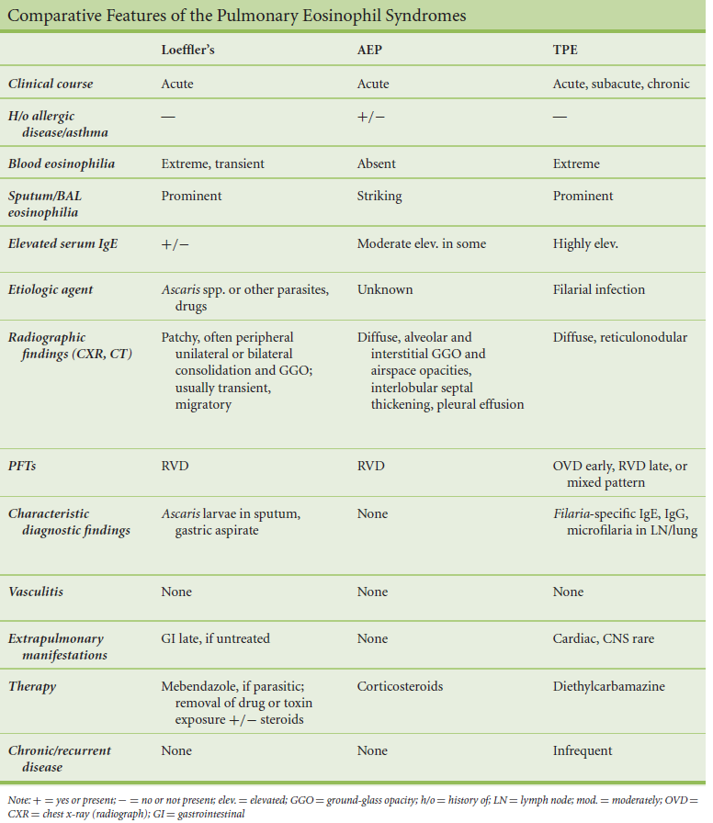
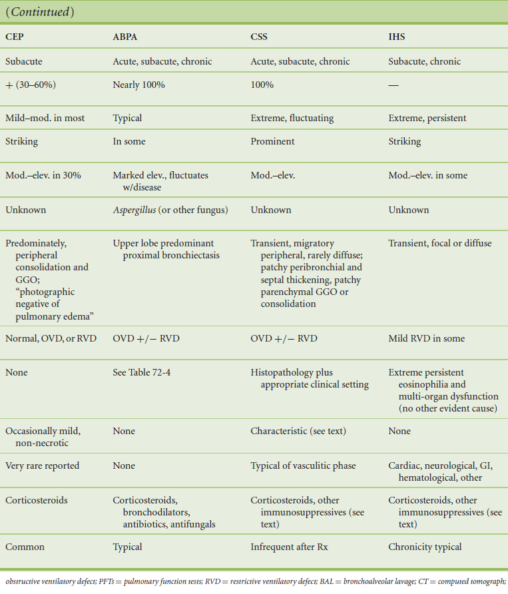
Fishman’s pulmonary diseases & disorders. 4th edition. Kristina crothers, carolyn rochester. The Eosinophilic Pneumonias; Vol1: 72: pg 1230

Slide 126
THANK YOU

