Slide 1
Pulmonary function tests in health and diseases
Dr. Amrita Verma
Medicine resident

Slide 2
Study of lung function is now an essential procedure in cardio respiratory practice.
It enables clear understanding of the impairment in the specific lung function caused by the disease process.
Uses of lung function tests:
Evaluating the course of disease and effectiveness of the treatment instituted.
Early detection of pulmonary insufficiency.
Quantitative measurement of the respiratory impairment.
Differentiate the breathlessness of cardiac origin from that of pulmonary origin.
Assess fitness for high altitude, air travelling and diving.
In industrial medicine to assess the degree of disability and the expectation of life due to occupational lung disease.
Assessment of immediate risks and expectation of life before and after thoracic surgery.
However, the tests are not sufficiently specific to identify with certainty
any individual disease. Essentially the tests show how disease has altered
respiratory function.

Slide 3
Pulmonary Physiology
The principal function of lungs is gas exchange.
Components contributing to gas exchange:
Ventilation: inspiration and expiration
Perfusion: adequate pulmonary circulation across the alveolar surface for exchange of gas all throughout lung tissue.
Diffusion: where gas & blood are brought into contact across the alveolar-capillary membrane for diffusion of gases.
The 3 processes are intimately linked in health, but the disease condition may affect any of them alone or together.

Slide 4
Ventilation
Process by which air is moved into the alveoli during inspiration and gases are moved out during expiration.
Normal ventilation is dependent upon:
An intact neuromuscular mechanism.
Unrestricted movement of the chest wall and pleura.
Distensible lungs.
Patent airways.
There are 3 imp. aspects of ventilation which can be
measured and are found clinically informative:
Lung volumes
Ventilation capacities
Mechanics of breathing
Ventilatory function is measured under static condition s for determiation
of lung volumes and under dynamic conditions for determination of
forced expiratory flow (FEF), VC, ERV, IC.

Slide 5
Lung volumes and capacities
Tidal volume (TV) 500ml
Inspiratory reserve volume (IRV) 3100ml
Expiratory reserve volume(ERV) 1200ml
Residual volume(RV) 1200ml
Inspiratory capacity(IC) 3600ml
Functional residual capacity(FRC) 2400ml
Vital capacity (VC) 4800ml
Total lung capacity(TLC) 6000ml
Volume of single breath inspired or expired.
Maximal volume that can be inspired from end-tidal inspiration.
Maximal volume that can be expired from end-tidal expiration.
Volume of gas remaining in lungs at the end of maximum expiration.
TV + IRV
ERV + RV
IC + ERV
VC + RV

Slide 6
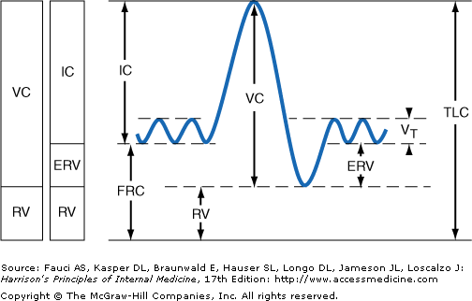

Slide 7
TV, IRV, ERV,IC, VC can be measured directly with a spirometer. As RV & FRC cannot be exhaled, RV , FRC & TLC are measured using indirect methods.
3 indirect methods are available :
Helium dilution ┐FRC is calculated from the known initial and final volume
Helium washout ┘ and the concentration of helium gas.
Body plethysmography : measures resting end-expiratory thoracic gas volume (TGV) which is identical to FRC measured by both helium dilution & helium washout techniques.
RV = FRC – ERV ┐
│Static lung volumes
TLC = RV + VC ┘
Static subdivisions of TLC have limited application as compared to dynamic ventilation tests. These are important when repeated at intervals in the pt.
An essential test is ratio of RV to TLC [RV/TLCX100] = 20%-35% in young pts.
Increase may reflect : larger residual volume as in emphysema or smaller total lung capacity as in fibrosis.
In older persons, ratio may be as high as 50%, with no apparent disability.

Slide 8
Dynamic lung tests:
Dynamic lung volumes are important in determining the physical basis of dyspnoea, obstructive or restrictive nature of the disease.
Commonly used tests are:
Resting Minute Ventilation(MV): measures total volume of air breathed in or out in 1 minute while the individual is resting. 15L/min. Better understanding of the performance of an individual can be obtained by comparing resting ventilation with the ventilation required for given exercise.
Walking Ventilation(WV): amount of air breathed in or out in 1 minute while the individual walks on level at 180 feet per minute. 15L/min.
Maximum voluntary ventilation(MVV): max. vol. of air that can be breathed per minute. It is the limit of ventilation available in reserve for exercise. 120L/min.

Slide 9
Ventilation indices:
Indices obtained from MV, WV, MVV which are used to indicate severity of dyspnea
Dyspnoea Index: =WV / MVV .
Normal value expressed in % is 10-20%.
No dyspnoea : < 30%
Mild dyspnoea : : > 35%
Moderate dyspnoea : > 45%
Severe dyspnoea : > 50%

Slide 10
Spirometry
Indications for spirometry:
Rapid and objective assessment of airflow obstruction and restrictive conditions.
Differentiate between asthma and COPD.
Early detection and monitoring of disease progression and quantitative assessment of response to treatment.
Quantitative assessment of severity of airflow obstruction.
Identifying upper airway obstruction & diseases associated with weakness of respiratory muscles.
Diagnosis of occupational lung disease.
Screening high risk population (eg. Smokers, pre-employment in industries in which occupational asthma is prevalent.)
Assessing pre-op risk prior to anesthesia and abdominal and thoracic surgery.

Slide 11
Types of Spirometry
Volume displaced spirometers
Flow sensor based spirometers
Volume based spirometers:
Convention spirometers.
Direct measure of respired volume from the displacement of a bell (water sealed), piston (rolling seal) or bellows (wedge bellows).
Indices FEV1 and FVC are manually calculated.
More accurate, simple to use and maintain.
Drawbacks: Bulky, time consuming.
Use generally restricted to research centers.

Slide 12
Flow-sensor based spirometers:
Detect & measure flow from a pressure drop across a known, constant resistance (pneumotachograph), cooling of one or more heated wires (aneometer), or by electronically counting the rotation of a turbine blade.
Lighter, portable and provide printout with all spirometry indices desired and interpretation of result.
Maneuver: 3 phases
Deep inhalation: most important & vital step. It records values FEV1 , FVC, MMFR.
The Blast: important for PEFR and to a certain extent FEV1 values.
Continue to remove as much air as possible out from lungs. FVC values are critically dependent on this phase.

Slide 13
Common spirometric indices used
FVC (Forced Vital Capacity): max. vol. of air that can be inspired or expired during a maneuver using maximal effort.
FEV1 (Forced Expiratory Volume in 1 sec.): vol. of air that can be forcefully expired in the first second of maximal expiration.
FEV1/FVC ratio : expressed as % and gives a clinically useful indicator of airflow obstruction.
MMFR(maximal midexpiratory flow rate): also called FEF25-75% . Average expired flow over mid-portion of FVC(25%-75%). Sensitive for small airway obstruction.

Slide 14
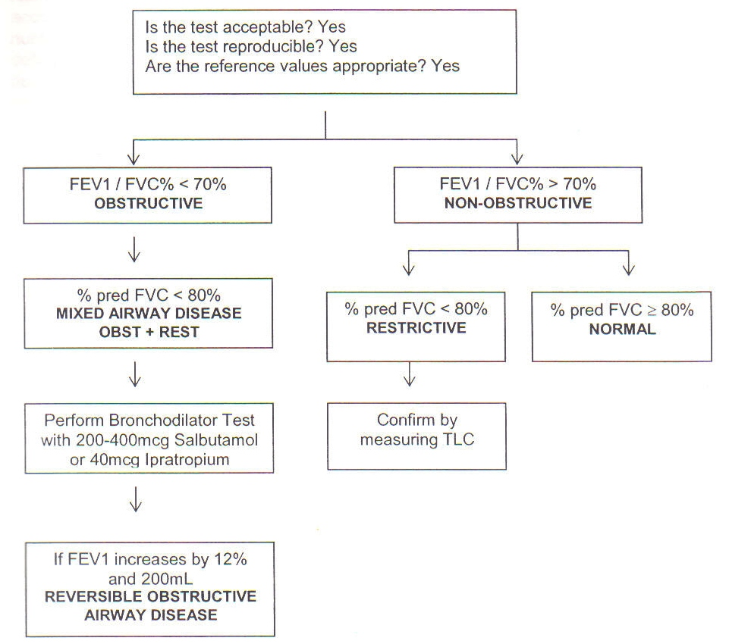
Algorithm for categorizing spirometry results

Slide 15
Obstructive Disease
Bronchial Asthma
Emphysema
Chronic Bronchitis
Bronchiectasis

Slide 16
Bronchial Asthma
↑hyper responsiveness of bronchial tract due to active airway inflammation
Diagnosis:
History
Physical Examination
Radiographic Findings
Spirometry
Bronchoprovocation Testing

Slide 17
Bronchoprovocation Testing
Performed with histamine or methacholine or hypertonic saline aerosol
profound bronchoconstriction in asthmatics and minimal response in normal subjects
Bronchodilators should be withheld in asthmatics as bronchial responsiveness is affected

Slide 18
Tests for exercise induced Asthma
Baseline FEV₁ value by spirometry
Incremental exercise till 80% target heart rate
FEV₁ measured at 5,10,20 and 30 mins
Positive Test: decline of 10% FEV₁
Negative Test: 10% decline of FEV₁ not obtained for 20-30 mins

Slide 19
Classification of Asthma Severity (GINA Guidelines)
Intermittent → FEV₁ ≥ 80%
PEF Viability < 20%
Mild persistent → FEV₁ ≥ 80%
PEF Viability 20 – 30%
Moderate persistent → FEV₁ 60-80%
PEF Viability >30%
Severe Persistent → FEV₁ ≤ 60%
PEF Viability >30%

Slide 20
Emphysema
Progressive diseases of lungs
Air sacs become over distended showing breaking of walls
Irreversible and does not improve with bronchodilators
Physiologic disturbance of emphysema differs from asthma by ↑RV and ↑RV/TLC ratio
↓Diffusing Capacity

Slide 21
Classification of COPD severity (Post Bronchodilator) (GOLD criteria)
At risk: Spirometry normal by symptoms evident
Mild : FEV₁/FVC < 70% and FEV₁ 50-80%
Moderate: FEV₁/FVC < 70% and FEV₁ 50-80%
Severe: FEV₁/FVC < 70% and FEV₁ 30-49%
Very Severe: FEV₁/FVC < 70% and FEV₁ <30%

Slide 22
Chronic Bronchitis
Excessive mucus in bronchial tree
Clinical Diagnosis:
Chronic cough for minimum of 3 months in a year
For not less then 2 successive years
Complication: Respiratory obstruction causing disabling breathlessness
Irreversible changes associated with emphysema but also a reversible or asthmatic element

Slide 23
Bronchiectasis
Abnormal & permanent dilation of bronchi
Segmental or widespread in distribution
PFT: marked reduction in VC with ↑RV
TLC may be normal or slightly decreased
Pulmonary compliance usually diminished
Airway obstruction is present

Slide 24
Restriction Defect
Disease that interfere with normal ventilation by restricting expansion of thoracic cage, lungs and pleura
Kyphosis
Pectus Excavatus
Ankylosing Spondylitis
Thoracoplasty
Pneumothorax
Pleural Effusion
Thickened pleura or pleural fibrosis
Collapse
Pneumonia
Fibrosing diseases like SLE, sarcoidosis, silicosis, asbestosis, radiation fibrosis, farmer’s lung
Thoracic Cage Deformities
Pleural diseases
Lung Diseases

Slide 25
Alterations in ventilatory functions
 | TLC | RV | VC | FEV₁/FVC | MIP
Obstructive | N or ↑ | ↑ | ↓ or N | ↓ | N
Restrictive | ↓ | ↓ | ↓ | N to↑ | N

Slide 26
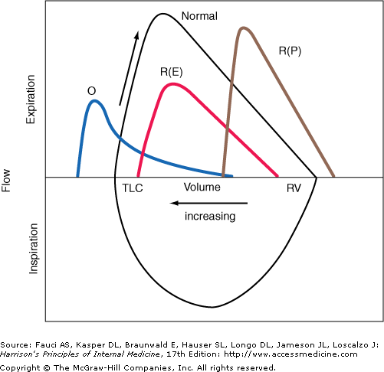

Slide 27
Alveolar Ventilation
Gas exchange occurs only in alveoli
Hence, it is important to determine:
Volume
Distribution of gas in alveoli

Slide 28
Volume
Calculated from:
Rate of breathing
Tidal Volume
Volume of conducting airways i.e. anatomical dead space which is 150ml
In healthy adults:
Alveolar ventilation (VA) =
TV – Anatomical Dead Space (VD) x RR
In disease disturbing ventilation
VA= Minute Ventilation – Wasted Ventilation
Wasted Ventilation is
%VD/TV = (PaCO₂ – PECO₂)/PaCO₂
↑ VD/TV > 45% in absence of obstruction or restrictive disease suggests vascular disease of lung

Slide 29
Distribution:
Markedly uneven in adults suggests pulmonary insufficiency
Seen in:
Bronchial Obstruction
Emphysema
Alteration in the uniform movements of the thoracic cage
Tests:
Nitrogen washout:
Normal: 1.5% or less
> 2.5% is uneven distribution
Single breath Nitrogen meter test:
Normal: Nitrogen conc. <1.5% in sample

Slide 30
Disorders of Alveolar Ventilation result in:
Hypoventilation: ↓ RR, ↓ TV, ↑VD
Results in hypoxemia, CO₂ retention, resp alkalosis
Causes:
Respiratory Centre Depression due to anaesthetics, narcotics, barbiturates
CVAs: ↑ICT, MND, Poliomyelitis
Myasthenia Gravis, infectious polyneuritis
Respiratory Muscle myopathy, thoracic cage deformities, pleural effusion, massive collapse, pulmonary oedema
Hyperventilation:
Excess removal of CO₂
↓ Alveolar and arterial CO₂ tension
Respiratory Alkalosis

Slide 31
Diffusion
Ability of the lungs to transfer gases across alveolar-capillary membrane
Carbon monoxide is normally used to measure DL (DLCO)
Expressed in mL/min/mmHg
Single breath DLCO is commonly used to test diffusing capacity
Normal DLCO: 15-40 mL/min/mmHg

Slide 32
DLCO | Normal or ↑ | ↓ed | ↑ed
 | Asthma | CCF Pulmonary Embolism COPD ILD Anaemia | Polycythemia Idiopathic pulmonary haemosiderosis Left to right Cardiac shunts Exercise

Slide 33
Diffusion Disturbance
Actual gaseous transfer takes place between alveolar air spaces and capillaries in alveolar wall
Disease causes thickening of alveolar wall resulting in alveolo-capillary block (diffusion defect)
Results in arterial oxygen desaturation in early stages
CO₂ plasma content ↑ in advanced stages

Slide 34
Diseases characterised by alveolo-capillary block
Diffuse ILD
Silicosis
Asbestosis
Aluminium fibrosis
Radiation fibrosis
Farmer’s lung
Sarcoidosis
Rheumatoid Fibrosis
SLE

Slide 35
Changes in alveolo-capillary block:
Restrictive ventilatory impairment due to loss of lung volume
Flow rates are preserved
Reduced CO diffusing capacity (DLCO)
Reduced compliance due to stiff non-distensible lungs with ↑ elastic recoil
↑Alveolar-arterial O₂ gradient at rest and exercise
Dyspnoea due to increased work of breathing, characterised by tachypneoa at rest and small TV
Hypoxemia and respiratory alkalosis on ABG

Slide 36
Disturbances in Pulmonary Circulation (Perfusion)
Pulmonary vasculature handles entire output of right ventricle (N 5L/min)
At perfusion pressures, vessels of pulmonary arterial system provide little flow resistance
Normal mean pulmonary arterial pressure is 15mmHg
Pulmonary vascular resistance can be measured from pulmonary artery pressure, pulmonary wedge pressure and cardiac output

Slide 37
Causes for ↑ PVR
Alveolar Hypoxia
COPD
ILD
Thoracic cage deformities
Sleep apnoea
Intravascular Thromboembolism
Vasculitis

Slide 38
Disturbances of Gas Exchange
Physiological functions of Respiratory system carried out by processes like ventilation, perfusion, diffusion and Ventilation-perfusion matching
Failure of these processes result in respiratory failure i.e. disturbed pulmonary gas exchange
Results in hypoxemia and/or hypercapnoea,
Basic aspects of gas exchange are:
Ventilation perfusion quotient (V/Q)
Alveolar arterial O₂ gradient P(A-a)O₂
Shunt Equation (QS/QT)

Slide 39
Ventilation-perfusion matching
Basic funtion of lungs is to tansfer O₂ to arterial blood and remove CO₂ from venous blood
Depends on alveolar ventilation (V) and capillary perfusion (Q)
V = Pulmonary Alveolar ventilation in L/min
Q Pulmonary capillary perfusion in L/min
This ratio is known as the ventilation perfusion quotient
Normally it is 0.8

Slide 40
Alveolar arterial O₂ gradient P(A-a)O₂
Applied to diagnose and assess severity of disease and management with mechanical ventilation and oxygen therapy
P(A-a)O₂ can be created by 3 mechanisms:
Anatomic shunting: venous blood passes through routes not exposed to alveolar air i.e Right to Left cardiac shunts. Eg: ASD, VSD, PDA
Functional Shunting: imbalance between supply of air and blood to certain areas of lung. Eg: Collapse, Pulmonary Arterial Occlusion
Diffusion defect: impaired transfer of gases across alveolar-capillary membrance. eg: interstitial lung fibrosis

Slide 41
Measurement of P(A-a)O₂ requires:
Alveolar oxygen tension
Simultaneous arterial blood oxygen tension

Slide 42
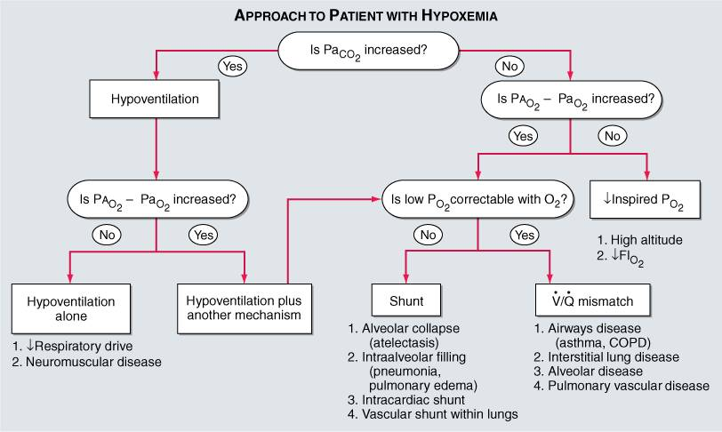
Hypoxemia

Slide 43
Arterial blood gases and acid base balance
Assessing progress and management of respiratory diseases.
routine analysis: direct radial artery puncture techniquein heparinized syringe. Specimen collected without exposure to air. Bubbles if any removed. Sample to be stored in ice & analysed immediately (2hrs).
Values :
pH: 7.35 – 7.45, PaCO2 : 35 – 45 mmHg,
HCO3 : 20 – 28 mmol/L

Slide 44
Respiratory Acidosis:
Primary increase in PaCO2. Renal compensation is increased secretion of HCO3 by 4mmol/L for every 10mmHg rise in CO2.
Causes:
Anesthetics, morphine, sedatives
Stroke
Asthma, COPD, ARDS
Barotrauma
Poliomyelitis
Myasthenia Gravis
Muscular dystrophies
Obesity

Slide 45
Respiratory Alkalosis:
Alveolar hyperventilation results in primary decrease in PaCO2 . Renal compensation is decrease in ammonia excretion leading to fall in HCO3.
Causes:
hypoxemia
Meningitis
Encephalitis
Salicylates
ILD
Pulmonary edema
Pneumonia
Pregnancy
Cardiac failure
Hysterical Hyperventilation

Slide 46
Metabolic Acidosis:
Primary decrease in HCO3 due to either HCO3 loss or accumulation of acid. Respiratory compensation is hyperventilation and fall in PCO2.
Causes:
lactic acidosis
Ketoacidosis ( diabetic, starvation, alcoholic)
Salicylates, methanol
Renal failure , acute or chronic
Diarrhoea
Ureterosigmodostomy, jejunal loop, ileal loop.

Slide 47
Metabolic alkalosis:
increase of HCO3 either due to loss of acid H ions or gain of base HCO3.
Causes:
Alkali administration
Vomiting
Gastric aspiration
Diuretics
Hypercalcemia/ hypoparathyroidism
Aldosteronism potassium depletion
Renal artery stenosis
Accelerated Hypertension

Slide 48
Lung function in Heart diseases
Cardiac diseases produce substantial alteration of lung function.
Respiratory disease may co-exist with cardiac disease
contributing to manifestations of effort intolerance & dyspnoea.
PFTs can distinguish dyspnoea of cardiac from respiratory
disease.
Tests of ventilation measuring lung volumes, vital capacities,
peak flow rates, blood gas analysis are sufficient.
Indication:
When respiratory symptoms are in disproportion to heart disease.
evaluation of pt. for cardiac surgery & management of such pts.

Slide 49
Alterations of lung function in Cardiac disease:
Lung volumes: VC ↓
RV ↓ or normal
TLC ↓
Ventilation & Perfusion: alteration in V/Q ratio, resulting in I increased physiological dead space or excessive venous admixture.
Diffusing capacity:
left-to-right shunts, increase in diffusing capacity
right-to-left shunt, decrease in diffusing capacity

Slide 50
Cardio-pulmonary Exercise testing
Maximal amount of physical work that can be performed by an individual within the physiologic limits imposed by his oxygen transport system can be measured by oxygen uptake studies during exercise testing. It is called Maximal oxygen uptake (VQ2 MAX).
Values monitored:
Respiratory: TV, RR, Minute Ventilation, O2 uptake, CO2 output, respiratory quotient.
Cardiac: H.R., B.P., ECG.
Indices: O2 uptake/ heart rate
respiratory exchange ratio
minute ventilation/volume of O2 uptake
minute ventilation/ volume of CO2 output

Slide 51
Indications
Assessment of physical fitness, pre-employment assessment
In sports medicine
In clinical medicine:
early detection of impairment of effort intolerance
estimation of severity of breathlessness
pre & post therapeutic assessment
pre & post operative assessment
In rehabilitation programme:
exercise training after cardiac infarction
training programme in chronic lung disease.
work prescription according to physical work capacity

Slide 52
THANK YOU

