Slide 1
Occupational Lung Diseases
By Dr Zahid Khan
Senior Lecturer King Faisal University, KSA.

Slide 2
Induction Periods
Short:
Asthma
Infections
Allergic alveolitis
Toxic poisonings
Long:
Pneumoconiosis
Neoplasms

Slide 3
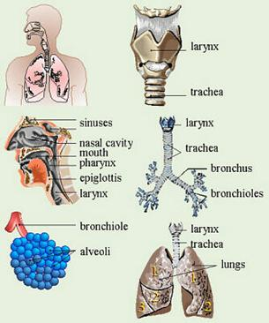
Fate of inhaled particles
Large particles may get trapped in the nose or large airways,
but very small ones may reach the lungs.
There, some particles dissolve and may be absorbed into the bloodstream;
Most solid particles that do not dissolve are removed by the body's defenses.
Toxic dust in the range 1 – 5 µm produce harmful effect

Slide 4
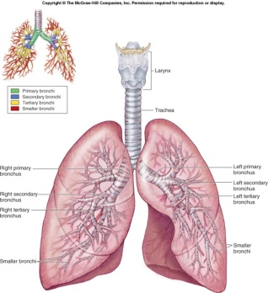
Classification of OLD
Inflammation of airways:
Inflammation of lining of respiratory system
Obstructive lung disease
Reversible: Occupational asthma, Byssinosis
Irreversible: Industrial bronchitis, Emphysema
Restrictive lung disease
Pneumoconiosis: Silicosis and asbestosis
EAA: Farmer’s Lung

Slide 5
I. Inflammation (Irritation) of Respiratory System
This effect can be produced by substances that are:
Soluble in water and
Can produce vesicant (inflammatory) effect
The site of the effect depends on the degree of solubility
Highly soluble Upper respiratory tract irritation
Moderately soluble Middle respiratory tract irritation
Sparingly soluble lower respiratory tract irritation

Slide 6
Classification of irritants
Upper respiratory tract irritants
E.g. Ammonia
Inflammation of mucosa of Eyes, Nose and Oro-pharynx
Mid-respiratory tract irritants
E.g. Chlorine
Asthma-like attack
Lower Respiratory tract irritant
E.g. Nitrogen dioxide
Pulmonary edema

Slide 7
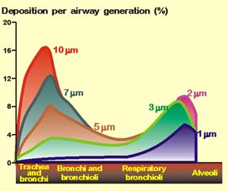
II. Parenchymal lung disease (Pneumoconiosis)
Produced by inorganic dust
E.g. silica and asbestos dust
Produce progressive fibrosis in the lung
Respirable dust
Less than 10 micrometer
Harmful dust
From 1 – 5 micrometer

Slide 8
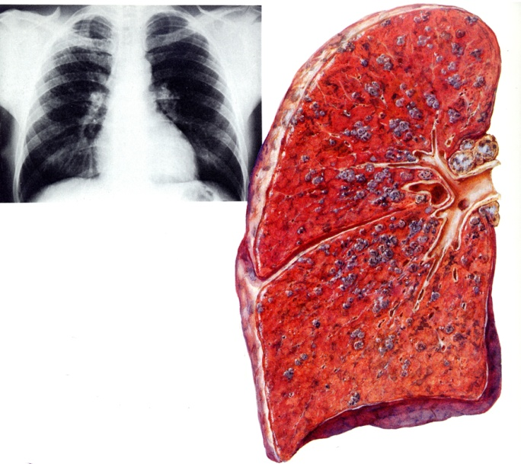
Definition of Pneumoconiosis
Occupational Lung disease
secondary to inhalation of inorganic dust
leading to change in the lung architecture
excluding chronic bronchitis, emphysema, and cancer

Slide 9
Asbestos Occupational exposure
Workers who demolish buildings that have insulation containing asbestos are at increased risk.
People who regularly work with asbestos are at greatest risk of developing lung disease.
The more a person is exposed to asbestos fibers, the greater the risk of developing an asbestos-related disease.

Slide 10
Asbestos related diseases
Diseases are:
Interstitial pulmonary fibrosis (asbestosis)
Bronchogenic carcinoma
Pleural Effusions
Fibrous plaques
Pleural fibrosis
Mesotheliomas (malignant tumor of pleura and peritoneum)
Laryngeal neoplasms

Slide 11
Prevention and treatment
Diseases caused by asbestos inhalation can be prevented by minimizing asbestos dust and fibers in the workplace.
Because industries that use asbestos have improved dust control, fewer people develop asbestosis today,
but mesotheliomas are still occurring in people who were exposed as many as 40 years ago.

Slide 12
Prevention and treatment
Asbestos in the home should be removed by workers trained in safe removal techniques.
Smokers who have been in contact with asbestos can reduce their risk of lung cancer by:
giving up smoking and
should probably have a chest x-ray annually.

Slide 13
2. Silicosis
Thickened pleura
Silicosis is permanent scarring of the lungs caused by inhaling silica (quartz) dust.
It is a slowly progressive, nodular, fibrosing pneumoconiosis
Fibrosis

Slide 14
Occupational Exposure to Silica
Silicosis, the oldest known occupational lung disease, develops in people who have inhaled silica dust for many years.
Silica is the main constituent of sand, so exposure is common among:
metal miners,
sandstone and granite cutters,
foundry workers,
and potters.

Slide 15
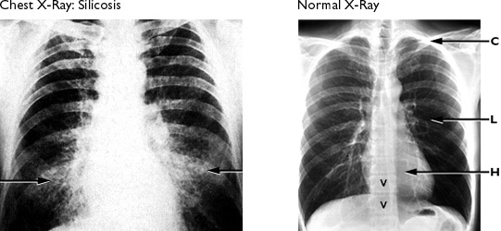
Diagnosis of Silicosis: CXR
Nodular opacities

Slide 16
Prevention and Control
Controlling silica dust in the workplace is key to preventing silicosis.
When dust cannot be controlled, as may be true in the sandblasting industry, workers should wear protective gear, such as hoods that supply clean external air or special masks that efficiently filter out the tiny particles.
Such protection may not be available to all people working in a dusty area (for example, painters and welders), so whenever possible, abrasives other than sand should be used.

Slide 17
Prevention and Control
Workers exposed to silica dust should have regular chest x-rays —every 6 months for sandblasters and every 2 to 5 years for other workers—so that problems can be detected early.
If the x-rays show silicosis, a doctor will probably advise the worker to avoid continued exposure to silica

Slide 18
Byssinosis
It is a worldwide disease, reported in many countries
It is An asthma like disease caused by inhalation of :
Cotton dust
Flax
Hemp
Sisal
It produces obstructive impairment of lung function
All are organic dust

Slide 19
Occupational exposure
Most dusty operations
Textile industry (during spinning)
Opening bale
Carding room
Cotton dust consists of:
Cotton fibers
Bacteria
Fungi
Minerals, …etc
Exact cause is not known

Slide 20
Exposure to cotton dust
First day of next working week
After days of work
Mast cell
After release of histamine
Shrunken mast cell
Histamine
Bronchospasm
Obstructed airway
Bronchi

Slide 21
Prevention and control
1. Medical measures
A. Preplacement examination
CXR, LFT, Atopy,
B. Periodic medical examination
Conducted every year
Include LFT
If susceptible worker (significant effect across shift after few month of exposure) should be transferred to other job

Slide 22
Prevention and control
2. Engineering and environmental measures
A. Dust control:
Spraying of ripening cotton with bactericidal and fungicidal gents
Treatment of raw cotton fibers with gaseous hydrogen chloride or acetic acid to inactivate active ingredients in cotton dust
Personal protective equipment

Slide 23
Occupational Asthma
Symptoms usually begin several weeks after exposure begins.
Early in the syndrome, the patient may just notice a dry cough.
Patient may not be continuously exposed to provoking antigen.
A portable peak-flow meter and a diary is very helpful in determining if a work-place antigen is responsible

Slide 24
Prevention of Occupational asthma
Transition to safer Chemicals.
Animal Allergens in the work place should be removed.
Control of Dust from Powder Dye Handling operations.
Allergic diseases should be controlled.

Slide 25
Industrial Bronchitis
Identical symptoms to chronic bronchitis seen with cigarette smoking
Coal workers
Grain Workers
Most non-smokers do not have a decrement in FEV 1.

Slide 26
Any Questions !!1
Thank You

