Slide 1
Kiran Radhakrishnan
Roll No. 8
ISEM – X

Slide 2
Introduction
“any chronic ailment that occurs as a result of work or occupational activity”
An important aspect of OS&H
It is called when it is more prevalent in a given body of workers
Should be distinguishable from injuries due to workplace hazards

Slide 3
Occur in varying time frames – from instantaneous development of symptoms to gradual development
instantaneous reactions - exposure to chemicals such as chlorine or ammonia gas
a delay of some six to twelve hours with fumes of aerosolized zinc
a delay of weeks to months with lead poisoning
a delay of decades with occupational carcinogens
even the finding of congenital malformations in children whose parents may have been exposed to hazardous materials
So, deaths from such diseases - difficult to enumerate

Slide 4
Some Numbers...
WHO - 100 million occupational injuries ➔ 0.1 million deaths in the world
India ➔ 17 million occupational non-fatal injuries (17% of the world) & 45,000 fatal injuries (45% of the total deaths due to occupational injuries in world) annually
11 million cases of occupational diseases in the world ➔ 1.9 million cases (17%) contributed by India
Of 0.7 million deaths in the world, 0.12 (17%) from India
Adverse occupational factors have been estimated to cost 2-14% of the gross national products for various countries

Slide 5
Classification
I. Diseases due to physical agents:
Heat: Heat hyperpyrexia, heat exhaustion
Cold: Trench foot, frost bite
Light: Occupational cataract, miner’s nystagmus
Pressure: Caisson disease, air embolism, blast (explosion)
Noise: Occupational deafness
Radiation: Cancer, leukaemia, aplastic anaemia, pancytopenia
II. Diseases due to chemical agents:
Gases: Gas poisoning
Pneumoconiosis
Metals and their compounds: Chemicals & Solvents

Slide 6
III. Diseases due to biological agents:
Leptospirosis, anthrax, actinomycosis, tetanus
IV. Occupational cancer:
Cancer of skin, lungs, bladder
V. Occupational dermatosis:
Dermatitis, eczema
VI. Diseases of psychological origin:
Industrial neurosis, hypertension, peptic ulcer, etc.

Slide 7
Agricultural Worker’s Diseases
Farmer’s Lung
a hypersensitivity pneumonitis induced by inhalation of biological dusts
could progress into a potentially dangerous chronic condition.
Fluid, protein and cells accumulate in the alveolar wall, slows blood-gas interchange and compromises the function of the lung.
Silo filler's disease (SFD)
pulmonary exposure to oxides of nitrogen – could manifest into pulmonary oedema

Slide 8
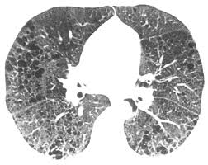
Farmer’s Lung
CT scan of a 44-year-old man with chronic hypersensitivity pneumonitis

Slide 9
Circadian Rhythm Sleep Disorder
Persistent/recurring pattern of sleep disruption resulting either from an altered sleep-wake schedule or an inequality between a person's natural sleep-wake cycle and the sleep-related demands placed on him/her
Extrinsic: Jet Lag, Shift Work Sleep Disorder
Intrinsic: Delayed
sleep phase syndrome,
advanced sleep phase
syndrome

Slide 10
Hand-arm vibration syndrome
Repeated and frequent use of hand-held vibrating tools/vibrating machinery (power drills, chainsaws, pneumatic drills)
Probably due to slight but repeated injury to the small nerves and blood vessels in the fingers
Raynaud's phenomenon (“white finger”) nerve symptoms, aches and pains

Slide 11
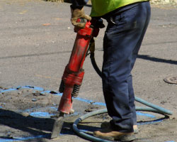
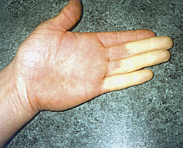
Hand-arm vibration syndrome

Slide 12
Occupational Dermatitis
Inflammation of the skin caused by exposure to a substance in the workplace. Exposure usually occurs from direct contact but may, in rare circumstances, occur through the airborne route
Allergic contact dermatitis - when a person becomes sensitized to a substance (allergen)
Irritant contact dermatitis when the skin is exposed to a mild irritant (such as detergent or solvents) repeatedly over a long period of time or to a strong irritant (such as acids, alkalis, solvents, strong soaps, or cleansing compounds) that can cause immediate skin damage

Slide 13
Pneumoconiosis
chronic lung disease caused due to the inhalation of various forms of dust particles, particularly in industrial workplaces, for an extended period of time
Shortness of breath, wheezing and chronic coughing are some of the symptoms

Slide 14
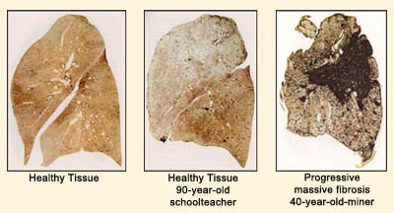
Coal Workers’ Pneumoconiosis - black lung disease - exposure to particles of carbon
When coal dust is inhaled for a long period of time, it builds up in the lungs, which the body is not able to remove - inflammation of the lungs - fibrosis - causes large size cavities in the lungs.

Slide 15
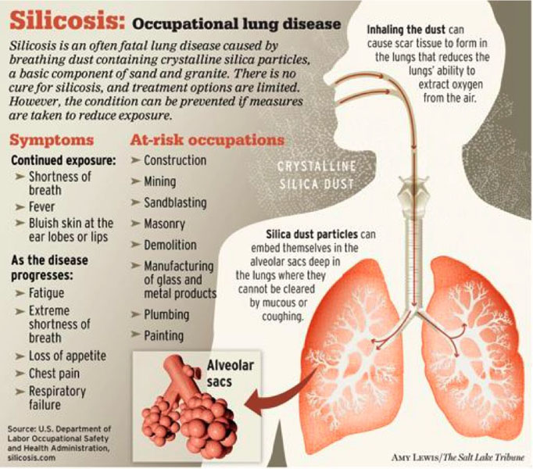

Slide 16
Asbestosis - inhalation of fibrous minerals of asbestos
Bauxite fibrosis - exposure to bauxite fumes which contain aluminium and silica particles.
Berylliosis - exposure to beryllium and its compounds
Siderosis, by deposition of iron in the tissue
Byssinosis “brown lung disease”, caused by exposure to cotton dust in inadequately ventilated working environments
Silicosiderosis, by mixed dust containing silica and iron

Slide 17
Prevention Methods
Medical Methods such as periodic examinations, preplacement examinations, working environment supervision and health education. Notification, maintenance and analysis of records, and counselling are also steps towards prevention.
Engineering Measures such as proper design of plant, ventilation, dust isolation through enclosure and isolation, and protective devices.
Legislative protection like the Factories Act of 1948 and the Employees State Insurance Act of 1948.

Slide 18
Sources
“Occupational Diseases” Encyclopedia of Public Health. Ed. Lester Breslow. Gale Cengage, 2002. eNotes.com. 2006. 9 Dec, 2010
eMedicine.com
U.S. National Library of Medicine website - http://www.nlm.nih.gov/
NIOSH Website

