Slide 1
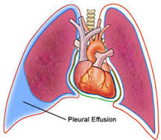
PLEURAL EFFUSION
Conducted By: Mr. Atul Lawrence
M. Sc Nursing 1st Year
Medical Surgical Nursing
Rattan Professional College of Nursing

Slide 2
Physiology of the Normal Lungs
The lungs are soft, spongy, cone-shaped organs located in the chest cavity.
They are separated by the mediastinum and the heart. There are 3 lobes on the right lung and 2 lobes on the left lung.

Slide 4
Physiology of the normal lungs cont..
The lungs are supplied with blood via the pulmonary and bronchial circulations.
• Pulmonary circulation: supplied from the pulmonary artery and provides for gas exchange function of the lungs.
• Bronchial circulation: distributes blood to the conducting airways and supporting structures of the lung.

Slide 5
Physiology of the normal lungs cont..
Layers of the lung
Parietal Pleura -Lines the thoracic cavity, including the thoracic cage, mediastinum, and diaphragm.
Pleural space- thin, transparent, serous membrane which lines the thoracic cavity a potential space between the parietal pleura and visceral pleura
Visceral pleura- Lines the entire surface of the lung.

Slide 8
Definition
The body produces pleural fluid in small amounts to lubricate the surfaces of the pleura, it lines the chest cavity and surrounds the lungs. The pleural cavity contains a relatively small amount of fluid, approximately 10 ml on each side A PLEURAL EFFUSION is an abnormal, excessive collection of this fluid . Excessive amounts of such fluid can impair breathing by limiting the expansion of the lungs during respiration

Slide 9
Types of Effusions
TRANSUDATIVE PLEURAL EFFUSIONS
a fluid substance that has passed through a membrane or has been extruded from a tissue it is of high fluidity and has a low content of protein, cells, or solid materials derived from cells. It caused by fluid leaking into the pleural space. This is caused by increased pressure in, or low protein content in, the blood vessels . A transudate is a clear fluid, similar to blood serum . It reflect a systemic disturbance of body

Slide 10
Causes of Transudates
Atelectasis
(early)Cirrhosis
Congestive heart failure
Hypoalbuminemia
Nephrotic syndrome
Peritoneal dialysis

Slide 11
Types Of Effusions cont..
EXUDATIVE EFFUSIONS
A fluid rich in protein and cellular elements that oozes out of blood vessels due to inflammation . It is caused by blocked blood vessels, inflammation, lung injury, and drug reactions. An exudate—which often is a cloudy fluid, containing cells and much protein . signify underlying local (pleuropulmonary) disease.

Slide 12
Causes of Exudates:
Asbestos exposure
Atelectasis
Hemothorax Infection (bacteria, viruses, fungi, tuberculosis, or parasites)
Pulmonary embolism
Uremia

Slide 14
Types of fluids
Four types of fluids can accumulate in the pleural space:
Serous fluid (hydrothorax) : A hydrothorax is a condition that results from serous fluid accumulating in the pleural cavity. This specific condition can be related to cirrhosis with ascites in which ascitic fluid leaks into the pleural cavity
Blood (haemothorax): is a condition that results from blood accumulating in the pleural cavity

Slide 15
Chyle (chylothorax): chyle is a milky bodily fluid consisting of lymph and emulsified fats, or free fatty acids (FFAs). It is formed in the small intestine during digestion of fatty foods .It is a type of pleural effusion . It results from lymphatic fluid (chyle) accumulating in the pleural cavity.
Pus (pyothorax or empyema) : is an accumulation of pus in the pleural cavity

Slide 16
Pathophysiology
It is explained by increased pleural fluid formation or decreased pleural fluid absorption. Increased pleural fluid formation can result from elevation of hydrostatic pressure & decreased osmotic pressure. It leads to increased capillary permeability & passage of fluid is through openings in the diaphragm Hence production increases & absorption is decreases lymphatic obstruction Pleural effusions produce a restrictive ventilatory defect and also decrease the total lung capacity and vital capacity

Slide 17
CLINICAL MANIFESTATION
Pleuritic chest pain indicates inflammation of the parietal pleura Physical examination findings that can reveal the presence of an effusion dull or flat note on percussion diminished or absent breath sounds on auscultation. Chest pain, usually a sharp pain that is worse with cough or deep breaths, Cough, Fever, Rapid breathing, Shortness of breath

Slide 18
DIAGNOSTIC EVALUATION
During a physical examination, the doctor will listen to the sound of your breathing with a stethoscope and may tap on your chest to listen for dullness. The following tests may help to confirm a diagnosis : Chest CT scan Chest x-ray Pleural fluid analysis (examining the fluid under a microscope to look for bacteria, amount of protein, and presence of cancer cells) Thoracentesis (a sample of fluid is removed with a needle inserted between the ribs) Ultrasound of the chest

Slide 19
Chest Radiography :The posteroanterior and lateral chest radiographs are still the most important initial tools in diagnosing a pleural effusion.
Ultrasound is useful both as a diagnostic tool and as an aid in performing thoracentesis. It assist in identifying pleural fluid loculations.
Computed Tomography: Cross-sectional computed tomography (CT) It helps distinguish anatomic compartments more clearly This modality is useful as well in distinguishing empyema

Slide 20
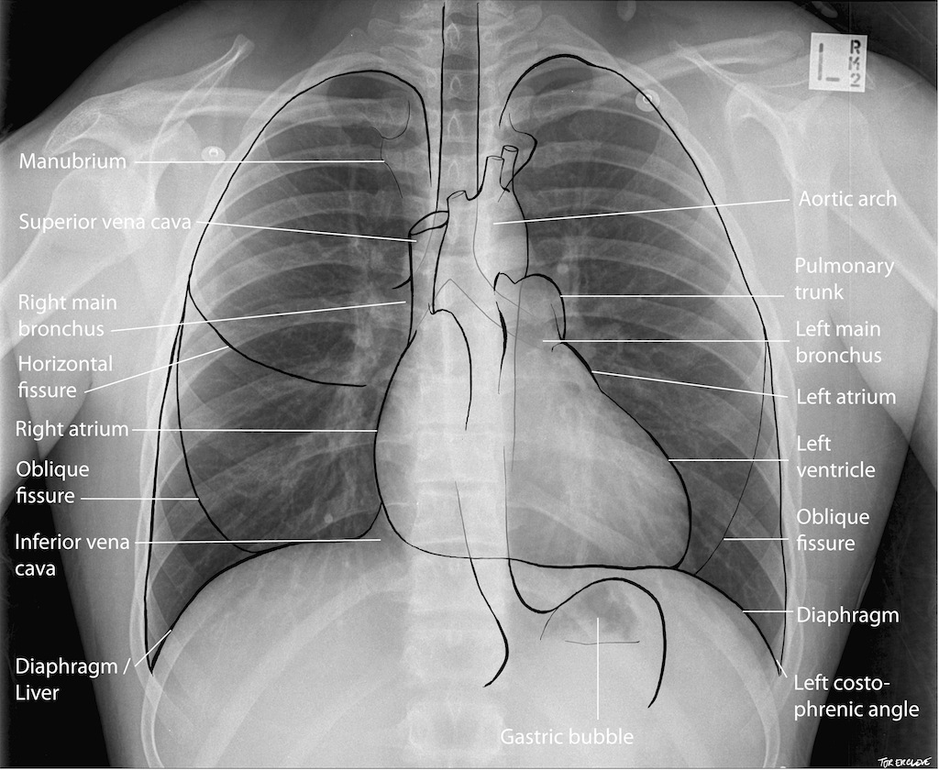
Normal Pleural effusion CRG CRG

Slide 21
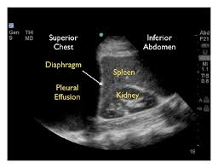
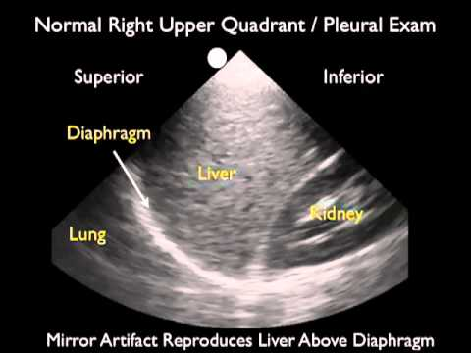

Slide 23
Treatment
Treatment aims to: Remove the fluid Prevent fluid from building up again Treating the cause of the fluid buildup
Therapeutic thoracentesis may be done if the fluid collection is large and causing chest pressure, shortness of breath, or other breathing problems, such as low oxygen levels. Removing the fluid allows the lung to expand, making breathing easier.

Slide 24
pleural effusions caused by congestive heart failure are treated with diuretics (water pills) and other medications that treat heart failure. Pleural effusions caused by infection are treated with appropriate antibiotics. In people with cancer or infections. the effusion is often treated by using a chest tube for several days to drain the fluid. small tubes can be left in the pleural cavity for a long time to drain the fluid.

Slide 25
In some cases, the following may be done: Surgery
Thoracentasis Pleural fluid is drawn out of the pleural space in a process called thoracentesis. A needle is inserted through the back of the chest wall in the sixth, seventh, or eighth intercostal space into the pleural space. The fluid may then be evaluated.
Gram stain and culture to identify possible bacterial infections Cytopathology to identify cancer cells, but may also identify some infective organisms

Slide 26
Nursing Diagnosis & Nursing Intervention
1. Ineffective breathing pattern related to decreased lung expansion(accumulation of liquid), as evidenced by dyspnea, changes in depth of breathing, accessory muscle use.
Interventions
Maintain a comfortable position is usually elevated headboard
Given oxygen through a cannula (8mls)

Slide 27
2. Acute Pain related to accumulation of fluid in the pleural space and rubbing of thoracostomy tube to the lungs
Interventions
-The presence of pain, the scale and intensity of pain was well assessed
-The client taught about pain management and relaxation with distraction
-Chest tube secured to restrict movement and avoid irritation
-Given prescribed analgesics i.e diclofenac 75mg.

Slide 28
3. Risk for nutrition impariment, less than body requirement related to inability to ingest adequate nutrients
Interventions
-Patient relative i.e his father encouraged to give him energy reaching food stuff together with energy supplement so that he can get enough energy.
-Administer DNS as prescribed to the patient to increase energy lost.

Slide 29
4. Risk for fluid volume deficit related to chest tube drainage.
Interventions
-encourage the patient to drink enough water to supplement the one lost by chest tube drainage
-IV fluids & DNS to replace fluid lost in drainage system monitored in 24hours.

Slide 30
5. Risk for infection related to the presence of fluid in the pleural space and the incision site.
Interventions
-The patient dressed at the incision site when it is wetted, probably after 2 to 3 days
-Given antibiotics as prescribed i.e IV metronidazole 500mg 8 hourly, IV ceftiaxone 1gm.

Slide 31
Possible Complications
A lung that is surrounded by excess fluid for a long time may be damaged. Pleural fluid that becomes infected may turn into an abscess, called an empyema, which will need to be drained with a chest tube. Pneumothorax (air in the chest cavity) can be a complication of the thoracentesis procedure.

Slide 32
References
A. Putnam JB. Malignant pleural effusions. Surg Clin N Am.2002;38;375-383.
B. Villena V, López Encuentra E, García-Luján R, Clinicalimplications of appearance of pleural fluid at thoracentesis.Chest.2004;125:156-9.
C. cleveland clinic journal of medicine volume 72 • number 10 october 2005
D. villena garrido v et al. diagnosis and treatment of pleural effusion(2005)
E. Jeffrey Rubins, MD; Chief Editor: Zab Mosenifar, MD. Pleural Effusion Clinical Presentation.
F. Sarah Avery, RGN Insertion and management of chest drains vol: 96, issue: 37, page no: 3 (2000).

Slide 33
G.Burrows CM, Mathews WC, Colt HG. Predicting survival in patientswith recurrent symptomatic malignant pleural effusions: an assessment of the prognostic values of physiologic, morphologic, and quality of life measures of extent of disease. Chest. 2000;117(1):73-78. [PubMed]
H.Anderson CB, Philpott GW, Gerguson TB. The treatment of malignant pleural effusion. Cancer.1974;33(4):916–922.

