Slide 1
Physiology of the Pleural Space

Slide 3
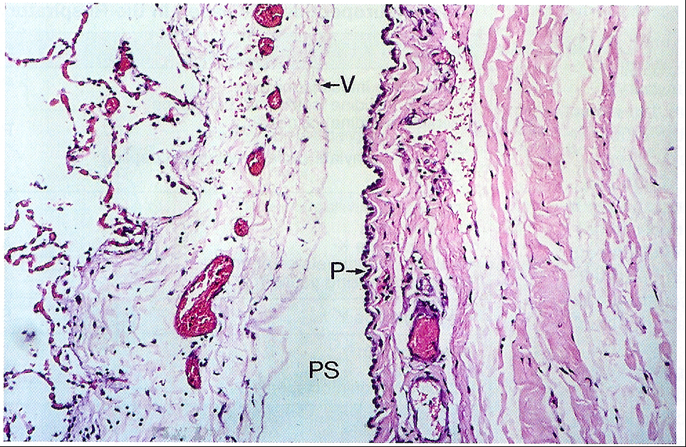

Slide 4
Visceral Pleura
Covers the lung parenchyma including the interlobar fissures.
Provides mechanical support to the lung.
Limits lung expansion, protecting the lung .
Contributes to the elastic recoil of the lung and lung deflation.

Slide 5
Visceral Pleura
Thick visceral pleura: mesothelium and dense layer of connective tissue.
Systemic circulation. Bronchial arteries.
Blood, lymph vessels and nerves.
Humans, sheep, cows, pigs and horses.
Thin visceral pleura: monkeys, dogs and cats.
Pulmonary circulation.

Slide 6
Visceral Pleura
Mean thickness:25-83 μm.
Distance from the microvessels to the pleura: 18-56 μm.
Drainage into the pulmonary veins.

Slide 7
Parietal Pleura
Lines the inside of the thoracic cavities.
Subdivided into the costal, mediastinal and diaphragmatic parietal pleura.
Loose connective tissue and single layer of mesothelial cells.
Capillaries and lymphatic lacunas.
Arterial blood supply from systemic capillaries.
Venous blood drainage: Intercostal veins.

Slide 8
Parietal Pleura
Mean thickness : 20-25 μm.
Distance from the micro vessel to the pleural space: 10-12 μm.
Stomas communicate lymphatic vessels with pleural space.
2 kinds of cells are suggested to occur in pleyral mesothelium. The first type should transport Na + water out of the pleural space. The second type is associated with the Na ⁺ - K⁺ - pump on the serosal side and thus – involved in recycling K⁺. Nitric oxide increases resistance, suggesting an effect on either pleural mesothelium or endothelium of lymphatic stomas, or both
Diaphragmatic pleura.

Slide 9
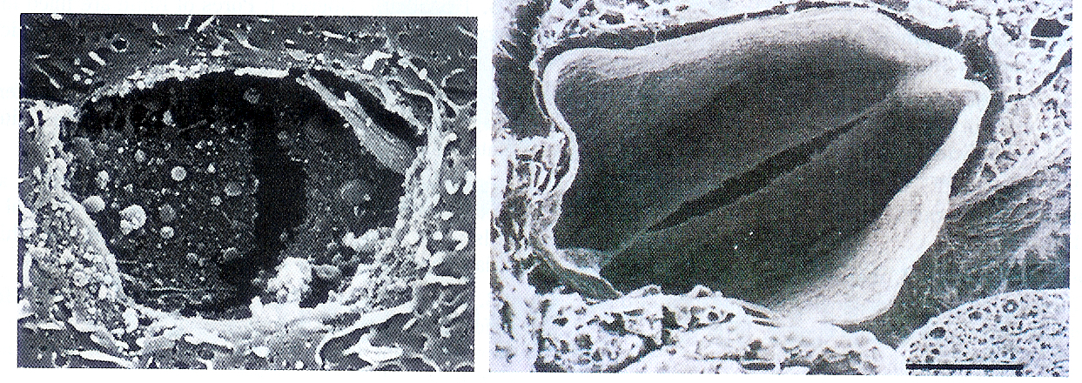
Stomas and Valves of the Parietal Pleura

Slide 10
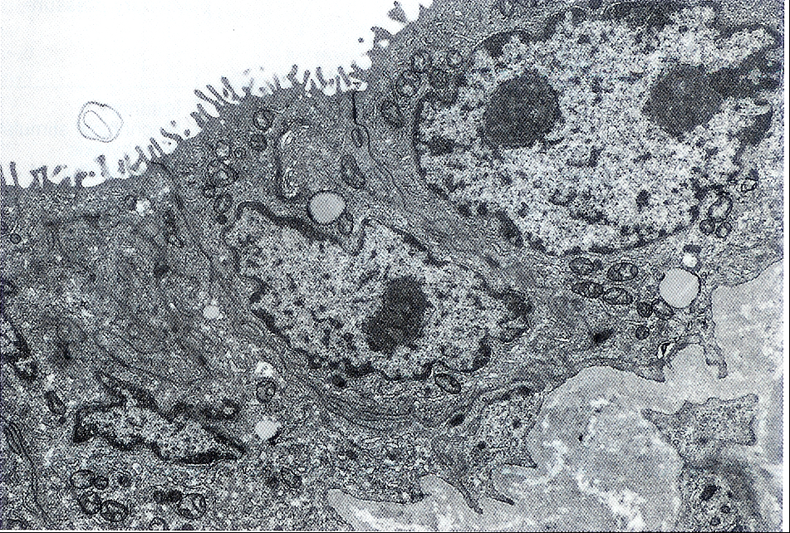
Parietal Pleura
Lymphatic lacunas are in communication with the pleural space by stomas and ultimately drain to the internal mammary, para aortic and diaphragmatic lymph nodes.

Slide 11
Mesothelial Cells
Very active cells.
Mesothelium. Dynamic cellular membrane.
Transport and movement of fluid and particulate matter.
Leukocyte migration.
Synthesis of cytokines, growth factors and extracellular proteins.

Slide 12
Mesothelial Cells
Mesothelial cell can convert to macrophages and myofibroblasts.
TGF Beta.
Microvilli: entangle glycoproteins rich in hyaluronic acid.

Slide 13
Pleural Fluid
8.4 +/- 4.3 mL.
Total pleural fluid volume: 0.26 +/- 0.1 mL/Kg.
Cell count: WBC: 1716x103 cells/ml. RBC: 700x103 cells/ml.
Macrophages:75%.
Lymphocytes: 23%
Mesothelial cells, neutrophils and eosinophils:2%.

Slide 14
Pleural Pressure
Negative pressure generated between the visceral and parietal pleura by the opposing elastic forces of the chest wall and lung at FRC.
Represents the balance between the outward pull of the thoracic cavity and the inward pull of the lung.
The actual pleural pressure in humans is approximately – 5 cm H₂O at FRC and –30 cm H₂O at TLC

Slide 16
Pleural Pressure
It is the pressure at the outer surface of the lung and the heart and inner surface of the thoracic cavity.
Distensible structures.
Compliance and pressure difference between inside and outside.
Primary determinant of the lung, cardiac and thoracic cavity volume.

Slide 17
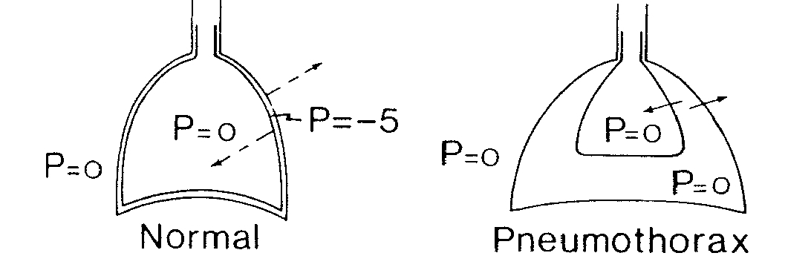

Slide 18
Measurement
Indirect measurement. Esophageal pressure.
Lower one third of the esophagus.
Upright posture.
Analysis of lung and chest wall compliance, work of breathing, respiratory muscle function and the presence of diaphragm paralysis.
Mechanical ventilation guided by esophageal pressures in ALI. November 13, 2008.

Slide 20
Pleural Pressure
Pleural pressure is not uniform.
Gradient between the superior ( lowest, most negative) and inferior (highest, least negative) portions of the lung.
0.3 cm H20/ cm vertical distance.
In the upright position, gradient of pleural pressure between the apex and the base is approximately 8 cm H20.

Slide 21
Pleural Pressure
Gravity.
Mismatching of the shapes of the lung and chest wall.
The weight of the lung and other intra thoracic structures.

Slide 22
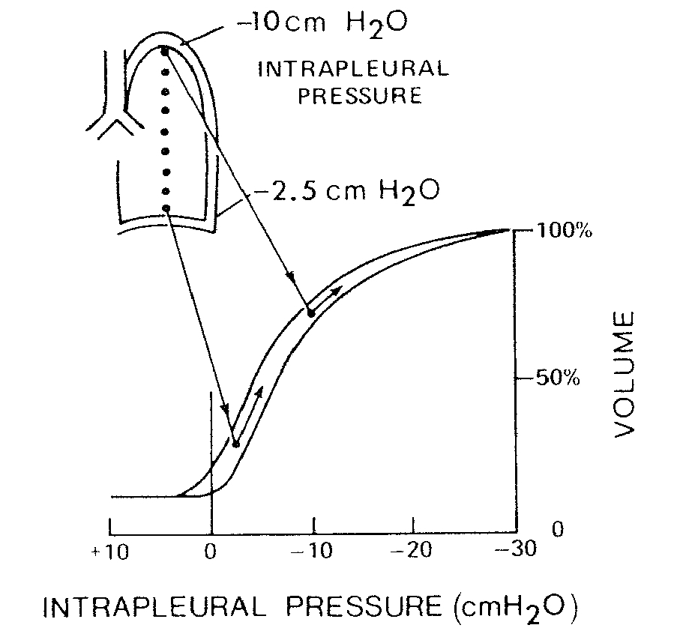

Slide 23
Alveolar pressure is constant throughout the lung.
Differents parts of the lung have different distending pressures.

Slide 25
Pleural Pressure
Different parts of the lungs have different distending pressures.
The alveoli in the superior parts of the lung tends to be larger than those in the inferior parts.
Formation of pleural blebs.
Uneven distribution of ventilation.

Slide 26
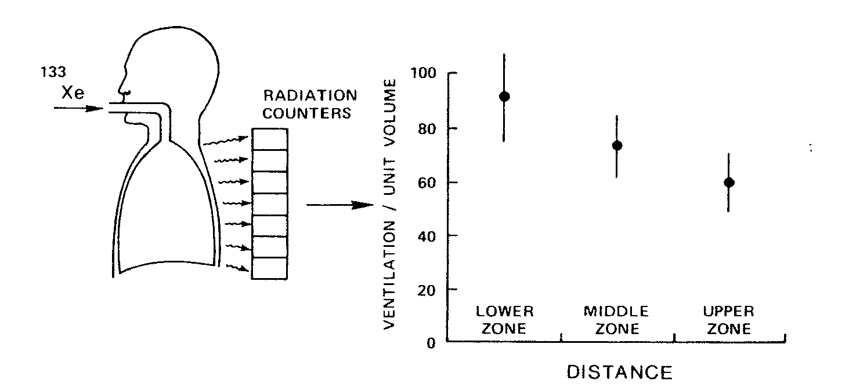

Slide 27
Pleural fluid formation
Pleural capillaries.
Interstitial space in the lung.
Intra thoracic blood vessels. Hemothorax.
Intra thoracic lymphatics. Chylothorax.
Peritoneal cavity.

Slide 28
Starling’s Law of Trans capillary Exchange
Q_{f} = Lp x A[(P_{cap}-P_{pl}) – σ_{d}(π_{cap}-π_{pl})]
Q_{f} = liquid movement
L_{p} = filtration coefficient /unit area of the membrane
A = surface area of the membrane
σ_{d} = solute reflection coefficient for protein (membrane's ability to restrict passage of large molecules
P = hydrostatic pressures
π = oncotic pressure

Slide 29
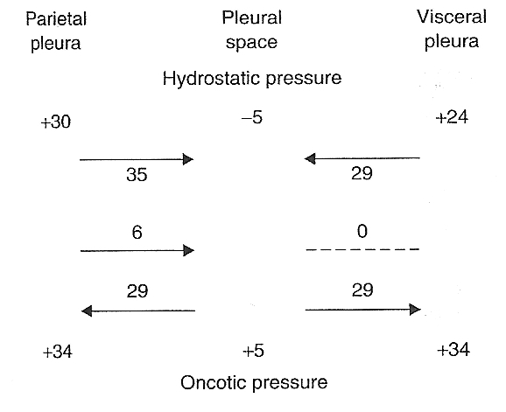

Slide 30
Pleural Capillaries
A gradient for fluid formation is normally present in the parietal pleura.
Hydrostatic pressure: 30cm H₂0.
Pleural Pressure: -5 cm H₂0.
Oncotic pressure in plasma: 34 cm H₂0.
Oncotic pressure in the pleural fluid: 5 cm H₂0.
Net pressure gradient: 6 cm H₂0.

Slide 32
Pleural Capillaries
Net gradient: close to zero.
Pleural visceral capillaries drain into the pulmonary veins.
The filtration coefficient is substantially less than for the parietal pleura.

Slide 33
Interstitial origin
Much of the pleural fluid.
High pressure pulmonary edema: the pleural fluid formed is directly related to the elevation in the wedge pressure.
Increases in pleural fluid formation occurs only after the development of pulmonary edema.

Slide 35
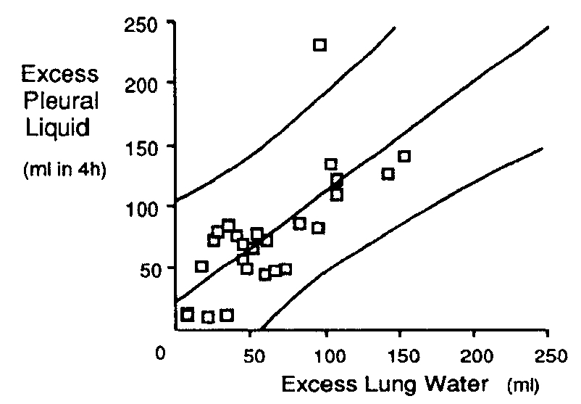

Slide 36
The presence of pulmonary effusion is more closely correlated with the pulmonary venous pressure than with the systemic venous pressure.
High permeability pulmonary edema: Pleural fluid accumulates only after pulmonary edema develops.

Slide 37
In general : pleural effusion develops when the extravascular lung water has reached a critical level in a certain amount of time.
5-8 g of fluid/ gram of dry lung.

Slide 38
Increasing levels of interstitial fluid is related with increase in sub pleural interstitial pressure, allowing fluid transverse the visceral pleura to the pleural space.
Pressure gradient rise from 1.3 to 4.4 cm H2O.
Associated to rise in lung water to 5-6 g/g dry lung.

Slide 39
Peritoneal Cavity
Free fluid in the peritoneal cavity.
Opening in the diaphragm. Diaphragmatic defects.
Pressure in the pleural cavity is less than the pressure in the peritoneal cavity.

Slide 40
Pleural Fluid Absorption
Mean lymphatic flow is 0.22-0.4 mL/kg/hour.
Lymphatics operate at maximum capacity once the volume of the pleural liquid exceeds a certain threshold.
The capacity for lymphatic clearance is 28 times as high as the normal rate of pleural fluid formation.

Slide 42
Pathogenesis of Pleural Effusion
Pleural fluid formation exceeds the rate of pleural fluid absorption.

Slide 43
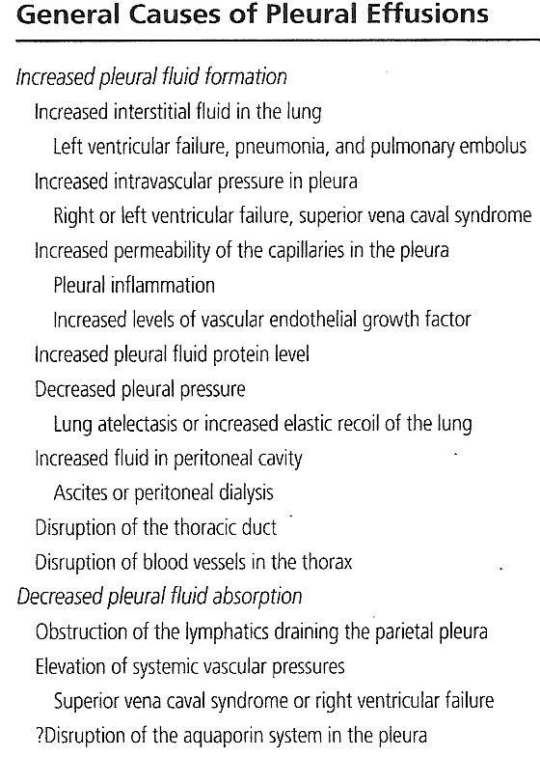

Slide 44
Clinical Implications of Pneumothorax

Slide 45
Effects of Pneumothorax on Pleural Pressure
Air will flow into the pleural space until a pressure gradient no longer exits or until the communication is sealed.

Slide 46
Effects of Pneumothorax on Pleural Pressure
The distribution in the increase in the pleural pressure is homogenous and the pressure is the same throughout the entire pleural space.
In pleural effusion there is a gradient in the pleural pressure due to the hydrostatic column of fluid.

Slide 47
Effects of Pneumothorax on Pleural Pressure
The upper lobe is affected more than the lower lobe in pneumothorax, because the pressure in the apices is much more negative that at the bases.

Slide 48
Effects of Pneumothorax in Lung Function
Restrictive ventilatory defect.
Decreased Vital Capacity.
Decreased FRC.
Decreased TLC.
Decreased RV.
Decreased end expiratory lung volume.
Increased end expiratory thoracic volume?.
Slightly decreased DLCO.

Slide 51
Effects of Pneumothorax in Lung Function
Expansion of the pleural space is accommodated partly by deflation of the lung and partly by relative expansion of the ipsilateral chest wall.

Slide 52
Effects of Pneumothorax in Blood Gases
Reduction of PaO2 : anatomic shunts and areas of low ventilation perfusion ratios.
Increased A-a oxygen difference.

Slide 53
Effects of Pneumothorax in Blood Gases
The more extensive the pneumothorax the lower is the arterial oxygen tension and the larger the anatomical shunt.

Slide 54
Anatomical Shunt and Lung Area Index

Slide 55
Effects of Pneumothorax in Blood Gases
Complete non-ventilation of alveoli does not occur in man until the lung volume is reduced to about 65% of normal.
Increase in A-aD02 is associated to anatomical shunt and decrease ventilation perfusion disturbances.

Slide 56
After Drainage of Pneumothorax

Slide 57
Effects of Pneumothorax in Blood Gases
The distribution of ventilation-perfusion ratios could became more uneven and could cause a rise in either A-aDo2 or VD/VT.
Relatively great pressure is required to open a ventilatory unit which is completely closed.

Slide 58
Effects of Pneumothorax in Blood Gases
Persistent alveolar collapse and bronchoconstriction (serotonin and histamine).
Persistent alveolar hypoxemia will cause local vasoconstriction and under perfusion.

Slide 59
Effects of Pneumothorax in Cardiac Function
Tension pneumothorax is associated to impaired hemodynamics.
Decreased CO and MSP.
Decreased cardiac output secondary to decrease venous return due to the increased pleural pressures.

Slide 60
Effects of Pneumothorax in Cardiac Function
Cardiovascular collapse in response to tension pneumothorax is preceded by and likely caused by respiratory failure resulting in profound hypoxemia, hypercarbia, and subsequent acidemia.

Slide 62
Circulatory changes associated with Tension Pneumothorax
Gradual increase in pressure thought out the system without significant gradients.
Cardiac output and systemic arterial pressure did not drop in association with rising pressures in the right side of the circulation.

Slide 63
Circulatory changes associated with Tension Pneumothorax
All low pressure vascular elements within the thorax are affected by rising intra thoracic pressure.

Slide 65
Ventilatory changes associated with Tension Pneumothorax
The ipsilateral pleural pressure become progressively less negative until become positive.
The contralateral pleural pressure will become progressively more negative.
The respiratory excursion will become wider, reflecting increased respiratory effort.

Slide 66
The mediastinum was the most significant factor behind this compensatory mechanism.

Slide 68
Depression of respiratory system by hypoxemia.
Worsening tensional pneumothorax associated to worsening in shunting.

Slide 70
References
Pleural Diseases. Richard W. Light.
Assessment of Pleural Pressure in the Evaluation of Pleural Effusion. David Feller-Kopman. Chest 2009;135;201-209
Changes in bronchial and pulmonary arterial blood flow with progressive tension pneumothorax. Paula Carvalho. J Appl Physiol 81:1664-1669, 1996.
Effects-of pneumothorax or pleural effusion on pulmonary function. JJ Gilmartin. Thorax 1985;40:60-65

