Slide 1
Respiratory MRCP Part 1 Pleural Effusion
Gary Lee
Demonstration

Slide 2
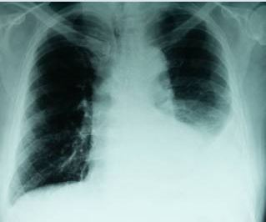
Pleural Effusion develops when Rate of fluid formation > Rate of fluid drainage

Slide 3
SEPARATION OF
EXUDATE AND TRANSUDATE
TRANSUDATE |  | EXUDATE
<0.5 | Pleural fluid: Serum Protein ratio | >0.5
<0.6 | Pleural Fluid: Serum LDH Ratio | >0.6
<2/3 | Pleural fluid LDH (upper serum limit) | >2/3
>1.2 g/dL | Albumin Gradient (Serum- Pleural fluid) | <1.2 g/dL

Slide 4
Table 2
TRANSUDATE |  | EXUDATE
Congestive heart failure |  | Parapneumonic Effusion
Hepatic Cirrhosis |  | TB effusion
Renal Failure (Nephrotic Syndrome) |  | Malignant effusion
 |  | Other: CVD, Chylothorax etc

Slide 5
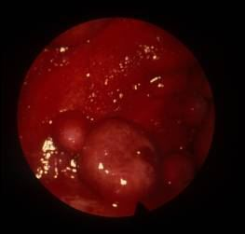
Malignant Pleural effusion

Slide 6
Malignant Pleural effusion
Most commonly from lung or breast carcinoma
Diagnosis: Pleural fluid cytology or pleural biopsy (closed, CT guided, Thoracoscopic)
Usual recurs
Produces dyspnea
Treatment: Pleurodesis: Indewelling catheter; Repeated thoracentesis

Slide 7
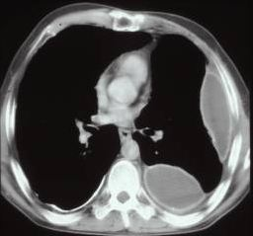
Chest Scan

Slide 8
Pleural Infection: Pathophysiology
Sub-Pleural infection
No effusion
‘Simple’ effusion
Straw coloured, pH> 7.02
Complicated effusion
Straw coloured, pH> 7.02
Fibrin +
Empyema
Pus and fibrin ++
‘Healing’ Empyema
Collagen; Fibrosis

Slide 9
Complicated Parapneumonic Effusion / Empyema
Always suspect pleural infection in a patient with a pleural effusion, pneumonia or fever/Sepsis
‘The sun should never set on a parapneumonic effusion.’
Early drainage and treatment may avoid development of empyema.
Treatment = Drainage of the infected pleural fluid + Appropriate antibiotics

Slide 10
Antibiotics: British Thoracic Society Recomendation
Community acquired empyema
Cefuroxime 1.5g tds + Metronidazole 400mg tds
Clindamycin 300mg qds po+ Ciprofloxacin 500mg bd
Hospital acquired empyema
Vancomycin 1mg bd+ Merophenem 1mg tds
Teicoplanin 400mg bd for 3 dosage then 400mg daily a merophenem 1g tds

Slide 11
A 57 years old woman developed a unilateral pleural effusion. The fluid was milky, lymphocytic and with an elevated triglyceride level (2.5mmol/L). There was no history of trauma or surgery.

Slide 12
Which of the following is most appropriate?

Slide 13
Which of the following is most appropriate?
Multiple pleural biopsies with Abram’s needle
Flow cytometry of the pleural fluid
CT Thorax to exclude mediastinal lymphadenopathy
Thoracoscopy
Screening for rheumatoid arthritis

