Slide 1
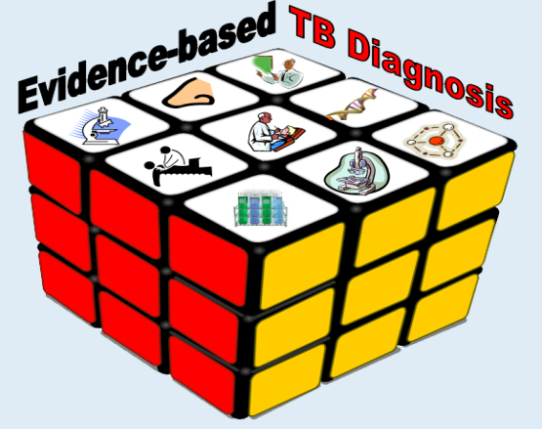
Tuberculosis newer diagnostic methods
Dr.T.V.Rao MD

Slide 2
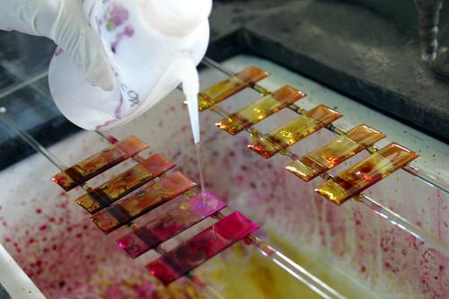
New Policy and Smear microscopy definition of a TB case
New definition in 2007*:
  “person with al least one smear-positive sample (1 AFB is sufficient) out of a total of two examined”
2 samples regardless the collection time
*The definition/policy can be applied to countries performing microscopy under satisfactory quality assurance programmes
2
Notes:
2

Slide 3
WHO recommendations on sputum smear microscopy (2010)
ZN light microscopy performed on UNCONCENTRATED sputum is suitable for all laboratory service levels
Concentration of sputum is NOT recommended in programmatic settings
Fluorescence microscopy is recommended for increased sensitivity (add 10%)
LED microscopy is recommended over conventional fluorescence

Slide 5
Region of higher burdens of tuberculosis
The South-East Asia (SEA) Region of the World Health Organization (WHO) has the highest burden of tuberculosis in the world. The Region accounted for about 40% of the global TB burden in 2010. It is estimated that about 3.5 million new cases of TB occurred in 2010 and that about half a million people die of this disease annually, most of them in the five Member countries Bangladesh, India, Indonesia, Myanmar and Thailand. Of the 3.5 million people living with HIV in the Region in 2010, roughly half were estimated to be co-infected with TB.

Slide 6
Advances in microscopy
Smear microscopy with carbol fuchsin and fluorochrome such as auramine-rhodamine remains a mainstay in the detection of Mtb in clinical specimens and is widely supported by the WHO . Fluorescence microscopy improves the sensitivity of Mtb detection . Previously, the light sources necessary for fluorescence microscopy were not available for field use. Recent advances in light-emitting diode (LED) technology have widened the applicability of fluorescent microscopy

Slide 7
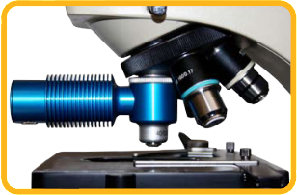
LED Fluorescence Microscopy
Advantages:
increase in performance
increase in lamp lifetime
reduces initial, operating and maintenance costs
No need for dark room

Slide 8
At present diagnosing tuberculosis is too slow – need for newer methods
According to the World Health Organization (WHO), Mycobacterium tuberculosis (MTB) is considered to be vastly under diagnosed today, despite approximately 500,000 new active cases reported in the WHO European region during 2007. This is a direct result of current MTB testing methods requiring weeks to deliver a definitive result, which can lead to patients being left untreated or placed on ineffective therapies. These patients may continue to spread MTB to others in the community, increasing the disease burden.

Slide 9
We still dependent on culturing MTB but has limitations ???
Culture of M. tuberculosis in clinical specimens is substantially more sensitive than smear microscopy. Culture can be performed using solid media, such as Lowenstein-Jensen, or liquid media, such as that used in commercially available automated systems. Until the recent advent of molecular tests for drug resistance (described in the next section), isolation of M. tuberculosis with use of culture was a prerequisite for subsequent phenotypic drug-susceptibility testing. The Achilles heel of culture is the long time to results (10–14 days for liquid culture and 3–4 weeks for solid culture), which is a consequence of the long doubling time of M. tuberculosis.

Slide 10

We need new tools in diagnosis of tuberculosis
Current tools and strategies for diagnosis of tuberculosis (TB) are inadequate, particularly in settings with a high prevalence of human immunodeficiency virus (HIV) infection. Several promising new tools are at advanced stages of development and evaluation. This review describes some of those promising new technologies and the key barriers to their effective implementation.

Slide 11
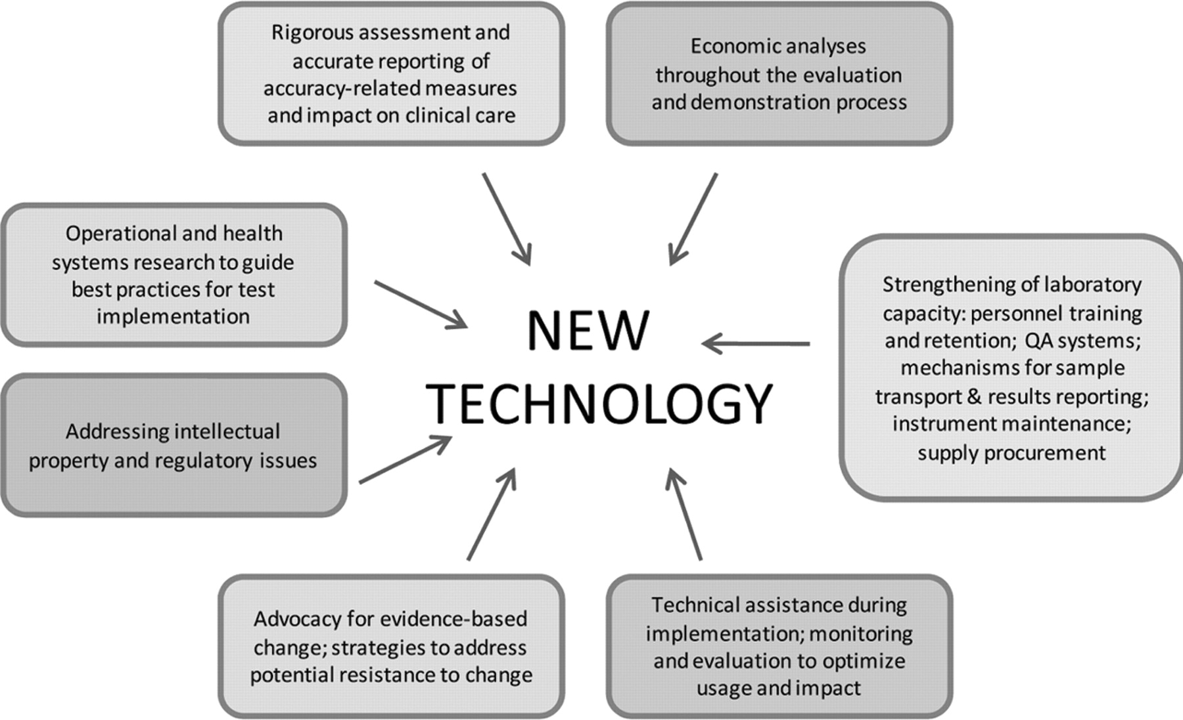

Components of the post-research-and-development process for promising new tuberculosis (TB) diagnostic technologies.
Dorman S E Clin Infect Dis. 2010;50:S173-S177
© 2010 by the Infectious Diseases Society of America
Notes:
Components of the post-research-and-development process for promising new tuberculosis (TB) diagnostic technologies. QA, quality assurance.

Slide 12
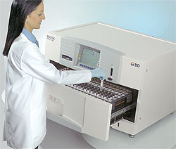
Mycobacterial Growth Indicator Tube (MGIT)
Rapid Method.
Consists of round bottom tubes containing 4 ml of modified Middlebrooks 7H9 broth which has an oxygen sensitive fluorescent sensor at the bottom.* When mycobacteria grow, they deplete the dissolve oxygen in the broth & allow the indicator to fluoresce brightly in a 365nm UV light.

Slide 13
Mycobacterial Growth Indicator Tube (MGIT)
Positive signals are obtained in 10-12 days. MGIT can also be used as a rapid method for the detection of drug resistant strains of Mtb directly from acid-fast smear positive samples as well as from indirect drug susceptibility studies.
􀂄 Advantages over BACTEC
􀂄 Cheaper.
􀂄 No problem of radioactive waste disposal.

Slide 14
MODS in detection of drug resistance
The microscopic-observation drug-susceptibility (MODS) assay is a low-cost alternate to the detection of drug resistance. By using Middle brook 7H9 broth culture containing antituberculous drugs, sputum is directly inoculated, and growth (seen as cord formation) is detected using an inverted light microscope. In Ethiopia, MODS detection of MDRTB was excellent with sensitivity and specificity of 95 and 100%, respectively, when compared with the MGIT 960 system . The time to detection has been shown to be 7 days and similar to the MGIT 960

Slide 15
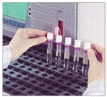
Detection and identification of mycobacteria directly from clinical samples
Genotypic Methods :
􀂄 PCR
􀂄 LAMP
􀂄 TMA / NAA
􀂄 Ligase chain reaction
􀂄 Phenotypic Methods :
􀂄 FAST Plaque TB

Slide 16
•PCR-based genetic tests
Detection is based on multiplication not of whole bacilli, as in culture, but of their genetic material, chromosomal DNA or ribosomal RNA. Provided all ingredients are present in the reaction tube, this will only take place when the target genetic sequences to which the added primers can bind are found in the sample. Specificity of the test will thus depend on the use of correct primers, using sequences typical for MTB or MTB complex. In principle, from one target sequence, of one bacillus, the reaction can produce millions of copies and thus yield a positive result

Slide 17
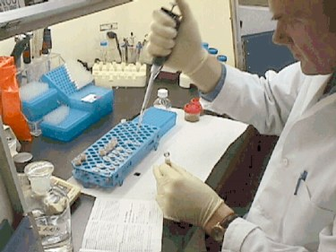
Polymerase Chain Reaction (PCR)
Essentially PCR is a way to make millions of identical copies of a specific DNA sequence , which may be a gene, or a part of a gene, or simply a stretch of nucleotides with a known DNA sequence, the function of which may be unknown

Slide 18
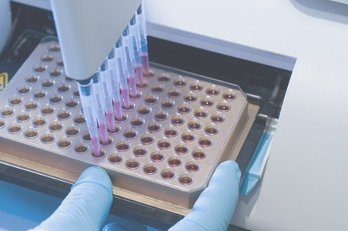
Advantages of PCR methods
The main advantage of PCR-based techniques is their speed; in principle, only 1-2 days are needed. This is true for diagnosis of TB, and even more so for applications such as diagnosis of drug resistance (mainly rifampicin) and species identification using probes.

Slide 19
Disadvantages of pcr methods
The main disadvantage of PCR-based tests is their extremely high cost, especially when more convenient and more sensitive commercial test kits are available. Even in rich countries this has restricted their use, for instance, to determining the species present in smear-positive disease (FDA approval). This restricted use may also reduce the speed of the results, since it may not be possible to schedule PCR-runs daily.

Slide 20
Loop-mediated isothermal amplification.
LAMP*
LAMP*
􀂄 Loop-mediated isothermal amplification.
􀂄 It is a novel nucleic acid amplification method in which reagents react under isothermal conditions with high specificity, efficiency, and rapidity. 􀂄 LAMP is used for detection of M.tb complex, M.avium, and M.intracellulare directly from sputum specimens as well as for detection of culture isolates grown in a liquid medium (MGIT) or on a solid medium (Ogawa’s medium).
*Iwamoto T et al J Clin Microbiol 2003;41 :2616-

Slide 21
LAMP*
This method employs a DNA polymerase and a set of four specially designed primers that recognize a total of six distinct sequences on the target DNA. Species-specific primers were designed by targeting the gyrB gene. Simple procedure, starting with the mixing of all reagent in a single tube, followed by an isothermal reaction during which the reaction mixture is held at 63°C 60-min incubation time.

Slide 22
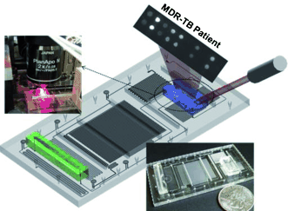
Ligase Chain Reaction
It is a variant of PCR, in which a pair of oligonucleotides are made to bind to one of the DNA target strands, so that they are adjacent to each other. A second pair of oligonucleotides is designed to hybridize to the same regions on the complementary DNA.

Slide 23
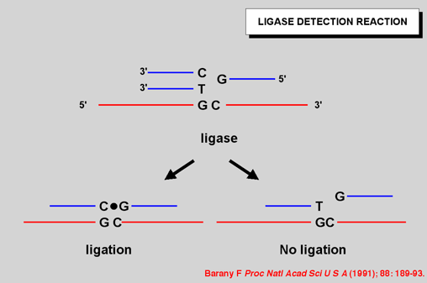
Ligase Chain Reaction
The action of DNA polymerase and ligase in the presence of nucleotides results in the gap between adjacent primers being filled with appropriate nucleotides and ligation of primers. It is mainly being used for respiratory samples, and has a high overall specificity and sensitivity for smear +ve and –ve specimens.

Slide 24

Quantiferon-GOLD
Due to advances in molecular biology and genomics, an alternative has emerged for the first time in the form of a new class of in vitro assays that measure interferon (IFN-γ) released by sensitized T cells after stimulation by M. tuberculosis antigens. Measures immune reactivity to M.tb.

Slide 25
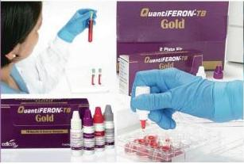
Quantiferon-GOLD
Interferon-γ assays measure cell-mediated immunity by quantifying IFN-γ released from sensitized T cells in whole blood/PBMCs incubated with TB antigens.

Slide 26
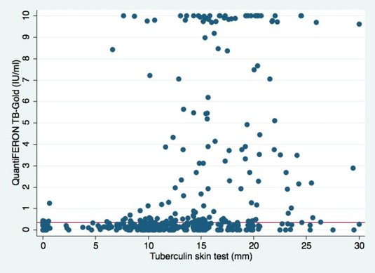
QuantiFERON-TB Gold
QuantiFERON-TB Gold is an in vitro diagnostic test to aid in the detection of Mycobacterium tuberculosis infection. It combines the simplicity of the QuantiFERON technology with the diagnostic power of synthetic TB-specific peptides (ESAT-6 and CFP-10) to provide the best available method of diagnosing TB infection.

Slide 27
QuantiFERON-TB ® test
QuantiFERON-TB ® test (Cellestis, Australia
– Commercially available.
– Measures amount of IFN-γ produced. (ELISA)
– FDA-approved for the detection of LTBI, 2001.
􀂄 ELISPOT assay (Oxford, UK)
– Similar to QFT.
– Measures number of reactive lymphocytes.
–

Slide 28
Quantiferon-GOLD
Early assays employed PPD (same specificity problems
as the TST). Newer assays (e.g., QFT-Gold) employ TB-specific antigens: ESAT-6 and CFP-10. Proteins encoded within the region of difference 1 of M.tuberculosis. Not shared with the BCG sub-strains and most NT (except: M. kansasii, M. szulgai, M. marinum and nonpathogenic
M.bovis).

Slide 29
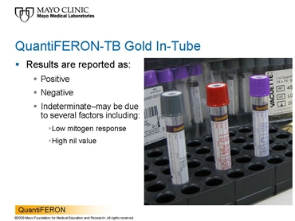
Quantiferon-GOLD
Improved specificity: able to distinguish between TB and NTM, BCG infection.
􀂄 Studies in contacts, HIV infected and children underway.
􀂄 Recommended for use in “ALL circumstances in which the tuberculin skin test is currently used”.* Includes contact investigations, immigrant evaluation, surveillance (e.g. healthcare workers).

Slide 30
Drug resistant tuberculosis
With the worldwide re-emergence of TB, multi-drug resistant (MDR) and extensively drug resistant (XDR) strains have become an even greater threat. According to the WHO Global Tuberculosis Control Report 2009, there may be more than 500,000 cases of MDR-TB worldwide. Current testing for drug resistance can take more than 4 weeks, leading to higher mortality and the further spread of MDR strains.

Slide 31
Advances in the detection of drug resistance
One of the most exciting advances in Mtb diagnostics is rapid DST. Given the increasing prevalence and impact of multidrug-resistant (MDR) and extensively drug-resistant Mtb , WHO along with the STOP TB partnership have prioritized greater access to DST. MDR Mtb is defined as resistance to two vital first-line agents, rifampin and isoniazid. Rifampin, a rifamycin, inhibits the DNA-dependent RNA polymerase , and in 96% of isolates resistant to rifampin resistance is attributable to an 81 base pair rpo hotspot .

Slide 32
Drug resistance in isoniazid
Isoniazid is bactericidal against actively replicating mycobacteria by inhibiting pathways of mycolic acid synthesis. It requires activation by the Mtb enzyme, katg, a mycobacterial catalase peroxidase, to form reactive intermediates to inhibit various targets of mycolic acid synthesis, including InhA, an enoyl acyl carrier protein reductase.

Slide 33
Xpert® MTB/RIF

Slide 34
Emerging technology in diagnosis of infectious diseases
The development of the Xpert MTB/RIF assay is platform technology that has the potential of being used for screening for infectious and non-infectious diseases, including HIV viral load, malaria, and detection of human papilloma virus (HPV) for cervical cancer. This TB platform was completed in 2009 and is considered to be an important breakthrough in the fight against TB. For the first time, a molecular test is simple and robust enough to be introduced outside conventional laboratory settings.

Slide 35
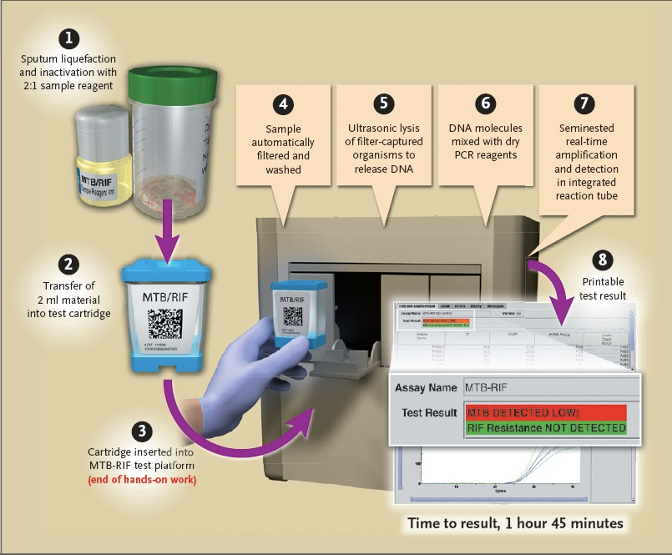
Xpert MTB/RIF

Slide 36
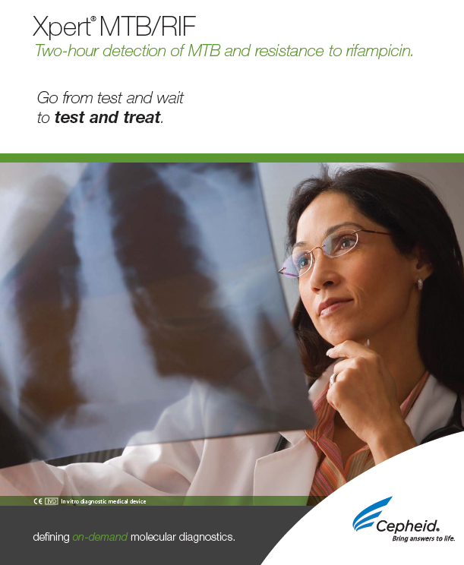
Xpert MTB/RIF
Xpert MTB/RIF detects M. tuberculosis as well as rifampicin resistance conferring mutations using three specific primers and five unique molecular probes to ensure a high degree of specificity. The assay provides results directly from the sputum within 100 minutes.

Slide 37
Advantages with GeneXpert
Simultaneous detection of both MTB and rifampicin resistance, a marker for MDR strains
Unprecedented sensitivity for detecting MTB — even in smear negative, culture positive specimens
Results in two hours; requires no instrumentation other than the GeneXpert® System
On-demand results enable physicians to treat rapidly and effectively

Slide 38
Our vision to future on tuberculosis
New programmatic approaches, including revised clinical algorithms for TB diagnosis, may be needed to maximize the impact of new tools. For example, should rapid molecular tests for drug resistance be performed for all persons with suspected TB during initial evaluation, be reserved for use in the initial evaluation only of persons with suspected TB with risk factors for drug resistance, or be used in some other place in a diagnostic algorithm?

Slide 39
Programme Created by Dr.T.V.Rao MD for Medical and Paramedical professionals in the Developing World
Email
doctortvrao@gmail.com

