Slide 1
Targeted Tuberculosis (TB) Testing and Treatment of Latent TB Infection
December 2011
National Center for HIV/AIDS, Viral Hepatitis, STD, and TB Prevention
Division of Tuberculosis Elimination

Slide 2
Targeted TB Testing and Treatment of Latent TB Infection
As TB disease rates in the United States decrease, finding and treating persons at high risk for latent TB infection (LTBI) has become a priority.
Targeted TB testing is used to focus program activities and provider practices on groups at the highest risk for TB.
Treatment of LTBI substantially reduces the risk that persons infected with M. tuberculosis will progress to TB disease.

Slide 3
Latent TB Infection (LTBI)
LTBI is the presence of M. tuberculosis organisms (tubercle bacilli) without signs and symptoms or radiographic or bacteriologic evidence of TB disease.

Slide 4
LTBI vs. Pulmonary TB Disease -1
Latent TB Infection Pulmonary TB Disease
Positive TST* or IGRA† TST or IGRA result is usually positive
Chest radiograph Chest radiograph is normal usually abnormal
*tuberculin skin test
†Interferon-Gamma Release Assay

Slide 5
LTBI vs. Pulmonary TB Disease -2
Latent TB Infection Pulmonary TB Disease
No symptoms or physical Symptoms may include findings suggestive of TB one or more of the following: fever, cough, night sweats, weight loss, fatigue, hemoptysis, decreased appetite
If done, respiratory Respiratory specimens specimens are smear are usually culture and culture negative positive (smear positive in about 50% of patients )

Slide 6
Targeted TB Testing
Essential TB prevention and control strategy
Detects persons with LTBI who would benefit from treatment
De-emphasizes testing of groups that are not at high risk for TB
Can help reduce the waste of resources and prevent inappropriate treatment

Slide 7
Treatment of LTBI – Milestones - 1
For more than 3 decades, an essential component of TB prevention and control in the United States has been the treatment of persons with LTBI to prevent TB disease.

Slide 8
Treatment of LTBI – Milestones - 2
1965: American Thoracic Society (ATS) recommends treatment of LTBI for those with previously untreated TB, tuberculin skin test (TST) converters, and young children.
1967: Recommendations expanded to include all TST positive reactors (≥ 10 mm).

Slide 9
Treatment of LTBI – Milestones - 3
1974: CDC and ATS guidelines established for pretreatment screening to decrease risk of hepatitis associated with treatment
Treatment recommended for persons ≤ 35 years of age

Slide 10
Treatment of LTBI – Milestones - 4
1983: CDC recommends clinical and laboratory monitoring of persons ≥ 35 who require treatment for LTBI
1998: CDC recommends 2 months of rifampin (RIF) plus pyrazinamide (PZA) as an option for HIV-infected patients (later changed)

Slide 11
Treatment of LTBI – Milestones - 5
2000: CDC and ATS issue updated guidelines for targeted testing and LTBI treatment¹
9-month regimen of isoniazid (INH) is preferred
2-month regimen of RIF and PZA and a 4 month regimen of RIF recommended as options (later changed)
¹ MMWR June 9, 2000; 49(No. RR-6)
http://www.cdc.gov/mmwr/preview/mmwrhtml/rr4906a1.htm

Slide 12
Treatment of LTBI – Milestones -6
2001: Owing to liver injury and death associated with 2-month regimen of RIF and PZA, use of this option de-emphasized in favor of other regimens²
2003: 2-month regimen of RIF and PZA generally not recommended — to be used only if the potential benefits outweigh the risk of severe liver injury and death³
² MMWR August 31, 2001; 50(34): 733-735 - http://www.cdc.gov/mmwr/preview/mmwrhtml/mm5034a1.htm
³ MMWR August 8, 2003; 52(31): 735-739 - http://www.cdc.gov/mmwr/preview/mmwrhtml/mm5231a4.htm

Slide 13
Treatment of LTBI – Milestones -7
2011: CDC recommends 12-doses (3 months) of isoniazid (INH) and rifapentine (RPT) as an option equal to the standard 9-month INH regimen for certain groups*
*MMWR . Recommendations for Use of an Isoniazid–Rifapentine Regimen with Direct Observation to Treat Latent Mycobacterium tuberculosis Infection
http://www.cdc.gov/mmwr/preview/mmwrhtml/mm6048a3.htm?s_cid=mm6048a3_w

Slide 14
Identifying Risk Factors That Lead to Development of TB Disease

Slide 15
Persons at Risk for Developing TB Disease
Persons at high risk for developing TB disease fall into 2 categories:
Those who have an increased likelihood of exposure to persons with TB disease
Those with clinical conditions that increase their risk of progressing from LTBI to TB disease

Slide 16
Increased Likelihood of Exposure to Persons with TB Disease
Persons at risk for exposure to persons with TB disease include:
Close contacts to person with infectious TB
Residents and employees of high-risk congregate settings (e.g., correctional facilities, homeless shelters, health care facilities)
Recent immigrants from TB-endemic regions of the world (within 5 years of arrival to the United States)

Slide 17
Increased Risk for Progression to TB Disease -1
Persons more likely to progress from LTBI to TB disease include:
HIV-infected persons
Those with a history of prior, untreated TB or fibrotic lesions on chest radiograph
Children ≤ 5 years with a positive TST

Slide 18
Increased Risk for Progression to TB Disease - 2
Persons more likely to progress from LTBI to TB disease include:
Underweight or malnourished persons
Injection drug users
Those receiving TNF-α antagonists for treatment of rheumatoid arthritis or Crohn’s disease

Slide 19
Increased Risk for Progression to TB Disease -3
Persons more likely to progress from LTBI to TB disease include:
Those with certain medical conditions such as:
Silicosis
Diabetes mellitus
Chronic renal failure or on hemodialysis
Solid organ transplantation (e.g., heart, kidney)
Carcinoma of head or neck
Gastrectomy or jejunoilial bypass

Slide 20
Testing for M. tuberculosis Infection

Slide 21
Testing for M. tuberculosis Infection
There are two testing methods available for the detection of M. tuberculosis infection in the United States:
Mantoux tuberculin skin test (TST)
Interferon-gamma release assays (IGRA)
These tests do not exclude LTBI or TB disease
Decisions about medical and public health management should include other information, and not rely only on TST or IGRA results

Slide 22
Mantoux Tuberculin Skin Test
Skin test that produces delayed-type hypersensitivity reaction in persons with M. tuberculosis infection
TST is useful for:
Determining how many people in a group are infected (e.g., contact investigation)
Examining persons who have symptoms of TB disease
Multiple puncture tests (e.g., Tine Test) are inaccurate and not recommended

Slide 23
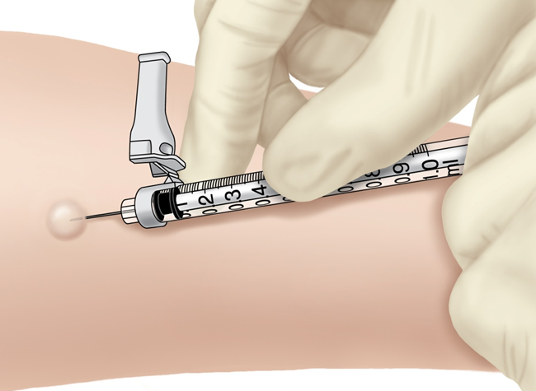
Administering the TST
Inject 0.1 ml of 5 TU PPD tuberculin solution intradermally on volar surface of lower arm using a 27-guage needle
Produce a wheal 6 to 10 mm in diameter

Slide 24
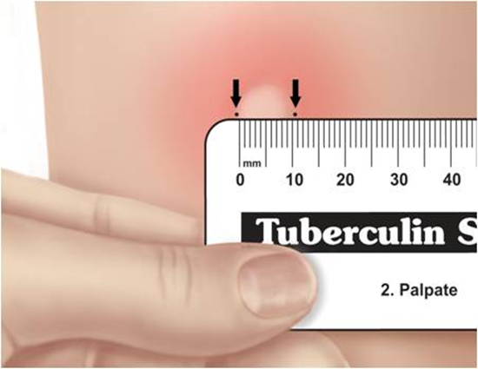
Reading the TST -1
Measure reaction in 48 to 72 hours
Measure induration, not erythema
Record reaction in millimeters, not “negative” or “positive”
Ensure trained health care professional measures and interprets the TST

Slide 25
Reading the TST - 2
Educate patient and family regarding significance of a positive TST result
Positive TST reactions can be measured accurately for up to 7 days
Negative reactions can be read accurately for only 72 hours

Slide 26
TST Interpretation - 1
≥ 5 mm induration is interpreted as positive in
HIV-infected persons
Close contacts to an infectious TB case
Persons with chest radiographs consistent with prior untreated TB

Slide 27
TST Interpretation - 2
≥ 5 mm induration is interpreted as positive in
Organ transplant recipients
Other immunosuppressed patients (e.g. , those taking the equivalent of > 15 mg/d of prednisone for 1 month or those taking TNF-α antagonists)

Slide 28
TST Interpretation - 3
≥ 10 mm induration is interpreted as positive in
Recent immigrants
Injection drug users
Residents or employees of congregate settings
Mycobacteriology laboratory personnel

Slide 29
TST Interpretation - 4
≥ 10 mm induration is interpreted as positive in
Persons with clinical conditions that place them at high risk
Children < 4 years; infants, children, and adolescents exposed to adults at high-risk

Slide 30
TST Interpretation - 5
≥ 15 mm induration is interpreted as positive in
Persons with no known risk factors for TB.
Although skin testing programs should be conducted only among high-risk groups, certain individuals may require TST for employment or school attendance. Diagnosis and treatment of LTBI should always be tied to risk assessment.

Slide 31
Factors That May Cause False-Positive TST Reactions
Nontuberculous myobacteria
Reactions caused by nontuberculous mycobacteria are usually ≤10 mm of induration
BCG vaccination
Reactivity in BCG vaccine recipients generally wanes over time; positive TST result is likely due to TB infection if risk factors are present

Slide 32
Factors That May Cause False-Negative TST Reactions -1
Anergy
Inability to react to a TST because of a weakened immune system
Usefulness of anergy testing in TST-negative persons who are HIV infected has not been demonstrated

Slide 33
Factors That May Cause False-Negative TST Reactions - 2
Recent TB Infection
Defined as less than 10 weeks after exposure
Very young age
Newborns (< 6 months)

Slide 34
Factors That May Cause False-Negative TST Reactions - 3
Live virus vaccination
For example, measles or smallpox
Can temporarily suppress TST reactivity
Overwhelming TB Disease
Poor TST administration technique
For example, TST injection too shallow or too deep, or wheal is too small

Slide 35
Boosting
Some people with LTBI may have a negative skin test reaction when tested years after infection because of a waning response.
An initial skin test may stimulate (boost) the ability to react to tuberculin.
Positive reactions to subsequent tests may be misinterpreted as new infections rather than “boosted” reactions.

Slide 36
Two-Step Testing - 1
A strategy to determine the difference between boosted reactions and reactions due to recent infection.
If 1st test positive, consider infected; if negative, give 2nd test 1–3 weeks later
If 2nd test positive, consider infected; if negative, consider uninfected
Use two-step tests for initial baseline skin testing of adults who will be retested periodically (e.g., health care workers).

Slide 37
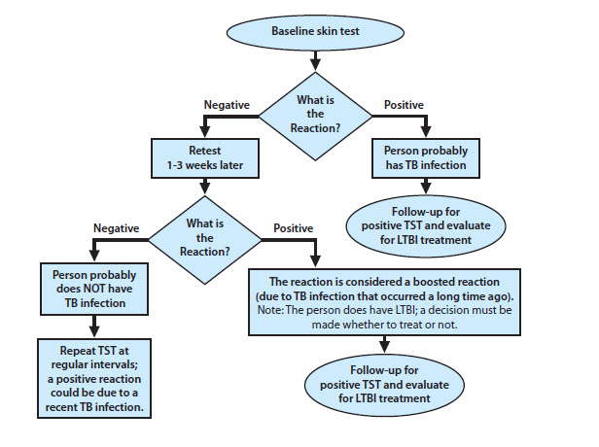
Two-step TST Testing - 2

Slide 38
Interferon-Gamma Release Assays (IGRAs)

Slide 39
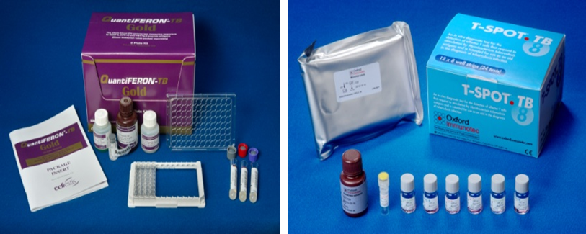
Interferon-Gamma Release Assays (IGRAs)
Whole-blood test used to detect M. tuberculosis infection
Two U.S. Food and Drug Administration (FDA) approved IGRAs are commercially available in the U.S.:
QuantiFERON® -TB Gold-in-tube test (QFT-GIT)
T.SPOT® .TB test (T-Spot)

Slide 40
How IGRAs Work - 1
Blood test that measures and compares amount of interferon-gamma (IFN-γ) released by blood cells in response to antigens
Entails mixing blood samples with antigens from M. tuberculosis and controls

Slide 41
How IGRAs Work - 2
Cells that recognize the antigen release interferon-γ
Amount of interferon released in response to M. tuberculosis antigens is compared to amount released in response to other antigens

Slide 42
Administering IGRAs
Confirm and arrange for delivery of blood sample within specific time-frame to ensure viability of blood samples
Draw blood sample according to test manufacturer’s instructions
Schedule a follow up appointment to receive test results, medical evaluation and possible treatment if needed

Slide 43
Interpretation of IGRA Test Results
IGRA Test Results Reported as
QFT-GIT Positive, negative, indeterminate
T-Spot Positive, negative, indeterminate, borderline
Note: Laboratory should provide both quantitative and qualitative results
Notes:
Based on the amount of interferon-γ released or on number of cells that release interferon-γ

Slide 44
Advantages of IGRAs
Requires a single patient visit to conduct test
Results can be available within 24 hours
Does not boost responses measured by subsequent tests
Prior BCG vaccination does not cause false-positive IGRA test result

Slide 45
Disadvantages/Limitations of IGRAs - 1
Errors in collecting and transporting blood, or in interpreting assays can decrease accuracy of IGRAs
Limited data on use of IGRAs to predict who will progress to TB disease in the future

Slide 46
Disadvantages/Limitations of IGRAs - 2
Tests may be expensive
Limited data on the use of IGRAS for
Children < 5 years of age;
Persons recently exposed to M. tuberculosis;
Immunocompromised persons; and
Serial testing

Slide 47
TB Test SELECTION

Slide 48
Selecting a Test to Detect TB Infection - 1
IGRAs are preferred method of testing for
Groups of people who have poor rates of returning to have TST read
Persons who have received BCG vaccine
TST is the preferred method of testing for
Children under the age of 5

Slide 49
Selecting a Test to Detect TB Infection - 2
Before initiating treatment for LTBI
Either TST or IGRA can be used without preference for other groups that are tested for LTBI
Routine testing with TST and IGRA is NOT recommended

Slide 50
Evaluation of Persons with Positive TB Test Results

Slide 51
Evaluation of Persons with Positive TB Test Results
Person has a positive test for TB infection
TB disease ruled out
Consider for LTBI treatment
Person accepts and is able to receive treatment of LTBI
If person refuses or is unable to receive treatment for LTBI, follow-up TST or IGRA and serial chest radiographs are unnecessary
Develop a plan of treatment with patient to ensure adherence
Educate patient about the signs and symptoms of TB disease

Slide 52
LTBI Treatment regimens

Slide 53
Initiating Treatment
Before initiating treatment for LTBI
Rule out TB disease by history, physical examination, chest radiography and, when indicated, bacteriologic studies
Determine prior history of treatment for LTBI or TB disease
Assess risks and benefits of treatment
Determine current and previous drug therapy

Slide 54
Treatment Regimens for Latent TB Infection
Drug(s) | Duration | Interval | Minimum Doses
Isoniazid | 9 months | Daily | 270
 |  | Twice weekly | 76
 | 6 months | Daily | 180
 |  | Twice weekly | 52
Isoniazid & Rifapentine | 3 months | Once weekly | 12
Rifampin | 4 months | Daily | 120
Note: Rifampin (RIF) and Pyrazinamide (PZA) should not be offered to persons with LTBI. RIF and PZA should continue to be administered in multidrug regimens for the treatment of persons with TB disease.

Slide 55
Latent TB Infection Treatment Regimens – Isoniazid (INH) - 1
9-month regimen of isoniazid (INH) is one of the preferred regimens
6-month regimen is less effective but may be used if unable to complete 9 months
May be given daily or intermittently (twice weekly)
Use directly observed therapy (DOT) for intermittent regimen
Preferred regimen for children 2-11 years of age

Slide 56
Latent TB Infection Treatment Regimens – Isoniazid (INH) - 2
Doses
INH daily for 9 months - 270 doses within 12 months
INH twice/week for 9 months - 76 doses within 12 months
INH daily for 6 months - 180 doses within 9 months
INH twice/week for 6 months - 52 doses within 9 months

Slide 57
Latent TB Infection Treatment Regimens – Isoniazid (INH) and Rifapentine (RPT) - 1
3-month regimen of INH and RPT is an option equal to 9-month INH regimen for treating LTBI in certain groups, such as otherwise healthy people, 12 years of age and older, who were recently in contact with infectious TB or who had tuberculin skin test conversions or positive blood test for TB*
Must use directly observed therapy (DOT)
*MMWR . Recommendations for Use of an Isoniazid–Rifapentine Regimen with Direct Observation to Treat Latent Mycobacterium tuberculosis Infection
http://www.cdc.gov/mmwr/preview/mmwrhtml/mm6048a3.htm?s_cid=mm6048a3_w

Slide 58
Latent TB Infection Treatment Regimens – Isoniazid (INH) and Rifapentine (RPT) - 2
Not recommended for children younger than 12 years of age, HIV-infected people taking antiretroviral therapy, pregnant women, or women expecting to be pregnant within the 12-week regimen
INH and RPT once a week for 3 months - 12 doses within 4 months

Slide 59
Latent TB Infection Treatment Regimens – Rifampin
Rifampin (RIF) given daily for 4 months is an acceptable alternative when treatment with INH is not feasible.
In situations where RIF cannot be used (e.g., HIV-infected persons receiving protease inhibitors), rifabutin may be substituted.
RIF daily for 4 months - 120 doses within 6 months

Slide 60
Latent TB Infection Treatment Regimens for Specific Situations – HIV-Infected Persons
HIV-Infected Persons
Consult an expert in managing HIV and TB
INH daily for 9-mo, rather than 6-mo, is optimal: 270 doses within 12 months
RIF is generally contraindicated for persons taking protease inhibitors or delavirdine
Rifabutin with dose adjustments can sometimes be substituted for RIF
INH/RPT regimen not recommended for HIV-infected people taking antiretroviral therapy

Slide 61
Latent TB Infection Treatment Regimens for Specific Situations – Fibrotic Lesions
Persons with Fibrotic Lesions Suggesting Previous TB
Should be treated for LTBI if they have
A positive TST reaction (at least 5 mm) or IGRA result
No symptoms of infectious TB disease
No history of treatment for TB disease
Treat only after active disease excluded with sputum testing
Acceptable regimens include
9 months of INH
4 months of RIF (with or without INH)
3 months of INH and RPT (12-dose regimen)

Slide 62
Latent TB Infection Treatment Regimens for Specific Situations – Multidrug-Resistant TB
Contacts of Persons with Multidrug-Resistant TB
Consider risk for progressing to MDR disease before recommending LTBI treatment
When prescribing treatment for these contacts, consult an MDR TB expert

Slide 63
Latent TB Infection Treatment Regimens for Specific Situations - Pregnancy
Pregnancy and Breast-Feeding
9 months of INH daily or twice weekly; give with vitamin B6
If cannot take INH, consult with TB expert
Women at high risk for progression to TB disease should not delay LTBI treatment; monitor carefully
Breast-feeding not contraindicated

Slide 64
Completion of Therapy
Completion of therapy is based on the total number of doses administered, not on duration alone.

Slide 65
Management of Patient Who Missed Doses
Extend or re-start treatment if interruptions were frequent or prolonged enough to preclude completion
When treatment has been interrupted for more than 2 months, patient should be examined to rule out TB disease
Recommend and arrange for DOT as needed

Slide 66
Monitoring Drug Treatment

Slide 67
Clinical Monitoring -1
Instruct patient to report signs and symptoms of adverse drug reactions:
Fever
Headache
Rash
Anorexia, nausea, vomiting, or abdominal pain in right upper quadrant
Fatigue or weakness
Dark urine
Persistent numbness in hands or feet

Slide 68
Clinical Monitoring - 2
Monthly visits should include a brief physical exam and a review of:
Rationale for treatment
Adherence with therapy
Symptoms of adverse drug reactions
Plans to continue treatment

Slide 69
Clinical Monitoring -3
Incidence of hepatitis in persons taking INH is lower than previously thought (as low as 0.1%)
Hepatitis risk increases with age
Uncommon in persons < 20 years old
Nearly 2% in persons 50 to 64 years old
Risk increases with underlying liver disease or heavy alcohol consumption

Slide 70
Laboratory Monitoring -1
Baseline liver function tests (e.g., AST, ALT, and bilirubin) are not necessary except for patients with risk factors:
HIV infection
History of liver disease
Regular alcohol use
Pregnancy or in early postpartum period

Slide 71
Laboratory Monitoring - 2
Repeat laboratory monitoring if patient has:
Abnormal baseline results
Current or recent pregnancy
High risk for adverse reactions
Symptoms of adverse reaction
Liver enlargement or tenderness during examination

Slide 72
Laboratory Monitoring - 3
Asymptomatic elevation of hepatic enzymes seen in 10%-20% of people taking INH
Levels usually return to normal after completion of therapy
Discontinue treatment if transminase level exceeds 3 times the upper limit of normal if patient has symptoms of hepatoxicity, and 5 times the upper limit of normal if patient is asymptomatic

Slide 73
Meeting the Challenge of TB Prevention
For every patient:
Assess TB risk factors
If risk is present, perform TST or IGRA
If TST or IGRA is positive, rule out TB disease
If TB disease is ruled out, initiate treatment for LTBI
If treatment is initiated, ensure completion

Slide 74
Additional Resources
Targeted Tuberculin Testing and Treatment of Latent Tuberculosis Infection MMWR 2000; 49 (No. RR-6) http://www.cdc.gov/mmwr/preview/mmwrhtml/rr4906a1.htm
Recommendations for Use of an Isoniazid–Rifapentine Regimen with Direct Observation to Treat Latent Mycobacterium tuberculosis Infection http://www.cdc.gov/mmwr/preview/mmwrhtml/mm6048a3.htm?s_cid=mm6048a3_w
CDC TB Website - http://www.cdc.gov/tb
Latent Tuberculosis Infection: A Guide for Primary Health Care Providers http://www.cdc.gov/tb/publications/LTBI/default.htm

Slide 75
Additional TB Guidelines Available Online
CDC’s Morbidity and Mortality Weekly Report http://www.cdc.gov/tb/publications/reportsarticles/mmwr/default.htm
American Thoracic Society http://www.thoracic.org/statements/

Slide 76
Case studies

Slide 77
Case Study A (1)
Patient History
47-year-old Hispanic male
Moved to U.S. from Bolivia 4 years ago
Known contact of infectious TB case
TST = 5 mm of induration
3 months later TST = 23 mm of induration
No symptoms of TB disease
Normal CXR, CBC, AST, and bilirubin

Slide 78
Case Study A (2)
Questions
What are this patient’s risk factors for TB infection or disease?
Has the management of this patient to date been appropriate?

Slide 79
Case Study A (3)
Discussion of risk factors
Patient is a contact of an infectious TB case
Recent immigrant to the US from a country with a high prevalence of TB
If the patient had not been a contact, the recency of his immigration (less than 5 years) would have made him a candidate for TB testing, but the 5-mm reaction would not be considered positive

Slide 80
Case Study A (4)
Discussion of risk factors
Persons who immigrate from TB-endemic countries have increased rates of TB
Rates of TB approach those of their countries of origin for 5 years after arrival in the U.S.
These increased rates most likely result from recent M. tuberculosis infection in their native country

Slide 81
Case Study A (5)
Discussion of management
As a contact of an active TB case, 5 mm of induration is considered positive
This patient should have been treated for LTBI immediately after the first TST

Slide 82
Case Study B (1)
Patient History
24-year-old Asian female
Moved to U.S. from Philippines > 5 years ago
Plans to work in a correctional facility
TST result negative (0 mm) 1 year ago
TST for pre-employment physical = 26 mm of induration
CXR normal
No symptoms of TB disease
No known contact with a TB patient

Slide 83
Case Study B (2)
Questions
What are this patient’s risk factors for TB infection or disease?
What is the appropriate management for this patient?

Slide 84
Case Study B (3)
Discussion of risk factors
Patient’s TST converted from negative to positive (within a 2-year period)
TST conversion increases risk for progressing from LTBI to TB disease
Foreign-born status is less of a risk factor, i.e., she immigrated more than 5 years ago

Slide 85
Case Study B (4)
Discussion of management
Patient’s TST conversion indicates failure to identify this person as high risk for recent exposure to TB
Patient may have had extended travel to her country of origin or other high-prevalence parts of the world
Patient is a recent converter and, as such, is a candidate for treatment of LTBI with INH

Slide 86
Case Study C (1)
Patient History
28-year-old Asian male
Moved to U.S. from China < 5 years ago
Received BCG vaccine in China as a child
QFT-GIT result = Positive
CXR normal
No symptoms of TB disease
Known contact with a TB patient

Slide 87
Case Study C (2)
Questions
What are this patient’s risk factors for TB infection or disease?
What is the appropriate management for this patient?

Slide 88
Case Study C (3)
Discussion of risk factors
Positive QFT-GIT result suggests that M. tuberculosis infection is likely (result is not affected by prior BCG vaccination)
Recent immigrant to the US from a country with a high prevalence of TB
Foreign-born status is a risk factor, i.e., he immigrated < 5 years ago
Known contact with a TB patient

Slide 89
Case Study C (4)
Discussion of management
Patient recently immigrated from a TB endemic country, positive QFT-GIT result may be indicative of LTBI
Contact with a TB patient could have been source of infection
Should be treated for LTBI

