Slide 1
TB & HIV
COINFECTION

Slide 2
HIV
A Retro virus, 1/10,000 mm
HIV-1 and HIV-2
Majority are HIV-1/ Sub-type C
Fragile , delicate….
Gets destroyed EASILY by commonly used disinfectants
&
High temperatures

Slide 3
HIV destroys the Immune System
of the body and we are not able to
protect ourselves from ordinary
infections ………………
CD4 Cells are particularly attacked
and destroyed…..HIV multiplies in these cells using them as factories.
HIV is present in almost all body fluids and organs…Maximum concentration in Semen , vaginal secretions and Blood

Slide 4
INTRODUCTION
HIV pandemic has caused a resurgence of tuberculosis cases world wide after 1980s
The occurrence of co infection is major problem in developing countries
Risk factors for both infections are similar: poor socioeconomic class, homeless and IVDU

Slide 5
The problem
HIV and TB: leading cause of ID related mortality
1.3 million with HIV/TB in 2007 (WHO report 2009)
TB 20 times more likely than HIV-ve (WHO report 2009)
India highest number of TB/MDR-TB cases (WHO report 2009)
TB: leading cause of death in HIV+ (HIV Med 2001;2:266)
  456000 deaths attributable to HIV in 2007 (WHO report 2009)
  Diagnosed in only 50% ante-mortem (Lancet 2006;367:926)
HIV testing should be offered to all TB patients

Slide 6
Tuberculosis burden
1.9 billion people infected each year
• 8 million new cases each year
• 2 million deaths each year(75% 15-50 yrs)
• 95% cases and 98% deaths occur in developing
nations
• South east Asian region :India ,Indonesia,
Thailand and Myanmar account for majority of
cases of TB
• Prevalence of drug resistance higher in this region

Slide 7
Indian scenario
40% of the Indian population has TB
infection.
• Every year, nearly 5 lakh die of TB – 1,000
deaths per day, one death every minute.
• Each infectious patient can infect 10-15
individuals in a year unless effectively
treated.
• In India , TB kills 14 times more people
than all tropical diseases combined, 21
times more than malaria,

Slide 8
Indian scenario
After the first HIV positive case was detected in a
commercial sex worker in Tamil Nadu in the year
1986
• Highest number of AIDS cases have been reported
from Tamil Nadu, Maharashtra , Karnataka,
Andhra Pradesh, Manipur and Nagaland.
• Total no of HIV infection ~3.97 million
• AIDS cases - 60 % had Tuberculosis

Slide 9
HIV TB pandemic
TB is the leading opportunistic infection in
HIV infected patients
• Often the first indicator of immune
deficiency (AIDS defining Illness)
• World wide 40 million HIV infected
of whom15 million are co infected with TB
• Tuberculosis accelerates the progression of
HIV infection and HIV increases the
likelihood of active TB disease.

Slide 10
Pathogenesis
Life time risk in HIV-ve: 10%
HIV+ incidence: 5-16/100 person-years(AIDS 2000, 14)
Increased risk of
  Higher susceptibility for infection
  Rapid progression after recent infection
  Reactivation disease
  ART associated TB including IRIS

Slide 11
Pathogenesis to clinical presentation
HIV mediated immune suppression
  Impaired granuloma formation
    Ineffective containment of MTB
    Diminished formation of cavities
Clinically
  Frequent EPTB
  Atypical chest radiographic findings, incl WNL
  Greater involvement of LL
  Lower concentration of AFB in sputum

Slide 12
Immune response to Tuberculosis
Two classes of CD4 T helper cells
T helper 1- produce IL2 and IFN gamma
T helper 2- produce IL 4,5,10
• Th 1 cells are major effector cell in the CMI
(granulomatous response) and enhance
clearing of infection by Tubercle bacilli
• Th 2 cells impairs the granulomatous
response to Tubercle bacilli and immunity

Slide 13
Immune response - HIV TB
HIV infection impairs the immune response
• Progressive depletion & dysfunction of
CD4 lymphocytes
• Impaired macrophage function
– impaired phagocytosis
– Intracellular killing(ROI)
– Altered cytokine production
– Defective antigen presentation

Slide 14
Immune response - HIV TB
Advanced HIV infection reduced number &
dysfunction of alveolar macrophages hence
high proportion of those infected develop
active disease
• Mycobacteria could invade even the
bronchial tree as inflamed airways have
increased number macrophages which serve
as breeding sites

Slide 15
Endogenous reactivation
HIV is the most potent risk factor for
reactivation of latent tuberculosis
HIV negative rate <1% per year
(10% lifetime)
HIV positive rate ~ 7-10% per year
(apprx 100% lifetime)
• Incidence of TB is 100 times in HIV than in
general population

Slide 16
Exogenous infection
• Patient with HIV infection develops infection with
Myco Tuberculosis ~ 40% develop active disease
within weeks and progresses rapidly.
•Associated with increased morbidity and mortality
despite optimal treatment
• Spread the disease rapidly among contacts and
health care workers leading to nosocomial
outbreaks

Slide 17
Evidence: exogenous infection
HIV patients with low CD4 counts are
likely to visit hospitals where TB
transmission is likely
• Usually have pattern of L Zone infiltrates,
adenopathy, pleural effusion suggestive of
recent infection
• RFLP analysis has confirmed 40% of such
patients have identical strain of MTB
suggesting clustering of contacts

Slide 18
Effects of TB on HIV
• Immune activation from TB enhances
both systemic and local HIV
replication.
• Viral load increases
• CD4+T lymphocyte count falls
• Immune suppression – Oppurtunistic
Infections
• Increased morbidity & mortality due
to OI

Slide 19
Effects of HIV on TB
One year mortality 20-35 % (four times
than TB in HIV negative with TB)
• Cause of death is complication other than
TB due to accelerated progression of HIV
• Increased incidence of ADR to ATT
• Increased emergence of drug resistance

Slide 20
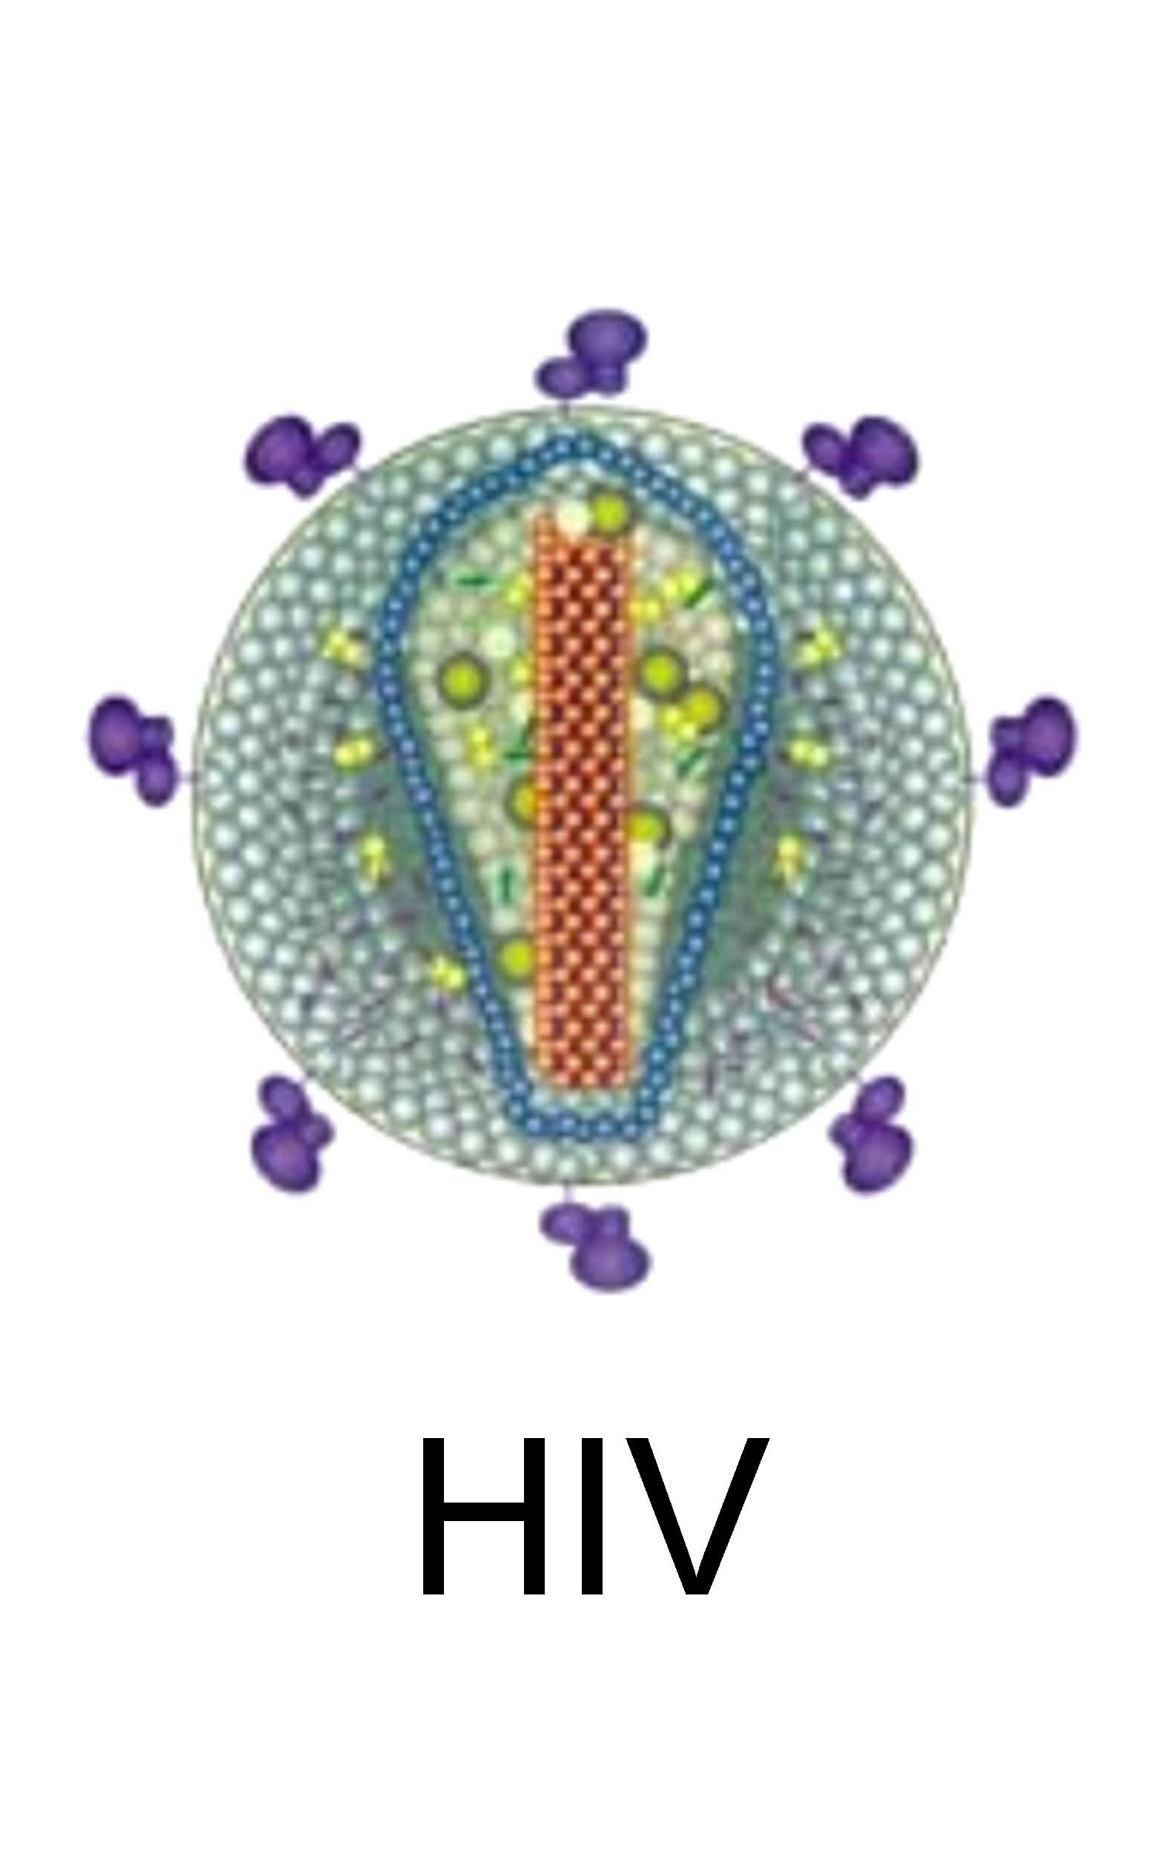

Slide 21
Clinical features
Manifestations depend on the state of
immunesuppression
• Early stage CD4 > 200 /mm3
Typical reactivation TB involving upper
lobes with focal infiltrates and cavitations
• Advance stage CD4 < 200/mm3
Atypical disease with varied manifestations
including extrapulmonary /disseminated TB

Slide 22
Atypical manifestations
• Diffuse pulmonary involvement, often LL
• Absence of cavity formation
• Prominent hilar /mediastinal LNE
• Pleural effusions more common
• Serositis- pericardial /peritoneal
• Miliary tuberculosis
• CNS tuberculosis- tuberculoma ,meningitis
• Lymph node,BM,liver&spleen, testes
• Cutaneous /chest wall abscess

Slide 23
Atypical manifestations
• Sputum smears negative despite extensive
involvement
• Normal chest x rays & sputum positive for AFB –
endobronchial TB or mycobacteremia
• Mycobacteria may be isolated from blood,
marrow, urine & fluids
• Lymph node aspirate/Bx- poorly formed
granulomas , focal areas of necrosis teeming with
AFB

Slide 24
Extrapulmonary tuberculosis
EPTB with HIV negative 15%
• Found in 20-50% with HIV infection
• Gen lymphadenopathy,
hepatosplenomegaly,anemia, leucopenia,
elevated liver enzymes, miliary infiltrates
• Kidney and genitourinary involvement
common
• More likely to have disseminated disease
concurrent pulmonary, abdominal and
Lymph nodal disease

Slide 25
EPTB
Mycobacteremia - positive blood cultures in
56%
• Cultures of urine,stool positive in 40-70%
• Sputum culture yield diagnosis in 90%
though smear shows AFB in 40%
• Tuberculin anergy ~75%
• EPTB has inverse relation with CD4 counts

Slide 26
Unusual manifestations
Massive abdominal lymphadenopathy
• Hemophagocytosis syndrome
• Broncho-esophageal fistulae
• Multiple visceral / brain abscesses
• Cutaneous , soft tissue abscess
• Osteomyelitis
• Sepsis with septic shock

Slide 27
Mortality
EPTB associated with shorter survival
• pulmonary - 30.4 months
• extrapulm - 15.6 months
• disseminated TB - 8.4 months
• factors associated with mortality were
lymphopenia, mycobacteremia ,peripheral
lymphadenopathy, anemia, tuberculin
anergy

Slide 28
Differential diagnosis of PTB
Pneumococcal pneumonia
• Typhoid septicemia
• Fungal pneumonia
• Pneumocystis carinii pneumonia
• lymphocytic interstitial pneumonia
• Kaposi’s sarcoma
• Lymphoma

Slide 29
Clinical features: TB with HIV
Clinical feature | HIV negative | Early HIV | Advanced HIV/AIDS
Tuberculin Reactivity >10mm | 75-85% | 40-70% | 10-30%
Chest X Ray | 50-70% typical(UL fibronodular lesions) 50% cavities | Mixed typical and atypical | Increased adenopathy effusions,L Zone inv miliary infiltrates Reduced Cavitation
Sites Involved | Pulmonary 80% Intermediate Extra pulmonary 16% Both 4% | Intermediate | Pulmonary 20-30% Extrapulm 20-50% Both 30-70%
Sputum smear positivity | 70-80% | ~50% | 30-40%

Slide 30
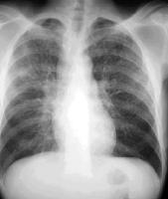

Slide 31
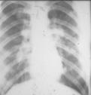

Slide 32
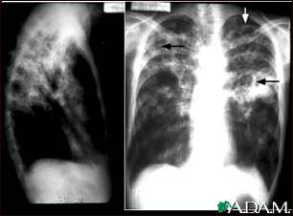

Slide 33
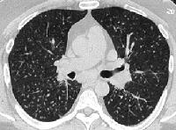

Slide 34
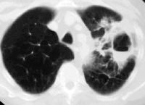

Slide 35
Definition: IRIS
Occurrence or worsening of clinical and/or laboratory parameters despite a ‘favorable’ development of HIV surrogate markers
  Can be to an infective agent
  Non-infective

Slide 36
Why TB IRIS is most common
TB prevalence high in HIV + (WHO TB report 2009)
In RLS, significant proportion of patients initiating have TB (AIDS 2006;20:1605)
  Proportion with atypical presentations and missed diagnosis high
Inflammatory response against TB, a Th1response

Slide 37
Immunopathogenesis
Development requires
  Advanced HIV with severe immune damage
  Presence of inciting antigens
  Loss of normal homeostatic control of immune responses
  Overexuberant inflammatory response
    Proinflammatory cytokines
    Th1 response: mycobacterial and fungal
    CD8 response: viral
  Protective pathogen specific immune response

Slide 38
Paradoxical TB IRIS
Frequency 8-43% (Int J TB and lung disease 2007;11:1282)
Expansion of PPD specific T cells and increased pro-inflam cytokines (AIDS 2006;20;F1-7)
Risk factors (Lancet Inf Dis 2008;8:516)
  Advanced HIV disease with low CD4 count
  Disseminated and EPTB
  Shorter time of ART initiation
  Vigorous immunological/virological response

Slide 39
Paradoxical TB IRIS: Case definition
Antecedent requirements
  Standard diagnosis of TB
  Initial response to ATT

Slide 40
Paradoxical TB IRIS: Case definition
Clinical criteria (within 3 months of ART)
  One major or 2 minor
  Major
    New, enlarging nodes, focal TB
    New, worsening radiological features
    New, worsening CNS TB
    New or worsening serositis
  Minor
    New, worsening constitutional symptoms
    New, worsening respiratory symptoms
    New, worsening abdominal pain with L+S+, nodes

Slide 41
Paradoxical TB IRIS: Case definition
Alternative explanations excluded
  TB drug resistance
  Poor adherence to ATT
  Another OI or neoplasm
  Drug toxicity

Slide 42
ART associated TB: Case definition
Patient not receiving ATT when ART initiated
Active TB diagnosed after ART initiation
Standard diagnosis of TB (e.g. WHO criteria)

Slide 43
Unmasking TB IRIS: Case definition
Not receiving ATT at ART initiation, presenting with active Tb within 3 months
AND ONE OF THESE
Marked inflammatory presentation e.g. high fever, hot abscesses, ARDS, SIRS
Once on ATT, paradoxical worsening

Slide 44
Diagnosis
Radiology:
  Less likely: upper zone infiltrates, sometimes normal
  USG/CT of chest/Abdomen, CT/MRI brain
CMI response
  For LTBI
  Tuberculin test
  IGRA assays: QuantiFERON-TB Gold, T Spot-TB (AIDS 2008;22:2471)
Serology (TB ELISA): limited role

Slide 45
Diagnosis
Sputum AFB:
  lower yield as HIV –ve (Lancet Infect Dis 2003;3:288)
  Fluorescence microscopy, alternative specimen processing
  BAL/TBLB better yield
NAAT:
  Amplicor MTB PCR, Gen-Probe MTD, SDA (BD)
  Useful in smear +ve
  Poor PPV for smear – ve specimens: ? Urine (IUATLD conf 2005)
  Validated only for sputum, not for other specimens
  DST: Genotype MTBDR, INNO-LiPA.Rif TB
Culture:
  LJ medium, BACTEC, MGIT, MODS
  11% Asymptomatic patients with sputum culture +ve (Clin Infect Dis 2005;40)
  Blood culture

Slide 46
HIV-TB treatment
What ATT regimen should be used?
  RMP/RBT based
Should we add EMB in maintenance phase?
  Yes, incidence of primary INH resistance is high
What is the duration of ATT?
  6 months except for CNS TB, non use of RMP/PZA
Is intermittent treatment ok?
  No, daily treatment throughout the course

Slide 47
When is ART indicated in HIV-TB?
  All patients irrespective of CD4 counts
  Improves morbidity and mortality
  Reduces recurrences of TB (AIDS 2009;4:325-333)
  More rapid smear and culture conversion (Am J Respir Crit

Slide 48
When to initiate ART in active TB?
Simultaneously with ATT
After completion of ATT
After completion of induction phase
At the end of 2 weeks of initiating ATT

Slide 49
Treatment
Recommendations
• CDC/ATS recommendation: 6 months ATT
with drug sensitive TB & prolongation to
9 months if slow clinical /micro response
• Factors assoc with poor outcome –advanced
immune suppression, noncompliance,
delayed clinical/ microbiological response
physician should prolong duration of ATT

Slide 50
TREATMENT
The best ATT option
2HRZE + 4HRE
2HRZE + 7HRE
2H3R3Z3E3 + 4H3R3
2HRZE + 4H3R3

Slide 51
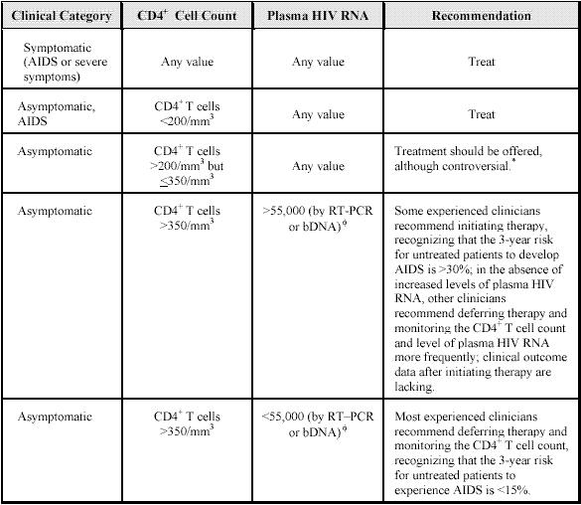

Slide 52
ART drug Classes
Nucleoside reverse transcriptase
inhibitors(NRTI)
• Non nucleoside reverse transcriptase
inhibitors(NNRTI)
• Protease inhibitors(PI)
• Fusion inhibitors

Slide 53
NRTIs
Zidovudine
• Lamivudine
• Stavudine
• Zalcitabine
• Didanosine
• Abacavir
• Tenofovir
• Emtricitabine

Slide 54
Protease Inhibitors
• Indinavir
• Ritonavir
• Nelfinavir
• Saquinavir
• Amprenavir
• Lopinavir
• Atazanavir

Slide 55
NNRTIs
• Nevirapine
• Delavirdine
• Efavirenz
FUSION INHIBITORS
• Enfuviritide

Slide 56
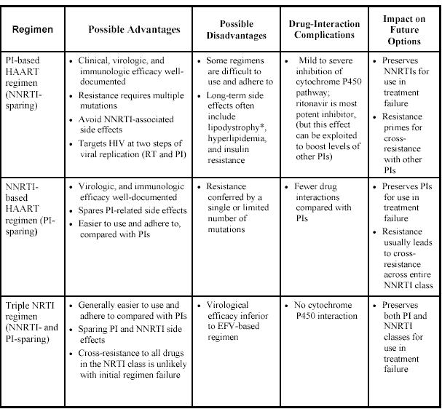
ART REGIMEN

Slide 57
Combinations never used
AZT+ Stavudine - antagonistic
• Ddi+ Stavudine
• Stavudine+Zalcitabine
• Zalcitabine+ Ddi additive toxicity
• Atazanavit+Indinavir
• Emtricitabine +lamivudine ~ resistance profile
• Efavirenz based regime in pregnancy

Slide 58
Drug interactions
Cytochrome P450 inducer | Cytochrome P450 inhibitor | Mixed inducer/inhibit
Rifampicin(+++) | Ritonavir | Delavirdine(-)
Rifapentine(++) | Indinavir | Nevirapine(+)
Rifabutin(+) | Nelfinavir | Efavirenz(both)
 | Amprenavir

Slide 59
Drug interactions
Use of Rifampicin with PI / NNRTI based
ART is contraindicated.
• NRTI are not metabolized by hepatic
cytochrome P 450 enzyme system hence
they can safely be used with Rifampicin
based ATT
• Other first line ATT (SHEZ) no interactions
with ART and can be used safely : SHEZ x
2 months followed by SHZx7months

Slide 60
Drug interactions
• Rifabutin :less potent inducer and can be
used in place of Rifampicin in ATT with PI
NNTRI based ART ( equivalent bactericidal
action, clinical cure rates )
• Ritonavir retards Rifabutin metabolism
(levels 35 fold) toxic reactions –uveitis,
neutropenia , arthralgia occur . combination
is contraindicated

Slide 61
Which ART is most preferred when using with rifampicin?
Stavudine/lamivudine/nevirapine
Zidovudine/lamivudine/nevirapine
Zidovudine/lamivudine/efavirenz
Tenofovir/Emtrictabine/efavirenz

Slide 62
IRIS: Management
Steroids
  Dose and duration variable: 1-2 mg/kg/day
  Some relapse and may need months of treatment
  Caution: use after alternative diagnosis excluded
  Paradoxical TB IRIS: steroids reduce morbidity (CROI 2009)
  Risks:
    Immune suppression: increased susceptibility/reactivation of infections
    A/E: hypertension, hyperglycemia, bone

Slide 63
IRIS: Management
NSAIDS:
  for milder
  Renal injury: background nephropathy, TDF etc
Discontinuing ART
  Considered when steroids fail esp CNS IRIS
  May develop new OIs
  Risk of ARV resistance
  Recur after ART re-initiation

Slide 64
IRIS: Management
Surgical
  Aspiration/drain abscess etc.
  CSF drainage in TBM: shunts
  Bowel perforations, spinal TB
Other immunomodulators
  Thalidomide: enlarging tuberculoma IRIS
  Pentoxyphylline
  IL-2 and GM-CSF
  Hydroxychloroquine
  Leukotrine antagonists: monteleukast, cyp4503A4 interaction
  TNF-alpha inhibitors: infliximab ?
No difference in long term outcomes

Slide 65
Chemoprophylaxis
Latent infection in HIV patients detected by
TST >5mm must be treated to prevent
disease and spread in community.
• INH daily x 9 months
• Rifabutin+ PZI daily x 2 months(On ART)
• Rifampicin +PZI daily x 2months(No ART)
• Rifampicin daily x 9 months

Slide 66
Chemoprophylaxis
Rifampicin regime- INH resistant strain,
intolerance, poor compliance
• In India ,INH resistance is significant the use of
combination drugs is advised
• For HIV positive contacts of MDR TB
– PZI + Flouroquinolone daily x 12 months
– PZI + Ethambutol daily x months
WHO does not recommend CP in region where
prevalence is high

Slide 67
Chemoprophylaxis
• Tuberculin anergic patients use of
chemoprophylaxis is not proven to be
effective
• Not recommended except when working in
areas of high transmission of TB ie hospital,
jails
• Use if tuberculin negative person becomes
reactive after antiretroviral drug therapy

Slide 68
Role of BCG
Contraindicated with persons with advanced
HIV disease/AIDS because of risk of
“disseminated BCGiosis”
• But in countries where risk of TB is high,
WHO recommends BCG should be given as
soon after birth.
• Disseminated BCGiosis treated with
INH+Rifampicin

Slide 69
Conclusions
Screen all cases of TB for HIV infection
• Initiate ATT preferably with DOT
• Consider optimal antiretroviral therapy
• Understand drug interactions of Rifamycins
with PI/NNRTI based ART
• Observe for paradoxical reactions
• Identify drug resistant tuberculosis

Slide 70
THANK YOU

