Slide 1
Manual Therapy and Postural Drainage

Slide 2
Objectives
Understand the meaning of postural drainage.
Understand the techniques used in manual therapy (percussion, vibrations and shaking).
Identify the indications and contraindications for postural drainage and manual therapies.
Demonstrate above therapeutic techniques to aid secretion drainage.

Slide 3
Definitions
Postural drainage is a technique in which different positions are assumed to facilitate the drainage of secretions from the bronchial airways.
Gravity helps to move the secretions to the trachea to be coughed up easily.
The goal of postural drainage and manual therapy is to help drain mucus from each of these lobes into the larger airways of the lungs so it can be coughed up more readily.

Slide 4
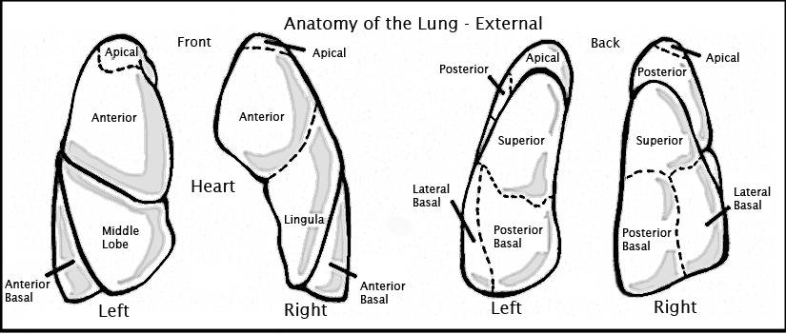
Anatomy of Lung

Slide 5
Anatomy of the Lungs
The lungs consist of 5 lobes -- 3 on the right and 2 on the left side of the chest cavity, each of which are further divided into segments. To be most effective, postural drainage should be accompanied by chest physiotherapy, which includes percussion and vibration, deep breathing and coughing.
Once a patient assumes the correct postural drainage position, the caregiver performs chest percussion and vibration to the desired area.
Chest physiotherapy is generally performed for 3 to 5 minutes on each segment. During this time, the patient is encouraged to take a slow, deep breath followed by a vigorous cough in an attempt to clear the airways of mucus. This technique should be repeated several times during the chest physiotherapy session.

Slide 6
Percussion
Chest percussion, also referred to as chest physiotherapy, is an airway clearance technique that involves clapping on the chest and/or back to help loosen thick secretions. Doing this makes mucus easier to expel, or cough up. Chest percussion is often coupled with postural drainage and vibration and can be performed using either cupped hands or a mechanical airway clearance device.

Slide 7
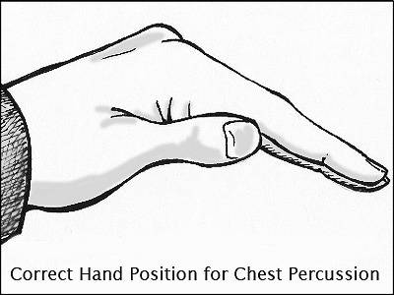
Chest Percussion

Slide 8
Vibration
Vibration is an airway clearance technique that, coupled with chest percussion, is applied during postural drainage to help clear mucus from the airways. Vibration helps to gently shake mucus and secretions into the large airways, making them easier to cough up. During vibration, place your flat hand firmly against the chest wall, atop the appropriate lung segment to be drained. Stiffen your arm and shoulder, apply light pressure and create a shaking movement, similar to that of a vibrator.
Ask service user to breathe in deeply during vibration therapy, and exhale slowly and completely. Taking a deep breath and then exhaling slowly and forcefully without straining will hopefully stimulate a productive cough.

Slide 9
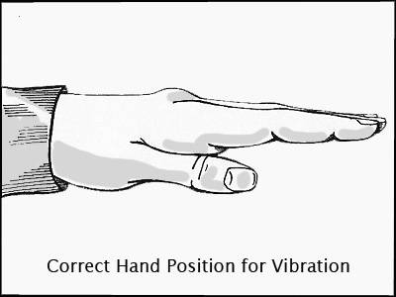
Vibration

Slide 10
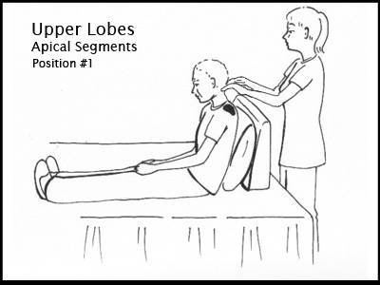
Upper lobes

Slide 11
Apical Segments
To drain mucus from the upper lobe apical segments, the service user sits in a comfortable position on a bed or flat surface and leans on a pillow against the headboard of the bed or the caregiver. The caregiver percusses and vibrates over the muscular area between the collar bone and very top of the shoulder blades (shaded areas of the diagram) on both sides for 3 to 5 minutes. Encourage the service user to take a deep breath and cough during percussion in order to help clear the airways. Do not percuss over bare skin.

Slide 12
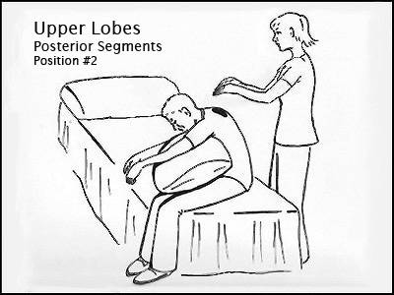
Upper Lobes

Slide 13
Posterior Segments
The service user sits comfortably in a chair or the side of the bed and leans over, arms dangling, against a pillow. The caregiver percusses and vibrates with both hands over upper back on both the right and left sides.

Slide 14
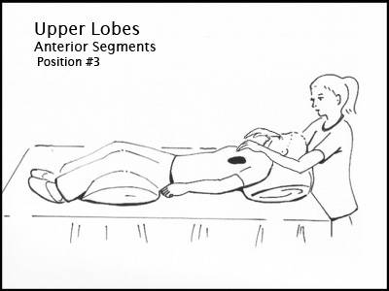
Upper Lobes

Slide 15
Upper lobes(anterior Segments)
The service user lies flat on the bed or table with a pillow for comfort under his or her head and legs. The caregiver percusses and vibrates the right and left sides of the front of the chest, between the collar bone and nipple.

Slide 16
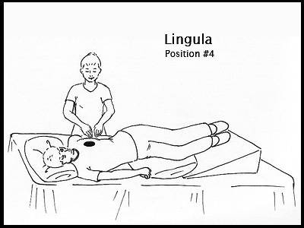
Lingula

Slide 17
Lingula
The service user lies with the head down toward the foot of the bed on the right side, hips and legs up on pillows. The body should be rotated about a quarter-turn towards the back. A pillow can also be placed behind the service user and their legs slightly bent with another pillow between the knees. The caregiver percusses and vibrates just outside the nipple area.

Slide 18
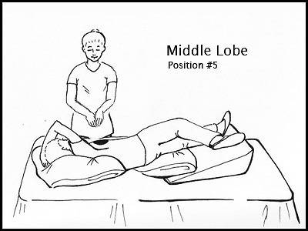
Middle Lobe

Slide 19
Middle lobe
The service user lies head-down on his left side, a quarter-turn toward the back with the right arm up and out of the way. The legs and hips should be elevated as high as possible. A pillow may be placed in back of the service user and between slightly bent legs. The caregiver percusses and vibrates just outside the right nipple area.

Slide 20
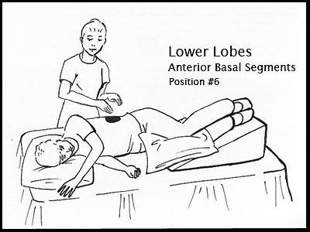
Lower Lobes

Slide 21
Lower lobes(anterior basal segments)
The service user lies on his right side with his head facing the foot of the bed and a pillow behind his back. The hips and legs should be elevated as high as possible on pillows. The knees should be slightly bent and a pillow should be placed between them for comfort. The caregiver percusses and vibrates over the lower ribs on the left side, as shown in the shaded part of the diagram. This should then be repeated on the opposite side, with percussion and vibration over the lower ribs on the right side of the chest.

Slide 22
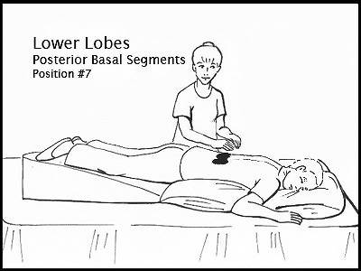
Lower lobes

Slide 23
Lower lobes(posterior basal segment)
The service user lies on his or her stomach, with the hips and legs elevated by pillows. The caregiver percusses and vibrates at the lower part of the back, over the left and right sides of the spine, careful to avoid the spine and lower ribs.

Slide 24
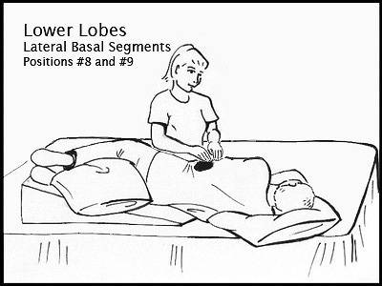
Lower lobes

Slide 25
Lower lobes(lateral basal segments)
The service user lies on his right side, leaning forward about one-quarter of a turn with hips and legs elevated on pillows. The top leg may be flexed over a pillow for support and comfort. The caregiver percusses and vibrates over the uppermost portion of the lower part of the left ribs, as shown in the shaded area. This should then be repeated on the opposite side, with percussion and vibration over the uppermost portion of the right side of the lower ribs.

Slide 26
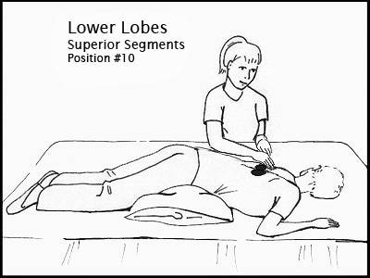
Lower Lobes

Slide 27
Lower lobes(superior segments)
For this position, the service user lies on his stomach on a flat bed or table. Two pillows should be placed under the hips. The caregiver percusses and vibrates over the bottom part of the shoulder blades, on both the right and left sides of the spine, avoiding direct percussion or vibration over the spine itself.

Slide 28
Indications and Contraindication
Indications
Chest infection
Cystic Fibrosis
Contraindication
Bruises on skin

Slide 29
References
Deborah Leader, RN,About.comGuideUpdated February 06, 2010.
Pediatr Pulmonol.2010; 45:291-300.
Encyclopedia and Dictiionary of Medicine, Nursing and Allied Health.(7th Edition).2003.

