Slide 1
BRONCHO HYGIENIC THERAPY
KISHORE JEBASINGH
MPT(Cardio-Respiratory), MSW, PGDHM

Slide 2
Bronchial Hygiene Therapy involves the use of noninvasive airway clearance techniques designed to help mobilize and remove secretions and improve gas exchange.

Slide 3
Bronchial Hygiene Therapy
accepted as part of the care of critically ill patients, largely due to risks of ETT obstruction.
Short term, aim to remove obstructive secretions from the airways thereby
  reducing work of breathing;
  improving delivery of mechanical ventilation;
  improving gaseous exchange;
  preventing and resolving respiratory complications;
  facilitating early weaning from the ventilator
    Main et al, 2004; Ntoumenopoulos et al, 2002; Wallis and Prasad, 1999; Ciesla, 1996.
Longer term, aim to
  Prevent postural deformities
  Improve exercise tolerance
  Return to optimal function

Slide 4
Indications for Bronchial Hygiene Therapy
“indications or contraindications for or against Bronchial Hygiene Therapy should never be formulated on the basis of diagnostic entities but should rather stem from a detailed analysis of the prevailing individual pathophysiology.”
  Oberwaldner (2000) Eur Respir J

Slide 5
Indications
Components for a patient to receive bronchial hygiene regimes are
  Excessive sputum production.
  Most authors state that more than
  25-30 ml/day ( 1/4 cup or 12 teaspoons) is excessive.
  Examples of common pathologies include:
  *cystic fibrosis
  *bronchitis
  *and bronchiectasis.

Slide 6
The second component required for bronchial hygiene therapy is an ineffective cough.
Examples of causes for an ineffective cough are
weakness,
pain, and
placement of an artificial airway.

Slide 7
PROPHYLACTIC
- Pre-operative high risk surgical patient
- Post-operative patient who is unable to
mobilize secretions
- Neurological patient who is unable to cough
effectively
- Patient receiving mechanical ventilation who has a
tendency to retain secretions
- Patients with pulmonary disease,
who needs to improve bronchial hygiene

Slide 8
THERAPEUTIC
- Atelectasis due to secretions
- Retained secretions
- abnormal breathing pattern due to primary or
secondary pulmonary dysfunction
- COPD and resultant decreased exercise
tolerance
- Musculoskeletal deformity that makes breathing
pattern and cough ineffective

Slide 9
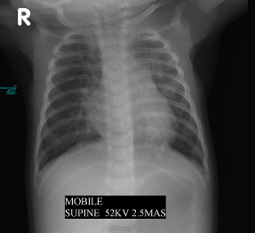
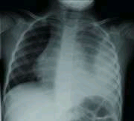
Minimal to no benefit
  Acute asthma
    Asher et al, Pediatr pulmonol 1990
  Bronchiolitis
    Webb et al (1985) Arch Dis Child
    Nicholas et al (1999) Physiotherapy
    Cochrane Systematic Review (Perrotta et al 2005)
  Respiratory failure without atelectasis
  Prevention of post-extubation atelectasis in neonates
  Hyaline membrane disease
    Schechter (2007) Resp Care
  Prevention of atelectasis following surgery
    Reines et al, 1982
  Undrained pleural collections

Slide 10
Contraindications
Specific contraindications for bronchial hygiene therapy are:
elevated intracranial pressure
acute, unstable head, neck or spine injury
increased risk of aspiration
cardiac instability
Other medical conditions that would be of concern when considering bronchial hygiene therapy are:
pulmonary embolism and pulmonary edema associated with congestive heart failure.

Slide 11
Precautions
Untreated tension pneumothorax
Abnormal coagulation profile
Status epileptics or status asthmatics
Immediately following intra cranial surgery
Head injury with raised ICP
Osteoporotic bones
Recent acute myocardial infarction, unstable vitals
Immediately after tube feedings
Sutures and ICD’s

Slide 12
Complications
hypoxia
increased metabolic demand and O₂ consumption
cardiac arrythmias
changes in blood pressure
raised intracranial pressure and decreased cerebral oxygenation
gastro-oesophageal reflux
pneumothoraces
atelectasis and
death.
    Chalumeau et al, 2002; Krause and Hoehn, 2000; Wallis and Prasad, 1999; Harding et al, 1998; Button et al, 1997; Cross et al, 1992; Reines et al, 1982.

Slide 13
Goals
Prevent accumulation of secretions
Improve mobilization and drainage of secretions
Promote relaxation to improve breathing patterns
Promote improved respiratory function
Improve cardio-pulmonary exercise tolerance
Teach bronchial hygiene programs to patients with chronic respiratory dysfunction

Slide 14
Traditional Forms Of Bronchopulmonary Hygiene Therapy
The three traditional methods of BHT are:
Directed cough
Postural drainage
External manipulation of the thorax.

Slide 15
Techniques
Positioning
Chest tapotement techniques
Manual hyperinflation
Airway suctioning
Coughing techniques
Breathing exercises
Neuro physiological facilitation
Controlled mobilization
Patient education

Slide 16
Positioning
POSITIONING is the use of body position as a specific treatment technique
(it has a marked influence on gas exchange because of the unevenly damaged lungs- Tobin et al, 1994)

Slide 17
Physiological effects of Positioning
Optimizes oxygen transport by improving V/Q mismatch
Increases lung volumes
Reduces the work of breathing
Minimizes the work of heart
Enhances mucociliary clearance (postural drainage)

Slide 18
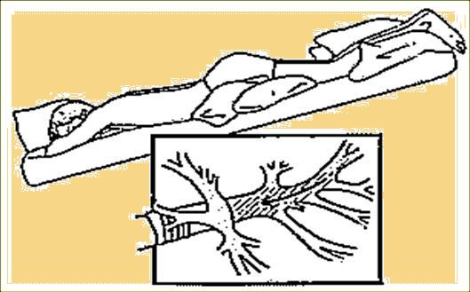

Slide 19
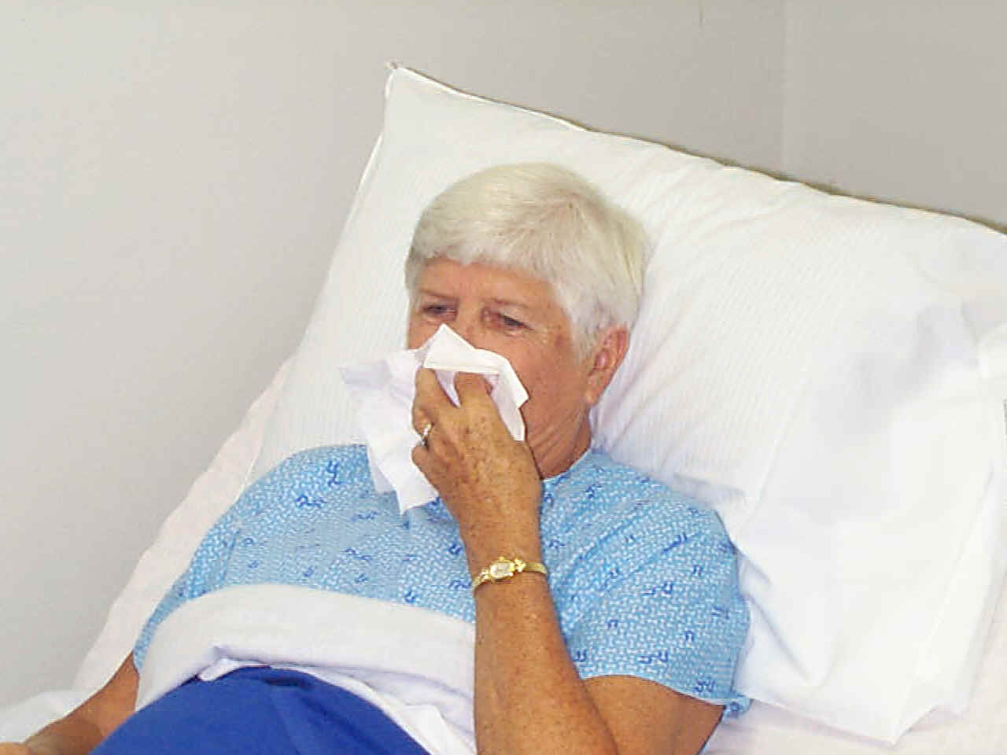
Directed Cough is one of the simplest techniques to employ when the patient's own spontaneous cough is not adequate in clearing secretions.

Slide 20
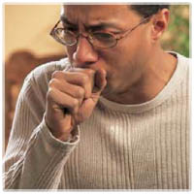
Coughing Techniques
Coughing: It is a forced expiratory technique performed with a closed glottis.
Huffing: It is a forced expiratory technique performed with a open glottis.
Sniffing: Its an respiratory maneuver performed after a full inspiration or expiration.

Slide 21
Effects of Coughing
Cough removes secretions from the larger airways
Huff mobilizes the secretions from the distal airways.
Sniff augments collateral ventilation thereby preventing distal airway collapse.
Notes:
During a huff the pleural pressure becomes positive and equals the alveolar pressure and so it opens up the distal collapsed airway.

Slide 22
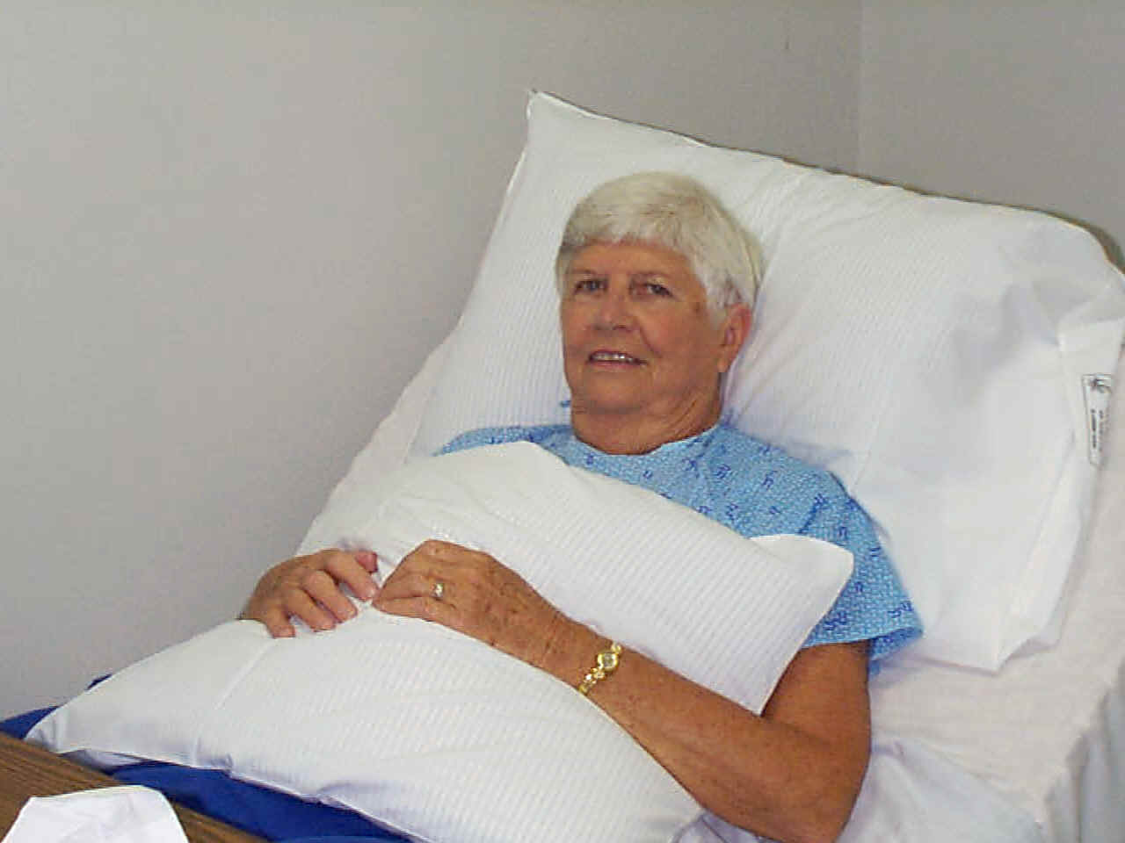
Limitations:
Patients who are uncooperative , or comatose
Patients with an artificial airway, effective closure of the glottis is not possible
Extremely thick, tenacious secretion may require other modes of therapy
If the patient has
incisional pain,
Splinting with a
pillow or towel
may be beneficial.

Slide 23



Breathing Exercises
Breathing exercise is a technique which concentrates on ventilation to specific areas of lungs.

Slide 24
External Manipulation of the Thorax
Commonly known as percussion and vibration.
The patient is placed in the appropriate position.
The therapist then either manually "claps" over the affected areas for 3 to 5 minutes.
The force applied with the clapping or percussor varies greatly primarily due to the patient's tolerance.

Slide 25
Clapping/Chest Percussion
Percussion consists of rhythmic clapping on the chest with loose wrist & cupped hand.
Effect : Dislodges & loosens secretions from the lung

Slide 26
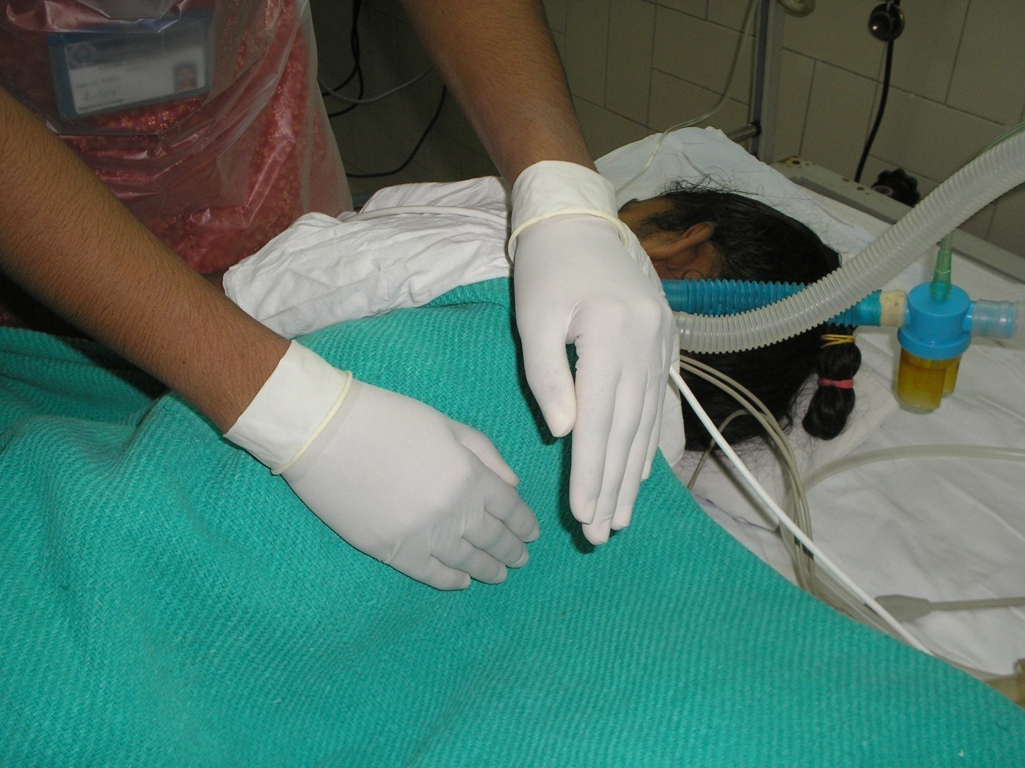

Slide 27
Chest Vibration
Vibrations consists of a fine oscillation of the hands directed inwards against the chest, performed on exhalation after deep inhalation.
Effects: Helpful in moving loosened mucous plugs towards larger airway

Slide 28
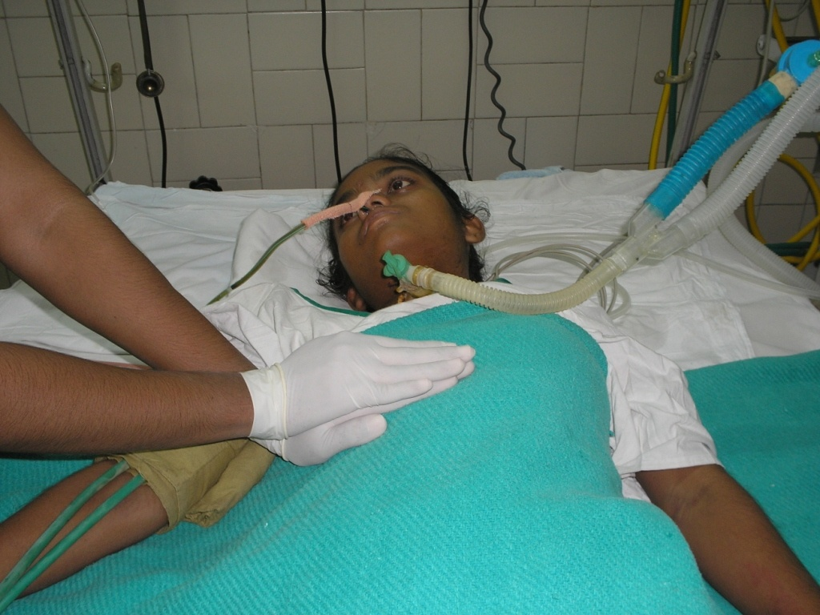

Slide 29
Rib Springing/Shaking
Shaking is a coarser movement in which the chest wall is rhythmically compressed.
Effects : Direct secretions towards larger airways & Stimulates cough.

Slide 30
Manual Hyperinflation
Was originally defined as inflating the lungs with oxygen and manual compression to a tidal volume of 1 liter requiring a peak inspiratory pressure of between 20 and 40 cm H2O (Med j Aust, 1972).

Slide 31
Advantages of MH
Reverses atelectasis (Lumb 2000)
Improves oxygen saturation and lung compliance (Patman et al.,1999)
Improves sputum clearance (Hodgson et al., 2000)

Slide 32
Disadvantages of MH
Haemodynamic and metabolic upset (Stone, 1991 & Singer et al.,1994)
Risk of barotrauma
Discomfort and anxiety

Slide 33
Suctioning
Suctioning is the mechanical aspiration of pulmonary secretions from a patient with an artificial airway in place.

Slide 34
criteria for suctioning:
Position client in fowlers for those with intact gag reflex.
Side lying for unconscious to prevent aspiration.
Set the pressure

Slide 35
Apply suction for 5 to 10 seconds
  - maximum of 15 seconds
Over suctioning can cause hypoxia and vagal stimulation.
Hyperventilate
Allow 20 to 30 second interval.

Slide 36
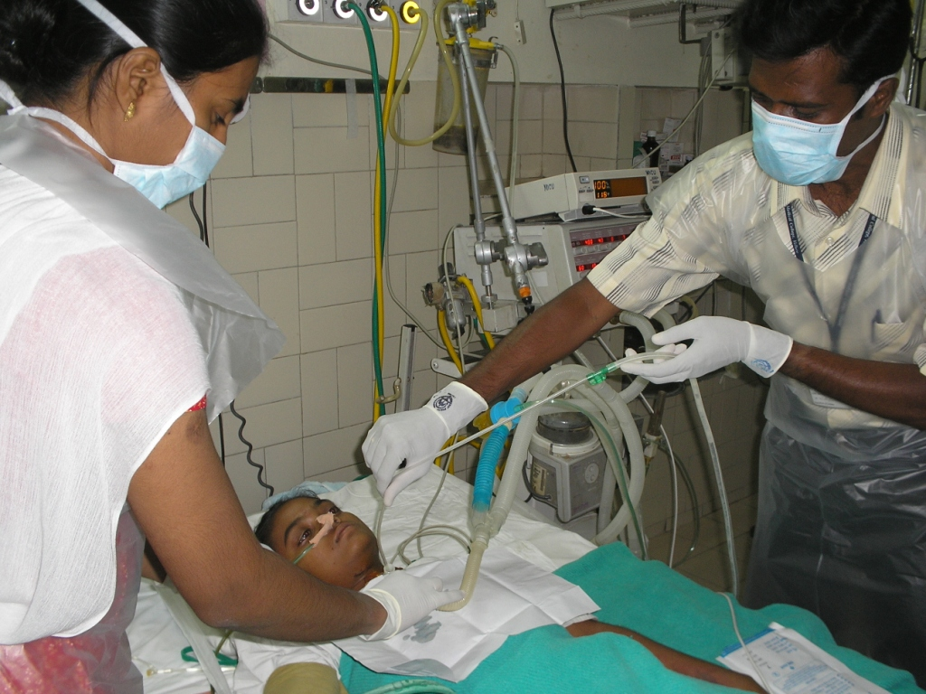

Slide 37
Positive Airway Pressure Adjuncts
Positive airway pressure (PAP) adjuncts are used to mobilize secretions and treat atelectasis.
Types of PAP Adjuncts
  Continuous positive airway pressure (CPAP)
  Expiratory positive airway pressure (EPAP)
  Positive expiratory pressure (PEP)

Slide 38
Indications of PAP Adjuncts
  To reduce air trapping in asthma and COPD
  To aid in mobilization of retained secretions (in cystic fibrosis and chronic bronchitis)
  To prevent or reverse atelectasis
  To optimize delivery of bronchodilators in patients receiving bronchial hygiene therapy

Slide 39
High Frequency Chest Wall Compression (HFCC)
It is a method to deliver high frequency vibration over the chest wall to cause transient increases in airflow and improve mucus movement.

Slide 40
High Frequency Chest Wall Oscillation (HFCWO)
It is a two-part system: the first, a variable air-pulse generator, and the second, an unstretchable, inflatable vest that covers the patient
creating an oscillatory motion against the patient’s thorax.
HFCWO increases airflow velocity, which creates repetitive cough-like shear forces and decreases the viscosity of secretions.
Therapy is usually performed in 30-minute sessions at varying oscillatory frequencies ( 5–25 Hz ). Depending on need,
one to six therapy sessions may occur per day.

Slide 41
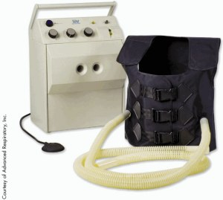
High Frequency Chest Wall Oscillation (HFCWO)

Slide 42

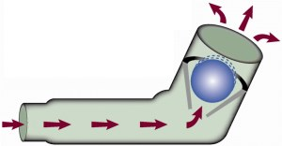
Flutter Valve Therapy
The Flutter Valve combines the technique of PEP with high frequency oscillations at the airway opening.

Slide 43
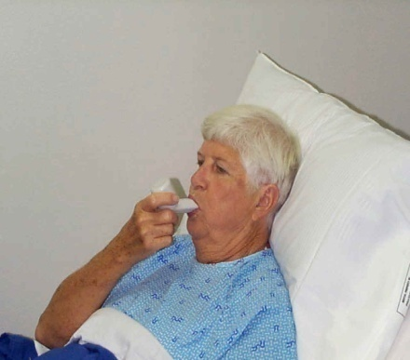
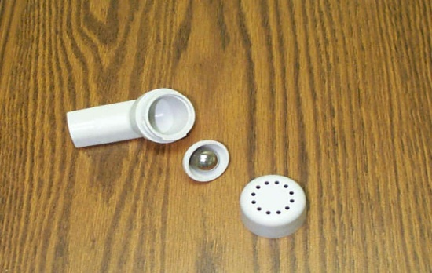
The effect is threefold:
First, to vibrate the airways and thus, facilitate movement of mucus;
Second, to increase endobronchial pressure to avoid air trapping and
Third, to accelerate expiratory airflow to facilitate the upward movement of mucus

Slide 44
Neuro Physiological Facilitation (NPF)
promoting or hastening the response of neuro muscular mechanism through proprioceptors (dorothy voss et al, 1985).
Cutaneous and proprioceptive stimulation reflexly increases the depth of breathing (Jones, 1998).
INDICATIONS:
Non alert patients such as those who are drowsy postoperatively.
Those with neurological conditions.
Partially breathing patient on ventilator, especially if they are unable to turn.

Slide 45
Techniques of NPF
Stimulation of diaphragm
(Dorothy voss et al, 1985).
Perioral technique
Intercostal stretch
Co- contraction of abdominal muscles
Vertebral pressure
        (D.D .Bethune, 1975)

Slide 46
Mobilization and Exercise
Immobility is a major factor contributing to retention of secretions
Early mobilization and frequent position changes are preventive interventions for atelectasis.
Exercise also improves overall aeration and ventilation perfusion matching.
Exercise can improve a patients general fitness, self esteem and quality of life.

Slide 47
Thank You

