Slide 1
Types of hypoxia and management
Dr. Gaurav Dhakate
University College of Medical Sciences & GTB Hospital, Delhi

Slide 2
Hypoxia
Lack of o₂ availability in tissues
Hypoxemia
Relative deficiency of o₂ in blood
Dysoxia
Lack of o₂ utilization by tissues
Arterial Po₂ <80 mmhg

Slide 3
Acceptable arterial o₂ tensions at sea level(breathing 21% o₂ )/room air
Adult and child
Normal
Acceptable range
Hypoxemia mild
moderate
Severe
Pao_{2(mmHg)}
97
>80
60
50
40
Sao₂(%)
97
>95
90
80
70

Slide 4
In new born
40- 70 mm Hg (median value) of Pao₂ is taken as normal

Slide 5
types
1.
Hypoxic hypoxia/hypoxemic hypoxia
2.
Anaemic hypoxia:- Anaemia &Dyshaemoglobinemia
3.
Stagnant hypoxia
4.
Histotoxic hypoxia

Slide 6
Low p 50
As mentioned in Egan’s as the 5th type of hypoxia.

Slide 7
Consequences and implications
Mild to moderate hypoxaemia is common in the postoperative period & is often underestimated
The focus of this review is to provide an understanding of the reasons why post-operative oxygen therapy is necessary, with emphasis on the practicalities of delivering oxygen to the patient.

Slide 8
Mild to mod. hypoxemia
Due to wide variability of patho physiology
Post- op morbidity

Slide 9
Extreme hypoxemia
Severe/permanent brain injury
Cardiac arrest
CPR

Slide 10
Surgical consequences
Resistance to infection,wound healing,anastomotic integrity
Loss of GI mucosal integrity
Bacterial translocation and sepsis

Slide 11
Rosenberg et al (1999)
Supplement o₂ for 1-4 days post- op
HR/PONV

Slide 12
Predisposed groups
Pt.s with heart ds.,(ischaemic and non ischaemic),
Extremes of age, pregnancy, obesity,
smokers,cardio resp. ds
Anaemias,
haemoglobinopathies,
head injury pts.

Slide 13
Consequences
Site of Sx,residual anaesthesia,lack of analgesia
Superimposed pulm.complications(atelectasis,
sputum retention,
pneumonia,
pulm. TE)
HYPOXEMIA

Slide 14
OXYGEN DELIVERY TO CELLS
Normal 1000 mls/minute (550 mls/min/m2) of oxygen is transported
Satisfactory delivery to tissues depends on a number of factors:
Adequate alveolar ventilation
Diffusion
macro and micro circulation

Slide 15
Alveolar ventilation
Inhalational agents
Post- op MI(3rd day)
opioids
Depress compensatory responses to hypoxia,hyper carbia, obstruction to airway
Depress central control of ventilation

Slide 16
ANAESTHETIC FACTORS
Gas exchange abnormalities in the post-operative period occur early or late.
Early post-operative hypoxaemia
alveolar hypoventilation (above),
Ventilation/perfusion mismatching,
Decreased cardiac output and
Increased oxygen consumption due to shivering (induced by volatile agents)
recovery from intra-operative hypothermia.
‘diffusion hypoxia’

Slide 17
The later onset
functional residual capacity (FRC)
patient’s inability to inspire deeply or cause the patient to be immobilised in bed.eg pain

Slide 18
FRC
On induction of anaesthesia
FRC
Atmospheric pleural pressure in gravity dep areas of lung
Small airway closure
Atelectasis, V/Q mismatch
hypoxemia
FRC
Obese, pregnant, elderly, infants, neonates

Slide 19
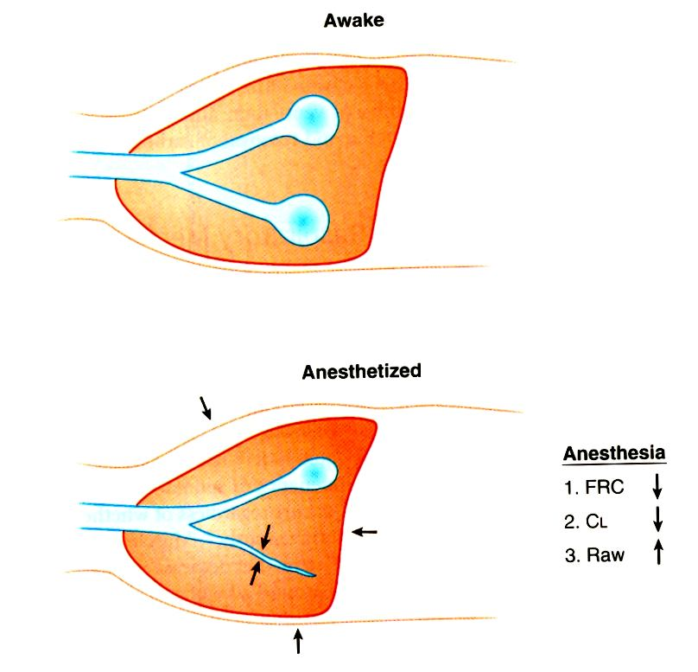

Slide 20
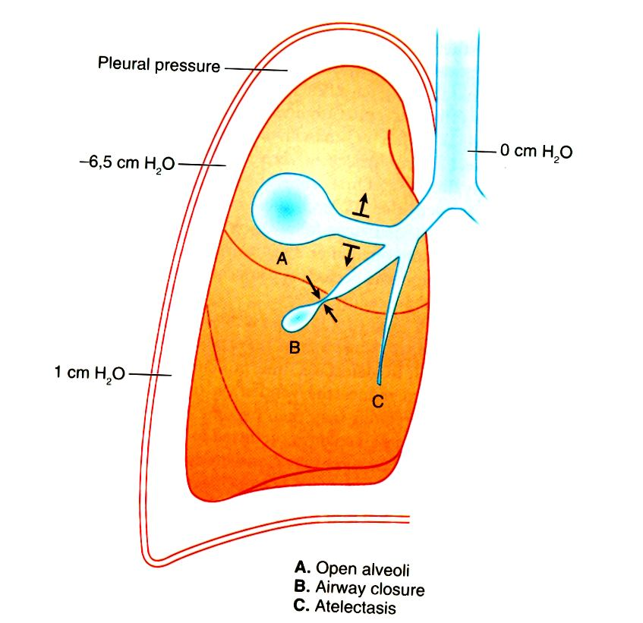

Slide 21
SURGICAL FACTORS
Site of surgery/type of incision
Lower abd,pelvic,lower limb
Influence on resp mechanics
Most marked at 24 hours,take 2 weeks to recover
Upper abdomen, thoracic

Slide 22
ADEQUATE CIRCULATION
.
Adequate post op fluid balance
.
Adequate CO
.
Adequate o2 carriage by tissue & cells

Slide 23
ADEQUATE CIRCULATION
Hypoxia
vasoconstriction
d/t hypovolemia,hypothermia , pain
Defective microcirculation/tissue perfusion

Slide 24
MONITORING & CLINICAL ASSESSMENT
altered mental status
disorientation and confusion to LOC and coma.
Dyspnoea/tachypnoea
Carotid chemoreceptors are stimulated when PaO2 levels fall below 50 mmHg
Cyanosis
Cardiac arrythmias
pre-existing cardiac dysfunction.
not readily detected in anaemic or in an environment with poor ambient lighting.

Slide 25
HOW MUCH AND FOR HOW LONG? BMJ 2000; 321: 864-5
no didactic rules as to which patients should receive a certain amount of oxygen. Oxygen therapy should always be monitored
period for which it is prescribed should take into account the surgery performed and the patient’s preexisting medical problems,
As a guideline, young, fit healthy patients having peripheral surgery should receive oxygen for about 30 minutes in recovery to allow resolution of the effects of diffusion hypoxia, and until they are awake and comfortable and protecting their airway. There is no need to administer high dose oxygen, 4 L/minute being adequate.

Slide 26
Cont.
A patient having major surgery should receive at least 72 hours of oxygen at concentrations of 28-60%.
In case of fit patients with no coexisting diseases, a pulse oximeter could be used to decide when to discontinue oxygen therapy. Oxygen saturations should exceed 90% on air before supplemental oxygen is withdrawn.
if the patient is at increased risk of the consequences of hypoxaemia, significant hypoventilation is a potential problem, then invasive arterial blood gases may give additional useful information to direct oxygen therapy.
A special mention must be made of patients who chronically retain carbon dioxide. These patients will often require advanced respiratory support in an intensive care unit environment post-operatively, particularly following major surgery,

Slide 27
I. HYPOXEMIC (DECREASED TISSUE OXYGEN TENSION)
I
A. HYPOXEMIC HYPOXIA (INADEQUATE ARTERIAL OXYGEN
  TENSION AND SATURATION)
CAUSES:
A. V/Q MISMATCH (EX: COPD, PE)
B. SHUNT (EX: ATELECTASIS, PULM. EDEMA)
C. HYPOVENTILATION (EX: DRUG INDUCED)

Slide 28
hypoxia
Increased AaDo2
DECREASED PaO2
Decreased mixed venous o2

Slide 29
PAo2 (is a result of dynamic equilibrium btw delivery and extraction)
Fio2(eg. Low fresh gas supply or rebreathing)
Pio2
PAo2
(alveoli)
BP(high altitude)
Minute ventilation(drug overdose)
O2 delivery

Slide 30
O2 extraction
Pulmonary capillary blood flow= CO
Mixed venous o2 content and Pvo2

Slide 31
AaDo2
Venous admixture
(true shunts) eg CHD, low V/Q ratio eg atelectasis
Diffusion defects
Thickening of alveolar capillary memb.eg ILD,ARDS
V/Q imbalance eg ageing ,COPD,pneumonia,lobar collapse

Slide 32
Mixed venous Po2 [Pvo2]
Pvo2 o2 extraction Pao2 hypoxia
demand
supply
More o2 consumption
inc. metabolic rate eg shivering ,convulsions ,fever
Low cardiac output eg hypovolemic shock
All this will lead to hypoxia
Less volume of blood presented to tissues per unit time so more o2 will be extracted by tissues

Slide 33
Management
FiO2
Barometric pressure
i.v. fluids
Blood trans.
Inotropes
Diuretics
Maintain MV
Optimize CO
Postural drain.
Chest physio
Humidification
Antibiotics
bronchodilators
Adjunctive
Improve lung cond.

Slide 34
Prob.= PAO2
Signs of resp. fatigue , circulatory collapse
Aim= PAO2
RR > 36/ min. | Signs of resp. fatigue, circulatory collapse
pO2 < 55 mmHg
pCO2 > 50 mmHg
Intubate+mech vent.(PEEP)
ECMO

Slide 35
V/Q mismatch
Diffusion capacity
Supplement O2
Spirometry
PEEP
Manual inflations
Prone posn.
CPAP by face mask
Lung recruitment measures
Removal of secreations
Control infection
Bronchodilator
Diuresis
Tracheal intubation
Adjunctive Th.

Slide 36
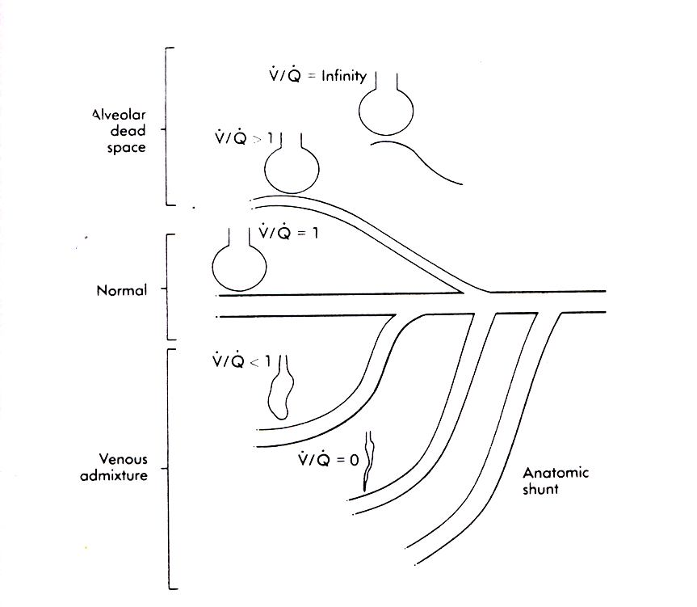
V/Q Relationship

Slide 37
B. ANEMIC HYPOXIA (DEFICIENT OXYGEN-CARRYING CAPACITY OF THE BLOOD)
      CAUSES:
      A. ANEMIA (DECREASED HEMOGLOBIN)
B. CARBON MONOXIDE POISONING
C. SULFHEMOGLOBIN AND METHEMOGLOBIN

Slide 38
At normal Hb conc. ,20 ml of o2 is carried by 1 dl(100 ml) of blood.
At tissue site,o2 consumption is same and perfusion is also same ,but due to decrease in o2 content,low Po2 in capillary adjacent to the tissues
Decrease pressure head for diffusion of o2 to tissues
Tissue hypoxia

Slide 39
CONTENT VS TENSION (PaO2)
A. CONTENT= TOTAL AMOUNT OF OXYGEN CARRIED IN BLOOD
NORMAL = 20.7 VOL% CALCULATION: CaO2 = [%sat x l.39 x hb] + [PaO2 x 0.003]
EXAMPLES/NORMAL
NORMAL Hb% = 15 GM%, 0.98 02 SAT = PaO2 = 100mmHg
[1.39 X 0.98 x 15] + [100 x 0.003] = 20.7 mg/dl
ANEMIA Hb%, %sat = 98%, PaO2 = 100mmHg
[1.39 x 0.98 x 10] + [100 x 0.003] = 14.2 mg/dl
HYPOXEMIA Hb% =15 gm%, %Sat=85%, PaO2=50mmHg
  [1.39 x 0.85 x 15] = [50 x 0.003] = 18.0mg/dl
    NORMAL MIXED VENOUS CONTENT = 15%
    ARTERIAL VENOUS DIFFERENCE (A-V) = 5 VOL%

Slide 40
Carboxyhaemoglobin
Causes:
Smoking.
Auto exhaust,fire
CO has 250 times more affinity for Hb than o2,
Part of Hb is unavailable for o2.
O2 dissociation curve shifts to left leading to hypoxia

Slide 41
carboxyHb
Symptoms | Level (%)
Headache, dizziness, occasional confusion | 15- 20%
Nausea,vomitting,disorientation | 20- 40%
Agitation,hallucination,coma,shock | 40 -60%
Death | > 60%

Slide 42
mangement
100%O2
TOC
Hyperbaric O2

Slide 43
Hyperbaric o₂
2 types:
monoplace ,
multi place
Decreases the half life of carboxyHb to 15- 30 mins.
Should be initiated within 6 hours.

Slide 44
Methemoglobin
Etiology
Acquired
Aniline dyes, paints
Nitrates, nitrites
Phenacetin, EMLA
Inherited
MOA: same as carboxyhb

Slide 45
methHb
Symptoms | Levels(%)
Asymptomatic | < 15%
Blood “chocolate brown”—cyanosis | 15 - 20%
Dizziness, dyspnea, fatigue, headache, lethargy, syncope | 20 – 45%
Depressed consciousness | 45 - 55%
Seizures ,coma , cardiac failure | 55 - 70%
High mortality | > 70%

Slide 46
Management
100 % o2
Methylene blue 1-2 mg/kg over 5 mins
Ascorbate! or hyperbaric O2

Slide 47
Sulfhaemoglobinemia
Etiology
Drugs
Phenacetin,acetanilid
Dapsone
Sulphur containing compounds
SO2,H2S

Slide 48
MOA:normal hb with a sulphur atom incorporated into porphyrin ring
Renders the Hb molecule incapable of O2 binding and reconversion to normal Hb is not possible
Degree of clinical impairment is less
It reduces the o2 affinity of unaffected Hb subunit

Slide 49
CONTINUED
C. CIRCULATORY HYPOXIA (DECREASE PERIPHERAL CAPILLARY BLOOD FLOW)
CAUSES : A. DECREASED CARDIAC OUTPUT
B. VASCULAR INSUFFICIENCY (SEPSIS)
D. HISTOTOXIC HYPOXIA (DECREASED UTILIZATION OF OXYGEN AT THE CELL LEVEL)
CAUSES: A. CYANIDE POISONING
B. ALCOHOL POISONING (RARE)

Slide 50
Stagnant hypoxia Cao2(reduced tissue perfusion)
Generalized hypoperfusion
Low cardiac output
Hypovolemia,
shock,MI,MS, constrictive pericarditis
Regional hypoperfusion
Arterial/venous occlusion
Vasoconstriction,
trauma,
emboli,
Atheroma

Slide 51
MOA:Fick’s Equation
Tissue o2 consumption/perfusion
Q=Vo2/CaO2-CvO2*10 (arterial venous arterial o2 difference)
When perfusion decreases in relation to o2 consumption CaO2-CvO2 diff.
Leads to resultant desaturation of mixed venous blood and thus hypoxia.

Slide 52
Management
.
Increase cardiac output
.
Avoid hypothermia

Slide 53
Histotoxic hypoxia / Dysoxia(central resp. arrest)
Cells cannot utilize O2
Cytochrome oxidase system is paralyxed
Etiology
Cyanide poisoning, diptheria toxin
Sodium nitro prusside
MOA
Inhibit oxydative phosphorylation
O2 utilization is decreased
SaO2 and normal PaO2 but PvO2

Slide 54
Sodium nitroprusside
Cyanide
Nitro prusside
=thiocyanite+sulphite
Nitroprusside infusion@>4ugm/kg/min---toxic cyanide conc. in 5 – 10 hrs
Kidneys
recommended dose:1-1.5 umg /kg 24 hrs
0.5 umg/kg/hr for > 48 hrs

Slide 55
antidotes
.
Nitrites
.
THIOSO4
.
Vit B12

Slide 56
Hyperbaric O_{2:} indications
CO,Cyanide
Acute anemias
myonecrosis
Thermal burns
Crush injuries
Necrotising fascitis, Fournier’s gangrene
Gas embolism
Irradiated tissues
Fungal infections

Slide 57
Effects of hypoxia :
CNS
Cerebral blood flow
.
Intra cranial pressure=twiching& convulsion
.
Brain edema leading to coma

Slide 58
Respiratory:
Hypoxia
In both TV,RR
In minute ventilation
Respiratory depression
ventilation
Work of breathing
O2 supply to resp. muscle
Reflex stimulation of respiratory centre

Slide 59
Cont.
Hypoxia
Shift of blood flow from poorly to well ventilated regions of lungs
Hypoxic pulmonary vasoconstriction

Slide 60
Effects on CVS
CO
arrythmias
Production of catecholamines
HR,BP(risk of MI)

Slide 61
Special cases:
HYPOXEMIA AND BURNS
UPPER AIRWAY INJURY(MOSTLY)AND LOWER AIRWAY INJURY
CARBON MONOXIDE TOXICITY
CYANIDE TOXICITY

Slide 62
SIGNS
INJURY INVOLVING PHARYNX AND TRACHEA
SIGNED FACIAL HAIR ,FACIAL BURNS,DYSPHONEA,HOARSENESS,COUGH
OR SOOT IN MOUTH OR NOSE, SWALLOWING DIFFICULTIES IN PATIENTS WITHOUT RESPIRATIORY DISTRESS
SUSPICIOUN OF UPPER AIRWAY INJURY
GLOTTIC AND PERI GLOTTIC EDEMA
COPIOUS AND THICK SECREATIONS
RESPIRATORY DISTRESS
THIS DISTRESS COULD BE AGGRAVATED BY FLUID RESUSITATION

Slide 63
IN LOWER AIRWAYS
DECREASED SURFACTANT AND MUCOCILIARY FUNCTION,MUCOSAL NECROSIS,ULCERATION,EDEMA ,TISSUE SLOUGHING
BRONCHIAL OBSTRUCTION AND AIR TRAPPING
WILL LEAD TO BRONCHOPNEUMONIA
IT COULD BE DIAG BY DIRECT FOB VISUALISATION AND PFT (LOW PEF, VC, COMPLIANCE) (INC. AIRWAY RESISTANCE)
P/V LOOP WILL SHOW EXTRATHORACIC OBSTRUCTION

Slide 64
MANAGEMENT
Admin of highest possible conc by face mask is first priority in mod- severe burn pt.with “patent airway”
In massive severe burns with stidor, resp. distress, hypoxemia,hypercarbia,LOC,or altered mentation.
Tracheal intubation
Prefarable: awake fiber optic intubation
Other :wuscope,airtraq,king systems,nobelsville,IN glidescope,intubatingLMA, retrograde intubation,trans tracheal jet ventilation.

Slide 65
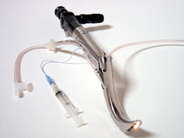
Wuscope

Slide 66
Paediatrics( a challenge due to small airway size and early compromisation)
Inhalation with 02 + sevo f/b fiber optic intubation
Surgical airway avoided d/t risk of sepsis
Mech ventilation with low PEEP (to prevent pulm. Edema)
Airway humidification with bronchial toilet with broncho dilators
Prophylactic intubation recommended even if distress is absent.

Slide 67
Hypoxia and cirrhosis(15%)
Intrinsic with cardio pulmonary disorder:
1.CHD
2.ILD
3.COPD
4.Pleural effusion
5.Pulmonary vascular ds.
6.Fluid retention
Without primary lung ds.
1.Intra pulmonary vascular dilatation(40%)

Slide 68
Hepato pulmonary syndrome
Chronic liver ds.
Evidence of IPVD
A-a gradient
Poor survival

Slide 69
Post op hypoxia
Mechanical,
haemodynamic,
pharmacological factors
Anaesthesia + surgery
Impair ventilation , oxygenation and airway maintainance

Slide 70
Increased risk
Heavy smoking
obesity
Sleep apnea
Severe asthma
COPD
Pre op PFT(limited role)

Slide 71
causes
Inadequate post op ventilation
Inadequate respiratory drive
Increased airway resistance
Decreased compliance
Neuromuscular and skeletal problems
Increased dead space
Increased co2 production
Inadequate post op oxygenation
Distribution of ventilation
Distribution of perfusion

Slide 72
11. Inadequate alveolar PAo2
12.Reduced mixed venous o2
13.Anaemia
14.Peri operative aspiration
15. Inadequate pain releif

Slide 73
Inadequate post-op vent.
Mild resp acidemia = accepted
Alarm= acidemia coincedent with tachypnea,anxiety,dyspnea,laboured breathing
pH < 7.30
PaCO2 with pH

Slide 74
Inadequate resp. drive
Residual effect of i.v & inhalational agent
i.v opioids given just befor shifting to post op care
ICH , Brain edema

Slide 75
Increased airway resistance
Obstruction in pharynx : tongue, soft tissue
In larynx: spasm , edema
In large airway : stenosis , hematoma
Residual effect of NMD
Reactive airways

Slide 76
compliance
Pulm edema
Lung contusion
RLD
Retained CO2 after lap
Skeletal ms anomaly
Obesity
Hemothorax, pneumothorax
Intra thoracic tumors
Parenchymal ds.

Slide 77
Neuromuscular and skeletal ms problems
Inadequate reversal residual paralysis
Diaphragmatic contraction , phrenic nr. paralysis
Flail chest, severe kyphoscoliosis

Slide 78
OXYGEN THERAPY
A. THREE CLINICAL GOALS OF O2 THERAPY
1. TREAT HYPOXEMIA
2. DECREASE WORK OF BREATHING (WOB)
3. DECREASE MYOCARDIAL WORK
B. FACTORS THAT DETERMINE WHICH SYSTEM TO USE
1. PATIENT COMFORT
2. THE LEVEL OF FIO2 THAT IS NEEDED
3. THE REQUIREMENT THAT THE FIO2 BE CONTROLLED
BE CONTROLLED WITHIN A CERTAIN RANGE.
4. THE LEVEL OF HUMIDIFICATION AND OR NEBULIZATION

Slide 79
HIGH FLOW VS LOW O₂ SYSTEMS
1.
HIGH FLOW SYSTEM DEFINED: THE GAS FLOW OF A
DEVICE THAT IS ADEQUATE TO MEET ALL INSPIRATORY
REQUIREMENTS. BY PROVIDING THE COMPLETE INSP.
VOLUME, THE HIGH FLOW SYSTEM DELIVERS IT'S FIO₂
VERY ACCURATELY. HIGH FLOW SYSTEMS CAN DELIVERY
BOTH HIGH AND LOW CONCENTRATIONS OF O₂.
A. VENTURI MASK
B. VENTURI TYPE NEBULIZERS (FAIL > .50 FIO₂)
C. HIGH FLOW BLENDER SYSTEM
D. THE NEW GAS INJECTION NEBULIZER (GIN)
WORKS FOR ALL FIO₂S.

Slide 80
HIGH FLOW VS LOW O₂ SYSTEMS CONTINUED
2. LOW FLOW SYSTEM
DEFINED: IS ONE THROUGH
WHICH O2 IS DELIVERED TO SUPPLEMENT THE PATIENTS
VT. THE FINAL FIO2 IS DETERMINED BY PROPORTIONATE
MIXING OF THE NUMBER OF LITERS OF 100% OXYGEN
BEING DELIVERED AND THE NUMBER OF THE PATIENT'S
VOLUME OF ROOM AIR THE PATIENT BREATHS IN TO
MIX WITH IT. FOR THE SAME OXYGEN FLOW THROUGH
EITHER DEVICE, THE FINAL FIO2 WILL BE HIGHER
IF THE VE IS LOW (HYPOVENTILATION) AND LOWER IF THE
VE IS HIGH (HYPERVENTILATION).
A. CANNULA
B. SIMPLE MASK
C. RESERVOIR OR NON-REBREATHER
(HIGHEST FIO2)

Slide 81
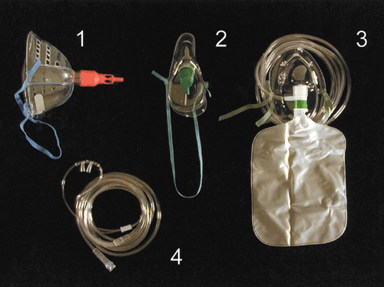
Oxygen delivery devices. 1. Venturi mask. 2. Hudson mask; 3. Trauma mask; 4. Nasal cannulae

Slide 82
ECMO
Extracorporeal membrane oxygenation
Chang 3rd ed.
Oxygenation of blood outside the body through a membrane oxygenator

Slide 83
Patient selection
Gestational age of 34 weeks or more*
Birth weight of 2000 gm or higher*
No significant coagulopathy or uncontrolled bleeding
No major intracranial hemorrhage (grade 1 intracranial hemorrhage)*
Mechanical ventilation for 10-14 days or less*
Reversible lung injury
No lethal malformations
No major untreatable cardiac malformation
Failure of maximal medical therapy

Slide 84
Indication
Patients with the following 2 major neonatal diagnoses
primary pulmonary hypertension of the newborn (PPHN), including idiopathic PPHN, meconium aspiration syndrome, respiratory distress syndrome, group B streptococcal sepsis, and asphyxia
Congenital diaphragmatic hernia (CDH)

Slide 85
Types
Veno arterial ECMO | Veno venous ECMO
Higher PaO₂ is achieved. | Lower PaO₂ is achieved
Lower perfusion rates are needed. | Higher perfusion rates are needed.
Bypasses pulmonary circulation | Maintains pulmonary blood flow
Decreases pulmonary artery pressures | Elevates mixed venous PO₂
Provides cardiac support to assist systemic circulation | Does not provide cardiac support to assist systemic circulation
Requires arterial cannulation | Requires only venous cannulation

Slide 86
Complications
Mechanical
Haemorrhagic
Neurological
Cardiac
Pulmonary
Renal
GI track
Metabolic
Infection & sepsis
Drug serum conc.

Slide 87
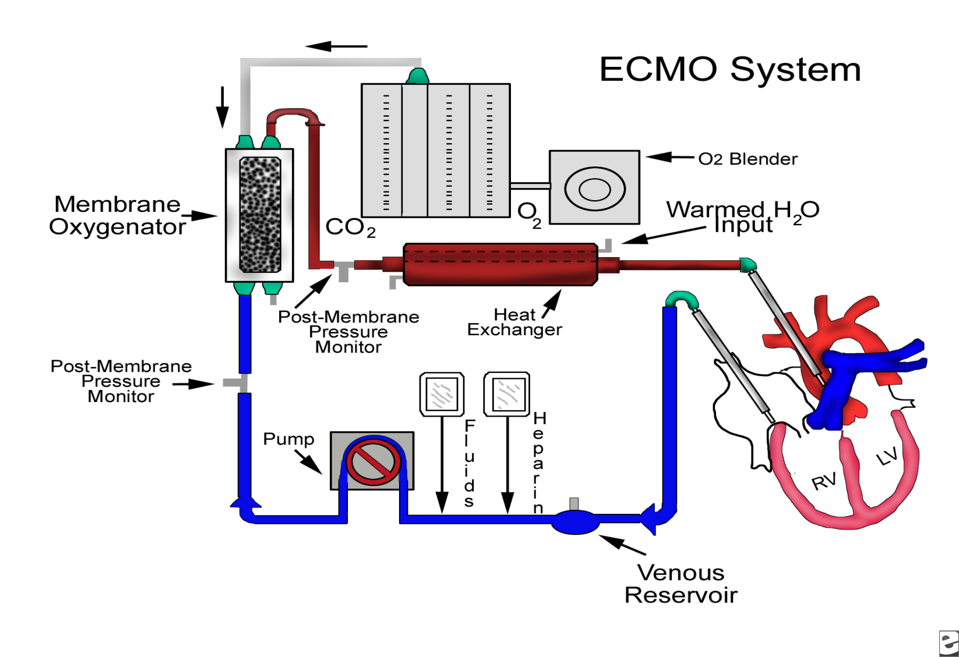

Slide 88
References
Dodd ME, et al ;Audit of oxygen prescribing before and after the introduction of a prescription chart. BMJ 2000; 321: 864-5
Knight PR, Holm BA. The three components of hyperoxia. Anesthesiology 2000; 93: 3-5
Aakerland LP, Rosenberg J. Post-operative delerium: treatment with supplementary oxygen. Br J Anaesth 1994; 72: 286-90
Rosenburg-Adamsen S, Effect of oxygen treatment on heart rate after abdominal surgery. Anesthesiology 1999; 90: 380-4
Greif R, Laciny S, Rapf B, Hickle RS, Sesslet DI. Supplemental oxygen reduces the incidence of postoperative nausea and vomiting. Anesthesiology 1999; 91: 1246-52
Chang 3rd ed.
Miller’s anaesthesia 7th ed.
Barash clinical anesthesia 6th ed.
Egan’s 9th ed.
Shapiro clinical applications of blood gases 5 ^{th} ed.

Slide 89

Thank you

