Slide 1
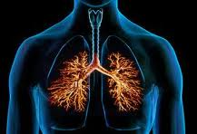
MECHANISM
OF
COUGH

Slide 2
Cough is an explosive expiration that provides a normal protective mechanism for clearing the tracheobronchial tree of secretions and foreign material.

Slide 3
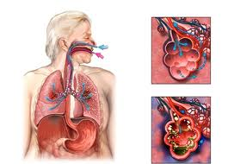
The bronchi and trachea are so sensitive to light touch that excessive amounts of foreign matter or other causes of irritation initiates the cough reflex.

Slide 4
Coughing may be initiated either voluntarily or reflexively
As a defensive reflex it has both afferent and efferent pathways

Slide 5
The afferent limb includes receptors within the sensory distribution of the trigeminal, glossopharyngeal, superior laryngeal, and vagus nerves.
The efferent limb includes the recurrent laryngeal nerve and the spinal nerves.

Slide 6
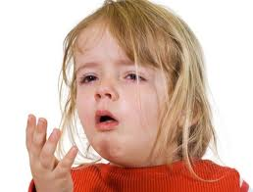
Mechanism
About 2.5L of air is inspired
Epiglottis closes, vocal cords shut tightly to entrap the air within the lung

Slide 7
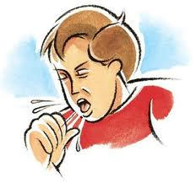
Abdominal muscles contract forcefully, pushing against the diaphragm
Internal intercosatal muscles also contract forcefully
Pressure in the lungs rises to 100mmHg or more.Markedly positive intrathoracic pressure causes narrowing of the trachea.

Slide 8
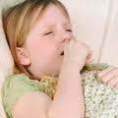
Vocal cords and epiglottis suddenly open widely .
The large pressure differential between the airways and the atmosphere coupled with tracheal narrowing produces rapid flow rates through the trachea.
Air is expelled at velocities ranging from 75 to 100 miles/hr.

Slide 9
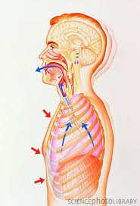
The shearing forces that develop aid in the elimination of mucus and foreign materials.

Slide 10
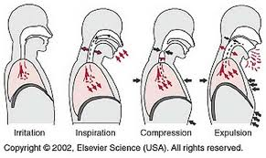

Slide 11
Thank You

