Slide 1
HEMOPTYSIS
By Dr. Vivian Wilson
Resident of Pulmonary Medicine

Slide 2
Hemoptysis
Hemoptysis represents 6.8% of chest clinic visits and 11% of thoracic surgery admissions. A survey done at American College of Chest Physicians, reveals that hemoptysis was the second most common indication for bronchoscopy.
It is defined as the expectoration of blood from the respiratory tract, a spectrum that varies from blood-streaking of sputum to coughing up large amounts of pure blood.
Massive hemoptysis is variably defined as the expectoration of >100 to >600mL over a 24-hr period. (Harrison’s).

Slide 3
The mortality ranges 7–30% for non-massive hemoptysis, and up to 80% for massive hemoptysis.
The definition for asphyxiating hemoptysis requires bleeding rates in excess of 150mL/hr, potentially causing airway occlusion & hypotension from volume loss

Slide 4
Most causes of hemoptysis originate from bronchial systemic circulation. Bronchial arteries are branches or aorta or its tributaries and supply up to terminal bronchioles. They also supply mediastinal, hilar & visceral pleural structures.
Distal supply to alveolar sacs and ducts is accomplished via diffusion gradient through pulmonary circulation and capillary bed.

Slide 5
WHAT ARE WE DEALING WITH?
Hemoptysis or Hematamesis?

Slide 6
 | Hemoptysis | Hematemesis
Definition | Coughing out of blood | Vomiting out of blood
Symptoms | Pulmonary & CVS diseases | Upper GIT diseases
Content & Color | Blood is mixed with sputum. Bright red & frothy due to mixture of air. | Blood mixed with food particles. Coffee ground in color.
Preceding symptoms | Cough, trickling sensation in throat | Nausea, vomiting, retching, abdominal discomfort
Melena | Does not occur | Usually followed by it the next day
Amount | Relatively less: shock rare | Can be in impending shock
Chemical reaction | Alkaline | Acidic
Cells involved | Alveolar macrophages laden with hemosiderin | Nil

Slide 7
Source of bleeding:
Upper airway
Tracheobronchial
Pulmonary parenchymal
Primary vascukar
Miscellaneous

Slide 8
Tracheobronchial source
The most common site of bleeding is the airways i.e the tracheobronchial tree, which can be affected by inflammation or by a neoplasm.
The bronchial arteries, which originate either from aorta or from intercostal arteries and are therefore part of a high pressure systemic circulation, are the source of bleeding.
For neoplasms, the lesion should communicate with the airway for hemoptysis to occur. It is a consequence of ulceration caused by expanding tumor.

Slide 9
Causes include:
Acute or chronic bronchitis
Bronchiectasis - In bronchiectasis, the development of tortuous, ectatic and hypertrophied bronchial arteries, which are subjected to systemic blood pressure, can lead to massive bleeding. The most common causes for bronchiectasis are post-tuberculous changes (not active), other previous lung infections, cystic fibrosis, immune defects or Kartagener's syndrome.
Broncholithiasis
Neoplasms (bronchogenic carcinoma, endobronchial metastatic carcinoma or bronchial carcinoid tumor or Kaposi’s sarcoma). These lesions are typically vascular.
Foreign body.

Slide 10
Pulmonary parenchymal source
Blood originating from the pulmonary parenchyma can be either from a localized source, such as an infection, or from a process diffusely affecting the parenchyma as with a coagulopathy or with an autoimmune process.
Causes include:
Pneumonia - In pneumococcal pneumonia, sputum is rusty. In staohylococcal it is mixed with pus. In Klebsiella, the bloody sputum resembles currrant jelly.
Lung abscess

Slide 11
Tuberculosis –
Tuberculosis can cause haemoptysis via various mechanisms. Active tuberculosis, defined as sputum positivity for acid-fast bacilli and/or culture for Mycobacterium tuberculosis, can cause both minor and massive haemoptysis.
Direct extension of tuberculous infection and inflammation into bronchial arterioles.
Bronchiectasis from chronic infection, obstruction and parenchymal destruction may result in large, tortuous fragile arteries.
Large parenchymal cavities may be secondarily infected with mycetomas resulting resulting in friable granulation tissue and neovascularisation
Rasmussen’s aneurysm
Pulmonary artery invasion, dilation and rupture may occur.

Slide 12
Mycetoma (fungus ball) – resides in healed tuberculous or bronchiectatic area or in a cystic residue of sarcoidosis. Aspergillus is the usual fungal agent; less often Mucor is the cause. They cause large bronchial artery dilation and invade the vascular intima.
Goodpasture’s syndrome
Wegner’s granulomatosis
Lupus pneumonitis
Lung contusion

Slide 13
Primary vascular source
Disorders primarily affecting the pulmonary vasculature include pulmonary embolic diseases & those conditions associated with elevated pulmonary venous & capillary pressures, such as or LVF.
Causes include:
AV Malformation
Pulmonary embolism
Elevated pulmonary pressure as in mitral stenosis (in this case the source of hemoptysis is the bronchial veins)

Slide 14
Trauma
Puncture of a lung by a fractured rib
Contusions of a lung by severe blunt trauma to chest
Necrosis of lining of the tracheobronchial tree by inhaled fumes or smoke
Laceration or fracture of the tracheobronchial tree
Stab or gunshot wounds
Mucosal lacerations following severe coughing
Post bronchoscopy, pneumectomy or lobectomy

Slide 15
Miscellaneous causes
Blood disorders (leukemia, hemophilia, thrombocytopenic purpuras)
Pulmonary endometriosis
Use of anricoagulants
Catamenial hemopytsis (accompanying menstruation).
Vitamin C deficiency.

Slide 16
Studies indicate that bronchitis and bronchogenic carcinoma are the two most common causes. Despite the lower frequency of tuberculosis and bronchiectasis seen in recent series, these two still remain the most common causes of massive hemopytsis in several series.

Slide 17
Up to 30% of patients have no identifiable cause for their hemopytsis. These patients are classified as having cryptogenic hemoptysis.
Subtle airway or parenchymal disease is presumably the cause.

Slide 18
Clinical evaluation

Slide 19
History taking:
The patient’s age is important in narrowing the differential diagnosis.
Bronchiectasis or valvular lesions typically cause hemoptysis in patients less than 40yrs of age.
In those patients over 40yrs with a history of cigarette smoking, the etiology of the hemoptysis is more likely to be caused by bronchogenic neoplasms.

Slide 20
History taking:
Blood streaking of mucopurulent or purulent sputum often suggests bronchitis.
Fever or chills accompanying blood streaked purulent sputum suggests pneumonia, whereas a putrid smell to the sputum the possibility of lung abscess.
When sputum production has been chronic and copious, the diagnosis of bronchiectasis should be considered.
Hemopytsis following the acute onset of pleuritic chest pain and dyspnea is suggestive of pulmonary embolism.

Slide 21
Previous disorders such as renal disease (Goodpasture’s syndrome or Wegner’s granulomatosis), lupus erythematosus (associated with pulmonary hemorrhage from lupus pneumonitis), or previous malignancy (either recurrent lung cancer or endobronchial metastasis from a non pulmonary primary tumor).
In a patient with AIDS, endobronchial or pulmonary parenchymal Kaposi’s sarcoma should be considered.
History of smoking or asbestos exposure are risk factors for bronchogenic carcinoma
A complete drug history
Occupational history

Slide 22
Examination:
Clubbing
Lymphadenopathy
Nasal septal ulcerations or cartilaginous deformity may suggest Wegner’s granulomatosis.
Petechia suggests underlying coagulopathy.

Slide 23
Systemic Examination:
Respiratory system:
Pleural friction rub (pulmonary embolism).
Localized or diffuse crackles (parenchymal bleeding or an underlying parenchymal process associated with bleeding)
Evidence of airflow obstruction (chronic bronchitis)
Prominent rhonchi (bronchiectasis)
Cardiovascular system:
Pulmonary artery hypertension
Mitral stenosis
Heart failure
Skin examination:
Kaposi’s sarcoma
SLE

Slide 24
Investigations

Slide 25
Initial evaluation
Blood tests
A venous blood sample should be taken to evaluate the platelet count, haemoglobin and the clotting profile as well.
Haemoglobin should be kept at >10 g·dL⁻¹. Repeat haemoglobin measurement helps to better quantify the significance of the blood loss. Initial readings may be higher than subsequent values due to haemodilution across compartments and infusion of intravenous fluids.
It is essential to send blood for typing and crossmatching, and to order an adequate number of packed cells.

Slide 26
Arterial blood gases assess the patient's respiratory compromise.
Renal and liver function tests may be of use in pulmonary–renal syndromes and liver failure.
Serological markers, including ANCA, RF and anti-GBM

Slide 27
Simple urinalysis may be useful in diagnosing a pulmonary-renal syndrome by detection of an active urinary sediment containing red cell casts.

Slide 28
Sputum examination
Sputum should be examined for organisms.
A Gram stain and a stain for acid-fast bacilli should be performed and sputum sent for culture, especially for mycobacteria and fungi.
In contrast to a common belief, acid-fast bacilli can often be found in the expectorated blood or bloody sputum of patients with active tuberculosis.
Sputum should also be sent for cytological examination, especially in patients at risk for lung cancer (aged >40 yrs with a smoking history).

Slide 29
Chest radiograph
Chest radiographs are readily available and may help to localise the bleeding site, as well as give clues to underlying disease. In 20–46% of patients with haemoptysis, the chest radiograph fails to localise a lesion because the chest radiograph is either normal or shows bilateral disease.

Slide 30
Subsequent evaluation
Computed tomography
Computed tomography (CT) is especially useful in the identification of small bronchial carcinomas and bronchiectasis. Contrasted CT scan may help in the identification of vascular lesions, such as aneurysms and arteriovenous malformations.
However CT was insensitive for demonstrating mucosal abnormalities such as bronchitis, metaplasia and papillomas.

Slide 31
Bronchoscopy
Bronchoscopy is useful in both the diagnostic work-up as well as a therapeutic modality. The timing of performing bronchoscopy is controversial. One suggestion is to perform urgent bronchoscopy when there is rapid deterioration and elective bronchoscopy within 24–48 h in stable patients [5].
In patients with massive haemoptysis, rigid bronchoscopy is the method of choice due to its better suction ability.

Slide 32
The major limitation of rigid bronchoscopy is that it is difficult or even impossible to visualise the upper lobes or peripheral lesions.
The current authors perform flexible bronchoscopy via the bevel of the rigid bronchoscope and thus overcome the above-mentioned problem.
Rigid bronchoscopy is usually performed under general anaesthesia, but in experienced hands it can also be attempted under local anaesthesia and conscious sedation.

Slide 33
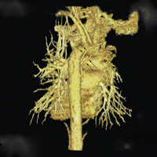
Angiography
Angiography helps to visualise bronchial and non-bronchial arterial anatomy. It is especially helpful as the physician can immediately proceed to bronchial artery embolisation (BAE) as a therapeutic option.
Multi-detector row helical computed tomography angiogram (3-dimensional reconstruction). Arrows demonstrate bronchial arteries arising from descending aorta.

Slide 34
History & physical examination
Suggestive of lower respiratory tract source
Suggestive of upper airway or GIT source
Chest radiograph
ENT, GI evaluation
Normal
Mass
Other parenchymal diseases
Suggests a particular diagnosis
CT
No risk factors. No s/o bronchitis
History of bronchitis & no risk of cancer
Risk factors for cancer
Bronchoscopy & CT
Recurrence of hemoptysis
Evaluation focused
Non specific
Consider bronchoscopy &/ CT
Observe
Cessation of bleeding
Bronchoscopy
No further evaluation
Non specific

Slide 35
Management

Slide 36
There are three important steps in the management of patients with massive haemoptysis:
Resuscitation and airway protection are the first priority.
Localisation of the site and establishing the cause of bleeding is the next step.
The final step is directed at specific and definitive treatments to stop the haemoptysis and to prevent re-bleeding

Slide 37
Airway protection and resuscitation
Basic resuscitation should be performed and the necessary baseline tests ordered. Patients with massive haemoptysis should be admitted to either high care or intensive care units. If the site of bleeding can be localised, the patient should be positioned with the bleeding side down to protect the unaffected lung.
Cough suppressants can be used but present a hazard of favouring the retention of blood in the lungs.
Patients with ongoing massive haemoptysis should always be intubated with the largest possible endotracheal tube to allow both flexible bronchoscopy and suction.

Slide 38
The airway techniques can be grouped into four major strategies:
A single lumen endotracheal tube directed into the good lung.
A single lumen tube with a balloon blocker.
A single lumen tube and then a bronchoscopically placed balloon catheter.
A double lumen endotracheal tube

Slide 39
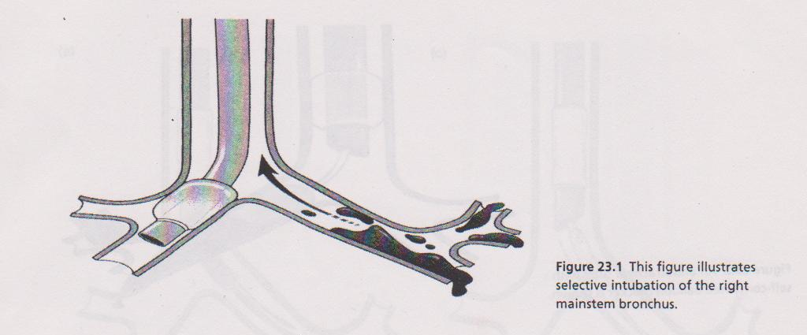
Single lumen endotracheal tube
Selective intubation of one lung can be performed by a rotational technique. After intubating the trachea, the tube is rotated through 90° in the direction of the desired placement until resistance is felt. The tube placement should be confirmed both clinically and radiologically.

Slide 40
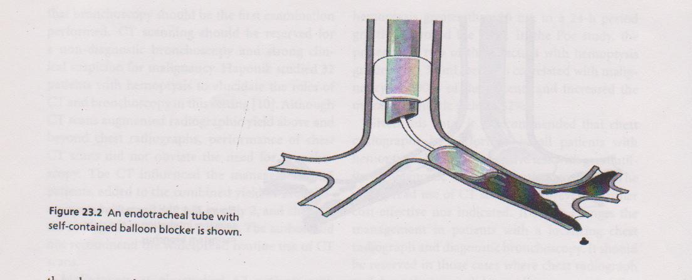
Single lumen tube with a balloon blocker

Slide 41
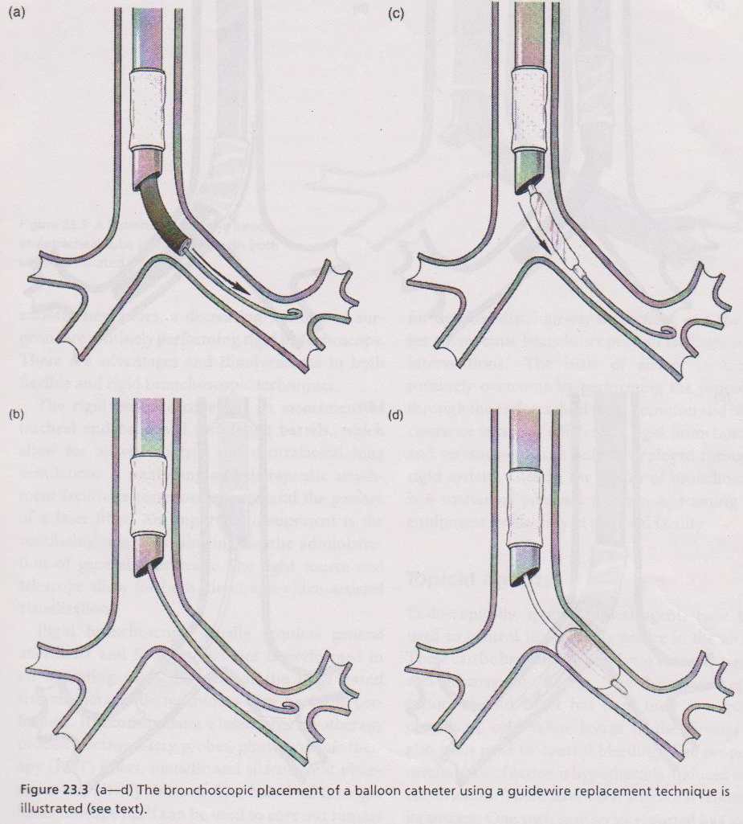
Single lumen tube and then a bronchoscopically placed balloon catheter

Slide 42
In massive haemoptysis endobronchial tamponade with a balloon catheter is widely used as a temporary measure to control bleeding.
A size 4–7 Fr 200-cm-long balloon catheter can be passed through the working channel of a flexible bronchoscope and inflated in the bleeding segment, thus isolating the bleeding site. The 4 Fr 80-cm-long Fogarty catheter can also be passed through a flexible bronchoscope.
The proximal hub needs to be cut off to allow for the removal of the bronchoscope by sliding it over the catheter. The pressure in the balloon is secured by inserting a pin into the proximal end of the catheter.

Slide 43
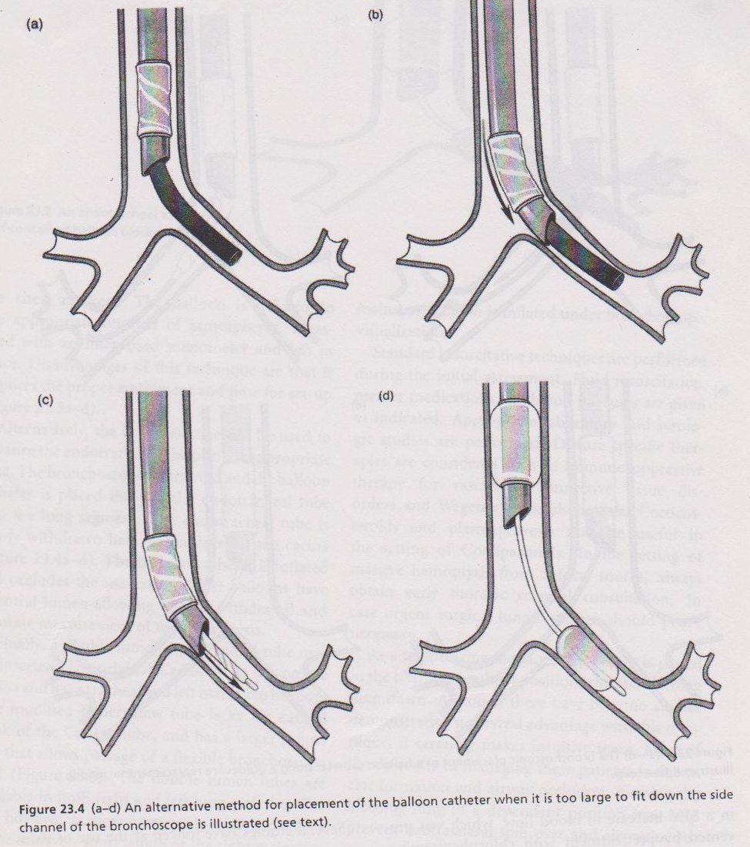
Single lumen tube and then a bronchoscopically placed balloon catheter

Slide 44
Alternatively, a double-lumen endotracheal tube can be passed to protect the unaffected lung. This requires experienced operators and positioning should be checked with the assistance of a bronchoscope.
There are two types of double lumen tubes:
Carlens tube – the original tube which sits on the carina and has a tracheal and left mainstem balloon.
Robertshaw’s tube – the modified tube lacking the carinal hook and has a larger lumen.

Slide 45
These balloons have a detachable valve at the proximal end facilitating easy removal of the bronchoscope with minimal risk of dislodging the catheter. The balloons were inserted for up to 7 days while definitive therapy could be administered. The various balloon catheters can also be inserted via a rigid bronchoscope.

Slide 46
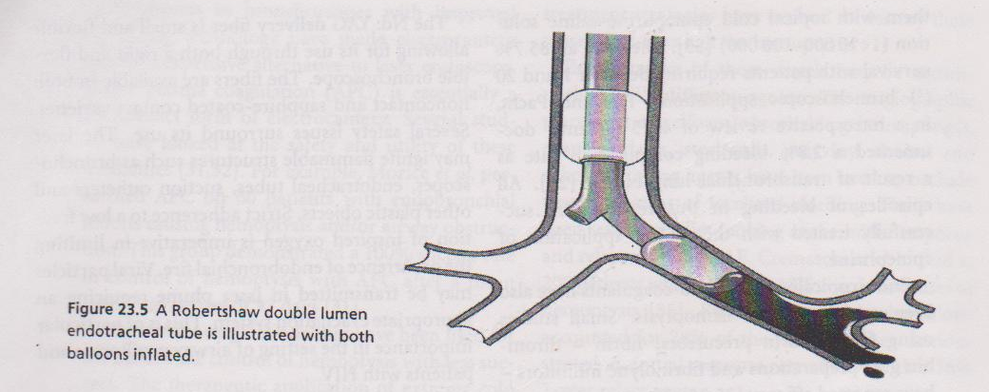
Double lumen endotracheal tube

Slide 47
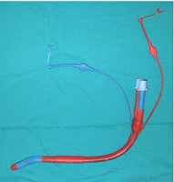
Left-sided, double-lumen endotracheal tube.

Slide 48
Localisation of site and cause of bleeding
Localisation of the bleeding site directs definitive treatment. This can be achieved by combining the various imaging techniques with bronchoscopy.

Slide 49
Treatment

Slide 50
Bronchoscopic treatment
Instillation of numerous substances has been used in the treatment of massive haemoptysis.
The instillation of adrenaline (1:20,000) is advocated but the efficacy in massive haemoptysis is uncertain.
Ornipressin (5 IU) or terlipressin (0.5 mg) are both recommended for procedure-related bleeding during bronchoscopy, but their efficacy has not been validated in patients with massive haemoptysis .

Slide 51
Laser bronchoscopy
For this the CO2 laser and Nd: YAG laser are used
The lesion should be proximal with an endoluminal component. A flexible or rigid bronchoscope is inserted. The probe is advanced 5mm proximal to the lesion, but distal to the bronchoscope. Low wattage is initially used in a pulsed fashion. After the tissue has been adequately coagulated it may be debulked with a cryotherapy probe, biopsy forceps or the barrel of the rigid bronchoscope.
Electrocautery has also been used successfully in the airway to coagulate bleeding foci.

Slide 52
Bronchial artery embolisation
Currently, it is the most effective non-surgical treatment for massive haemoptysis. BAE is a technically demanding procedure and should always be performed by skilled interventional radiologists.
Arteriography is performed initially to locate the bleeding bronchial artery. Various signs can be used to determine the site of bleeding such as vessel size, vascular blush, the degree of hypervascularity, as well as evidence of vascular shunting.

Slide 53
As alluded to earlier, multi-detector row helical CT angiography could be used as a road map guiding the interventional radiologist. This is particularly useful in centres where BAE is not regularly performed.

Slide 54
a) Tortuous right-sided intercostal artery: pre-embolisation. b) Right-sided intercostal artery: post-embolisation.

Slide 55
Subsequent to localisation of the bleeding, vessel embolisation is performed. First, the bronchial arteries are embolised. Initial embolisation of the bronchial arteries facilitates visualisation of the non-bronchial collaterals, which might have to be embolised as well.
Various materials are used to perform BAE. The most commonly used agent is polyvinyl alcohol (PVA) with particles sized 350–500 μm in diameter. These particles are suspended in x-ray contrast medium. As they are not absorbable, they prevent recanalisation.

Slide 56
Another agent, absorbable gelatin sponge, is unfortunately fraught with a high degree of recanalisation and is, therefore, used as a supplement to PVA particles only.
These are microspheres that are precisely calibrated, spherical, hydrophilic, micro-porous beads made of an acrylic co-polymer (trisacryl) which is then cross-linked with gelatin.

Slide 57
This proprietary and patented design allows a more complete and targeted occlusion of the blood vessels feeding a hypervascularized tumor or arteriovenous malformation.
Furthermore, the hydrophilic surface and spherical shape prevent aggregation within the catheter lumen and in the vasculature, promoting ease and accuracy of delivery. Finally, the elastic properties of the microspheres also allow the temporary deformation of the sphere, which facilitates the passage through small delivery systems.

Slide 58
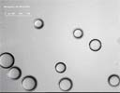
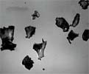
Embosheres:
· Flexible spheres
· Non Aggregating
· Uniform occlusion
· Predictable penetration
PVA:
· Irregular shape
· Clumping
· Non-uniform occlusion
· More proximal occlusion

Slide 59
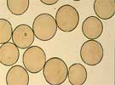
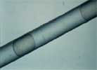
Compressible and Hydrophilic: Elastic shape and hydrophilic surface prevent aggregation within the catheter, simplifying handling and promoting accurate delivery to the target vesse

Slide 60
Isobutyl–2 cyanoacrylate, as well as absolute ethanol, is not recommended because of the high risk of developing tissue necrosis [34, 38–40].
Immediate response rates after BAE range 73–98% [38, 41–48].
Numerous complications have been described of which chest pain is the most common. Chest pain is most likely ischaemic in origin and usually transient. The most feared complication is spinal cord ischaemia with a prevalence of 1% [5, 39]. This complication has been reduced from as high as 6.5% due to the invention of coaxial microcatheter systems that can be used for more selective, so-called supra-selective embolisation

Slide 61
Surgery
Up to two decades ago, surgery was seen as the treatment modality of choice in patients with massive haemoptysis, in whom the site of bleeding could be localised, provided the patient had sufficient cardiopulmonary reserves.
Currently, surgery represents one of a few treatment options, but still represents the only definitive one.
Surgery remains the procedure of choice in patientswith localised bronchiectasis, trauma, hydatid cyst, arteriovenous malformations, thoracic aneurysm and aspergilloma, because it is curative for these underlying diseases.

Slide 62
After stabilisation and investigation, the initial response is assessed.
In patients with a good response, defined by no more haemoptysis or expectoration of minimal amounts of mainly blood clots, a watchful waiting attitude can be adopted.
Patients with a poor response, defined as ongoing haemoptysis, undergo bronchial arteriography and, if suitable, a BAE is performed.
BAE is not regarded as definitive therapy in massive heamoptysis, surgical resection is therefore indicated. To determine operability, a functional assessment is performed to determine adequate cardiopulmonary reserve;

Slide 63
Thank you…

