Slide 1
Oxygen devices
Prepared by : Muteb Ayedh Alotaibi

Slide 2
EGAN’S Fundamentals of Respiratory Care Except : pictures & last 3 slides
Reference

Slide 3
low flow
Nasal cannula
Nasal catheter
Transtracheal catheter
Simple mask
Partial rebreathing mask
Nonrebreathing mask
We must Know
Flow
Fio2 range
Advantages
Disadvantages
Best use

Slide 4
Nasal cannula

Slide 5
Nasal cannula
Flow
¼ - 8 l/min ( adult )
≤ 2 L/min (infants)
FiO2
24% - 40%
Advantages :
Use on adult , children , infants
Easy to use
Disposable
4. Low cost ,Well tolerated
Disadvantages :
Easily dislodged
High flow un-comfortable
Can cause dryness , bleeding
Mouth breathing may reduced Fio2

Slide 6
cout
Best Use
Patient in staple condition who needs low Fio2
Home care pathent who needs long term therapy
Low to moderate Fio2 while eating

Slide 7
Nasal catheter

Slide 8
Nasal catheter
Flow
¼ - 8 l/min
FiO2
22% - 45%
Advantages :
Use on adult , children , infants
Good stability
Disposable
4. Low cost
Disadvantages :
Difficult to insert
Need regular changing
May block insertion , may provoke gagging

Slide 9
Cou
Best Use
Procedures in which cannula is difficult use ( bronchoscopy )
Long- term care of infants

Slide 10
Transtracheal catheter

Slide 11
Transtracheal catheter
Flow
¼ - 4 L/ min
FiO2
22% - 35%
Advantages :
Increased exercise tolerance
Increased mobility
Disadvantages :
High cost
Surgical complications
Mucus plugging

Slide 12
Cou
Best Use
Home care or ambulatory pathents who need increased mobility or do not accept nasal oxygen

Slide 13
Simple mask

Slide 14
Simple mask
Flow
5- 10 L/ min
FiO2
35% - 50%
Advantages :
Use on adults, children , infants
Quick, easy to apply
Disposable
Inexpensive
Disadvantages :
Uncomfortable
Must be removed for eating
Blocks vomitus unconscious patients

Slide 15
Cou
Best Use
Emergencies
Short-term therapy requiring moderate Fio2 mouth breathing patients requiring moderate Fio2

Slide 16
Partial rebreathing mask

Slide 17
Partial rebreathing mask
Flow
Minimum of 10 L/ min ( prevent bag collapse on inspiration )
FiO2
40% - 70%
Advantages :
Same as simple mask
Moderate to high Fio2
Disadvantages :
Same as simple mask
Potential suffocation hasard

Slide 18
Cou
Best Use
Emergencies
Short-term therapy requiring moderate to high Fio2

Slide 19
Nonrebreathing mask

Slide 20
Nonrebreathing mask
Flow
Minimum of 10 L/ min ( prevent bag collapse on inspiration )
FiO2
60% - 80%
Advantages :
Same as simple mask
high Fio2
Disadvantages :
Same as simple mask
Potential suffocation hasard

Slide 21
Cou
Best Use
Emergencies
Short-term therapy requiring high Fio2

Slide 22
high flow system
Air-entrainment mask
Oxyhood
Aerosol mask
Trach collar
Oxygen tent

Slide 23
Air-entrainment mask

Slide 24
Air-entrainment mask
Flow
Varies , should provide output flow > 60 L/ m
FiO2
24% - 50%
Advantages :
Easy to apply
Disposable
Inexpensive , stable , precise Fio2
Disadvantages :
Limited to adult use
Must be removed for eating
Fio2 >0.40 not ensured

Slide 25
Cou
Best Use
Patient unstable condition who need precise low Fio2

Slide 26
Oxyhood

Slide 27
Oxyhood
Flow
≥7 L /min
FiO2
21% - 100 %
Advantages :
Full range of Fio2
Disadvantages :
Difficult to clean , disinfect
Best use :
Infants who need supplemental oxygen

Slide 28
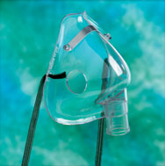
Aerosol mask
Flow
5-10 L/min.
FiO2
21% - 100%.

Slide 29
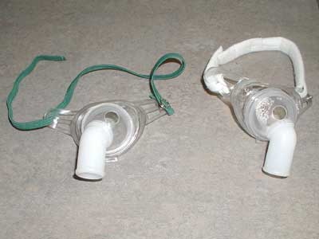
Trach collar
Flow :
5-10 L/min.
FiO2 range :
21% - 100%.

Slide 30
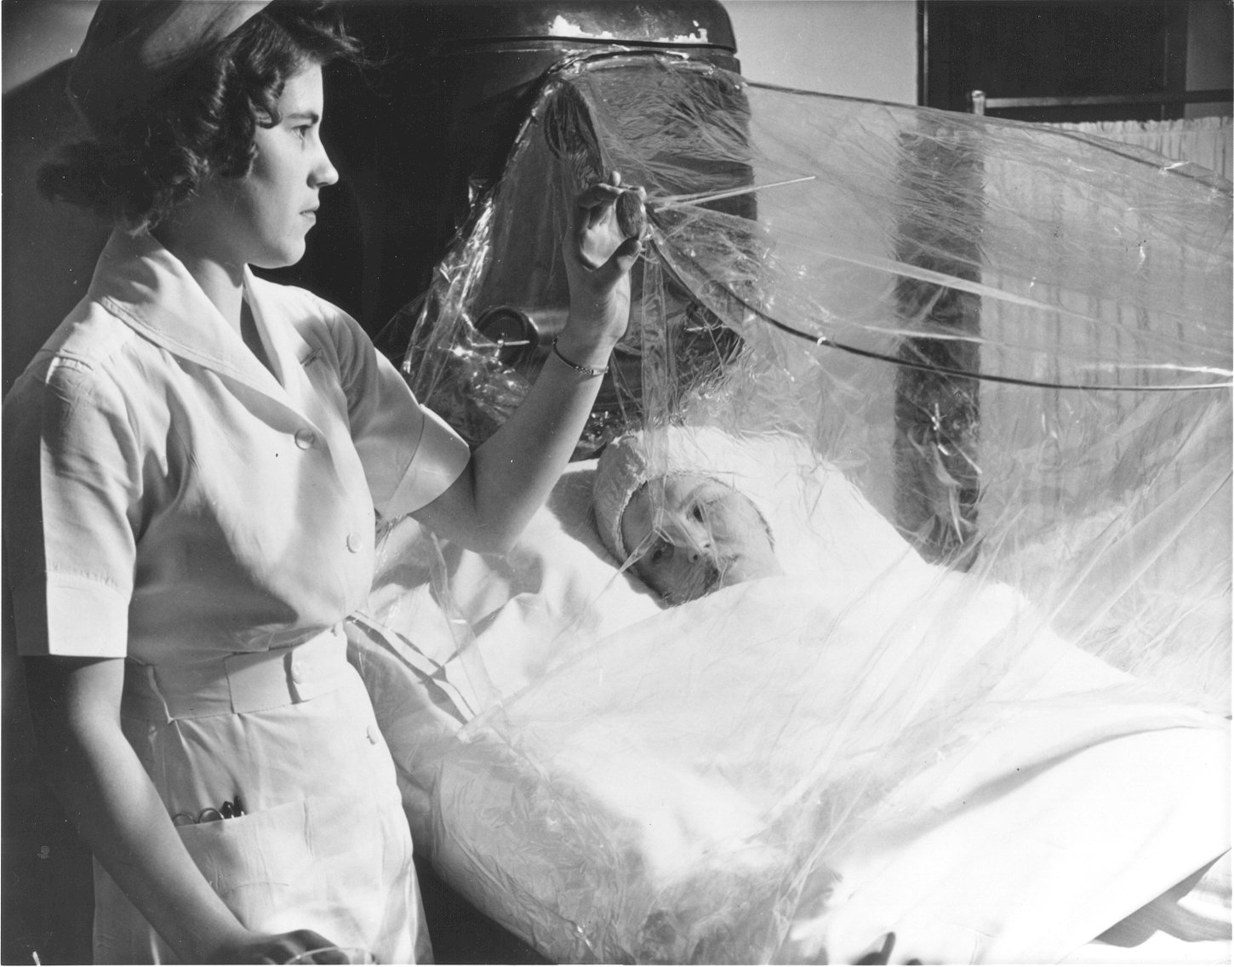
Oxygen tent
Flow :
8-15 L/min.
FiO2 range :
40% - 50%.
Best use :
- Used primarily on children with croup or pneumonia.

Slide 31
Thank you

