Slide 1
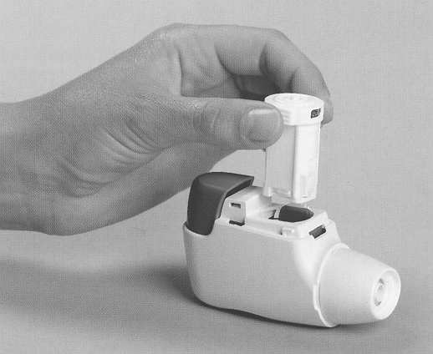
INHALATION THERAPY
BY: DR.SHILPA PRAJAPATI (1ST YEAR MPT)

Slide 2
CONTENTS
Inhalation- Definition
Common conditions
Advantages and disadvantages
Inhalant drugs
Types

Slide 3
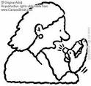
Inhalation- Definition
Inhalation is any drug or solution of drugs administered by the nasal or oral respiratory route.
Inhalation (also known as inspiration) is the movement of air from the external environment, through the air ways, and into the alveoli.

Slide 4
Particle Size
Mass median aerodynamic diameter
<1μm: reach up to the alveoli,
0.5~5μm: beyond the 10th generation of
bronchi (respirable particles),
>5μm: oropharynx

Slide 5
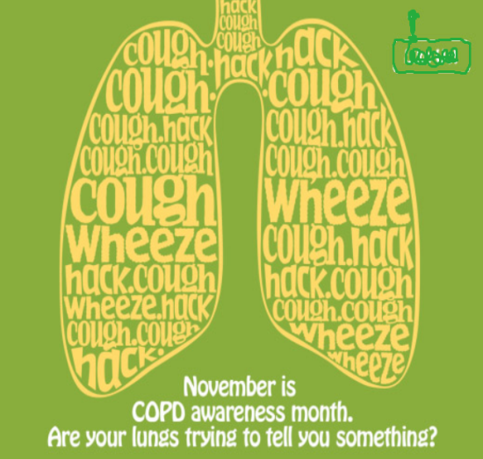
Common conditions
Inhalation therapy is a traditional treatment in chronic asthma and chronic bronchitis.
Emphysema,
Bronchiectasis

Slide 6
Advantages and disadvantages
Advantages:
- Less systemic toxicity
- More rapid onset of medication
- Delivery to target of action
- Higher concentrations available in the lung
Disadvantages:
- Time and effort consuming
- Limitation of delivery device

Slide 7
Inhalant drugs
Antiallergic agents
Budesonide (glucocortico steroid)
Cromolyn sodium(Cromoglicic acid)
Bronchodilators
Salbutamol (β2 agonist)
Terbutaline (β2 agonist)
anti-cholinergic
Anesthetics
Opioids

Slide 8
Inhalant drugs
Mucolytic agents
Acetein (Acetylcysteine)
Mistabron (Mesna)
Antimicrobials
Tobramycin(anti bacterial)
Pentamidine(anti fungal)
Ribavirin(antiviral)
Amphotericin

Slide 9
Device
Selections of device include：
Nebulizer: small volume,
large volume, ultrasonic
Metered dose inhaler, MDI
Dry powder inhaler, DPI
Spacer
Rotahaler
spinhaler

Slide 10
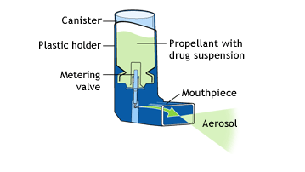
Metered-dose inhalers
A liquid propellant
A metering valve that dispenses a constant volume of a solution in the propellant.
Inhalation technique is critical for optimal drug delivery – only about 10% of drug reaches the lungs.
Its also use with nebuhaler.

Slide 11
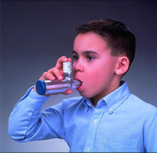
Metered-dose inhalers
Fist be shaken to ensure that drug should be evenly distributed.
Held upright and the cap is removed.
Breathes out gently, but not fully
With the mouth around the mouthpiece of the inhaler, the device is pressed to release the drug as soon as inspiration has begun.
Inspiration should be slow and deep, be held for 10seconds if possible.
Dose of inhalation will involve > 1 “puff”
The length of time between inhalation is 15- 20 seconds.

Slide 12
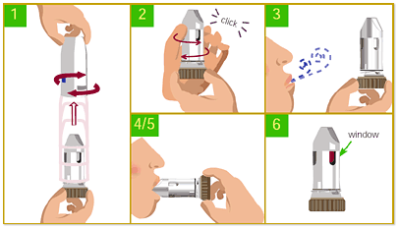
Dry powder inhalers
No propellant
Breath-activated, and patient
coordination is not as important an issue.
The drug is formulated in a filler and contained in a capsule that is placed in the device and punctured to release the powder.
Releasing drug on inspiration, require faster inspiratory flow rate
Inspiratory flow required depends on the resistance with in device.

Slide 13
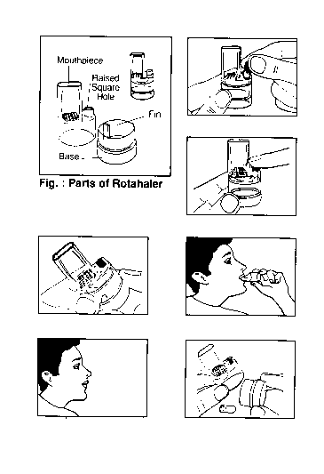
Rotahaler
Insert a capsule into the rotahaler , the coloured end first.
Twist the rotahaler to break the capsule
Inhale deeply to get powder into the airway
Several breath may be required, does not required the coordination of the aerosol

Slide 14
Spinhaler
It works similar to rotahaler,
except that outer sleeve slides down to pierce the capsule
and the propellor disperse the drug

Slide 15
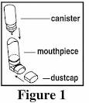
Spacer
Patient could not required coordinate inspiration
Patient seals lips around the mouthpiece
Depresses the actuator
The mist is trapped in the middle
section
Inhale without loosing the drug

Slide 16
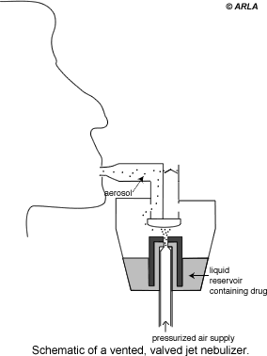
Nebulizers
Patient cooperation and coordination is not as critical
It converts solution into aerosol particles, < 5μm.
An acceptable time 5-10minutes.
Two types: Jet nebulizers
: Ultrasonic nebulizers
Commercially available nebulizers deliver 12% to 20% of the nebulized dose into the bronchial tree.

Slide 17
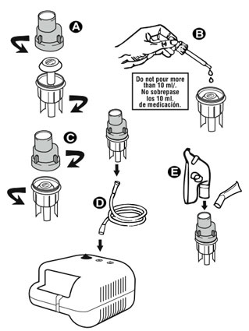
Jet nebulizer
With a jet nebulizer driving gas is forced through a narrow orifice.
The negative pressure created around the orifice and it allows the smaller particles for inhalation and larger particles drop back into the reservoir

Slide 18
Some Disadvantages of Jet Nebulizers
Less portable than inhalers
Requires power source, maintenance, and cleaning
Output is device dependent
Delivery may take 5 to 10 minutes or longer
O’Donohue et al. Chest. 1996;109:814-820; Dolovich et al. Chest. 2005;127:335-376; Pulmicort Respules 0.25 and 0.5 mg [package insert]. Wilmington, DE: AstraZeneca LP, 6/2005. NAEPP. Publication no. 97-4051.
Notes:
Slide 23. Some Disadvantages of Jet Nebulizers
Jet nebulizers are less portable than inhalers; a power source and pressurized gas source are required.^{32,33}
Contamination is possible if the nebulizer components are not carefully cleaned.^{32,33}
The treatment time for small-volume jet nebulizers is longer than that for inhalers. However, ultrasonic nebulizers provide faster delivery than jet nebulizers.^{32,33}
Output is device dependent, with substantial internebulizer and intranebulizer output variances.³ Delivery may take 5 to 10 minutes or longer.¹⁷

Slide 19
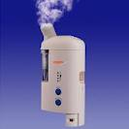
Ultrasonic nebulizers
An aerosol can also created by high frequency(1-2MHz) sound waves.
Piezo-electric crystal causes ultrasonic vibrations, it will travel through liquid to the surface where they produce aerosol.
Produce higher output than jet
nebulizers
Advantage- they operate quietly

Slide 20
Inhaled Beta-2 Agonist Bronchodilators
Short-acting (3~6hr)
Salbutamol / Albuterol (Ventolin)
Terbutaline (Bricanyl)
Fenoterol (Berotec)
Long-acting (>12hr)
Salmeterol
Formoterol

Slide 21
Inhaled Anti-cholinergics
Ipratropium bromide (Atrovent)
Inhaled Corticosteroids
Beclomethasone
Triamcinolone
Budesonide (Pulmicort)

Slide 22
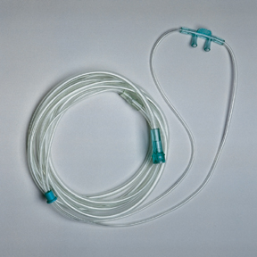
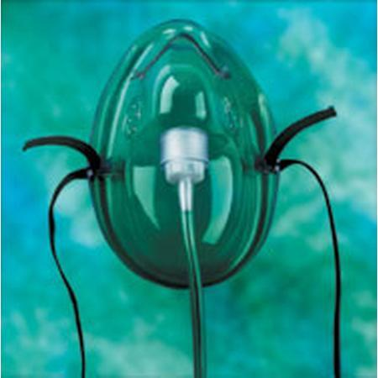
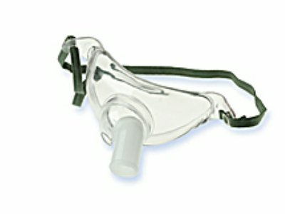
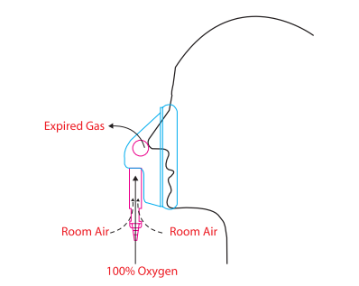
Oxygen therapy
Nasal cannula
Oxygen masks
Venturi-type masks
Tracheostomy masks

Slide 23
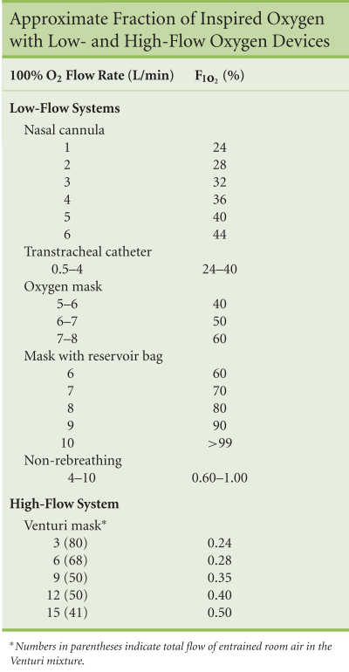

Slide 24
Variable performance systems
Small reservoirs and low gas flow (2-15L/min)
Shallow breathing → less entrained room air, higher FiO2
Exhalation time → variable filling of devices’ inspiratory reservoir
Nasal cannula
Oxygen mask
Tracheostomy mask

Slide 25
Nasal cannula
The proximity and size of the reservoir (NP/OP~50ml=1/3 of anatomic dead space) imply sensitivity to changes in inspiratory flow rate and particularly the loss of respiratory pause
Flows>6L/min do not significantly increase FiO2>44%
Drying of mucosa and epistaxis

Slide 26
Oxygen masks
Reservoir volume= 150-250ml
Re-breathing occurs at flow rates <4L/min
Approx FiO2 0.4-0.6
Interfere with eating
Easy displacement
Increases aspiration by concealment of vomitus

Slide 27
Tracheostomy masks
Delivery depends on presence of ETT and inflation status of its cuff
If absent or cuff is deflated, air from NP will mix with that being delivered to the tracheosotmy, further diluting the FiO2

Slide 28
Fixed performance systems
So called because O2 delivery is independent of the patient factors outlined above
Venturi-type masks
Anesthestic breathing circuits

Slide 29
Venturi-type masks
High flow oxygen delivery device
Venturi modification of Bernoulli principle
Jet of 100% oxygen through a fixed orifice, past open side ports, entraining room air
FiO2 depends on size of side ports and oxygen flow
Accurate FiO2 up to 0.5

Slide 30
Anaesthestic breathing circuits
Closed system with valves (e.g. Ambu-bag)
Reservoir volume = 600-1000ml
Re-breathing at low flows (most require flows >150ml/kg)
Theoretically capable of delivery FiO2 1.0 but practically ~0.6-0.8 due to sealing problem

Slide 31
Complications
Barotrauma (middle ear and sinuses), gas embolism on decompression
Oxygen toxicity
Visual problem (myopia, cataract)

Slide 32
Humidification
A device to provide humidification of the air ways may be considered if either the normal means of humidifying the air ways or the mucociliary escalator are not functioning effectively.
The upper air ways acts as a heat and moisture exchanger with the fully saturated expired gas giving up some heat and water to the mucosa.
The epithelial lining of the airways from trachea to the respiratory bronchioles contains ciliated cells which are responsible for moving mucus proximally to the level of larynx.

Slide 33
Humidification
The efficiency of mucus transport is dependent on current functioning cilia and the composition of peri-ciliary and mucus layers.
Viscosity of mucus is increased during bacterial infection
Humidification has been shown to enhance tracheobronchial clearance

Slide 34
Humidification
Conway (1992) hypothesizes that humidification by water or saline aerosol produces an increase in depth of the peri-ciliary and mucus layers, there by decreasing viscosity and enhancing the shearing of secretions by huffing or coughing.
Humidification may be indicated to assist clearance of secretions when the clearance mechanisms is not optimally effective or when the normal heat or moisture exchange system of the upper airways is by passed by an endotracheal or tracheostomy tube.

Slide 35
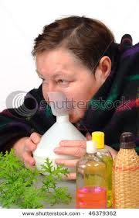
Humidification
Methods
Systemic hydration – adequate humidification may be obtained by increasing the oral or intravenous fluid intake of the patient.
Heat and moisture exchangers(HME)
Nebulizer
Steam inhalation

Slide 36
Hazards
Inhalation of cold mist or water may cause broncho constriction in patients with hyper reactive air ways
Water reservoirs may become infected
Regular disposal, disinfection or sterilization of all humidification equipment is essential to prevent infection.

Slide 37
References
Cash’s text book, 4th Edition
Physiotherapy for respiratory and cardiac problems, Jennifer A Pryor and Barbara A Webber, 3rd Edition
Cardiopulmonary physical therapy, By: Elizabeth Dean, 3rd Edition
Medical pharmacology, by: K D Tripathi, 4th Edition

Slide 38
Thank you for your attention!

