Slide 1

The Lung and the Heart: syncrony in fate
Leonardo M. Fabbri
Clinica di Malattie dell’Apparato Respiratorio
Università degli Studi di Modena e Reggio Emilia
Azienda Ospedaliero-Universitaria - Policlinico di Modena

Slide 2
THE LUNG AND THE HEART:
SYNCRONY IN FATE
MULTIMORBIDITY
HISCHAEMIC HEART DISEASE AND COPD
CHRONIC HEART FAILURE AND COPD
COMPLEXITY OF ACUTE RESPIRATORY SYMPTOMS IN PATIENTS WITH COPD

Slide 3
. . . . Main Take Home Messages
COPD IS ALMOST INVARIABLY ASSOCIATED WITH CONCOMITANT CHRONIC DISEASES RELATED TO COMMON RISK FACTORS, PARTICULARLY SMOKING AND AGEING
COPD EXACERBATIONS SHOULD BE RENAMED EXACERBATIONS OF RESPIRATORY SYMPTOMS IN PATIENTS WITH COPD
CONCOMITANT CARDIOVASCULAR DISEASES, AND PARTICULARLY ISCHEMIC HEART DISEASE AND CHRONIC HEART FAILURE, CARRY IMPORTANT NEGATIVE PROGNOSTIC WEIGHT IN PATIENTS WITH COPD

Slide 4
Global Strategy for Diagnosis, Management and Prevention of COPD
Definition of COPD 2011
COPD, a common preventable and treatable disease, is characterized by persistent airflow limitation that is usually progressive and associated with an enhanced chronic inflammatory response in the airways and the lung to noxious particles or gases
Exacerbations and comorbidities contribute to the overall severity in individual patients.

Slide 5
Global Strategy for Diagnosis, Management and Prevention of COPD
Assess COPD Comorbidities
COPD patients are at increased risk for:
  Cardiovascular diseases
  Osteoporosis
  Respiratory infections
  Anxiety and Depression
  Diabetes
  Lung cancer
  These comorbid conditions may influence mortality and hospitalizations and should be looked for routinely, and treated appropriately.

Slide 6
Pathogenesis of COPD
Cigarette smoke
or air pollutant
?
CD8+ T-cell
Alveolar
macrophage
CXCR3
Inflammatory cytokines
(IL-8, LTB₄)
CXCL-10
Neutrophil
Alveolar wall destruction
EMPHYSEMA
Proteases
Mucus hypersecretion
BRONCHIOLITIS
Adapted from PJ Barnes, 2000; Fabbri, Sinigaglia, Papi, Saetta 2002; Cosio, Saetta and Cosio 2012

Slide 7

Leading Causes of
Death in U.S.
1. Myocardial
Infarction
2. Cancer
3. Cerebrovascular
Diseases
4. COPD
Cigarette Related Diseases
Leading Causes of
Death Worldwide 2010
Notes:
7

Slide 8
INTERACTION OF OCCUPATIONAL AND PERSONAL RISK FACTORS IN WORKFORCE HEALTH AND SAFETY
Age
Genetics
Smoking
Diet/Obesity
Inactivity
Alcohol use
Indoor/Outdoor/Occupational pollution
Schulte PA et al, Am J Public Health. 2012;102:434–448.

Slide 9
RISK FACTORS AND COMORBIDITIES IN THE PRE-CLINICAL STAGES OF COPD
Comorbidities and their associations with different risk factors in COPD is mainly based on patient-based samples with an established diagnosis of moderate to very severe COPD.
The present study conducted in patients with mild to moderate early COPD show that physical inactivity and smoking, but not COPD as such, are associated with their development.
Van Remoortel H et al, Am J Respir Cr Care Med, 2014 Jan 1;189(1):30-8.
,
5

Slide 10
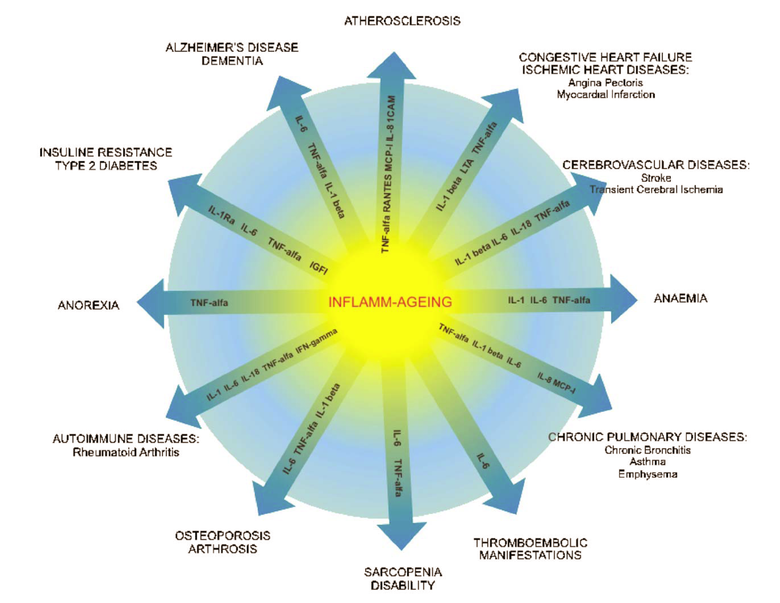
Martinis M et al. Exp. Mol. Pathol. 80 (3):219-227, 2006
Notes:
10

Slide 11
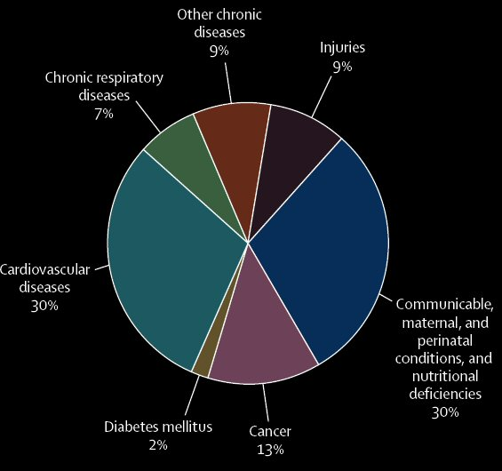
Chronic diseases represent a huge proportion of human illness
58 million deaths in 2005:
Cardiovascular disease 30%
Cancer 13%
Chronic respiratory diseases 7%
Diabetes 2%
Beaglehole R et al. Lancet 2007;370:2152-57.
Notes:
Chronic diseases like cardiovascular disease, respiratory diseases, cancers and diabetes represent a very significant proportion of human illness. And while they are leading causes of death and disability, they are badly neglected by the global health agenda.
Of all worldwide deaths in 2005, 60% were a result of chronic disease, with 32% attributed to cardiovascular disease and diabetes, 13% to cancer, and 7% to chronic respiratory illnesses. If global goals for prevention and control of chronic diseases were realized, 36 million deaths could be averted by 2015.
We must consider the complexity of chronic diseases – they present a major challenge and are considered a significant problem in an ageing population.
1. Beaglehole R et al on behalf of the Chronic Disease Action Group. Prevention of chronic diseases: a call to action. Lancet 2007;370:2152-57.

Slide 12
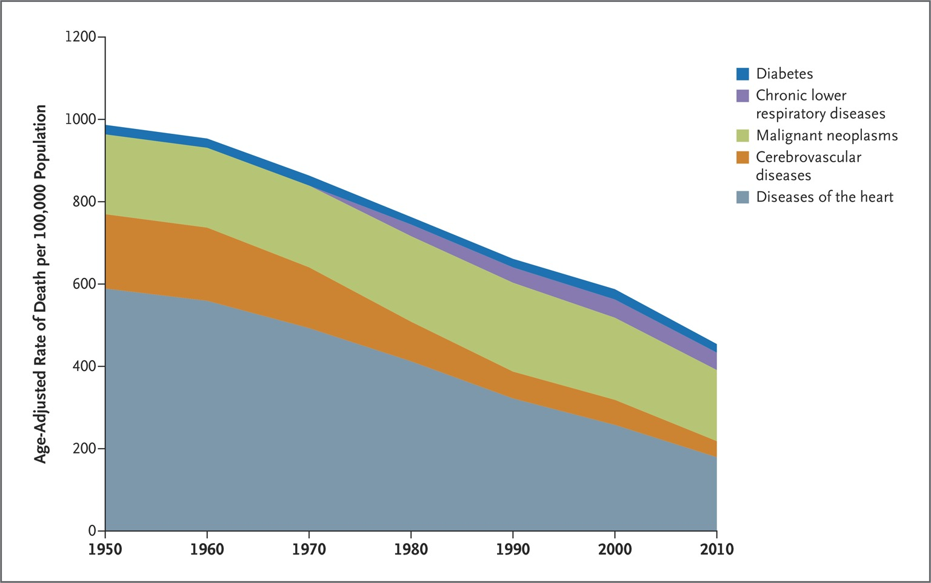

Declines in Rates of Death from Major Noncommunicable Diseases in the United States, 1950 to 2010.
Hunter DJ, Reddy KS. N Engl J Med 2013;369:1336-1343
Notes:
Figure 4 Declines in Rates of Death from Major Noncommunicable Diseases in the United States, 1950 to 2010. Adapted from the National Center for Health Statistics, Centers for Disease Control and Prevention.18

Slide 13
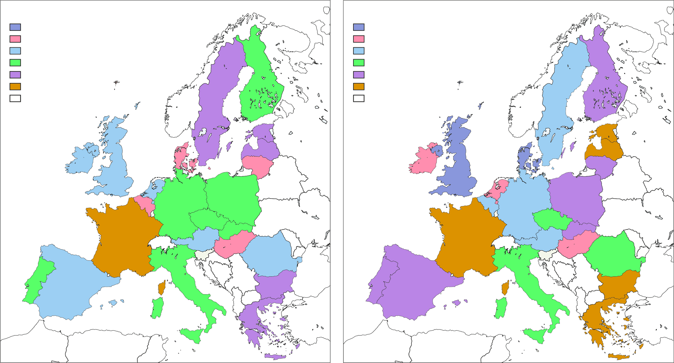
COPD MORTALITY STANDARDISED RATE RATIOS FOR EVERY COUNTRY
IN THE EU IN 2010
MEN
WOMEN
Standardised rate ratios
Standardised rate ratios
≥ 2.00
1.50-1.99
1.00-1.49
0.80-0.99
0.50-0.79
<0.50
No data
≥ 2.00
1.50-1.99
1.00-1.49
0.80-0.99
0.50-0.79
<0.50
No data
López-Campos J.L. et al., Lancet Respir Med 2014; 2: 54-62

Slide 14
AGE-STANDARDISED COPD MORTALITY TRENDS
IN EUROPE AND ITALY (1994–2010)
EUROPEAN UNION
ITALY
100
100
90
90
80
80
70
70
60
60
Men (Joinpoint regression lines)
Men (Age-standardised mortality)
Women (Joinpoint regression lines)
Women (Age-standardised mortality)
50
50
Age-standardised death rate per 100000 person-years
40
40
30
30
20
20
10
10
0
0
1994
1996
1998
2000
2002
2004
2006
2008
2010
1994
1996
1998
2000
2002
2004
2006
2008
2010
Year
Year
López-Campos J.L. et al., Lancet Respir Med 2014; 2: 54-62

Slide 15
NUMBER OF CHRONIC DISORDERS BY AGE-GROUP
100
90
0 disorders
1 disorder
2 disorders
3 disorders
4 disorders
5 disorders
6 disorders
7 disorders
≥ 8 disorders
80
70
60
Patients (%)
50
40
30
20
10
0
0-4
5-9
10-14
15-19
20-24
25-29
30-34
35-39
40-44
45-49
50-54
55-59
60-64
65-69
70-74
75-79
80-84
85+
Age groups (years)
Barnett, K et al, Lancet, 2012 Jul 7;380(9836):37-43

Slide 16
NONCOMMUNICABLE DISEASES
Noncommunicable diseases will be the predominant global public health challenge of the 21st century
Prevention of premature deaths due to noncommunicable diseases and reduction of related health care costs will be the main goals of health policy.
Improving the detection and treatment of noncommunicable diseases and preventing complications and catastrophic events will be the major goals of clinical medicine
Hunter DJ and Reddy KS. N Engl J Med 2013; 369:1336-1343

Slide 17
EPIDEMIOLOGY OF MULTIMORBIDITY AND IMPLICATIONS FOR HEALTH CARE, RESEARCH, AND MEDICAL EDUCATION
Our findings challenge the single-disease framework by which most health care, medical research, and medical education is configured
A complementary strategy is needed, supporting generalist clinicians to provide personalised, comprehensive continuity of care, especially in socioeconomically deprived areas.
Barnett, K et al, 2012 Jul 7;380(9836):37-43

Slide 18
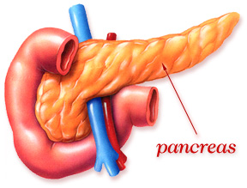

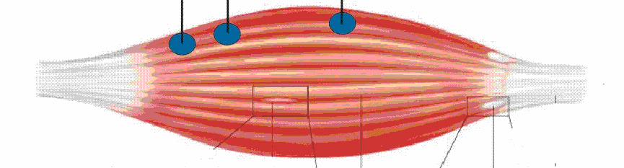
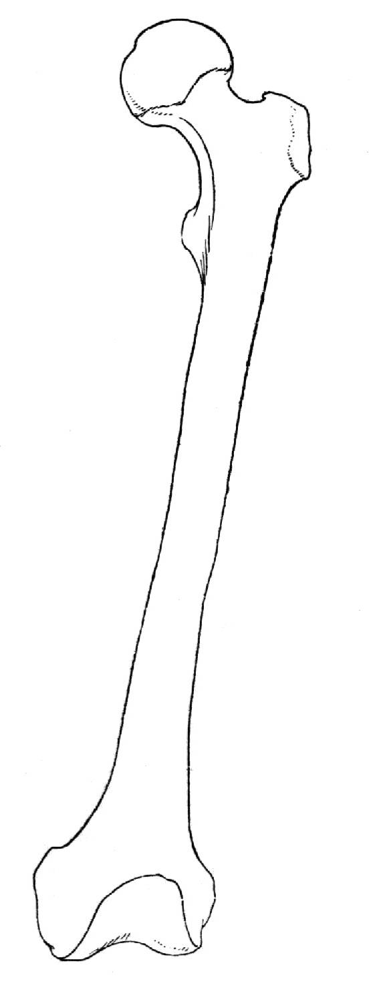
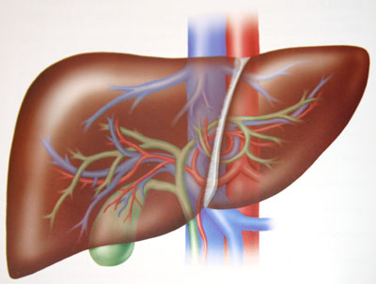
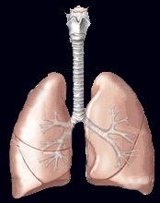
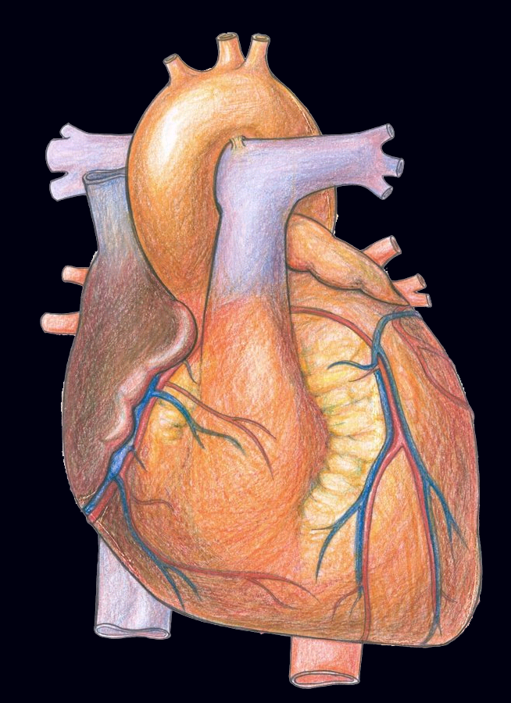
Complex Chronic Co-morbidities of COPD
Sindrome Metabolica
Diabete di Tipo 2
Debolezza/Deperimento
Muscolo
TNFa
IL-6
Infiammazione
Locale
?
Osteoporosi
Eventi
Cardiovascolari
PCR
Fegato
Fabbri, Beghé, Luppi and Rabe et al., Eur Respir J 2008; 31: 204-12

Slide 19
CLUSTERS OF OBJECTIFIED COMORBIDITIES AND SYSTEMIC INFLAMMATION IN PATIENTS WITH CHRONIC OBSTRUCTIVE PULMONARY DISEASE
Multimorbidity is common in COPD and different comorbidity clusters can be identified
Low-grade systemic inflammation occurs mostly in the metabolic comorbidity
cluster, but is comparable among other comorbidity clusters
Vanfleteren L.E.G.W., et al. AJRCCM 2013 Apr;187(7):728-35.

Slide 20
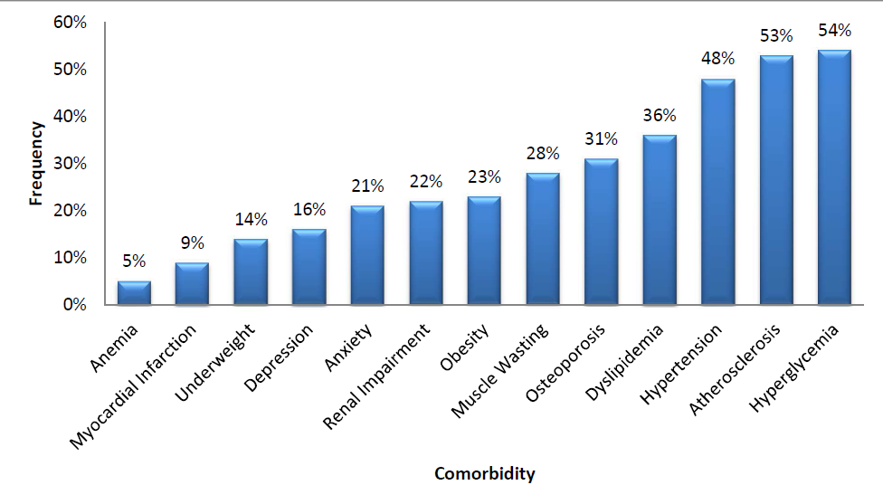
FREQUENCIES OF OBJECTIFIED COMORBIDITIES
Vanfleteren L.E.G.W., et al. AJRCCM 2013 Apr;187(7):728-35.

Slide 21
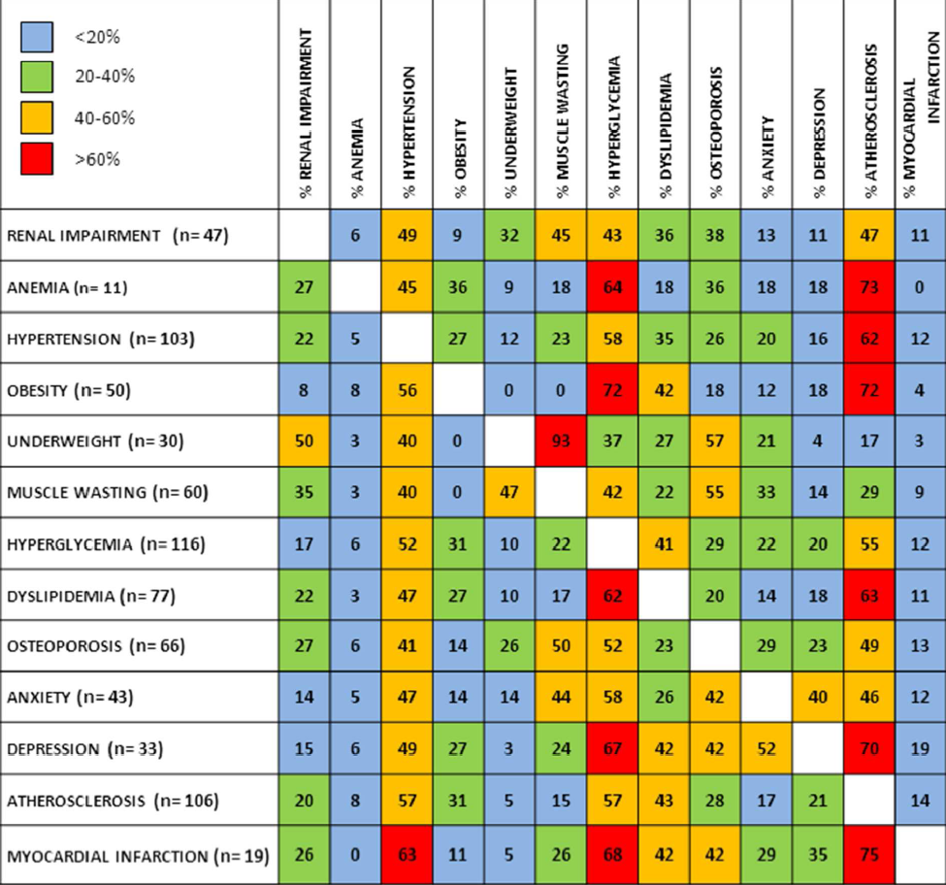
THE FREQUENCIES OF OBJECTIFIED COMORBIDITIES IN COPD PATIENTS WITH EACH OF THE 13
SELECTED SPECIFIC COMORBIDITIES
Vanfleteren L.E.G.W., et al. AJRCCM 2013 Apr;187(7):728-35.

Slide 22
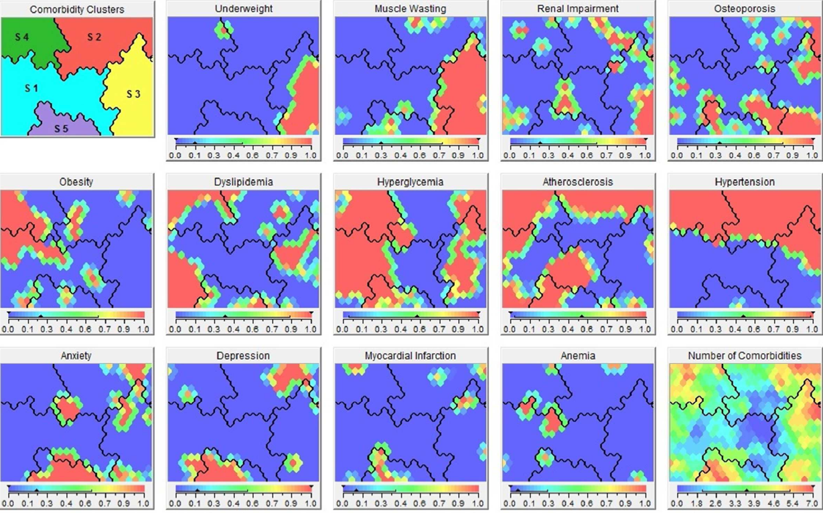
MULTIMORBIDITY CLUSTERS IN COPD
Vanfleteren L.E.G.W., et al. AJRCCM 2013 Apr;187(7):728-35

Slide 23
What do COPD Patients Die From?
Mannino et al, Resp Med, 2001

Slide 24
5-yrs mortality
The present study analysed data from 20,296 subjects aged >45 yrs at baseline in
the Atherosclerosis Risk in Communities Study (ARIC) and the Cardiovascular
Health Study (CHS).

Slide 25
Legend
OSA
Hyperlipidemia
50%
CVA
10%
Pulmonary HIN/RHF
CHF
PAD
Pulmonary Fibrosis
1/HR = 0.5
CAD
Lung Cancer
A. Fibrillation
Anxiety
BPH
Breast Cancer
Esophageal Cancer
Hypertension
CRF
Pancreatic Cancer
Diabetes
Diabetes
w. Neuropathy
Liver Cirrhosis
Erectile Dysfunction
Depression
Gastric Duodenal Ulcer
Substance abuse
DJD
GERD
Divo M et al, Am J Respir Cr Care Med 2012;186(2):155-61

Slide 26
Cardiovascular mortality in
COPD
For every 10% decrease in FEV₁, cardiovascular mortality increases by approximately 28% and non-fatal coronary event increases by approximately 20% in mild to moderate COPD
Anthonisen et al, Am J Respir Crit Care Med 2002

Slide 27
Relationship Between Lung Function Impairment and Incidence or Recurrence of Cardiovascular Events
in a Middle-Aged Cohort
0.3
GOLD 3 or 4
Restricted
0.2
GOLD 2
Risk of cardiovascular event
GOLD 0
GOLD 1
0.1
Normal
0
0
2
4
6
8
10
12
14
Years of follow-up
Johnston AK et al., Thorax 2008;63:599-605
Notes:
27

Slide 28
THE LUNG AND THE HEART:
SYNCRONY IN FATE
MULTIMORBIDITY
HISCHAEMIC HEART DISEASE AND COPD
CHRONIC HEART FAILURE AND COPD
COMPLEXITY OF ACUTE RESPIRATORY SYMPTOMS IN PATIENTS WITH COPD

Slide 29
ASSOCIATION OF HEART DISEASES WITH COPD AND RESTRICTIVE LUNG FUNCTION:
a population study
Ischemic heart disease
4% in subjects with normal spirometry
13% in COPD
21% in restrictive lung function
COPD was associated with ischemic heart disease and ischemic heart disease with COPD
Eriksson B et al, Respiratory Medicine (2013) 107, 98e106

Slide 30
CHRONIC OBSTRUCTIVE PULMONARY DISEASE AS A CARDIOVASCULAR RISK FACTOR. RESULTS OF A CASE–CONTROL STUDY (CONSISTE STUDY)
As compared to controls, COPD had
> ischemic heart disease 12.5% vs 4.7%
> cerebrovascular disease 10% vs 2%
> peripheral vascular disease 16.4% vs 4.1%
COPD > cardiovascular disease, > than expected given age and classic cardiovascular risk factors
de Lucas-Ramos et al, International Journal of COPD 2012; 679

Slide 31
CORONARY ARTERY DISEASE IS UNDER-DIAGNOSED AND UNDER-TREATED IN ADVANCED LUNG DISEASE
Patients with either COPD or ILD evaluated for lung transplantation
Coronary artery disease is common and under-diagnosed
Guideline recommended cardioprotective medications are suboptimally utilized in this population
Read LM et al, Am J Med 2012; 125:1228

Slide 32
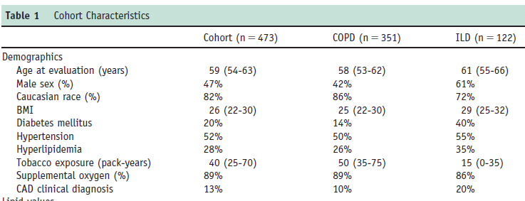
CORONARY ARTERY DISEASE IS UNDER-DIAGNOSED AND UNDER-TREATED IN ADVANCED LUNG DISEASE
Read RM et al, Am J Med 2012; 125:1228

Slide 33
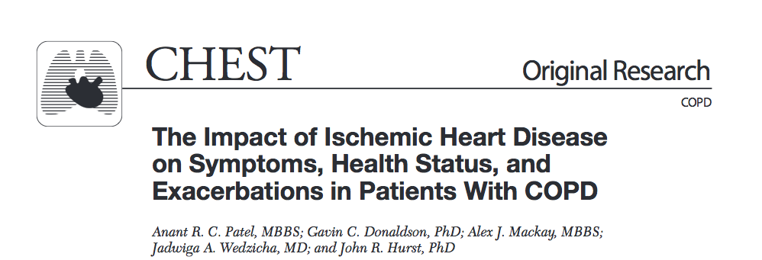
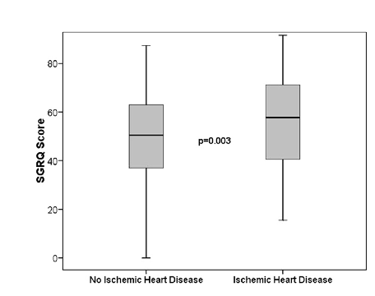
Chest 2012; 141(4):851–857
Notes:
worst functional status in AECOPD if concomitant ischemic disease

Slide 34
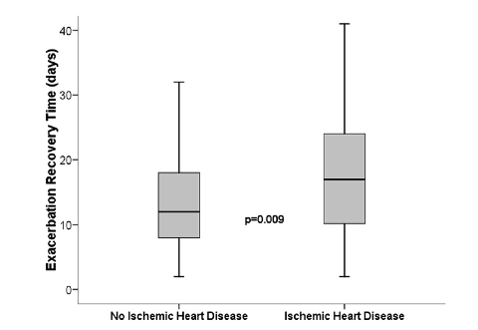
Chest 2012; 141(4):851–857
Notes:
Longer recovery time in AECOPD if concomitant ischemic disease

Slide 35
Summary of prevalence of airflow limitation at the study level (Evaluable patients)
 | Total (N=2776)
Airflow limitation
n | 2776
Yes | 819 (29.5%)
No | 1957 (70.5%)
95% CI (Yes) | [27.8%;31.2%]
Missing data | 0
 | Total (N=2776)
Post-bronchodilator %FEV1/FVC below the LLN
n | 2776
Yes [95% CI] | 395 (14.2%) [13.0%;15.6%]
 | Total (N=2776)
Reduced lung volumes with %FEV1/FVC > 0.7
n | 2776
Yes [95% CI] | 311 (11%) [13.0%;15.6%]
Soriano J ……. and Fabbri LM, 2013 in preparation

Slide 36
HIGH PREVALENCE AND UNDERDIAGNOSIS OF LUNG FUNCTION ABNORMALITIES IN PATIENTS WITH ISHEMIC HEART DISEASE
Fig 1: Prevalence and Under-diagnosis of Airflow Limitation
Soriano J ……. and Fabbri LM, 2013 in preparation
*COPD, chronic bronchitis or emphysema

Slide 37
HIGH PREVALENCE AND UNDERDIAGNOSIS OF LUNG FUNCTION ABNORMALITIES IN PATIENTS WITH ISHEMIC HEART DISEASE
Patients referring to a specialized cardiology center with documents ischemic heart disease, there is a very high prevalence (> 40%) of lung function abnormalities:
29% obstructive (COPD)
11% restrictive
Soriano J ……. and Fabbri LM, 2013 in preparation

Slide 38
IMPACT OF COPD ON LONG-TERM OUTCOME AFTER STEMI RECEIVING PRIMARY PCI
As compared to patients without COPD, patients with STEMI and concomitant COPD
> risk for death (25% vs 16.5%)
> hospital readmissions
> cardiovascular risk
due to recurrent MI, HF, bleedings
Campo G., et al. Chest. 2013 Sep;144(3):750-7

Slide 39
CUMULATIVE INCIDENCE OF ACUTE-CONGESTIVE HEART FAILURE ACCORDING TO PRESENCE OR NOT OF COPD
Campo G., et al. Chest. 2013 Sep;144(3):750-7

Slide 40
CHRONIC OBSTRUCTIVE PULMONARY DISEASE AND CEREBRAL MICROBLEEDS: THE ROTTERDAM STUDY
Our findings are compatible with an increased risk of COPD on the development of cerebral microbleeds in deep or infratentorial locations
Lahousse L et al. AJRCCM, 2013 Oct 1;188(7):783-8.

Slide 41
IDENTIFYING AND TREATING COPD IN CARDIAC PATIENTS
Patients with STEMI (and I would say any type of chronic CVD, ndr) must be properly investigated and possibly treated for concomitant diseases, particularly COPD and vice versa.
Nozzoli C, Beghè B, Boschetto P, and Fabbri LM. Chest Sep;144(3):723-6

Slide 42
THE LUNG AND THE HEART:
SYNCRONY IN FATE
MULTIMORBIDITY
HISCHAEMIC HEART DISEASE AND COPD
CHRONIC HEART FAILURE AND COPD
COMPLEXITY OF ACUTE RESPIRATORY SYMPTOMS IN PATIENTS WITH COPD

Slide 43
Prevalence of heart failure in stable ‘COPD’ (aged 65 years or over)
Rutten FH et al, Eur Heart J 2005;26:1887-94
405 ‘COPD‘
≥ 65years
244 (60.2%)
COPD (GOLD)
50 (20.5%)
heart failure
191 (39.8%)
‘rest’
33 (20.5%)
Heart failure
Rutten FH et al, Eur Heart J 2005;26:1887-94
Notes:
43

Slide 44
COPD vs. CHF
Up to 1\3 of elderly pts. with CHF have COPD
Up to 1\5 of elderly pts. with COPD have CHF
The risk ratio of developing HF in COPD pts is 4.5
The rate-adjusted hospital prevalence of CHF is 3 times greater among pts. discharged with a diagnosis of COPD compared with patients discharged without mention of COPD
14 million Americans have
COPD
and
5 million have
CHF
M. Padeletti-LeJemtel et al Int. J Cardiology, 2008
Notes:
Questi sono dati statunitensi in cui si stima che circa 14 milioni di soggetti sono affetti da COPD e 5 da CHF.
Circa 173 dei pazienti con scompenso cardiaco è probabile che abbiano la COPD e che un !75 della popolazione con COPD abbia anche lo scompenso cardiaco

Slide 45

ERS ANNUAL CONGRESS
BARCELONA, Spain 7 – 11 September
The utility of echocardiography in elderly smokers with COPD and of spirometry in elderly smokers with CHF
Beghe B, …… Fabbri LM, and Boschetto P, PLoS One 2013 Nov 11;8(11):e80166.
Department of Respiratory Diseases
University of Modena & Reggio Emilia, Italy

Slide 46


Results
COPD patients
CHF patients
Airflow limitation*
34%
Left ventricular dysfunction
0%
NO
Airflow limitation
66%
* Only 6 out of 42 patients were aware and properly treated
Beghe B, …… Fabbri LM, and Boschetto P, PLoS One 2013 Nov 11;8(11):e80166.

Slide 47
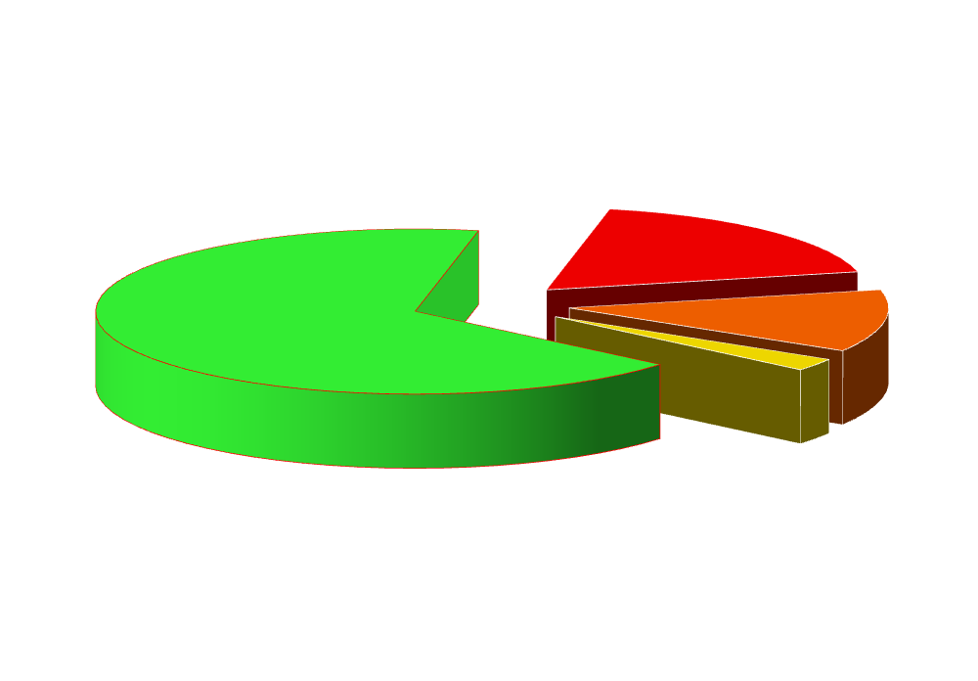
Results
Up to 1/3 of CHF had fixed airflow limitation
GOLD I
NO Airflow
limitation
GOLD II
GOLD III
Beghe B, …… Fabbri LM, and Boschetto P, PLoS One 2013 Nov 11;8(11):e80166.

Slide 48
COPD IN CHRONIC HEART FAILURE: LESS COMMON THAN PREVIOUSLY THOUGHT?
COPD prevalence
19.8% (LLN-COPD) vs 32.1% (GOLD-COPD)
One fifth, rather than one third, of the patients with chronic HF had concomitant COPD using the LLN instead of the fixed ratio
Minasian AG et al, Heart & Lung 2013; 42:365-371

Slide 49
Why is heart failure important?
doubles mortality of patients with COPD
primary care patients with COPD ≥ 65 years (n=404)
adjusted HR 2.1 (1.2–3.6)
1.0
0.9
0.8
Survival
0.7
COPD
COPD GOLD
0.6
COPD + Heart Failure
COPD GOLD + Heart Failure
0.5
0
12
24
36
48
60
72
Time (Months)
Boudestein LC et al. Eur J Heart Fail 2009; 11:1182-8.
Notes:
Perché è importante diagnsticare la presenza di CHF in pazienti con COPD?
Questo studio analizza l’impatto della presenza di CHF sulla sopravvivenza di soggetti con e si dimostra che i soggetti diagnosticati con criteri GOLD e (verosimilmente con diagnosi più accurata) hanno una mortalità quasi raddoppiata rispetto i soggetti senza CHF.
AIMS: To compare prognosis in patients with chronic obstructive pulmonary disease (COPD) with or without concomitant heart failure. METHODS AND RESULTS: Patients aged 65 years or over with a general practitioner (GP)'s diagnosis of COPD but without a prior diagnosis of heart failure underwent an extensive diagnostic work-up including echocardiography and pulmonary function tests in the period 2001-03. An expert panel then confirmed the presence or absence of COPD according to the GOLD criteria and (previously undiagnosed) heart failure according to the criteria of the ESC heart failure guidelines. This cohort of 405 patients was followed up for a mean duration of 4.2 (SD 1.4) years. The GP's electronic medical files relating to the participants, including any specialist letters, were scrutinized until April 2007 for information about drug use, exacerbations of COPD, pneumonia, hospitalizations, death, and cause of death. The mean age of patients at the start of the study was 73.0 (SD 5.3) years, and 54% were male. The presence of newly detected heart failure significantly increased all-cause mortality independent of gender, age, history of ischaemic heart disease, hypertension, diabetes mellitus, atrial fibrillation, smoking, and cardiovascular drug use at baseline (adjusted hazard ratio, 2.1; 95% confidence interval, 1.2-3.6; P = 0.01). CONCLUSION: Heart failure is a strong independent predictor of all-cause mortality in patients with a diagnosis of COP
Section 3: Diuretic Therapy in Acute Decompensated Heart Failure

Slide 50
IMPACT OF COMORBIDITY ON MORTALITY AMONG OLDER PERSONS WITH ADVANCED HEART FAILURE
Comorbidity confers a significantly increased mortality risk even among older adults with an overall high mortality risk due to HF
Clinicians who routinely care for this population should consider the impact of comorbidity on outcomes in their overall management of HF
Such information may also be useful when considering the risks and benefits of aggressive, high-intensity life-prolonging interventions
Ahluwalia et al, J Gen Internal Med 2012; 275: 513-9
Notes:
Diabetes Intervention Study (1)
L’importanza della glicemia postprandiale come fattore di rischio cardiovascolare è stata dimostrata anche per i pazienti diabetici Tipo 2 in questo studio condotto in 1139 pazienti diabetici di Tipo 2 di nuova diagnosi.

Slide 51
IMPACT OF NONCARDIAC COMORBIDITIES ON MORBIDITY AND MORTALITY IN A PREDOMINANTLY MALE POPULATION WITH HEART FAILURE AND PRESERVED VERSUS REDUCED EJECTION FRACTION
There is a higher non-cardiac comorbidity burden associated with > non-HF hospitalizations in patients with HFpEF compared with those with HFrEF
However, individually, most comorbidities have similar impacts on mortality in both groups
Aggressive management of comorbidities may have an overall greater prognostic impact in HFpEF compared to HFrEF
Ather et al, Am Coll Cardiol 2012;59:998–1005
Notes:
Diabetes Intervention Study (1)
L’importanza della glicemia postprandiale come fattore di rischio cardiovascolare è stata dimostrata anche per i pazienti diabetici Tipo 2 in questo studio condotto in 1139 pazienti diabetici di Tipo 2 di nuova diagnosi.

Slide 52
COPD AND HISCHAEMIC HEART DISEASE
MULTIMORBIDITY
ISCHAEMIC HEART DISEASE AND COPD
CHRONIC HEART FAILURE AND COPD
COMPLEXITY OF ACUTE RESPIRATORY SYMPTOMS IN PATIENTS WITH COPD

Slide 53
COPD exacerbations
COPD
Chronic disease
Exacerbations
progressive nature
lung function
symptoms
comorbidities
typically 1 - 3 per year
frequency proportional
to COPD severity
the frequent exacerbator
chronic decline resulting
in poorer prognosis
➢ ↓ HRQL
➢ ↑ hospitalizations
➢ ↑ mortality
Tashkin D. N Engl J Med 2010; 363: 1184
Hurst et al, N Engl J Med 2010; 363: 1128-38
Notes:
53
Vestbo J. What is an exacerbation of COPD? European Respiratory Review 2004;13:6–13
Synopsis: This review explores the different ways in which exacerbations of COPD are defined and examines the aetiology of these events and the burden they impose on patients and society in terms of morbidity, mortality, HRQL and costs. The impact of ICS and ICS/LABA combinations, including Symbicort, on exacerbations and related outcomes are discussed.
Published abstract: Patients with chronic obstructive pulmonary disease (COPD) experience acute exacerbations that increase in frequency with disease severity. Exacerbations may be defined in various ways, depending on the needs of researchers, clinicians, patients or healthcare payers. At present, action-based definitions (based on the need for treatment with oral corticosteroids, antibiotics, or both, and/or hospitalisation due to respiratory symptoms) are the best available for the purposes of comparing medical treatments that may reduce or prevent exacerbations. Further research is required to elucidate the mechanisms underlying COPD exacerbations, including the possible role of eosinophils. Exacerbations of COPD accelerate lung function decline, increase the risk of hospitalisation and death, cause sustained impairment of health status, and generate substantial socio-economic costs. Combination therapy with inhaled corticosteroids and long-acting β₂-agonists reduces the frequency of exacerbations, in addition to improving lung function, symptoms and health status and, possibly, lowering the risk of mortality. In summary, a greater awareness of the pathogenesis of exacerbations and their impact is necessary to encourage optimal treatment. Interventions that effectively prevent or treat exacerbations, such as inhaled corticosteroids/long-acting β₂-agonists combination therapy, have the potential to significantly reduce the impact of chronic obstructive pulmonary disease on patients and society.
This material has been supplied by AstraZeneca to you under licence from the copyright owner, and may not be recopied or redistributed outside AstraZeneca without permission from the copyright owner.

Slide 54
EXACERBATIONS OF RESPIRATORY SYMPTOMS IN PATIENTS WITH COPD MAY NOT BE EXACERBATIONS OF COPD
Beghe B, Verduri A, Roca M and Fabbri LM. Eur Respir J 2013, April 1; 41: 993-5
Roca M, Verduri A, Clini EM, Fabbri LM and Beghè B. Eur J Clin Invest, Feb 11, 2013

Slide 55
Biochemical Markers of Cardiac Dysfunction Predict Mortality in
Acute Exacerbations of COPD
Elevated levels of NT-proBNP and troponin T are strong predictors of early mortality among patients admitted to hospital with acute exacerbations of COPD independently of other known prognostic indicators
The pathophysiological basis for this is unknown, but indicates that cardiac involvement in exacerbations of COPD may be an important determinant of prognosis
Chang CL et al, Thorax, available on line 9 june 2011

Slide 56
ACUTE EXACERBATION OF COPD IS ASSOCIATED WITH 4-FOLD ELEVATION OF CARDIAC TROPONIN T
AECOPD is associated with higher hscTnT as compared with stable COPD
In stable COPD, hs-cTnT appears to be positively associated with indices of COPD severity
No clear determinants of hs-cTnT in AECOPD
Søyseth V, et al. Heart 2013;99:122–126.

Slide 57
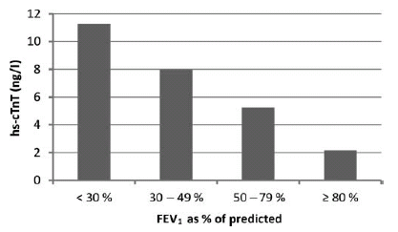
ACUTE EXACERBATION OF COPD IS ASSOCIATED WITH 4-FOLD ELEVATION OF CARDIAC TROPONIN T
Søyseth V, et al. Heart 2013;99:122–126.

Slide 58

ACUTE EXACERBATION OF COPD IS ASSOCIATED WITH 4-FOLD ELEVATION OF CARDIAC TROPONIN T
Søyseth V, et al. Heart 2013;99:122–126.

Slide 59
RAISED TROPONIN LEVELS IN COPD: A POSSIBLE MECHANISM
A possible mechanisms which could account at least in part for the troponin rises detected in both
acute exacerbation of COPD and stable COPD could be right ventricular myocardial
necrosis and inflammation, thought secondary
to increased right ventricular stretch and
strain
Orde MM. Heart 2013;99:894.

Slide 60
A postmortem analysis of major causes of early death in patients hospitalized with COPD exacerbation
Forty-three pts. with a hospital admission diagnosis of COPD exacerbation underwent autopsy; all had died within 24 h of admission to the hospital.
The main (primary) causes of death:
cardiac failure, 37.2%,
pneumonia, 27.9%,
pulmonary thromboembolism, 20.9%.
respiratory failure due to a progression of COPD, 14%
77% of pts. had more then one comorbid disease and the
most frequent was chronic heart failure (58%).
None was receiving β-blockers.
Zvezdin B et al. Chest 2009;136:376-380
Notes:
BACKGROUND: Mortality from COPD is increasing worldwide, but detailed causes of death are rarely assessed, particularly in low-income countries.
METHODS: In a retrospective study, we reviewed the autopsy reports and medical records of deceased patients admitted to the hospital for severe exacerbation of COPD, from January 2005 to December 2007, at the Institute for Pulmonary Diseases of Vojvodina, Serbia.
RESULTS: Forty-three patients with a hospital admission diagnosis of COPD exacerbation underwent autopsy; all had died within 24 h of admission to the hospital. Twenty-three patients (54%) had a long COPD history (> 10 years), and 19 patients (44%) had more than one hospitalization in the last year of life. The median age at death was 70 years (interquartile range, 65 to 75 years), and male sex was predominant (n = 31; 72%). The main (primary) causes of death were reported as cardiac failure (n = 16; 37.2%), pneumonia (n = 12; 27.9%), and pulmonary thromboembolism (PTE) (n = 9; 20.9%). Respiratory failure due to a progression of COPD was the primary cause of death in six patients (14%). Most patients had more then one comorbid disease (n = 33; 77%), and the most frequent comorbid disease was chronic heart failure (n = 25; 58%).
CONCLUSIONS: Autopsy results suggest that common contributing causes of early death in patients hospitalized with severe COPD exacerbation are concomitant complications, as follows: cardiac failure, pneumonia, and PTE. Quality improvement interventions should focus on recognizing and treating these conditions at the time of hospital admission

Slide 61
Mechanisms of risk for cardiovascular events in ECOPD
Exacerbation of airway and lung inflammation in COPD
↑von Willebrand factor ↑Fibrinogen ↑Microalbuminuria
↑von Willebrand factor ↑D-dimer ↑Prothrombin,↑IL6
Systemic inflammation, VEGF elevation
Alteration of flow-mediated vascular dilatation
↑Circulating platelet–monocyte aggregates
Endothelial dysfunction
↑Endothelial progenitor cells
Platelet activation
Prothrombotic condition
Elevated risk for acute cardiovascular events
Roca M, et al. Eur J Clin Invest. 2013;43:510-21

Slide 62
Pulmonary embolism – cause of respiratory symptoms exacerbations in COPD
Pulmonary embolism
Pulmonary artery acute obstruction
Alveolar haemorrhage
Bronchopulmonary C-fibres
Dead space sudden increase in lung parenchima
Bronchoconstriction
Atelectasis,
injured parenchyma
Ventilation/perfusion mismatch
Hypercapnia
Hypoxemia
Carotid arterial chemoreceptor
Rapidly adapting stretch receptor, J receptor
Vascular chemoreceptor
DYSPNOEA
Moua T, et al. Int J Chron Obstruct Pulmon Dis. 2008; 3: 277–284.

Slide 63
. . . . Main Take Home Messages
COPD IS ALMOST INVARIABLY WITH CHRONIC COMORBIDITIES RELATED TO COMMON RISK FACTORS, PARTICULARLY SMOKING AND AGEING
COPD EXACERBATIONS SHOULD BE RENAMED EXACERBATIONS OF RESPIRATORY SYMPTOMS IN PATIENTS WITH COPD
CARDIOVASCULAR COMORBIDITIES, AND PARTICULARLY ISCHEMIC HEART DISEASE AND CHRONIC HEART FAILURE, CARRY IMPORTANT NEGATIVE PROGNOSTIC WEIGHT IN PATIENTS WITH COPD

Slide 64
THE LUNG AND THE HEART:
SYNCRONY IN FATE
MULTIMORBIDITY
HISCHAEMIC HEART DISEASE AND COPD
CHRONIC HEART FAILURE AND COPD
COMPLEXITY OF ACUTE RESPIRATORY SYMPTOMS IN PATIENTS WITH COPD

Slide 65
The Lung and the Heart: syncrony in fate
BARCELONA
LUNG CONFERENCE
BOSTON
Barcelona 24-25 January 2014

