Slide 1
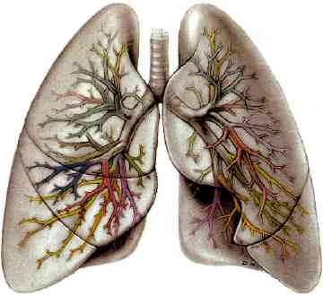
COPD AND COMORBIDITIES
Dr. Pratik Kumar

Slide 2
Reference :
Fishman’s Pulmonary Diseases and Disorders Edition- 4
Global Initiative for Chronic Obstructive Lung Disease (GOLD) guideline: 2014 Update
American Thoracic Society and European Respiratory Society guideline: 2004 Update

Slide 3
Definition and Overview
Pathology, Pathogenesis and Pathophysiology
Diagnosis and Assessment
Therapeutic Options
Manage Stable COPD
Manage Exacerbations
Comorbidities and Management

Slide 4
DEFINITION OF COPD
COPD is a common preventable and treatable disease, is characterized by persistent airflow limitation that is usually progressive and associated with an enhanced chronic inflammatory response in the airways and the lung to noxious particles or gases.
Exacerbations and comorbidities contribute to the overall severity in individual patients.
© 2014 Global Initiative for Chronic Obstructive Lung Disease

Slide 5
Burden of COPD
COPD is a leading cause of morbidity and mortality worldwide.
The burden of COPD is projected to increase in coming decades due to continued exposure to COPD risk factors and the aging of the world’s population.
COPD is associated with significant economic burden.
© 2014 Global Initiative for Chronic Obstructive Lung Disease

Slide 6
Natural history
COPD has a variable natural history and not all individuals follow the same course.
It is increasingly apparent that COPD often has its roots decades before the onset of symptoms
Impaired growth of lung function during childhood and adolescence, caused by recurrent infections or tobacco smoking, may lead to lower maximally attained lung function in early adulthood.
This abnormal growth will, often combined with a shortened plateau phase in teenage smokers, increase the risk of COPD.

Slide 7
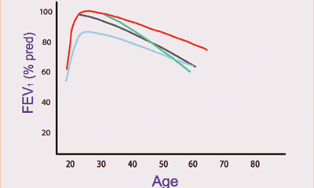
Natural history
The normal course of forced expiratory volume in one second (FEV1) over time (–––)
is compared with the result of impaired growth of lung function (–––), an accelerated decline
(–––) and a shortened plateau phase (–––). All three abnormalities can be combined.

Slide 8
Natural history
An accelerated decline in lung function is nevertheless still the single most important feature of COPD.
COPD is generally a progressive disease, especially if the patient’s exposure to noxious substances, most often tobacco smoking, continues.
If exposure is stopped, the disease may still progress, mainly due to the decline in lung function that normally occurs with ageing.
Nevertheless, stopping exposure to noxious agents, even after significant airflow limitation is present, can result in some improvement in function and will slow or even hold the progression of the disease.

Slide 9
Risk Factors for COPD
Genes
Exposure to particles
Tobacco smoke
Occupational dusts, organic and inorganic
Indoor air pollution from heating and cooking with biomass in poorly ventilated dwellings
Outdoor air pollution
Lung growth and development (Peri natal events and childhood respiratory illness)
Gender (Male)
Age
Respiratory infections
Socioeconomic status
Asthma/Bronchial hyperreactivity
Chronic Bronchitis
© 2014 Global Initiative for Chronic Obstructive Lung Disease

Slide 10
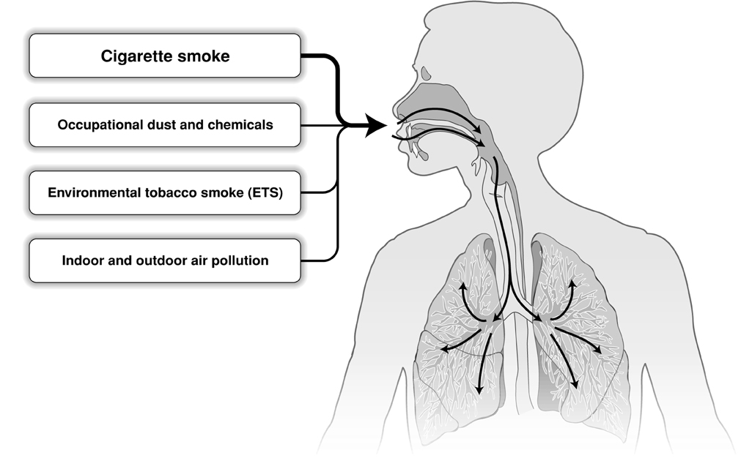
Risk Factors for COPD
Genes
Infections
Socio-economic status
Aging Populations
© 2014 Global Initiative for Chronic Obstructive Lung Disease

Slide 11
MECHANISMS UNDERLYING AIRFLOW LIMITATION IN COPD
Small Airways Disease
Airway inflammation
Airway fibrosis, luminal plugs
Increased airway resistance
Parenchymal Destruction
Loss of alveolar attachments
Decrease of elastic recoil
AIRFLOW LIMITATION
© 2014 Global Initiative for Chronic Obstructive Lung Disease

Slide 12
Pathology, pathogenesis and pathophysiology
COPD comprises pathological changes in four different compartments of the lungs:
Central airways
Peripheral airways
Lung parenchyma and
Pulmonary vasculature
which are variably present in individuals with the disease.

Slide 13
Pathology
Central airways (cartilaginous airways >2mm of internal diameter)
Bronchial glands hypertrophy and goblet cell metaplasia occurs.
Results in excessive mucous production or chronic bronchitis.
Cell infiltrates also occur in bronchial glands.
Airway wall changes include squamous metaplasia of the airway epithelium, loss of cilia and ciliary dysfunction, and increased smooth muscle and connective tissue.

Slide 14
Different inflammatory cells predominate in different compartments of the central airways.
In the airways wall these are lymphocytes, predominantly of the CD8+ type, but as the disease progresses neutrophils also become prominent.
In the airspaces, in addition to lymphocytes, neutrophils and macrophages can also be identified.

Slide 15
Peripheral airways (noncartilaginous airways <2mm internal diameter)
Bronchiolitis is present in the peripheral airways at an early stage of the disease.
There is pathological extension of goblet cells and squamous metaplasia in the peripheral airways.
The inflammatory cells in the airway wall and airspaces are similar to those in the larger airways.
As the disease progresses, there is fibrosis and increased deposition of collagen in the airway walls.

Slide 16
Lung parenchyma (respiratory bronchioles, alveoli and capillaries)
Emphysema, defined as an abnormal enlargement of air spaces distal to the terminal bronchioles, occurs in the lung parenchyma in COPD.
As a result of emphysema there is a significant loss of alveolar attachments, which contributes to peripheral airway collapse.

Slide 17
There are two major types of emphysema:
Centrolobular ( involves dilatation and destruction of the respiratory bronchioles); and
2) Panlobular emphysema ( involves destruction of the whole of the acinus).

Slide 18
The former is the most common type of emphysema in COPD and is more prominent in the upper zones, while the latter predominates in patients with α1-antitrypsin deficiency and is more prominent in the lower zones.
In the early stages of the disease, these are microscopic lesions.

Slide 19
During the course of the disease, they may progress to macroscopic lesions or bullae (defined as an emphysematous space >1 cm in diameter).
Bullous disease can also occur in the absence of COPD.
The inflammatory cell profile in the alveolar walls and the airspaces is similar to that described in the airways and persists throughout the course of the disease.
There is some evidence suggesting the persistence of inflammation in the proximal and distal airspaces after smoking cessation.

Slide 20
Pulmonary vasculature
Pulmonary vascular changes begin early during the course of the disease.
Initially, these changes are characterised by thickening of the vessel wall and endothelial dysfunction.
These are followed by increased vascular smooth muscle and infiltration of the vessel wall by inflammatory cells, including macrophages and CD8+ T lymphocytes.

Slide 21
In advanced stages of the disease, there is collagen deposition and emphysematous destruction of the capillary bed.
Eventually, these structural changes lead to pulmonary hypertension and right ventricular dysfunction (cor pulmonale).

Slide 22
Pathogenesis
Tobacco smoking is the main risk factor for COPD, although other inhaled noxious particles and gases may also contribute.
This causes an inflammatory response in the lungs of all smokers.
Some smokers display an exaggeration of this normal, protective inflammatory response to these inhalation exposures, which eventually causes tissue destruction, impairs the defence mechanisms that limit such destruction and disrupts the repair mechanisms, leading to the characteristic pathological lesions of COPD.

Slide 23
In addition to inflammation, two other processes that are also important in the pathogenesis of COPD are an imbalance of proteinases and antiproteinases in the lungs, and oxidative stress.
Inflammation
COPD is characterised by an increase in neutrophils, macrophages and T-lymphocytes (specifically CD8+) in various parts of the lungs, which relate to the degree of airflow limitation.

Slide 24
There may be an increase in eosinophils in some patients, particularly during exacerbations.
These inflammatory cells are capable of releasing a variety of cytokines and inflammatory mediators, most notably leukotriene-4, interleukin-8 and tumour necrosis factor-α.
This inflammatory pattern is markedly different from that seen in patients with bronchial asthma.
Inflammatory changes may persist after quitting smoking.

Slide 25
Proteinase and antiprotease imbalance
This may occur in COPD due to increased production (or activity) of proteinases or inactivation (or reduced production) of antiproteinases.
Cigarette smoke (and possibly other COPD risk factors), as well as inflammation itself, can produce oxidative stress that, on the one hand, primes several inflammatory cells (macrophages, neutrophils) to release a combination of proteinases and, on the other hand, decreases (or inactivates) several antiproteinases by oxidation.

Slide 26
The major proteinases involved in the pathogenesis of COPD include those produced by neutrophils (elastase, cathepsin G and proteinase-3) and macrophages (cathepsins B, L and S), and various matrix metalloproteinases (MMP).
The major antiproteinases involved in the pathogenesis of COPD include, α1-antitrypsin, secretory leukoproteinase inhibitor and tissue inhibitors of MMPs.
Neutrophil elastase not only contributes to parenchymal destruction but it is also a very potent inducer of mucous secretion and mucous gland hyperplasia.

Slide 27
Oxidative stress
Different markers of oxidative stress are found in increased amounts in the lungs, exhaled air breath condensate and urine of smokers and patients with COPD, including hydrogen peroxide, nitric oxide and lipid peroxidation products (isoprostane F2α-III).

Slide 28
Oxidative stress can contribute to COPD by oxidising a variety of biological molecules (that can lead to cell dysfunction or death), damaging the extracellular matrix, inactivating key antioxidant defences (or activating proteinases) or enhancing gene expression (either by activating transcription factors (e.g. nuclear factor-κB) or promoting histone acetylation).

Slide 29
Pathophysiology
The different pathogenic mechanisms discussed above produce the pathological changes, which, in turn, give rise to the following physiological abnormalities in COPD: mucous hypersecretion and cilliary dysfunction, airflow limitation and hyperinflation, gas exchange abnormalities, pulmonary hypertension, and systemic effects.

Slide 30
Mucous hypersecretion and cilliary dysfunction
These are typically the first physiological abnormalities in COPD.
Mucous hypersecretion is due to stimulated secretion from enlarged mucous glands.
Cilliary dysfunction due to squamous metaplasia of epithelial cells.

Slide 31
Airflow limitation and hyperinflation
Expiratory (largely irreversible) airflow limitation is the physiological hallmark of COPD.
The major site of the airflow limitation is in the smaller conducting airways <2 mm in diameter and is mainly due to airway remodelling (fibrosis and narrowing).

Slide 32
Other factors that also contribute include loss of elastic recoil (due to destruction of alveolar walls), destruction of alveolar support (alveolar attachments), accumulation of inflammatory cells, mucous and plasma exudate in the bronchi, and smooth muscle contraction and dynamic hyperinflation during exercise.

Slide 33
Gas exchange abnormalities
These occur in advanced disease and are characterised by arterial hypoxaemia with or without hypercapnia.
An abnormal distribution of ventilation-perfusion ratios is the main mechanism of abnormal gas exchange in COPD.
An abnormal diffusing capacity of carbon monoxide per litre of alveolar volume correlates well with the severity of the emphysema.

Slide 34
Pulmonary hypertension
This occurs late in the course of COPD, normally after the development of severe gas exchange abnormalities.
Factors contributing to pulmonary hypertension in COPD include vasoconstriction (mostly of hypoxic origin), endothelial dysfunction, remodelling of pulmonary arteries and destruction of the pulmonary capillary bed.

Slide 35
This combination of events may eventually lead to right ventricular hypertrophy and dysfunction (cor pulmonale).
Systemic effects
COPD is associated with extrapulmonary effects, including systemic inflammation and skeletal muscle wasting.
These systemic effects contribute to limit the exercise capacity of these patients and to worsen prognosis, independent of their pulmonary function.

Slide 36
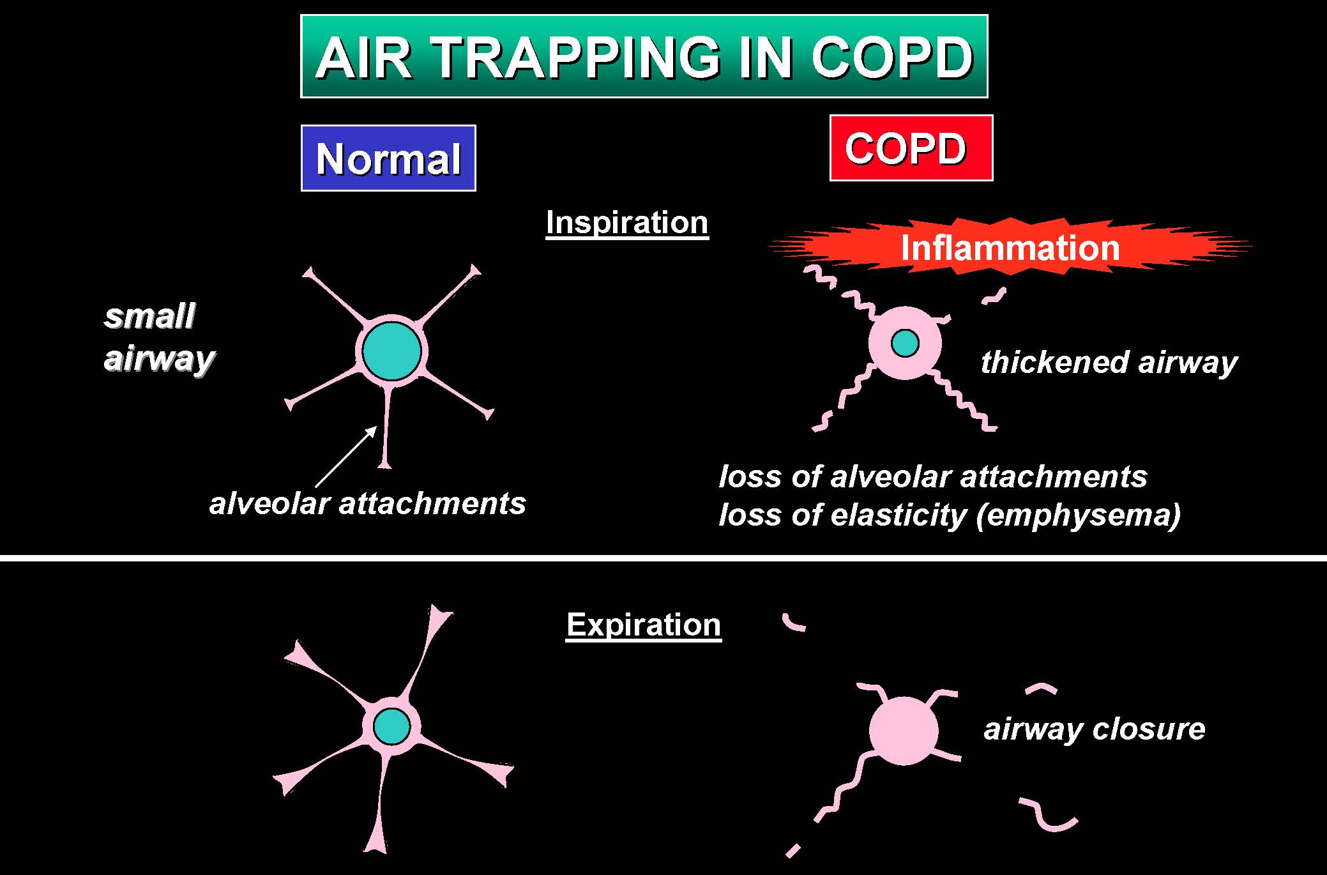

Slide 37
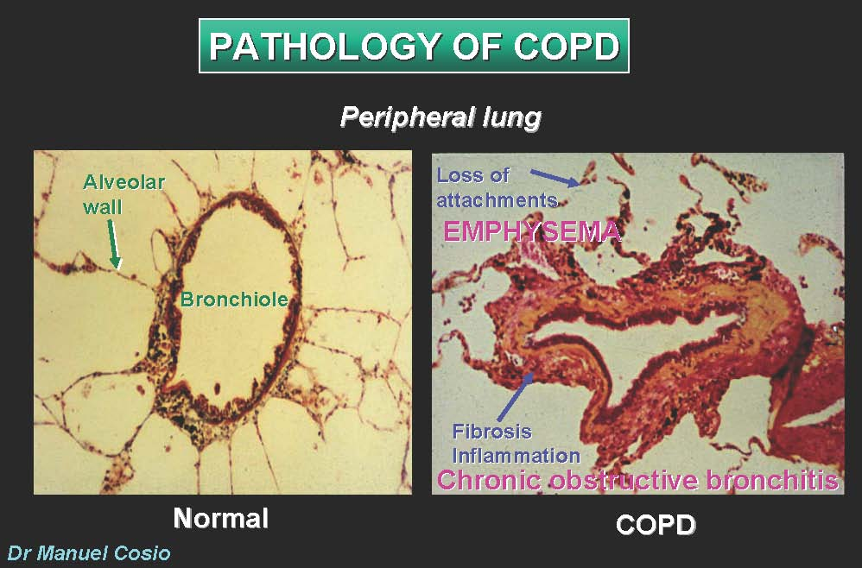

Slide 38
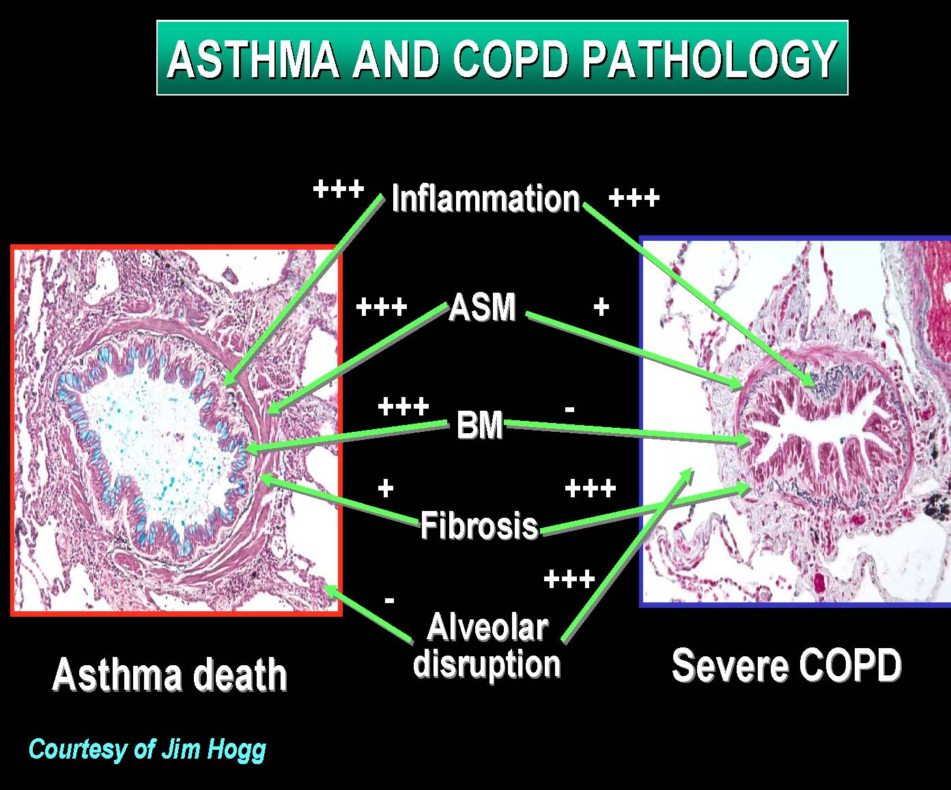

Slide 39
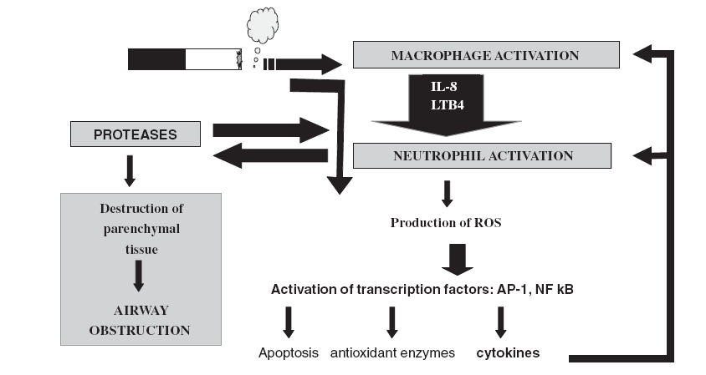
(Inflammation)
Chronic Disease

Slide 40
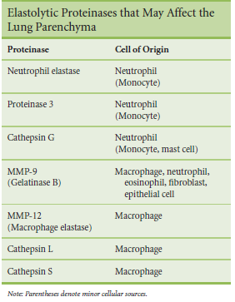

Slide 41
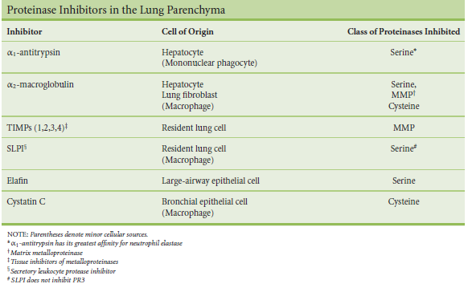

Slide 42
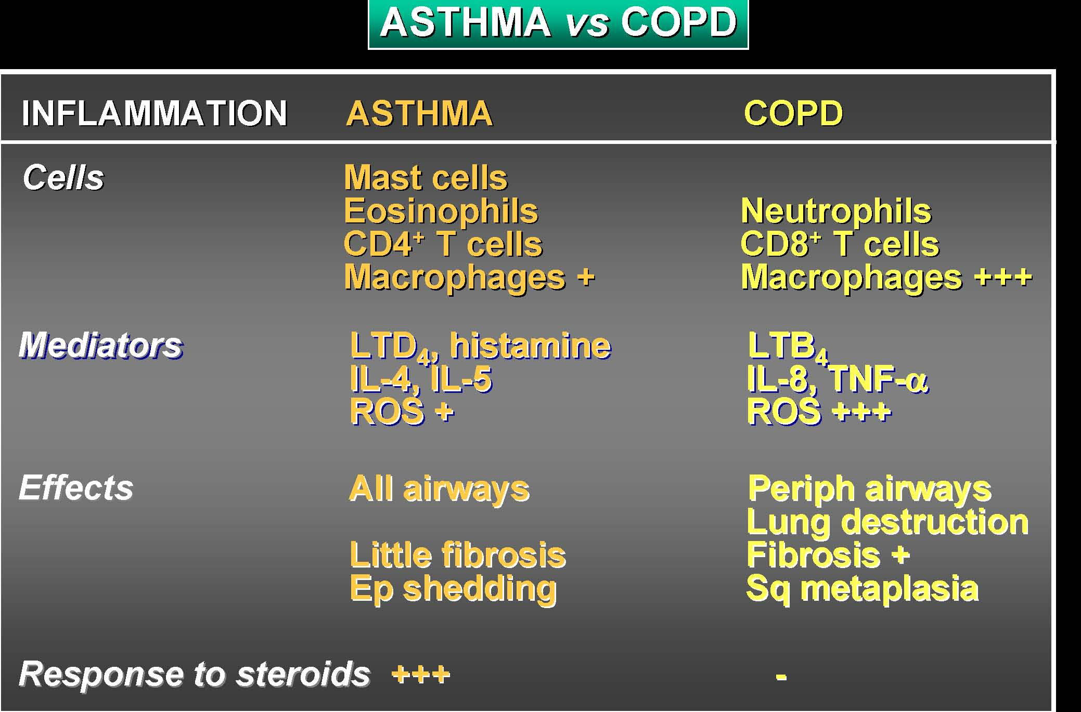
Professor Peter J. Barnes, MD
National Heart and Lung Institute, London UK

Slide 43
Differential Diagnosis of Airspace Enlargement
 | Distribution | Enlarged Structure
Centrilobular emphysema | Upper lobes, center of lobule | Alveolar ducts, alveoli
Panlobular emphysema | Lower lobe, uniform in lobule | Alveoli
Paraseptal emphysema | Apical, adjacent to septum | Alveoli
Irregular emphysema | No typical site, adjacent to scars | Alveoli
Aging | Uniform in lung | Alveolar duct
Compensatory alterations | Uniform in lung | Alveoli
Obstructive alterations Genetic alterations Asthma Honeycomb lung | Affected area Uniform in lung During acute attack Variable—often subpleural | Alveoli Lack of septuation Alveoli Total remodeling

Slide 44
Diagnosis and Assessment: Key Points
A clinical diagnosis of COPD should be considered in any patient who has dyspnea, chronic cough or sputum production, and a history of exposure to risk factors for the disease.
Spirometry is required to make the diagnosis; the presence of a post-bronchodilator FEV₁/FVC < 0.70 confirms the presence of persistent airflow limitation and thus of COPD.
© 2014 Global Initiative for Chronic Obstructive Lung Disease

Slide 45
Diagnosis and Assessment: Key Points
The goals of COPD assessment are to determine the severity of the disease, including the severity of airflow limitation, the impact on the patient’s health status, and the risk of future events.
Comorbidities occur frequently in COPD patients, and should be actively looked for and treated appropriately if present.
© 2014 Global Initiative for Chronic Obstructive Lung Disease

Slide 46
Diagnosis of COPD
EXPOSURE TO RISK
FACTORS
SYMPTOMS
shortness of breath
tobacco
chronic cough
occupation
sputum
indoor/outdoor pollution
SPIROMETRY: Required to establish diagnosis
© 2014 Global Initiative for Chronic Obstructive Lung Disease

Slide 47
Assessment of Airflow Limitation:
Spirometry
Spirometry should be performed after the administration of an adequate dose of a short- acting inhaled bronchodilator to minimize variability.
A post-bronchodilator FEV₁/FVC < 0.70 confirms the presence of airflow limitation.
Where possible, values should be compared to age-related normal values to avoid overdiagnosis of COPD in the elderly.
© 2014 Global Initiative for Chronic Obstructive Lung Disease

Slide 48
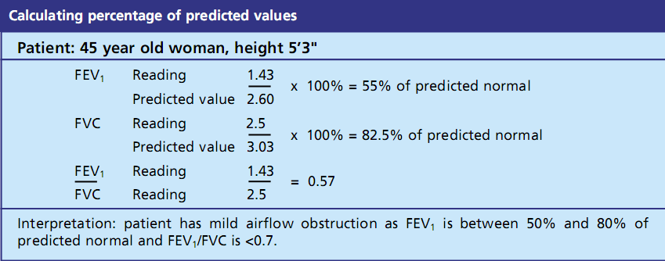
mod

Slide 49
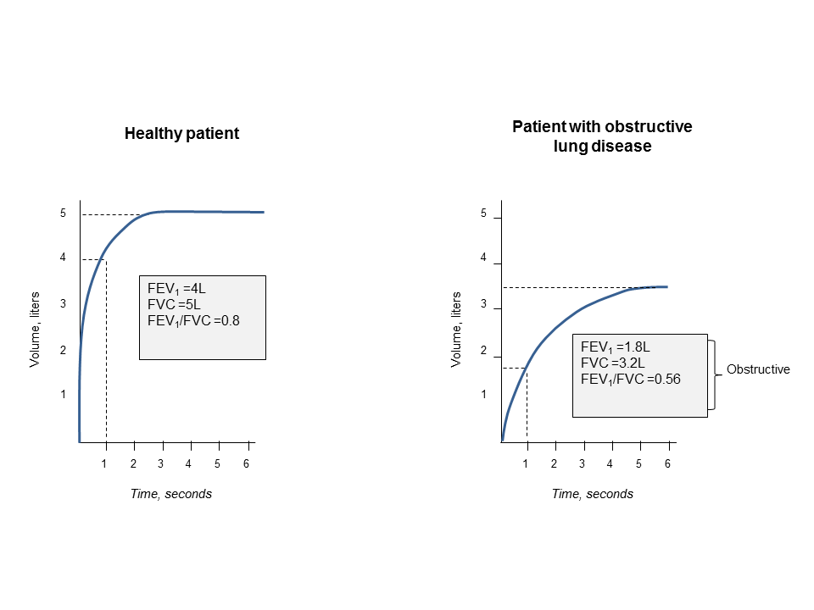
Spirometry:
5
4
3
Volume, liters
2
1
1
2
3
4
5
6
Time, seconds
© 2014 Global Initiative for Chronic Obstructive Lung Disease

Slide 50
Assessment of COPD: Goals
Determine the severity of the disease, its impact on the patient’s health status and the risk of future events (for example exacerbations) to guide therapy. Consider the following aspects of the disease separately:
current level of patient’s symptoms
severity of the spirometric abnormality
frequency of exacerbations
presence of comorbidities.
© 2014 Global Initiative for Chronic Obstructive Lung Disease

Slide 51
Assessment of COPD
Assess symptoms
Assess degree of airflow limitation using spirometry
Assess risk of exacerbations
Assess comorbidities
© 2014 Global Initiative for Chronic Obstructive Lung Disease

Slide 52
Symptoms of COPD
The characteristic symptoms of COPD are chronic and progressive dyspnea, cough, and sputum production that can be variable from day-to-day.
Dyspnea: Progressive, persistent and characteristically worse with exercise.
Chronic cough: May be intermittent and may be unproductive.
Chronic sputum production: COPD patients commonly cough up sputum.
© 2014 Global Initiative for Chronic Obstructive Lung Disease

Slide 53
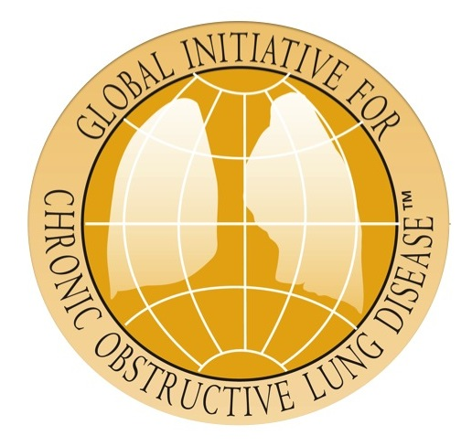
Assessment of COPD
Assess symptoms
Assess degree of airflow limitation using spirometry
Assess risk of exacerbations
Assess comorbidities
COPD Assessment Test (CAT)
or
Clinical COPD Questionnaire (CCQ)
or
mMRC Breathlessness scale
© 2014 Global Initiative for Chronic Obstructive Lung Disease

Slide 54
Assessment of Symptoms
COPD Assessment Test (CAT): An 8-item measure of health status impairment in COPD.
Clinical COPD Questionnaire (CCQ): Self-administered questionnaire developed to measure clinical control in patients with COPD.
© 2014 Global Initiative for Chronic Obstructive Lung Disease

Slide 55
Assessment of Symptoms
Breathlessness Measurement using the Modified British Medical Research Council (mMRC) Questionnaire: relates well to other measures of health status and predicts future mortality risk.
© 2014 Global Initiative for Chronic Obstructive Lung Disease

Slide 56
COPD Assessment Test (CAT)
I never cough | I cough all the time
I’ve no phlegm in my chest at all | My chest is completely full of phlegm
My chest does not feel tight at all | My chest feel very tight
When I walk up a hill, I’m not breathless | When I walk up a hill, I’m very breathless
I’m not limited doing any activities at home | I’m very limited doing any activities at home
I sleep soundly | I don’t sleep soundly
I’m confident leaving my home despite my lung condition | I’m not at all confident leaving my home despite
I’ve lots of energy | I’ve no energy at all

Slide 57
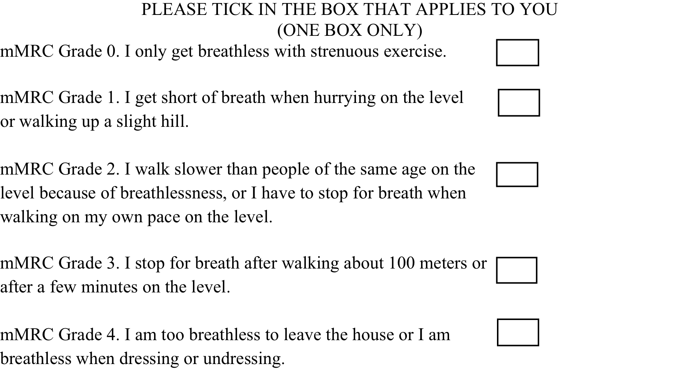
Modified MRC (mMRC)Questionnaire

Slide 58
Assessment of COPD
Assess symptoms
Assess degree of airflow limitation using spirometry
Assess risk of exacerbations
Assess comorbidities
Use spirometry for grading severity according to spirometry, using four grades split at 80%, 50% and 30% of predicted value
© 2014 Global Initiative for Chronic Obstructive Lung Disease

Slide 59
Classification of Severity of Airflow Limitation in COPD
In patients with FEV₁/FVC < 0.70:
GOLD 1: Mild FEV₁ > 80% predicted
GOLD 2: Moderate 50% < FEV₁ < 80% predicted
GOLD 3: Severe 30% < FEV₁ < 50% predicted
GOLD 4: Very Severe FEV₁ < 30% predicted
*Based on Post-Bronchodilator FEV₁
© 2014 Global Initiative for Chronic Obstructive Lung Disease

Slide 60
Assessment of COPD
Assess symptoms
Assess degree of airflow limitation using spirometry
Assess risk of exacerbations
Assess comorbidities
© 2014 Global Initiative for Chronic Obstructive Lung Disease

Slide 61
Assess Risk of Exacerbations
To assess risk of exacerbations use history of exacerbations and spirometry:
Two or more exacerbations within the last year or an FEV₁ < 50 % of predicted value are indicators of high risk.
One or more hospitalizations for COPD exacerbation should be considered high risk.
© 2014 Global Initiative for Chronic Obstructive Lung Disease

Slide 62
Combined Assessment of COPD
Assess symptoms
Assess degree of airflow limitation using spirometry
Assess risk of exacerbations
Combine these assessments for the purpose of improving management of COPD.
© 2014 Global Initiative for Chronic Obstructive Lung Disease

Slide 63
Combined Assessment of COPD
Assess symptoms first
If CAT < 10 or mMRC 0-1:
Less Symptoms/breathlessness (A or C)
If CAT > 10 or mMRC > 2:
More Symptoms/breathlessness (B or D)
(C)
(D)
(A)
(B)
CAT < 10
CAT > 10
Symptoms
mMRC 0–1
mMRC > 2
Breathlessness
© 2014 Global Initiative for Chronic Obstructive Lung Disease

Slide 64
Combined Assessment of COPD
Assess risk of exacerbations next
≥ 2
or
> 1 leading
to hospital
admission
1 (not leading
to hospital
admission)
0
If GOLD 3 or 4 or ≥ 2 exacerbations per year or > 1 leading to hospital admission:
High Risk (C or D)
If GOLD 1 or 2 and only
0 or 1 exacerbations per year (not leading to hospital admission):
Low Risk (A or B)
4
(C)
(D)
3
Risk
(GOLD Classification of Airflow Limitation)
Risk
(Exacerbation history)
2
(A)
(B)
1
CAT < 10
CAT > 10
Symptoms
mMRC 0–1
mMRC > 2
Breathlessness
© 2014 Global Initiative for Chronic Obstructive Lung Disease

Slide 65
Combined Assessment of COPD
≥ 2
or
> 1 leading
to hospital
admission
1 (not leading
to hospital
admission)
4
(C)
(D)
3
Risk
(GOLD Classification of Airflow Limitation))
Risk
(Exacerbation history)
2
(A)
(B)
1
0
CAT < 10
CAT > 10
Symptoms
mMRC 0–1
mMRC > 2
Breathlessness
© 2014 Global Initiative for Chronic Obstructive Lung Disease

Slide 66
Combined Assessment of COPD
When assessing risk, choose the highest risk according to GOLD grade or exacerbation history. One or more hospitalizations for COPD exacerbations should be considered high risk.
Patient | Characteristic | Spirometric Classification | Exacerbations per year | CAT | mMRC
A | Low Risk Less Symptoms | GOLD 1-2 | ≤ 1 | < 10 | 0-1
B | Low Risk More Symptoms | GOLD 1-2 | ≤ 1 | > 10 | > 2
C | High Risk Less Symptoms | GOLD 3-4 | > 2 | < 10 | 0-1
D | High Risk More Symptoms | GOLD 3-4 | > 2 | > 10 | > 2
© 2014 Global Initiative for Chronic Obstructive Lung Disease

Slide 67
BODE index
A multidimensional prognostic index
Takes into account several indicators of COPD prognosis (body mass index [BMI], obstructive ventilatory defect severity, dyspnea severity, and exercise capacity).
The components are derived from measures of the body mass index (weight in kg/heightm2), FEV1 percent predicted, the modified Medical Research Council dyspnea and 6 min. walk Test.

Slide 68
BODE index
A BODE score greater than 7 is associated with a 30 percent 2-year mortality;
A score of 5 to 6 is associated with 15 percent 2-year mortality.
If score is less than 5, the 2-year mortality is less than 10 percent.

Slide 69
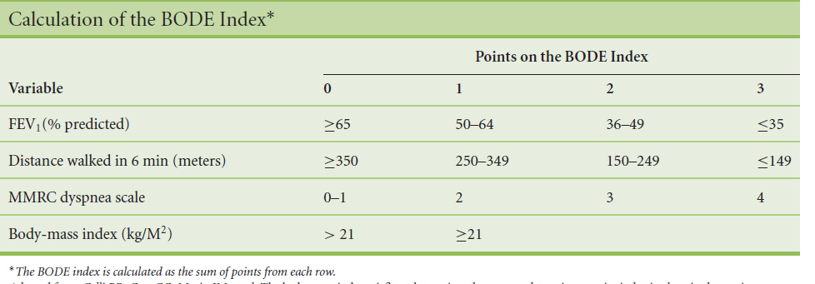

Slide 70
Differential Diagnosis:
COPD and Asthma
COPD
ASTHMA
Onset in mid-life
Symptoms slowly progressive
Long smoking history
Onset early in life (often childhood)
Symptoms vary from day to day
Symptoms worse at night/early morning
Allergy, rhinitis, and/or eczema also present
Family history of asthma
© 2014 Global Initiative for Chronic Obstructive Lung Disease

Slide 71
Additional Investigations
Chest X-ray: Seldom diagnostic but valuable to exclude alternative diagnoses and establish presence of significant comorbidities.
Lung Volumes and Diffusing Capacity: Help to characterize severity, but not essential to patient management.
Oximetry and Arterial Blood Gases: Pulse oximetry can be used to evaluate a patient’s oxygen saturation and need for supplemental oxygen therapy.
Alpha-1 Antitrypsin Deficiency Screening: Perform when COPD develops in patients of Caucasian descent under 45 years or with a strong family history of COPD.
© 2013 Global Initiative for Chronic Obstructive Lung Disease

Slide 72
Additional Investigations
Exercise Testing: Objectively measured exercise impairment, assessed by a reduction in self-paced walking distance (such as the 6 min walking test) or during incremental exercise testing in a laboratory, is a powerful indicator of health status impairment and predictor of prognosis.
Composite Scores: Several variables (FEV₁, exercise tolerance assessed by walking distance or peak oxygen consumption, weight loss and reduction in the arterial oxygen tension) identify patients at increased risk for mortality.
© 2013 Global Initiative for Chronic Obstructive Lung Disease

Slide 73
Therapeutic Options: Smoking Cessation
Counseling delivered by physicians and other health professionals significantly increases quit rates over self-initiated strategies. Even a brief (3-minute) period of counseling to urge a smoker to quit results in smoking quit rates of 5-10%.
Nicotine replacement therapy (nicotine gum, inhaler, nasal spray, transdermal patch, sublingual tablet, or lozenge) as well as pharmacotherapy with varenicline, bupropion, and nortriptyline reliably increases long-term smoking abstinence rates and are significantly more effective than placebo.

Slide 74
Therapeutic Options: Risk Reduction
Encourage comprehensive tobacco-control policies with clear, consistent, and repeated nonsmoking messages.
Emphasize primary prevention, best achieved by elimination or reduction of exposures in the workplace. Secondary prevention, achieved through surveillance and early detection, is also important.
Reduce or avoid indoor air pollution from biomass fuel, burned for cooking and heating in poorly ventilated dwellings.
Advise patients to monitor public announcements of air quality and, depending on the severity of their disease, avoid vigorous exercise outdoors or stay indoors during pollution episodes.
© 2014 Global Initiative for Chronic Obstructive Lung Disease

Slide 75
Therapeutic Options: COPD Medications
Beta₂-agonists
Short-acting beta₂-agonists
Long-acting beta₂-agonists
Anticholinergics
Short-acting anticholinergics
Long-acting anticholinergics
Combination short-acting beta₂-agonists + anticholinergic in one inhaler
Methylxanthines
Inhaled corticosteroids
Combination long-acting beta₂-agonists + corticosteroids in one inhaler
Systemic corticosteroids
Phosphodiesterase-4 inhibitors
© 2014 Global Initiative for Chronic Obstructive Lung Disease

Slide 76
Therapeutic Options: Bronchodilators
Bronchodilator medications are central to the symptomatic management of COPD.
Bronchodilators are prescribed on an as-needed or on a regular basis to prevent or reduce symptoms.
The principal bronchodilator treatments are beta2- agonists, anticholinergics, theophylline or combination therapy.
The choice of treatment depends on the availability of medications and each patient’s individual response in terms of symptom relief and side effects..
© 2014 Global Initiative for Chronic Obstructive Lung Disease

Slide 77
Therapeutic Options: Bronchodilators
Long-acting inhaled bronchodilators are convenient and more effective for symptom relief than short-acting bronchodilators.
Long-acting inhaled bronchodilators reduce exacerbations and related hospitalizations and improve symptoms and health status.
Combining bronchodilators of different pharmacological classes may improve efficacy and decrease the risk of side effects compared to increasing the dose of a single bronchodilator.
© 2013 Global Initiative for Chronic Obstructive Lung Disease

Slide 78
Therapeutic Options: Inhaled Corticosteroids
Regular treatment with inhaled corticosteroids improves symptoms, lung function and quality of life and reduces frequency of exacerbations for COPD patients with an FEV₁ < 60% predicted.
Inhaled corticosteroid therapy is associated with an increased risk of pneumonia.
Withdrawal from treatment with inhaled corticosteroids may lead to exacerbations in some patients.
© 2014 Global Initiative for Chronic Obstructive Lung Disease

Slide 79
Therapeutic Options: Combination Therapy
An inhaled corticosteroid combined with a long-acting beta₂-agonist is more effective than the individual components in improving lung function and health status and reducing exacerbations in moderate to very severe COPD.
Combination therapy is associated with an increased risk of pneumonia.
Addition of a long-acting beta₂-agonist/inhaled glucorticosteroid combination to an anticholinergic (tiotropium) appears to provide additional benefits.
© 2014 Global Initiative for Chronic Obstructive Lung Disease

Slide 80
Therapeutic Options: Phosphodiesterase-4 Inhibitors
In patients with severe and very severe COPD (GOLD 3 and 4) and a history of exacerbations and chronic bronchitis, the phospodiesterase-4 inhibitor, roflumilast, reduces exacerbations treated with oral glucocorticosteroids.
© 2014 Global Initiative for Chronic Obstructive Lung Disease

Slide 81
Therapeutic Options: Theophylline
Theophylline is less effective and less well tolerated than inhaled long-acting bronchodilators and is not recommended if those drugs are available and affordable.
There is evidence for a modest bronchodilator effect and some symptomatic benefit compared with placebo in stable COPD. Addition of theophylline to salmeterol produces a greater increase in FEV₁ and breathlessness than salmeterol alone.
Low dose theophylline reduces exacerbations but does not improve post-bronchodilator lung function.
© 2014 Global Initiative for Chronic Obstructive Lung Disease

Slide 82
Therapeutic Options: Other Pharmacologic Treatments
Influenza vaccines can reduce serious illness. Pneumococcal polysaccharide vaccine is recommended for COPD patients 65 years and older and for COPD patients younger than age 65 with an FEV1 < 40% predicted.
The use of antibiotics, other than for treating infectious exacerbations of COPD and other bacterial infections, is currently not indicated.
© 2014 Global Initiative for Chronic Obstructive Lung Disease

Slide 83
Therapeutic Options: Other Pharmacologic Treatments
Alpha-1 antitrypsin augmentation therapy: not recommended for patients with COPD that is unrelated to the genetic deficiency.
Mucolytics: Patients with viscous sputum may benefit from mucolytics; overall benefits are very small.
Antitussives: Not recommended.
Vasodilators: Nitric oxide is contraindicated in stable COPD. The use of endothelium-modulating agents for the treatment of pulmonary hypertension associated with COPD is not recommended.
© 2014 Global Initiative for Chronic Obstructive Lung Disease

Slide 84
Therapeutic Options: Rehabilitation
All COPD patients benefit from exercise training programs with improvements in exercise tolerance and symptoms of dyspnea and fatigue.
Although an effective pulmonary rehabilitation program is 6 weeks, the longer the program continues, the more effective the results.
If exercise training is maintained at home, the patient's health status remains above pre-rehabilitation levels.
© 2014 Global Initiative for Chronic Obstructive Lung Disease

Slide 85
Therapeutic Options: Other Treatments
Oxygen Therapy: The long-term administration of oxygen (> 15 hours per day) to patients with chronic respiratory failure has been shown to increase survival in patients with severe, resting hypoxemia.
Ventilatory Support: Combination of noninvasive ventilation (NIV) with long-term oxygen therapy may be of some use in a selected subset of patients, particularly in those with pronounced daytime hypercapnia.
© 2014 Global Initiative for Chronic Obstructive Lung Disease

Slide 86
Therapeutic Options: Surgical Treatments
Lung volume reduction surgery (LVRS) is more efficacious than medical therapy among patients with upper-lobe predominant emphysema and low exercise capacity.
LVRS is costly relative to health-care programs not including surgery.
In appropriately selected patients with very severe COPD, lung transplantation has been shown to improve quality of life and functional capacity.
© 2014 Global Initiative for Chronic Obstructive Lung Disease

Slide 87
Manage Stable COPD: Goals of Therapy
Relieve symptoms
Improve exercise tolerance
Improve health status
Prevent disease progression
Prevent and treat exacerbations
Reduce mortality
Reduce
symptoms
Reduce
risk
© 2014 Global Initiative for Chronic Obstructive Lung Disease

Slide 88
Manage Stable COPD: All COPD Patients
Avoidance of risk factors
- smoking cessation
- reduction of indoor pollution
- reduction of occupational exposure
Influenza vaccination
© 2014 Global Initiative for Chronic Obstructive Lung Disease

Slide 89
Manage Stable COPD: Non-pharmacologic
Patient Group | Essential | Recommended | Depending on local guidelines
A | Smoking cessation (can include pharmacologic treatment) | Physical activity | Flu vaccination Pneumococcal vaccination
B, C, D | Smoking cessation (can include pharmacologic treatment) Pulmonary rehabilitation | Physical activity | Flu vaccination Pneumococcal vaccination
© 2014 Global Initiative for Chronic Obstructive Lung Disease

Slide 90
Manage Stable COPD: Pharmacologic Therapy
(Medications in each box are mentioned in alphabetical order, and therefore not necessarily in order of preference.)
Patient | RecommendedFirst choice | Alternative choice |  | Other Possible Treatments
A | SAMA prn or SABA prn | LAMA or LABA or SABA and SAMA |  | Theophylline
B | LAMA or LABA | LAMA and LABA |  | SABA and/or SAMA Theophylline
C | ICS + LABA or LAMA | LAMA and LABA or LAMA and PDE4-inh. or LABA and PDE4-inh. |  | SABA and/or SAMA Theophylline
D | ICS + LABA and/or LAMA | ICS + LABA and LAMA or ICS+LABA and PDE4-inh. or LAMA and LABA or LAMA and PDE4-inh. |  | Carbocysteine SABA and/or SAMA Theophylline

Slide 91
Manage Stable COPD: Pharmacologic Therapy
RECOMMENDED FIRST CHOICE
C
D
GOLD 4
2 or more
or
> 1 leading
to hospital
admission
1 (not leading
to hospital
admission)
ICS + LABA
or
LAMA
ICS + LABA
and/or
LAMA
GOLD 3
Exacerbations per year
A
B
GOLD 2
SAMA prn
or
SABA prn
LABA
or
LAMA
GOLD 1
0
CAT < 10
mMRC 0-1
CAT > 10
mMRC > 2
© 2014 Global Initiative for Chronic Obstructive Lung Disease

Slide 92
Manage Stable COPD: Pharmacologic Therapy
ALTERNATIVE CHOICE
C
D
LAMA and LABA
or
LAMA and PDE4-inh
or
LABA and PDE4-inh
ICS + LABA and LAMA
or
ICS + LABA and PDE4-inh
or
LAMA and LABA
or
LAMA and PDE4-inh.
2 or more
or
> 1 leading
to hospital
admission
1 (not leading
to hospital
admission)
GOLD 4
GOLD 3
Exacerbations per year
A
B
GOLD 2
LAMA
or
LABA
or
SABA and SAMA
LAMA and LABA
GOLD 1
0
CAT < 10
mMRC 0-1
CAT > 10
mMRC > 2
© 2014 Global Initiative for Chronic Obstructive Lung Disease

Slide 93
Manage Stable COPD: Pharmacologic Therapy
OTHER POSSIBLE TREATMENTS
C
D
Carbocysteine
SABA and/or SAMA
Theophylline
2 or more
or
> 1 leading
to hospital
admission
1 (not leading
to hospital
admission)
GOLD 4
SABA and/or SAMA
Theophylline
GOLD 3
Exacerbations per year
A
B
GOLD 2
SABA and/or SAMA
Theophylline
Theophylline
GOLD 1
0
CAT < 10
mMRC 0-1
CAT > 10
mMRC > 2
© 2014 Global Initiative for Chronic Obstructive Lung Disease

Slide 94
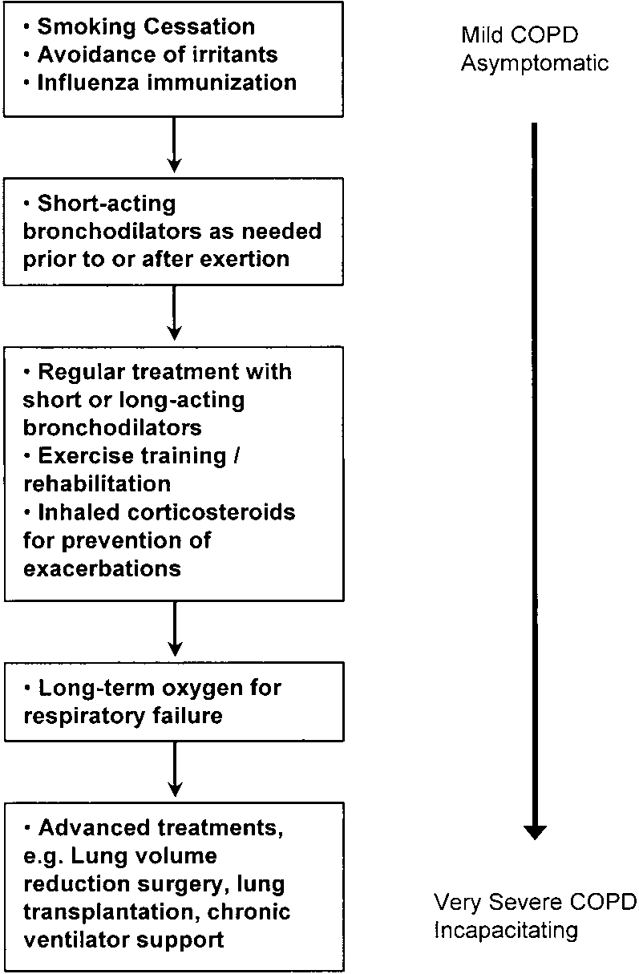
Step-care approach to treatment of COPD

Slide 95
Manage Exacerbations
  An exacerbation of COPD is:
  “an acute event characterized by a worsening of the patient’s respiratory symptoms that is beyond normal day-to-day variations and leads to a change in medication.”
© 2014 Global Initiative for Chronic Obstructive Lung Disease

Slide 96
Manage Exacerbations: Key Points
The most common causes of COPD exacerbations are viral upper respiratory tract infections and infection of the tracheobronchial tree.
Diagnosis relies exclusively on the clinical presentation of the patient complaining of an acute change of symptoms that is beyond normal day-to-day variation.
The goal of treatment is to minimize the impact of the current exacerbation and to prevent the development of subsequent exacerbations.
© 2014 Global Initiative for Chronic Obstructive Lung Disease

Slide 97
Manage Exacerbations: Key Points
Short-acting inhaled beta₂-agonists with or without short-acting anticholinergics are usually the preferred bronchodilators for treatment of an exacerbation.
Systemic corticosteroids and antibiotics can shorten recovery time, improve lung function (FEV₁) and arterial hypoxemia (PaO₂), and reduce the risk of early relapse, treatment failure, and length of hospital stay.
COPD exacerbations can often be prevented.
© 2014 Global Initiative for Chronic Obstructive Lung Disease

Slide 98
Consequences Of COPD Exacerbations
Negative
impact on
quality of life
Impact on
symptoms
and lung
function
EXACERBATIONS
Accelerated
lung function
decline
Increased
economic
costs
Increased
Mortality
© 2014 Global Initiative for Chronic Obstructive Lung Disease

Slide 99
Manage Exacerbations: Assessments
Arterial blood gas measurements (in hospital): PaO2 < 8.0 kPa with or without PaCO2 > 6.7 kPa when breathing room air indicates respiratory failure.
Chest radiographs: useful to exclude alternative diagnoses.
ECG: may aid in the diagnosis of coexisting cardiac problems.
Whole blood count: identify polycythemia, anemia or bleeding.

Slide 100
Manage Exacerbations: Assessments
Purulent sputum during an exacerbation: indication to begin empirical antibiotic treatment.
Biochemical tests: detect electrolyte disturbances, diabetes, and poor nutrition.
Spirometric tests: not recommended during an exacerbation.

Slide 101
Manage Exacerbations: Treatment Options
Oxygen: titrate to improve the patient’s hypoxemia with a target saturation of 88-92%.
Bronchodilators: Short-acting inhaled beta2-agonists with or without short-acting anticholinergics are preferred.
Systemic Corticosteroids: Shorten recovery time, improve lung function (FEV1) and arterial hypoxemia (PaO2), and reduce the risk of early relapse, treatment failure, and length of hospital stay. A dose of 40 mg prednisone per day for 5 days is recommended. Nebulized magnesium as an adjuvent to salbutamol treatment in the setting of acute exacerbations of COPD has no effect on FEV1.
© 2014 Global Initiative for Chronic Obstructive Lung Disease

Slide 102
Manage Exacerbations: Treatment Options
Antibiotics should be given to patients with:
Three cardinal symptoms: increased dyspnea, increased sputum volume, and increased sputum purulence.
Who require mechanical ventilation.
© 2014 Global Initiative for Chronic Obstructive Lung Disease

Slide 103
Manage Exacerbations: Treatment Options
Noninvasive ventilation (NIV) for patients hospitalized for acute exacerbations of COPD:
Improves respiratory acidosis, decreases respiratory rate, severity of dyspnea, complications and length of hospital stay.
Decreases mortality and needs for intubation.
© 2014 Global Initiative for Chronic Obstructive Lung Disease

Slide 104
Manage Exacerbations: Indications for Hospital Admission
Marked increase in intensity of symptoms
Severe underlying COPD
Onset of new physical signs
Failure of an exacerbation to respond to initial medical management
Presence of serious comorbidities
Frequent exacerbations
Older age
Insufficient home support
© 2014 Global Initiative for Chronic Obstructive Lung Disease

Slide 105
Comorbidities in COPD
COPD often coexists with other diseases (comorbidities) that may have a significant impact on prognosis.
In general, presence of comorbidities should not alter COPD treatment and comorbidities should be treated as if the patient did not have COPD.

Slide 106
Common Comorbidities in COPD
Cardiovascular Disorders Pulmonary hypertension Right heart failure, Cor pulmonale Vascular disease -Coronary artery disease -Cerebrovascular disease -Periferal vascular disease Systemic hypertension
Nutritional Disorders, Cachexia
Musculoskeletal Disorders Muscle dysfunction Osteoporosis
Cancer
Other Sleep disorders Sexual dysfunction Diabetes Depression, anxiety Anaemia Peptic ulcus Glocoma

Slide 107
CAUSES of COMORBIDITIES
Related to Causes of COPD
  Smoking
  Genetic characteristics of the host
Related to COPD itself
  Tissue hypoxia
  Inactivity due to dyspnea on exertion
  Pulmonary inflammation/ activation of inflammatory cells in the lungs
Not related to COPD

Slide 108
Manage Comorbidities
Cardiovascular disease (including ischemic heart disease, heart failure, atrial fibrillation, and hypertension) is a major comorbidity in COPD and probably both the most frequent and most important disease coexisting with COPD. Benefits of cardioselective beta-blocker treatment in heart failure outweigh potential risk even in patients with severe COPD.
© 2014 Global Initiative for Chronic Obstructive Lung Disease

Slide 109
Osteoporosis and anxiety/depression: often under-diagnosed and associated with poor health status and prognosis.
Lung cancer: frequent in patients with COPD; the most frequent cause of death in patients with mild COPD.
Serious infections: respiratory infections are especially frequent.
Metabolic syndrome and manifest diabetes: more frequent in COPD and the latter is likely to impact on prognosis.
© 2014 Global Initiative for Chronic Obstructive Lung Disease

Slide 110
Cardiovascular Disease
Pulmonary hypertension
Right heart failure, Cor pulmonale
Vascular disease
-Coronary artery disease
-Cerebrovascular disease
-Periferal vascular disease
Systemic hypertension

Slide 111
Right Heart Failure, Cor pulmonale
Long-standing pulmonary hypertension can lead to right-sided heart failure or cor pulmonale.
Diagnosis:
  Physical examination
  Chest x-ray
  ECG
Therapy:
  Oxygen
  Diuretic
  Digitalis, β-bloker

Slide 112
Pulmonary Hypertension
Alveolar hypoxemia and respiratory acidosis can cause pulmonary artery vasoconstruction and pulmonary hypertension.
Diagnosis:
ABG
Chest x-ray
ECG
Right-sided heart catheterization
Therapy:
LTOT
Vasodilator

Slide 113
Coronary Artery Disease
Most common cause of death in cardiovascular disease (50%).
Smoking and obesity are most common risk factors.
Related to systemic inflammation.

Slide 114
Coronary Artery Disease
Diagnosis:
  Symptoms
  ECG
  Treadmill
  Nuclear perfusion imaging
  Angiography
Therapy:
  Oxygen
  Aspirin
  Nitrates
  Calcium channel blockers
  β-blockers (selective)
  Stent
  By-pass

Slide 115
Systemic Hypertension
Affects approximately 30 to 37% of adults.
Prevelance is not increased in patient with COPD.
Blood pressure monitoring in every patient.
Therapy:
  Diuretics
  ACE inh,
  Calcium channel blockers
  β-blockers (selective)

Slide 116
Malnutrition and cachexia
Weight loss and malnutrition occur in up to 50% of persons with COPD.
More severs in advanced COPD.
Fat Free Mass (FFM) is important.

Slide 117
Wagner ERJ,2008

Slide 118
Weight Loss and Respiratory Failure

Slide 119
Wagner ERJ,2008

Slide 120
Skeletal Muscle Dysfunction
Skeletal muscle itself can contribute to systemic inflammation. This has been demonstrated in patients with COPD during exercise.
Physical exercise and oxidative stress increases plasmaTNF-α levels.
TNF-α induce muscle loss.
Fabbri, ERJ 2008
The most important reason is deconditioning.
Malnutrition.
Myopathy from systemic steroids.

Slide 121
Osteoporosis
Postmenopausal osteoporosis is related to high serum levels of TNF-α and IL-6.
Osteopenia found in COPD is also associated with an increase in circulating TNF-α.
Increased levels of TNF-α (IL-1) stimulate the differentiation of macrophages into osteoclasts.
Management:
  Early screening
  Exercize
  Calcium 120-1500mg/day, D vit 400 IU
  Avoidence from systemic CS
  Biphosphonate
  Calcitonin
  Testesteron

Slide 122
Diabetes
Fibrinogen, white blood cell count and lower albumin predict the development of type 2 diabetes.
Patients with type 2 diabetes have increased levels of TNF-α, IL-6 and CRP.
Diabetes is independently associated with reduced lung function, which together with obesity could further worsen the severity of COPD.
Fabbri, ERJ 2008

Slide 123
Peptic Ulcus
Peptic ulceration is more frequent in patients with COPD.
Helicobacter sero-positivity is increased in COPD patients.
Roussos, Respir Med 2005
Chronic activation of inflammatory mediators induced by H pylori could amplify the development of COPD
Sevenoaks, Respir Research 2006

Slide 124
Sleep Disorders
Factors associated with impaired sleep quality
  Hypoxemia
  Beta-2 agonist
  Cough
  Dyspnea
  Nocturia
  OSAS
Oxygen
Treatment against cough end dyspnea
CPAP (OSAS)

Slide 125
Sexual dysfunction
Loss of libido and erectile dysfunction in more than one third of patients with COPD.
Testesteron levels below normal.
Therapy:
  Oxygen.
  Sildenafil might be considered if there are no contraindications.

Slide 126
THANK YOU

