Slide 1
Pulmonary Manifestations of Systemic
Lupus Erythematosus

Slide 2
Acute lupus pneumonitis
Acute lupus pneumonitis is an abrupt febrile pneumonic process mostly without infectious etiology, and antibiotics usually fail to favorably alter its course.
A favorable response to corticosteroid, with normalization of the clinical and radiological manifestations, can be helpful in establishing its diagnosis.

Slide 3
The histopathologic findings include alveolar wall damage and necrosis, inflammatory infiltrates, hemorrhage, edema, and hyaline membrane.
The radiologic findings consist of patchy unilateral or bilateral areas of ground glass opacity or air space consolidation, involving mainly lung bases

Slide 4
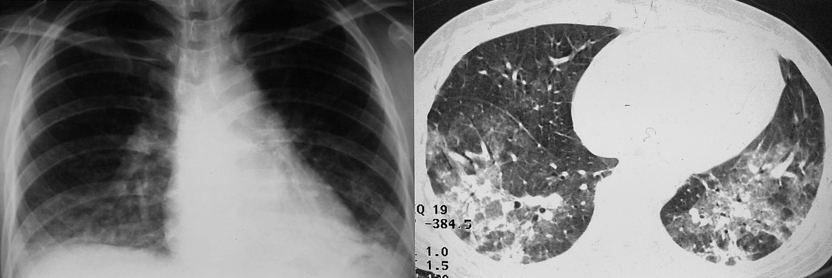
Frontal chest radiograph shows ill-defined hazy opacities in both lower lungs.
Thin-section CT at the level of basal lung shows areas of nodular consolidation and ground-glass attenuation in both lower lobes.

Slide 5
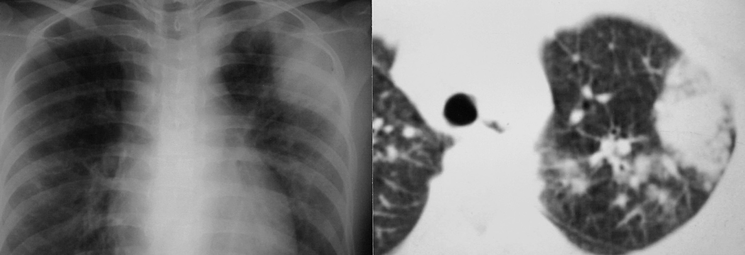
A. Frontal chest radiograph shows focal air-space consolidation in the left upper lung.
B. CT scan at the level of the aortic arch shows air-space consolidation and multiple, ill-defined nodular opacities. Laboratory studies, including biopsy of the lung, did not reveal any infectious organism at this time.

Slide 6
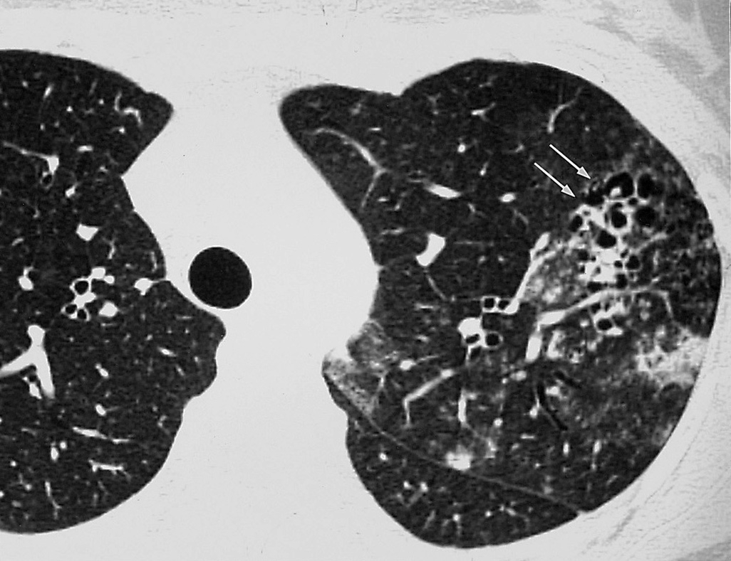
Thin-section CT at the level similar to B, obtained after steroid medication for 1 month, shows improvement of the consolidation but newly developed lung cysts or airway dilatation
(arrows).

Slide 7
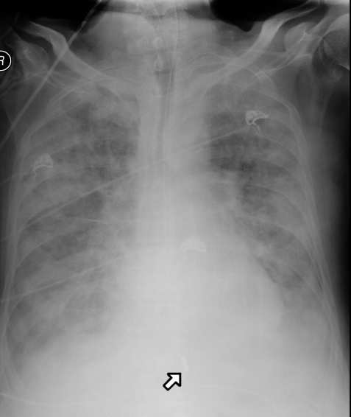
Chest X-ray showing diffuse alveolar infiltrates in a patient with acute lupus pneumonitis

Slide 8
Pulmonary hemorrhage
Pulmonary hemorrhage in SLE, varies from a mild, subclinical,chronic form to acute, massive, life-threatening bleeding.
In patients with hemoptysis, two find ings may suggest significant pulmonary hemorrhage:
A marked drop in hematocrit over a period of 12 to 36 hours.
Unexplained increase in the diffusive capacity of carbon monoxide, or DLCO.
*(Hemoptysis and hypoxemia, may be lacking even where hemorrhage is severe.)

Slide 9
Chest radiography depicts areas of ill-defined, patchy, acinar opacity that are usually bilateral and located in the lower lung zones .
With the cessation of hemoptysis, the findings of radiography improve rapidly and often normalize within 2-4 days.

Slide 10
CT demonstrates ground-glass opacity and, sometimes, frank consolidation.
A nodular pattern with no zonal predominance or bronchocentricity may be also seen, especially during complete or partial clinical remission.

Slide 11
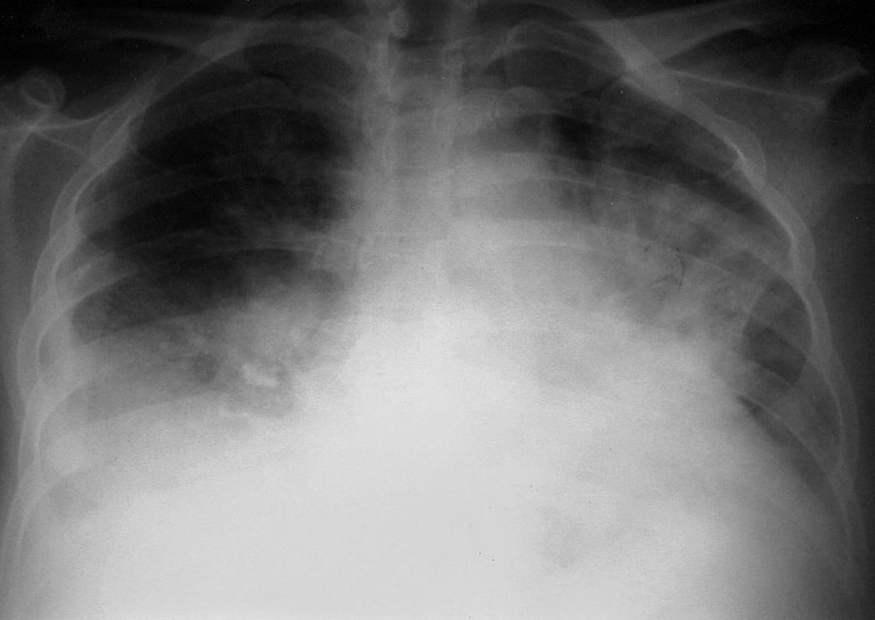
Pulmonary hemorrhage in a 33-year-old woman with
SLE

Slide 12
Bronchiolitis obliterans organizing pneumonia
Is a pathologic entity characterized by the formation of plugs of fibrous tissue in bronchioles and alveolar ducts.
Most cases are idiopathic, but a BOOP-like reaction has been described in association with several connective tissue diseases including SLE.

Slide 13
Bronchiolitis obliterans organizing pneumonia typically manifests with scattered, bilateral ground-glass attenuation or air space consolidation.
All lung zones are equally affected.

Slide 14
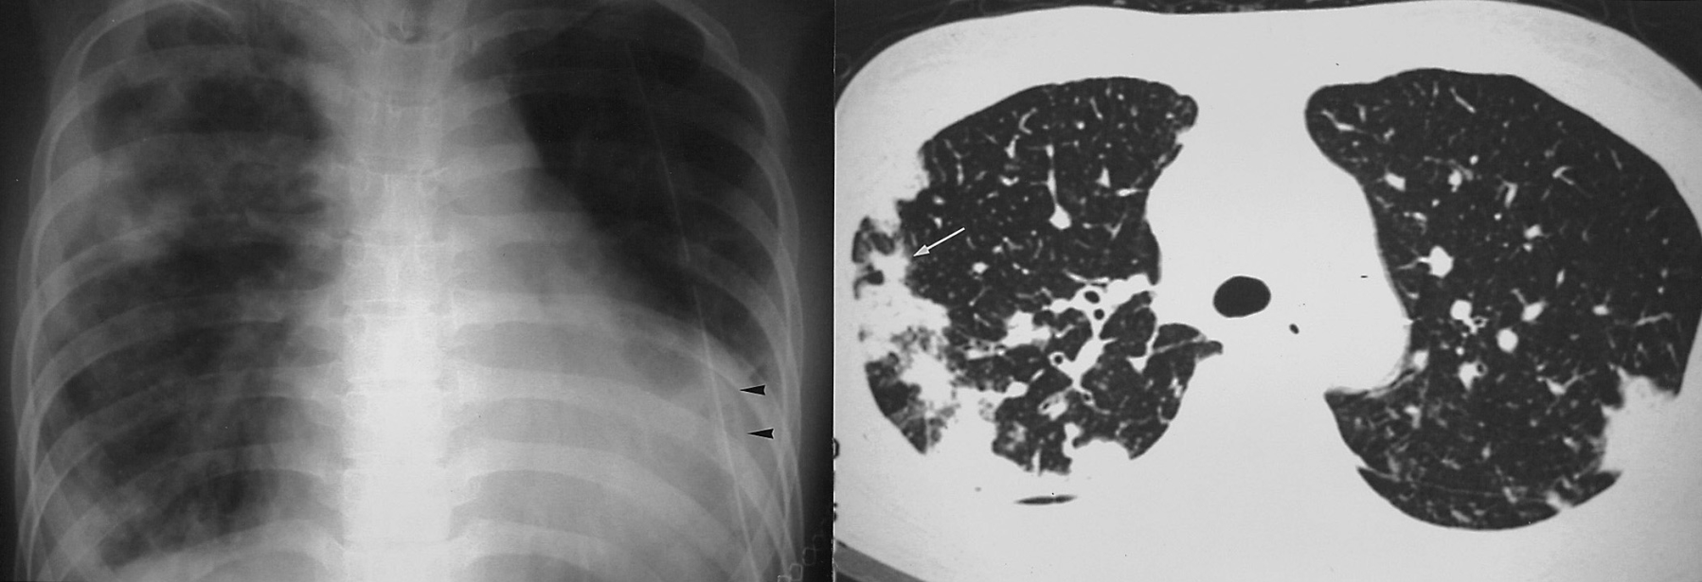
Frontal chest radiograph shows cardiomegaly, bilateral pleural effusion, and peripheral patchy increased opacities, predominantly in the right lung.
Thin-section CT scans at levels of the aortic arch consolidations predominantly in the peripheral lung.
Interlobular septal thickening and dilated pulmonary veins (arrowhead) indicate pulmonary congestion associated with lupus cardiac disease.

Slide 15
Constrictive bronchiolitis (obliterative bronchiolitis)
At lung function testing, constrictive bronchiolitis is characterized by airflow obstruction due to submucosal and peribronchiolar inflammation and fibrosis, which primarily involves respiratory bronchioles, and the absence of diffuse parenchymal inflammation.

Slide 16
The most obvious thin-section CT findings are focal, often sharply defined, areas of decreased lung attenuation associated with vessels of decreased caliber in the absence of parenchymal consolidation; bronchiectasis, mainly at a subsegmental level, may also be noted
Expiratory CT shows focal areas of air trapping consistent with small airway obstruction.

Slide 17
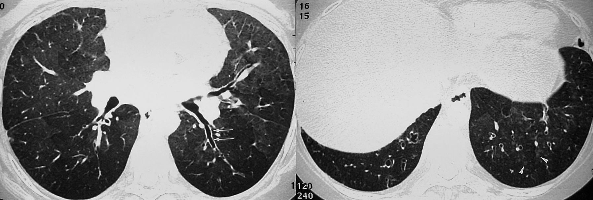
Inspiratory thin-section CT at levels of the superior segmental bronchus of the lower lobe (A) and basal lungs (B) show mosaic attenuation in both lungs. Pulmonary vessels in lower attenuation areas are smaller in caliber and number than those in higher attenuation areas

Slide 18
Chronic interstitial pneumonitis and fibrosis
The prevalence of clinically significant interstitial lung disease in SLE has been reported in as few as 1-6% of patients.
The radiographic findings include bibasilar areas of irregular linear opacity, ground-glass attenuation, and loss of lung volume .

Slide 19
The typical CT appearance includes interlobular and intralobular interstitial thickening, areas of ground-glass attenuation. traction bronchiectasis with predominantly subpleural and basal involvement.
End-stage disease is accompanied by honeycombing, traction bronchiectasis, and achitectual distortion, as in the case of usual interstitial pneumonitis .

Slide 20
Although the disease which complicate SLE resemble those of idiopathic pulmonary fibrosis, including both usual and nonspecific interstitial pneumonitis, both pathologically and radiologically, its course is usually less severe from clinical and functional points of view.

Slide 21
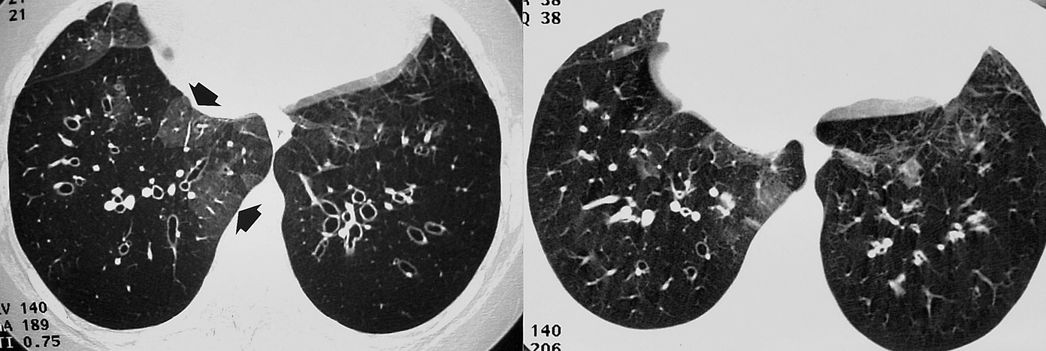
A. Inspiratory thin-section CT at the level of basal lungs shows focal, relatively well defined normal areas of increased attenuation (arrows) interspersed with radiolucent areas indicative of air trapping. Also, note bronchial dilatation.
B. Expiratory thin-section CT at the same level as A show marked air trapping

Slide 22
Pulmonary vascular disease
Pulmonary vascular involvement in SLE may include the capillary, arterial, and venous systems.
Venous involvement, however, is radiographically distinct from pulmonary hypertension caused by arterial involvement.

Slide 23
Pulmonary veno-occlusive disease
Pulmonary veno-occlusive disease is a rare form of pulmonary hypertension characterized pathologically by repeated pulmonary venous thrombosis.
Clinically by pulmonary arterial hypertension and edema.

Slide 24
Radiographically, pulmonary veno-occlusive disease shows signs of pulmonary arterial hypertension very similar to those associated with primary pulmonary arterial hypertension or thromboembolic disease, but includes an important additional sign of pulmonary edema.

Slide 25
The most common CT findings include smooth interlobular thickening and areas of ground-glass attenuation consistent with interstitial pulmonary edema, enlarged central pulmonary arteries, and pulmonary veins of normal caliber.

Slide 26
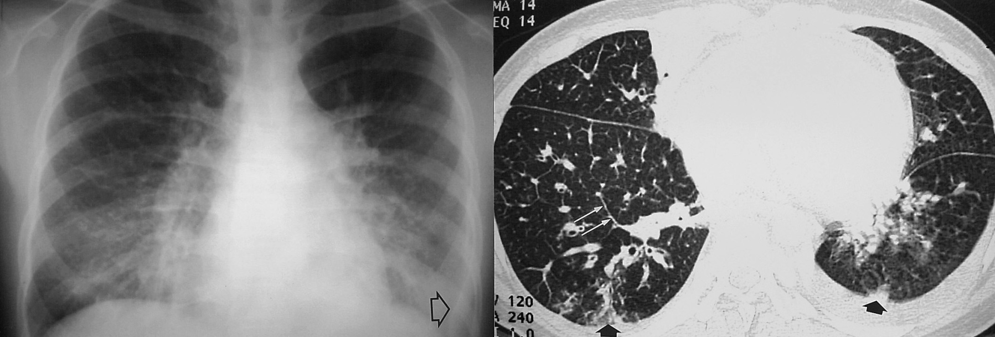
A. Frontal chest radiograph shows prominent hilar shadows and diffuse haziness in both lower lungs. Also note left pleural effusion
(arrow).
B. Thin-section CT at the level of basal lungs shows thickening of interlobular septa (long arrow) and bronchial wall, and focal consolidations
(short arrows).

Slide 27
Pulmonary arterial hypertension
In approximately 10% of SLE patients, clinically evident pulmonary arterial hypertension is present .
The potential mechanisms of the condition include interstitial pneumonitis, small pulmonary arterial vasculitis, thrombosis in situ or pulmonary thromboembolism, and primary pulmonary hypertension.

Slide 28
Vascular abnormalities typically afflict small muscular arteries.
During the early phase, chest radiographic findings may be normal, but advanced radiographic findings include enlargement of the right ventricle, and prominent main pulmonary artery with distal attenuation of the arteries

Slide 29
Ventilation/perfusion scanning or pulmonary angiography can help exclude pulmonary embolism.

Slide 30
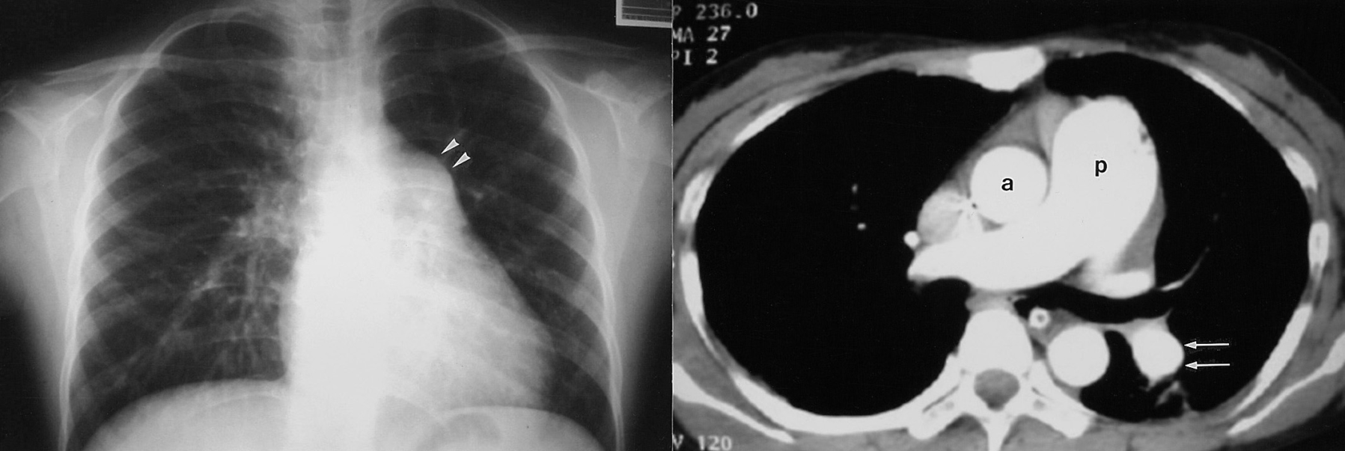
Frontal chest radiograph shows typical features of pulmonary arterial hypertension, including bulging of the pulmonary conus
(arrowheads) and prominent proximal pulmonary arteries.
B. Thin-section CT obtained before contrast administration show the enlarged pulmonary trunk (p), which is larger in diameter than the ascending aorta (a). Also note enlarged left pulmonary arteries (arrows).

Slide 31
Secondary Involvement of the Respiratory System
Severe multi-organ diseases often confound the clinical status of patients with SLE, treatment for such disease, and its attendant complications.
Renal failure, central nervous system involvement, or cardiac involvement may lead to pulmonary edema.

Slide 32
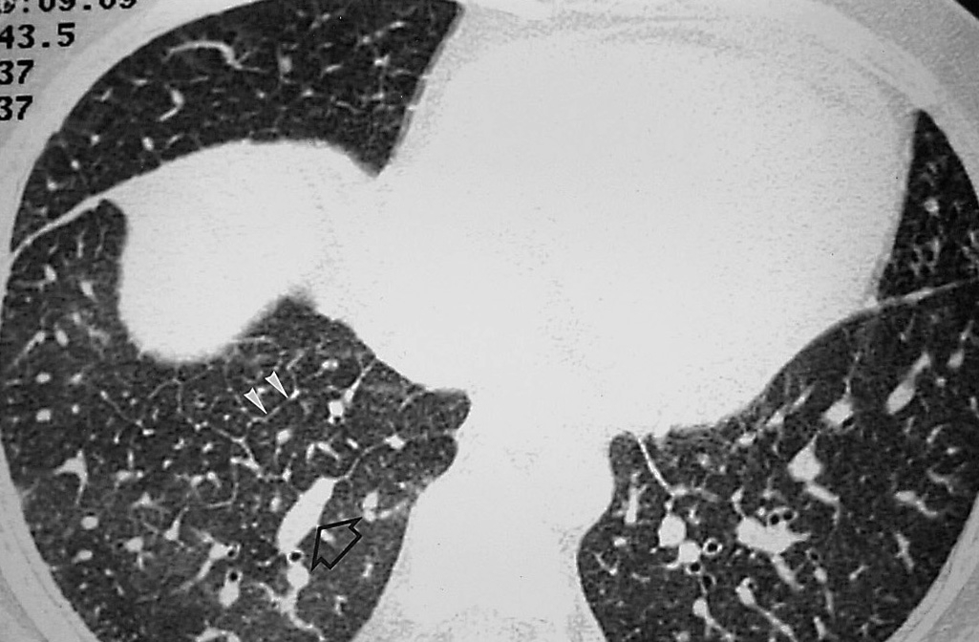
Pulmonary edema in a 34-year-old woman with SLE.
Thin-section CT at the level of the diaphragm shows typical features of pulmonary edema, including dilated pulmonary vessels (arrow), smooth thickening of the interlobular septa
(arrowheads), and areas of ground-glass attenuation.

Slide 33
Pericardial effusion, neuromuscular disease, and diaphragmatic dysfunction can affect the respirator system, resulting in passive atelectasis and oxygen therapy or cytotoxic chemotherapy may cause pulmonary toxicity.
Infection, however, is the most important cause of indirect involvement of the lungs in SLE.

Slide 34
Shrinking lung syndrome (SLS) is a rare manifestation of SLE.
It was first described in patients with lupus who presented with unexplained dyspnea, decreased lung volumes and elevation of the diaphragm on radiographic imaging and restriction on pulmonary function tests in the absence of any parenchymal disease.

Slide 35
Clinically, patients present with dyspnea that is particularly worse when supine.
Pleuritic chest pain is present in 65% of patients.
Physical examination reveals diminished breath sounds at the lung bases with or without basilar crackles.
Chest radiographs and CT show elevation of both diaphragms with basal linear atelectasis and without any evidence of parenchymal lung disease.

Slide 36
Assessment of respiratory muscles show reduced maximal inspiratory pressure (MIP) and stable maximal expiratory pressure (MEP).
Diaphragmatic weakness can be established by measuring the transdiaphragmatic pressure or by doing electromyography of the diaphragms. Autopsy findings include diffuse fibrosis and atrophy of the diaphragms.
Oral glucocorticoids with or without immunosuppressive medications have been shown effective.

Slide 37
Pulmonary infection other than tuberculosis in SLE
Pulmonary infection is a major cause of morbidity and mortality in SLE, with either common bacterial agents or more unusual opportunistic organisms causing pulmonary infections.
Opportunistic infections in SLE patients include aspergillosis, cryptococcosis, pneumocystis carinii ,cytomegalovirus, and nocardia.

Slide 38
The risk of infection in the absence of immunosuppression is small, though an aggressive diagnostic approach to exclude infection in any patient with SLE presenting with new pulmonary infiltrates is warranted, particularly if immunosuppressive therapy is ongoing.

Slide 39
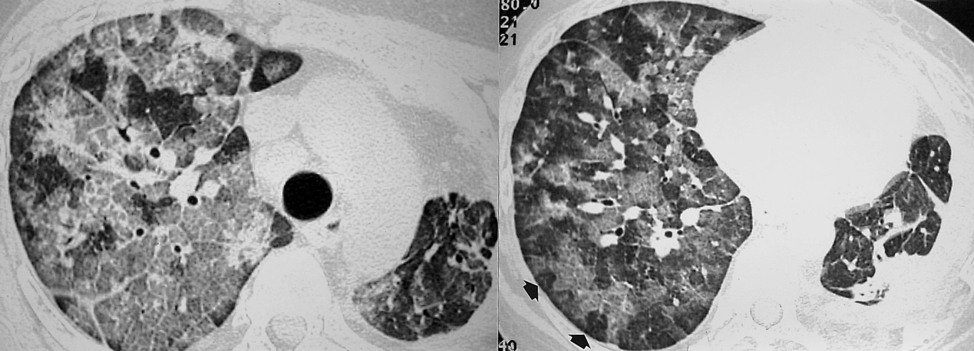
Thin-section CT scans at levels of the aortic arch (A) and basal lungs (B) show mosaic pattern of ground-glass opacities admixed with intra- and interlobular septal thickening, namely crazy-paving appearance. Also note clear sparing of isolated secondary lobules (arrows). Left lung shows fibrosis and marked volume contraction secondary to longstanding tuberculosis. The organism was isolated from bronchoalveolar lavage fluid.

Slide 40
Pulmonary Tuberculosis in SLE
Pulmonary tuberculosis in patients with SLE may manifest differently than in immunocompetent patients, and because of the abnormal functioning of alveolar macrophages and exposure to corticosteroid and cytotoxic drugs, the incidence in the former may be higher.

Slide 41
Delayed diagnosis may contribute to a higher incidence of miliary, far-advanced, and extrapulmonary tuberculosis.
In patients with SLE who are taking steroids, the radiologic findings can be similar to those seen in secondary tuberculosis, such as areas of apical nodular opacity or in primary tuberculosis, such as large air-space consolidation, lymphadenitis, pleural effusion, or miliary tuberculosis.

Slide 42
Thin-section CT findings of miliary tuberculosis resemble those described in that previous report: miliary nodules associated with interlobular septal thickening, intralobular reticulation, ground-glass attenuation, and pleural effusion.

Slide 43
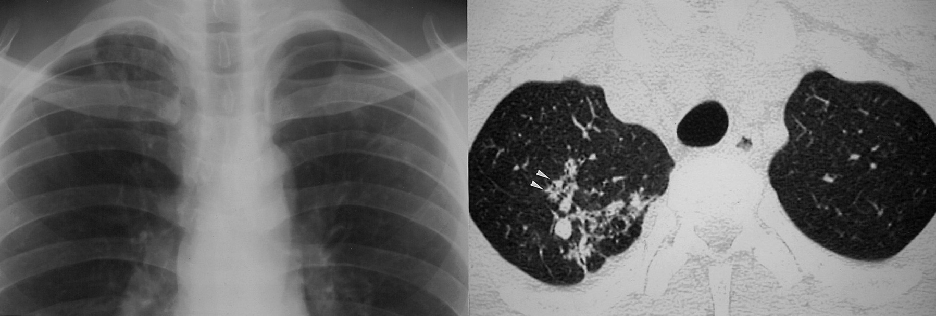
A. Magnified frontal chest radiograph shows poorly-defined nodular and linear opacities in both upper lungs.
B. Magnified thin-section CT showing the right lung apex reveals centrilobular nodular and branching opacities (arrowheads) in the right upper lobe.

Slide 44
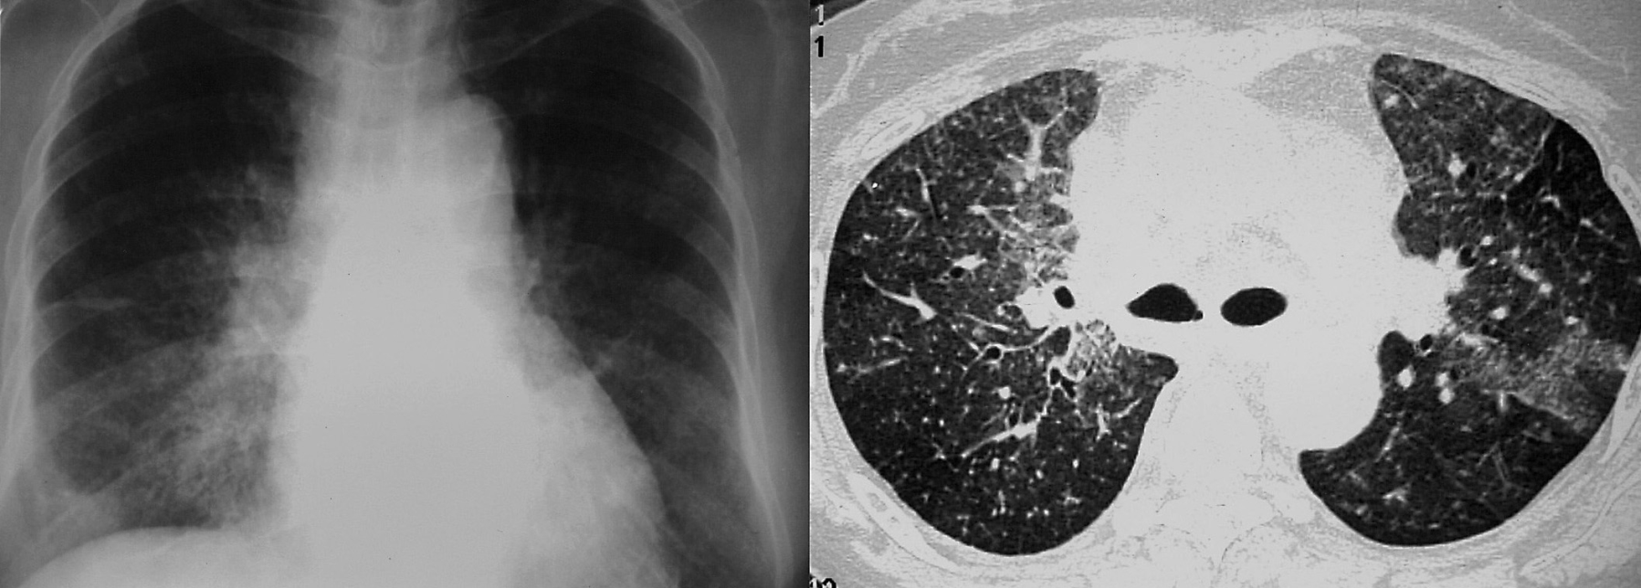
A. Plain chest radiograph obtained at admission shows innumerous tiny nodular shadows in the entire lung.
B. Thin-section CT at the level of the carina shows miliary nodules of random distribution and areas of ground-glass attenuation.

Slide 45
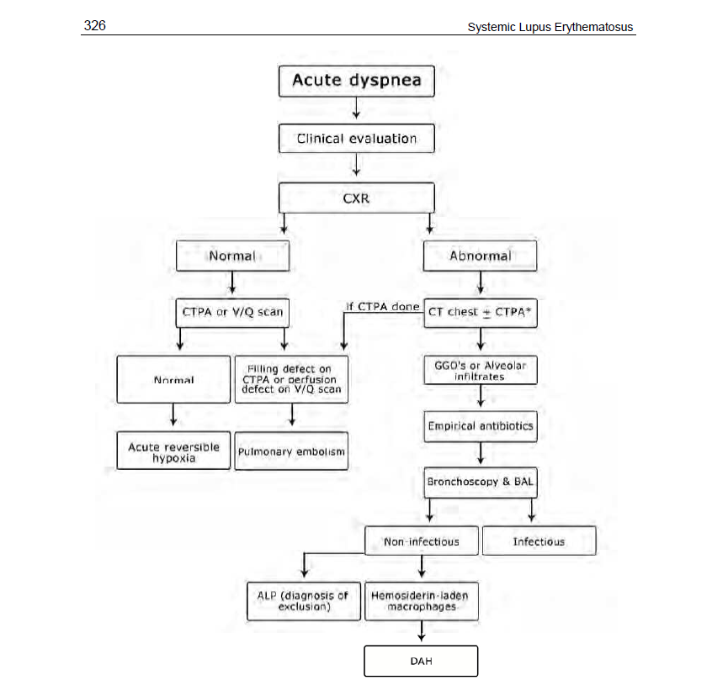
Work-up of patients with SLE presenting with acute dyspnea. acute lupus pneumonitis (ALP); bronchoalveolar lavage (BAL); chest x-ray (CXR); computed tomography (CT); computed tomography pulmonary angiogram (CTPA); diffuse alveolar hemorrhage (DAH); ground-glass opacities (GGO’s); ventilation/perfusion lung scan (V/Q Scan)

Slide 46
