Slide 1
HISTIOCYTOSIS X
DR KARTIK SOOD
JUNIOR RESIDENT
DEPTT OF PUL MED

Slide 2
WHAT IS HISTIOCYTOSIS X?
Histiocytosis is a general name for a group of syndromes that involve an abnormal increase in the number of immune cells called histiocytes.
Histiocytomas are disorders that involve the proliferation of cells in the mononuclear phagocytic and the dendritic system
The X refers to the unknown entities of the disorder as there were and still are many questions about the etiology of this disorder

Slide 3
INTRODUCTION AND BACKGROUND
Sometimes referred to as histiocytosis x
Lch is a disease of abnormal clonal proliferation of a unique type of cell in the monocyte-macrophage cell line known as the langerhans cell.
It is named after the medical student paul langerhans, the first scientist to describe the cell (1868).

Slide 4
CLASSIFICATION OF THE HISTIOCYTOMAS
Class | Syndrome | Cells Involved
I | Langerhans cell histiocytosis | Langerhans Cells
II | Reactive Histiocytosis(Non langerhans) | Macrophages
III | Malignant Histiocytosis | Acute Monocytic Leukemia

Slide 5
LANGERHANS CELL HISTIOCYTOSIS
IS DIVIDED INTO 3 GROUPS
UNIFOCAL-
…………… EOSINOPHILIC GRANULOMA OF LUNG
…………… EOSINOPHILIC GRANULOMA OF BONE

Slide 6
2.MULTIFOCAL UNISYSTEM-
HAND-SCHULLER CHRISTIAN DISEASE WHICH IS A TRIAD OF
OSTEOPHYTIC BONE LESIONS
DIABETES INSIPIDUS
EXOPHTHALMOS

Slide 7
3.MULTIFOCAL MULTISYSTEM i.e
LETTERER-SIWE DISEASE
Acute, disseminated form that is often fatal
Skin: seborrheic eruptions on the trunk and scalp
Hepatosplenomegaly, lymphadenopathy, lung lesions and osteolytic bone lesions are present
Bone marrow = anemia/thrombocytopenia
50% chance of 5 year survival
Requires chemotherapy (Vinblastine or etoposide)

Slide 8
Langerhan’s Cells
FUNCTION:
Monocytic Antigen presenting cells of the skin
Found in foci and clusters
Secrete IL-1 and PGE2 to recruit other immune cells
FEATURES:
“Birbeck’s granules”
Irregularly grooved nuclei and single nucleolus
Finely dispersed chromatin
Abundant acidic cytoplasm
CD1a + markers

Slide 9
Birbeck Granules
Plasma membrane invaginations
Rodlike structures with a dilated end -discribed as “tennis raquets”
Their presence on biopsy confirms the diagnosis

Slide 10
Etiology
Much debate still exists as to whether this disease is immunologically based, viral or neoplastic
Due to the clonality of CD1a+ histiocytes, current opinion holds that it is a clonal neoplastic disease with variety of presentations that differ in severity and behavior

Slide 11
PULMONARY LANGERHANS’-CELL HISTIOCYTOSIS
Pulmonary langerhans’-cell histiocytosis, eosinophilic granuloma of the lung is characterized by abnormal organ infiltration by langerhans’ cells.
Smoking-related, interstitial lung disease that primarily affects young adults (20 to 40 years of age)
Pulmonary Langerhans’-cell histiocytosis is not a granulomatous disorder. Moreover, the lesions are often devoid of eosinophils. Thus, the older term,eosinophilic granuloma, is a misnomer.

Slide 12
PATHOGENESIS
The pathogenesis of pulmonary Langerhans’-cell histiocytosis is unknown
One hypothesis of disease pathogenesis, the bombesin hypothesis, contends that increased bombesin like peptide production plays a central role .
Bombesin is a neuropeptide produced by neuroendocrine cells, which are increased in the lungs of smokers.

Slide 13
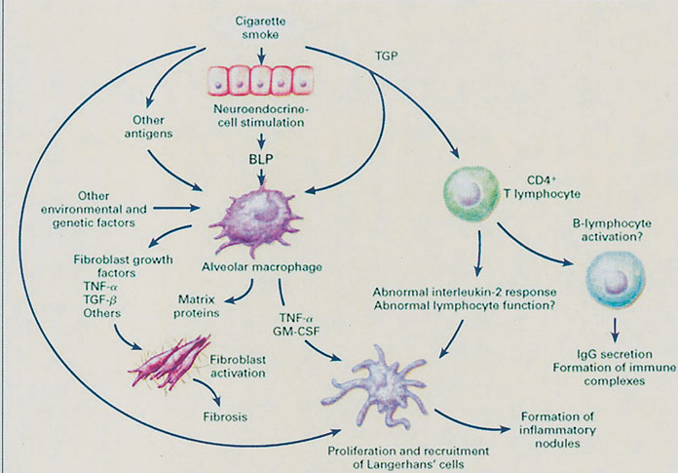
bombesin-like peptides
(BLP)
tobacco glycoprotein
(TGP)
granulocyte-macrophage colony-stimulating factor [GM-CSF])

Slide 14
SIGNS AND SYMPTOMS
Symptomatic patients present with
Nonproductive cough
Breathlessness with exertion
Chest pain
Fatigue
Weight loss
Fever
History of rhinitis has been elicited

Slide 15
Pleuritic pain and acute dyspnea with a spontaneous pneumothorax can be a recurrent problem.
Hemoptysis is occasionally reported, and it should prompt consideration of superimposed infection ( Aspergillus)
Cystic bone lesions are present in 4 to 20 percent of patientswith pulmonary Langerhans’-cell histiocytosis and may develop a pathological bone fracture. Skeletal involvement may be either the sole symptomatic manifestation of pulmonary Langerhans’-cell histiocytosis or may precede the more typical pulmonary manifestations.

Slide 16
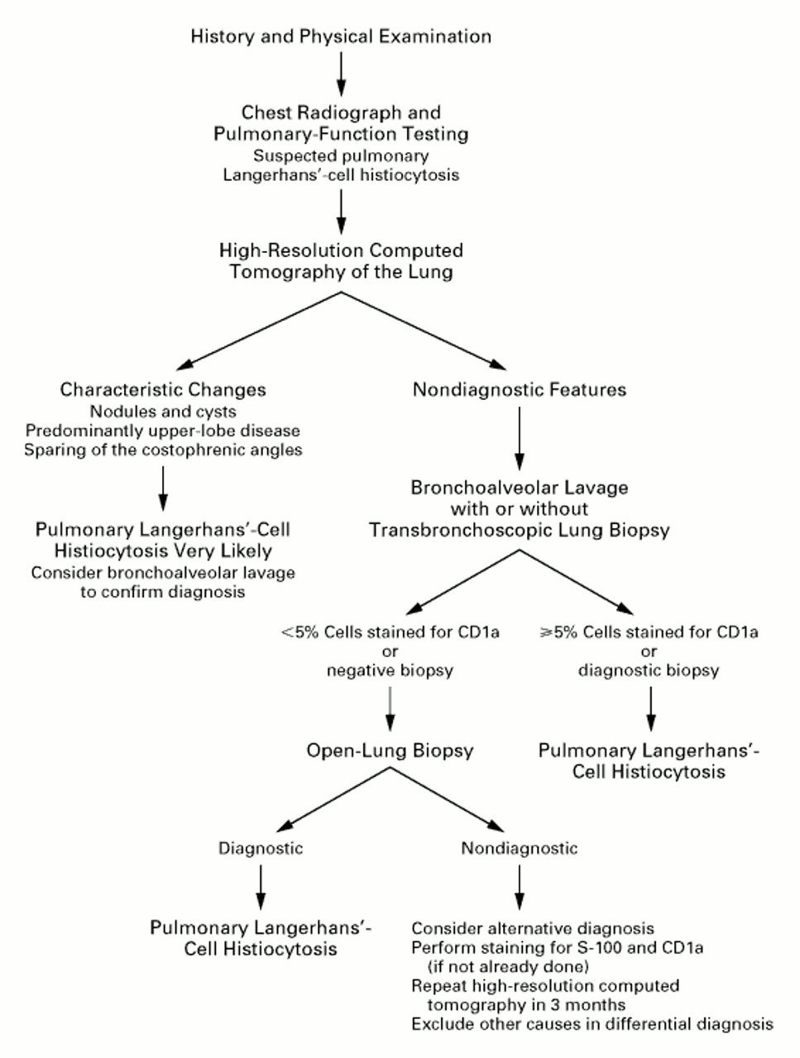
Notes:
Figure 8. Suggested Diagnostic Algorithm for the Workup of Patients with Suspected Pulmonary Langerhans'-Cell Histiocytosis.

Slide 17
INVESTIGATIONS
CHEST RADIOGRAPH - very characteristic if not diagnostic. The combination of ill-defined or stellate nodules (2 to 10mm in size), reticular opacities, upper-zone cysts or honeycombing,preservation of lung volume, and costophrenic angle sparing are believed to be highly specific for this disorder.

Slide 18
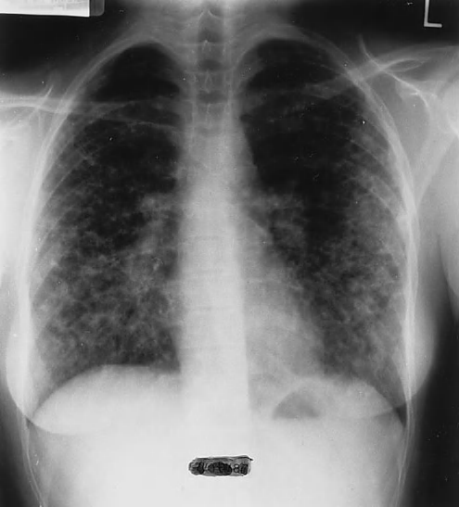

Slide 19
COMPUTED TOMOGRAPHY
Combination of multiple cysts and nodules with a middle to upper-zone predominance with interstitial thickening in a young smoker is characteristic and diagnostic of PLCH .Honeycombing can be seen in advanced disease.

Slide 20
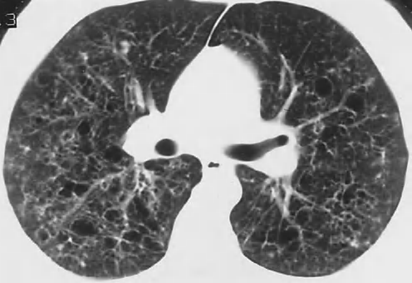
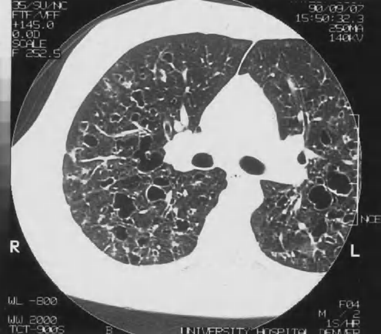

Slide 21
Magnetic Resonance Imaging
The role of magnetic resonance imaging in pulmonary Langerhans’-cell histiocytosis is limited to the evaluation of bony and central nervous system lesions.

Slide 22
BAL FLUID ANALYSIS
Bronchoalveolar lavage (BAL) can be of diagnostic value in cases of suspected histiocytosis X.
the CD4:CD8 ratio may be decreased.
Langerhans’ cells in BAL can be recognized by their characteristic staining for S-100 protein or peanut agglutination antigen.
These cells are also OKT-6 (CD-1) positive, are identified by a specific monoclonal antibody (MT-1), and contain characteristic Birbeck bodies on electron microscopic evaluation

Slide 23
Transbronchial biopsy
Video-guided thoracoscopic lung biopsy

Slide 24
Treatment of LCH
Smoking cessation!!
However, it has never been proven whether smoking cessation actually improves progression or survival
High dose Corticosteroids(prednisolone) may be of benefit in symptomatic patients, but again, no studies to actually prove efficacy
Salvage chemotherapy (chlorambusil,vincristine,methotrexate) is reserved for relentless disease or when steroids fail .
Lung transplantation is an option for end stage disease, although there are no formal guidelines specific to LCH

Slide 25
FUTURE PROJECTS IN TREATEMENT LIKE GENE THERAPY, MONOCLONAL ANTIBODY THERAPY, AND CYTOKINE-BASED THERAPIES ARE UNDER TRIAL
THANKYOU

