Slide 1
Interstitial Lung Diseases
S. Wijetunge MBBS MD
Dept. of Pathology
Faculty of Medicine
University of Peradeniya

Slide 2
Diffuse interstitial lung diseases
A heterogeneous group of disorders
Involves the lung parenchyma – alveoli, alveolar walls, capillary endothelium and connective tissue.
Diseases caused by infectious agents are excluded from this group.

Slide 3
Diffuse interstitial lung diseases
Common clinical features:
  Progressive dyspnoea and tachypnoea
  End respiratory crackles (usually no wheezing or other evidence of air way obstruction)
  Eventual cyanosis

Slide 4
Diffuse interstitial lung diseases
Lung function test:
  Reduce lung volume and compliance – restrictive type of lung disease
Reduced CO diffusing capacity

Slide 5
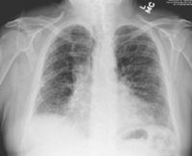
Diffuse interstitial lung diseases
Chest X ray
Diffuse infiltrative pattern – small nodules, irregular lines or ground glass shadow

Slide 6
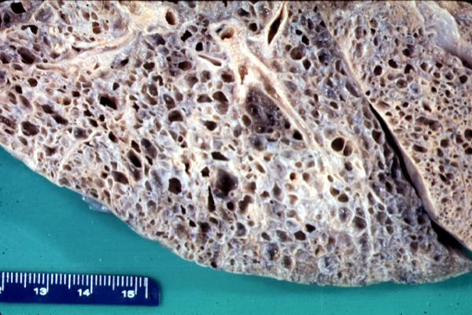
Diffuse interstitial lung diseases
End satge:
Diffuse destruction of the lung – alveoli are replaced by air filled spaces, surrounded by fibrous septae (honey comb lung).
This is the common end stage of many diffuse interstitial lung diseases.
Usually at this stage there is significant impairment of pulmonary function, pulmonary hypertension and cor pulmonale.

Slide 7
Diffuse interstitial lung diseases
Most diffuse interstitial lung diseases are of unknown eotiology.
When an association is present most common associations are:
    Exposure to environmental hazards ( Commonly smoking)
    Sarcoidosis
    Collagen vascular diseases

Slide 8
Investigations
Chest Xary – bilateral reticular pattern. In granulomatous types could be nodular opacities
CT/HRCT – better assessment of extent and distribution of disease
Pulmonary function testing – extent of pulmonary involvement is assessed
Diffusing capacity – reduced diffusing capacity of the lung for CO
Arterial blood gas
Bronchoscopy and broncho -alveolar lavarge
Lung biopsy
Others:
  In CTDs – ANA, anti DsDNA, rheumatoid factor
  LDH – a nonspecific finding in ILDs

Slide 9
Diffuse interstitial lung diseases
Diagnosis of ILDs should be based on correlation of
Clinical history
Radiological findings – X ray and CT
Hitopathological patterns ( from lung biopsies)

Slide 10
Diffuse interstitial lung diseases
Although ILDs are due to multiple initiating causes the pathologic response and repair mechanisms by the lung have similar patterns.
Therefore, this group of disorders can be categorized into two broad groups depending on the pathologic patterns. These are:
  Those associated with predominant inflammation and fibrosis
  those associated with predominantly granulomatous response in the interstium and/or vascular endothelium.

Slide 11
Diffuse interstitial lung diseases
Lung response: predominant inflammation and fibrosis
Pathogenesis:
Initial injury
Inflammation in the alveolar walls and lung parenchyma
Diffuse involvement of lung parenchyma
Lung fibrosis, ultimate end result – honey combing of the lung

Slide 12
Lung response: predominant inflammation and fibrosis
Cause unknown
Idiopathic interstitial diseases/pneumonias – histological patterns
  Usual interstitial pneumpnia (UIP)
  Organizing pneumonia (OP) [old term-Bronchioloitis obliterance with organizing pneumonia (BOOP)]
  Desquamative interstitial pneumonia (DIP)
  Diffuse alveolar damage (DAD)
  Nonspecific interstitial pneumonia (NSIP)
Others
  Lymphocytic interstitial pneumonia
  Eosinophilic pneumonias
  Pulmonary alveolar proteinosis
  Connective tissue disorders associated ILD
  Lymphangioleiomyomatosis

Slide 13
Lung response: predominant inflammation and fibrosis
Cause known
  Asbestosis
  Drugs, fumes and gases induced pneumonias
  Radiation induced pneumonias
  Aspiration pneumonias
  Residual ARDS

Slide 14
Lung response: predominantly granulomatous
Unknown cause
  Sarcoidosis
  Langerhans cell histiocytosis
  Granulomatous vasculitids (e.g, Wegener’s, Churg – Strauss)
Known Cause
  Hypersensitivity pneumonitis (organic dust)
  Inorganic dust – beryllium, silica

Slide 15
Diagnosis:
Diffuse interstitial lung diseases
Clinical features
HRCT ( more clinicopathological correlation is possible)
Lung biopsy – open or thoracoscopic biopsy

Slide 16
Idiopathic interstitial Diseases/pneumonias
Major histopathological patterns
  Usual interstitial pneumonia (UIP)
  Organizing pneumonia (OP) [old term - Bronchioloitis obliterance with organizing pneumonia (BOOP)]
  Desquamative interstitial pneumonia (DIP)
  Diffuse alveolar damage (DAD)
  Nonspecific interstitial pneumonia (NSIP)

Slide 17
Usual interstitial pneumonia (UIP) pattern
The most commonly diagnosed histological pattern of interstitial lung disease.
Main histological features:
Interstitial inflammation is mild, fibrosis is marked

Slide 18
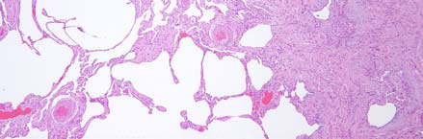
Usual interstitial pneumonia (UIP) pattern

Slide 19
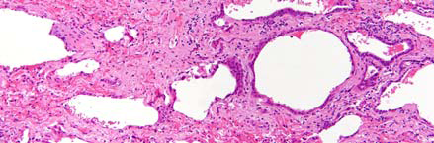
Usual interstitial pneumonia (UIP) pattern
Honeycombing

Slide 20
Usual interstitial pneumonia (UIP) pattern
The clinical diagnosis where UIP pattern is most commonly found in is idiopathic pulmonary fibrosis (IPF) – ( this is also called cryptogenic fibrosing alveolitis (CFA)
Other interstitial lung diseases where UIP pattern could be seen are – CTDs , drug induced pneumonias, irradiation, asbestosis

Slide 21
Usual interstitial pneumonia (UIP) pattern
Idiopathic pulmonary fibrosis (IPF)
  Chronic fibrosing interstitial pneumonia
  Unknown cause
  Surgical lung biopsy shows a histologic pattern of UIP

Slide 22
Idiopathic pulmonary fibrosis (IPF)
In the presence of a surgical lung biopsy showing UIP, the clinical diagnosis of IPF requires
  Exclusion of other known causes of ILD including drug toxicities,
  environmental exposure, and collagen vascular disease
  Characteristic chest radiograph or HRCT findings
  Abnormal pulmonary functions

Slide 23
Idiopathic pulmonary fibrosis (IPF)
Clinical features
  Over 50 years
  Slight male predominance
  Insidious onset of dyspnea - 6 months before diagnosis
  Restrictive ventilatory defect
  BAL fluid - excess of neutrophils
  Gradual deterioration - median survival 2.5-3.5 years

Slide 24
Idiopathic pulmonary fibrosis (IPF)
Changes in lung – radiological findings
  Bilateral reticular pattern
  Mainly peripheral involvement ( basal and subpleural) with central sparing

Slide 25
Idiopathic pulmonary fibrosis (IPF)
Changes in lung – radiological findings
Normal lung
IPF

Slide 26
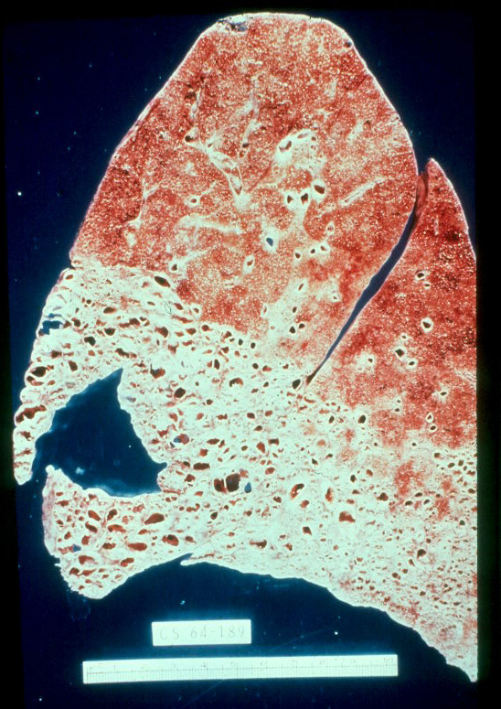
Idiopathic pulmonary fibrosis (IPF)
Lung – macroscopy – firm, grey and contracted. Sharp demarcation between involved and uninvolved areas.
Advanced stage – honey combing

Slide 27
Desquamative interstitial pneumonia (DIP)
DIP is both a histological pattern and a specific clinical diagnosis.
Clinical features
  Primarily cigarette smokers
  4th to 5th decade
  Male:female 2:1
  Dyspnea, dry cough
  Restrictive ventilatory defect
  Good prognosis, 70% after 10 years
      Cessation of smoking
      Corticosteroids

Slide 28
Desquamative interstitial pneumonia (DIP)
Radiological – bilateral symmetrical ground glass appearance. Most prominent in basal regions.

Slide 29
Desquamative interstitial pneumonia (DIP)
Histopathology
  Most prominent feature – increased alveolar macrophages

Slide 30
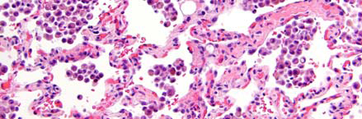
Desquamative interstitial pneumonia (DIP)

Slide 31
Organizing pneumonia (OP) pattern
Defined pathologically by the presence of masses or plugs of fibroblasts containing fibrous tissue (Masson’s bodies) in the distal air spaces .i.e. in the alveolar spaces and bronchiolar lumens
[hence the previous term-Bronchioloitis obliterance with organizing pneumonia (BOOP)].
Masson’s bodies are formed by organization of fibrinous exudates in the distal air spaces.

Slide 32
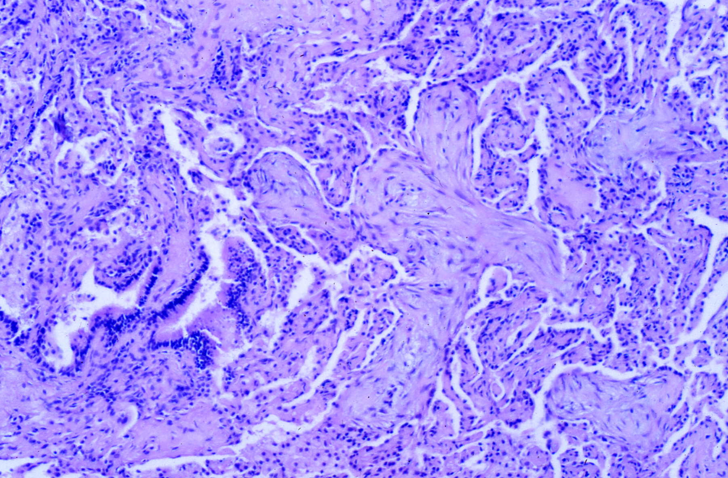
Organizing pneumonia (OP) pattern

Slide 33
Organizing pneumonia (OP) pattern
This pathological pattern is not specific for any disorder or cause, but reflects one type of inflammatory process resulting from lung injury.

Slide 34
Organizing pneumonia (OP) pattern
Organising pneumonia may be classified into two categories according to its cause:
    Organizing pneumonia secondary to other causes;
    Cryptogenic ( idiopathic ) organising pneumonia (COP)

Slide 35
Organizing pneumonia (OP) pattern
Organizing pneumonia secondary to other causes
  Infection – e.g. bacterial pneumonias
  Acute interstitial pneumonias
  ARDS
  Distal to obstruction
  Aspiration pneumonia
  Drugs – e.g. chemotherapeutic agents, phenytoin, salfasalazine
  Fume, and toxic exposures – e.g, paraquate
  Collagen vascular disease
  Vasculitids – e.g. WG
  Hypersensitivity pneumonitis
  Eosinophilic lung disease
  Inflammatory bowel disease
  Secondary reaction to chronic bronchiolitis
  Reaction around other processes, e.g. tumors, abscesses

Slide 36
Organizing pneumonia (OP) pattern
Cryptogenic organising pneumonia (COP)
A rare but characteristic clinicopathological entity

Slide 37
Cryptogenic organising pneumonia (COP)
Clinical features
    Mostly affected 50 – 60 years
    No gender bias
    No strong relationship with smoking
    Short onset
      Median, less than 3 months
      Dyspnea, cough
      Usually follows suspected but unconfirmed LRT infection
      One to multiple courses of antibiotics
    Restrictive ventilatory defect
    BAL fluid
      Excess of lymphocytes
    Diagnosis – clinicopathological features and exclusion of recognized causes and associated disorders
    Most recover with steroids
    Relapse common

Slide 38
Cryptogenic organising pneumonia (COP)
Radiological findings-
  Most commonly – consolidations which could be bilateral or unilateral.
  Some may have nodules

Slide 39
Diffuse alveolar damage (DAD)
Histologically characterized by presence of hyaline membranes along alveolar walls.
This is a result of acute diffuse alveolar wall damage due to various causes

Slide 40
Diffuse alveolar damage (DAD)
Pathogenesis:
Damage to type I pneumocytes and endothelium – damage to respiratory membrane
Leakage of fibrin rich proteinacous fluid
Ropy eosinophilic material lining the alveoli
Proteinacous fluid and RBC in alveoli

Slide 41
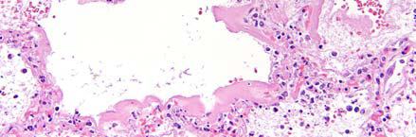
Diffuse alveolar damage (DAD)

Slide 42
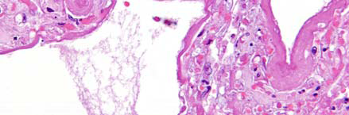
Diffuse alveolar damage (DAD)
Hyaline membrane

Slide 43
Diffuse alveolar damage (DAD)
Clinical conditions associated with DAD
Infection
Inhalants
Ingestants
Drug toxicity
Collagen vascular disease
Uremia
Sepsis
Shock
Trauma
Miscellaneous
Idiopathic – AIP

Slide 44
Diffuse alveolar damage (DAD)
Acute interstitial pneumonia (AIP)
Rapidly progressive
Histologically distinct form of interstitial pneumonia – Diffuse alveolar damage
Term AIP is reserved for cases of unknown cause

Slide 45
AIP

Slide 46
Acute interstitial pneumonia (AIP)
Clinical features
    Wide age range, mean 50 years
    No gender bias
    Not smoking related
    Severe exertional dyspnea
    – Develops over few days
    Restrictive pulmonary defect
    – Hypoxemia develops early
    Rapid progression to respiratory failure
    Mechanical ventilation usually required
    BAL fluid
    – Increased total cells, RBCs, neutrophils
    Treatment is supportive
    – Mortality 50% or more

Slide 47
Nonspecific interstitial pneumonia pattern (NSIP)
IPs that do not fit histologically into any classic lesion.
Not a specific disease. Could be a non representative biopsy of another process
This is the second most common diagnosis pattern of ILDs (most common is UIP).
Common associations are:
    CTD’s
    Organic dust or other exposures
    Prior acute lung injury

Slide 48
Lung response - granulomatous
Hypersensitivity pneumonitis (extrinsic allergic alveolitis)
Chronic granulomatous disease of the lungs that result of inhalation of organic substances that are capable of acting as a foreign substance and cause local hypersensitivity reaction.
Different names are given dpending on the circumstances. E.g.,
    Farmers lung
    Pigeon fancier’s lung
    Maple bark strippers lung
All have similar pathologies

Slide 49
Hypersensitivity pneumonitis (extrinsic allergic alveolitis)
Clinical features
  Low Constance exposure: gradual onset and progressive disease ( progressive breathlessness)
  Heavy short term exposure: acute onset. Could be episodic. Usually a feew hours after exposure- cough, breathlessness, perhaps haemoptysis.
  X ray – transient opacities

Slide 50
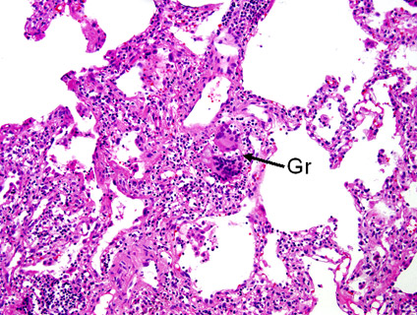
Hypersensitivity pneumonitis (extrinsic allergic alveolitis)

Slide 51
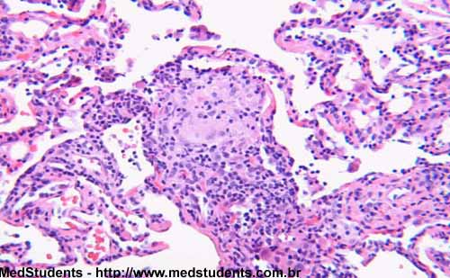
Hypersensitivity pneumonitis (extrinsic allergic alveolitis)

