Slide 1
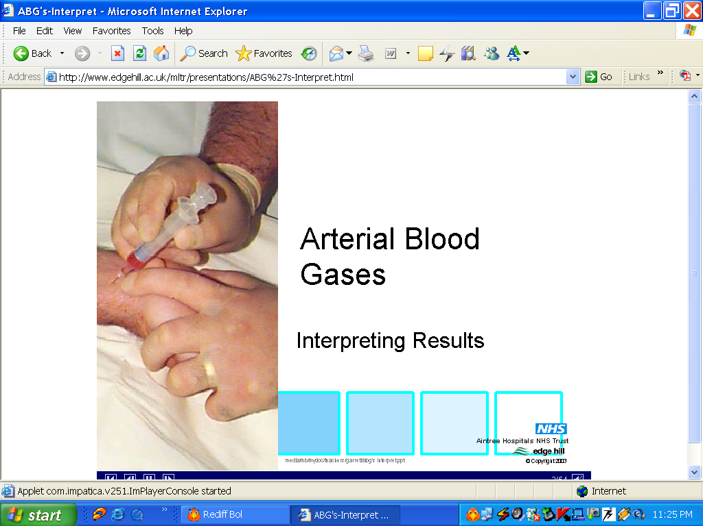
CLINICAL INTERPRETATION OF ABG
Dr Vishram Buche
Director, NICU
Central InDIA’S CHILD hOSPITAL
& Research INSTITUTE
NAGPUR
INDIA

Slide 2

Central India’s
C H I L D
HOSPITAL
& Research Institute

Slide 3
Acid –Base Status
Oxygenation
Ventilation
pH
PO₂
HCO₃
PCO₂

Slide 4

Facts about Acid-Base balance……
Remember format………..
pH………….. 7.4 (7.35 - 7.45)
PCO₂ …….…40 (35 -45)
HCO₃ ……… 24 (22 -26)
…A respiratory component
…A respiratory acid
…Moves opposite to the direction of pH.
…A metabolic component
…It is a base (Metabolic)
…Moves in the same direction of pH.
…Moves in same direction... Primary disorder
…Moves in opposite direction …Mixed Disorder
CO₂
HCO₃
CO₂
HCO₃

Slide 5
Getting a Feel Of Blood Gases
pH
HCO₃
PCO₂

Slide 6
LOW HCO₃
LOW pH
LOW pCO₂ (compensated)
CO₂
HYPER VENTILATION
compensation
pH
HCO₃ changes
pH in same direction
HCO₃
Low
Alkali
Primary lesion
METABOLIC ACIDOSIS

Slide 7
HIGH HCO₃
HIGH pH
HIGH pCO_{2 (compensated)}
CO₂
HYPO VENTILATION
compensation
pH
BICARB CHANGES
pH in same direction
HCO₃
High
Alkali
Primary lesion
METABOLIC ALKALOSIS

Slide 8
HIGH pCO₂
LOW pH
HIGH HCO_{3 (compensated)}
BICARB
CO 2 CHANGES
pH in opposite direction
compensation
pH
CO ₂
High
CO₂
Primary lesion
Respiratory acidosis

Slide 9
BICARB
LOW pCO₂
HIGH pH
LOW HCO_{3 (compensated)}
CO 2 CHANGES
pH in opposite direction
compensation
pH
CO ₂
Low
CO₂
Primary lesion
Respiratory alkalosis

Slide 10
Compensation….
Body’s physiologic response to Primary disorder
in order to bring pH towards NORMAL limit
Full compensation
Partial compensation
No compensation…. (uncompensated)
BUT never overshoots,
If a overshoot pH is there,
Take it granted it is a MIXED disorder

Slide 11

Remember…….
Respiratory compensation
is always FAST …12-24 hrs
Metabolic compensation
is always SLOW...5 -7 days
Respiratory disturbances are better compensated than metabolic ones.
Predictable in……… Metabolic acidosis.
Un-predictable in……. metabolic alkalosis.

Slide 12
How to identify the type of compensation…..?
pH HCO₃ CO₂
7.20 15 40
7.25 15 30
7.37 15 20
Un Compensated
Partially Compensated
(pH abnormal)
Fully Compensated
(pH in normal range)

Slide 13
COMPENSATION LIMITS
Metabolic Acidosis
PaCO₂ up to 10
Metabolic Alkalosis
PaCO₂ up to 60
Respiratory
Acidosis
Bicarb up to 40
Respiratory Alkalosis
Bicarb up to 10
Compensation Beyond Limits…………..
Mixed disorder

Slide 14
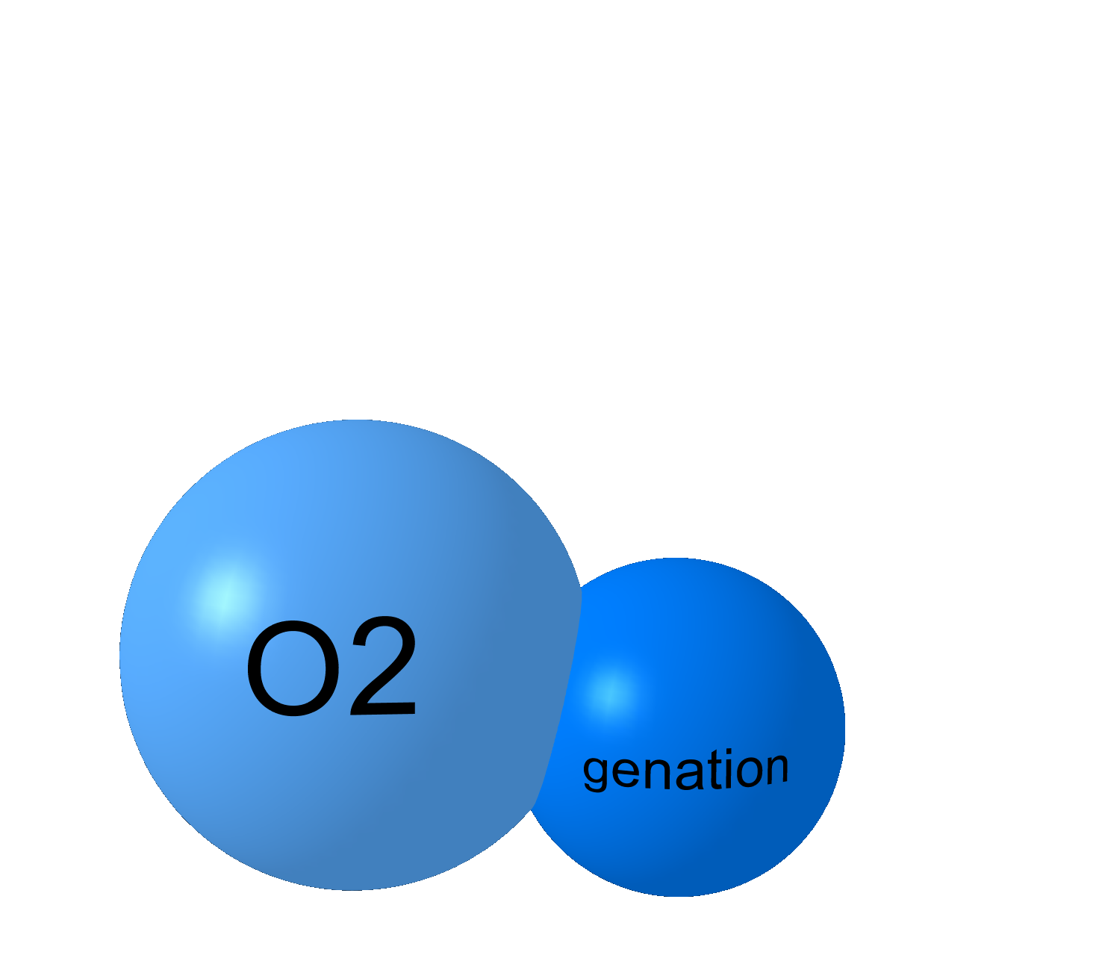
xygenation

Slide 15
PAO₂
PaO₂
O₂
SaO₂
CaO₂
DO₂

Slide 16
calculated
SaO₂
CaO₂
PaO₂
DO₂
Pulse ox (m)
Calculated
calculated
calculated
PAO₂
MEASURED

Slide 17
…To calculate A-a gradient….
Is the baby hypoxic?
Type and severity of Hypoxia.
…Relationship of PaO₂ and FiO₂?
FiO₂ X 5 = Expected PaO₂
…Whether PaO₂ is appropriate for the given FiO₂?
…Is the O₂ content (CaO₂) enough to prevent hypoxia?

Slide 18
Alveolar-arterial O₂ Difference
Classify Respiratory Failure
Ventilation–perfusion mismatch
……FiO₂ dependant derivation
………..PAO₂ – P_{a}O₂ = ?
PAO₂ = PiO₂* -(PCO₂/0.8)
✓ (calculated)PAO₂ = 150 – 1.2 (PCO₂)
= 150 – 1.2 × 40
= 150 – 50 = 100 mm Hg
O₂
CO₂
PAO2
✓(measured) P_{a}O₂ = 90 mmHg
PaO2
PAO₂ – P_{a}O₂ = 10 mmHg
* When FiO₂ = 21 % :
PiO₂ = (760-45) x .21= 150 mmHg

Slide 19
Alveolar-arterial Difference
Oxygenation Failure
Wide Gap
PCO₂ = 40
PaO₂ = 45
P_{A}O₂ = 150 – 1.2 (40)
= 150 - 50
= 100
Ventilation Failure
Normal Gap
PCO₂ = 80
PaO₂ = 45
PAO₂ = 150-1.2(80)
= 150-100
= 50
O₂
CO₂
Alveolar – arterial G.
100 - 45 = 55
……………….Wide A-a
Alveolar arterial G.
50 – 45 = 5
…………….Normal A-a

Slide 20
Expected PaO₂ =
20 × 5 = 100
Normal
FiO₂ × 5 = PaO₂

Slide 21
We always correlate PaO₂ with FiO₂
BUT………………………….
never forget to correlate with PaCO₂
It is essential to have
ELECTROLYTES
for
crucial interpretation of ABG.
esp. Na, Cl, K

Slide 22
The essentials of Blood gas…
pH………..7.40 (7.35-7.45)
PCO₂ …..40 (35-45) mm of Hg
PO₂ ……. 80-100 mm of Hg
HCO₃ (act) …..24 (22-26) mEq/L
PO₂
pH
HCO₃
PCO₂
O₂ Sat…. >95
O₂ Ct…. >18
It Is Incomplete without…… FiO₂
Hb ct

Slide 23

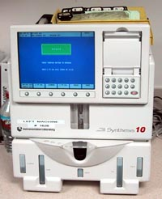
----- XXXX Diagnostics ------
Blood Gas Report
248 05:36 Jul 22 2000
Pt ID 2570 / 00
Measured 37.0º C
pH 7.463
pCO₂ 44.4 mm Hg
pO₂ 113.2 mm Hg
Corrected 38.6º C
pH 7.439
pCO₂ 47.6 mm Hg
pO₂ 123.5 mm Hg
Calculated Data
TPCO2 49
HCO₃ act 31.1 mmol / L
HCO₃ std 30.5 mmol / L
BE 6.6 mmol / L
O₂ CT 14.7 mL / dl
O₂ Sat 98.3 %
ct CO₂ 32.4 mmol / L
pO₂ (A - a) 32.2 mm Hg
pO₂ (a / A) 0.79
Entered Data
Temp 38.6 ºC
ct Hb 10.5 g/dl
FiO₂ 30.0 %
Now that I have this data, what does it mean?
output

Slide 24
Experience is the ability to
make the same mistake
repeatedly with increasing
confidence

Slide 25
-----XXXX Diagnostics-----
Blood Gas Report
328 03:44 Feb 5 2006
Pt ID 3245 / 00
Measured 37.0 ⁰C
pH 7.452
pCO2 45.1 mm Hg
pO2 112.3 mm Hg
Corrected 38.6 ⁰C
pH 7.436
pCO2 47.6 mm Hg
pO2 122.4 mm Hg
Calculated Data
HCO3 act 31.2 mmol / L
HCO3 std 30.5 mmol / L
B E 6.6 mmol / L
O2 ct 15.8 mL / dl
O2 Sat 98.4 %
ct CO2 32.5 mmol / L
pO2 (A -a) 30.2 mm Hg 
pO2 (a/A) 0.78
Entered Data
Temp 38.6 0C
FiO2 30.0 %
ct Hb 10.5 gm/dl
Measured values…
most important
The Anatomy
of a Blood Gas Report
Temperature Correction :
Is there any value to it ?
Calculated Data :
Which are useful one?
Entered Data :
Important

Slide 26
Uncorrected pH & pCO₂ are reliable reflections of in-vivo acid base status
Temperature correction of pH & pCO₂ do
not affect calculated bicarbonate
“ There is no scientific basis ... for applying temperature corrections to blood gas measurements…” Shapiro BA, OTCC, 1999.
pCO₂ reference points at 37º C are well established as a reliable reflectors of alveolar ventilation
Reliable data on DO₂ and oxygen demand are unavailable at temperatures other than 37º C
Measured values should be considered
And
Corrected values should be discarded

Slide 27

-----XXXX Diagnostics-----
Blood Gas Report
328 03:44 Feb 5 2006
Pt ID 3245 / 00
Measured 37.0 ⁰C
pH 7.452
pCO2 45.1 mm Hg
pO2 112.3 mm Hg
Corrected 38.6 ⁰C
pH 7.436
pCO2 47.6 mm Hg
pO2 122.4 mm Hg
Calculated Data
HCO3 act 31.2 mmol / L
HCO3 std 30.5 mmol / L
B E 6.6 mmol / L
O2 ct 15.8 mL / dl
O2 Sat 98.4 %
ct CO2 32.5 mmol / L
pO2 (A -a) 30.2 mm Hg 
pO2 (a/A) 0.78
Entered Data
Temp 38.6 0C
FiO2 30.0 %
ct Hb 10.5 gm/dl
Act Bicarbonate:
Bicarbonate is calculated on the basis of the
Henderson equation:
[H⁺] = 24 pCO₂ / [HCO₃⁻]
or
for the
Mathematically inclined…

Slide 28
-----XXXX Diagnostics-----
Blood Gas Report
328 03:44 Feb 5 2006
Pt ID 3245 / 00
Measured 37.0 ⁰C
pH 7.452
pCO2 45.1 mm Hg
pO2 112.3 mm Hg
Corrected 38.6 ⁰C
pH 7.436
pCO2 47.6 mm Hg
pO2 122.4 mm Hg
Calculated Data
HCO3 act 31.2 mmol / L
HCO3 std 30.5 mmol / L
B E 6.6 mmol / L
O2 ct 15.8 mL / dl
O2 Sat 98.4 %
ct CO2 32.5 mmol / L
pO2 (A -a) 30.2 mm Hg 
pO2 (a/A) 0.78
Entered Data
Temp 38.6 0C
FiO2 30.0 %
ct Hb 10.5 gm/dl
Standard Bicarbonate:
Plasma HCO₃ after equilibration
to a PCO₂ of 40 mm Hg
: reflects non-respiratory acid base change
: does not quantify the extent of the buffer base abnormality
: does not consider actual buffering capacity of blood
Base Excess:
D base to normalise HCO₃ (to 24) with PCO₂ at 40 mm Hg
(Sigaard-Andersen)
: reflects metabolic part of acid base D
: no info. over that derived from pH, pCO2 and HCO3
: Misinterpreted in chronic or mixed disorders

Slide 29
-----XXXX Diagnostics-----
Blood Gas Report
328 03:44 Feb 5 2006
Pt ID 3245 / 00
Measured 37.0 ⁰C
pH 7.452
pCO2 45.1 mm Hg
pO2 112.3 mm Hg
Corrected 38.6 ⁰C
pH 7.436
pCO2 47.6 mm Hg
pO2 122.4 mm Hg
Calculated Data
HCO3 act 31.2 mmol / L
HCO3 std 30.5 mmol / L
B E 6.6 mmol / L
O2 ct 15.8 mL / dl
O2 Sat 98.4 %
ct CO2 32.5 mmol / L
pO2 (A -a) 30.2 mm Hg 
pO2 (a/A) 0.78
Entered Data
Temp 38.6 0C
FiO2 30.0 %
ct Hb 10.5 gm/dl
Oxygenation
Parameters: /limitations
O₂ Content of blood:
(Hb x1.34x O₂ Sat + 0.003x Dissolved O₂ )
Remember Hemoglobin
Oxygen Saturation:
( remember this is calculated …error prone)
Alveolar / arterial gradient:
( classify respiratory failure)
Arterial / alveolar ratio:
Proposed to be less variable
Same limitations as A-a gradient

Slide 30

A Systematic and Pointed
………. approach

Slide 31
7
Steps for
Successful
Blood Gas
Analysis

Slide 32
7 steps to analyze ABG
1.
2. Look at pH?
3. Who is the culprit ?...Metabolic / Respiratory
4. If respiratory…… acute and /or chronic
5. If metabolic acidosis,
Anion gap ↑ed and/or normal or both?
Is more than one disorder present?
Correlate clinically
Consider the clinical settings! Anticipate the disorder

Slide 33
Step 2
Look at the pH
Is the patient acidemic pH < 7.35
or alkalemic pH > 7.45
If pH = 7.4 …… Normal
Mixed
or Fully compensated

Slide 34
Step 3 ……. CULPRIT?
HCO₃…… METABOLIC
> 26 ….. Met. Alkalosis
< 22 ……Met. Acidosis
PCO₂ ……RESPIRATORY
> 45 …… Resp. Acidosis
< 35 …… Resp. Alkalosis
HCO₃ = Base
Normal…22-26
CO₂ = ACID
Normal…35-45

Slide 35
PCO₂
pH
HCO₃
pH

Slide 36
Step 4 …
If there is a primary Respiratory disturbance,
is it acute ?
10 mm
Change
PaCO₂
=
.08 change in pH ( Acute )
.03 change in pH (Chronic)
Remember………… relation of CO₂ and pH

Slide 37
Step 4 continued…
pH
PCO₂ of 10
Acute change .08
Chronic change .03

Slide 38
Step 4 continued…
pH
Last two digits
80 – PaCO₂
PaCO₂
pH
70
7.10
60
7.20
50
7.30
40
7.40
30
7.50
20
7.60
Acute respiratory change

Slide 39
Step 4 continued…
RESPIRATORY disorders…
Expected HCO₃ for a Change in CO₂ ......... 1 2 3 4
Acidosis…. (expected) HCO₃ = 0.1 x ∆ CO₂
Alkalosis…. (expected) HCO₃ = 0.2 x ∆ CO₂
Acidosis…. (expected) HCO₃ = 0.35 x ∆ CO₂
Alkaosis…. (expected) HCO₃ = 0.4 x ∆ CO₂
Acute respiratory
Chronic respiratory

Slide 40
Step 5
If it is a primary Metabolic disturbance,
whether respiratory compensation appropriate?
For metabolic acidosis:
Expected PCO₂ = (1.5 x [HCO₃]) + 8 + 2
(Winter’s equation)
Remember If :
Suspect .............
actual PaCO₂ is more than expected
additional...respiratory acidosis
actual PaCO₂ is less than expected
additional...respiratory alkalosis
CO₂ is equal to
Last two digits
of pH
For metabolic alkalosis:
Expected PCO2 = 6 mm… for 10 mEq. rise in Bicarb.
………UNCERTAIN COMPENSATION

Slide 41
Step 5 cont.
If metabolic acidosis is there
How is anion gap ? Is it wide ...
Na - (Cl⁻+ HCO₃⁻) = Anion Gap usually <12
If >12, Anion Gap Acidosis :
M ethanol
U remia
D iabetic Ketoacidosis
P araldehyde
I nfection (lactic acid)
E thylene Glycol
S alicylate
Common pediatric causes
Lactic acidosis
Metabolic disorders
Renal failure

Slide 42

Step 6…
Is more than one DISORDER present?

Slide 43
Mixed Acid-Base Disorders : Clues
-- Clinical history
-- pH normal, abnormal PCO₂ n HCO₃
-- PCO₂ n HCO₃ moving opposite directions
-- Degree of compensation for primary
disorder is inappropriate
-- Find Delta Gap

Slide 44
Metabolic Acidosis…….
+ additional disorders
Equivalent rise of AG and Fall of HCO3……
….Pure Anion Gap Metabolic Acidosis
Discrepancy…….. in rise & fall
+ Non AG M acidosis, + M Alkalosis

Slide 45
PURE Anion Gap Acidosis +
Delta gap = HCO₃ + ∆ AG
Delta Gap = 24….Pure AG acidosis
< 24 = non AG acidosis (+ AG M Acidosis)
> 24 = metabolic alkalosis (+ AG M Acidosis)

Slide 46
Delta Gap = 24 ……AG met Acidosis
< 24 ….. + Non AG Mac
> 24 ….. + Meta. Alkalosis
    N-HCO3 = 24, N-Anion Gap = 12
    Delta Gap = HCO3 + ∆AG
    e.g. if HCO3= 12, AG = 24, ∆ AG = 12
    Delta gap = 12 + 12 = 24
    ….Pure AG Metabolic Acidosis
    N-HCO3 = 24, N-Anion Gap = 12
    Delta Gap = HCO3 + ∆ AG
    e.g. if HCO3 = 12, AG = 30, ∆ AG = 18
    Delta Gap = 12 + 18 = 30
    > 24 ….AG + metabolic Alkalosis
    N-HCO3 = 24, N-Anion Gap = 12
    Delta Gap = HCO3 + ∆ AG
    e.g. if HCO3 = 12, AG = 20, ∆ AG = 8
    Delta Gap = 12 + 8 = 20,
    < 24 …AG + Non AG metabolic Acidosis

Slide 47
Double……… triple…………….
Quadruple…….???

Slide 48

7
th step
Clinical correlation

Slide 49

Validity of ABG report… a lab error
PCO2
H= 24 x
HCO3
e.g. pH = 7.30, PCO₂ = 38, HCO₃ = 30
By Henderson-Hasselbach
H+ = 24 x pCO₂/HCO₃
= 24 x (38/30) = 30
80 - last two digit pH = H+
80 - H+ = last two digit pH (after 7)
pH should be 7.50

Slide 50
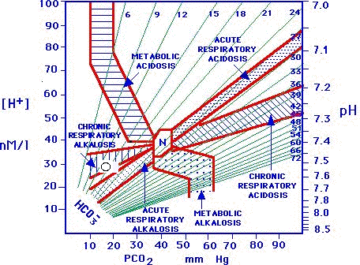
Ready Chart………

Slide 51


It’s not magic understanding
ABG’ s, it just takes a little practice!

Slide 52
Experience is a wonderful
thing. It enables you to recognize a mistake when you make it (again).

Slide 53

pH = 7.4
PaCO2 = 40
HCO3 = 24
9 months old male with Acute Enteritis…..
pH............7.34
PaCO₂.....33.9
HCO₃.......18.2
Partially compensated Metabolic Acidosis
Partially compensated Metabolic Acidosis

Slide 54
pH = 7.4
PaCO2 = 40
HCO3 = 24
pH.............7.55
PaCO2.....49.0
HCO3.......48.2
Partially compensated Metabolic Alkalosis

Slide 55
pH = 7.4
PaCO2 = 40
HCO3 = 24
pH............7.44
PaCO2.....27.0
HCO3.......18.1
Fully compensated Respiratory Alkalosis

Slide 56
pH = 7.4
PaCO2 = 40
HCO3 = 24
pH............7.28
PaCO2.....79.5
HCO3.......37.1
Partially compensated Respiratory Acidosis

Slide 57
pH = 7.4
PaCO2 = 40
HCO3 = 24
pH............7.51
PaCO2.....39.4
HCO3.......31.3
Uncompensated
Metabolic Alkalosis

Slide 58
pH = 7.4
PaCO2 = 40
HCO3 = 24
pH............7.39
PaCO2.....39.0
HCO3.......23.4
Normal A.B.G.

Slide 59
pH = 7.4
PaCO2 = 40
HCO3 = 24
pH............7.25
PaCO2.....58.5
HCO3.......25.1
Uncompensated
Respiratory Acidosis

Slide 60
pH = 7.4
PaCO2 = 40
HCO3 = 24
pH............7.46
PaCO2.....34.0
HCO3.......26.0
Uncompensated
Respiratory Alkalosis

Slide 61
pH = 7.4
PaCO2 = 40
HCO3 = 24
pH..............7.37
PaCO2.......75.1
HCO3.........42.6
Fully compensated Respiratory Acidosis

Slide 62
pH = 7.4
PaCO2 = 40
HCO3 = 24
pH..............7.52
PaCO₂.......31.0
HCO₃.........29.4
Combined Alkalosis

Slide 63
pH = 7.4
PaCO2 = 40
HCO3 = 24
pH..............7.08
PaCO₂.......54.0
HCO₃.........18.0
Combined Acidosis

Slide 64
pH ………7.563
PCO2 ….19.8
HCO3 ….18.7
What is the
Diagnosis ?
▲Respiratory
Alkalosis
Is it acute / Chronic?
Acute Respiratory Alkalosis
For a 10 mm change of PCO2
pH changes by 0.08 ……Acute
by 0.03 ……Chronic

Slide 65

THANKS
: vbuche@gmail.com

